Slide 1
Understanding Tuberculosis
Heather Fox-Sutek RN BSN CSN
Charleroi Area School District
Certified School Nurse

Slide 2
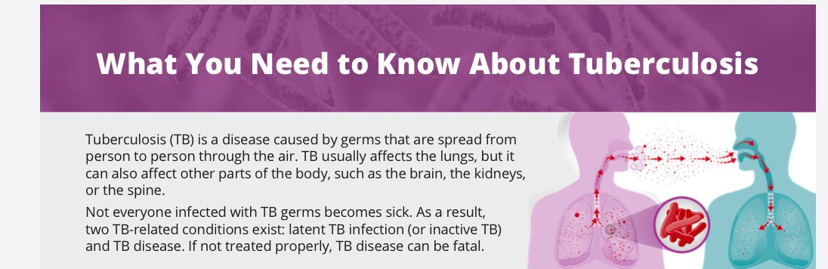
What is Tuberculosis (TB)?

Slide 3
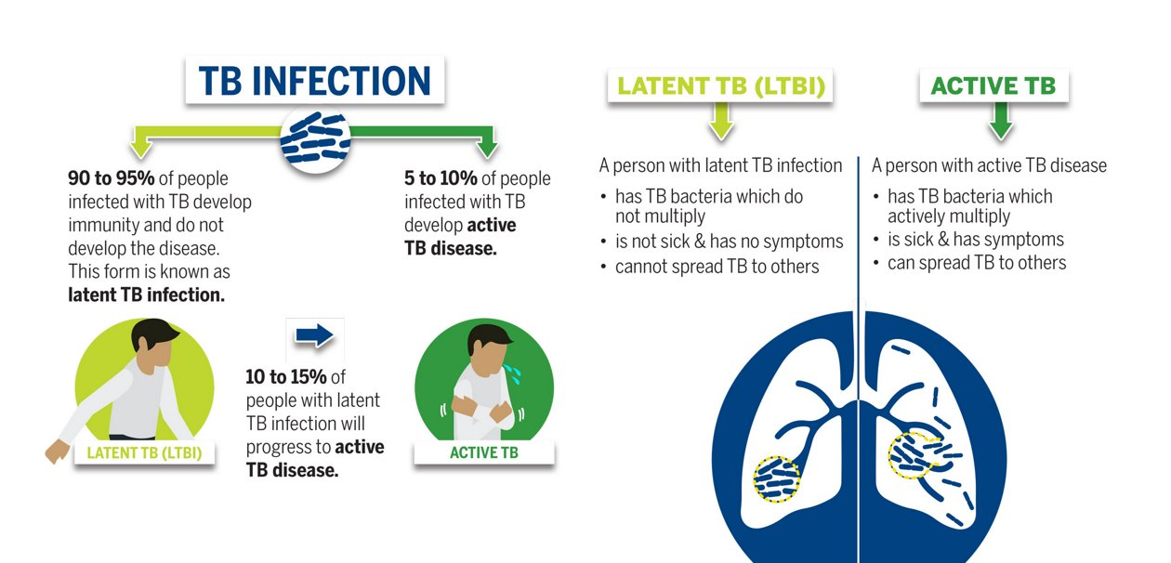
Two TB-related conditions exist:
Latent TB Infection and Active TB Disease.

Slide 4
Tuberculosis in the United States
CDC estimates that up to 13 million people in the United States have latent TB infection.
While not everyone with latent TB infection will develop TB disease, without treatment about 5%–10% of infected people will develop TB disease over their lifetimes.
Vaccination: The tuberculosis vaccine (BCG) is not usually required in the United States.
BCG is NOT a vaccine required for entry to school in Pennsylvania

Slide 5
Testing for school settings
Re Pa. code § 23.9 amendment Pa.B. 2163
  In 1997, PA school districts were approved to be exempted from TB testing for students with the exception of the Philadelphia Area City Schools.
  All staff members in all PA school districts are required to be tested during the hiring process.

Slide 6
Latent TB Infection
Inactive TB
LATENT TB Infection also known as Inactive TB:
Persons with latent TB have a small number of TB bacteria in their body that are alive but inactive
Latent TB is not contagious
Persons with Latent TB Cannot spread TB bacteria to others
Do not feel sick, but may become sick if the bacteria in their bodies become active
Usually have a positive TB blood test or TB skin test results indicating TB infection
Have typically normal chest radiographs
Have negative sputum smears and cultures
Should consider treatment for latent TB infection to prevent TB disease
Do not require respiratory isolation

Slide 7
Symptoms and Treatment of
Latent TB Infection/Inactive TB
There are no symptoms of Latent TB Infection because the germs are inactive. Thus the term Inactive TB
Again: Inactive TB CANNOT be spread to others
Only persons with active TB disease can spread TB to others
NO ISOLATION IS REQUIRED for Latent TB Infection (Inactive TB)
Treatment for inactive TB
Treatment for inactive TB can take three, four, six, or nine months depending on the treatment plan.
The treatment plans for inactive TB use different combinations of medicines that may include:
Isoniazid
Rifampin
Rifapentine

Slide 8
Active Tuberculosis Disease
TB Disease
Active tuberculosis (TB) disease happens when the immune system cannot keep TB germs from multiplying and growing in the body.
People with TB disease (ACTIVE TB) feel sick and can spread TB germs to others.
TB disease can almost always be treated and cured with medicine. Without treatment, it can be fatal.
Only persons with Active TB disease can spread TB to others

Slide 9
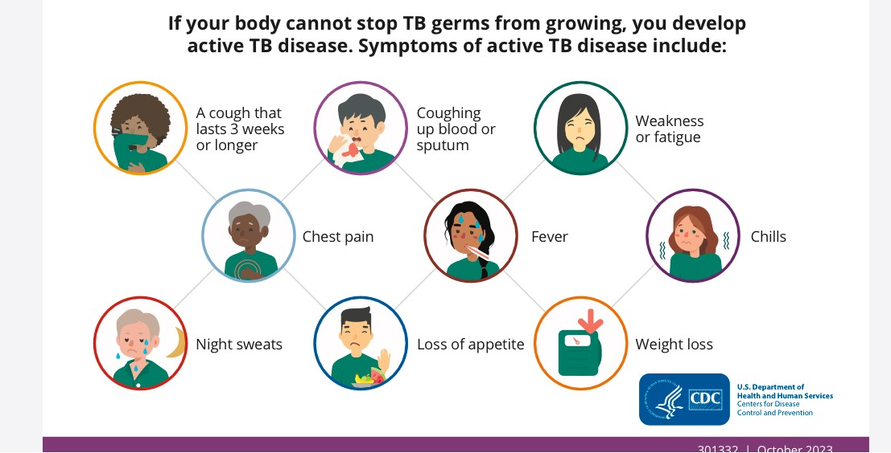
Active TB disease symptoms

Slide 10
Treatment of Active TB
Treatment for active TB disease can take four, six, or nine months depending on the treatment plan.
The treatment plans for active TB disease use different combinations of medicines that may include:
Ethambutol
Isoniazid
Moxifloxacin
Rifampin
Rifapentine
Pyrazinamide

Slide 11
Testing
There are two types of tests for tuberculosis (TB) infection: the TB blood test and the TB skin test.
A positive test result for TB infection means you have TB germs in your body.
A positive result does NOT mean you have active TB.
Your health care provider will do other tests to determine if you have inactive TB (also called latent TB infection) or active TB disease.

Slide 12
What to do if you have a positive TB test:
If you received the BCG vaccine:
  A blood test can confirm whether the positive TB test is due to infection or is a false positive due to the vaccine.
If you test positive for TB infection, your health care provider will do other tests to determine if you have inactive TB (latent TB infection) or active TB disease.
  Your health care provider will do other tests to determine if you have inactive TB or active TB disease if you have a:
    Positive TB blood test or TB skin test result
    Negative TB blood test or TB skin test result, but you have symptoms of active TB disease
  These tests may include a chest x-ray, and a test of the sputum (phlegm) you cough up.

Slide 13
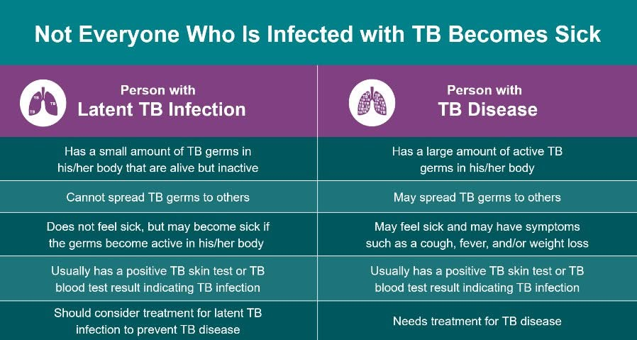
Key Differences Between Latent TB Infection (Inactive TB) and TB Disease (Active TB)

Slide 14
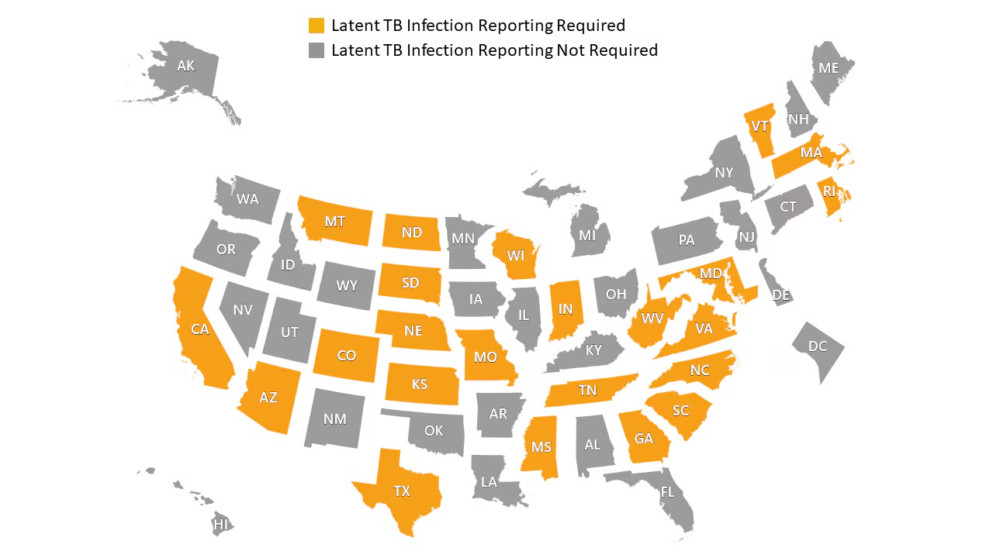
Reportability and Contact Tracing
Active Tuberculosis Disease is required to be reported to local and/or state health departments AND to the Centers for Disease Control and Prevention (CDC).
  Pennsylvania requires suspected and confirmed active cases of TB to be reported to the PA Department of Health
  The PA Department of Health will then conduct an investigation and contact tracing and testing of exposed individuals.
Latent TB Infection (inactive TB) is not required to be reported to the CDC although some states require CDC reporting of inactive TB. PA is one that does not.
  Contact tracing is not required as latent TB is not contagious.

Slide 15
Important takeaways
There are two TB related conditions: inactive TB (latent TB infection) and TB Disease (active TB)
A positive TB test does not equal TB disease (active TB)
You do not need to be tested for TB if you’ve spent time with someone with inactive TB (latent TB infection).
Latent TB infection is not required by PA to be reported to the CDC.
Contact tracing is not required for Latent TB as it is not contagious.
The Pennsylvania Department of Health is required to conduct contract tracing on cases of active TB disease

Slide 16
Timeline of the recent potential tuberculosis (TB) case involving one of our Charleroi Area School Disrict (CASD) students.
December 26, 2024: Phone call to Pennsylvania Department of Health (PA DOH) regarding Facebook (FB) rumor.
  Upon learning of a FB rumor via a screenshot sent to us regarding a possible TB diagnosis of one of our students, we contacted the PA DOH for guidance upon their opening on Dec. 26th.
  At this time, no name was associated with the rumor, but we wanted assurance from the PA DOH on what we needed to do as a district to protect the safety and welfare of our students.
  Our local PA DOH nurse assured us that no active TB cases were reported among CASD students or staff members.
  The PA DOH nurse further confirmed that, in the event of an active TB case within our students or staff, the PA DOH would notify us, conduct contact tracing, and test close contacts as necessary.

Slide 17
Timeline continued
January 9, 2025:
  A specific name became associated with the rumor.
  Our school nurse and high school principal contacted the PA DOH.
  The local PA DOH nurse supervisor reiterated that no active TB cases were identified among our students or staff.
  The PA Department of Health reassured us that they would take appropriate action if a case were to arise, including notifying the district.

Slide 18
Timeline continued
January 13, 2025
  The rumored student returned for the first time since before the holiday break.
  Being proactive and fact-checking the rumor, our nursing staff thoroughly reviewed the health documentation that the student had with them for a separate issue.
  Out of an abundance of caution, we isolated the student and sent the student home with instructions to obtain medical clearance confirming they are not contagious and are allowed medically to return to school.
  Additionally, we deep-cleaned the area the student was in.

Slide 19
Timeline continued
January 13, 2025 continued
  We again contacted the PA DOH to confirm the student’s status and were reassured that there were “no active cases requiring public health action in our school population”.
  Although the PA DOH stated that no public health action was necessary at this time, we chose to err on the side of caution and take proactive steps that align with our unwavering commitment to the health and safety of our school community.
  Our community was notified of the event.
Late afternoon, January 13, 2025:
  We received a letter from the PA DOH stating that the student we sent home had been evaluated by a PA DOH physician and determined not to be infectious.
  The letter further stated that the student was cleared to return to school.

