Slide 1
Grant Development
with a Purpose:
Diversifying Funding Sources
Grant champions 2024
Office of Grant Development Services

Slide 2

Office of Grant Development
The Office of Grant Development provides grant resources and consultative support to help schools navigate the grant approval process and develop competitive grant proposals.
Participating in Grant Champions is an opportunity to build grant development skills and secure additional funding for your school.
As a Grant Champion, you will serve as the school’s grant lead and create a grant team to identify resource gaps and develop and submit competitive grant proposals to fund programs and projects for your school.
The time Grant Champions invest in the program will vary, from an hour a month to an hour a week, based on the needs of your school and the structure you develop.

Slide 3
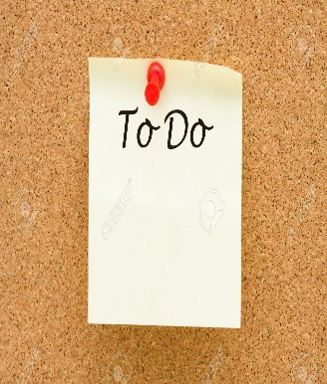
Grant Champion Activities
Form a Grant Committee
Principal, Teachers, Staff, Parents, PTA and board members
Assign team member duties
Grant lead, researcher, grant writer, proofreader and a community liaison
Know your School's strategic plan
Discuss the school’s funding needs and resource gaps
Create a one-page project proposal
  Include school demographics with needs statement, project goals and a budget to share with stakeholders
Review Monthly Grant Alerts and Twitter Alerts
Your grant researcher can review opportunities each month
6. Encourage all teachers to participate in DonorsChoose.org
    Post current projects on Donors Choose throughout the year to take advantage of flash funding opportunities

Slide 4
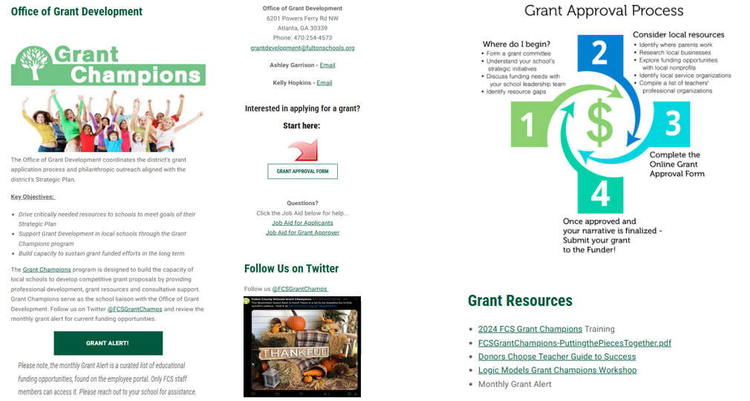
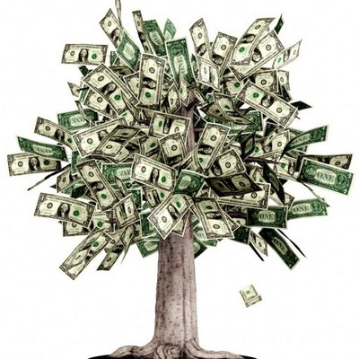
Online Resources
www.fultonschools.org/all-departments/financial-services/grant-development

Slide 5

Mining Local Resources
Identify where parents work - Possible opportunities for Corporate Contributions, Corporate Foundation grants, Matching Grants, ‘Dollars for Doers’
Review Strategic Partners - Non-profit organizations that support the school and have a 501(c)3 IRS determination letter, e.g., YMCA, Boys and Girls Club, etc.
Connect with local service organizations that may have a grant program - Rotary, Kiwanis, Junior League, faith-based organizations, etc.
Find professional organizations of which your teachers are members - Many offer grants, contests, scholarships to members, e.g., National Council of Teachers of Mathematics, National Science Teachers Association, etc.
Reach out to the local business community – Chamber, Partners in Education, retail stores and restaurants in the area, etc.
Research Government grant opportunities at GaDOE Competitive Grants

Slide 6

Partners and Sponsors
Build relationships with your Community Partners, Partners in Education and local business partners.
  Invite them to school events, like PTA Meetings, Career Day, orchestra/band concerts, and STEM/Literacy nights.
  Ask for volunteers at Saturday events like Fall Festivals, Fun Runs, clean up day, robotics showcase.
  Determine partner’s interest and look for alignment.
  Start small, ask them to sponsor a breakfast/coffee or donate refreshments for a school event.
  Offer customizable sponsorship options with branding, marketing and exposure opportunities, benefits, ROI.

Slide 7

Current Grant Champions
College Park Elementary received a $10,000 grant from Dicks Sporting Goods “Sports Matter” Foundation
A. Philip Randolph Elementary was awarded $4,000 from GaDOE’s Opportunity Grant to support Math Manipulatives
Sandtown Middle School received $7,000 from Fidelity Charitable Fund to support Young Ladies of Sandtown Mentoring program
Webb Bridge Middle School’s Band Program awarded $1,500 from the Walmart Spark for Good Foundation
River Eves ES and Highpoint ES Teacher Grant for Innovation $1,000 each from Georgia Foundation for Public Education Non-Government
Langston Hughes High School was awarded $500 from National Society of High School Scholars

Slide 8
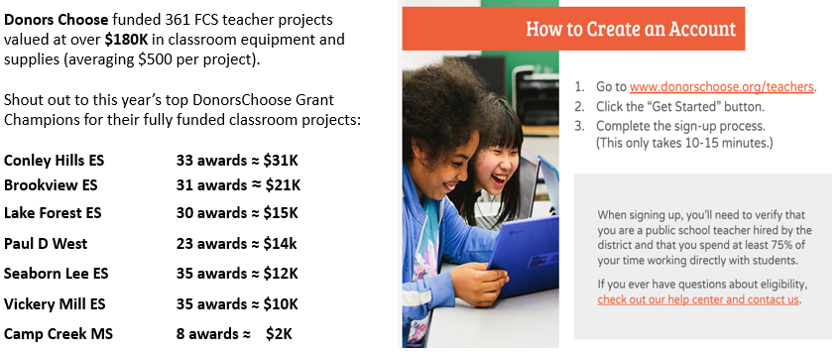

Donors Choose Grant Champions

Slide 9
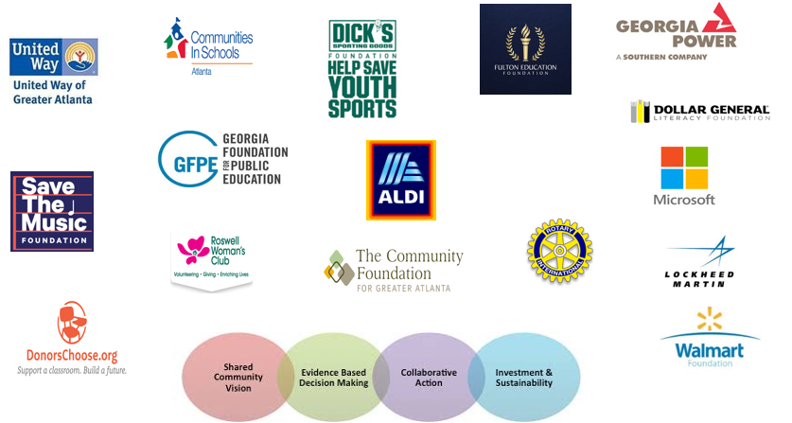
Diversify Funding through Collective Impact
Partnering with Non-profits, Corporate Foundations, Government and Philanthropic Organizations to meet the need in our community

Slide 10

Grant Writing Tips and Tricks
Create a grants calendar with your team
Assign a grant researcher to follow monthly grant alerts
Determine eligibility and follow the grant instructions carefully
Work with your PTA to serve as a 501(c)(3) fiscal sponsor if needed
Ensure your proposal aligns with the funder’s area of focus
Look at past grantees and the amount funded
For online grant proposals, copy and paste the questions into Word
Have someone outside your team proofread for understanding
Contact the program officer with any questions
Start small and keep trying!

Slide 11
Current Grant Opportunities
Aldi Community Grant and Gift Card Program
Walmart Spark Good Local Grants
State Farm Good Citizen Community Grants
Dicks Sporting Goods Sports Matter Grants
Dollar General Literacy Grants

Slide 12

  Contact:
  Office of Grant Development
  Ashley Garrison garrisona@fultonschools.org
  Kelly Hopkins HopkinsK@fultonschools.org
Follow us on Twitter @FCSGrantChamps

