Slide 1
DBUG
Escape Information
November 19, 2020

Slide 2

Upcoming Workshops
Escape 2020 – W2 Reporting
When: Wednesday, Dec 11th
9:00 am – 12:00 pm
Where: Zoom Meeting
Register: SCOE Classes
Escape 2020 – ACA Reporting
When: Wednesday, Dec 11th
1:00 pm – 4:00 pm
Where: Zoom Meeting
Register: SCOE Classes
Escape 2020 – 1099 Reporting
When: Wednesday, Dec 16th
9:00 am – 12:00 pm
Where: Zoom Meeting
Register: SCOE Classes

Slide 3
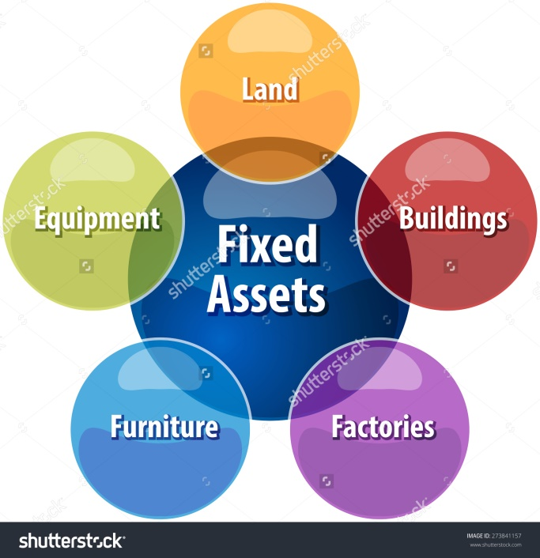
Fixed Assets in Escape
November 2020

Slide 4
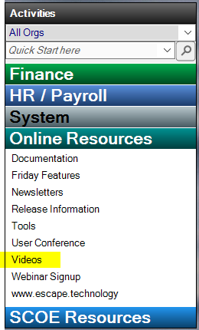
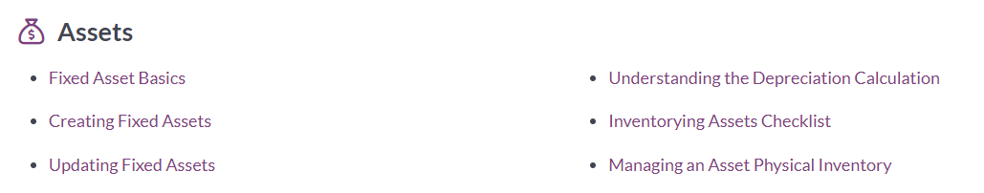
Fixed Assets
  Before you get started
  Go to Online Resources
  Videos
  Finance
  Assets

Slide 5

Fixed Assets – Setup Records
  Escape Finance – Setup – Assets
    Groups/Categories
    Disposal Methods
    Asset Departments
    Escape Import Template available

Slide 6
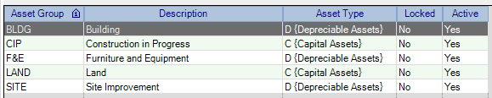
Fixed Assets – Setup Records
    Groups/Categories – Set up default for asset types
      Examples: Buildings, Furniture, Equipment, etc…

Slide 7
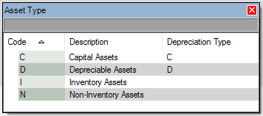
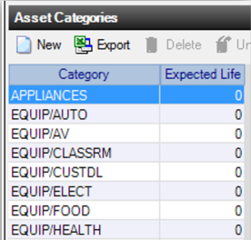

Fixed Assets – Setup Records
Asset Types
Examples: Capital, Depreciable, Inventory, Non-Inventory
(customized for District)
Add unlimited Asset Categories

Slide 8

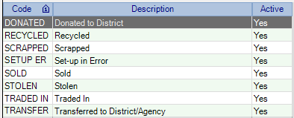
Fixed Assets – Setup Records
Disposal Methods
        Examples: Donated, lost, recycled, stolen…

Slide 9

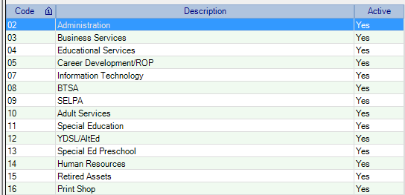
Fixed Assets – Setup Records
      Asset Departments
        Who “owns” the asset?
        (Not related to “Finance” Departments)
        Examples: School Sites, Maintenance, Technology, Food Service, etc…

Slide 10
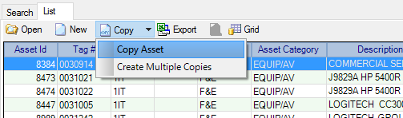
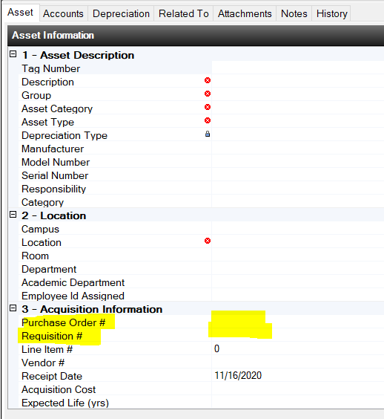
Creating Fixed Assets
  Import Available
  Create Manually
  Copy an Asset
  Copy Multiple Assets
  Reference PO or Requisition
  Account Rules apply
  Accounts must equal 100%

Slide 11
Creating Fixed Assets
  Finance – Assets – Fixed Assets
  Manually Add Assets
    Asset Tab – required fields
      Description
      Group
      Asset Category
      Asset Type (Drives Depreciation)
      Location
      Employee Id (optional)
    Account Tab – As many accounts needed
    Related Tab – Can list items in project
    Attachment Tab – Add pictures of item, user manual, warranty info

Slide 12
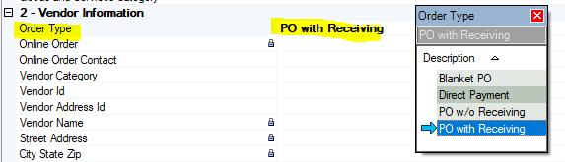

Creating Fixed Assets
  Finance – Requisitions – Vendor Requisitions
    Order Type: PO w/Receiving
    Items Tab
    Create Asset: Yes
    Select Asset Group and Category

Slide 13
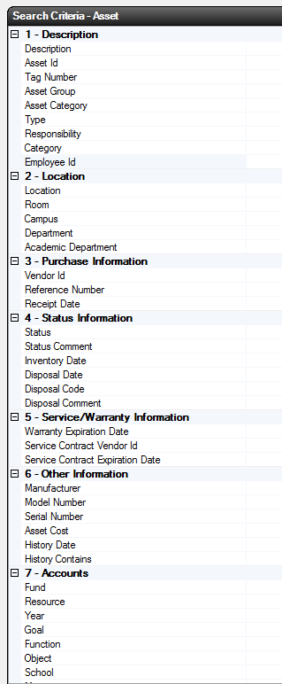

Searching Fixed Assets
  Finance – Setup – Fixed Assets
  Description
  Tag # (Can search by range)
  Groups/Category
  Type (Can select multiple)
  Location
  Department
  Emp Id (Can assign Asset to employees)
  Status (Can select multiple)
  History Contains
  Accounts
  Options are endless!

Slide 14
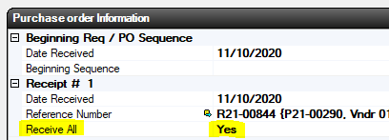
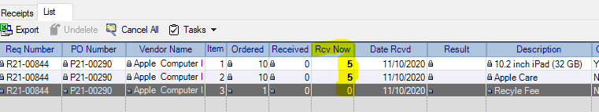
Updating Fixed Assets
    Finance – Purchasing – Receive PO Items
    Receive PO Items
    Receive All: Change to Yes if all items received
    Or if partial, Click Go to enter by item in Rcv Now

Slide 15
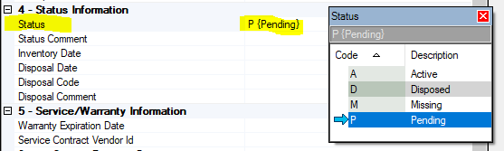
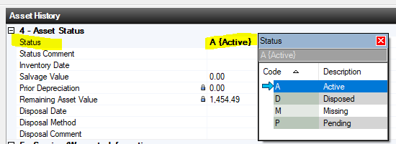
Updating Fixed Assets
    Finance – Setup – Fixed Assets
    Search in Assets
      By Pending Status
      Update to Active

Slide 16

Physical Inventory
  Finance – Assets – Asset Physical Inventory
      Define your search criteria to create list
      Save as a favorite
      Export the data
      Perform physical inventory
      Import file
      Find missing assets
      Dispose of assets
      Print Reports

Slide 17
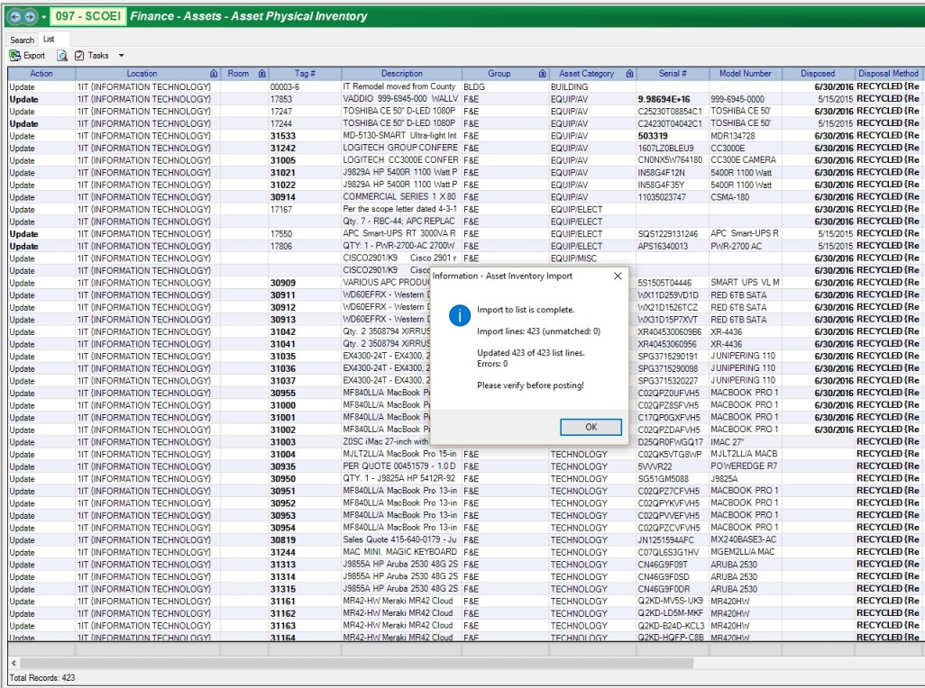
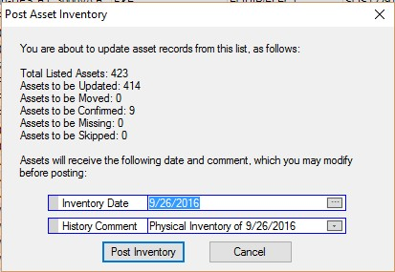
Physical Inventory
  Can update directly on list
  Use Task to Export Data to CSV file
  Can send list to site to take inventory
  Update on list
  Import to update
  Review and Post

Slide 18
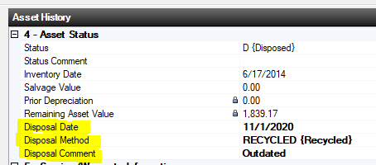
Disposing Fixed Assets
  Search for Asset
    Open Record
    Enter Disposal Date
    Enter Disposal Method
      Choose Methods Defined in Setup
    Enter Disposal Comment
    Save/Close
    Can search by these fields

Slide 19
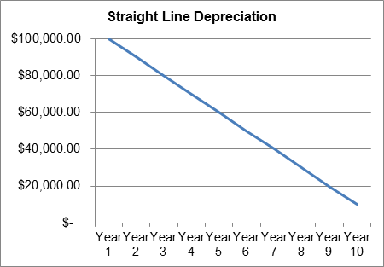

Depreciation
  Straight Line Depreciation
    Method = Asset Cost – Less salvage cost / Expected Life
    Asset Type must be D (Depreciable Assets)
    Depreciation begins with the first open year, regardless of the received date
    If an asset has prior year depreciation, then send to helpdesk@scoe.org

Slide 20
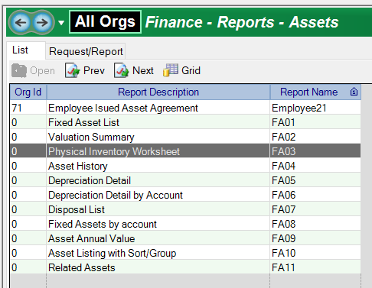

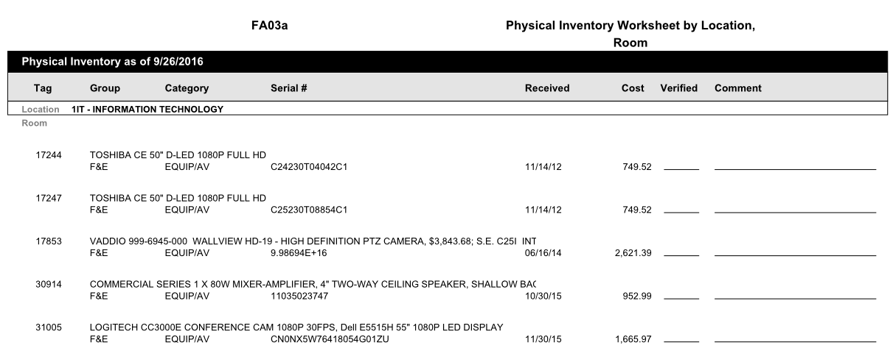
Reports
  Finance – Reports – Assets
  Create Favorites
    FA03 – Physical Inventory Worksheet to send to sites

Slide 21
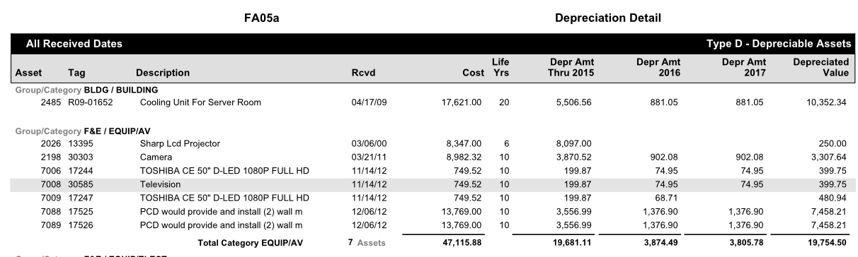
Reports
    FA05 – Depreciation Detail

Slide 22

    Set up Fixed Assets in Escape!
    Send email to helpdesk@scoe.org

