Slide 1

Audit Review Process 2021-2022
What’s Covered:
Timeline & Deadlines
Reviewing the Draft
Audit Adjustments
Audit Findings

Slide 2
Timeline & Deadlines
Audit Activities Timeline
April 1 | Notify SCOE of auditor selection and approval of audit contract EdC 41020(b)(1) & (3), EdC 41020e | CBO
Summer through early Fall | Auditor conducts audit work including field visit. CBO conducts exit interview with auditor at end of field work. | Auditor CBO
Sept 15 | Unaudited Actuals is Board approved and submitted to SCOE Ed C 42100(a), 47604.33(a)(5), 42100(b) | Board
Late Nov – early Dec | Receive draft copy of audit report from auditor. Review and communicate to auditor any questions or document changes. | CBO
Jan 31 ** | Audit report filed with State Controller’s Office (SCO), California Department of Education (CDE), and SCOE Ed C 41020, 47605(m),41020(h) | Auditor
Feb 28– board meeting | Prepare board presentation to review: -The annual audit -Audit exceptions, adjustments -Findings, corrective action plans | CBO
* Feb 28 | Board accepts audit report at meeting Ed C 41020.3 | Board
* March 15 | Signed Audit Certification due to SCOE | Board
* April 15 | Signed Certification of Corrective Actions due to SCOE (if applicable) Ed C 4120(j)(2) & (3) | Board
Various | Respond to questions from SCOE and/or SCO on corrective action plans for findings if further explanations are required (if applicable) | CBO
Second Interim, at the latest, or immediately following board approval. | Journal any audit adjustments so that the adjusted beginning balance is correctly reported on Second Interim reports (if applicable) | CBO
*The above dates are in statute. If your audit is not complete by the statutory date, please submit at the next available board date and to SCOE immediately following.

Slide 3

Timeline & Deadlines
The Audit Report Process
1
Audit Contract Executed
2
Audit Work Begins
3
Unaudited Actuals
4
Audit Work Ends
5
6
7
8
9
Draft Audit Reviewed
Audit Report Finalized
Board Accepts Audit Report
Audit Certified
Certification of Corrective Action
10
11
Audit Findings Resolved
2nd Interim Reflects Adjusted Beginning Balance

Slide 4
Reviewing the Draft
It is important to read the entire audit report, including financial statements and graphics, thoroughly. Verify that all of the information is accurate and consistent with the Unaudited Actuals (UA). Also verify there are no data entry errors. Reach out to your auditor if you have any questions or if changes are needed to the draft.
Steps for the entire document
◻ | The Audit Report | Read it thoroughly
◻ | Review the financial statements and graphics | Is all the information accurate and consistent with the Unaudited Actuals (UA)? Are there any incorrect data entries?
Reviewing the Financial Section
◻ | Independent Auditor’s Report on the Financial Statements * | Determine the type of opinion and any qualifications
◻ | Management Discussion and Analysis | This is your section. Be sure to edit it carefully.
◻ | Basic Financial Statements | Compare with the Unaudited Actuals
◻ | Notes to the Financial Statements
Examples to follow:

Slide 5
Reviewing the Draft
Example: Fund Balance Check

Slide 6
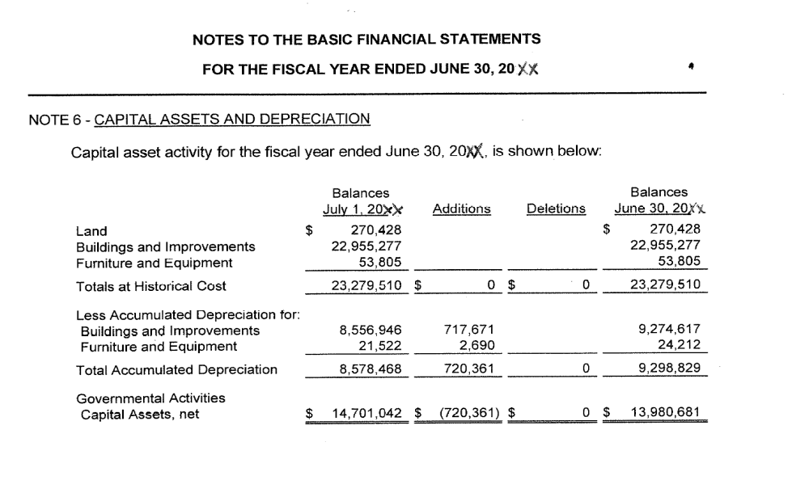
Reviewing the Draft
Example: Notes Check

Slide 7
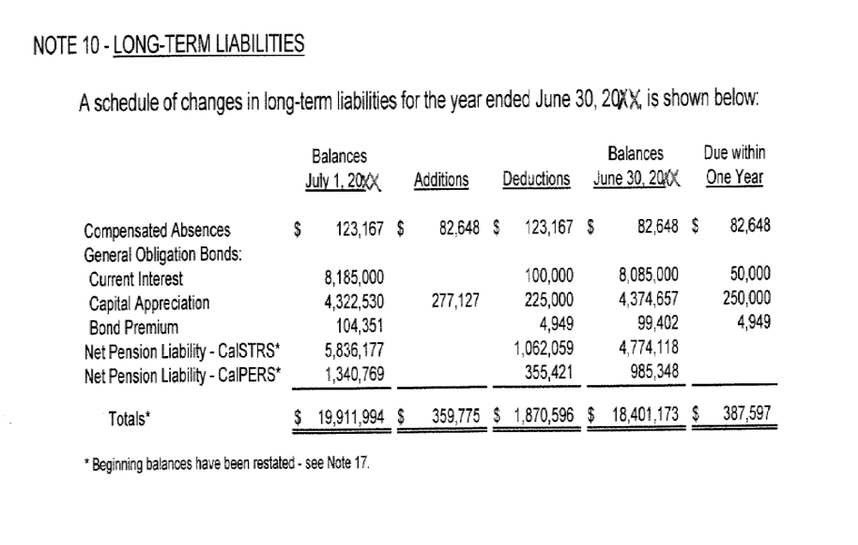
Reviewing the Draft
Example: Notes Check

Slide 8

Reviewing the Draft
List of Schedules: Be sure to review all Supplementary Information Schedules included in the Audit Report.
Schedule of Budgetary Comparison Data for General Fund
Schedule of Proportionate Share of the Net Pension Liability
Schedule of Pension Contributions
Combining Statements for Non-Major Governmental Funds
LEA Organization Structure
Schedule of Average Daily Attendance
Schedule of Instructional Time
Schedule of Financial Trends and Analysis
Schedule of Charter Schools
Schedule of Expenditures of Federal Awards
Reconciliation of Annual Financial & Budget Report with Audited Financial Statements
Notes to Supplementary Information

Slide 9
Reviewing the Draft
Supplementary Information
Supplementary Information
 | There are numerous schedules in this section. In your review, include detailed checking of the following:
◻ | Schedule of ADA | Compare to ADA reports submitted to SCOE
◻ | Combining Statements & Individual Fund Statements | Compare fund balances with the Unaudited Actuals
◻ | Reconciliation of Annual Financial and Budget Report with Audited Financial Statements | Were there Audit Adjustments or Restatements? Verify that these are incorporated with next Interim Report
Examples to follow:

Slide 10
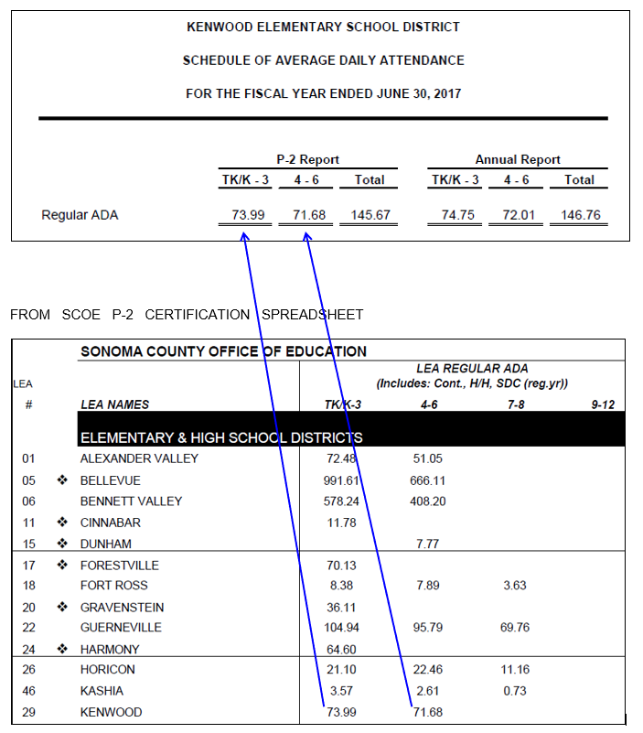
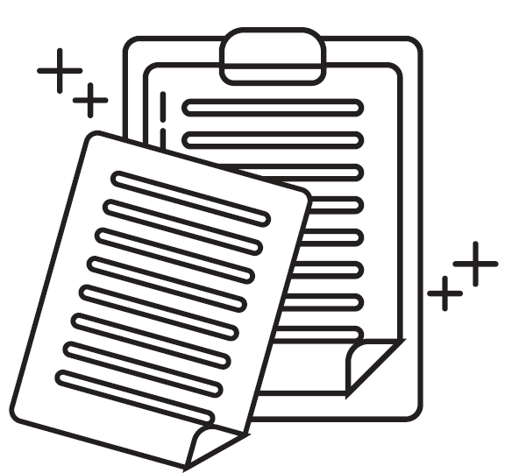
Reviewing the Draft
Schedule of ADA

Slide 11
Reviewing the Draft
Statements

Slide 12
Reviewing the Draft
Other Independent Auditor Reports
Other Independent Auditor Reports
◻ | Report on State Compliance | Verify report states all procedures that were either performed or not applicable
◻ | Report Internal Controls Over Financial Reporting and on Compliance … | Review and note any instances of noncompliance or material weakness in internal controls
◻ | Report on Compliance for Each Major Federal Program and on Internal Control Over Compliance | Review the opinion on compliance with federal contracts and internal control requirements

Slide 13
AUDIT ADJUSTMENTS
    At the completion of the audit, the auditors must meet with management to discuss any proposed audit adjustments
    It is the responsibility of the LEA to prepare all of the financial statements, notes, and schedules that are the subject of the audit
        Even if these are prepared for the LEA by the auditors
Therefore, the LEA must agree to any adjustments identified by the auditors before the adjustments are made to the financial statements

Slide 14
AUDIT ADJUSTMENTS
Review Audit for Adjustments
Audit adjustments can be found in the audit report under the section titled, Reconciliation of Annual Financial and Budget Report with Audited Financial Statements
Fund adjustments not in agreement with the Annual Financial & Budget Reports will be listed by Fund
Only those Funds within the Escape financial system will require entries to adjust the current year beginning Fund balance(s)

Slide 15
AUDIT ADJUSTMENTS
Review Audit for Reclassifications
If an LEA separately reports activity in Special Revenue Funds, the auditor may restate the ending fund balance to the General Fund in order to comply with GASB 54
Restatement of Fund balances for presentation purposes will not require Escape system entries to adjust the ending Fund balance(s)

Slide 16
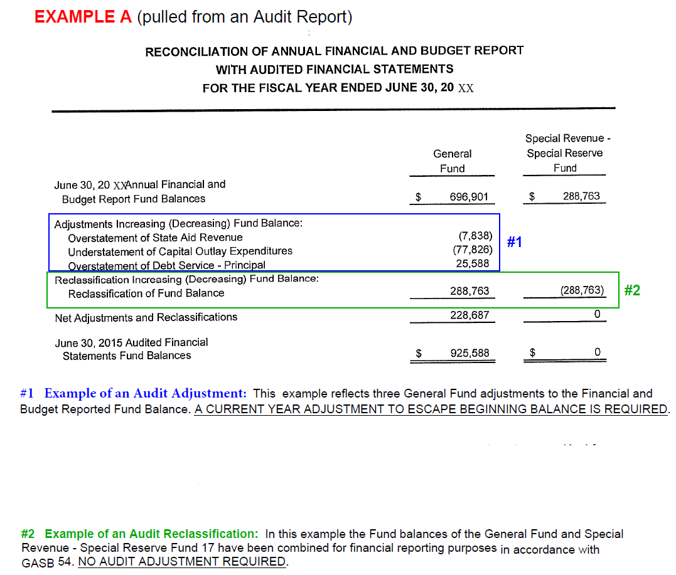
AUDIT ADJUSTMENTS

Slide 17
AUDIT ADJUSTMENTS
How to complete an audit adjustment in Escape – Step 1
To increase or decrease fund balance in the Actuals column
Initiate Journal Entry
Use applicable resource
  Note: if to a deferred balance resource, see your SCOE Advisor. These resources do not allow beginning balances and an offsetting entry should have been made to keep the balance at zero
Using the auditor’s working papers:
  Make an entry to Debit (decrease to EFB) or Credit (increase to EFB) object 9793 Audit Adjustment
  Make and entry to Debit or Credit an offsetting revenue or expense object
Select Task “Submit”
Run a Fiscal 13 to make sure the entry posted as expected

Slide 18
AUDIT ADJUSTMENTS
How to complete an audit adjustment in Escape – Step 2
To increase or decrease fund balance in the Revised Budget column
Initiate Budget Transfer
Use applicable resource
  see Step 1 Note regarding deferred balance resources
Using the auditor’s working papers:
  Make an entry to Decrease or Increase object 9793 Audit Adjustment
  2 options for other side of this entry depending on the current status of budget
    Option 1: If you have not adjusted the current year rev/exp budget to account for the audit adjustment
      Make an entry to Increase or Decrease the rev/exp object
    Option 2: If you have adjusted the current year rev/exp budget to account for the audit adjustment
      Make an entry to Increase or Decrease object 9790
Select Task “Submit”
Run a Fiscal 13 to make sure the entry posted as expected

Slide 19
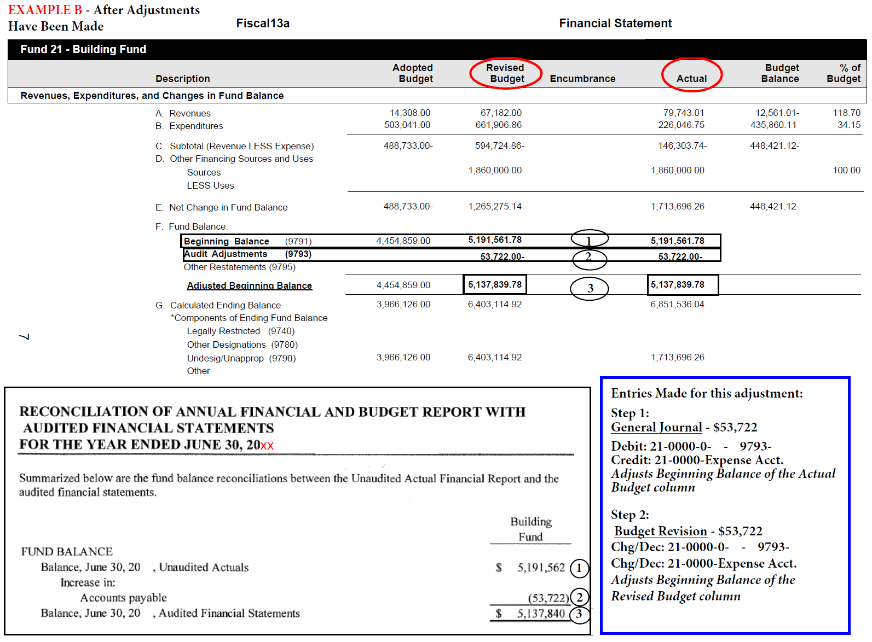
AUDIT ADJUSTMENTS

Slide 20
AUDIT FINDINGS
If an audit exception is made, the auditor is required to report the exception (finding) in the Schedule of Findings and Questioned Costs section of the annual audit report
What is an audit exception (finding)?
An audit finding is a weakness in internal controls or an instance of noncompliance with applicable laws and regulations that is presented in the audit report
How do I know if my audit contains an audit finding?
Before the end of the auditor’s visit, the district should be aware of any finding(s) that will be included in the audit
  Communicate with your auditor throughout the audit process, an audit finding should not be a surprise
When auditors present audit exceptions in the audit report, they typically include the following elements for each:
Category, criteria, conditions, effect, questioned cost, and cause for the finding
Recommendation for corrective action
Response from the LEA

Slide 21
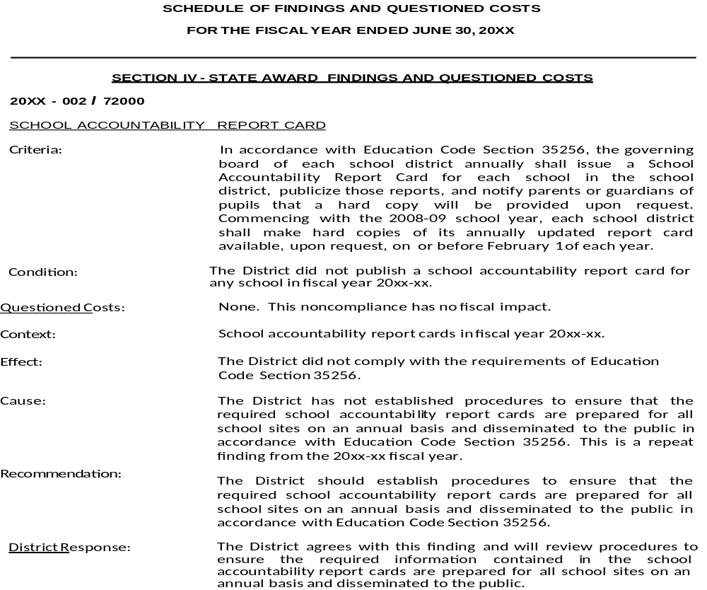
AUDIT FINDINGS

Slide 22
AUDIT FINDINGS
Steps for dealing with audit findings
Step 1:
Discuss with your Board the audit findings and corrective actions necessary (February meeting)
Step 2:
Complete the Certification of Corrective Action sheet and send to your SCOE Advisor (April 15)
  This is a certification from the LEA Superintendent that all corrective actions have been reviewed by the Board and corrective actions have been implemented
Complete the Audit Finding Corrective Action sheet(s) and send to your SCOE Advisor (April 15)
  This is a form describing specific corrective actions used in resolving audit finding(s)
  Note: these forms are in addition to the Audit Certification form

Slide 23
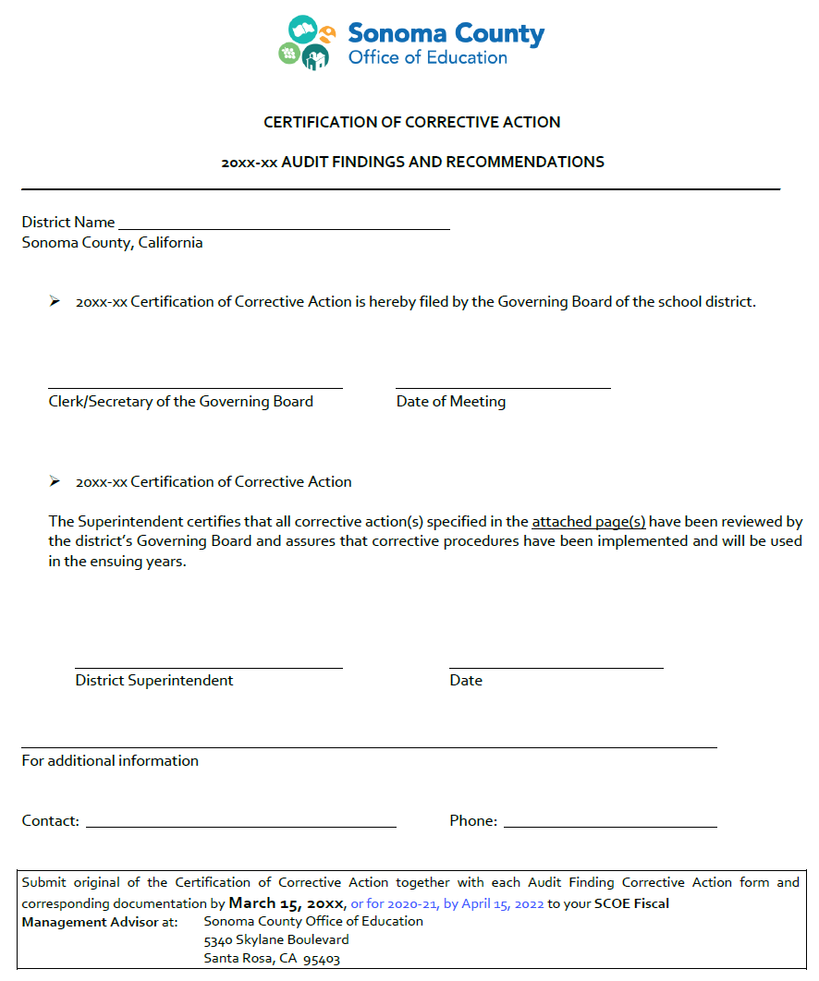
AUDIT FINDINGS
Step 1

Slide 24
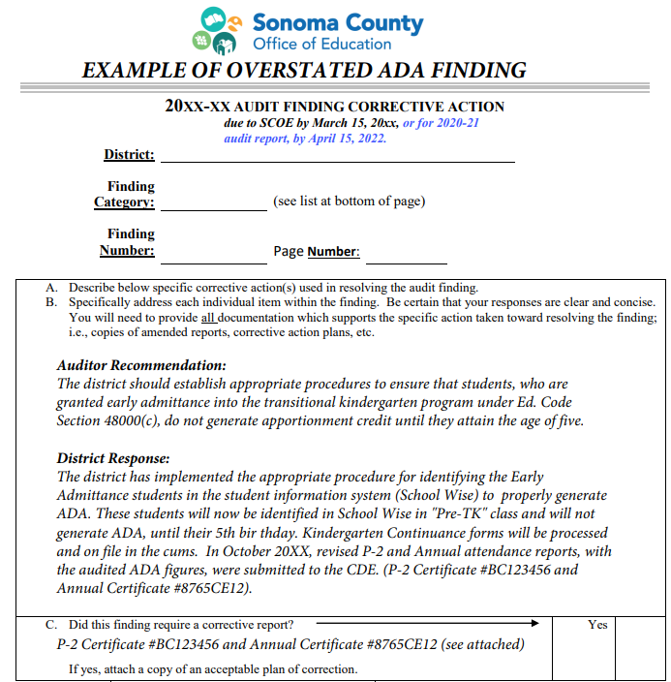
AUDIT FINDINGS
Step 2

Slide 25

Questions

