Slide 1


Understanding YOUR Budget
November 16, 2023
Presented by: SCOE Fiscal Advisors

Slide 2


Workshop Objective
To gain understanding of the process in how to create reasonable budgets and multi-year projections (MYP), while aligning resources to decisions made at the LEA-level.

Slide 3
Today’s Topics
Understanding Your Base Year (2022-23)
Reviewing Current Year Budget (2023-24)
Building an MYP off the Current Year
MYP Analysis & Group Discussions

Slide 4
Understanding Your Base Year (2022-23)
General Ledger Clean up
Clear or Evaluate Receivables and Payables set up in the prior year (PY) and not yet cleared in the current year (CY)
  Has all PY revenue been received and have all PY payables been paid out?
  If not, why has it not cleared?
    Is it still valid?
    Did the revenue or expense to clear hit the wrong code?
    Manual journal entries may need to be completed
    Research may be needed!

Slide 5
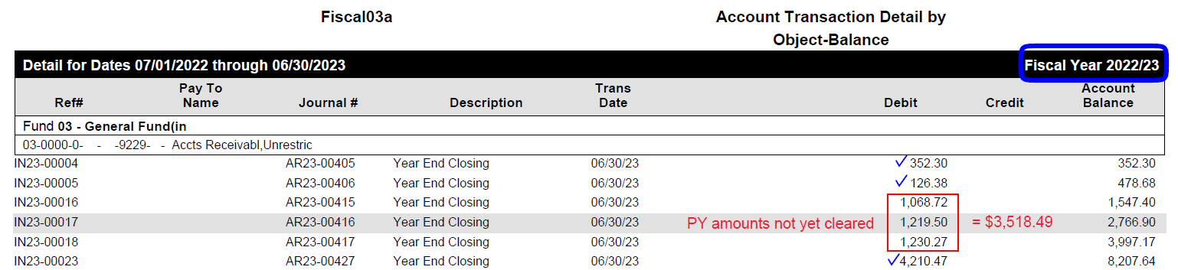
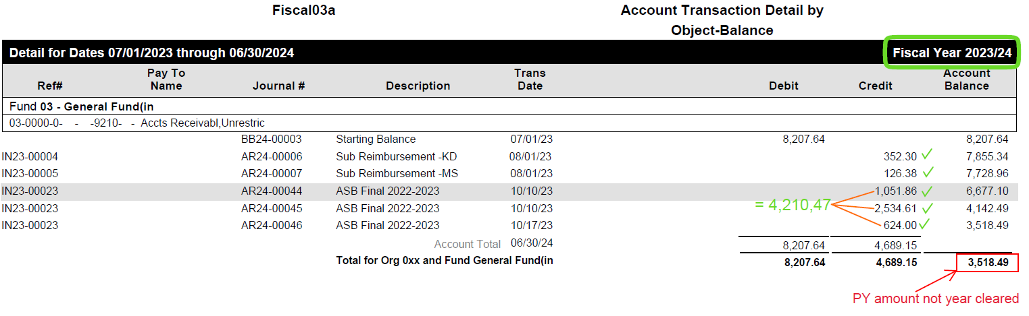
Understanding Your Base Year (2022-23)
Clearing AR/AP Example
Compare CY GL balances to PY set up:
Identify amounts still not cleared
In this example, revenue from three invoices have not been received
If it is determined the revenue will not actually be received, this could affect the amount of current year revenue and the amount to be budgeted
Reminder! A receivable/payable set up in the PY to 9229/9529 will roll to 9210/9510 in the CY

Slide 6
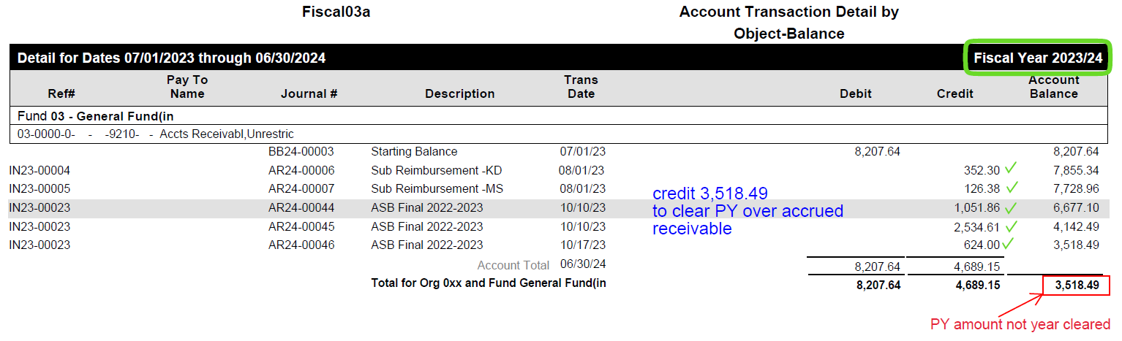
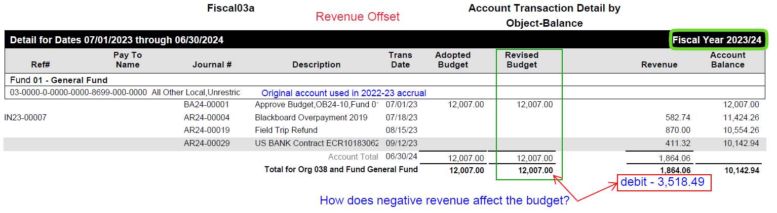
Understanding Your Base Year (2022-23)
Clearing AR/AP Example
Compare CY GL balances to PY set up:
If it is determined the revenue will not actually be received, receivable will need to be cleared to the original revenue account in which it was accrued in the PY
  This will create a negative revenue amount in the CY
  Re-evaluate the CY budget
  Does the CY budget need to be adjusted due to this?

Slide 7
Fund Balance Resources
Understanding Your Base Year (2022-23)
Unearned Revenue Resources
Revenue is recognized in the year received
Ending fund balance is allowed
Fund balance is reduced as expenses are recognized, potentially over multiple years
Examples of Fund Balance Resources:
  Lottery
  Educator Effectiveness
  Expanded Learning Opportunity Program
  Art, Music, & Instructional Materials Discretionary Block Grant
Some charters fall under FASB and not GASB and therefore fund balance is not allowed in some resources (check with your auditor)
Revenue is recognized in the year in which it is earned (spent)
Ending fund balance is not allowed
Revenues must equal expenditures
Resources subject to unearned revenue can NOT carry forward a fund balance and therefore, any revenue received but not expended must be “pushed forward” from the prior year to the current year
Examples of Unearned Review Resources:
  Many Federal resources such as:
    Title I, II, II, IV
    Special Ed IDEA
    One-Time Federal ELOG and ESSER

Slide 8
Understanding Your Base Year (2022-23)
Understanding your Prior Year Carryover
Clear your Unearned Revenue set up during the prior year
It is important to review now as revenue available to be spent in the current year could include:
  Prior year unearned revenue that was received and “pushed forward” to the next year
  The balance of the prior year allocation not yet received or recognized in the prior year
  The current year allocation

Slide 9
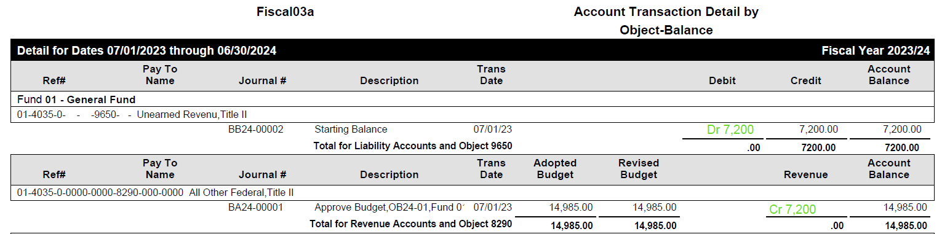

Understanding Your Base Year (2022-23)
Clearing Unearned Revenue Example
Review unearned revenue balances:
Identify amounts still not cleared
In this example, unearned revenue was set up in 2022-23 because it was received but not spent
Create a journal entry in 2023-24:
  Debit object 9650
  Credit object 8xxx
This will “push forward” the prior year revenue into the current year and make it available to expend.

Slide 10
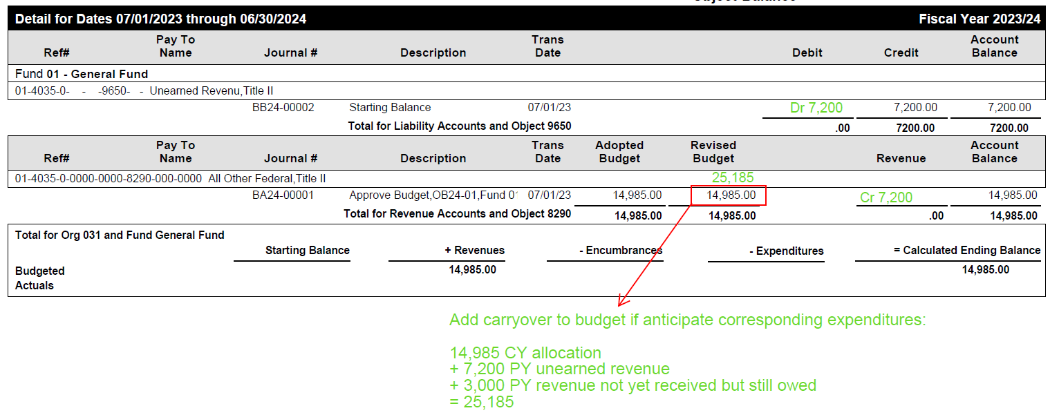
Understanding Your Base Year (2022-23)
Understanding Unearned Revenue
What is available to spend in the CY?
Update your 2023-24 budget to account for the amount of unearned revenue and carryover
If you do not intend to spend the remaining PY allocation plus the CY allocation, you may need to adjust your budget and book additional unearned revenue prior to the current year-end close
  Revenue = Expenditures for Unearned Revenue Resources
Assumptions for this example:
2022-23 allocation = 15,000
2022-23 received = 12,000
2022-23 spent = 4,800
2022-23 revenue “pushed forward” to 2023-24 = 7,200 (12,000-4,800)
2022-23 revenue still not yet received = 3,000 (15,000 - 12,000)
2023-24 allocation = 14,985
Total amount available to be spent in 2023-24 = 25,185
PY unearned revenue 7,200
PY revenue due 3,000
CY allocation 14,985

Slide 11

Reviewing Current Year Budget

Slide 12
Reviewing Current Year Budget
Adjust for PY
Carryover
Updating Categorical
One-time Funding
Compare to Actuals
Historical Trends
For resources subject to unearned revenue, account for any carryover or deferred revenue that needs to be recognized in the current year.
Remember, carryover is essentially one-time funds and should only be recognized once.
Update revenue and expenditures for current year with updated entitlements.
Current entitlement funding information is available on the CDE website and may be updated throughout the year.
Remember, each dollar can only be spent one time.
Run a multi-year Fiscal 04/06 report to verify revenue and expenditures have not been recognized more than one time.
Review actuals-to-date to determine if projections are on target or if adjustments to projections should be made.
Use Fiscal Summary or Comparative Summary reports and review balances to determine if update is needed.
Review historical trends to ensure projections are reasonable.
Run a Fiscal 04/06 using actuals for at least 3 prior years.

Slide 13
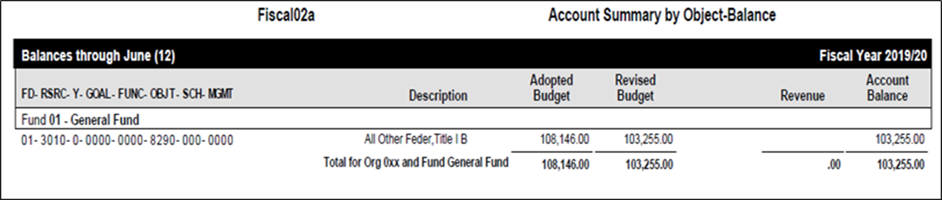
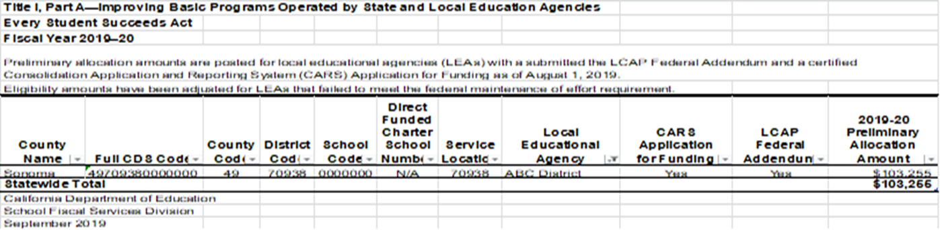
Reviewing Current Year Budget
Updating Categoricals:
Update entitlements for the current year. Remember to analyze each resource to determine if ending fund balances are allowed.

Slide 14
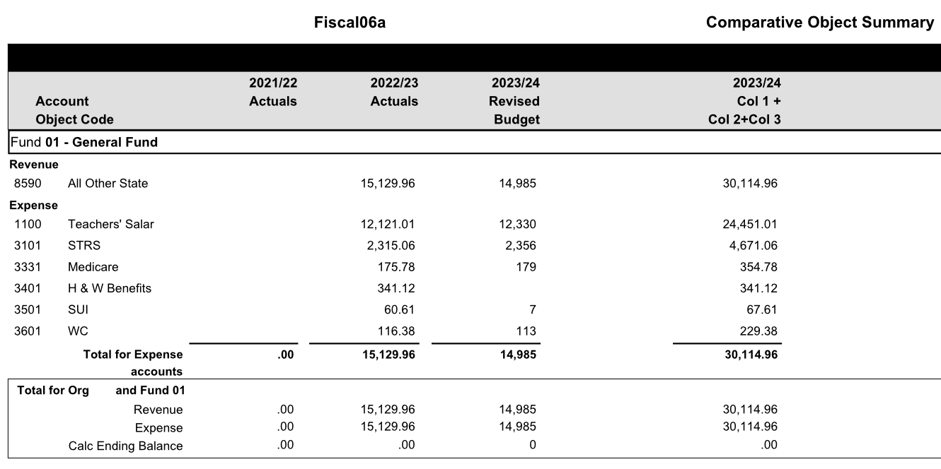
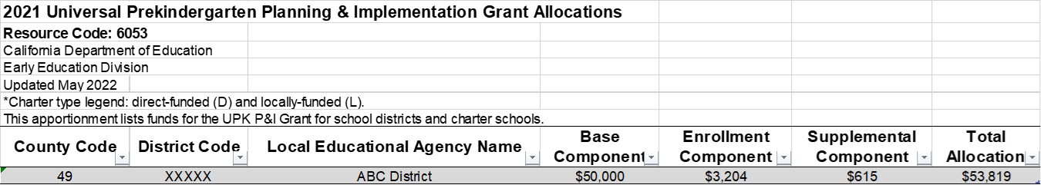
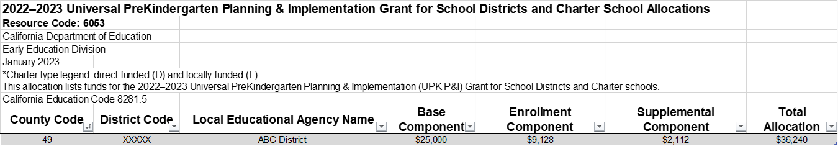
Reviewing Current Year Budget
Unearned Revenue
One-Time Funds:
Remember, each dollar can only be spent one time. Run multi-year report to compare revenue and expenditure recognition to the entitlements on the CDE’s website.
Total allocation of $90,059 - total recognized of $30,115 = $59,944 balance remaining to recognize in current year or subsequent years of the MYP.
Example: Universal Pre-K (Resource 6053)
2021-22 Allocation
2022-23 Allocation
Total allocation: $53,819 + $36,240 = $90,059
Total recognized

Slide 15
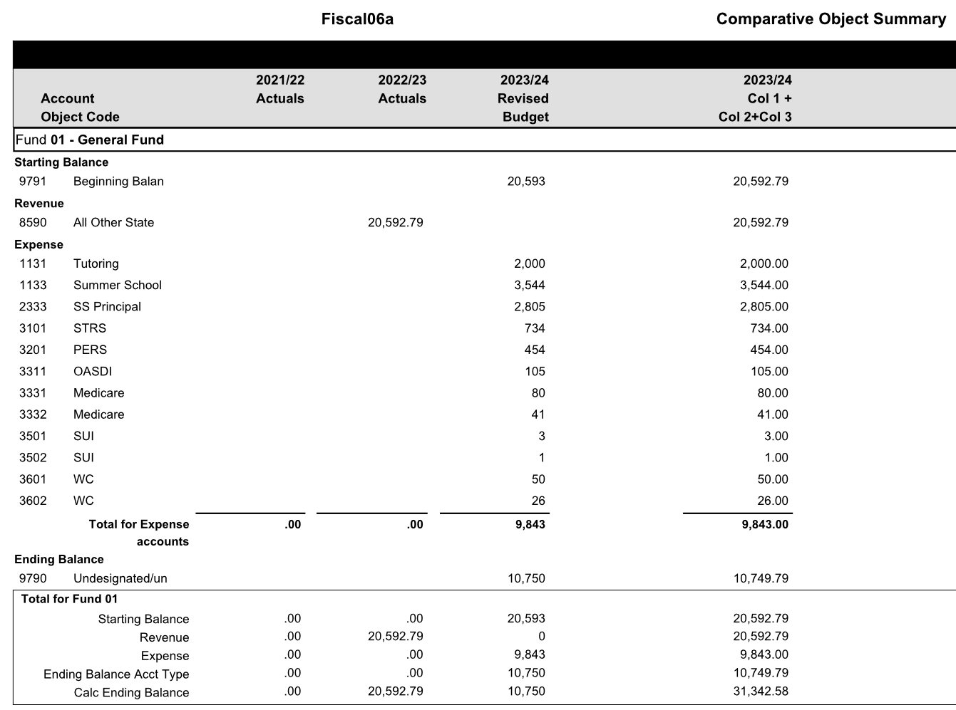
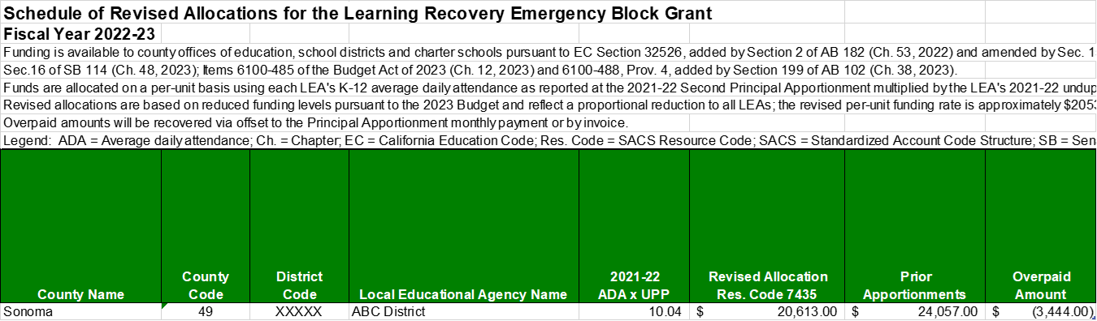
Reviewing Current Year Budget
Fund
Balance
One-Time Funds:
Revenue: Total revised allocation of $20,613 - total recognized of $20,593 = $20 balance remaining to recognize in current year.
Expenditures: Total revised allocation of $20,613 - total recognized of $9,843 = $10,770 balance remaining to spend in the current year or subsequent years of the MYP.
Example: Learning Recovery Grant (Resource 7435)
Total recognized

Slide 16
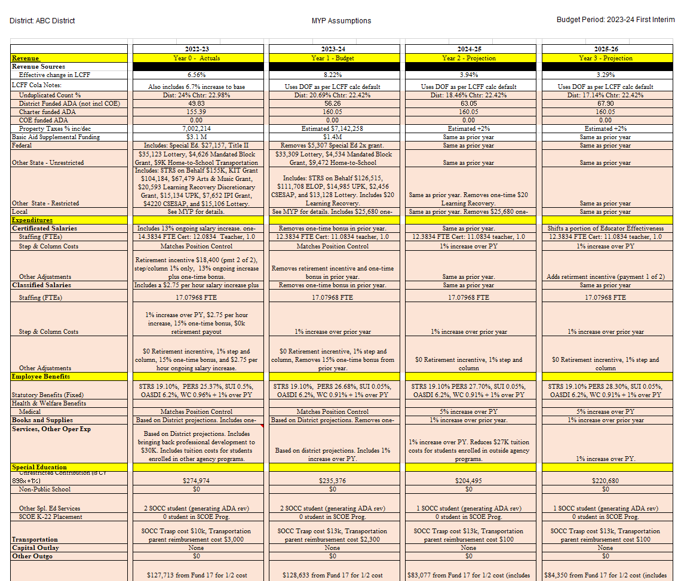
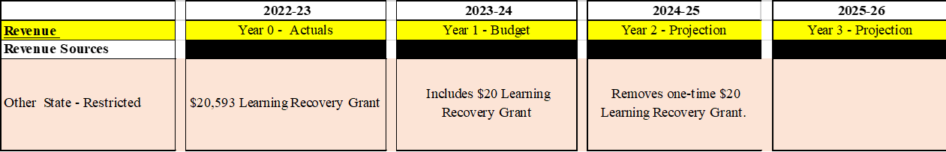
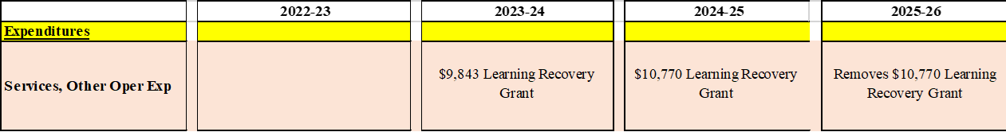
Reviewing Current Year Budget
Assumptions are key!
Documenting Assumptions
Example: Learning Recovery Grant (7435 Resource)
Removes $20,593 LR Grant
Be mindful of spending deadlines when budgeting in the MYP!

Slide 17
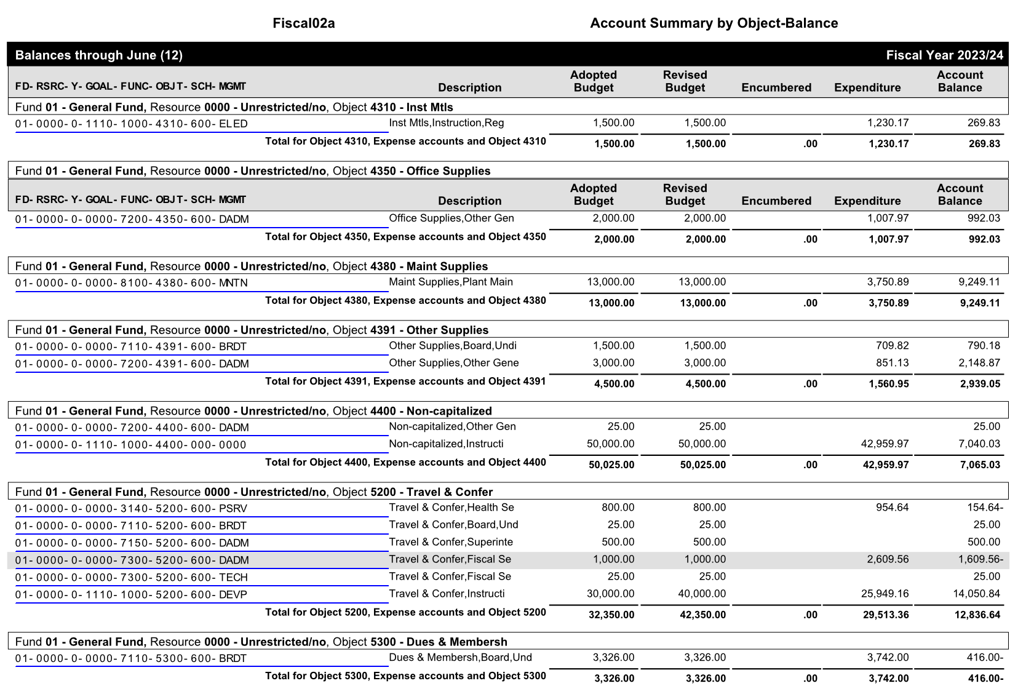
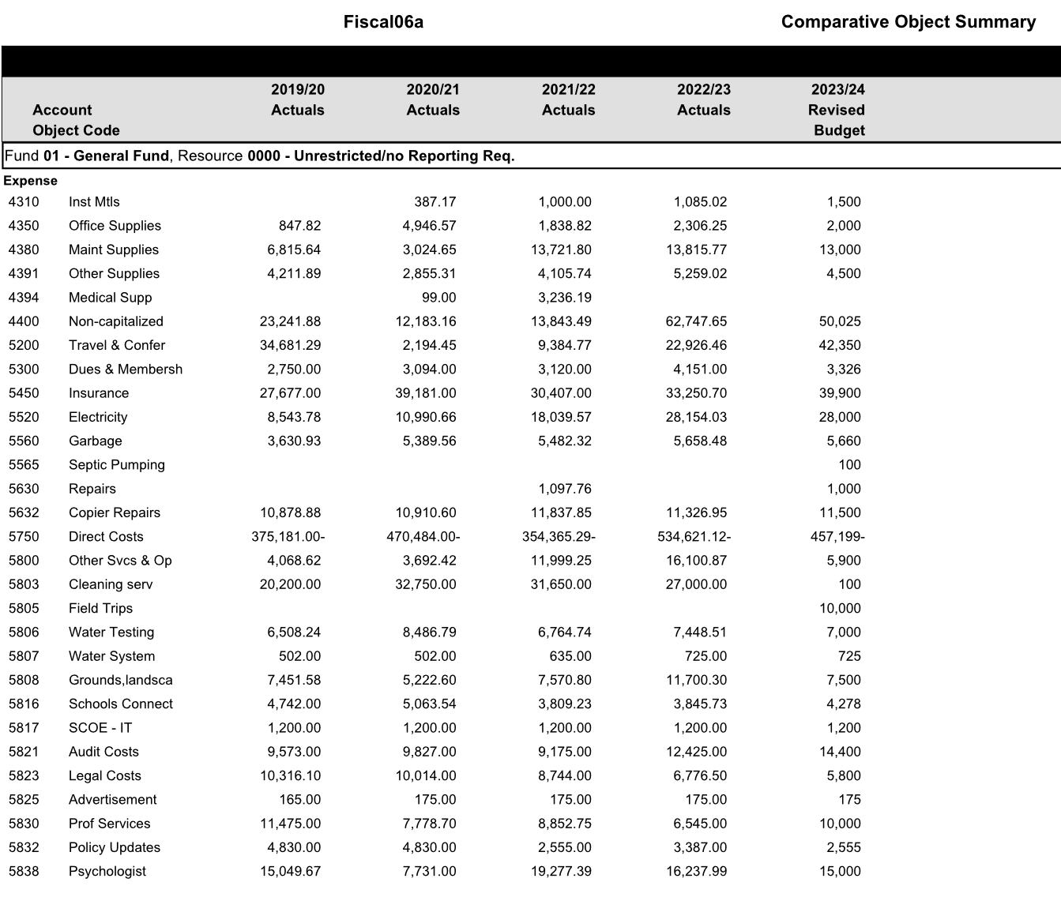
Reviewing Current Year Budget
Compare to Actuals: Historical Trends:
What changed?
Are projections in line with actual prior years?
One-time expenses?
Review account balances and determine if revisions are needed.
Review historical trends and determine if revisions are needed

Slide 18
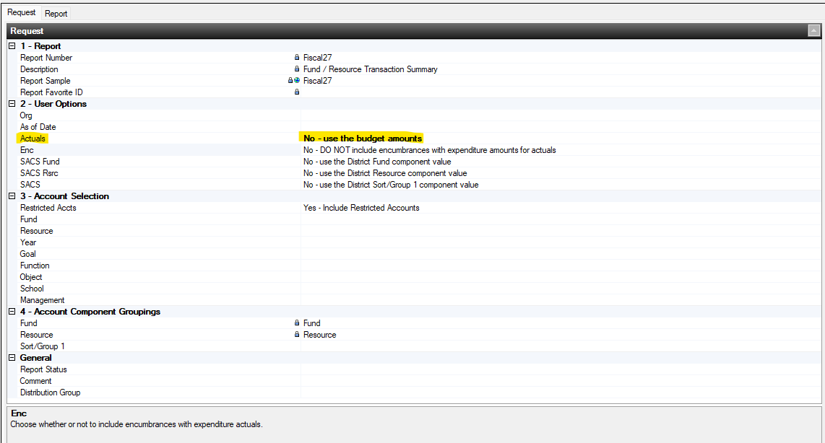
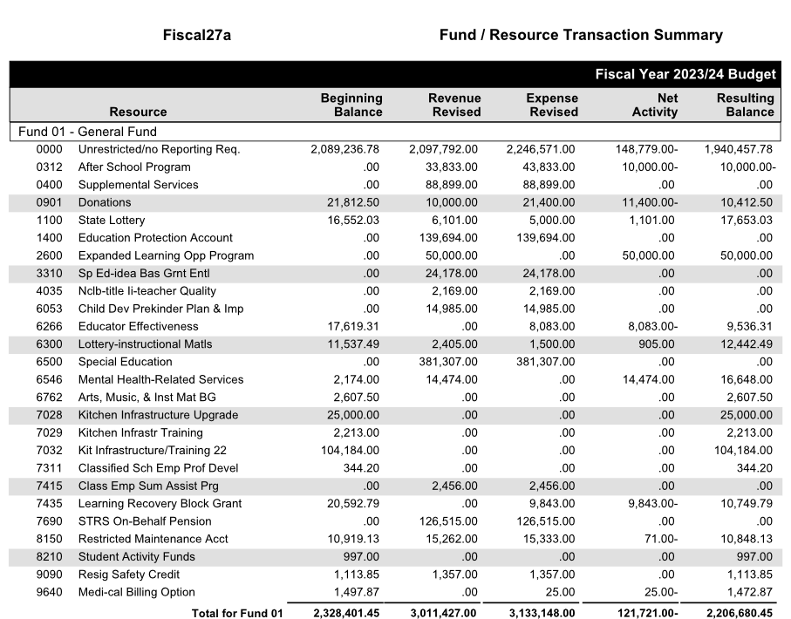
Reviewing Current Year Budget
Balancing Resources:
Determine which resources are subject to unearned revenue and which resources are subject to fund balance. Use the Fiscal 27 report as a guide in balancing resources in the current year before building your MYP.
All resources should have positive balances. If negative, determine if a contribution should be made or if revenue or expenditures should be adjusted.

Slide 19
Building an MYP off the Current Year

Slide 20
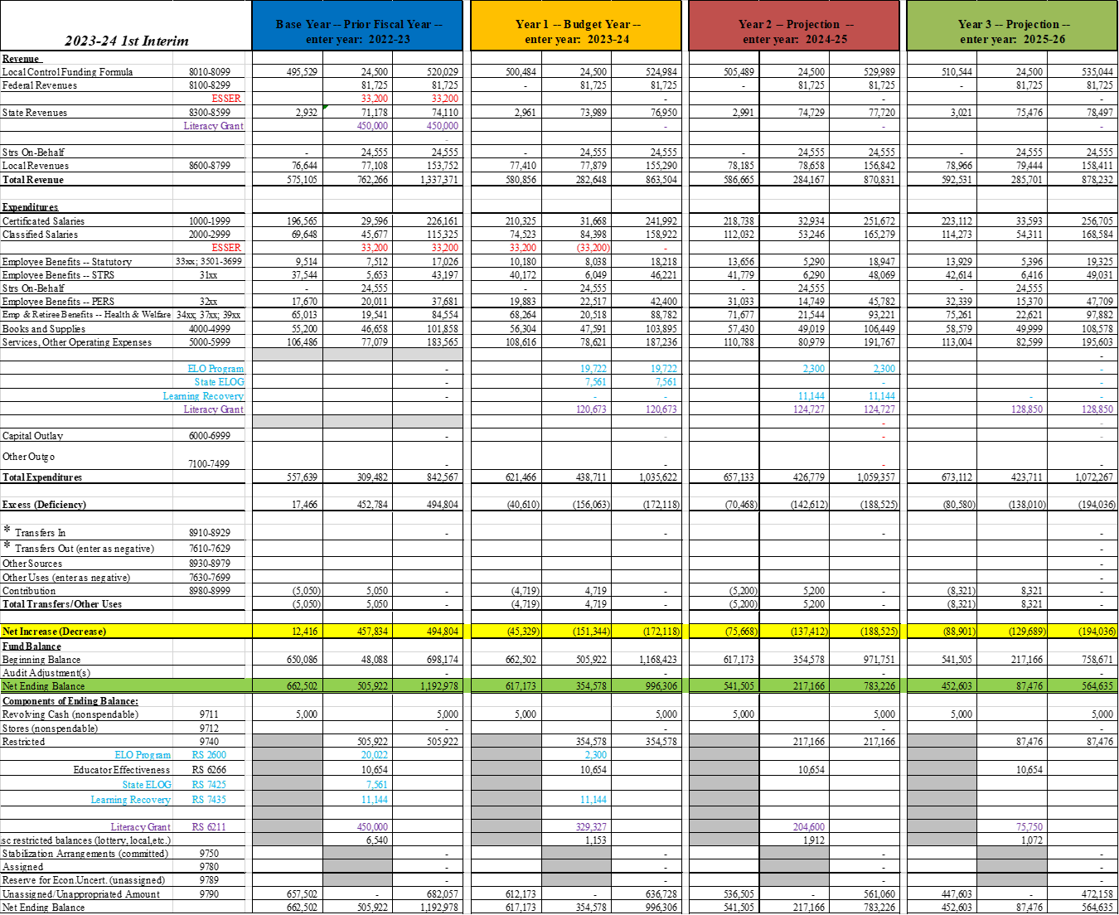
Building an MYP off the Current Year
MYP Topics
Recognizing one-time funds in the MYP
Correlating expenses to revenue assumptions for resources subject to unearned revenue
Correlating expenses to restricted balances for one-time funds subject to fund balance
Restricted Balances and Contributions to Restricted Programs
Deficit spending
Documenting assumptions

Slide 21
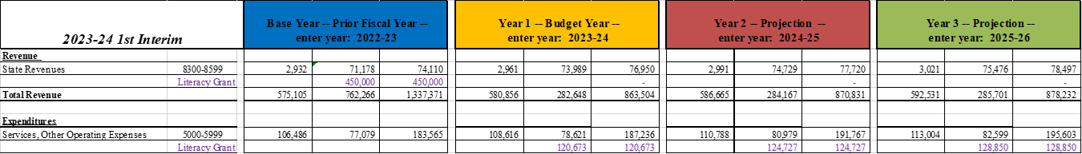
Building an MYP off the Current Year
Recognizing One-Time Funds in the MYP
Example: Removing / adding one-time funds in MYP
For resources subject to Fund Balance:
Revenue is recognized in the year it is received
Expenditures are recognized in the year they are spent
Once funds are fully exhausted, either remove expenditures from the MYP or if they are on-going, move to another funding source

Slide 22
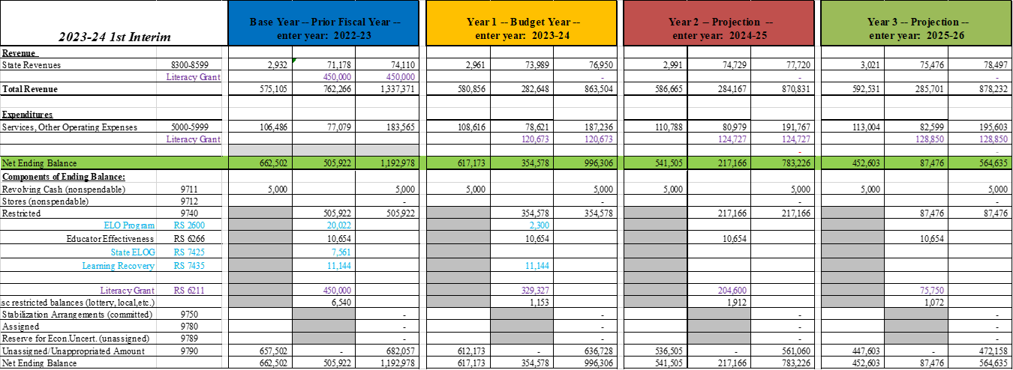
Building an MYP off the Current Year
Recognizing One-Time Funds in the MYP
Example: Removing / adding one-time funds in MYP
Document Year to Year Changes in Assumptions!
22/23 Revenue = 450,000
23/24 Expense = 120,673
24/25 Expense = 124,727
25/26 Expense = 128,850
Remaining Balance = 75,750

Slide 23
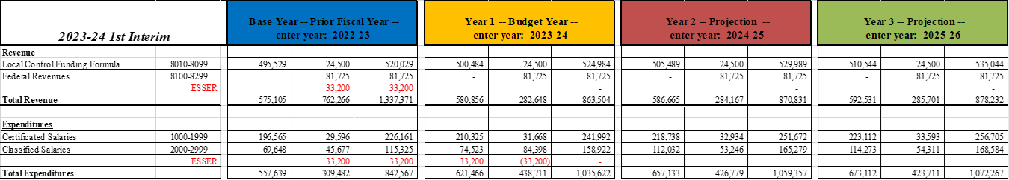
Building an MYP off the Current Year
Recognizing One-Time Funds in the MYP
In this example, The expense is on-going. Once the revenue is gone, the expense is moved to another funding source
Example: Removing / adding one-time funds in MYP
For resources subject to Unearned Revenue:
Revenue is recognized in the year it is spent
Revenue = Expenditures
Once funds are fully exhausted, either remove expenditures from the MYP or move to another funding source if on-going

Slide 24
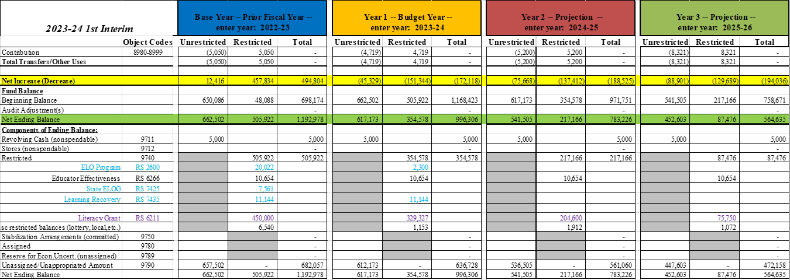
Building an MYP off the Current Year
Restricted Balances and Contributions to Restricted Programs
Examples:
Educator Effectiveness does not have correlating expenditures so restricted balance remains flat
Literacy & Reading Grant is reduced each year by the amount of expenditures occurring in that year. Once exhausted, expenditures should be removed or shifted to another funding source.
Helpful Tip!
When projecting contributions to restricted programs, first determine what the restricted balances are each year.

Slide 25
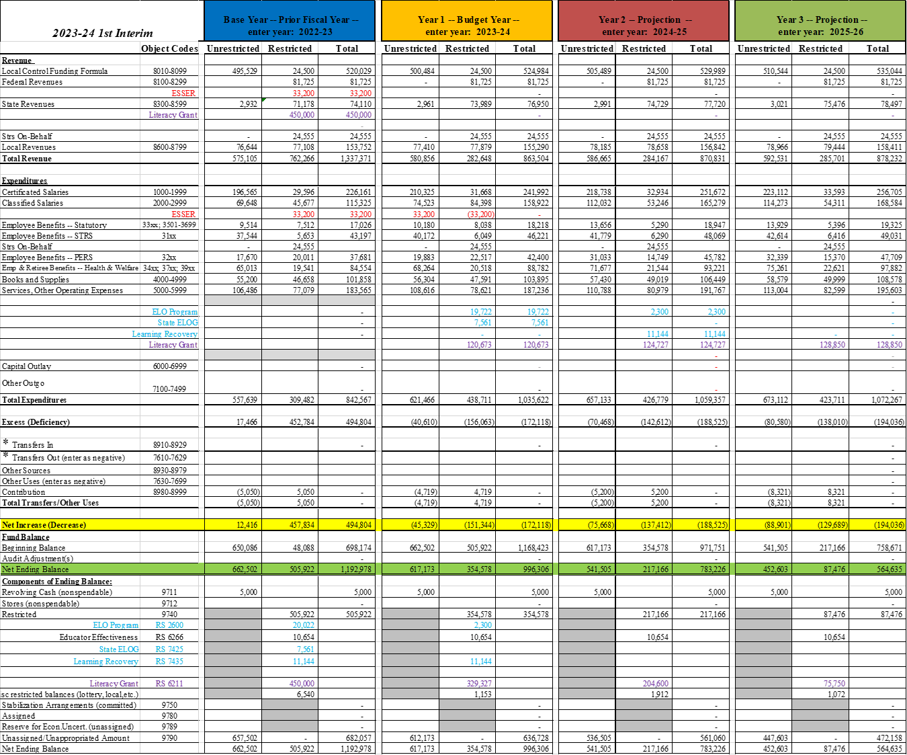
Building an MYP off the Current Year
Deficit Spending
Analyze Deficit Spending
Structural Deficit:
Projected spending levels are greater than projected revenue levels when intentional spending down of one-time funds is removed.
Know the root causes:
Unrestricted / Restricted
Planned spending of reserves
One-time expenses
Base operation costs exceed revenues

Slide 26
Building an MYP off the Current Year
Stimulus Funds Expiration Schedule
Fund | SACS Resource | Date Expires
ESSER II | 3212 | 9/30/2023
ELO-G (ESSER II) | 3216 | 9/30/2023
ELO-G (GEER II) | 3217 | 9/30/2023
ESSER III | 3213 / 3214 | 9/30/2024
ELO-G (ESSER III Emg) | 3218 | 9/30/2024
ELO-G (ESSER III LL) | 3219 | 9/30/2024
Homeless Children & Youth II | 5634 | 9/30/2024
Consider ESSER III plan alignment and revise the plan as necessary. Know what staff are assigned to one-time funding sources.

Slide 27
Building an MYP off the Current Year
Declining Enrollment
Know and understand your local data and trends
  Each LEA has a unique story about community, enrollment, programs, competition, causes, and opportunities
Be strategic about your approach, and be intentional about collaboration between business and human resources
  Know your staffing: attrition, temporary and non-classroom assignments, forecast
ADA mitigation slowed the impact, but there is not a current hold harmless and there will be an impact beginning in 2024-25.
  Funded ADA may drop at a faster rate than enrollment is declining.

Slide 28
Building an MYP off the Current Year
How to Plan Strategically
Economic data is more stable than a year ago, but a slowing economy is evident
Monitor the economy and state revenue closely
  Use remaining one-time resources strategically, balanced among short and long-term needs
  Understand your LEA’s tolerance for risk
  Update MYP regularly
  Craft multiple scenarios for enrollment / ADA, UPC, UPP
Be strategic and thoughtful about out year commitments
  Verify assumptions and understand base year to which those assumptions applied

Slide 29
MYP Analysis Exercise

Slide 30

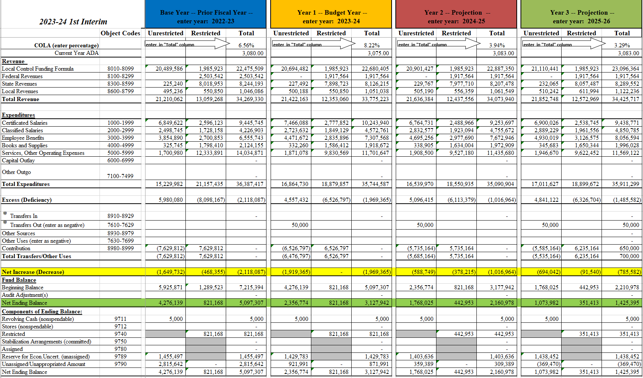
MYP Analysis Exercise
Does this MYP appear reasonable?
What are the areas of concern?
Identify areas where assumptions are needed
Discuss as a group questions/issues with these projections

Slide 31
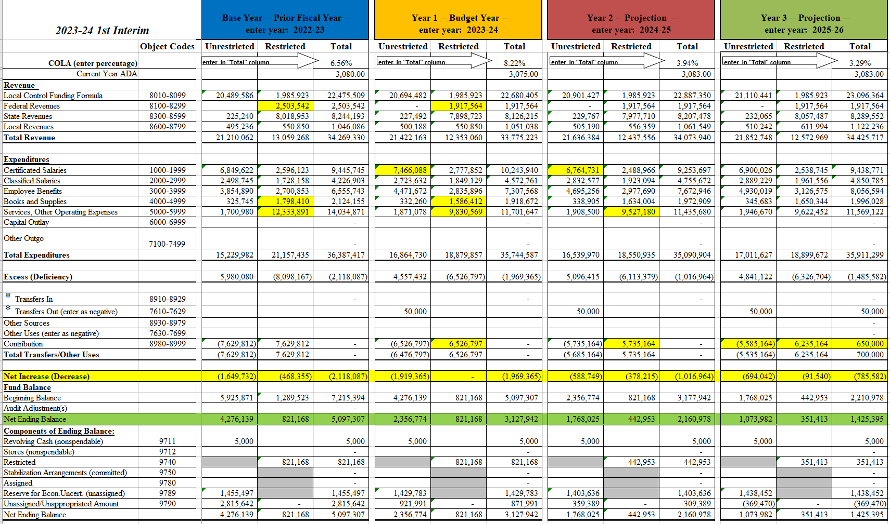
MYP Analysis Exercise
Why is Federal revenue decreasing by $600k yet books, supplies, and services are decreasing by $3M over 2 years with the restricted fund balance remaining fairly constant?
If ADA is remaining fairly flat, why is unrestricted salaries significantly decreasing in the 1st SY?
How is it possible that the contribution to restricted is decreasing by a much higher rate as compared to expenses without using restricted fund balance?
Appears structural unrestricted deficit is being masked by unrealistic restricted contribution and/or misalignment or overstatement of 1x revenues and expenditures
Contribution in the 3rd year is out of balance

Slide 32
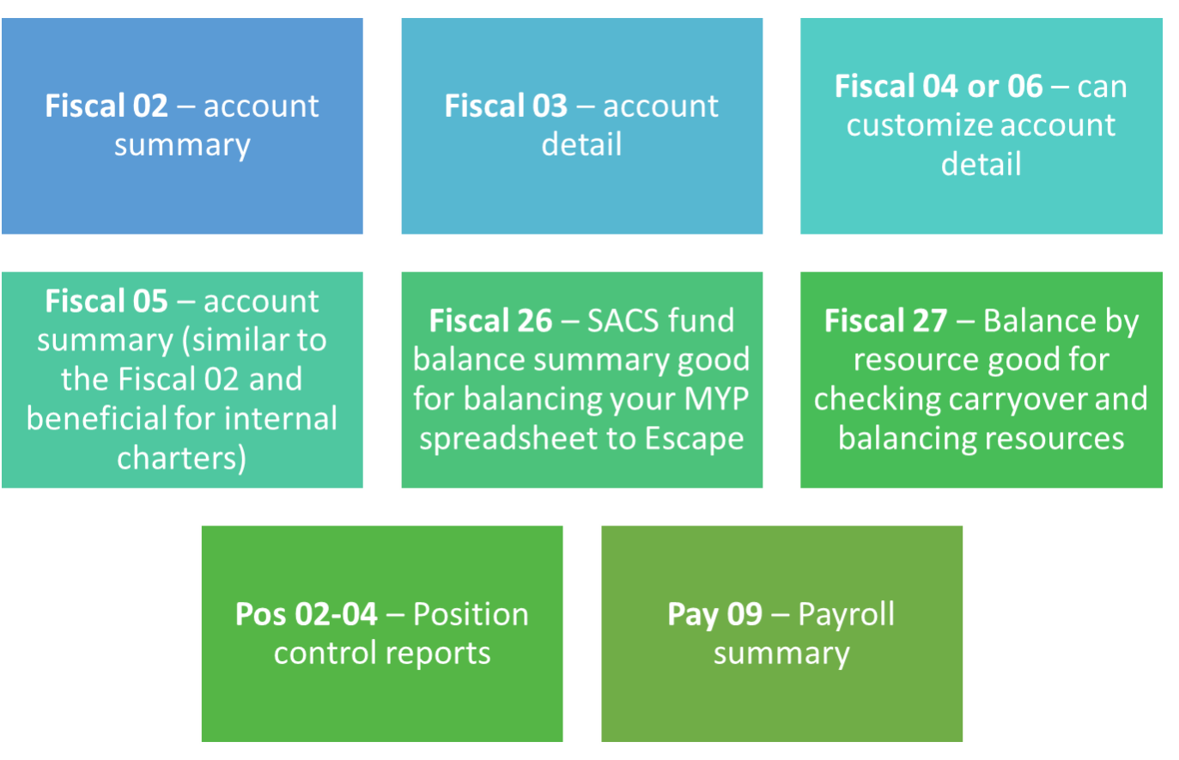
Resources
Recommended Reports to Run:

Slide 33

Resources & Reminders
Upcoming Workshops:
Visit SCOE’s website to access previous workshop materials, checklists and guides, and DBUG Resources.
Audit Review | December 5, 2023 | 9:00 - 10:30 a.m.
The Basics and General Ledger Mid-Year Cleanup | January 25, 2024 | 9:00 - 11:00 a.m. (working session)
CARS and Unearned Revenue Understanding | February 1, 2024 | 9:00 - 11:00 a.m. (working session)
LCAP Training | March 21, 2024 April 4, 2024 | 9:30 - 11:30 a.m.
Come learn with us!

Slide 34

Questions?

