Slide 1

PROGRAM OVERVIEW
& ACTION STEPS FOR DISTRICTS

Slide 2

WHAT IS KYND?
KYND is a cyber risk management system that RESIG is providing this year as a benefit to all member districts
Service objectives
Cyber Risk Control Service
Tools for members to manage their own risk
On-going, continuous risk management - external and internal risks
Real-time support via dedicated email and chat
Provides simple, actionable and powerful insights with support from KYND’s cyber experts
Extension of RESIG’s risk management practice
Provides RESIG with a constant, updated snapshot of the cyber security of members to provide insight on where to manage efforts
Underwriting performance and control
Visibility of pool’s cyber exposure at any given time
Prioritized signals that enable more informed decisions
Track individual members cyber posture between renewals.

Slide 3
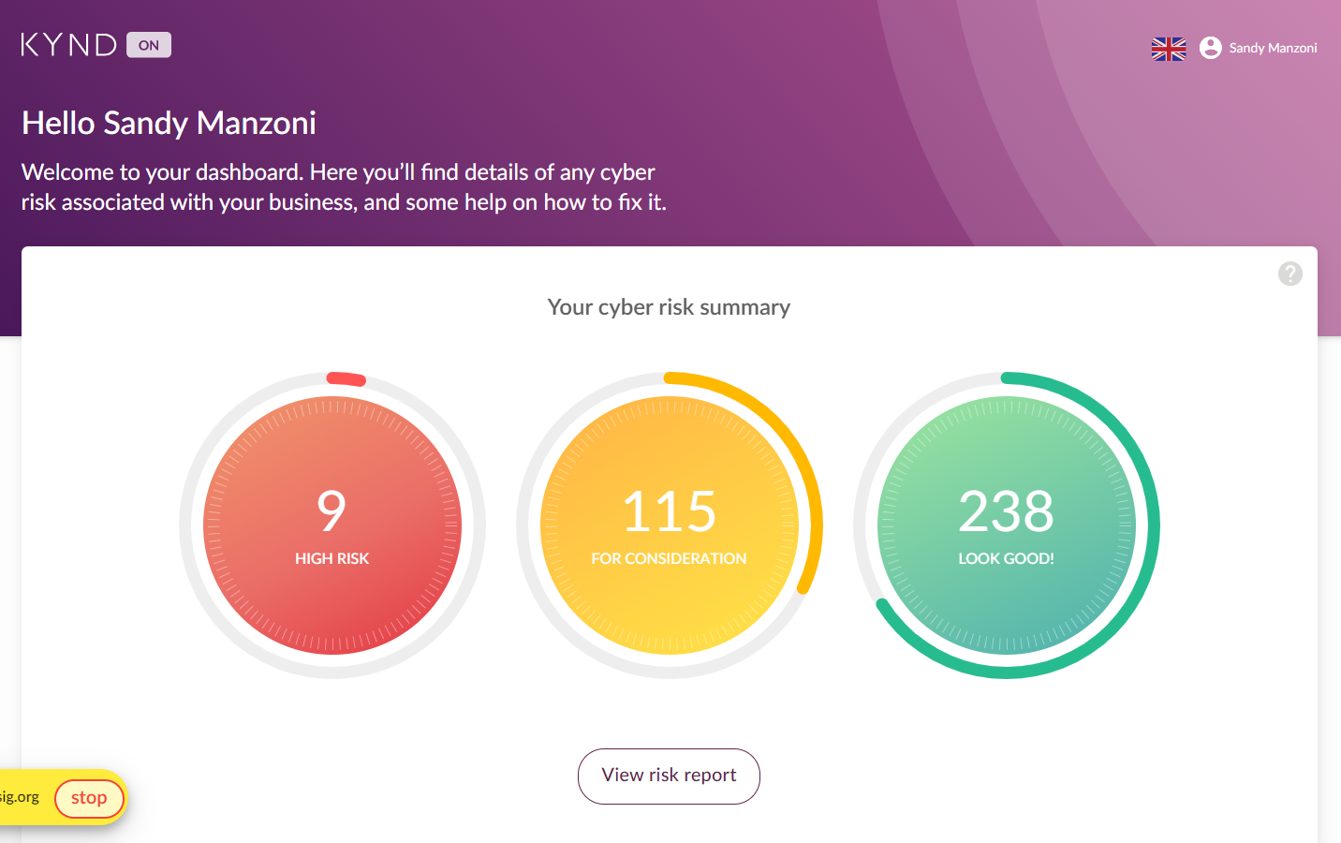
WHAT STEPS ARE WE ASKING YOU TO TAKE?
Service objectives
Log into your KYND dashboard
Step 1 is just getting the right person logged in!

Slide 4
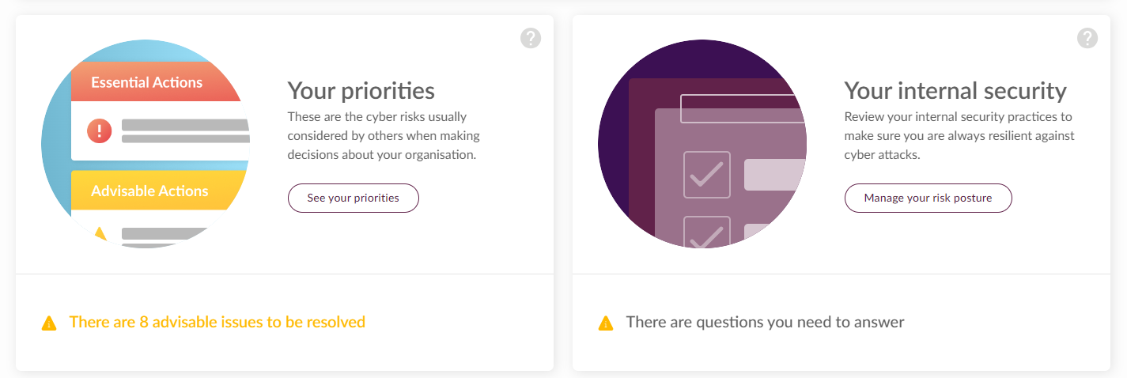
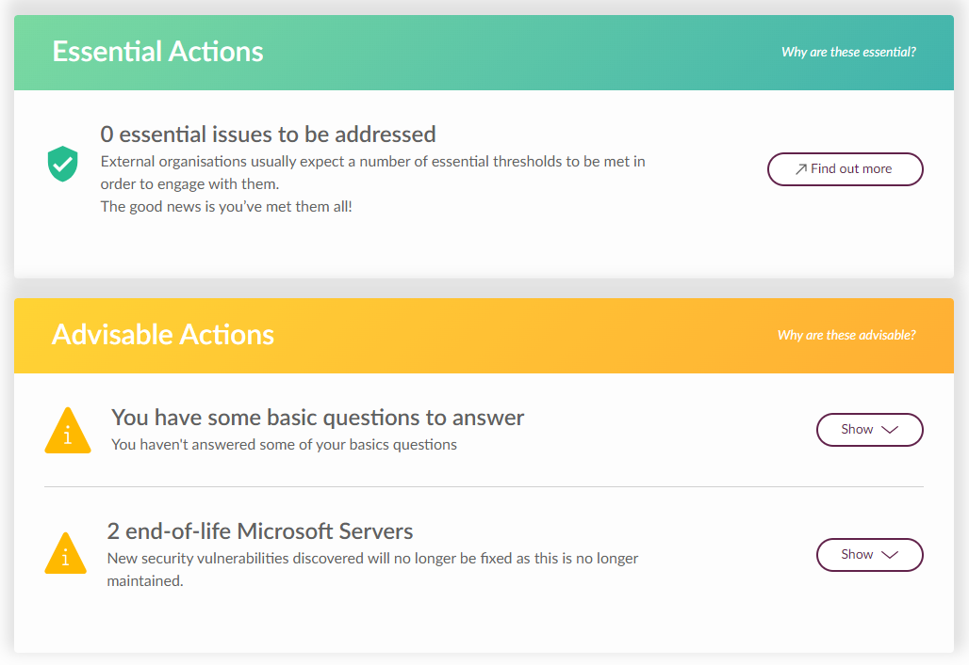
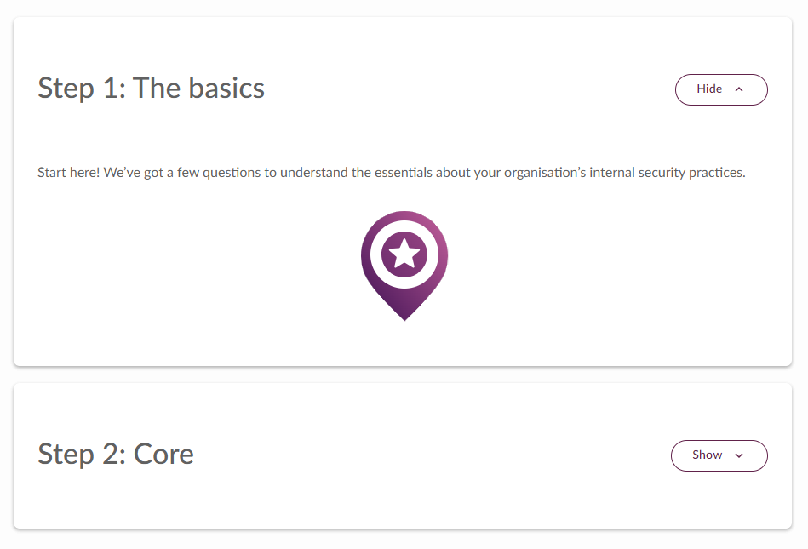
WHAT STEPS ARE WE ASKING YOU TO TAKE?
Service objectives
Answer question in your KYND dashboard
Answer the questions in “Your Priorities”
Answer the questions in “Your Internal Security”

Slide 5
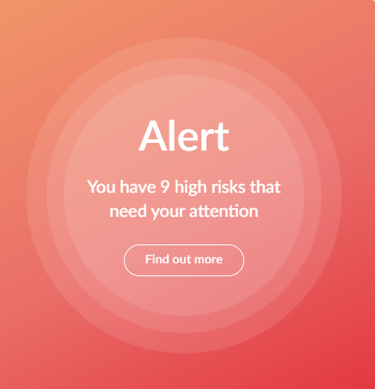
WHAT STEPS ARE WE ASKING YOU TO TAKE?
Service objectives
Engage in a Ready Call with KYND & RESIG
Once questions have been answered, KYND will reach out to set up a meeting
In the meeting they’ll discuss opportunities for improving your cyber security, based on the answers you’ve provided, as well as their monitoring of your domains
A RESIG staff member will attend the call
Address any new suggestions that arise
After your Ready Call, KYND will continuously monitor for changes
RESIG or KYND may be in touch with action items as they come up

Slide 6
MORE QUESTIONS?
Chat directly with KYND through your Dashboard
Sandy Manzoni
P&L Risk Manager
smanzoni@resig.org
(707) 836-0779 x 106
Nicole Thysell
P&L Risk Specialist
nthysell@resig.org
(707) 836-0779 x 121

