Slide 1
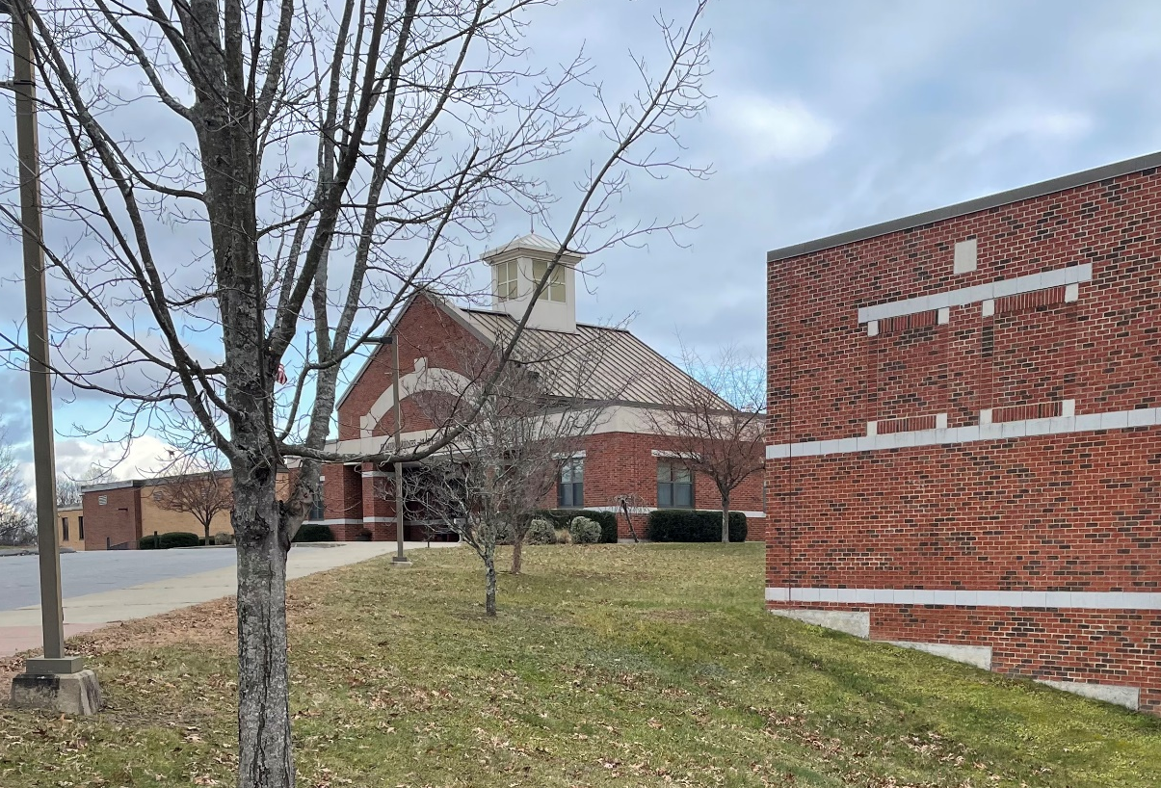

Marlborough School District
Educational Facility Assessment and Long-Term Capital Plan
MARLBOROUGH BOARD OF EDUCATION PRESENTATION
January 9, 2025 | 7:00 PM

Slide 2
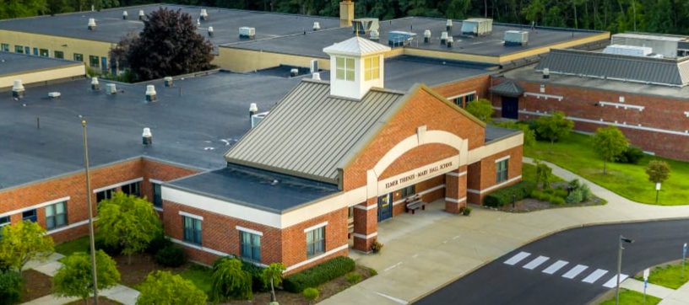




ANTINOZZI ASSOCIATES
Facility Assessment Team
Michael V. LoSasso,
AIA, LEED AP BD+C
Principal-in-Charge
David C. Ferris,
Senior Associate
Project Manager
Derek T. Bride,
LEED AP BD+C
Principal, CES
Thomas Hardin,
CPE / LEED AP
Principal, PACs
Antinozzi Associates
Architecture + Interior Design
CES
MEP/FP Engineering
Pan American Consulting Services
Cost Consultant
CLA Engineers, Inc.
Site/Civil/Geotechnical/Survey
CSG (Construction Solutions Group)
Educational Specifications/Programming
e2 Engineers
Structural Engineering

Slide 3
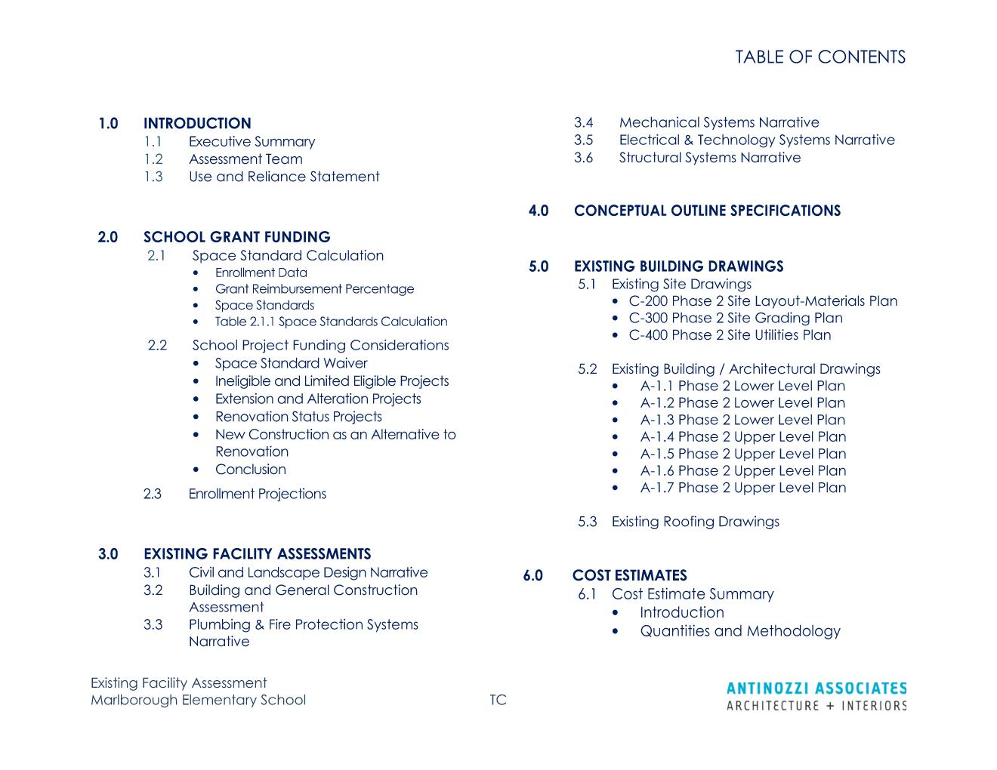
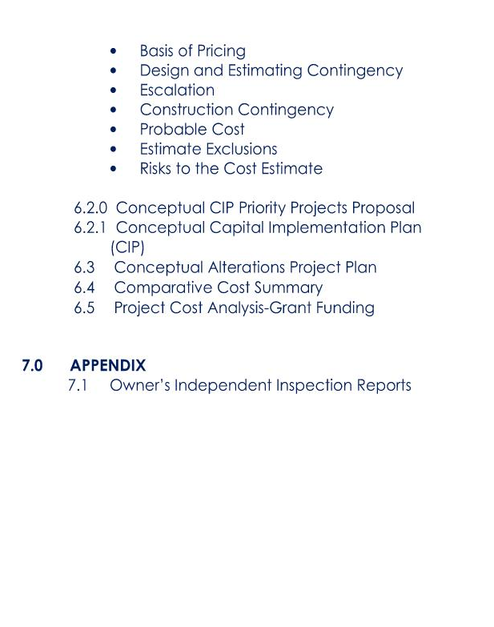
PROJECT APPROACH
Existing Conditions Assessment: Report Contents

Slide 4
PROJECT APPROACH
Existing Conditions Assessment: Recommended Priorities
A
B
C
YEAR 1
YEARS 2 - 3
YEARS 4 - 5
Demolish Canopy Structure, and construct new 2-Story Vestibule
Moisture infiltration at Gymatorium Stage
Roof replacement project (including replacement of skylights and roof hatches, and new roof drain inserts)
Upgrade Electric Service & Switchgear /
New underground electric service.
Mechanical System upgrades - Classrooms
  Install VRF Heat Pumps and Split system units in classrooms
  Install DOAS units & Associated ductwork for Classroom
  Replace impacted ceilings & lighting.
Replace AHU’s (RTU’s) throughout, new Controls Package – BMS/DDC Gymatorium & Stage
  Original Gym
  Admin**
  Cafeteria
  Media Center
  Computer Lab
  Art
  Building B Core
  Boiler room (combustion air
  Replace impacted ceilings & lighting
Clean & reconfigure ductwork as new AHU are replaced (Areas with more severe work – ceiling configurations etc. – may be delayed and completed simultaneously with Mechanical upgrade scope of work).
Fire Suppression Sprinkler System Infrastructure
  Fire water service line
  Fire water storage
  Sprinkler riser assemblies
  Fire Pump & fire pump building
Fire Suppression Sprinkler System – Distribution system (implement simultaneously with mechanical upgrades)
Remove oil tanks (2 UST & 2 day tanks – one in each boiler room along with pumps) / Convert existing boilers to gas / Install new Propane Tank & Pad / Replace water heater to make gas fired (propane) (or simply replace the burner – for the one installed in 2021) / Provide new gas piping
Window replacement project
Replace / Add new window treatments throughout
Renovate Gang Toilet Rooms
Replace exhaust Fans
  General
  Toilet rooms
  Kitchen
Add strainers to Janitor sinks (Inexpensive fix that can be completed immediately)

Slide 5
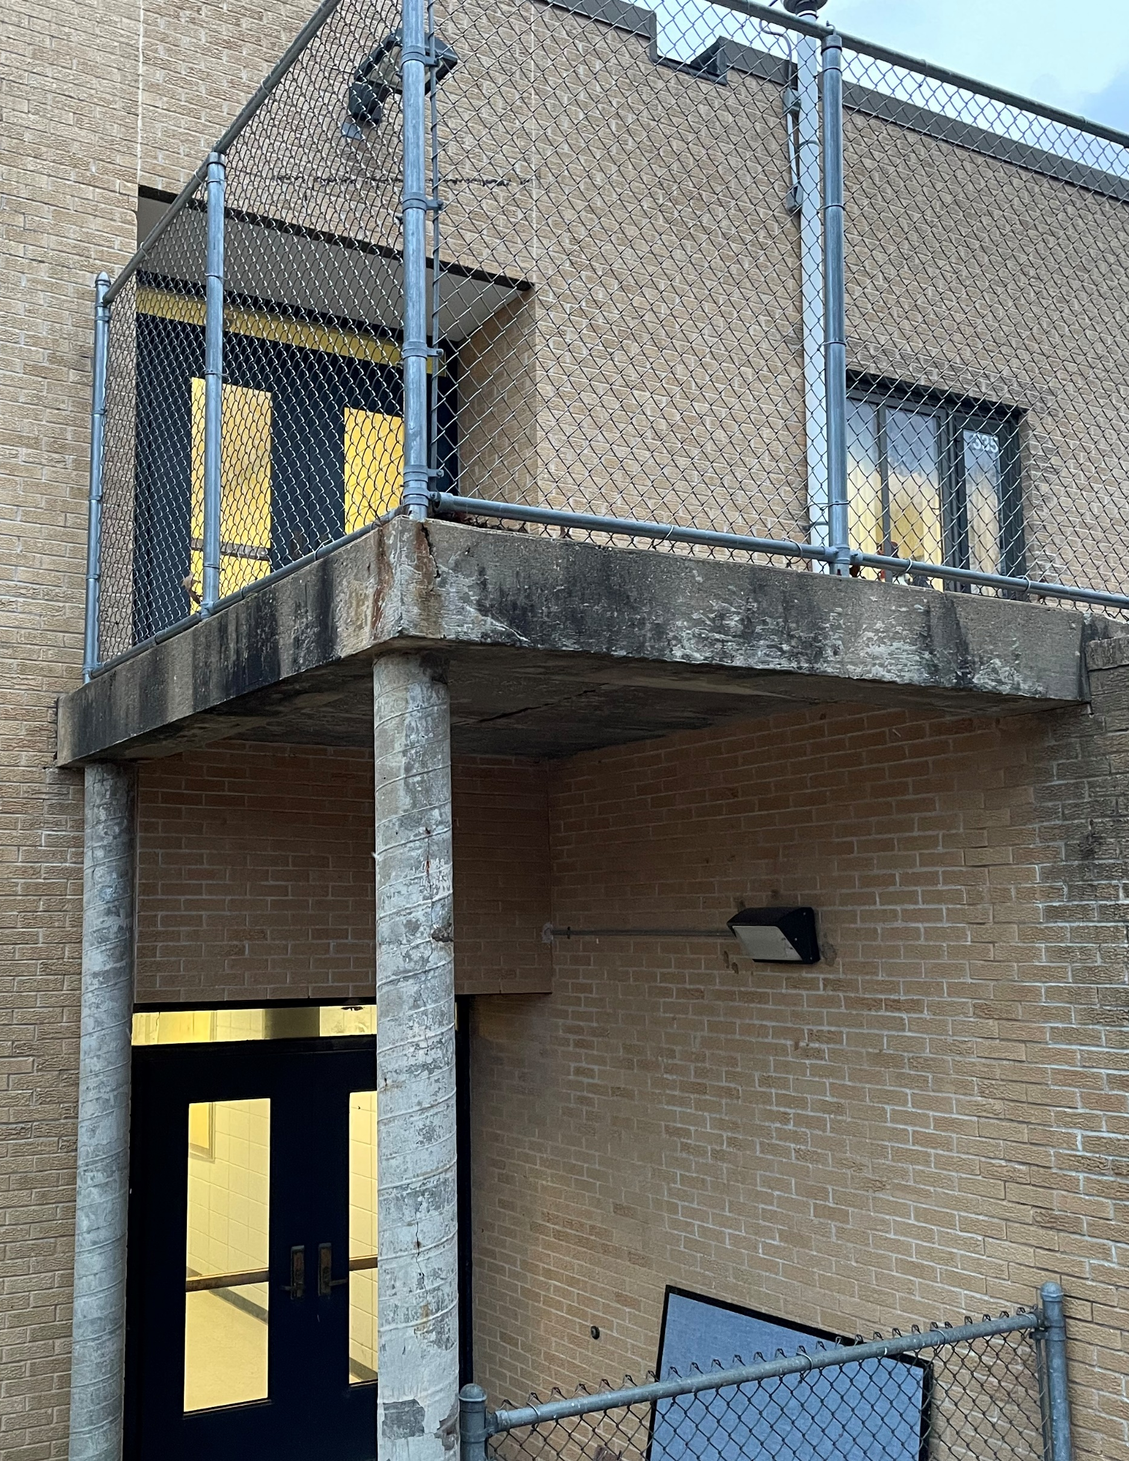
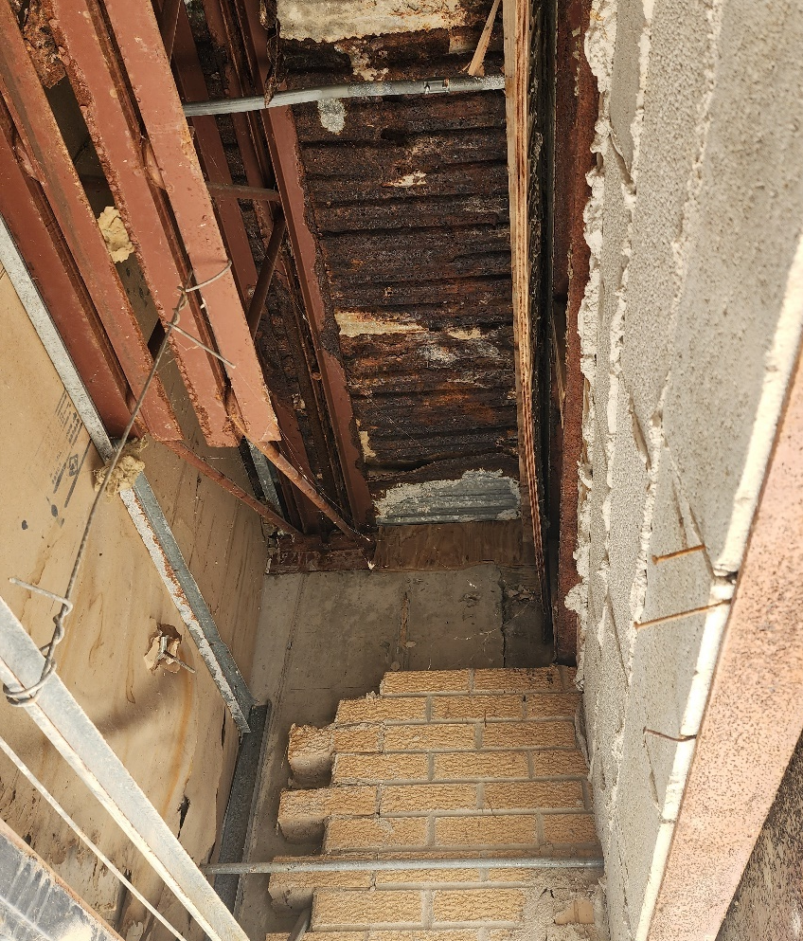
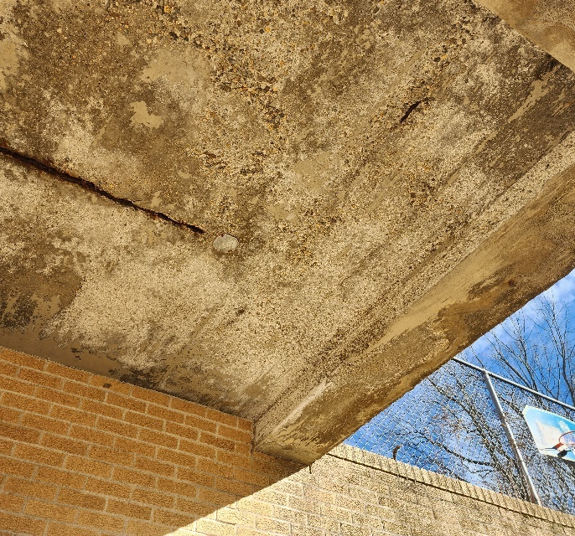
PROJECT APPROACH
Existing Conditions Assessment: Recommended Priorities
A

Slide 6
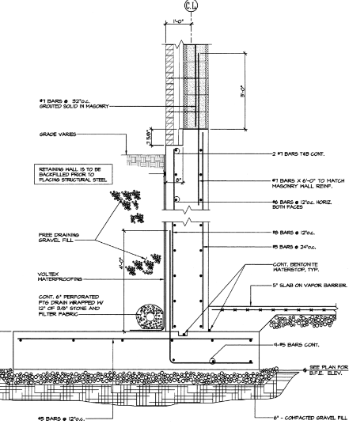
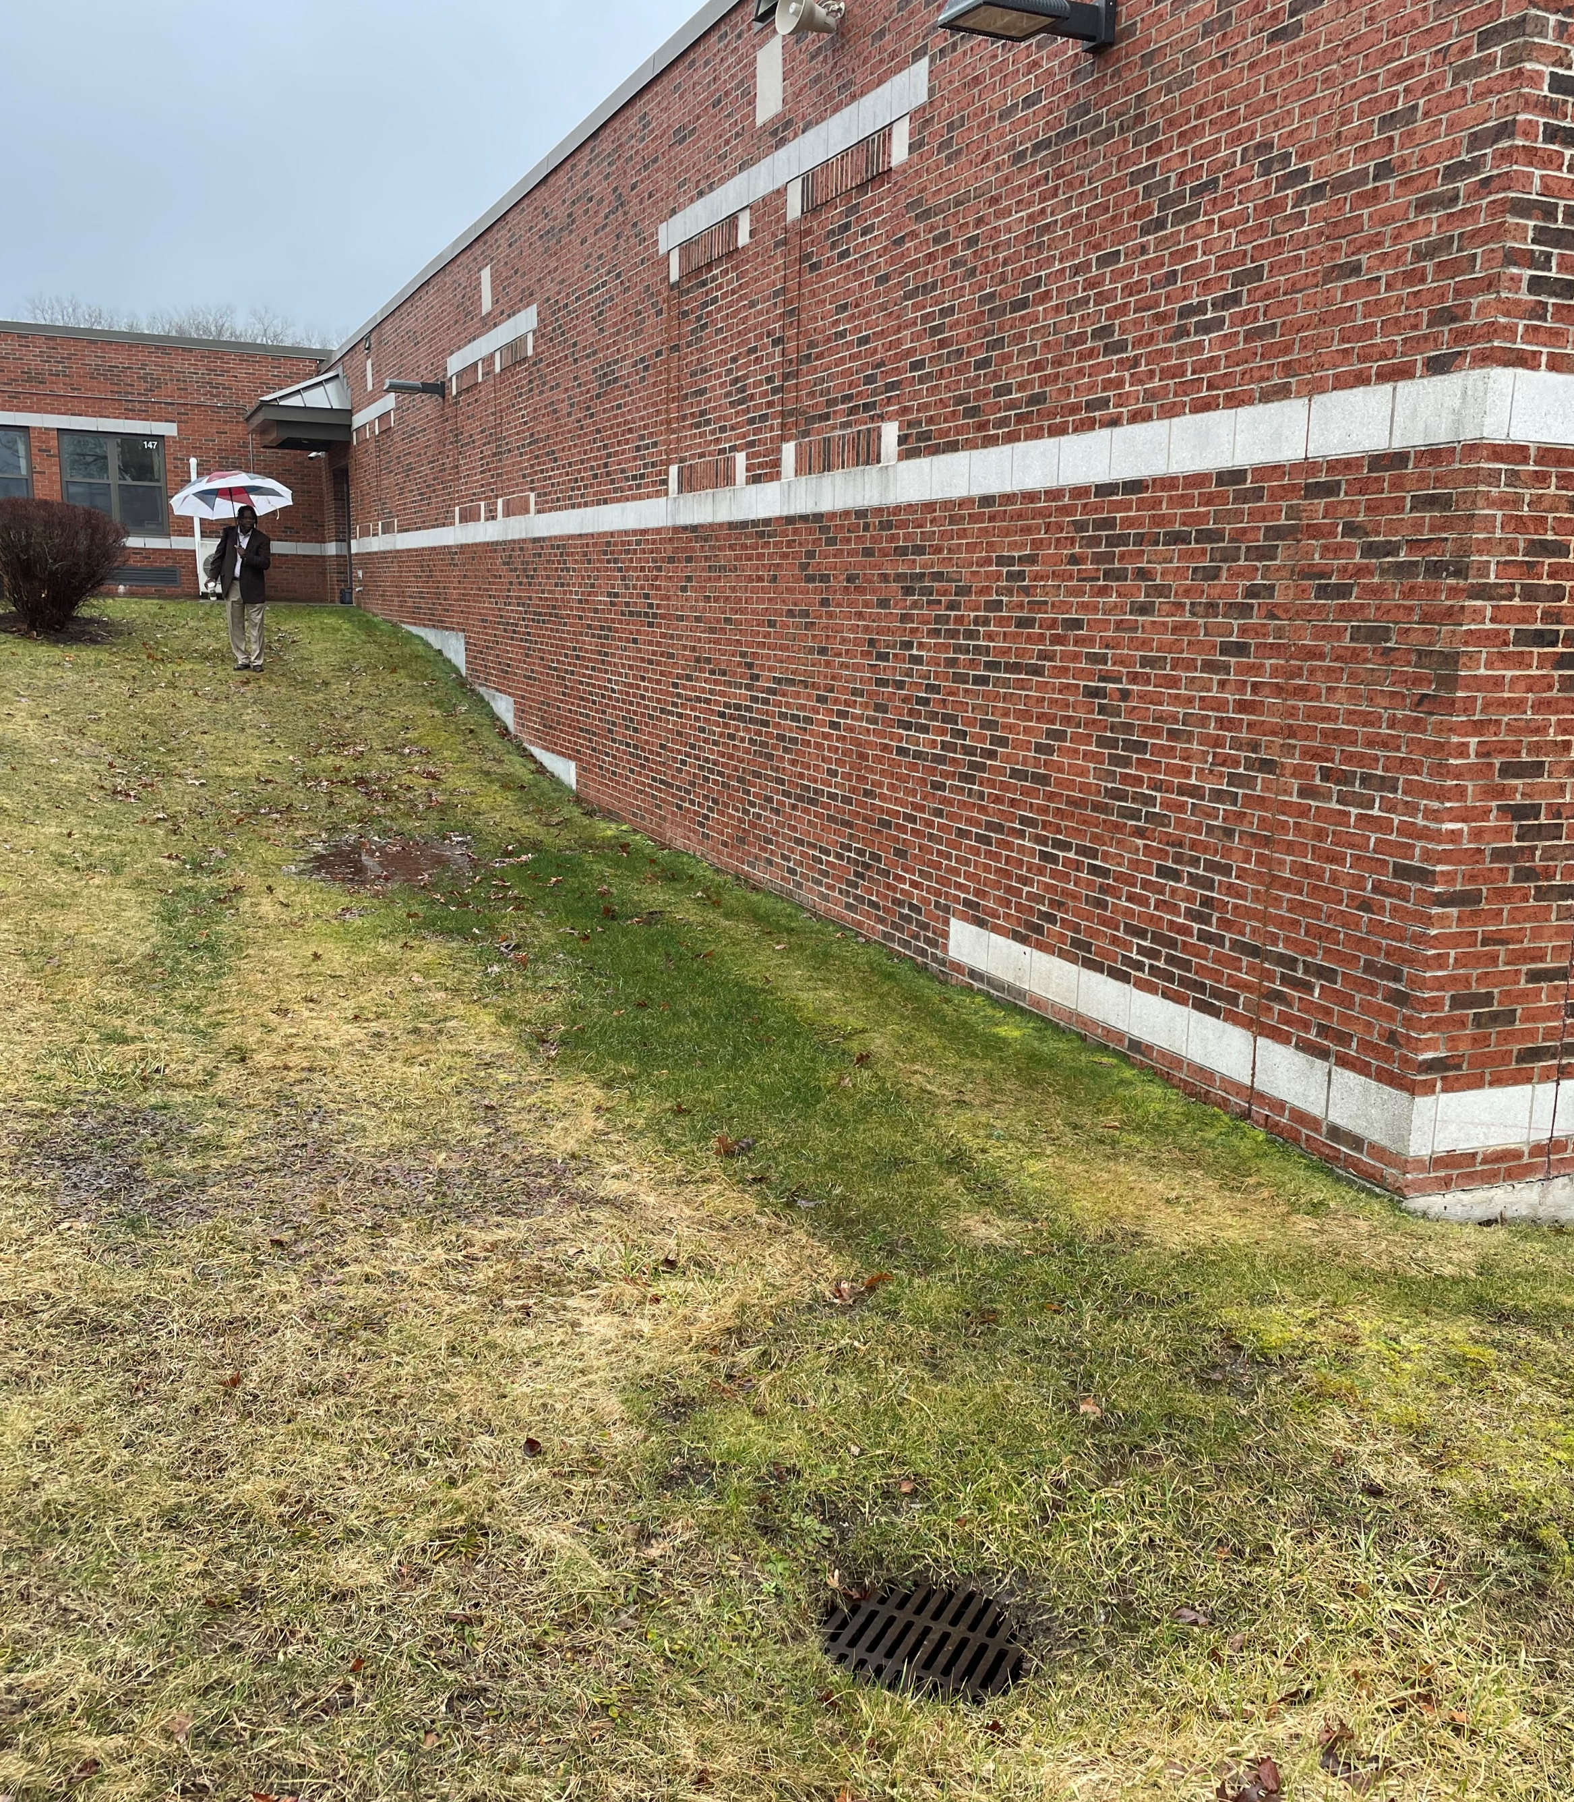
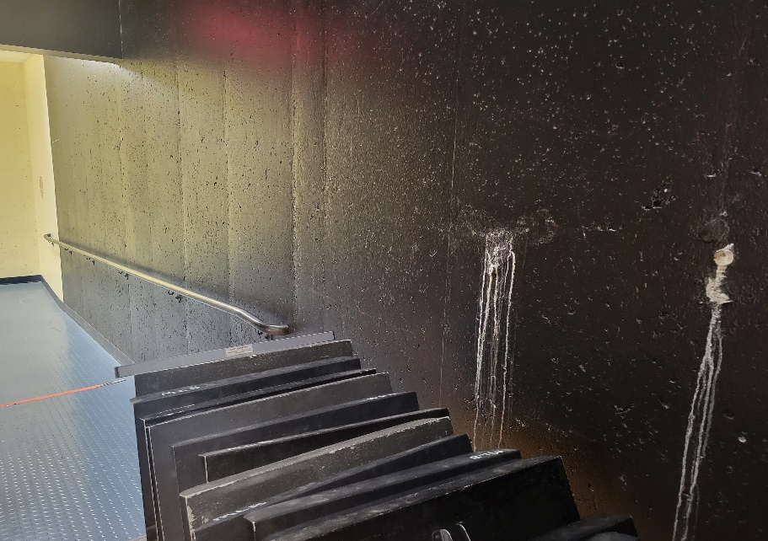
PROJECT APPROACH
Existing Conditions Assessment: Recommended Priorities
A

Slide 7
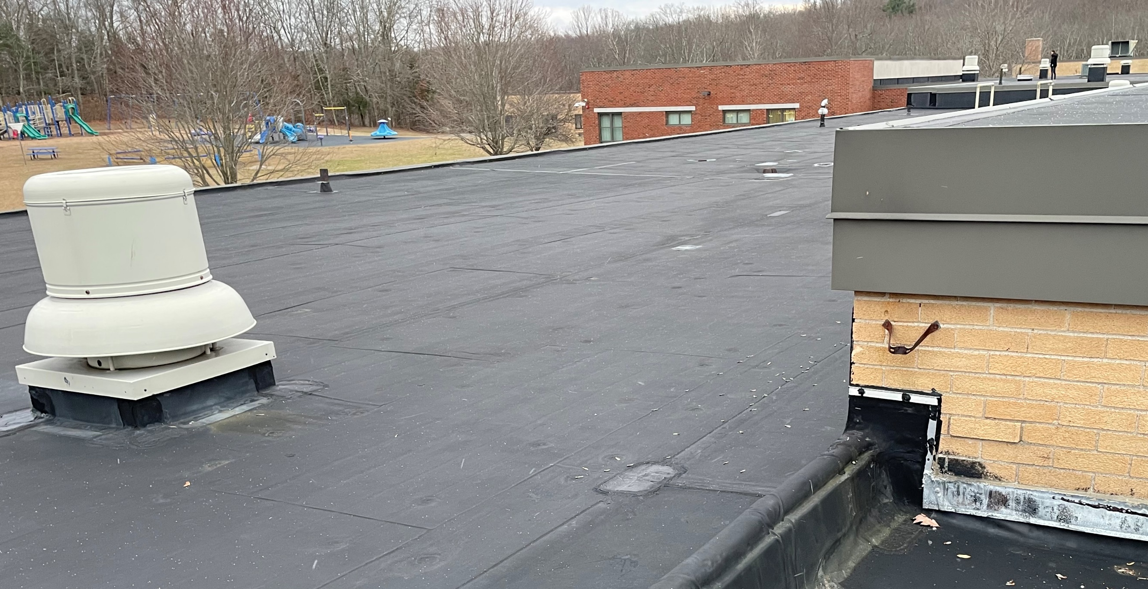
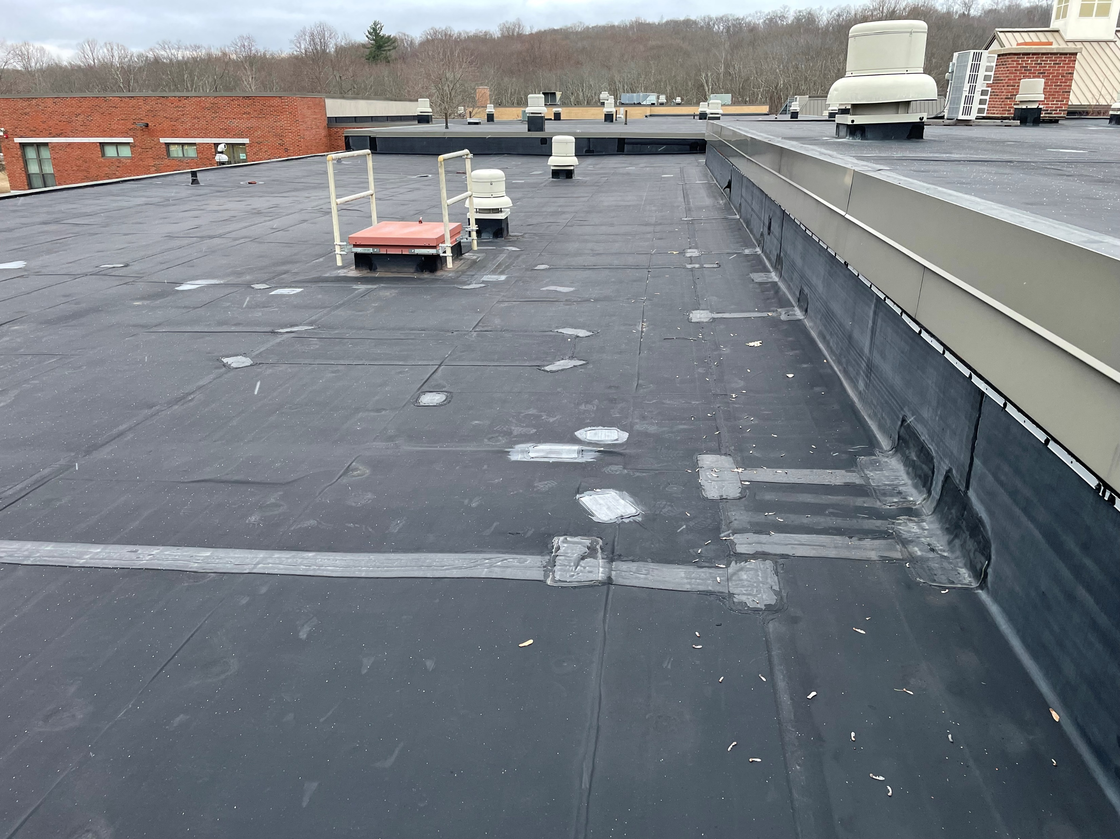
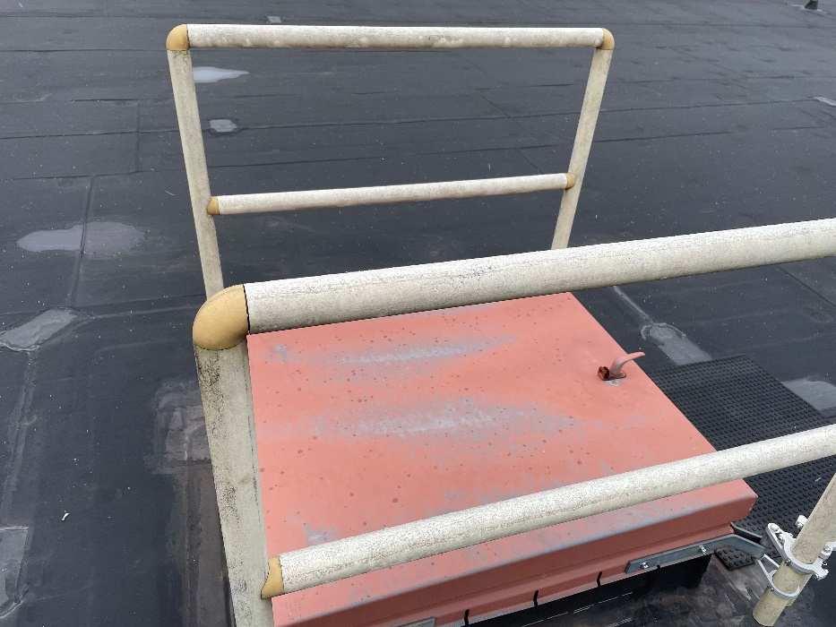
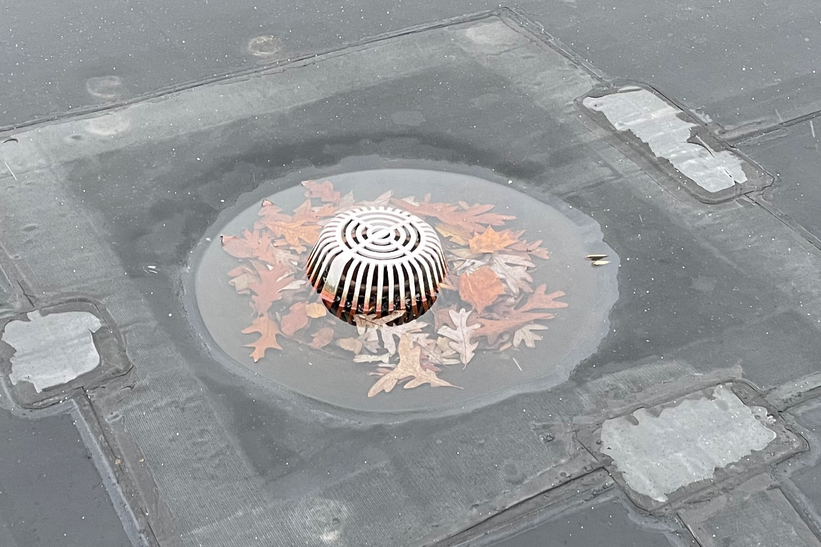
PROJECT APPROACH
Existing Conditions Assessment: Recommended Priorities
A

Slide 8
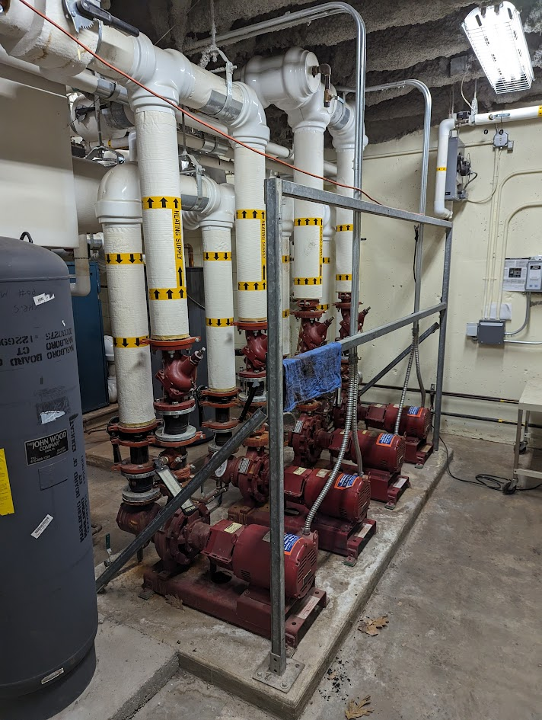
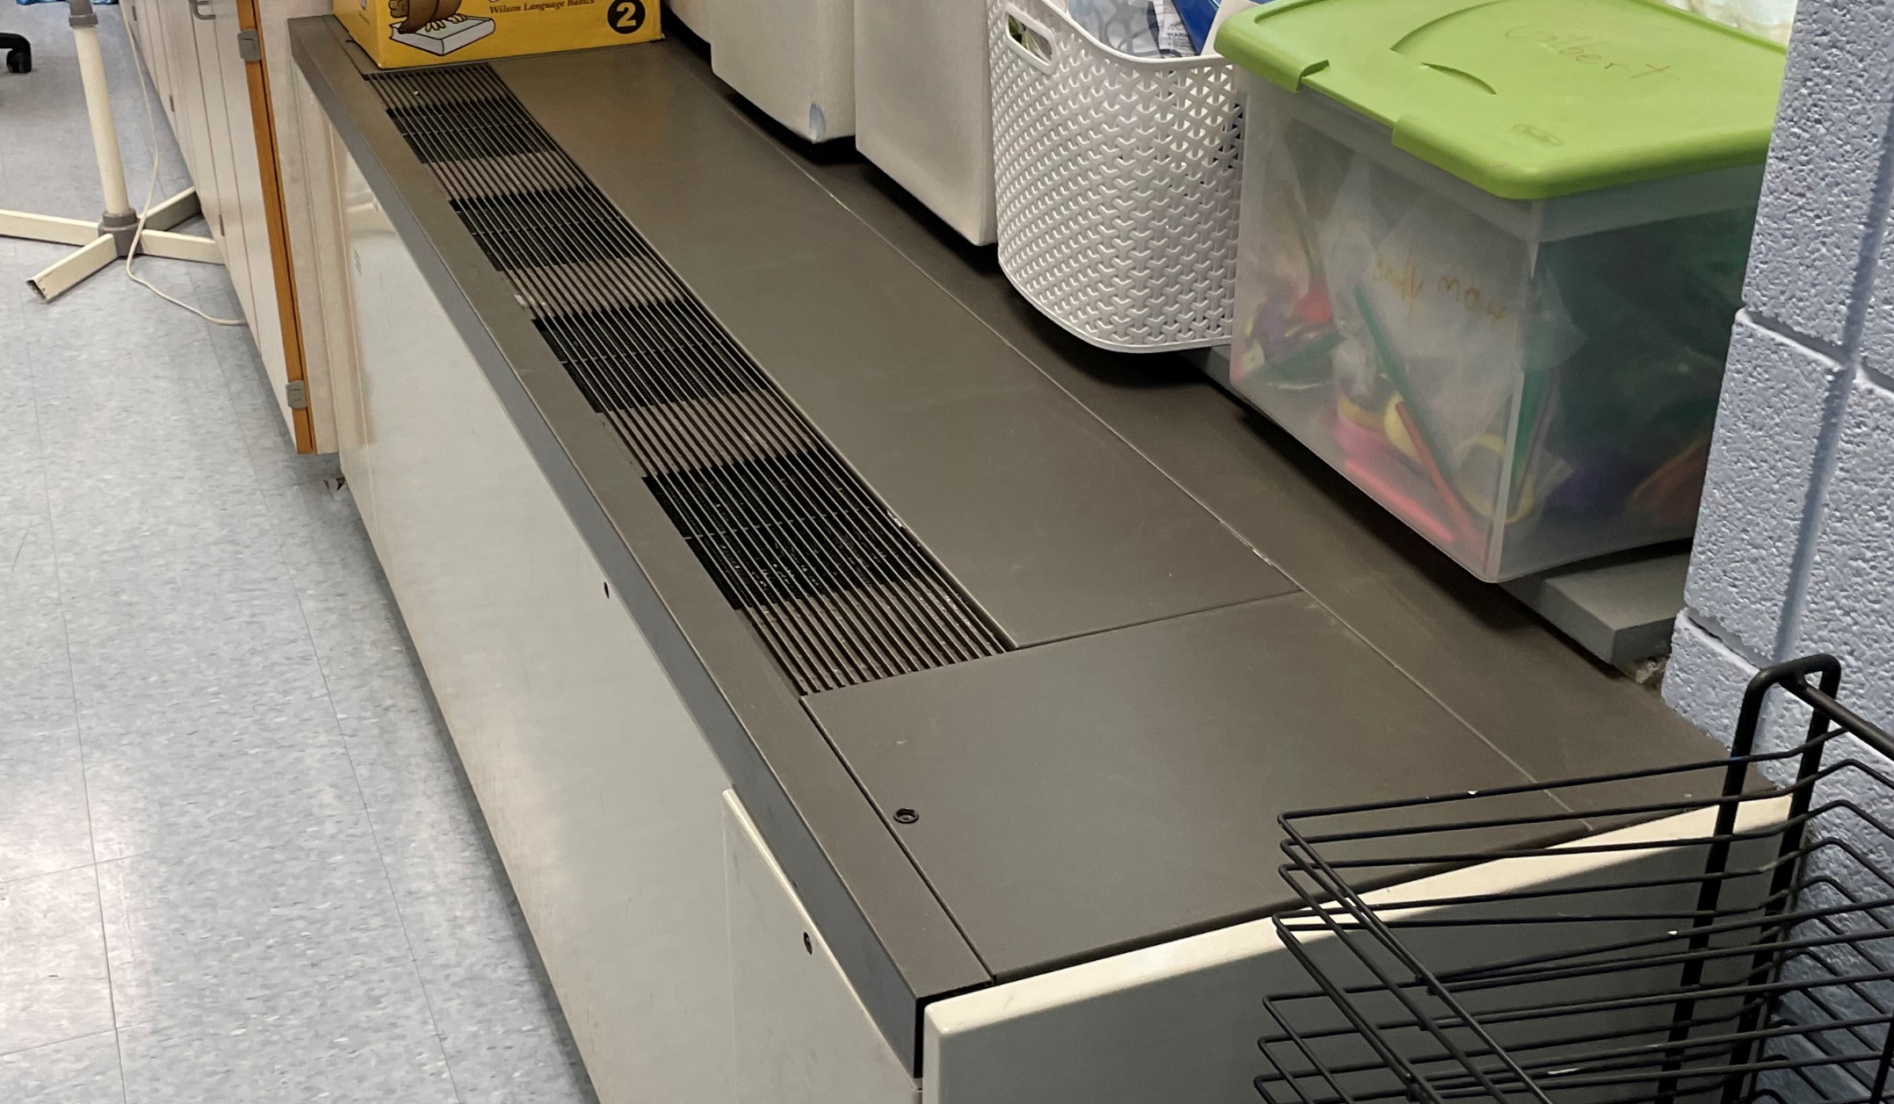
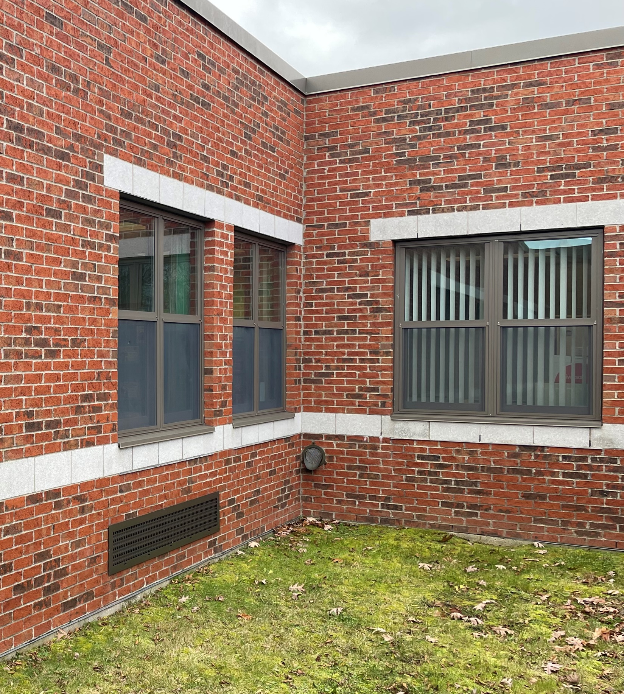
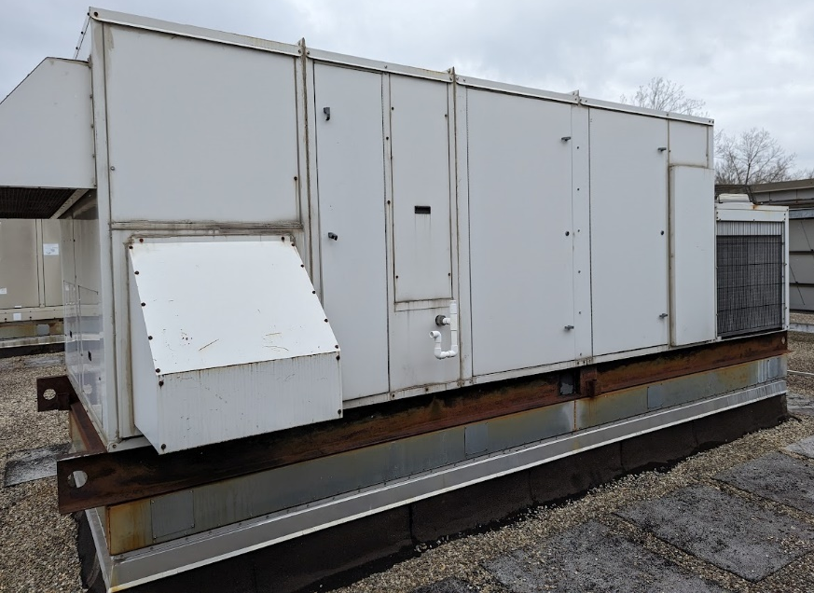
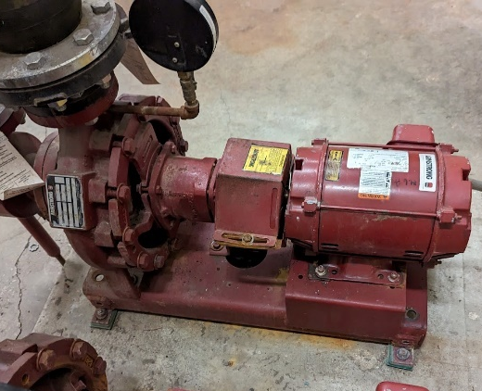
PROJECT APPROACH
Existing Conditions Assessment: Recommended Priorities
B

Slide 9
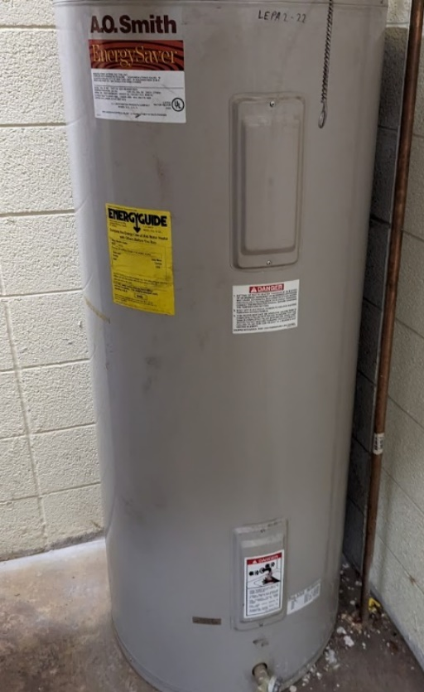
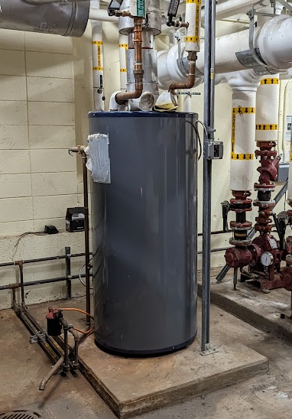
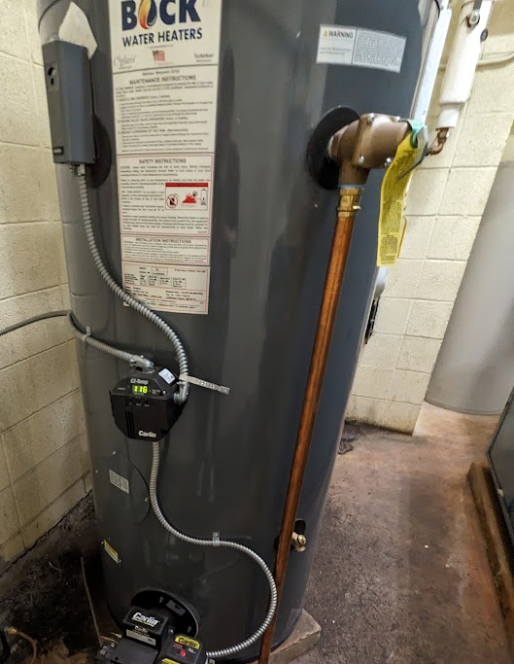
PROJECT APPROACH
Existing Conditions Assessment: Recommended Priorities
C

Slide 10
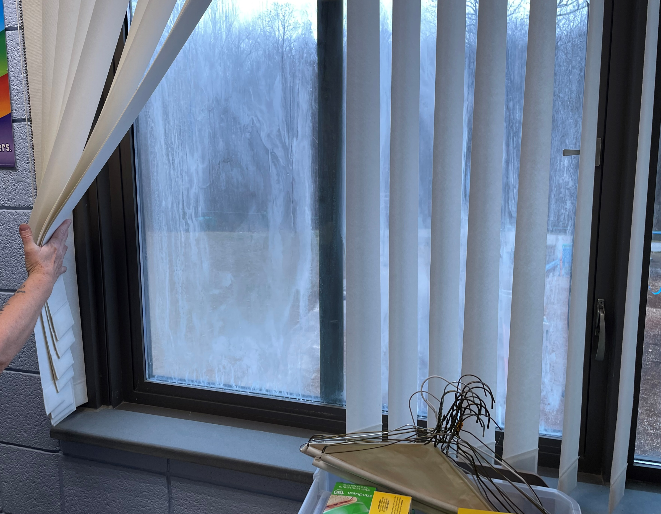
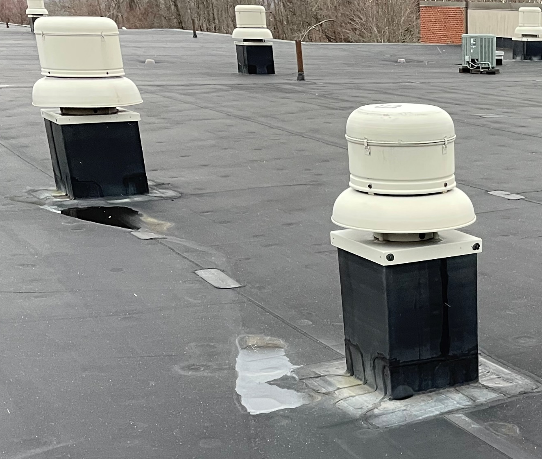
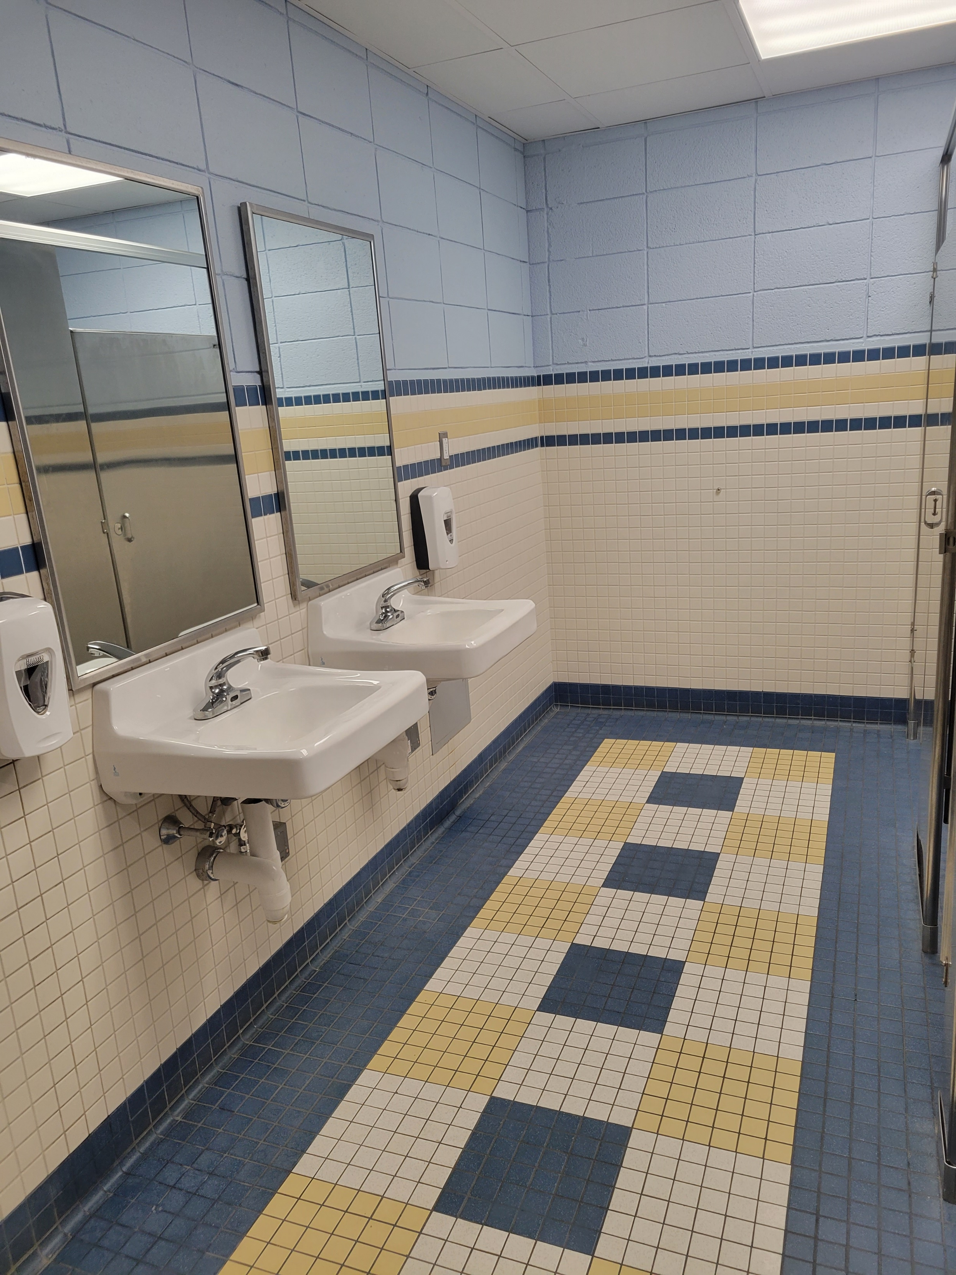
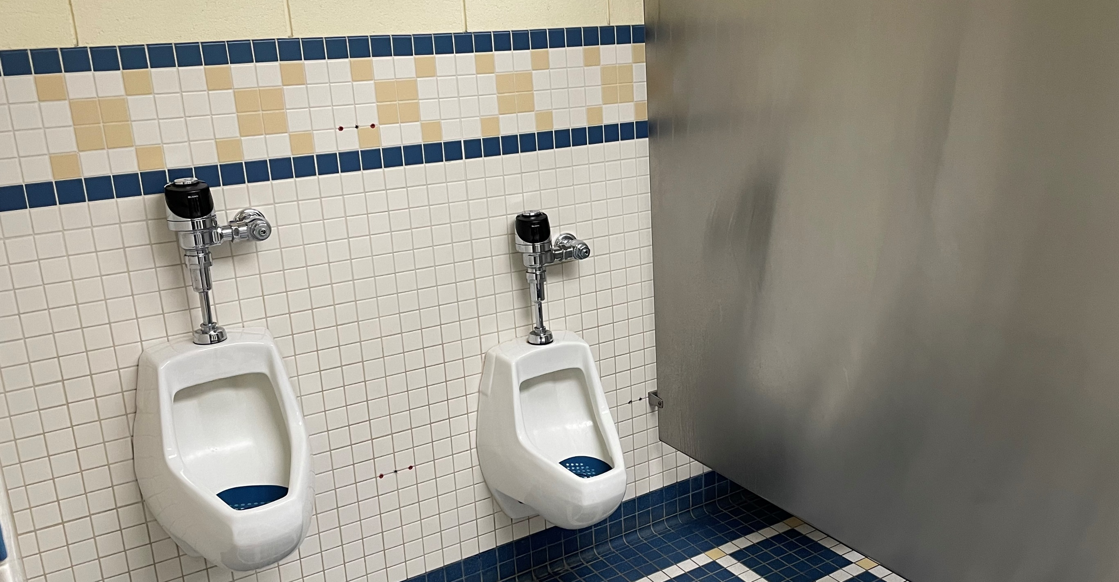
PROJECT APPROACH
Capital Improvements Plan: Recommended Priorities
C

Slide 11
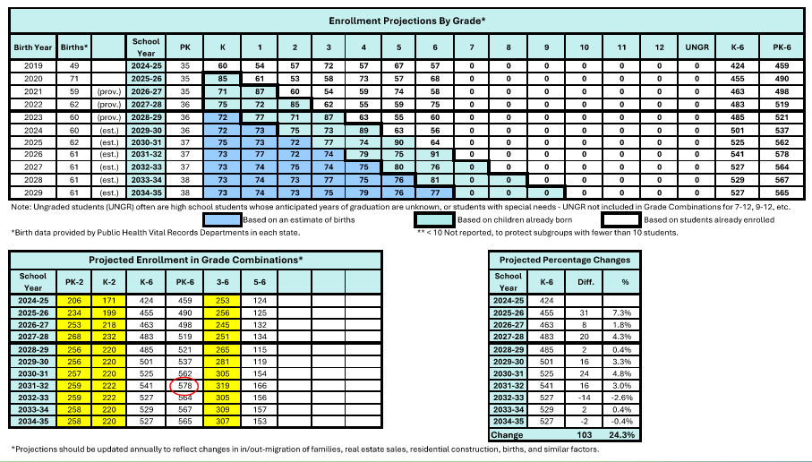
PROJECT APPROACH
Comparative Cost Summary | Enrollment Projection

Slide 12
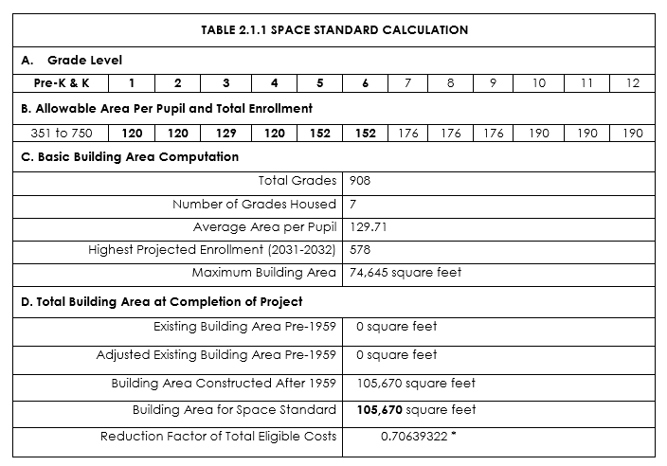
PROJECT APPROACH
Comparative Cost Summary | Space Standard Calculation
This computation indicates that, based upon the highest projected enrollment over an eight-year period, the school’s existing Building Area, Marlborough Elementary exceeds the Space Standard. If no action is taken, the district’s otherwise eligible reimbursement will be reduced by a factor of 0.70639322

Slide 13
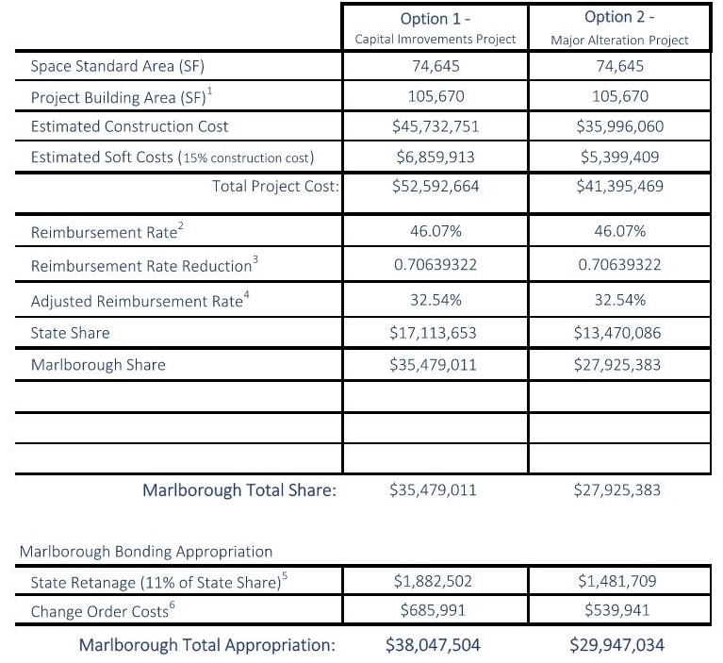
PROJECT APPROACH
Comparative Cost Summary | Estimate Reimbursement
NOTES:
1. Building Area is measured to the inside face of exterior walls.
Total Building Area 105,870 sf per 2005 Code Plan, includes 874sf
allocated to Board of Education Administrative spaces. Grant
reimbursement for Central Offices is eligible for only 50% of a
district's percentage reimbursement. This reduction is negligible
and has not been factored into this calculation.
Reimbursement Rate estimate based on 2025 General Construction State Reimbursement Rates. Percentages may be reduced due to ineligible and limited eligible costs.
Reimbursement Rate Reduction applies when actual or proposed area exceeds maximum net area allowed for reimbursement by State Space Standard. A Space Waiver could mitigate the reduction of eligible costs, if approved.
Adjusted Reimbursement Rate factors reduction of total eligible costs due to space in excess of maximum eligible for reimbursement.
5. State Retainage returned to Town after Audit Process.
6. Estimated at 1.5% of the Construction Cost.

Slide 14
PROJECT APPROACH
Comparative Cost Summary
CAPITAL IMPROVEMENTS PLAN | Capital Projects Timeline
 | 2027 | 2028 | 2029 | 2030 | 2031 | Subtotals
Direct Construction Costs | $5.25M | $6.41M | $6.61M | $4.91M | $2.76M | $25.93M
Indirect Construction Costs | $3.55M | $4.18M | $4.63M | $4.16M | $3.27M | $19.80M
Total Construction Cost |  |  |  |  |  | $45.73M
Owner Soft Costs (15% of Construction Cost) |  |  |  |  |  | $6.86M
Total Project Cost (CIP) |  |  |  |  |  | $52.59M
ALTERATION PROJECT | Alteration Project Timeline
 | 2027 | 2028 | Subtotals
Direct Construction Costs | $24.84M |  | $24.84M
Indirect Construction Costs | $ 11.16M |  | $ 11.16M
Total Construction Cost |  |  | $35.99M
Owner Soft Costs (15% of Construction Cost) |  |  | $5.40M
Total Project Cost (Alteration) |  |  | $41.40M

Slide 15

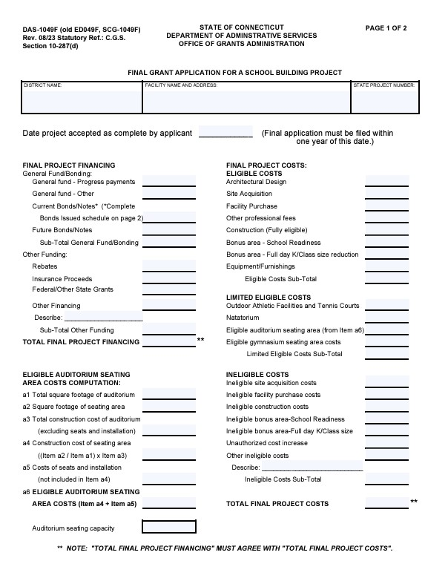

STATE GRANT REIMBURSEMENT

Slide 16
state Grant Reimbursement
Grant Funding Project Types
Renovation Status (RNV)
Extension / Alteration (EA)
New Construction (N)
Offers 10% Additional Reimbursement with few ineligible costs
Requires entire facility update
Lower average SF cost
May require a Space Waiver
Offers 10% Additional Reimbursement except for ineligible costs (replacements, repairs, refurbishment)
Ability to designate work areas
Specific, ‘targeted’ approach to renovate areas at FULL reimbursement and repair other less costly areas
Offers 10% Additional Reimbursement if demonstrated to cost less than renovation
Higher average SF cost
Offset by construction and programmatic efficiency
Additional Grant Incentives:
Sec. 10-286 (10)(c)(1): Maximum square footage per pupil limit increased by 25% for schools constructed prior to 1959.
Sec. 10-286 (10)(c)(2): Maximum square footage per pupil limit increased by 1% for heating, ventilation or air conditioning project.

Slide 17
state Grant Reimbursement
Grant Funding Project Types
Renovation Status
Renovate Existing Built Space
Space Reconfiguration to address Educational Specification program requirements
Extension / Alteration
Repair and Expand Modified Built Space
Includes Optimal
Space Reconfiguration
New Construction
Replace Existing with New Space
Includes Optimized Space Reconfiguration, Further Program Flexibility and future expansion
  Utilizes existing built space in manner that conforms to existing layout as much as possible
  Resolves issues with
  early learning space egress code compliance
  Replaces failing infrastructure components and systems with minimum 20-year service life
  Optimizes space configuration for educational needs
  Resolves issues with
  K-Wing and early learning space egress
  Replaces failing infrastructure components
  Optimizes space configuration for educational needs
  Resolves issues with
  early learning space egress
  Provides all new systems and infrastructure components
  Identifies further program flexibility through more efficient and comtempory New Century use of space
$$$$ M
$$$$ M
$$$$ M

Slide 18
state Grant Reimbursement
Grant Funding Project Types
Renovation Status
Renovate Existing Built Space
Space Reconfiguration to address Educational Specification program requirements
1. Superintendent’s letter requesting RNV Status
2. Cost Analysis for Proposed RVN Project
3. Cost Comparison of New Construction with RNV
4. Professional Cost Estimate demonstrating RNV costs less
5. Certify that facility will be brought up to applicable codes
6. Define Education Technology for RNV facility
7. Certify that structure will have service life comparable to new construction
8. Provide detailed report on existing building systems
9. Certify that systems will have a minimum service life of 20 years
10. Certify that new windows will be energy efficient
11. Certify that RNV project will meet High Performance Building Requirements
12. Superintendent’s statement that is central to the area served and adequate/appropriate to provide the education programs offered
  Utilizes existing built space in manner that conforms to existing layout as much as possible
  Resolves issues with
  early learning space egress code compliance
  Replaces failing infrastructure components and systems with minimum 20-year service life
$$$$ M

Slide 19
state Grant Reimbursement
Renovation vs New Construction
Chapter 173 - Public School Building Projects
Section 10-285a - Percentage determination for school building project grants
(a) The percentage of school building project grant money a local board of education may be eligible to receive, under the provisions of section 10-286, shall be assigned by the Commissioner of Administrative Services in accordance with the percentage calculated by the Commissioner of Education as follows: (1) For grants approved pursuant to subsection (b) of section 10-283 for which application is made on and after July 1, 1991, and before July 1, 2011, (A) each town shall be ranked in descending order from one to one hundred sixty-nine according to such town's adjusted equalized net grand list per capita, as defined in section 10-261; and (B) based upon such ranking, a percentage of not less than twenty nor more than eighty shall be determined for each town on a continuous scale; (2) for grants approved pursuant to subsection (b) of section 10-283 for which application is made on and after July 1, 2011, and before July 1, 2017, (A) each town shall be ranked in descending order from one to one hundred sixty-nine according to such town's adjusted equalized net grand list per capita, as defined in section 10-261, and (B) based upon such ranking, (i) a percentage of not less than ten nor more than seventy shall be determined for new construction or replacement of a school building for each town on a continuous scale, and (ii) a percentage of not less than twenty nor more than eighty shall be determined for renovations, extensions, code violations, roof replacements and major alterations of an existing school building and the new construction or replacement of a school building when a town or regional school district can demonstrate that a new construction or replacement is less expensive than a renovation, extension or major alteration of an existing school building for each town on a continuous scale; and (3) for grants approved pursuant to subsection (b) of section 10-283 for which application is made on and after July 1, 2017, (A) each town shall be ranked in descending order from one to one hundred sixty-nine according to the adjusted equalized net grand list per capita, as defined in section 10-261, of the town two, three and four years prior to the fiscal year in which application is made, and (B) based upon such ranking, (i) a percentage of not less than ten nor more than seventy shall be determined for new construction or replacement of a school building for each town on a continuous scale, and
(ii) a percentage of not less than twenty nor more than eighty shall be determined for renovations, extensions, code violations, roof replacements and major alterations of an existing school building and the new construction or replacement of a school building when a town or regional school district can demonstrate that a new construction or replacement is less expensive than a renovation, extension, or major alteration of an existing school building for each town on a continuous scale.

Slide 20

state Grant Reimbursement
Maximize OGA Reimbursement
Maximize State Reimbursement
Minimize duplicate use of program spaces and square footage beyond eligible amount per grade configuration
Marlborough Rate (46.07% / 36.07%), represents millions of dollars!
Minimize ‘Non-Eligible’ & ‘Limited-Eligible’ items
  A - E Non-Eligible:
  Site work off school property
  Repair, Replacement, & Maintenance Work
  Window Replacements (labor, blinds/shades)
  Other:
    Athletic Facility Lighting, Parking, Turf
    Feasibility Study
    Movable Site Furnishings
    Expendables
  F Limited-Eligible:
  Outdoor Athletic Facilities (includes tennis courts)
  Swimming Pools and Natatoriums
  Retractable Gym Seating (movable bleachers)
  Permanent (non-retractable) Gym Spectator Seating
  New/Replacement Seating Areas in an Auditorium

Slide 21
STATE GRANT REIMBURSEMENT
Requirements for June 30 Application
Sample of the Three Required Resolutions by June 30, 2025
(FUNDING)
RESOLVED, that Marlborough authorizes the Board of Education to apply to the Commissioner of Administrative Services and to accept or reject a grant for the [project type] at Marlborough Elementary School
RESOLVED, that the Marlborough Elementary School Building Committee is hereby established as the building committee with regard to the [project type] at Marlborough Elementary School
RESOLVED, that the Town of Marlborough authorizes at least the preparation of schematic drawings and outline specifications for the [project type] at the Marlborough Elementary School
(OVERSIGHT)
(ED SPECS)
Note: A Town/District can authorize Resolution 1 only upon the availability of funding (i.e. passing of referendum); Resolution 3 authorization is contingent upon BOE approval of Educational Specifications

Slide 22
Thank You | Questions

