Slide 1
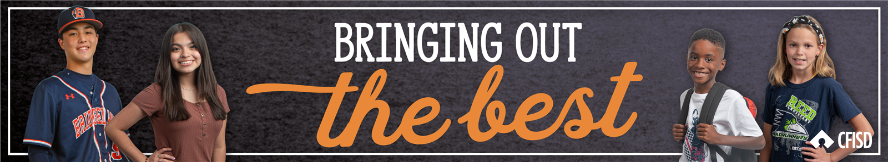
Respect for Authority
PK-2
May 2025

Slide 2
Respect for Authority
Define
Identify
Apply
We will define Respect for Authority.
We will identify what respect for authority looks like, sounds like, and feels like.
We will determine how to show respect towards various authority figures.

Slide 3
Respect for Authority
Following the rules and expectations of those in charge

Slide 4
Insert District Video Here:

Slide 5



Respect
Looks Like
Sounds Like
Feels Like
Eyes on the speaker
Calm voices
Trust
Waiting your turn
Using your manners
Cared for
Following directions
Safe
Kind words

Slide 6


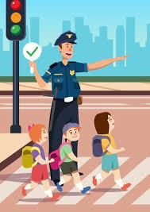
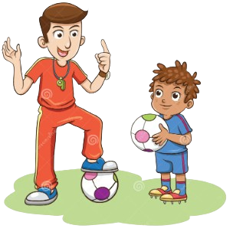
Who is “Authority?”
Guardian
Teacher
Coach
Police Officer

Slide 7
How are the students below showing respect for authority?

Slide 8
How are the students below showing respect for authority?

Slide 9
Home Activity: How can you show respect for authority in the following places?
Home:
After School Activity:
Restaurant:
A Relative’s House:

