Slide 1
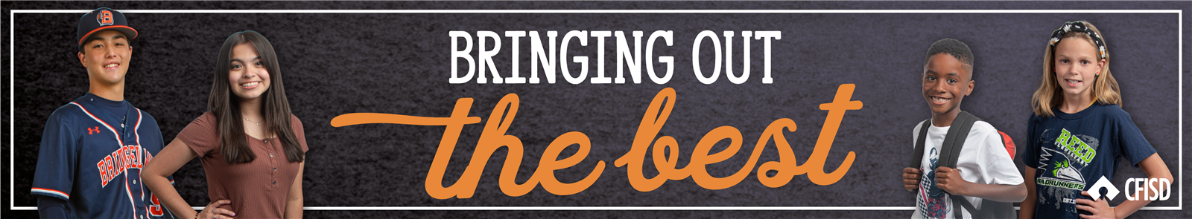
Grades
3rd-5th
Respect for
Authority
May 2025

Slide 2
The learner will…
01
Discuss the meaning of respect for authority
02
Explain why it is important to show respect for authority
03
Explore ways how to demonstrate respect for authority

Slide 3
Respect for Authority
Following the rules and expectations of those in charge

Slide 4
CFISD Respect for Authority Video

Slide 5
Imagine This:
You are playing an important basketball game. The referee calls a foul on you for intentional physical contact against an opposing player.
You do not believe that the call was right and no contact was made.
How would you respond?

Slide 6
Referees ensure that all players follow the rules and regulations for fair and safe play during a game. They are considered authority figures.
Like a referee, there are many authority figures at school to help students be safe and successful.

Slide 7
Guess Who Activity
On each slide are clues to an authority figure on campus. As a class, find out who that authority may be.

Slide 8
Guess Who?
This person:
Greets students in the morning
Is the leader of our school
Ensures all staff and students are safe
Helps with activities and functions
Principal
Insert Picture of Campus Principal

Slide 9
Guess Who?
This person:
Keeps our cafeteria, classrooms, and hallway clean
Helps if we spill food or liquids
Is always happy to see you
Custodian
Insert Picture of Custodian

Slide 10
Guess Who?
This person:
Screens and checks every visitor that enters the building to make sure we are all safe
Answers phone calls for the school
Greets visitors when they arrive
Front Desk Receptionist
Insert Picture of Front Desk Receptionist

Slide 11
Guess Who?
This person:
Makes sure you get to and from school safely
Ensures your safety by checking your badge
Seats you in a safe place
Makes sure you are wearing your seatbelt
Bus Driver
Insert Picture of Campus Bus Drivers

Slide 12
Guess Who?
This person:
Provides a safe learning environment
Communicates with parents
Enforces rules to keep the classroom safe
Challenges your learning and knowledge
Teacher
Insert Picture of Campus Staff

Slide 13
Guess Who?
This person:
Patrols all elementary, middle, and high school campuses
Checks the doors to ensure they are closed
Makes sure everyone is safe inside and outside
Provides assistance when needed
CFISD Police Officer
Insert Picture of Campus CFISD Officer

Slide 14
Reflection
How do I show respect for these authority figures everyday?
Principal
Bus Driver
Custodian
Front Desk Receptionist
Teacher
CFISD Police Officer

Slide 15
Home Connection
Students will read scenarios that involve interacting with an authority figure at school. Decide if the response was an example of showing respect for authority or not. Include why you chose that response.
Home Connection Respect for Authority Activity

Slide 16
Resources
Respect for Authority
SILAS, Improve Life Outcomes, 2012, https://curriculum.silassolutions.com/jumpstart-respecting-authority-universal/

