Slide 1






May
Character Trait
Respect for Authority

Slide 2


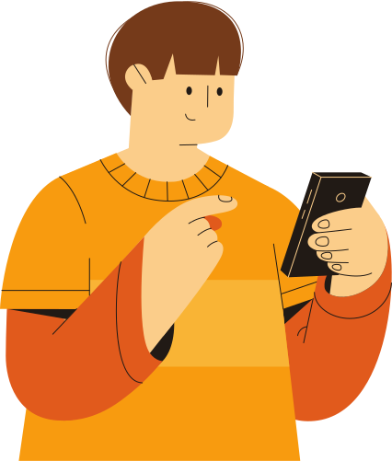
Teachers…
In the presentation, students will learn what it means to have RESPECT FOR AUTHORITY.
Each slide will contain interactive activities and guided questions for “Bringing Out The Best” RESPECT FOR AUTHORITY Character Trait
for grades 6-8.
RESPECT FOR AUTHORITY

Slide 3
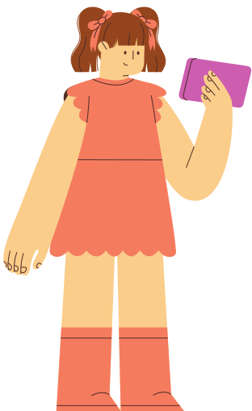

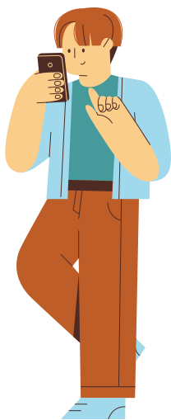
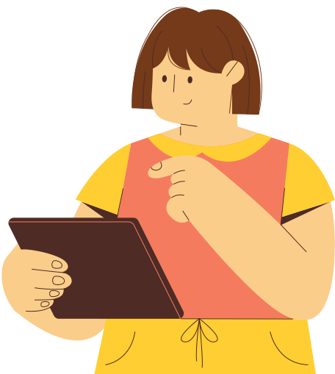
CAMPUS MATRIX
RESPECT FOR AUTHORITY
Notes:
Campus Liaison - Add your campus matrix if your campus has one, if not then delete this slide.

Slide 4



LESSON OBJECTIVES
EXPLORE EXAMPLES OF AUTHORITY AND HOW TO SHOW RESPECT FOR AUTHORITY.
DEFINE WHAT IT MEANS TO SHOW RESPECT FOR AUTHORITY.
IDENTIFY WAYS TO SHOW RESPECT FOR AUTHORITY AT SCHOOL, HOME AND COMMUNITY.
RESPECT FOR AUTHORITY

Slide 5
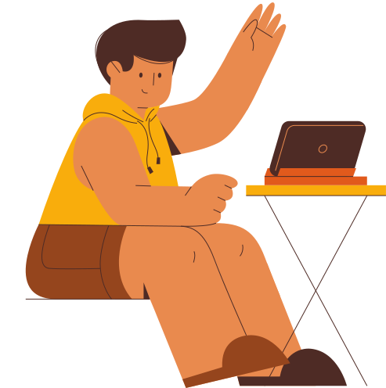



Definition of
RESPECT FOR AUTHORITY
Following the rules and expectations of those in charge.
RESPECT FOR AUTHORITY

Slide 6


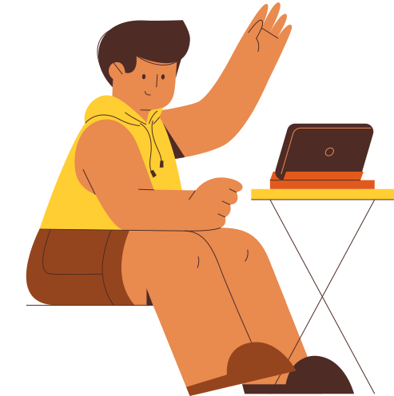
DISTRICT VIDEO
RESPECT FOR AUTHORITY

Slide 7


VIDEO REFLECTION
WHAT ARE YOUR THOUGHTS ABOUT HAVING RESPECT FOR AUTHORITY?
WHAT ARE EXAMPLES OF SHOWING RESPECT FOR AUTHORITY?
WHY IS IT IMPORTANT TO SHOW RESPECT FOR AUTHORITY?
RESPECT FOR AUTHORITY
Notes:
Discuss each of these questions together after viewing the video.

Slide 8
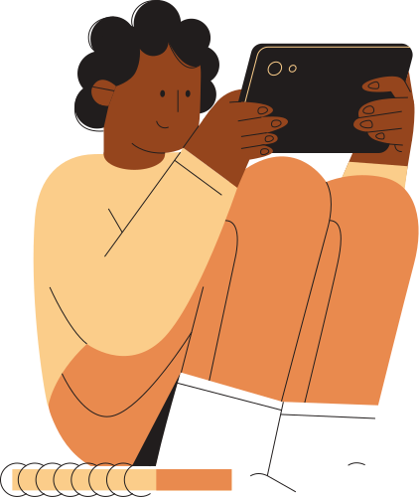
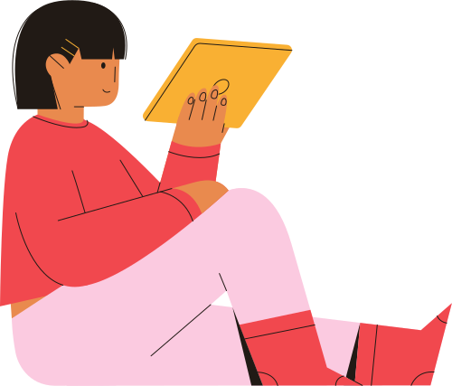
Who is the Authority?
At
School
Outside
of
School
RESPECT FOR AUTHORITY
Notes:
Brainstorm together people of authority at School. Brainstorm together people of authority outside of School.

Slide 9
What are the rules?
At
School
Outside
of
School
RESPECT FOR AUTHORITY
Notes:
Brainstorm and discuss rules at School. Brainstorm and discuss rules outside of School.

Slide 10
Discuss the following Scenarios?
While in Science Class, the teacher has already given the Lab Safety Lesson. Your class is about to start lab, when Johnny brings in food and drops it all on the floor as other students are walking in.
Discuss who is the Authority here, what are the rules, and why is it important to Respect the Authority.
What would happen if there was never a person of Authority and/or rules to be followed in this scenario?
RESPECT FOR AUTHORITY
Notes:
Read the scenario and discuss. Then discuss the discussion questions as a whole class or think-pair-share as appropriate for your classroom.

Slide 11
Scenario 2
During dismissal at Car-Rider line, a student decides to ride on their skateboard in between cars. This resulted in the CFPD having to discuss with the student why this is a safety hazard. The student decided to ignore the officer and rode off in between the vehicles causing more traffic and wait time for dismissal.
Discuss who is the Authority here, what are the rules, and why it is important to Respect the Authority.
RESPECT FOR AUTHORITY
Notes:
Read the scenario and discuss. Then discuss the discussion questions as a whole class or think-pair-share as appropriate for your classroom.

Slide 12
Scenario 3
During passing period, students are pulling on each others backpack and throwing their water bottles at each other. The Assistant Principal is called to the stairs by another Teacher who witnessed it. The students disagreed and stated that they are just having fun. They are struggling to understand why this is a safety concern.
Discuss who is the Authority here, what are the rules, and why it is important to Respect the Authority.
RESPECT FOR AUTHORITY
Notes:
Read the scenario and discuss. Then discuss the discussion questions as a whole class or think-pair-share as appropriate for your classroom.

Slide 13
Scenario 4
During lunch, students were laughing and throwing food at each other. The food landed on the floor. The custodian asked the students to pick it up and clean their area.
Discuss who is the Authority here, what are the rules, and why it is important to Respect the Authority.
RESPECT FOR AUTHORITY
Notes:
Read the scenario and discuss. Then discuss the discussion questions as a whole class or think-pair-share as appropriate for your classroom.

Slide 14
Scenario 5
There is a substitute in class today. The substitute is giving directions on the assignments based on what your teacher instructed them to do. Classmates are arguing with the substitute about what needs to be done and doesn’t follow their directions.
Discuss who is the Authority here, what are the rules, and why it is important to Respect the Authority.
RESPECT FOR AUTHORITY
Notes:
Read the scenario and discuss. Then discuss the discussion questions as a whole class or think-pair-share as appropriate for your classroom.

Slide 15



Think-Pair-Share
Do you have RESPECT FOR AUTHORITY?
How can you have RESPECT FOR AUTHORITYat school, home or your community?
Now that you know what RESPECT FOR AUTHORITY means, is there a time or situation where you could have had more RESPECT FOR AUTHORITY? Explain
RESPECT FOR AUTHORITY
Notes:
These discussion questions are for closure. You can do them whole group or small groups as appropriate for your classroom.

Slide 16
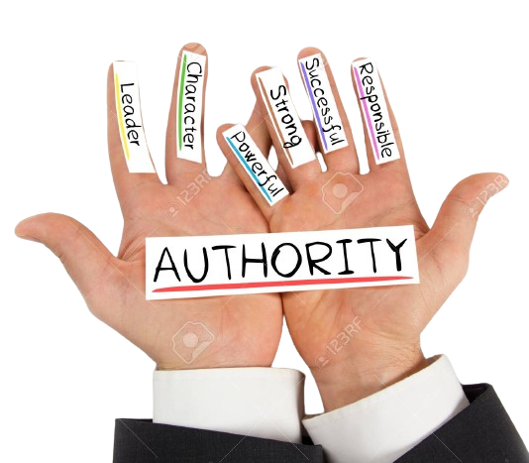
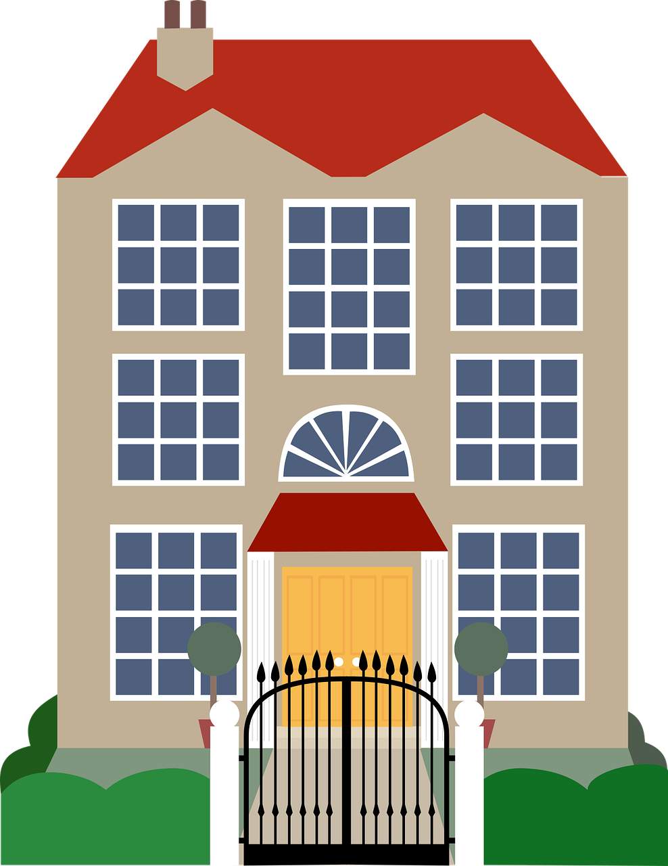
RESPECT FOR AUTHORITY
HOME ACTIVITIES
  IDENTIFY THREE DIFFERENT AUTHORITY FIGURES IN YOUR COMMUNITY. EXPLAIN WHY IT IS IMPORTANT TO SHOW THEM RESPECT.
.
  DISCUSS THREE REASONS WHY YOUR PARENTS SET LIMITS FOR YOU AT HOME.
  WHY IS SHOWING RESPECT FOR YOUR PARENTS IMPORTANT?

Slide 17

FOR
EXTENSION ACTIVITIES
ONLY
'S
HAVE STUDENTS DO A “PAY IT FORWARD” CHALLENGE BY SEEING WHAT GRADE LEVEL CAN PICK UP THE MOST TRASH AT LUNCH.
HAVE STUDENTS THINK OF SOMEONE (TEACHER, COACH, PARENT) THEY MAY HAVE WRONGED. WRITE “APOLOGY CARDS” TO MAKE A WRONG, RIGHT TO SHOW RESPECT FOR AUTHORITY.
RESPECT FOR AUTHORITY
Notes:
These are available for you to do additional activities to reinforce Respect for Authority.

