Slide 1

Consideration
PK-2
March 2025

Slide 2
Consideration
Define:
Identify:
Apply:
We will define consideration.
We will identify ways to be considerate.
We will determine ways to show consideration in different scenarios.

Slide 3
Consideration
Continuous and careful thought

Slide 4
Insert District Video Here:

Slide 5
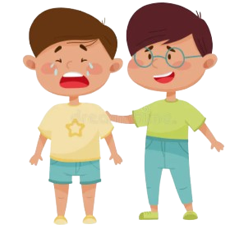
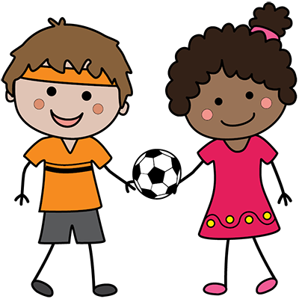



Ways to be Considerate:
Sharing and taking turns
Cheering up a friend who is sad
Helping to carry in the groceries
Helping someone up when they fall
Using your manners

Slide 6
Scenarios!

Slide 7
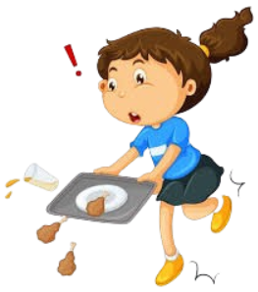
How can you show consideration?
You see a classmate drop their lunch on the ground.

Slide 8
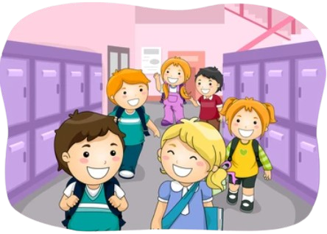
How can you show consideration?
You see a new student that is lost in the hallway.

Slide 9

How can you show consideration?
You have a substitute teacher.

Slide 10
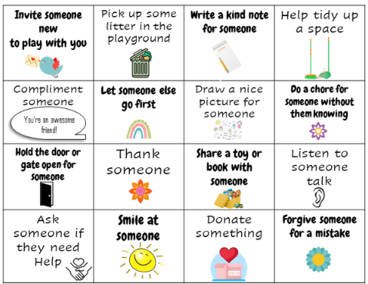
Home Activity
Consideration Bingo
See how many considerate acts you can complete:

