Slide 1








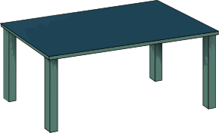


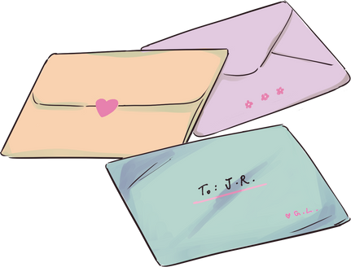

MARCH
CHARACTER TRAIT
Consideration
Consideration

Slide 2

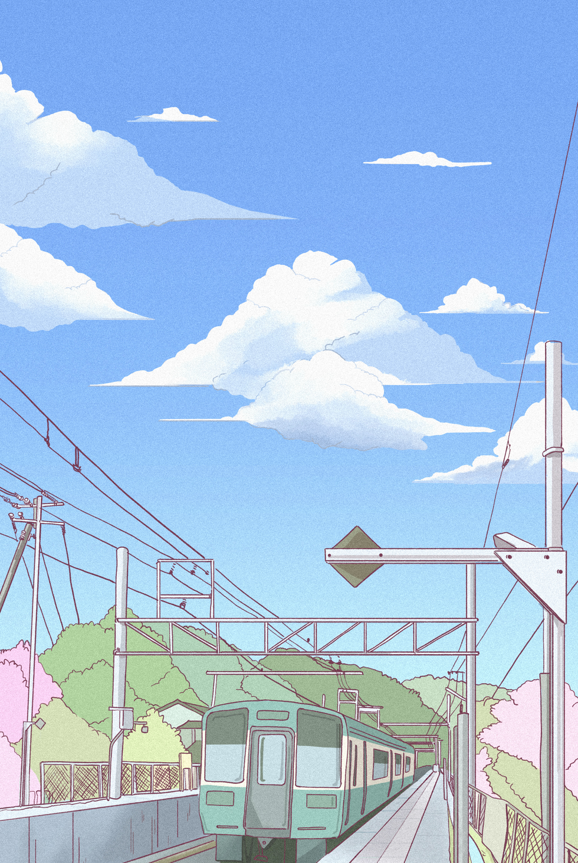

Teachers…
In the presentation, students will learn what it means to have CONSIDERATION in different situations.
Each slide will contain interactive activities and guided questions for “Bringing Out The Best” CONSIDERATION Character Trait
for grades 6-8.
CONSIDERATION

Slide 3


CAMPUS MATRIX
CONSIDERATION

Slide 4



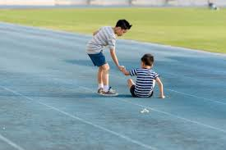
Lesson Objectives
Define what it means to be CONSIDERATE.
Examples of what being CONSIDERATE is.
Identify and Reflect on ways to be CONSIDERATE in different situations at home and school.
CONSIDERATION

Slide 5



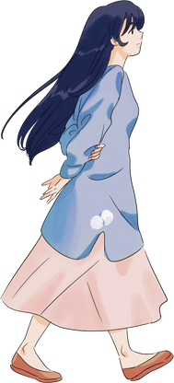


Definition of Consideration
Being considerate is the act of continuous careful thought.
CONSIDERATION

Slide 6
DISTRICT VIDEO
CONSIDERATION

Slide 7


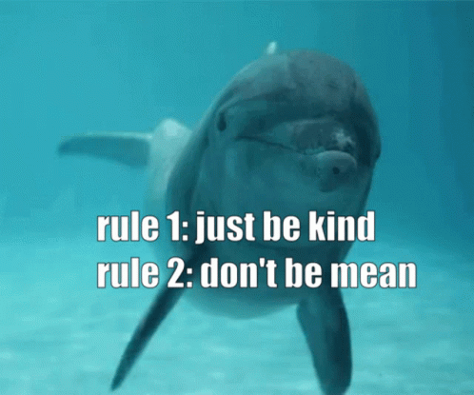
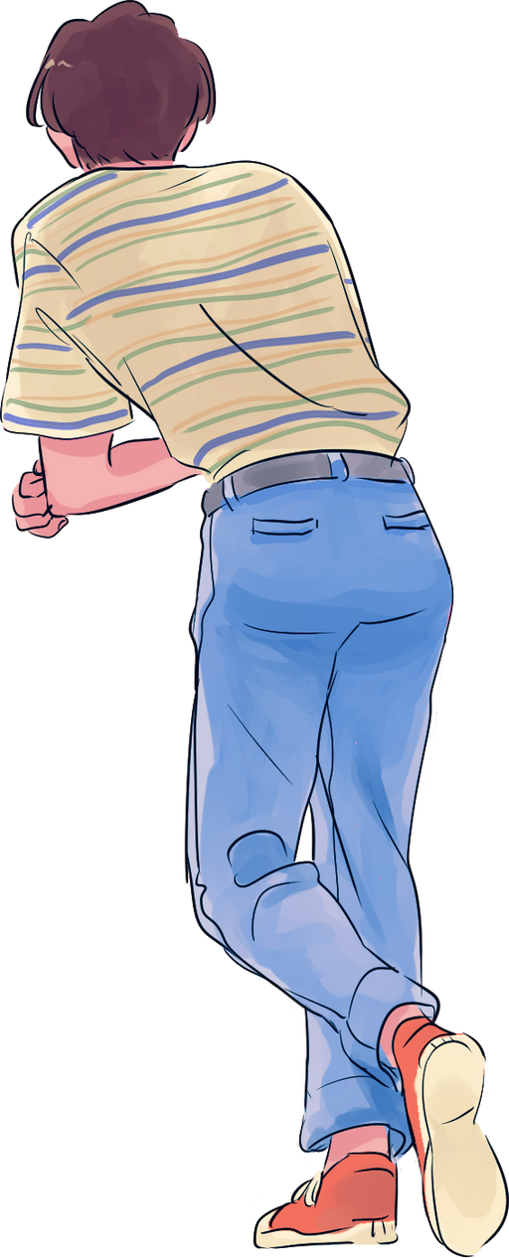

Video Reflection
Share any reflections you may have after watching this video about what CONSIDERATION is.
Can you think of a time you or someone else showed CONSIDERATION?
Discuss what happened.
CONSIDERATION

Slide 8
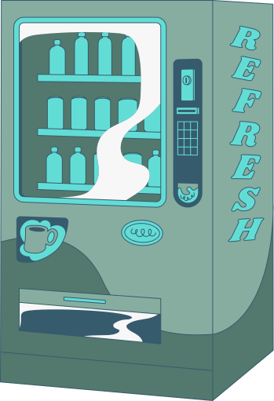


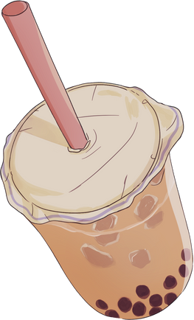


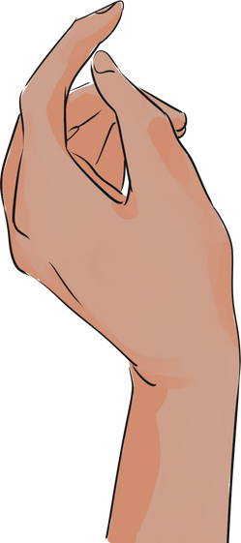
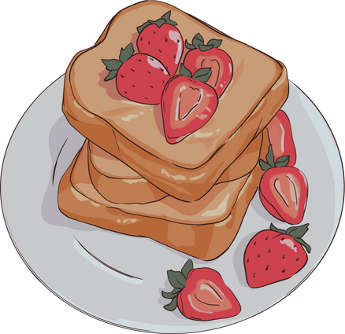



Examples of Consideration
1.Hold the door for someone who is walking behind you.
2.Moving your backpack off a chair to allow someone to sit down.
3.Cover your sneeze and cough to not spread germs.
4.Patiently waiting your turn in the lunch line.
CONSIDERATION

Slide 9
Is it Considerate or not?
Show the images on the next few slides.
Discuss as a class whether or not the person is being CONSIDERATE.
Explain why and/or how the image does or does not show CONSIDERATION.
  If the image is NOT showing CONSIDERATION, what can be changed to show CONSIDERATION?
CONSIDERATION

Slide 10
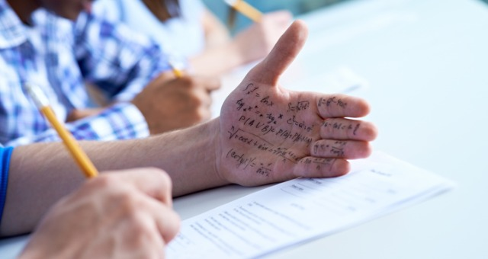
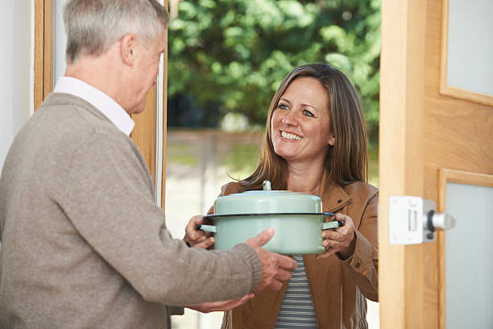
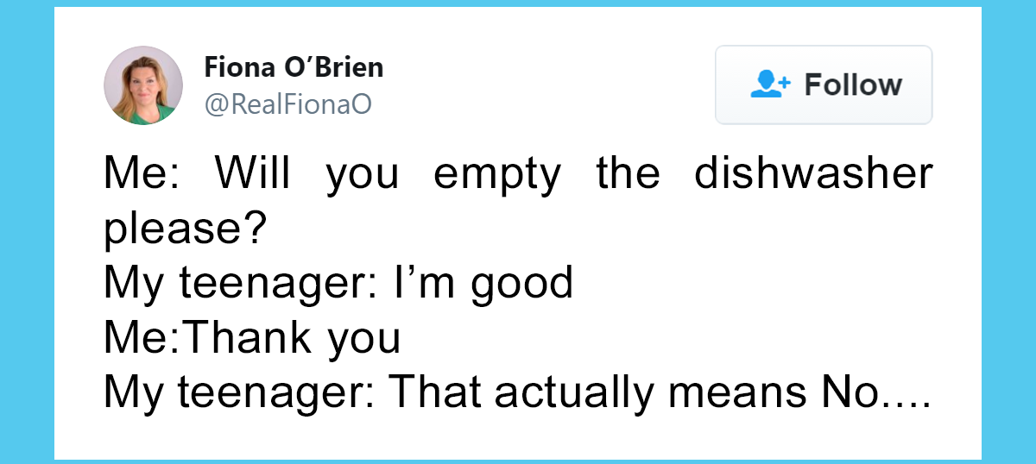
Is it Considerate or not?
CONSIDERATION

Slide 11
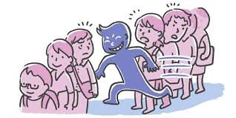


Is it Considerate or not?
CONSIDERATION

Slide 12
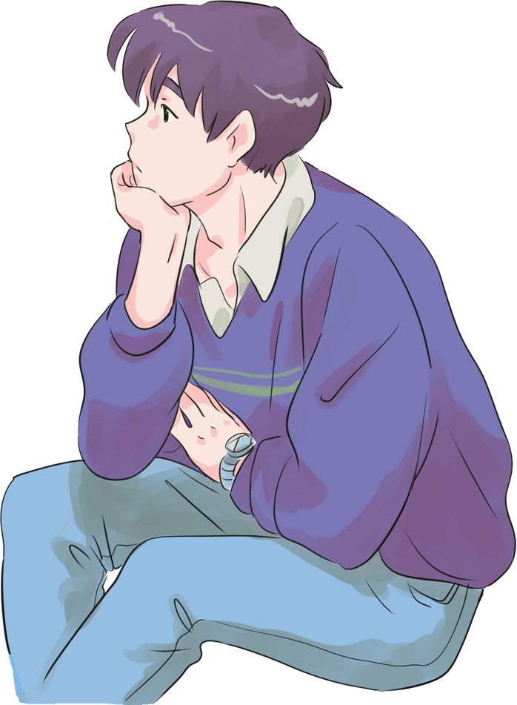

Think, Pair, Share
1.Are you a CONSIDERATE person?
2.How can you be more CONSIDERATE with your friends, family, and community?
Now that you know what CONSIDERATION means, is there a time or situation where you could have been more considerate? Explain
CONSIDERATION

Slide 13

CONSIDERATION
HOME ACTIVITIES
  HAVING MANNERS, BEING POLITE, DOING CHORES AND SHOWING KINDNESS ARE ALL WAYS OF BEING CONSIDERATE.
  DISCUSS OTHER WAYS TO BE CONSIDERATE WITH YOUR PARENT.
  WHY IS BEING CONSIDERATE IMPORTANT?
CONSIDERATION

Slide 14

Extension Lessons
FOR
WANT ANOTHER ACTIVITY TO CONTINUE OUR TRAIT OF THE MONTH?
ONLY
'S
CREATE A COMPETITION BETWEEN EACH CLASS PERIOD THAT IS SHOWING CONSIDERATION.
HAVE STUDENTS WRITE “THINKING OF YOU CARDS” WHEN A STUDENT IS SICK.
PROVIDE STICKY NOTES TO STUDENTS TO WRITE POSITIVE AFFIRMATIONS. DISPLAY THEM IN YOUR CLASSROOM.
CONSIDERATION

