Slide 1
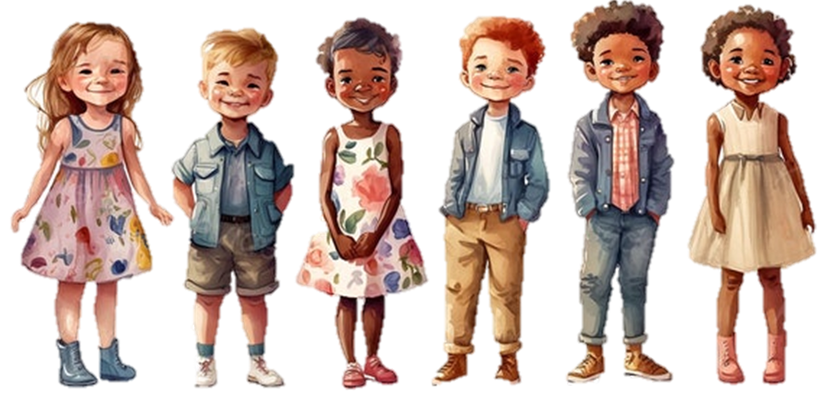

L O Y A L T Y
CFISD Bringing Out the Best

Slide 2
L O Y A L T Y
Objectives
The learner will:
Discuss the characteristics of loyalty.
Explain loyalty in your own words.
Explore how loyalty relates to friendship.

Slide 3
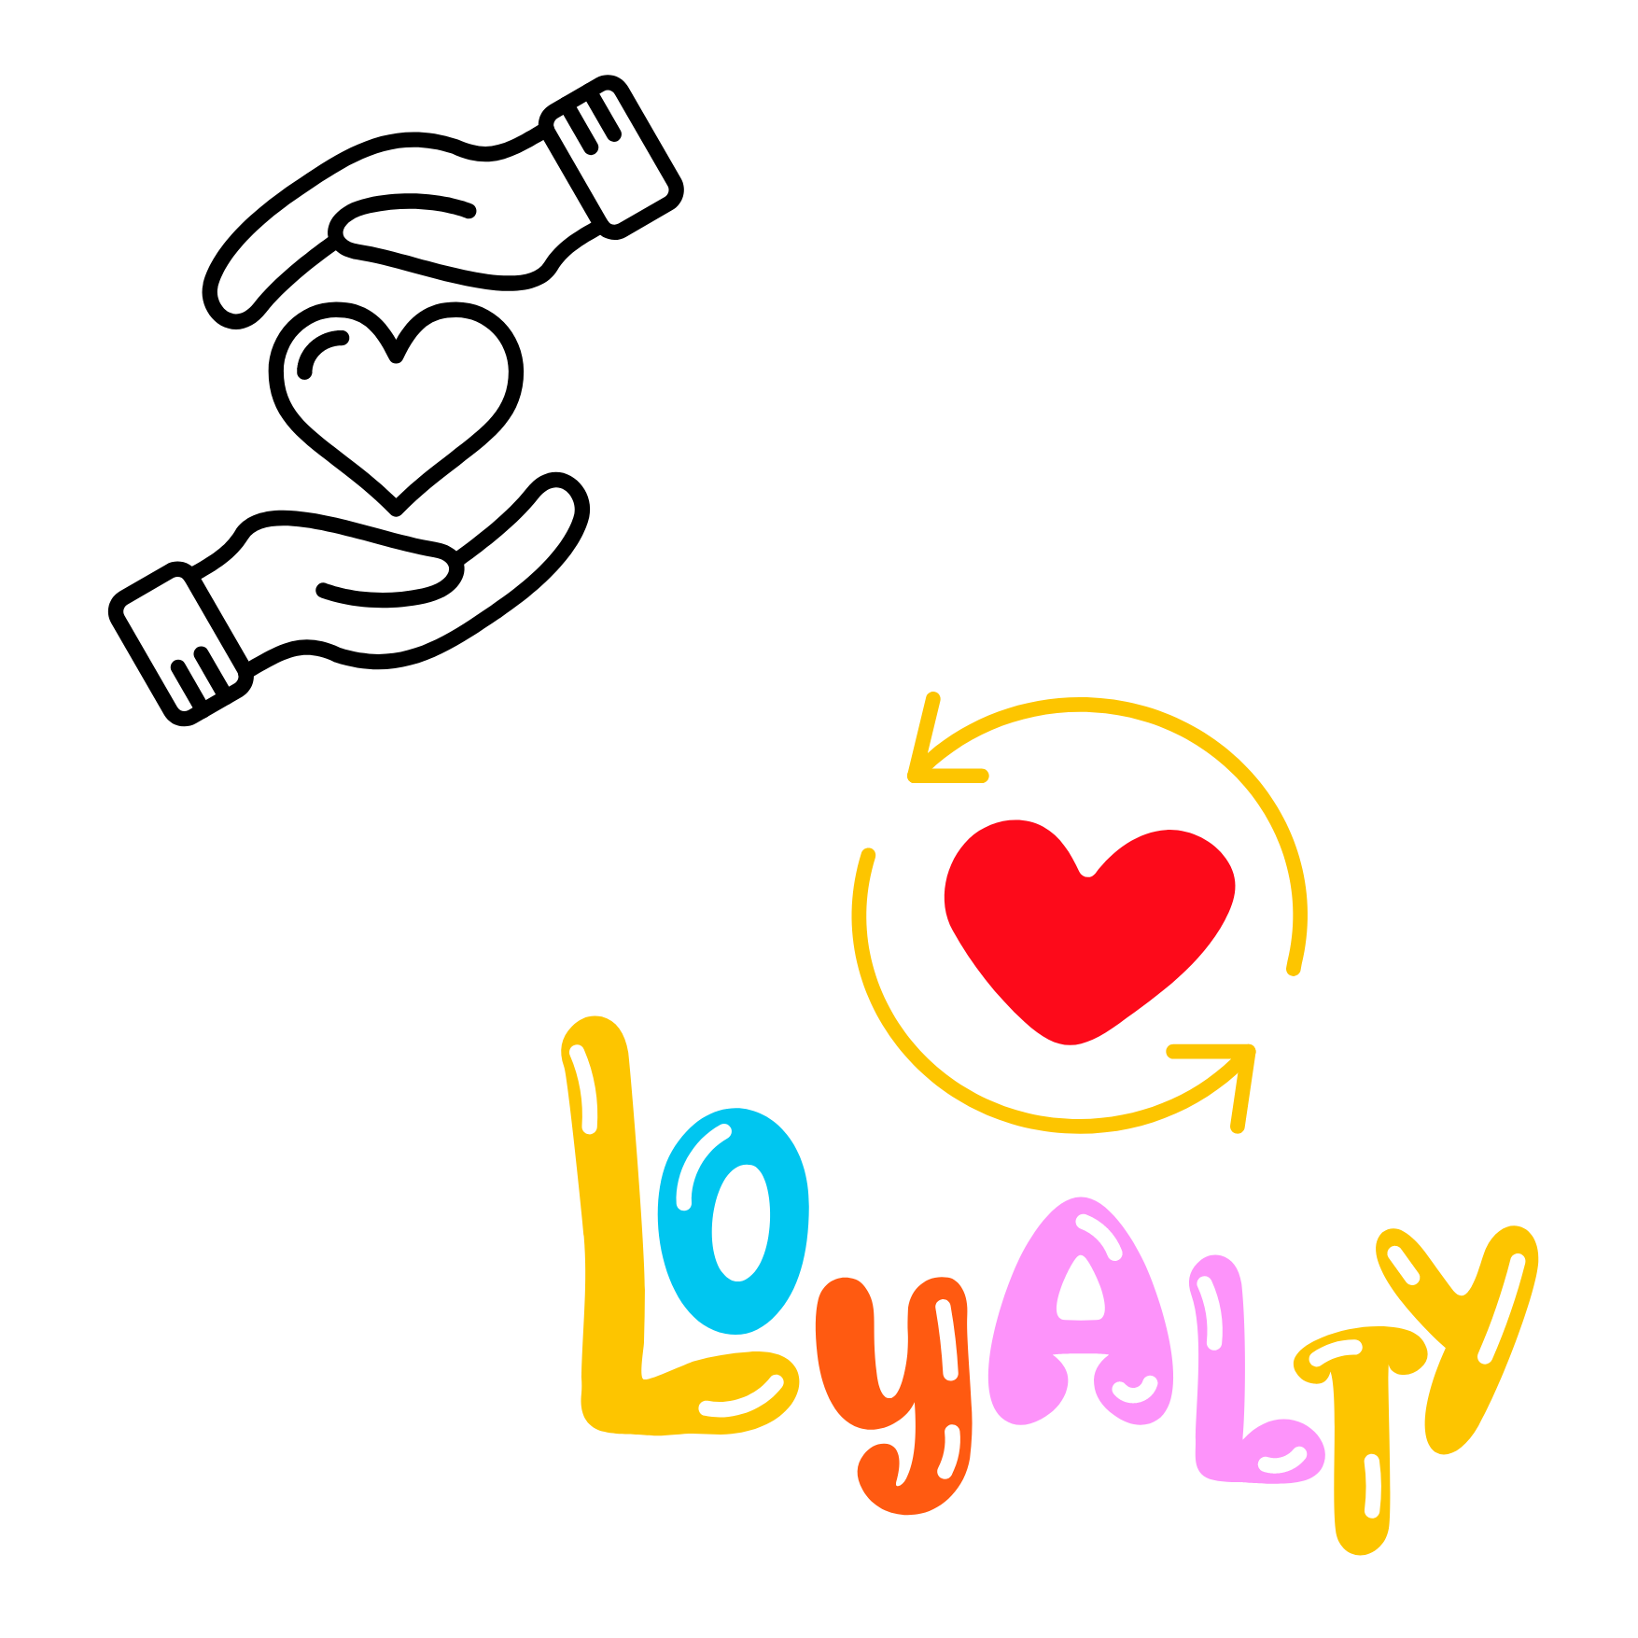
What is Loyalty?
Faithfulness to a person, cause, ideal, or institution

Slide 4
CFISD Video

Slide 5
Characteristics of a Loyal Friend
Trustworthy
Mutual
Reliable and Dependable
Agree to Disagree, It’s okay.
Honest
Caring
Integrity from within yourself
Showing respect toward others

Slide 6


How Does Loyalty Relate to Friendship?
Loyalty
Friendship
Discuss with a partner how loyalty relates to friendship. Share with the class.

Slide 7
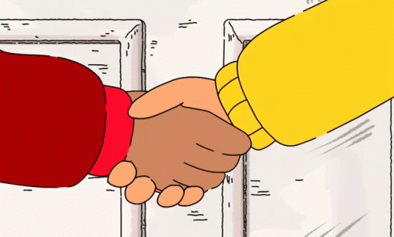
Create a Class Handshake
1 | Think about something you have in common as a class.
2 | Consider a way to make a connection.
3 | Add your own special style.
4 | Practice, practice, practice.
5 | Present it to another class.
“I’ll be there for you!”

Slide 8

WHat are You Loyal to?
Play a modified game of “corners” by designating three areas in the classroom. Students will go to the area that matches their “loyalty” choice. For example, stand near the whiteboard if you are loyal to the Rockets. Stand near the back of the room if you are loyal to the Spurs.
Category 1: Chick-fil-A, McDonalds, Whataburger
Category 2: Basketball, Football, Soccer
Category 3: PS5, Xbox, Nintendo Switch

Slide 9
Loyal
Not Loyal
Sharing gossip
Standing up for a friend
Talking behind someone’s back
Being an upstander
Being dependable
Spreading rumors
Celebrating others’ successes
Showing empathy
Notes:
For this slide, exit presentation mode to drag and drop elements.

Slide 10

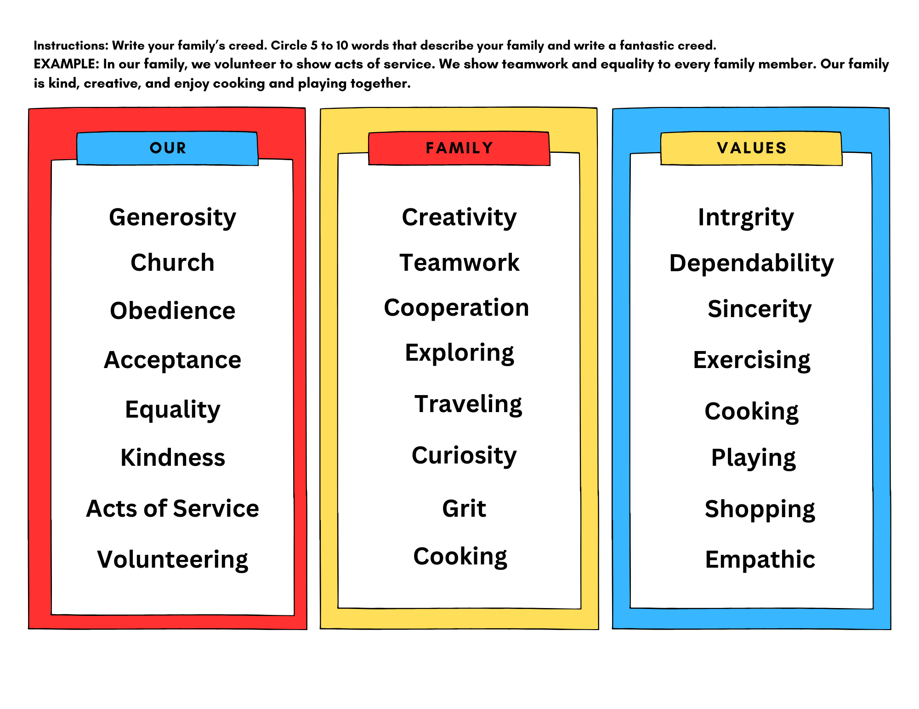

Take Home Activity Our Family Values
As a family, look at the values below and create a family creed. Then you can make a collage representing your family values.
Family Creed
Values Collage
Target Words List Worksheet (1).png

