Slide 1
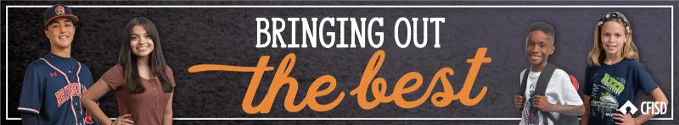
February Character Trait
LOYALTY
2024-2025

Slide 2

Campus
Matrix
LOYALTY

Slide 3
OBJECTIVES
The Learner will be able to:
1
2
identify the qualities of a LOYAL person
define LOYALTY.
3
differentiate between LOYALTY and TOXIC LOYALTY.
4
respond to scenarios in which a person’s LOYALTY will be tested.
LOYALTY

Slide 4
Insert District Video Here
LOYALTY

Slide 5


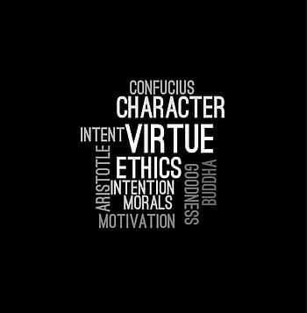
Video Reflections
Can you think of a time that you or someone else showed loyalty?
Share Reflections you may have after watching the video.
Discuss what happened. What went well and what would you change?
LOYALTY

Slide 6
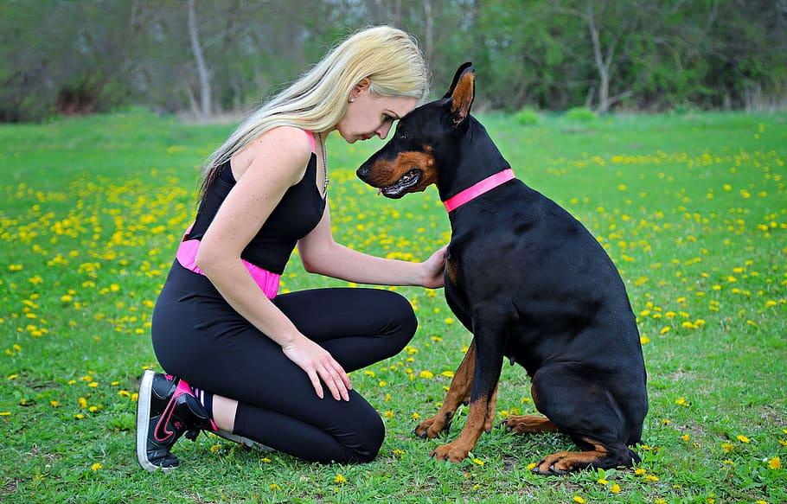
Let’s Chat!
What does loyalty mean to you?
LOYALTY

Slide 7
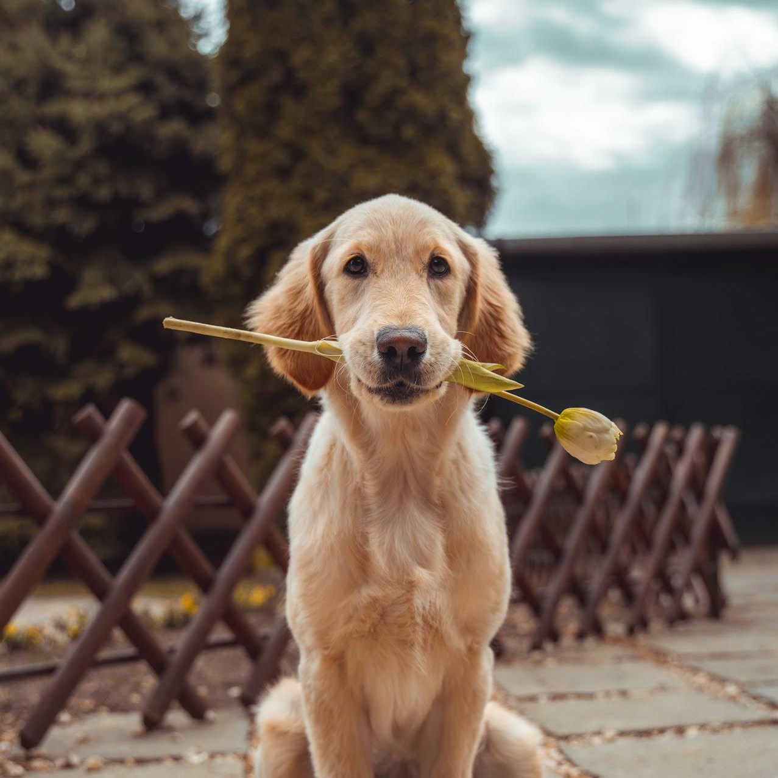
LOYALTY
Faithfulness to a person, cause, ideal, or institution.
“Trust is earned, respect is given, and loyalty is demonstrated.” - Ziad K. Abdelnour
LOYALTY

Slide 8
Questions to Consider
01
02
Why is loyalty an important character trait?
List some qualities of a loyal person.
03
04
How does a person show loyalty?
Do you know a person who is loyal? What makes this person loyal?
LOYALTY
Notes:
Present this slide in Slideshow mode and press enter to make the questions appear on the screen. Discuss the questions as a class either in a restorative circle or as think-pair-share.

Slide 9
Did you know that loyalty can be toxic?
Toxic loyalty…
Examples include…
You are…
Is when your faithfulness to a person, cause, idea, or institution is detrimental to yourself.
-Being underpaid at a job
Valued and deserve respect!!
-Constantly feeling devalued
-Pressure to act immorally
Be loyal to yourself!
-Enduring physical or verbal abuse.
LOYALTY

Slide 10
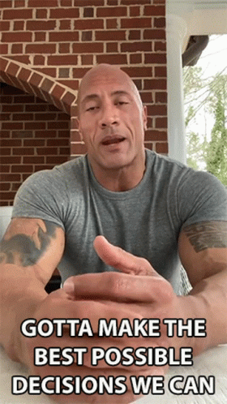
Loyalty Dilemmas
Read each scenario. Discuss what would be the best solution that would demonstrate both loyalty and respect. Then share your decision.
LOYALTY

Slide 11

Scenario 01
You’re in a class and you overhear some other students talking about your friend. They turn to you and ask if you agree with them. What do you do?
LOYALTY

Slide 12
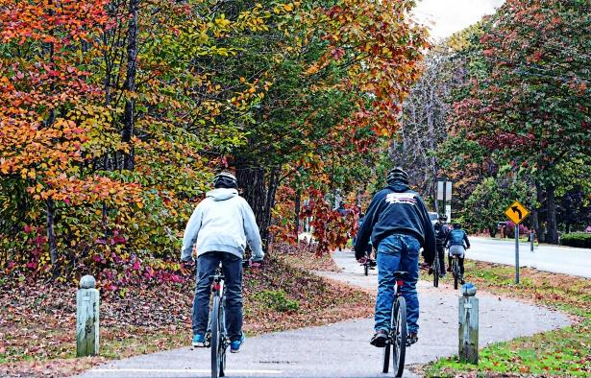
Scenario 02
You’re riding your bike to the park with your younger brother and some friends. Your brother isn’t able to keep up. What do you do?
LOYALTY

Slide 13

Scenario 03
Some older, popular kids from your school invite you to go to the movies with them on Friday after school, but you have practice at the same time. What do you do?
LOYALTY

Slide 14
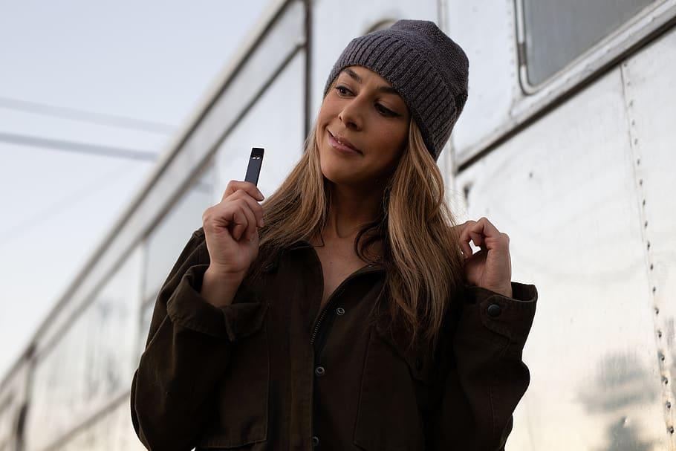
Scenario 04
Your friends decide to meet up at your house. One friend pulls out a vape to pass around. The vape gets to you and you say, “No.” One friend says that if you don’t , they will not be your friends anymore. How do you show loyalty? How would you handle this?
LOYALTY
Notes:
Teacher: Add to the discussion by stating that this is an example of Toxic Loyalty.

Slide 15
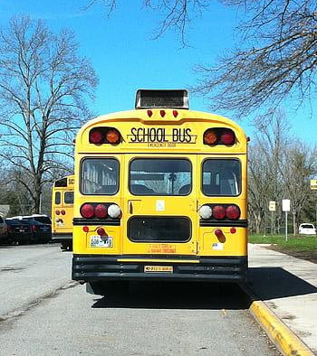
Scenario 05
While riding the bus to school, your best friend asks you if he can copy your math homework. How do you respond?
LOYALTY

Slide 16
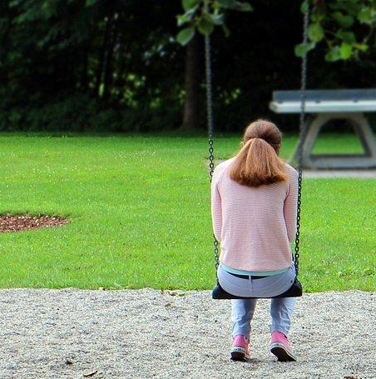
Scenario 06
Your two best friends are fighting. They tell you that you have to choose which one of them you want to keep as a friend. How would you respond?
LOYALTY

Slide 17
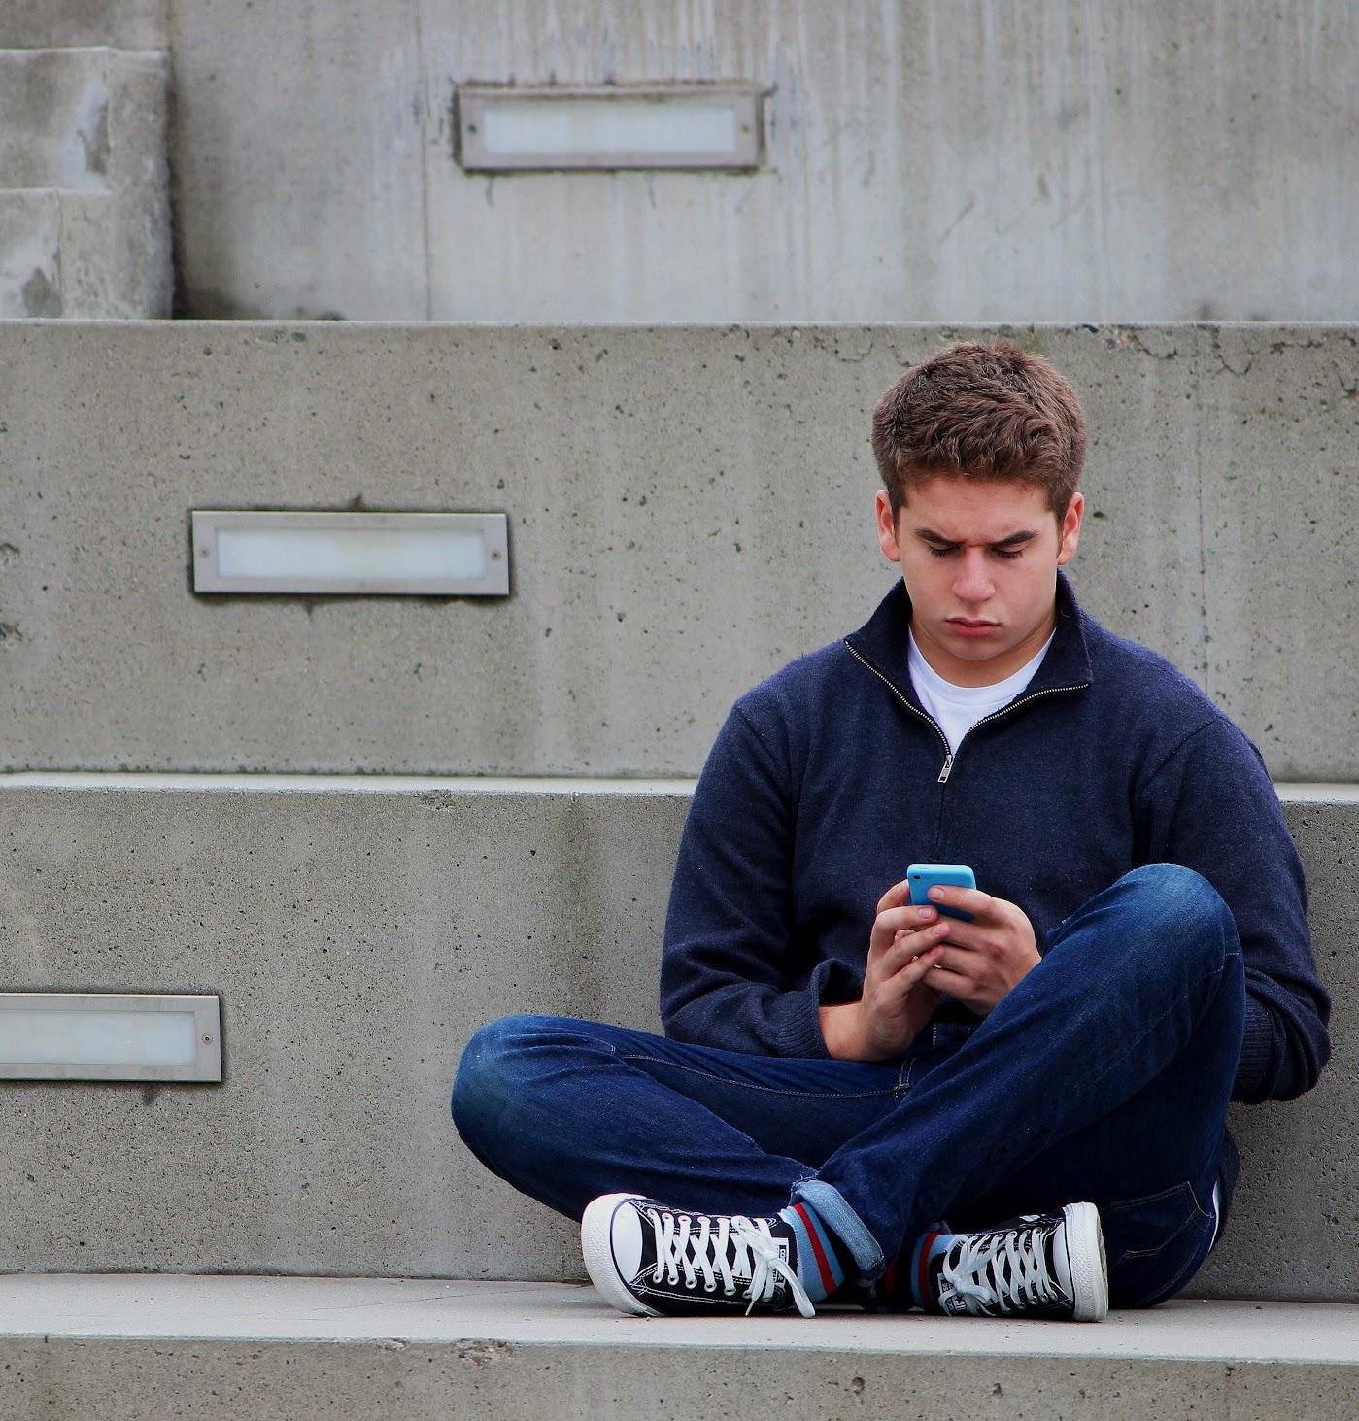
Scenario 07
You invite your oldest friend to play video games with you at your house. Before he arrives, some of your new friends call and ask if you want to hang out with them. What do you do?
LOYALTY

Slide 18
Home Connection
Discuss this scenario as a family.
Your school has planned to have a “Campus Beautification” day next Saturday. A school email went out to the parents and students were notified about it at school. A Sign-Up Genius was included in the email and people could sign up to pick up trash, clean out and refresh the flower beds, paint some benches, and freshen up some hallway bulletin boards. Those who could, were asked to come and help, but no one had to come.
How would your family decide whether or not to attend and which beautification project would you sign up for?
LOYALTY

Slide 19
Resources
Presentation Template: SlidesMania
Sample Images: Unsplash
Fonts used in this presentation: Questrial and Belanosima Semi Bold.
LOYALTY

