Slide 1
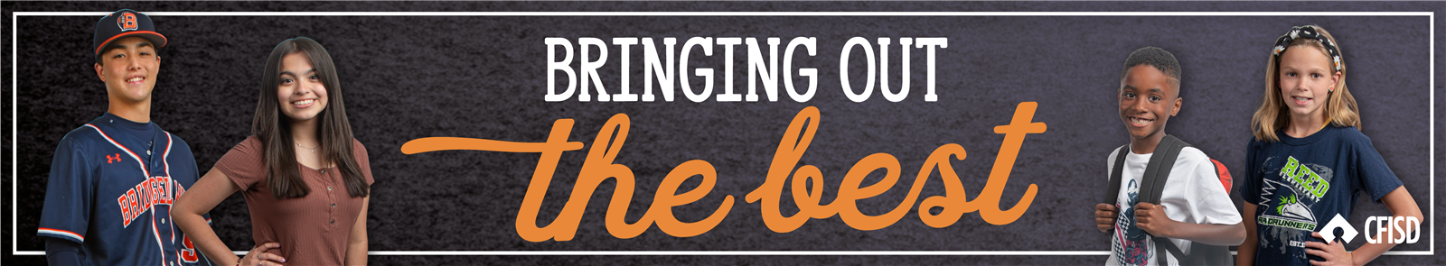
Loyalty
February - PreK - 2nd

Slide 2
Loyalty
Define
We will define loyalty.
Identify
We will identify ways to be loyal.
Apply
We will determine ways to show loyalty in different scenarios.

Slide 3
Definition
Faithfulness to a person, cause, ideal or institution

Slide 4
Loyalty Video
Insert CFISD Loyalty Video

Slide 5
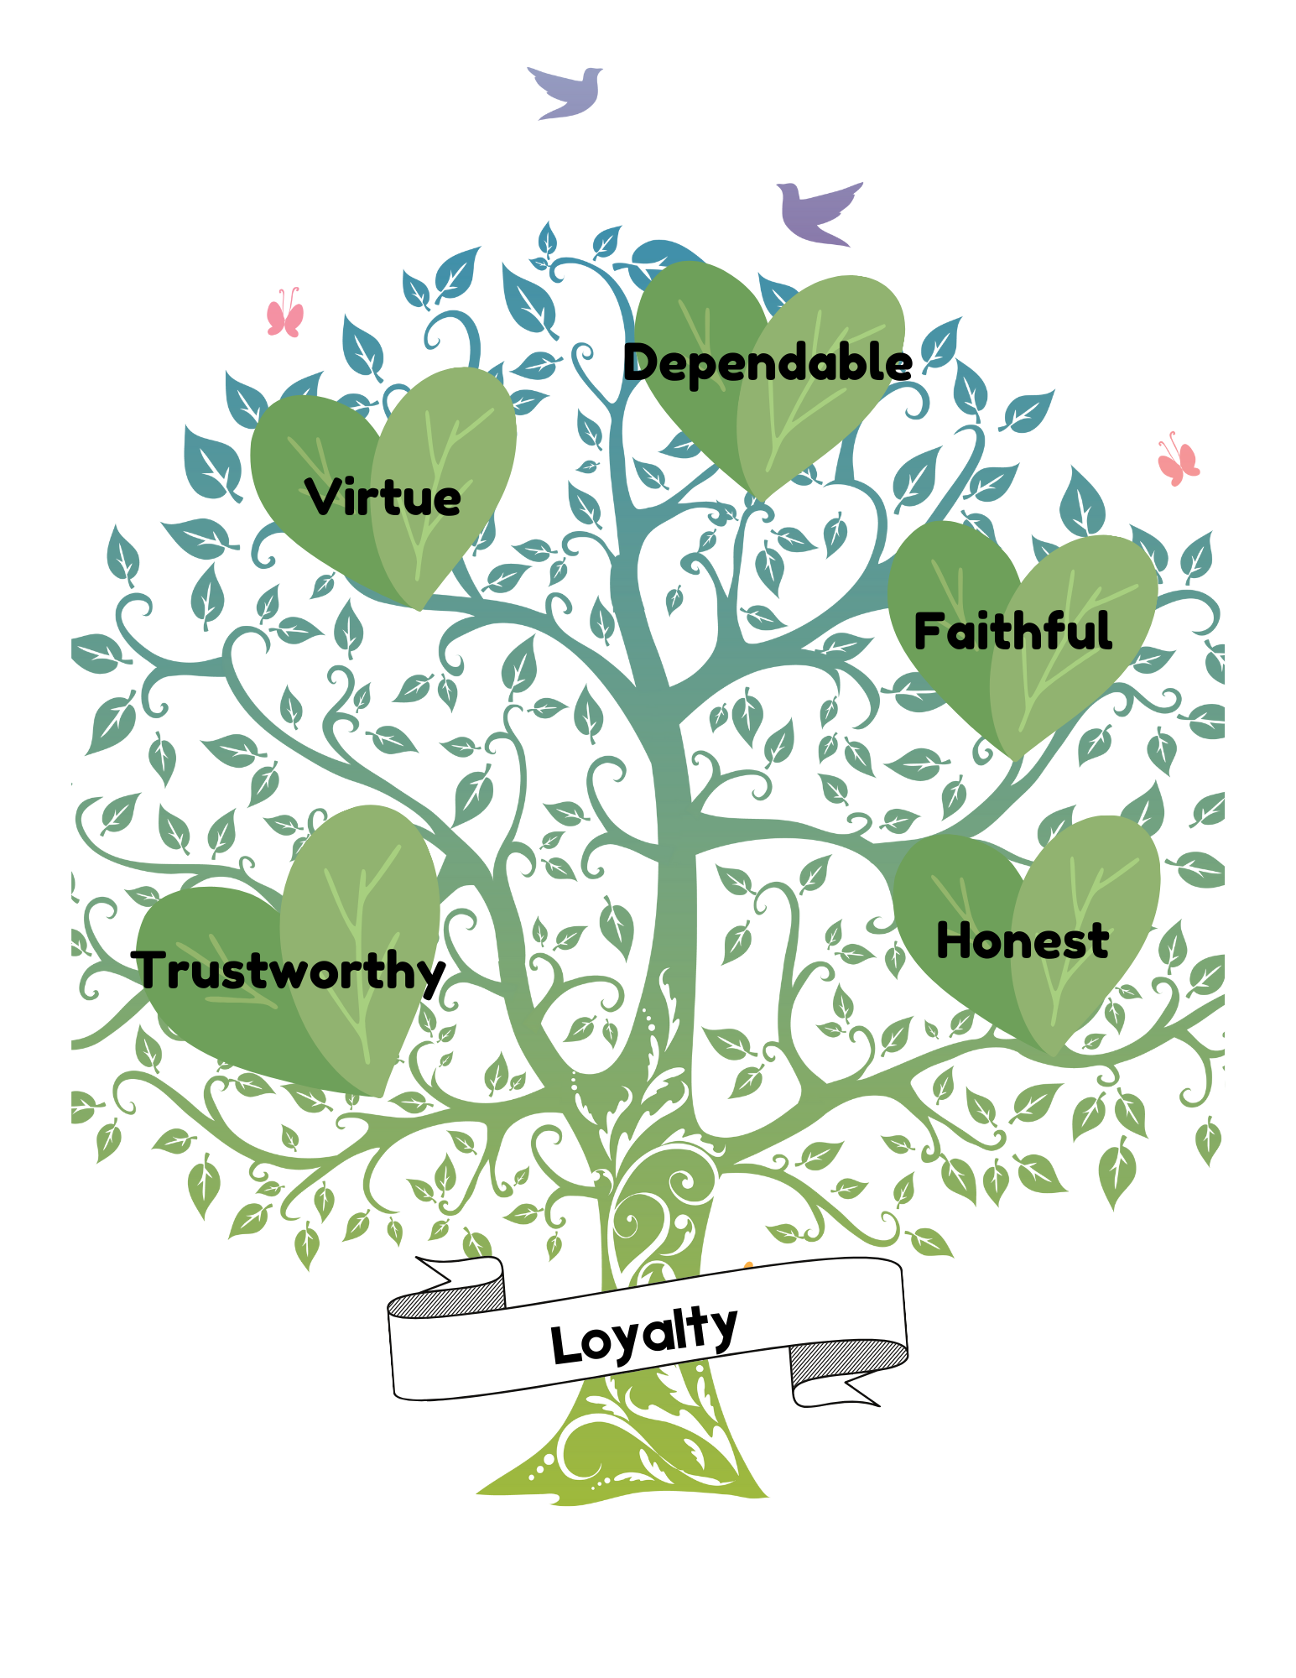

Slide 6

Loyalty Scenarios
You told your friend a secret and he promised he wouldn’t tell, but then he told everyone.
Loyal | Disloyal

Slide 7
Loyalty Scenarios
You wait for your neighbor everyday at the bus stop.
Loyal | Disloyal

Slide 8
Loyalty Scenarios
Your classmate tells you to ignore your best friend, so you don’t listen when he asks you a question.
Loyal | Disloyal

Slide 9
Loyalty Scenarios
Your friend wants to learn how to tie their shoes, so you help her learn.
Loyal | Disloyal

Slide 10

Build a Loyal Friend!
How could you be loyal to your friend?
Write in the person, ways to be loyal to your friend and family

Slide 11
How can you show loyalty in your class and school?
We can be loyal to our friends and family but we can also show loyalty to our school. What are some ways we can be loyal to our class and school?

Slide 12

Build stronger friendships
Actions that match words
Doing what you say you will do: Honesty
Think of the other person first
Celebrating success for the other person
Stops rumor spreading
Friends that have Loyalty

Slide 13
Home activity
Fill in how loyalty looks, sounds, and feels to your family
Loyalty to my family looks like…
Loyalty to my Loyalty to my
family sounds like… family feels like…

