Slide 1
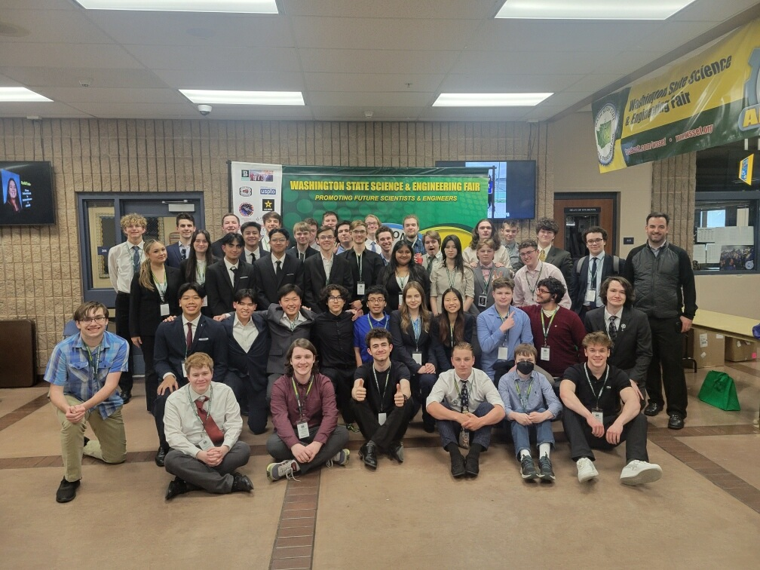

STEM Magnet Program
At Mountlake Terrace High School
Notes:
James

Slide 2
Imagine a world...
Where you operate $120,000 machines before you can drive…
Where the instructor lets you play games in class….. IF you design them yourself
Conduct original scientific research, with the support of experts in the field
You turn food borne bacteria into nightlights
Students are challenged to be independent, creative, and see failure as a necessary step to success
HS students graduate with college transcripts full of relevant, transferable credits
Curriculum is guided by an advisory committee of industry representatives
Notes:
James

Slide 3

Imagine a world...
Notes:
James

Slide 4
Tonight’s Agenda/Introductions
Part 1: 6:15- 6:45 Introduction and Student Perspective
Overview of program
Student perspectives
First courses in the program
Part 2: 6:50 - 7:20 Student Activities & Parent Information
Parents: Nuts and bolts of the program
Students: STEM activities in the HUB
Part 3: 7:30 - 8:30 Lab Tours and Pathway Information
Lab tours led by STEM Club Students
Notes:
James: 2 minutes

Slide 5
MTHS STEM Program
Four-Year Program with Engineering, Math and Science and all other required HS Classes
Three Pathways for Students
  Aerospace
  Computer Science
  BioTech
Strong STEM Clubs/Community
  After school clubs
  Community Building events
  Interaction with local industry
College Credits and National Recognition
  Credit Partnerships with UW, Shoreline CC & Edmonds CC
Inspire, Engage, and Prepare Students for the World of STEM
Notes:
James: 2 minutes

Slide 6

Diploma Options:
 | Foundations (IED+STEM12) | STEM Electives | Math | Science
Exploratory |  | Explore! Any Two STEM Classes | 3+ Credits | 3+ Credits with more options
Honors |  | Dive Deep! Two aligned STEM Classes | 4.0 Credits mostly honors | 4.0 Credits rigorous Sciences
Notes:
James: 3 minutes

Slide 7
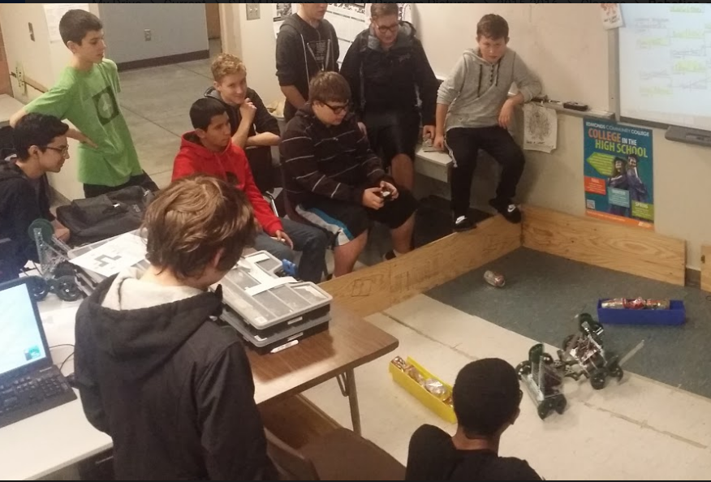

9th Grade - Taking Algebra 1
Computer Science Foundations
Progression from block-based to text-based
Write programs in Python
Team project/ Story Creation
Robotics 1
Block and text-based programming languages
Hardware, Sensors, wiring
Teamwork/Problem Solving/Troubleshooting
Notes:
Owings: 2 minutes

Slide 8
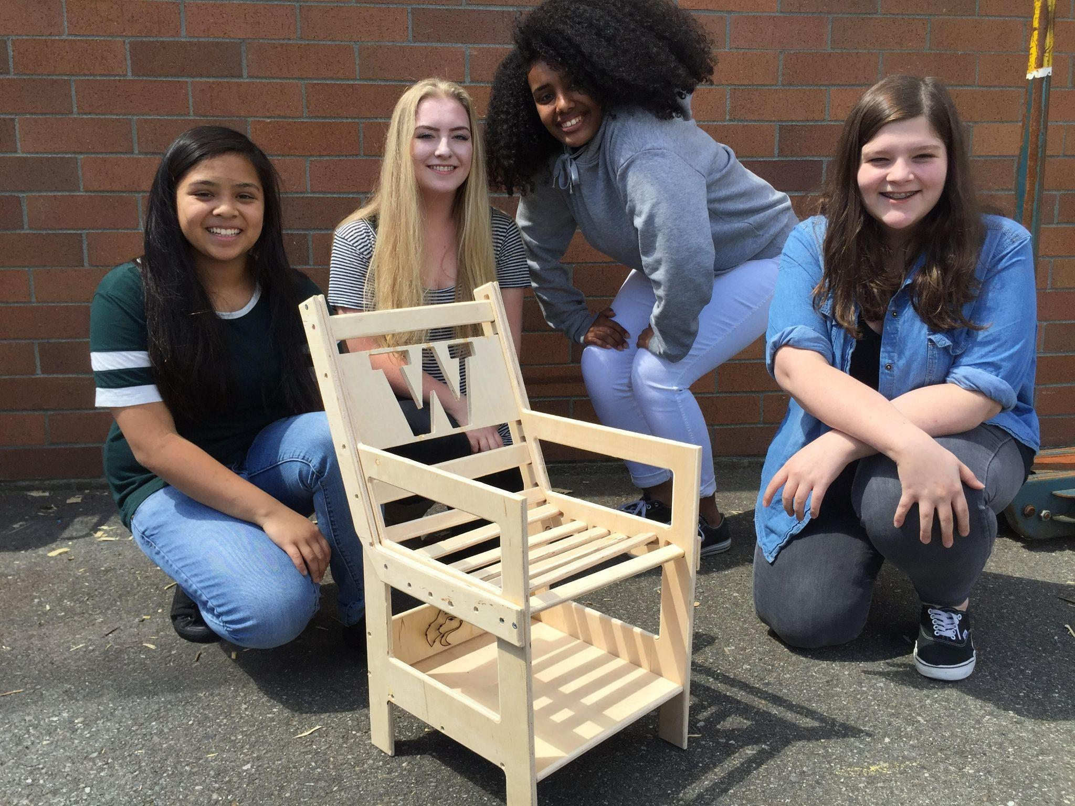
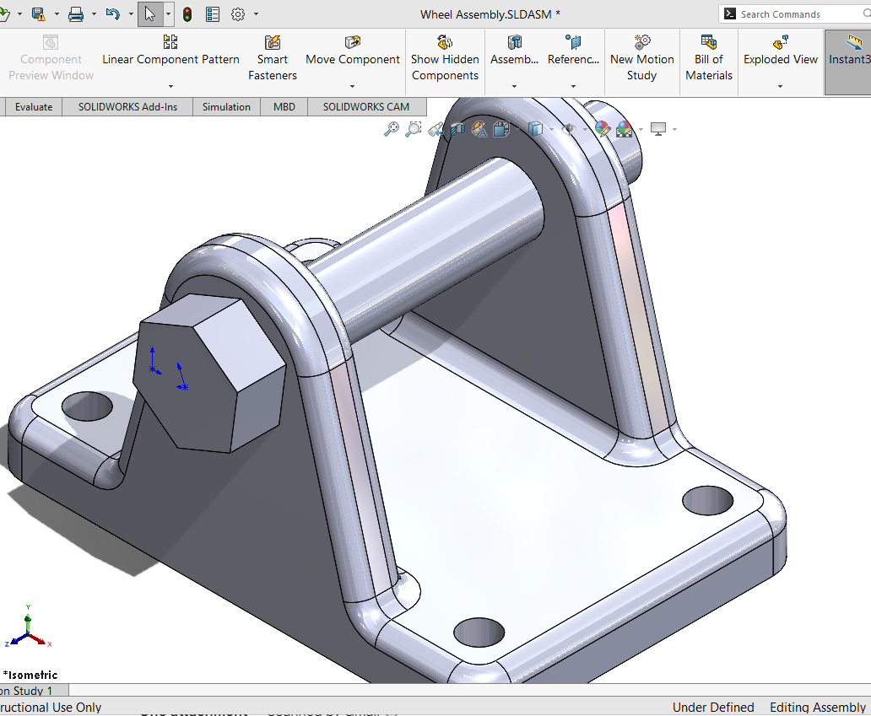
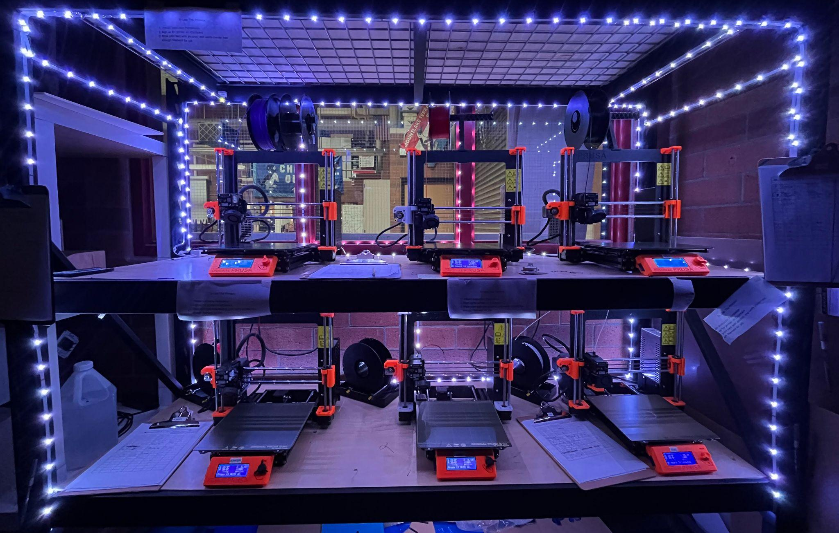
9th Grade - Taking Honors Geometry +
Intro to Engineering Design
Foundation of STEM Program
Focus on Creativity
Community building
“21st century skills”
Notes:
James - 2 minutes

Slide 9
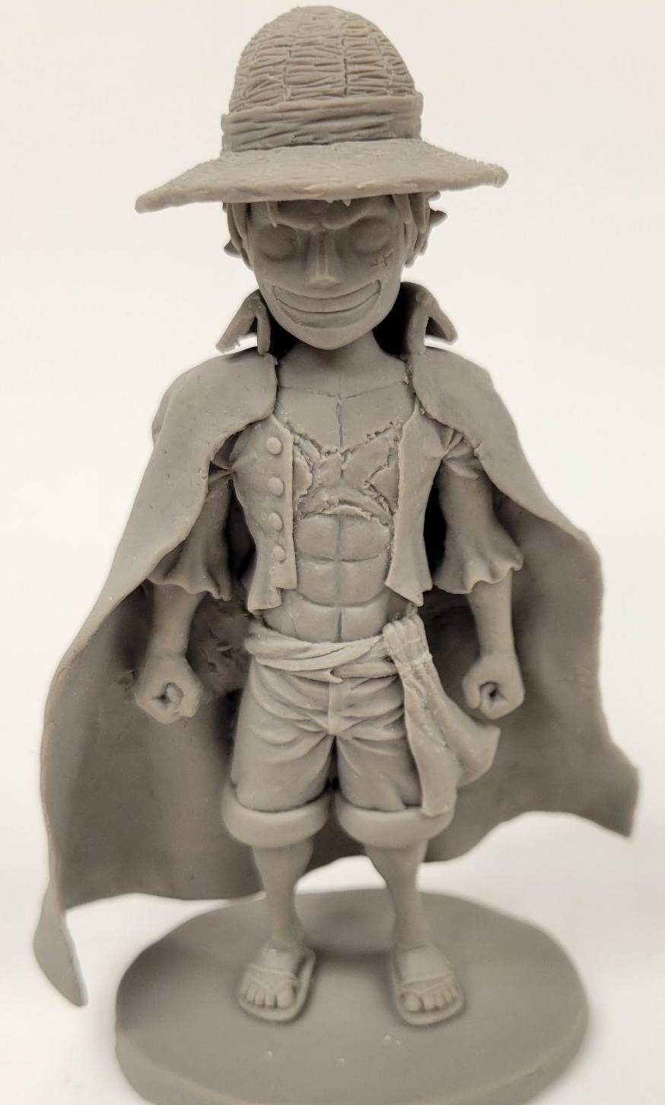
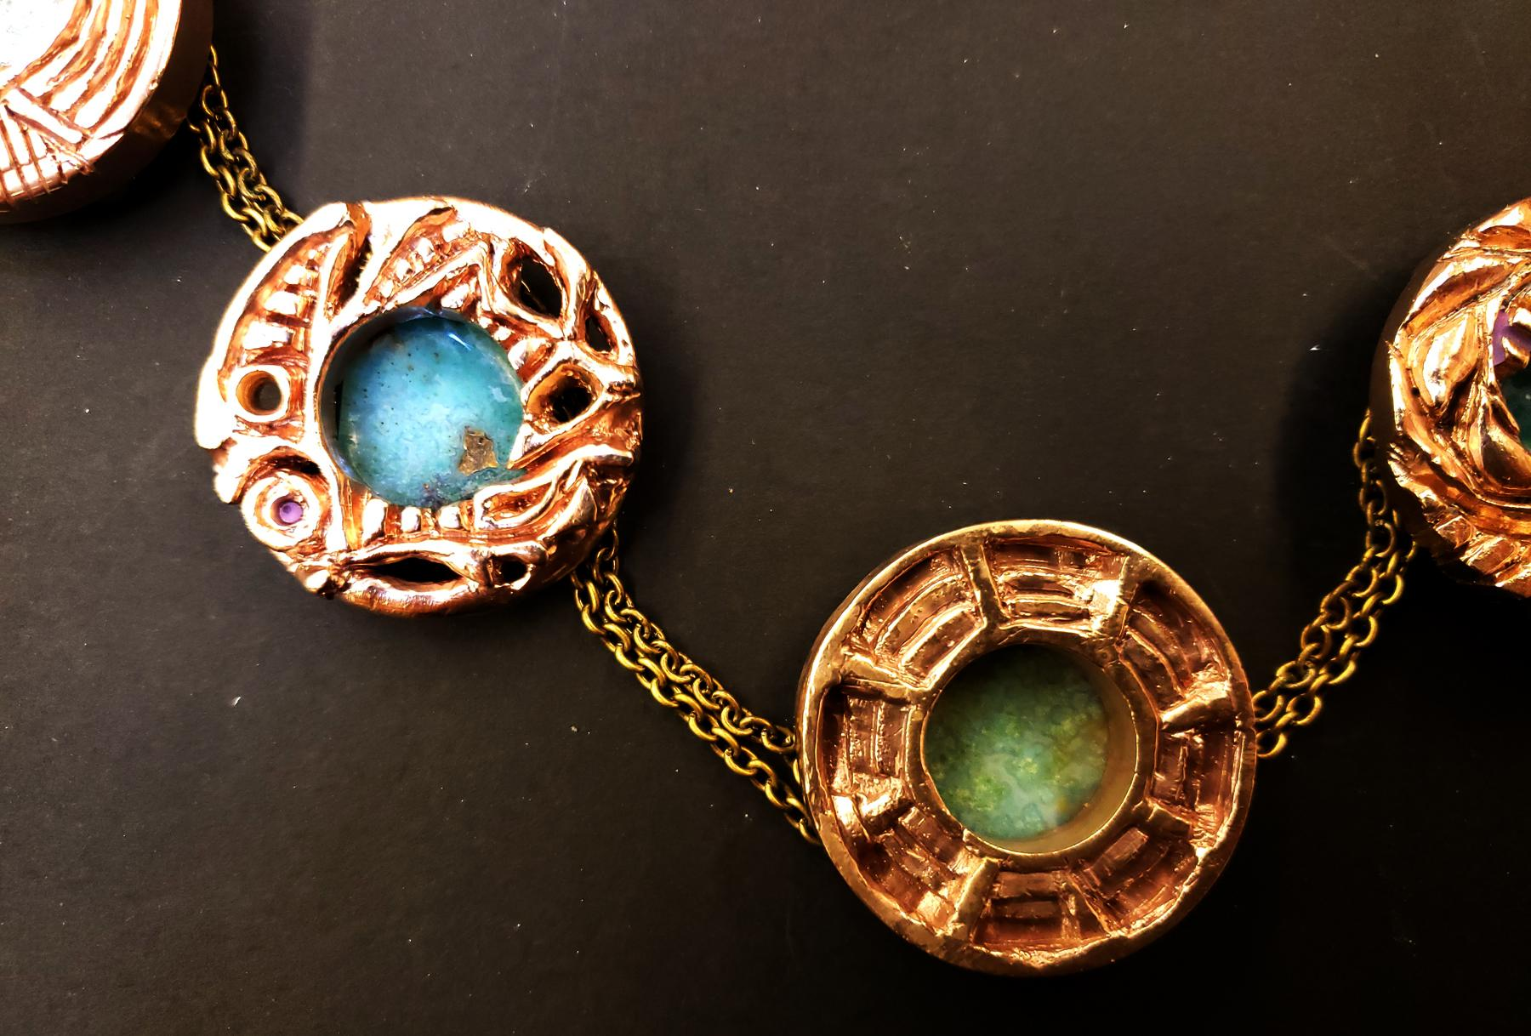
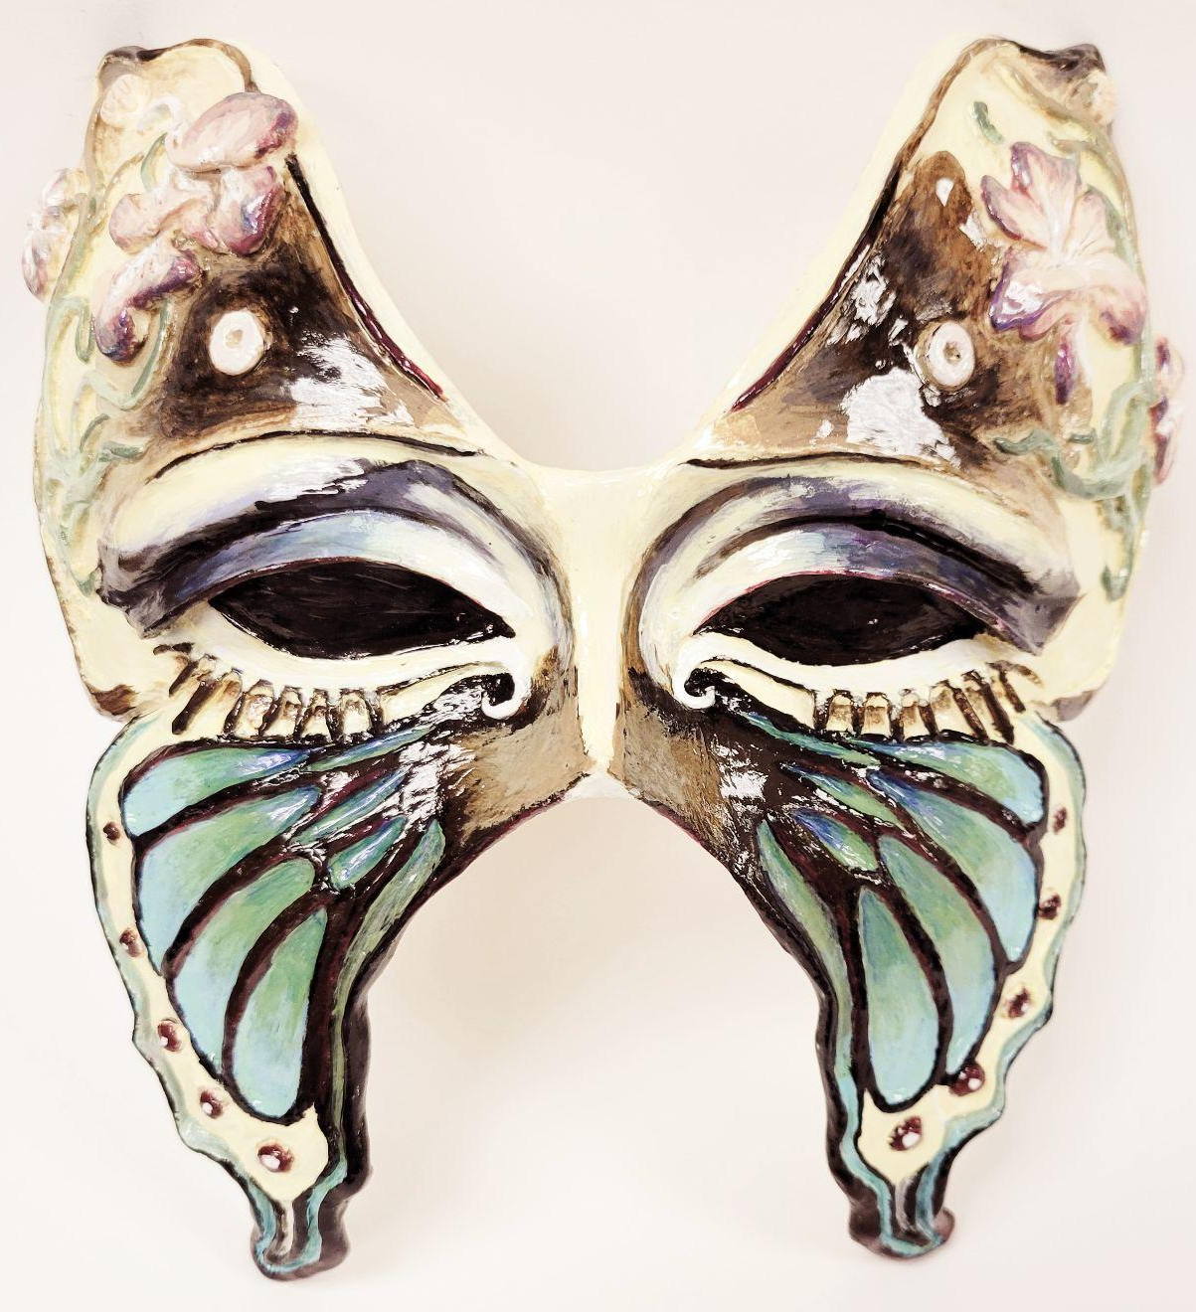
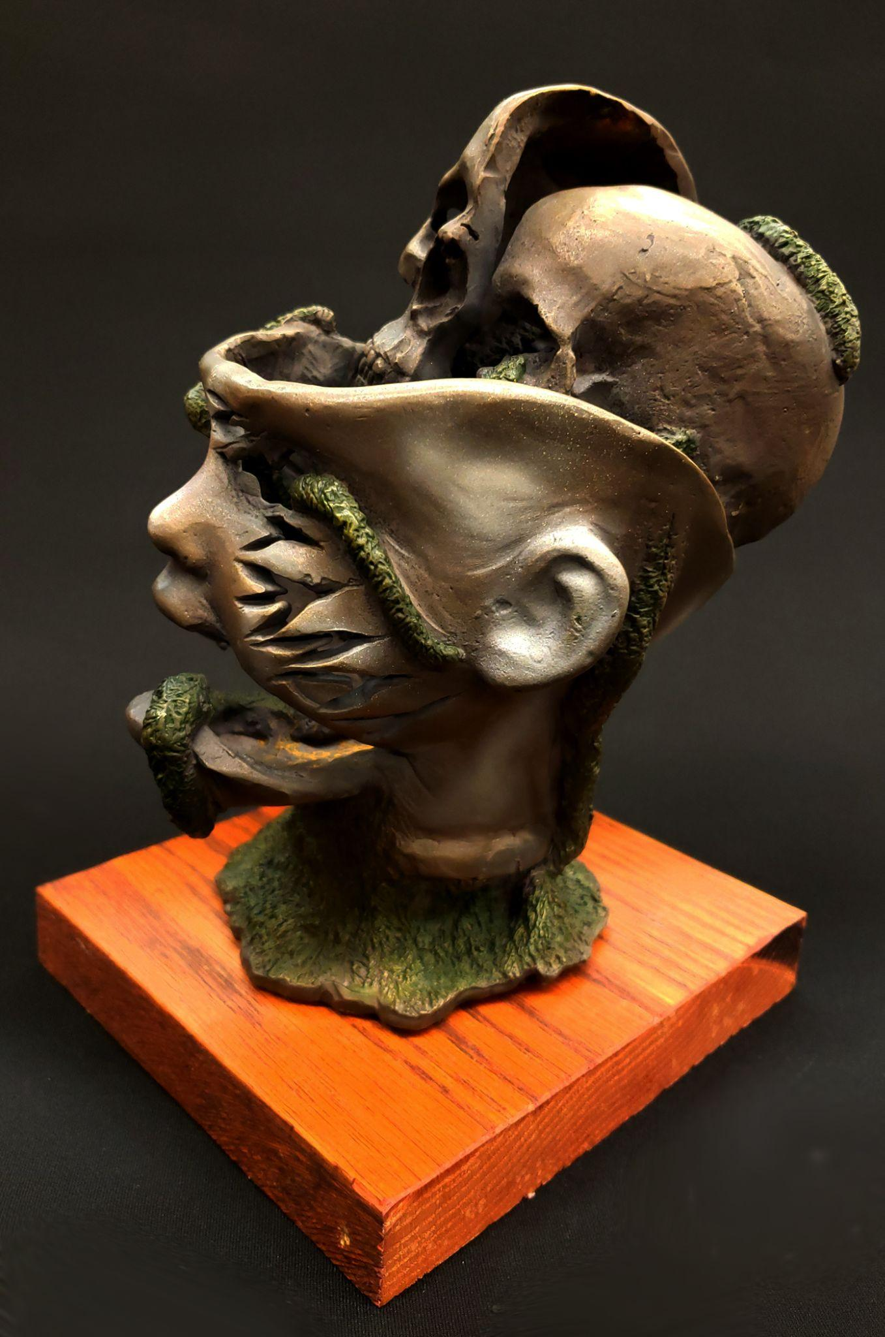
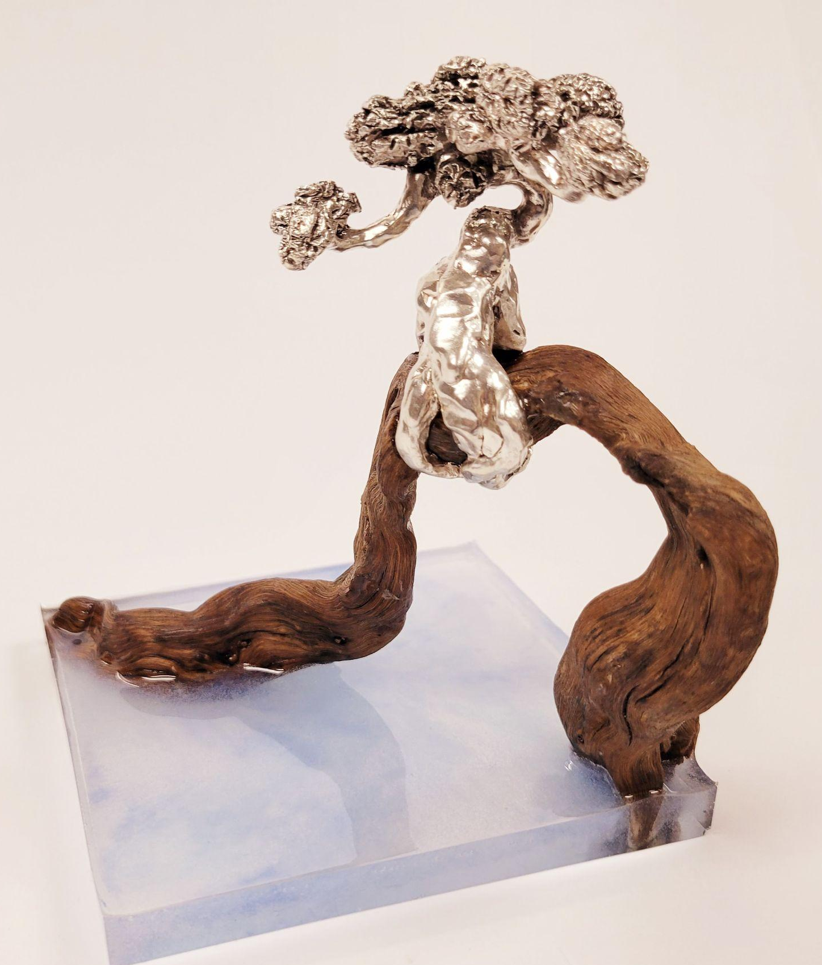
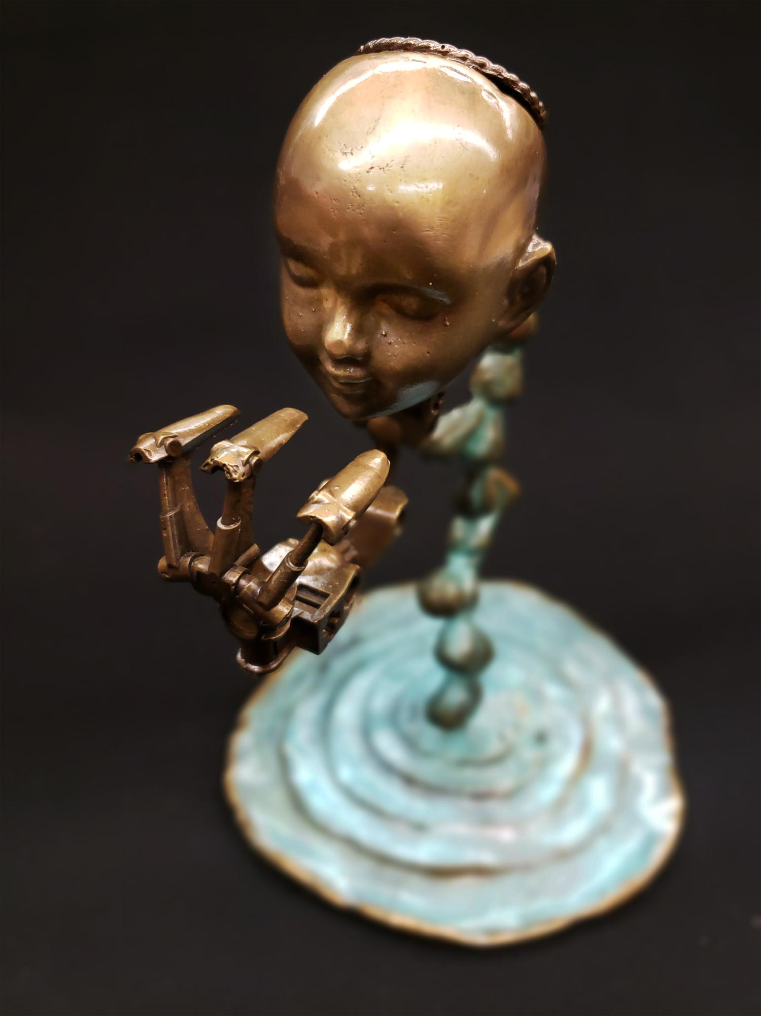
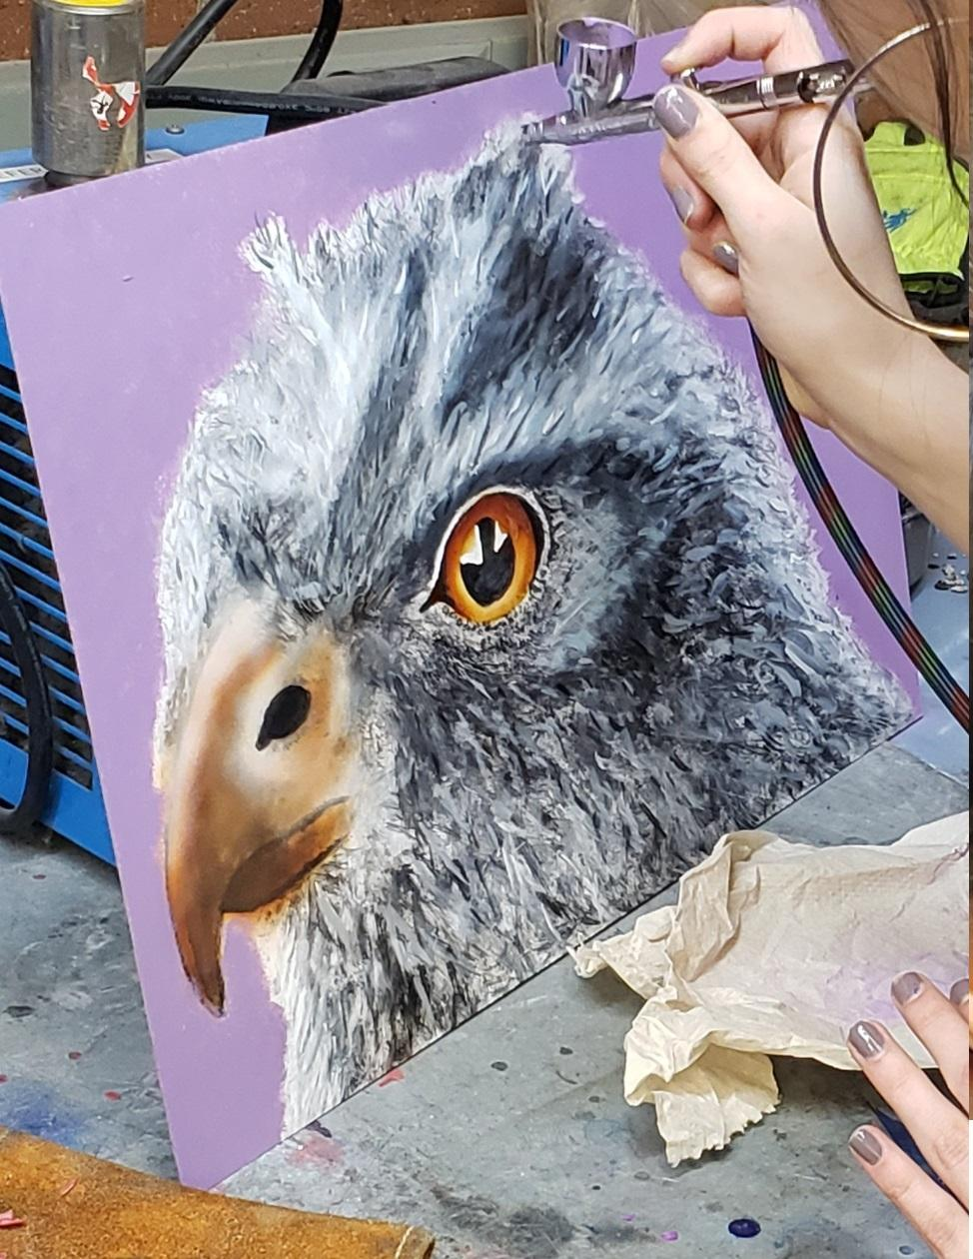
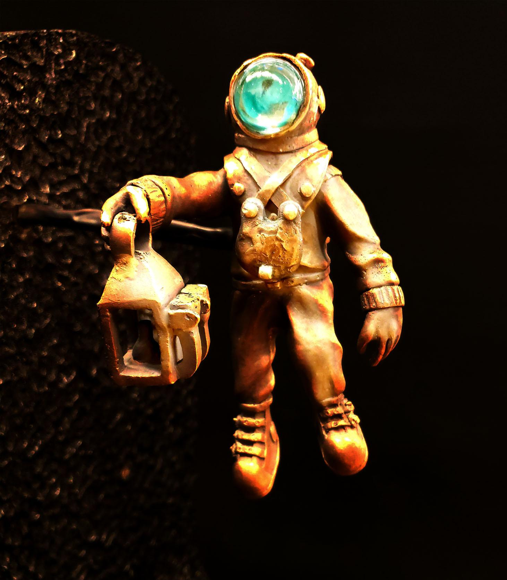
Art/Manufacturing at Terrace
CTE (Tech) ART
Industrial Arts Digital Arts
Manufacturing Innovations
Sheet Metal Work
Glass Lampwork
Lapidary Stonework
Plastic & Casting
Mold Making
Metal Casting
Torch Work
Fine Art
Painting & Drawing 1&2
Clay Design 1&2
AP Studio Art
Photography ( l & ll)
Graphic Design ( l & ll)
Video Production
Notes:
Nichole: 3 minutes

Slide 10
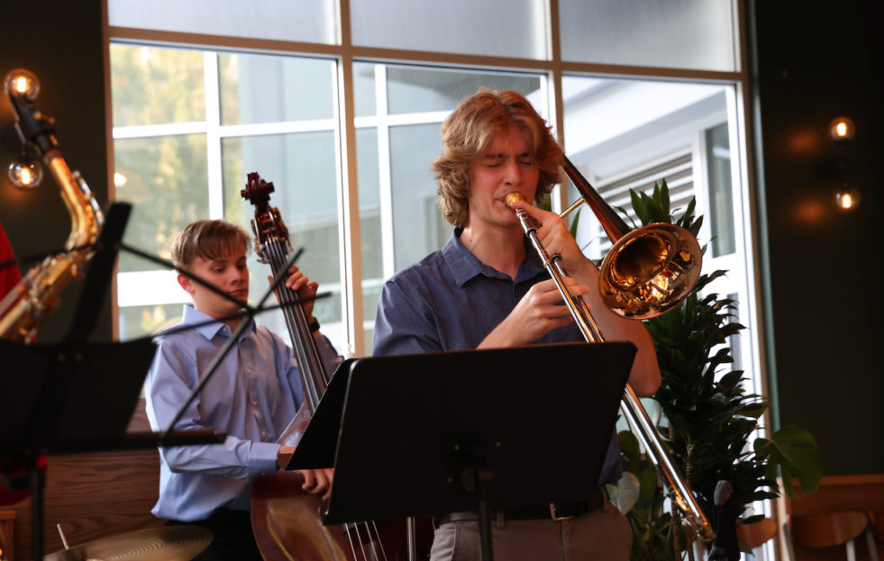
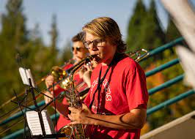

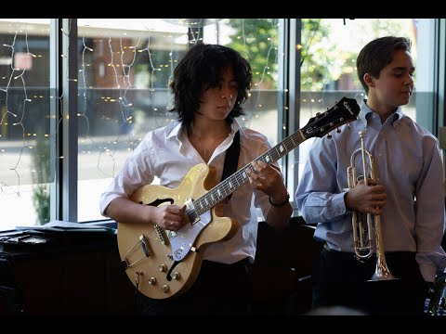
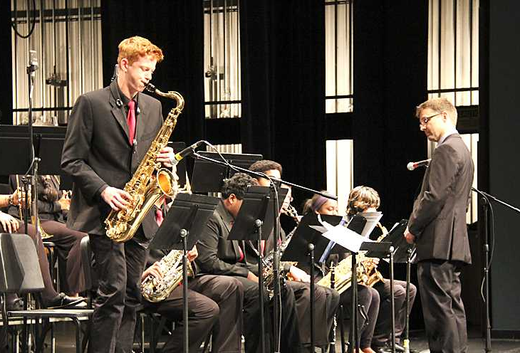
Music at Terrace
Notes:
Faul: 3 minutes

Slide 11

Student Experiences

Slide 12
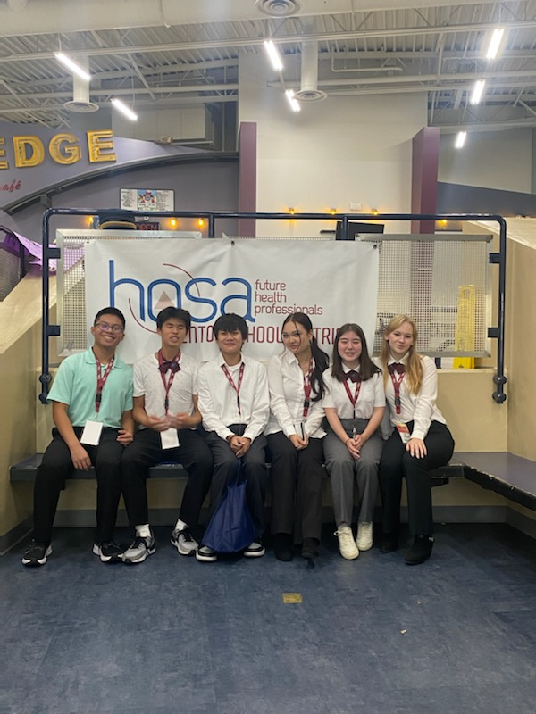
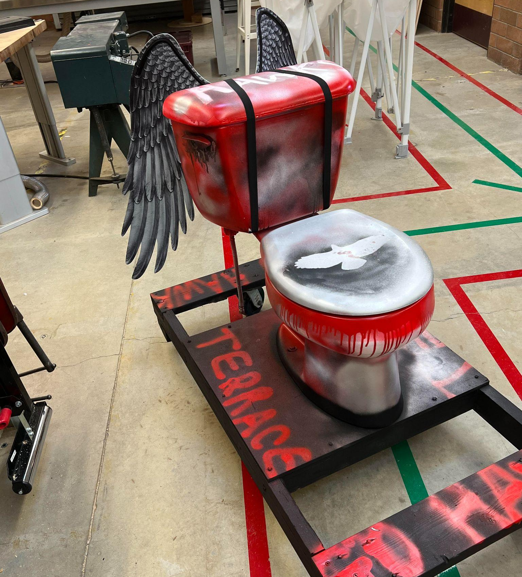
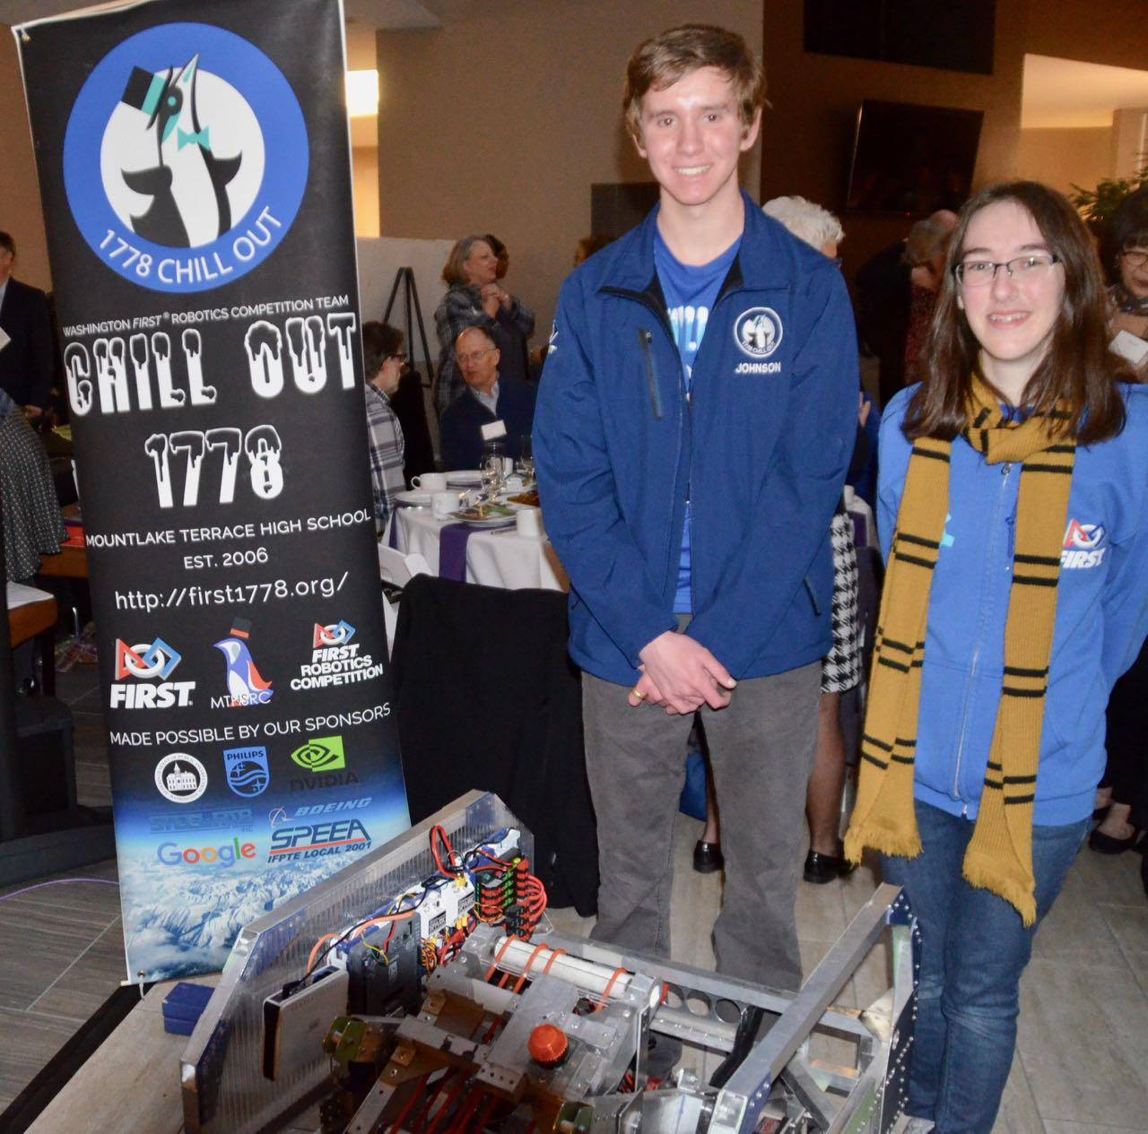
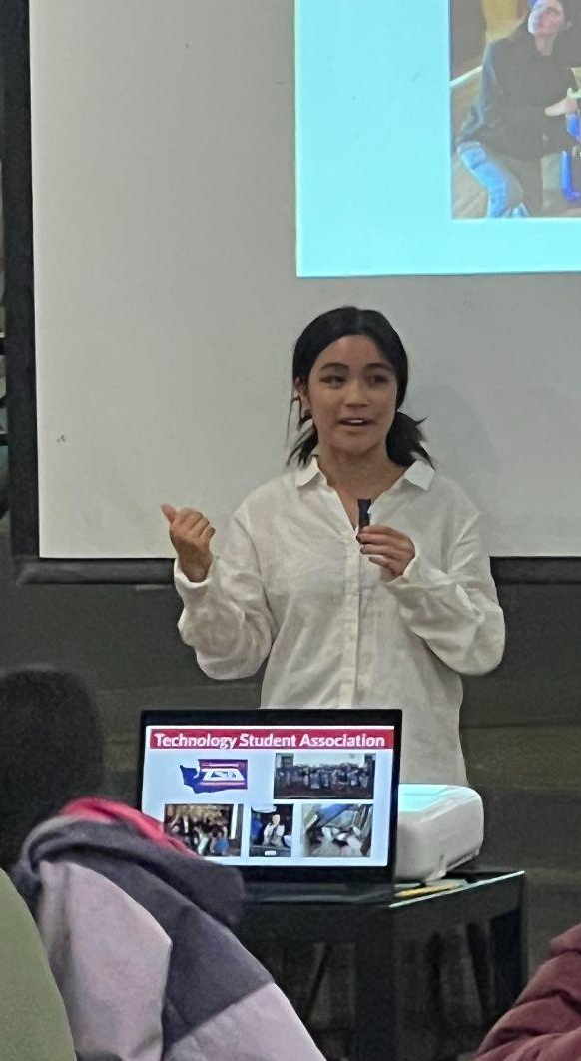
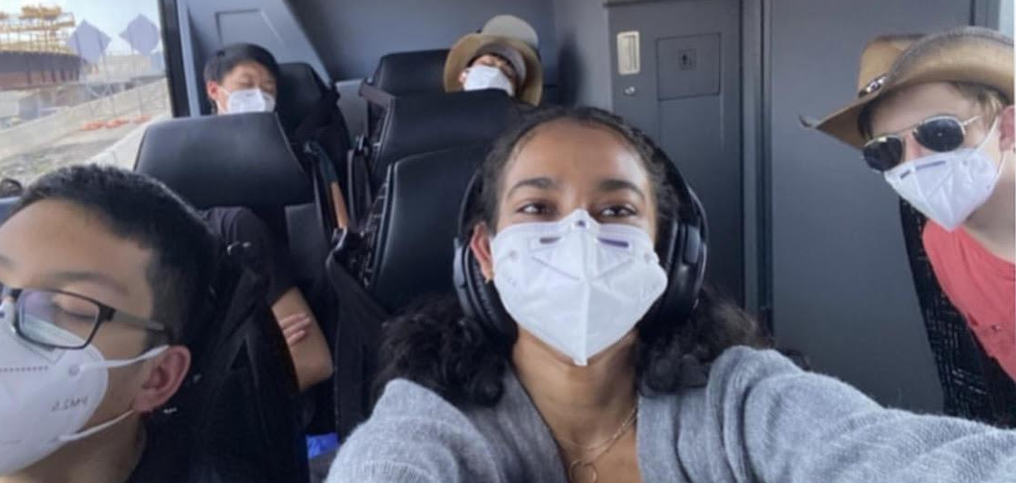
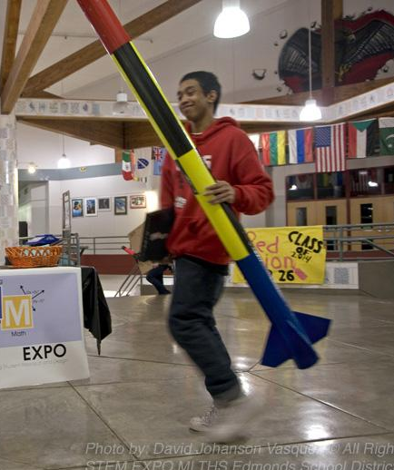
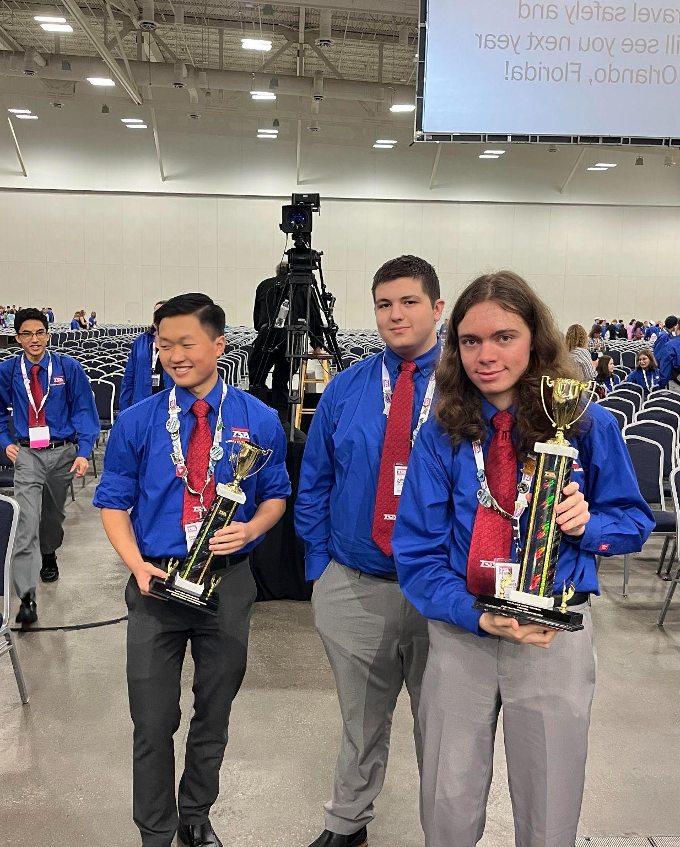
Student Experiences
Cyrus McMillion: Exploratory+Tennis+Robotics
Efrata Solomon: Biotech+HOSA+TSA+Journalism
Katarina Moye: CS+Girls who Code+Music
Notes:
12 minutes total (3 minutes each)

Slide 13
Career Tech Student Organizations
TSA: Largest in State, 1st in Coding, 2nd in Structural Design & Essays on Tech nationally
HOSA: 1st in Clinical Laboratory Science, 4th in Forensic
Science, 5th in Biotechnology; national qualifiers
FRC: 2 Worlds Qualification
VEX: State Qualifier
Rocketry: Four+ NAR Level 1 High-Power Rocketry Certifications
Girls Who Code: Girls Who Code is on a mission to close the gender gap in technology and to change the image of what a programmer looks like and does.
Notes:
James - 2 minutes

Slide 14
Section 2: Time to explore!
Section 2: Time to explore!
Notes:
James 3 minutes

Slide 15
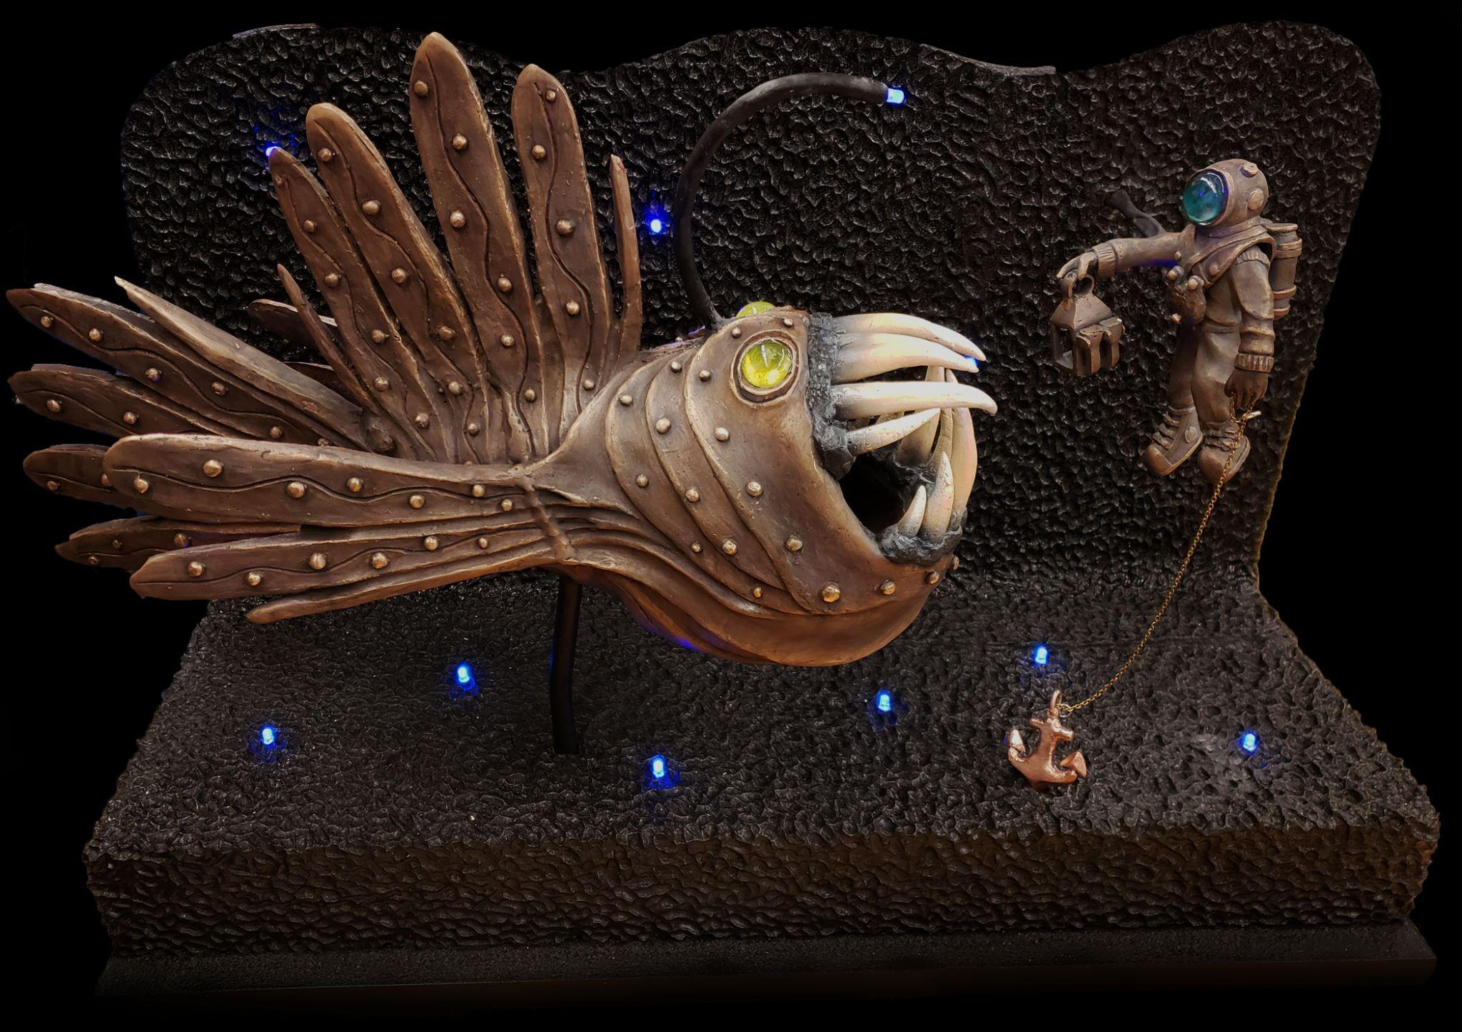
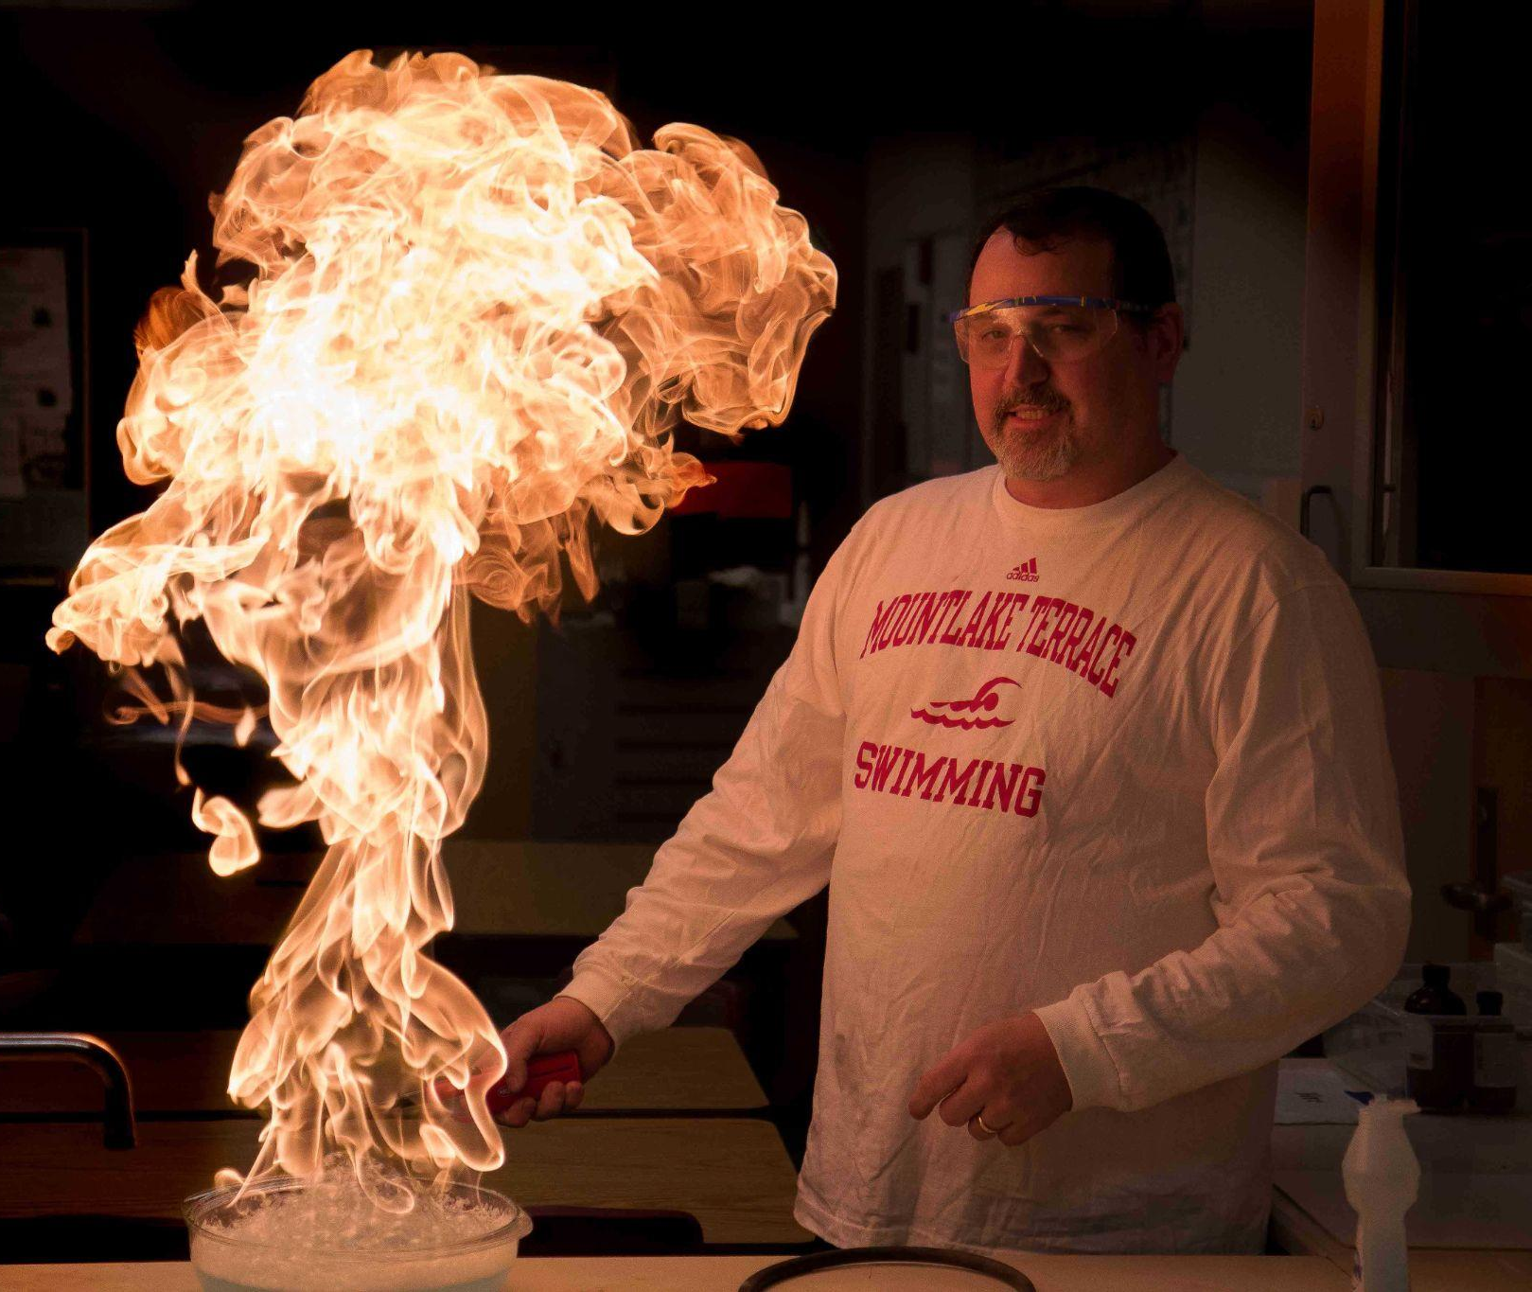
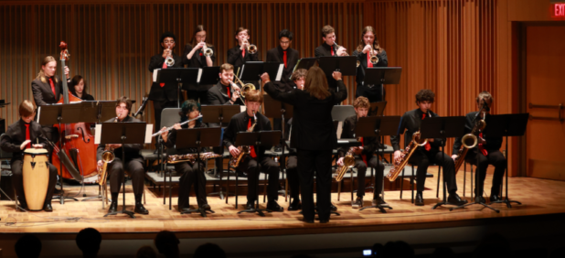
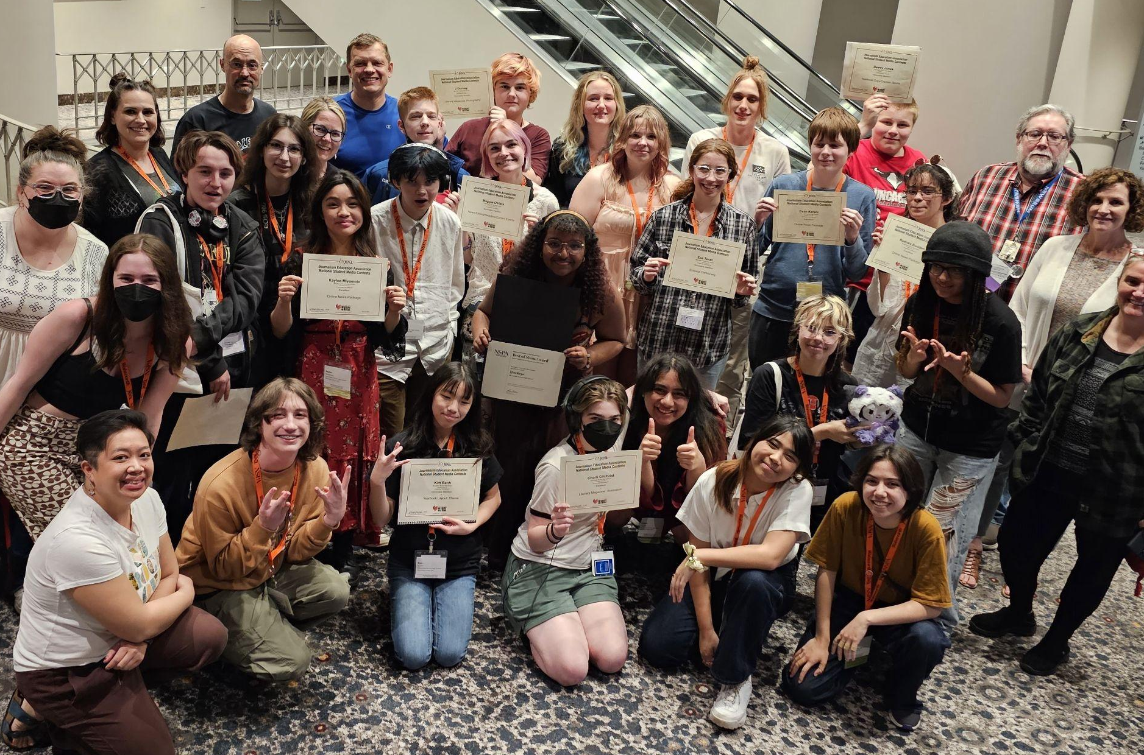
MTHS Beyond STEM
Notes:
James

Slide 16
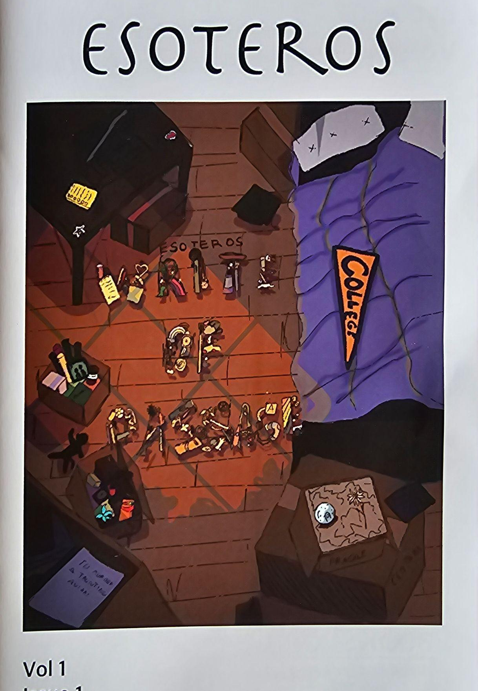

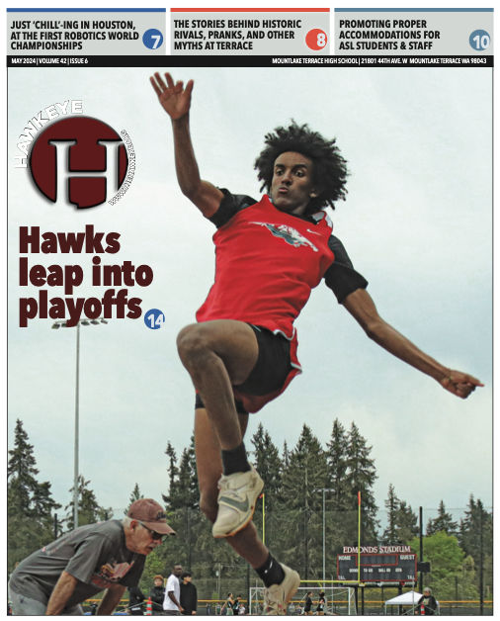
MTHS Humanities
Humanities @ Terrace
Honors as a block class in grade 10 with combined English & Social Studies
Gives students more time with the subject and cross-disciplines for deeper understanding of literature and history and how they are interconnected
Journalism (CTE 7th Period)
Website building
Adobe Suite (Indesign, Illustrator, Photoshop, etc.),
Art and graphic design
Yearbook (layout & design)
Photography (also separate photography classes)
Only school in district with a print and web program
Awards: *National & *Local
No prior experience required
HBN
Broadcasts news, live sports & podcasts
Creative Writing Club & Literary Magazine
We provide a creative outlet for all forms of art
Submissions are open to ALL students @ Terrace
Notes:
DeMiero: 3 minutes

Slide 17
MTHS Science Department
Science Classes at MTHS:
Dual credit / Advanced Placement courses in:
  Chemistry/Honors/AP
  Biology/Honors/AP
  Physics/AP
  Anatomy and Physiology (dual)
  Biotechnology (dual)
Also offered
Earth and Space Physical Science
Zoology Astronomy
Science Curriculum Highlights:
Emphasis on a “hands-on approach”
Advanced lab grade equipment:
  Pipettes
  Spectrophotometers
  DNA analysis/Gel electrophoresis
  PCR machines
  Dissection
Goals:
Prepare students for college
Teach modern ideas
Teach methods used in advanced scientific laboratories
Notes:
Traxler: 2 minutes - No updates needed

Slide 18
MTHS Math Department
Our Department’s Focus: Making one’s thinking clear to others while developing mathematical, communication, and collaborative skills
Other Notes:
Secondary Emphasis: not preparing students for a test, but for work with others
True Learning: By students who are proficient, our math SBA results are top in Edmonds School District
Flexibility: Students can jump immediately into Honors (or non-Honors) classes
...all the way up to AP Calculus AB and BC, AP Stats
Notes:
Traxler: 2 minutes

Slide 19




College Credit in High School
10+ AP course options - college credits can be earned through high end of course exam performance.
18+ CHS course options - college credit earned by passing the class.
Running Start is compatible with STEM Program and allows for accelerated college credits.
Notes:
Smelcer

Slide 20
College Credit in High School
AP Chem Results (53)
3-19, 4-17, 5-6 (82% Passing)*
AP Physics Results (32)
3-4, 4-6, 5-17 (84.4% Passing)*
AP 2023 Bio Results (53),
3-19, 4-13, 5-10 (79% Passing)
AP Computer Science: AP CS Principles (43)
3-20, 4-6,5-7 (76.7% Passing)
AP Computer Science A (19),
3-6, 4-5, 5-3 (73.7% pass rate)
CHS free AND transferable college credits
Among the highest passing rates in the state
Notes:
Smelcer

Slide 21
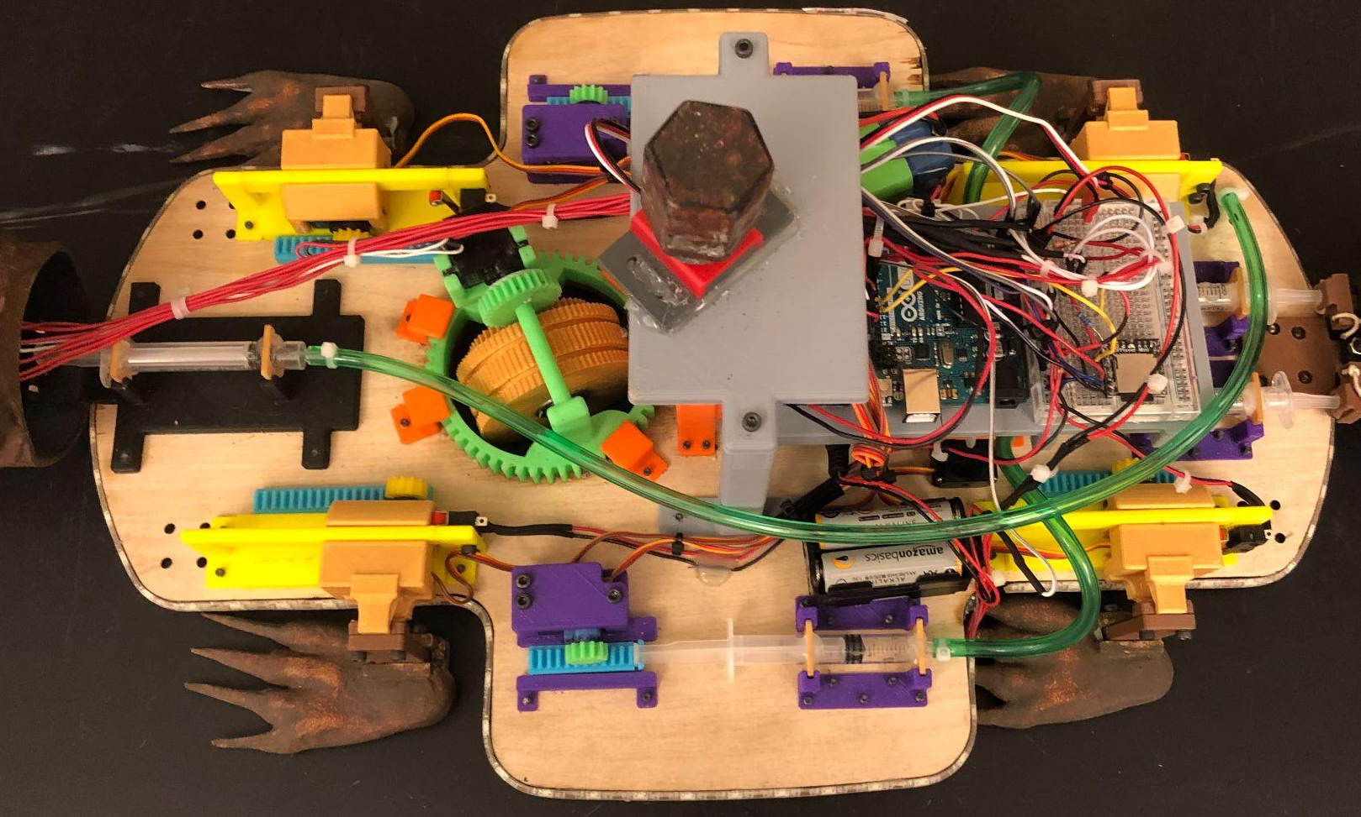
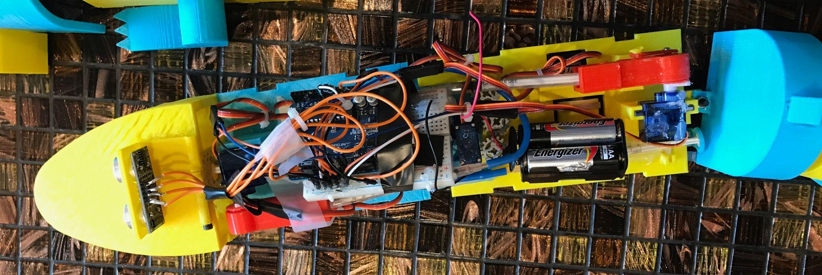
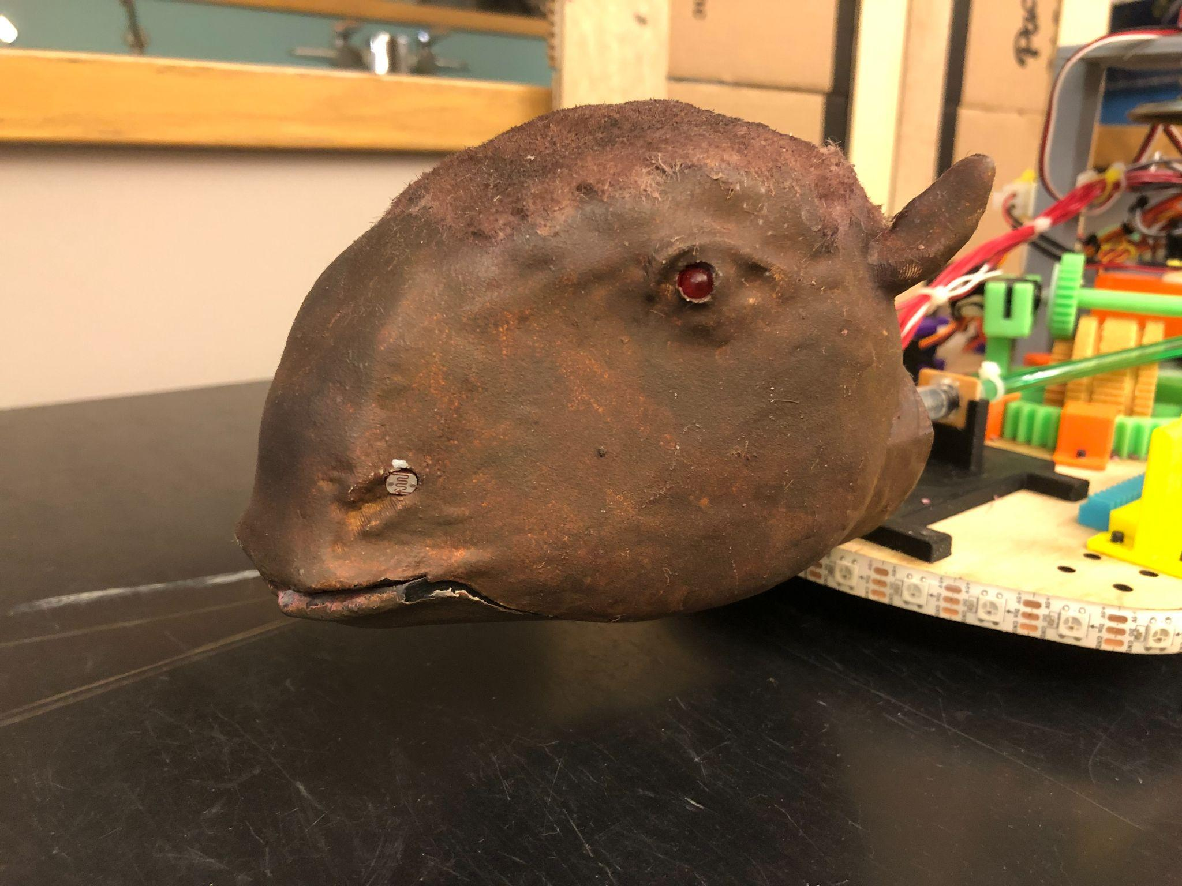
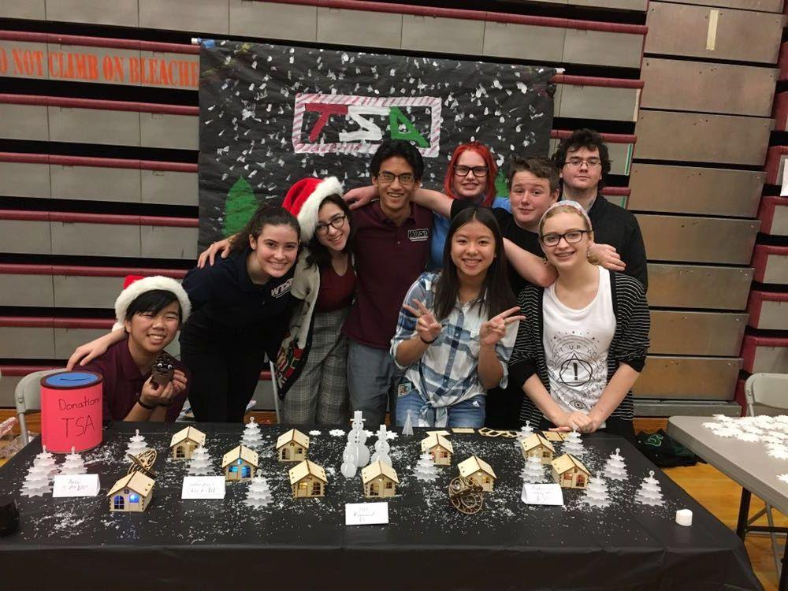
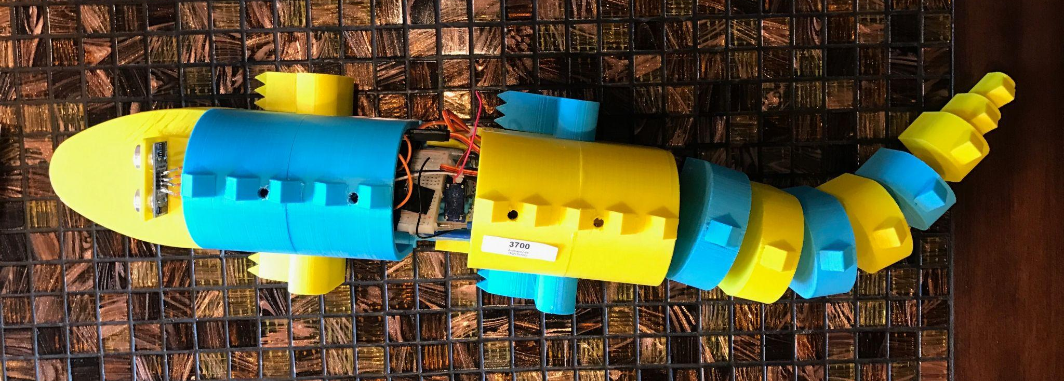
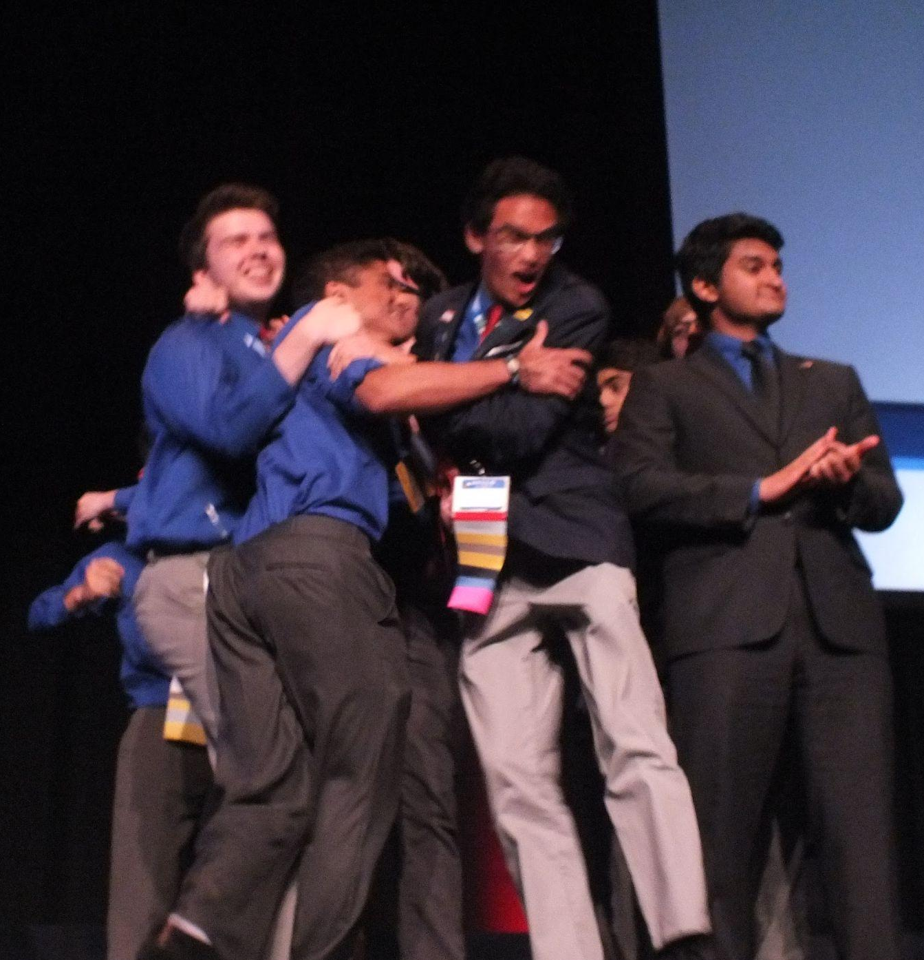
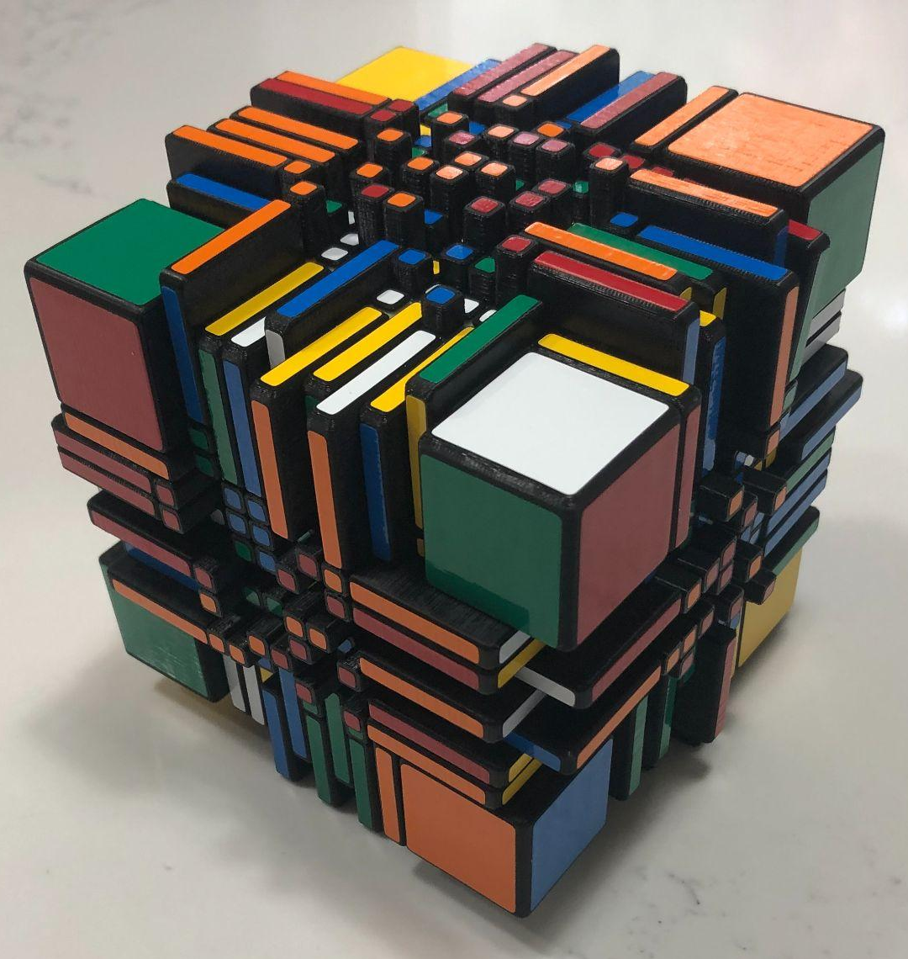
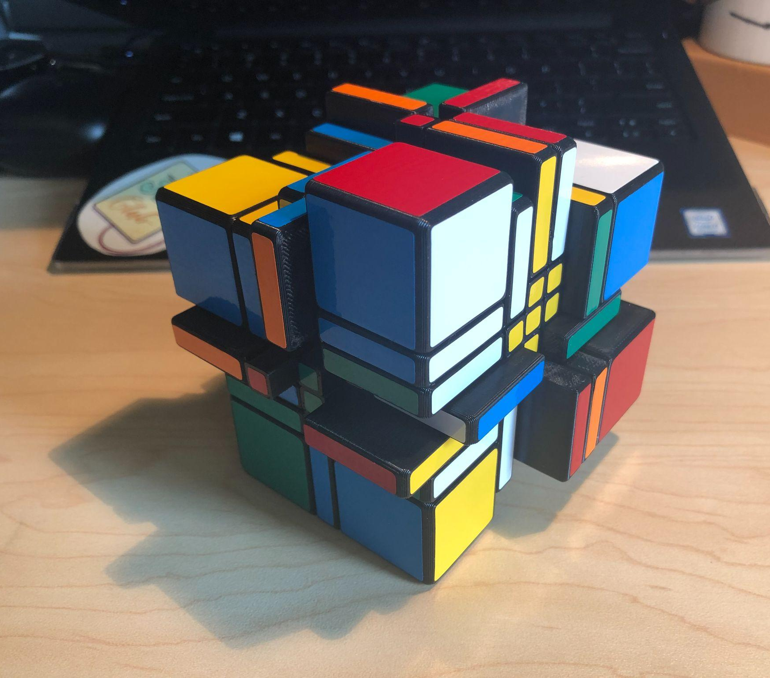
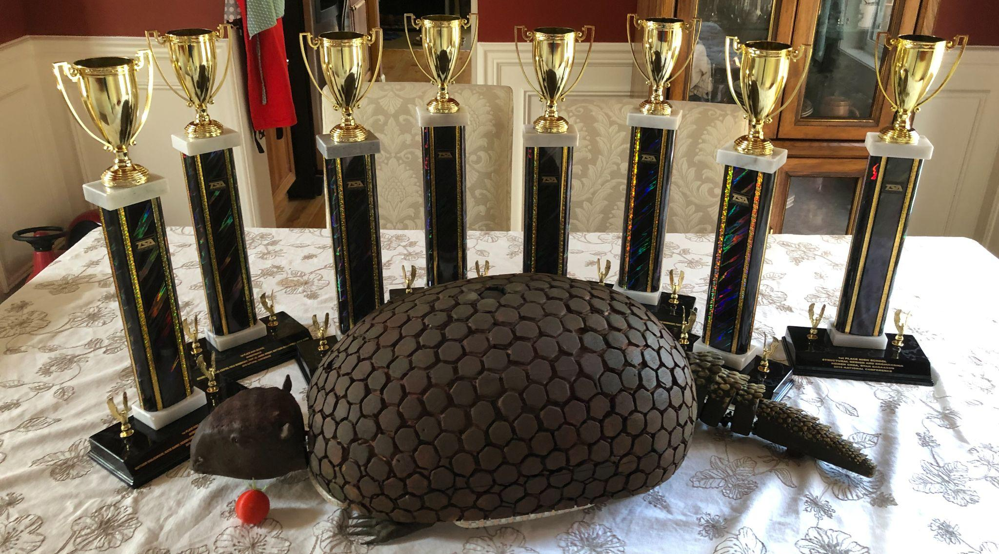
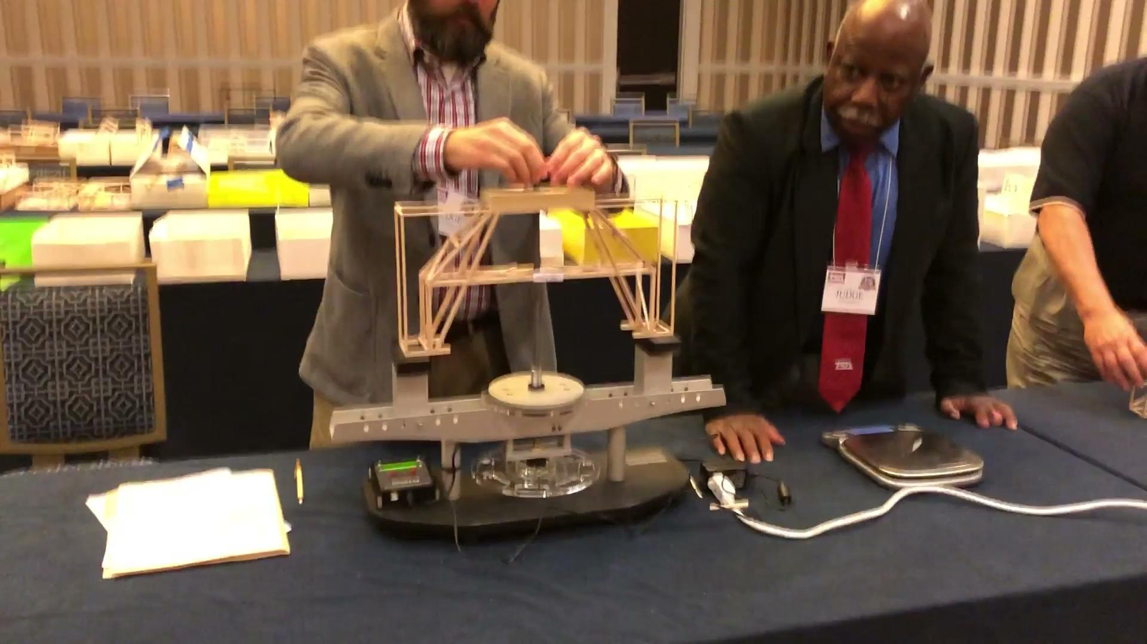
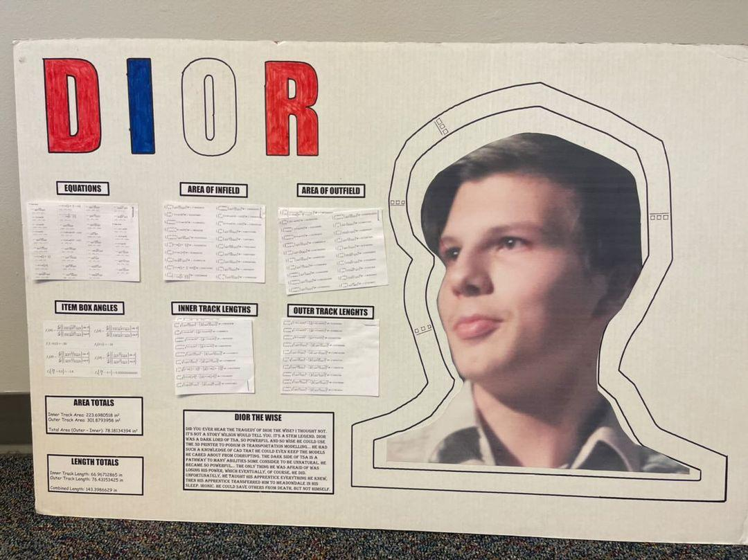
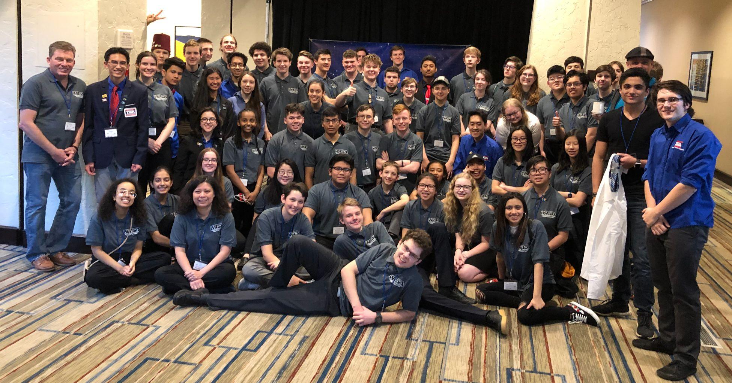
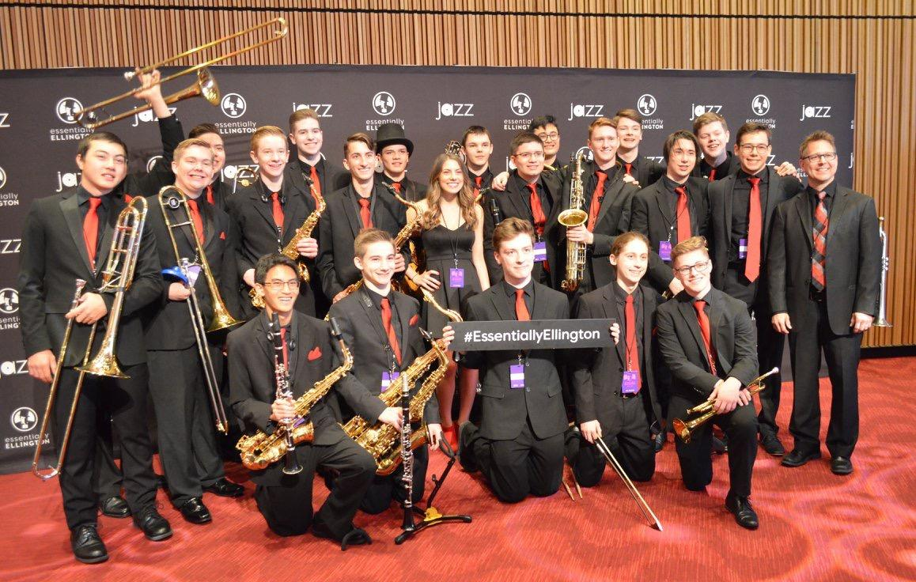
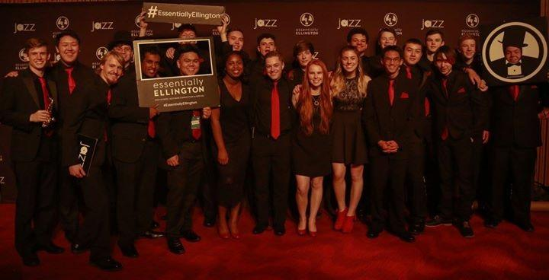
Alumni: Reiden Chea
Notes:
4 -5 minutes
Outline:
Focus on outcomes in my future, less about the projects themselves
Emphasize opportunities as they applied to my career/success

Slide 22

AP: Mins for Maxes
Sophomore Year:
AP World: 3
AP Chem: 5
AP CSP: 3
Senior Year:
AP Bio: 4
AP CalcAB: 5
AP Gov: 3
Junior Year:
AP US: 3
AP Stats: 3
AP CSA: 4
AP Lang: 3
Total UW Credits: 69 ($18,092 @ $262.20/Credit)
Toss in CHS* → 90 credits = JUNIOR standing on entry
*College In the High School is now free!
Notes:
Smelcer

Slide 23




English 12 STEM (Capstone)
Curricular Highlights:
Writing, reading, speaking and listening
Emphasis on technical writing and
professional presentation
District designed and approved honors level course
Students work with a mentor to choose an engineering/science research project
Notes:
Smelcer

Slide 24


Competition Drives Innovation
Students are required to present in three competitions:
Central Sound Regional Science and Engineering Fair (CSRSEF) - MTHS is hosting this year!
Washington State Science and Engineering Fair (WSSEF)
International Science and Engineering Fair (ISEF)
STEM Expo
Currently implementing research into underclass STEM classes to
create opportunities for:
Science Talent Search (STS)
Junior Science and Humanities Symposium (JSHS)
Notes:
Smelcer

Slide 25
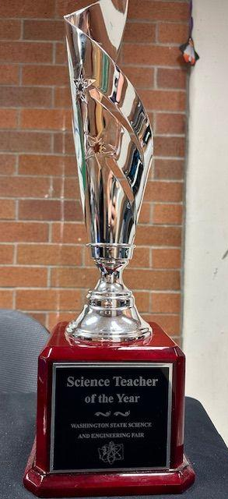
WSSEF Washington State Science & Engineering Fair
Notes:
Smelcer

Slide 26
STEM Results
Our STEM students have been admitted to:
Cal Poly
Colorado School of Mines
Penn State
UW (direct to Engineering)
Berkeley (direct to Bio)
Georgia Tech
Embry-Riddle (AZ and FL)
Seattle University
US Naval Academy
Wellesley
Purdue
USC
Carnegie Mellon
Our STEM students are majoring in:
Mechanical Engineering
Electrical Engineering
Astronautic Engineering
Computer Science
Computer Engineering
Chemical Engineering
Biology
BioEngineering
Physics
Economics
Music
International Relations
Notes:
Smelcer

Slide 27


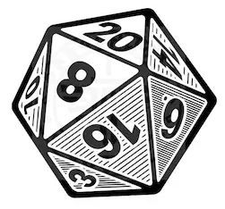
STEM Community at MTHS
STEM Community Building
  Movie Nights
  Quarterly Game Nights
  Other Social Events
  Club Competitions
  Mentoring opportunities at Edmonds Elementary Schools
Students enjoy being together… after school the department is typically busy!
  Working/chatting with teachers
  Leadership/club meetings
  Side projects
  Additional work time
Parent Involvement
  FRC
  TAC
  STEM Boosters
Notes:
James
STEM Students are enjoying a very strong camaraderie. A great example is our shop after school… it’s often very busy with energized students working on projects from both classes and clubs. It is really an inspiring place to be. Our clubs are a great place for student to… strong and vital.

Slide 28
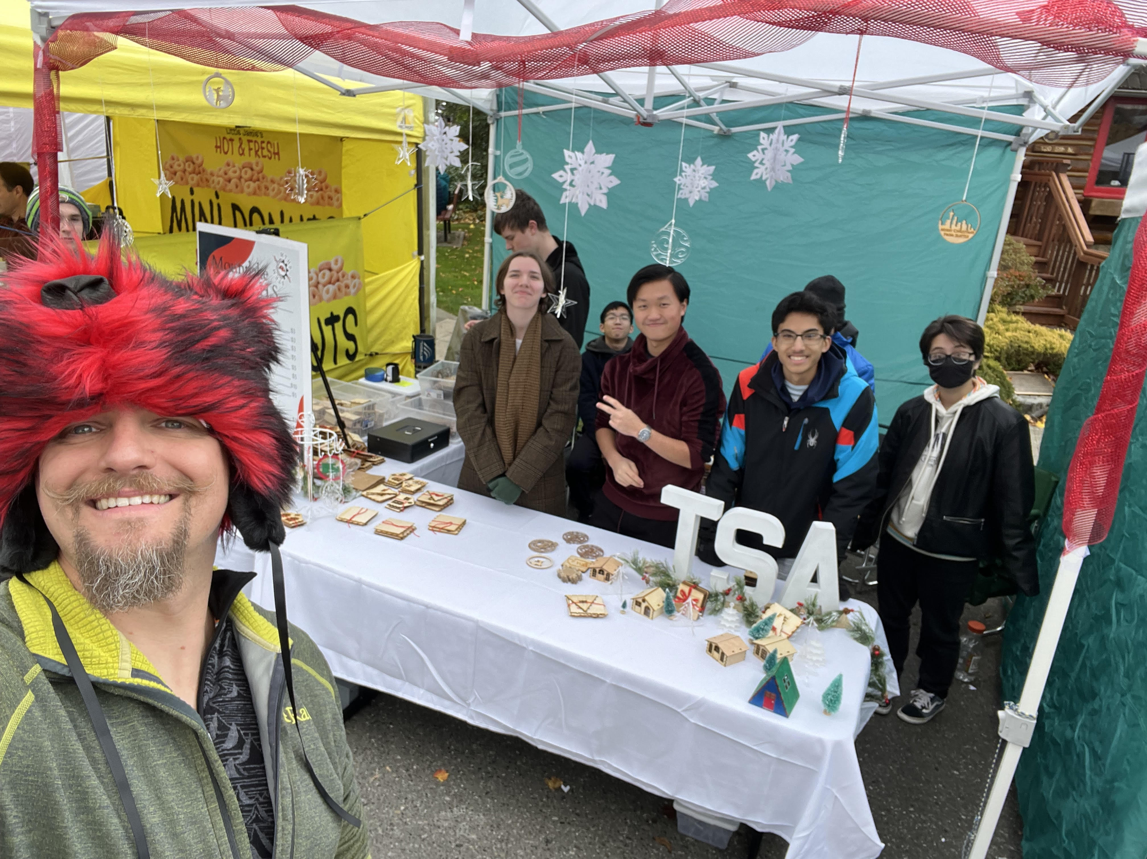
STEM Community at MTHS
Notes:
James
STEM Students are enjoying a very strong camaraderie. A great example is our shop after school… it’s often very busy with energized students working on projects from both classes and clubs. It is really an inspiring place to be. Our clubs are a great place for student to… strong and vital.

Slide 29
STEM Program Timeline
January 31st
Online STEM Program Applications Due
End of Feb.
All 8th Grade Registration Forms Due
Mid February
Notes of admittance to the STEM Program mailed out
In-area students: Normal registration process in February; sign up for “IED” and indicate participation in the MTHS STEM program on your form.
STEM Program Application forms are required from all interested 8th grade students… both in-area and out-of-area students.
Late applications to the STEM program will be given consideration
Notes:
James
Update

Slide 30
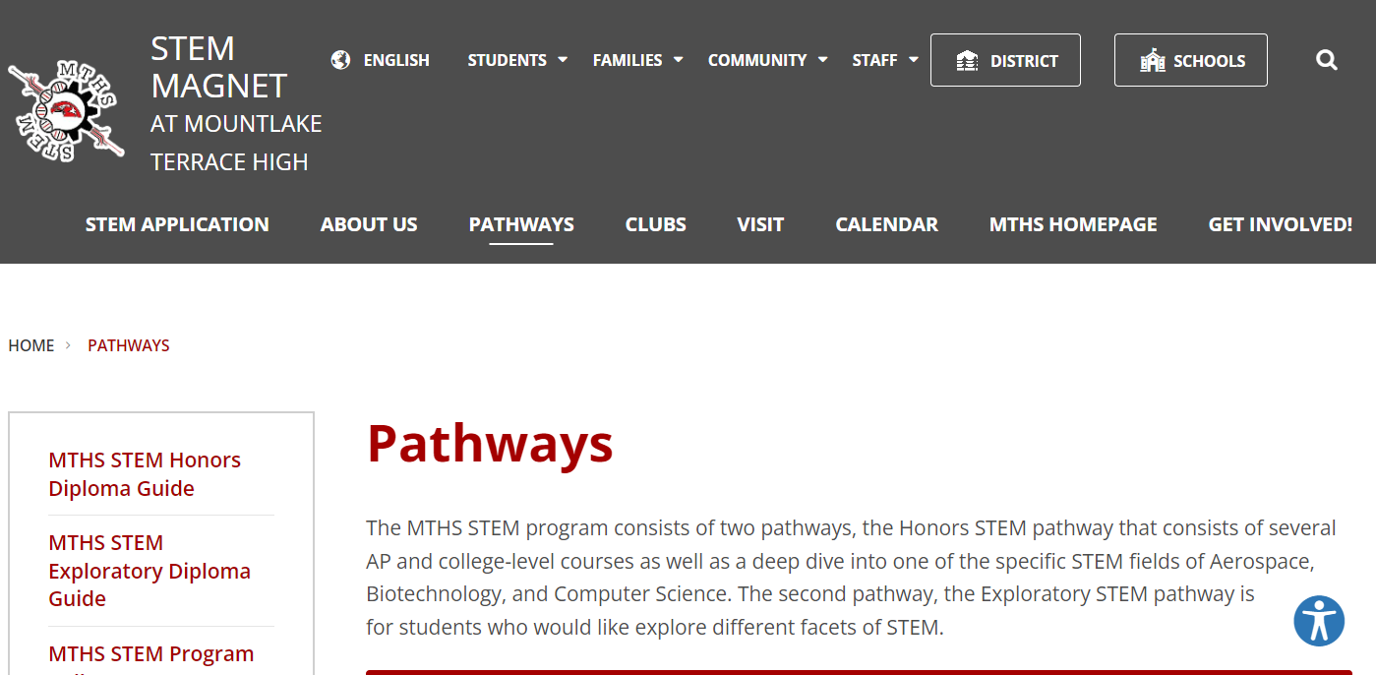
MTHS STEM Website
Notes:
James
Update

Slide 31

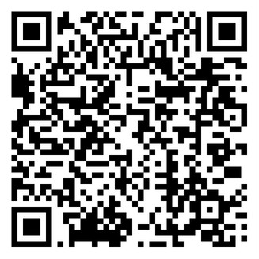
STEM Application 2024-2025
Registration live now!

