Slide 1
MCSD Construction Update
November 12, 2024
Ward Odom
Senior Director Plant Services / Construction

Slide 2
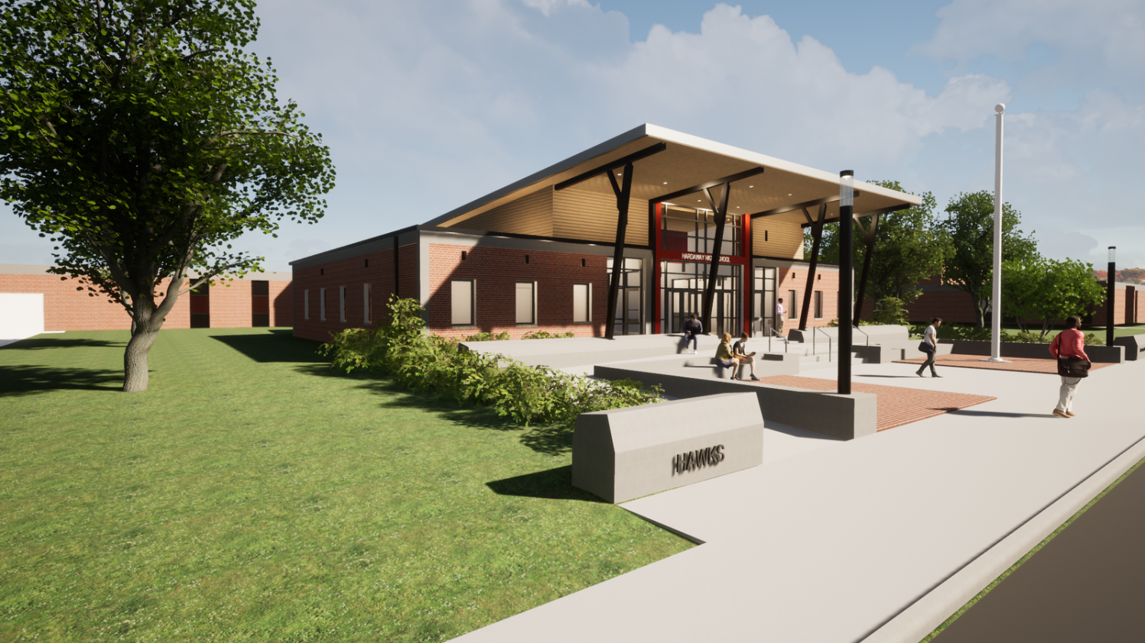
Hardaway Addition/Upgrade
Estimated Completion: Winter 2024/2025
Rendering

Slide 3
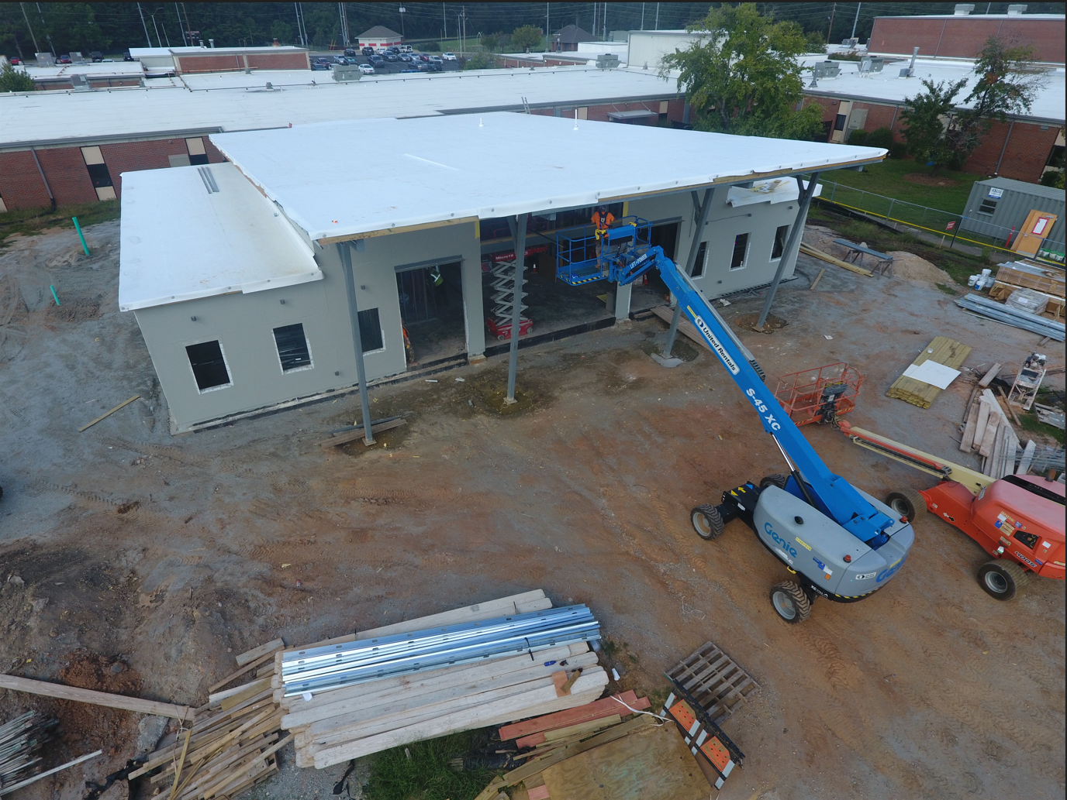
Hardaway Addition/Upgrade
Estimated Completion: Winter 2024/2025

Slide 4
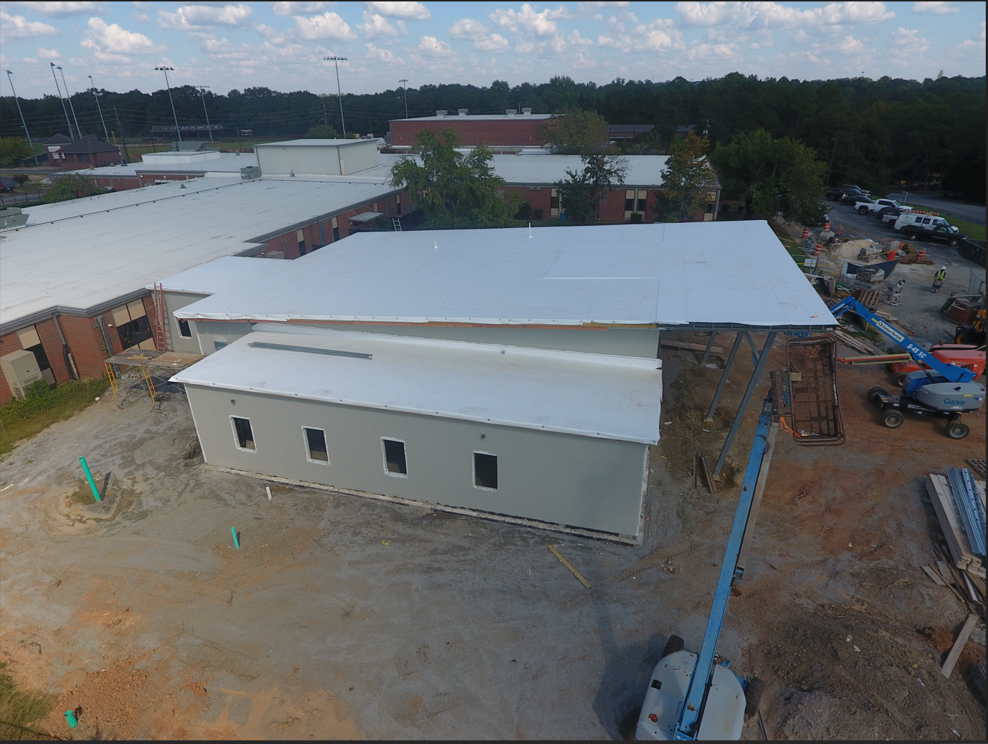
Hardaway Addition/Upgrade
Estimated Completion: Winter 2024/2025

Slide 5
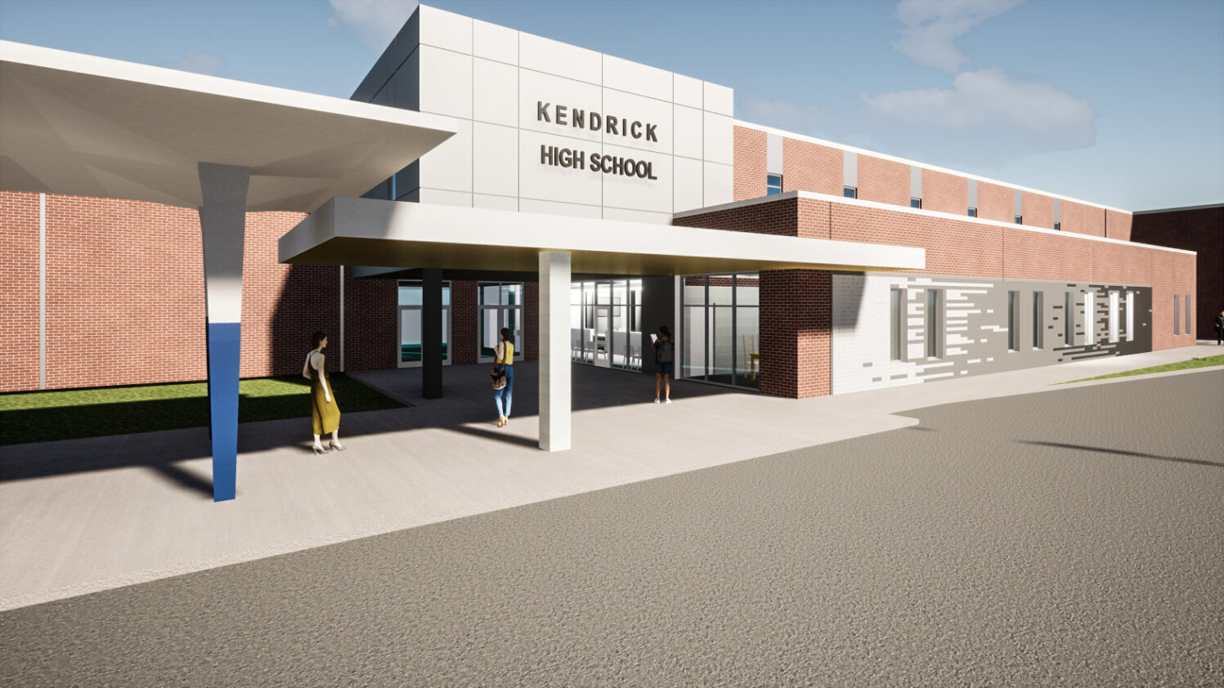
Kendrick Addition/Upgrade
Estimated Completion: Fall 2024
Rendering

Slide 6
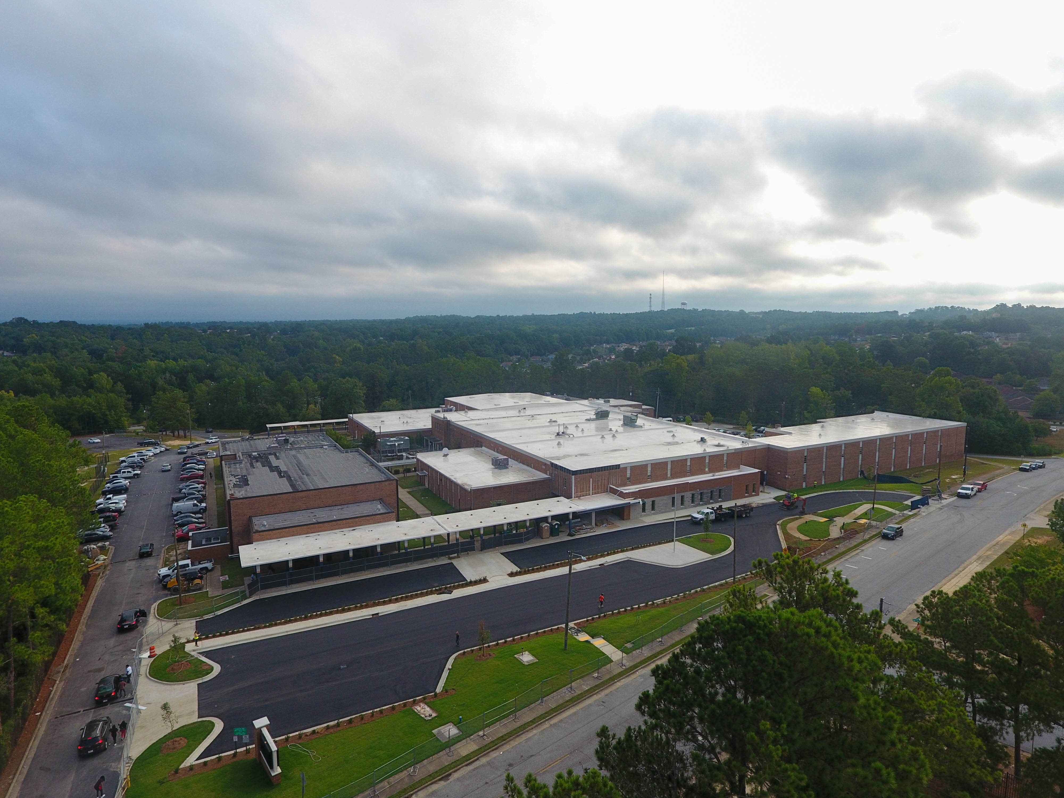
Kendrick Addition/Upgrade
Estimated Completion: Fall 2024
Front Driveway Entrance
Main Office Addition

Slide 7
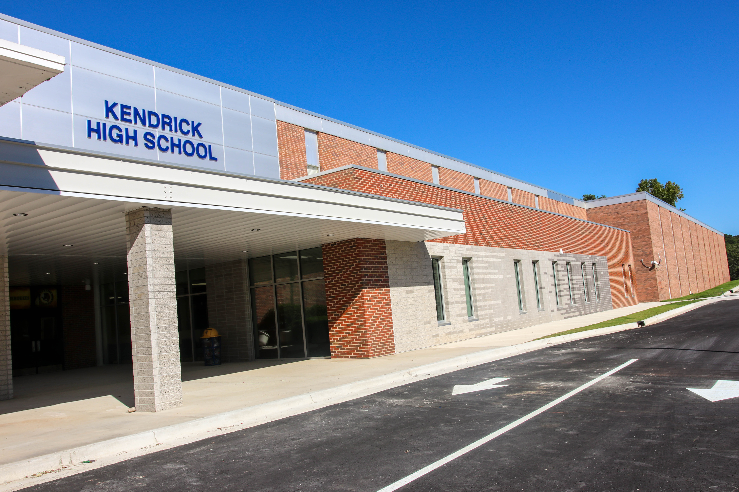
Kendrick Addition/Upgrade
Estimated Completion: Fall 2024

Slide 8
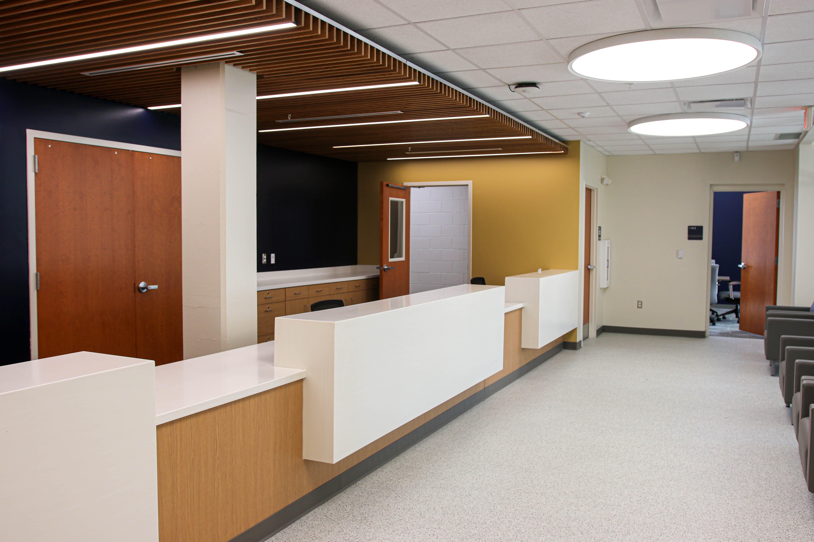
Kendrick Addition/Upgrade
Estimated Completion: Fall 2024

Slide 9
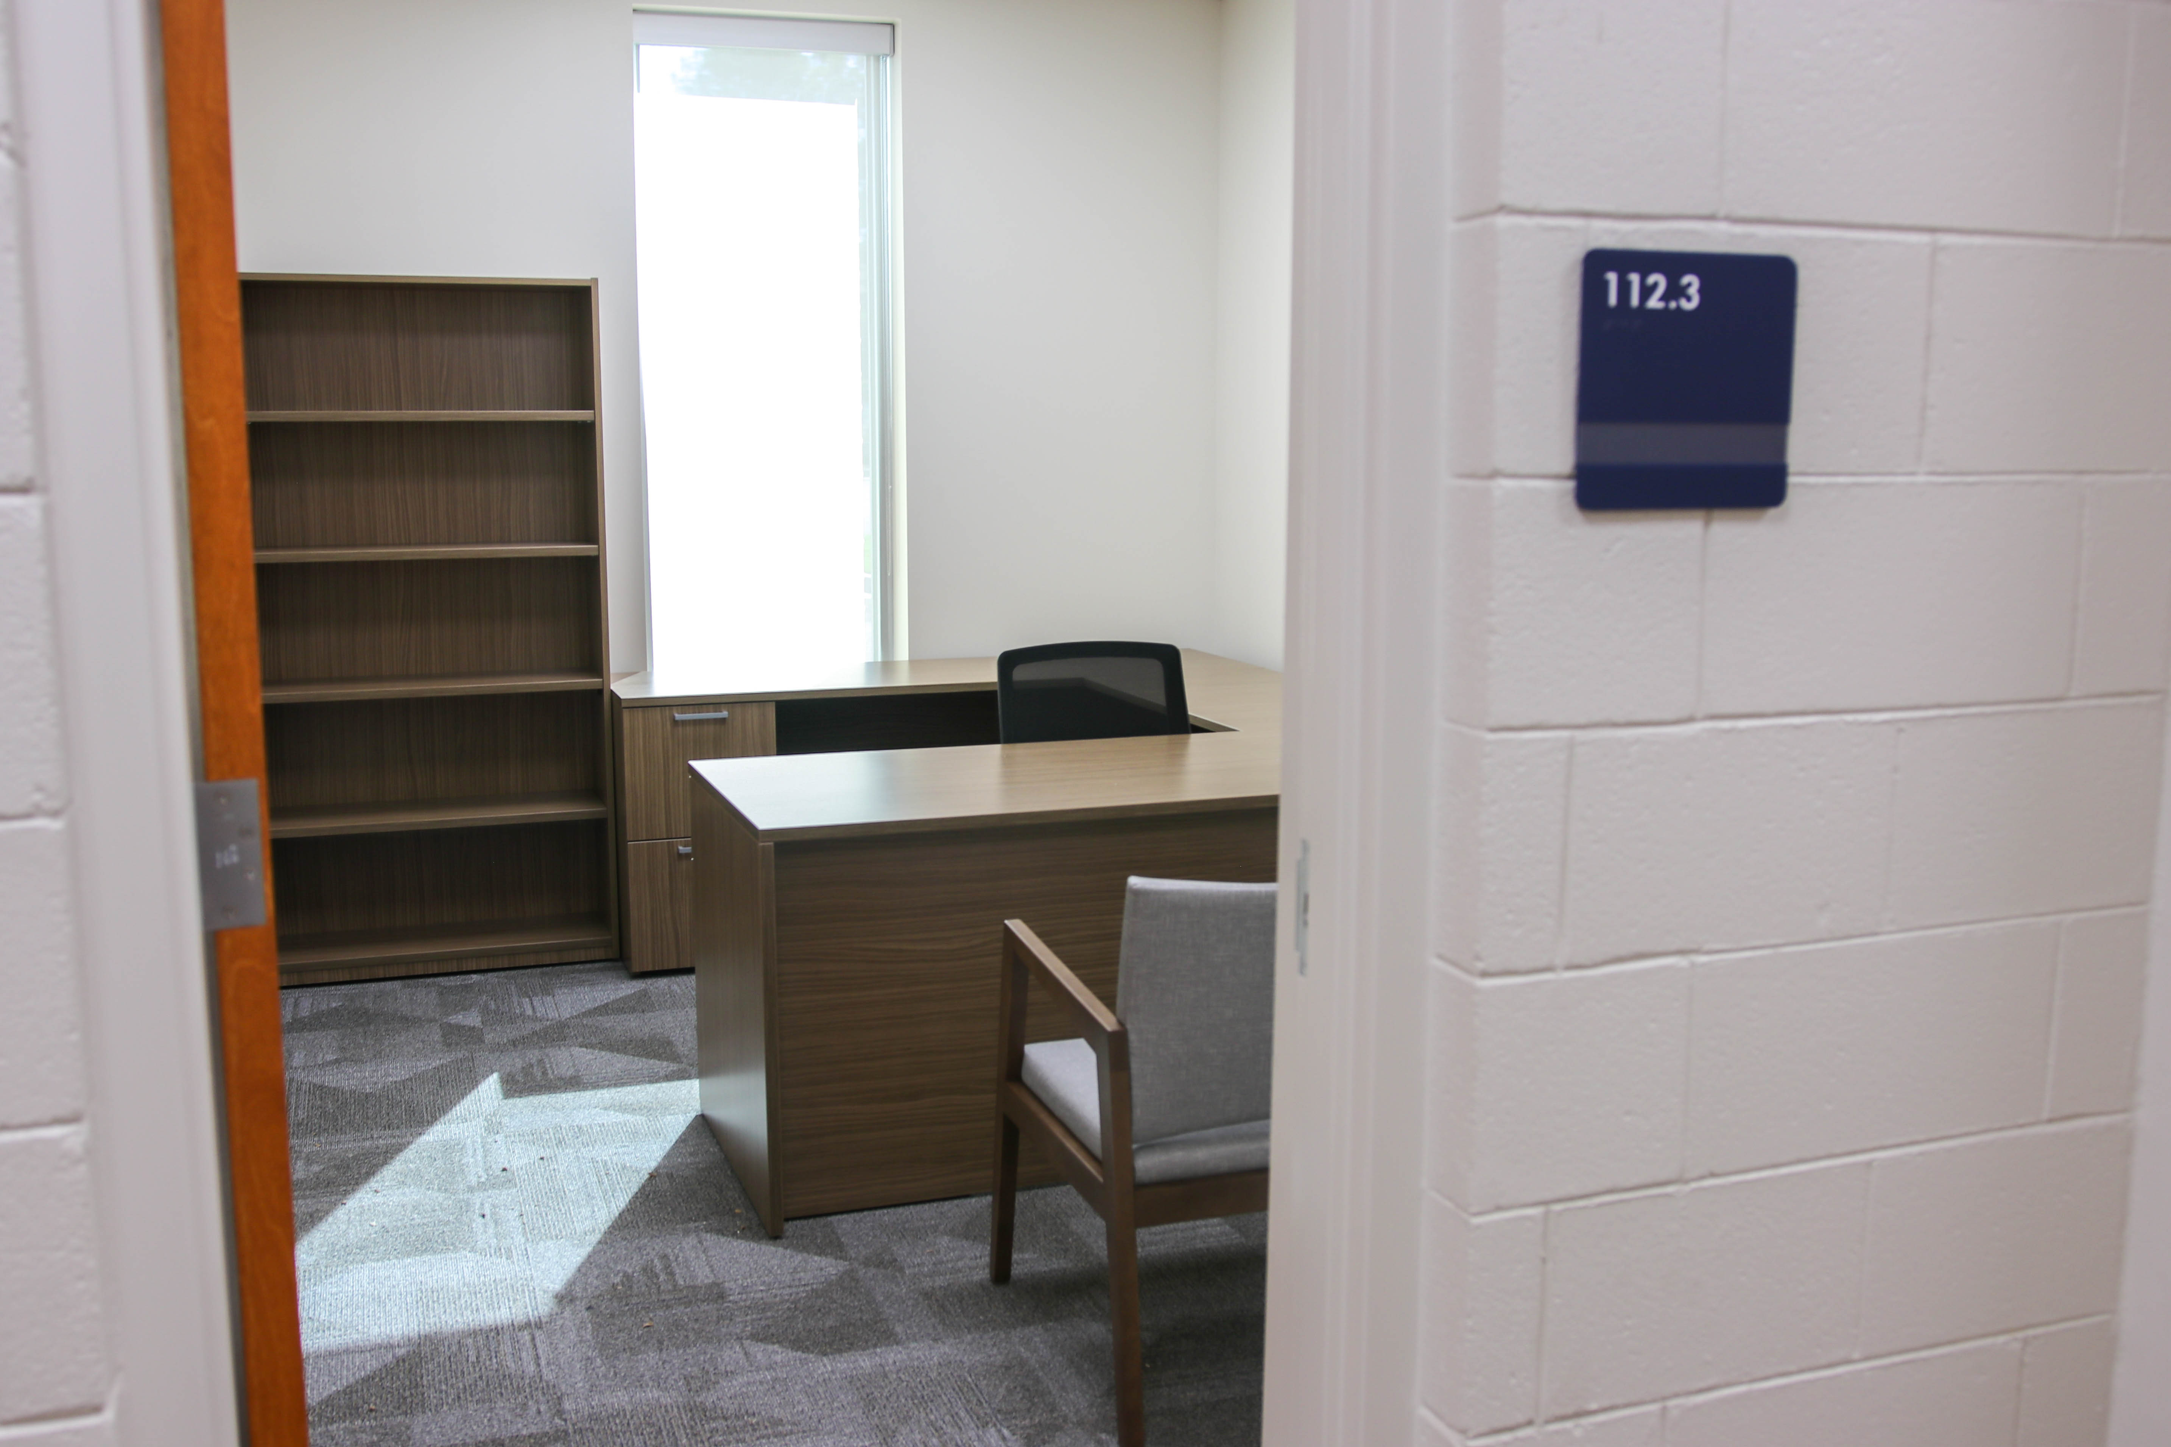
Kendrick Addition/Upgrade
Estimated Completion: Fall 2024

Slide 10
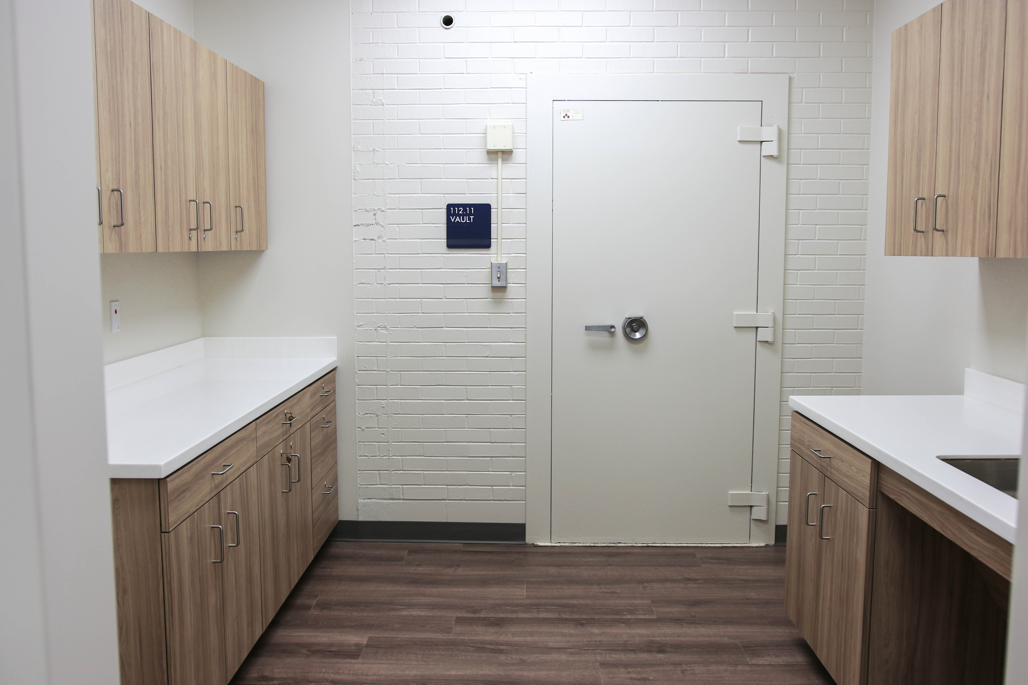
Kendrick Addition/Upgrade
Estimated Completion: Fall 2024

Slide 11
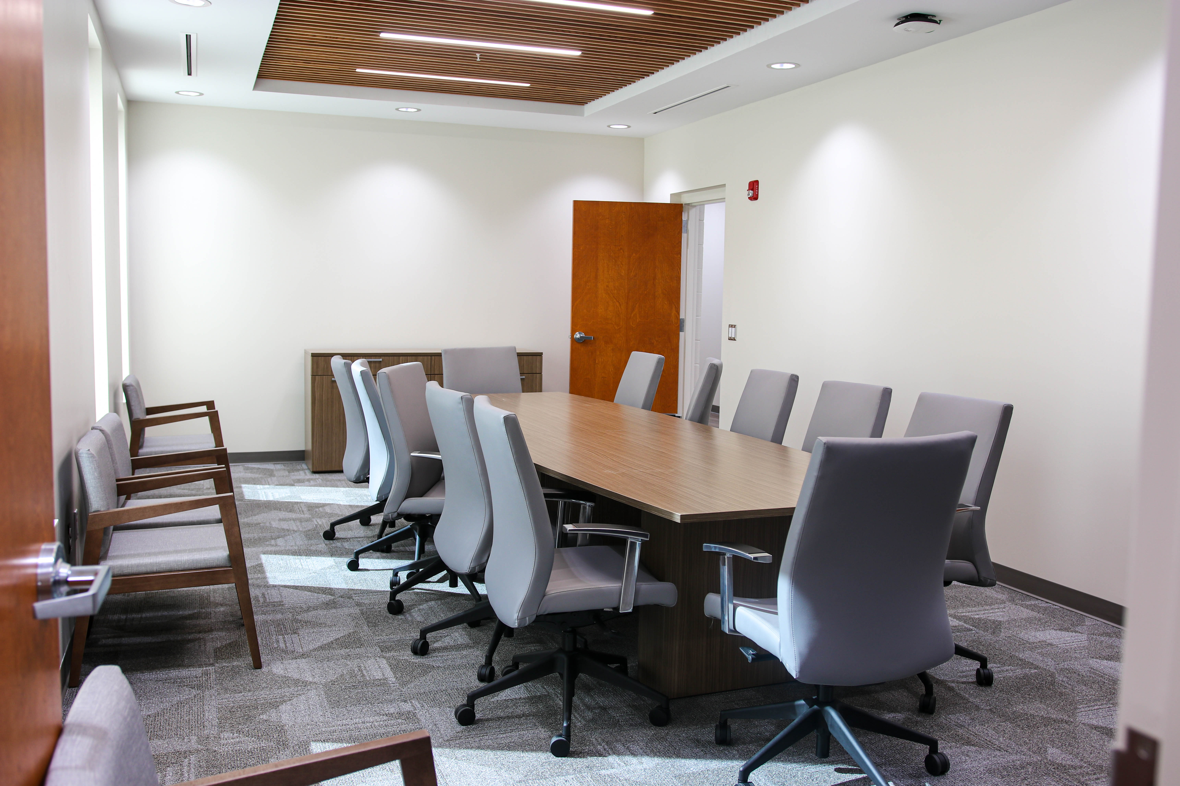
Kendrick Addition/Upgrade
Estimated Completion: Fall 2024

Slide 12
Kendrick Addition/Upgrade
Estimated Completion: Fall 2024

Slide 13
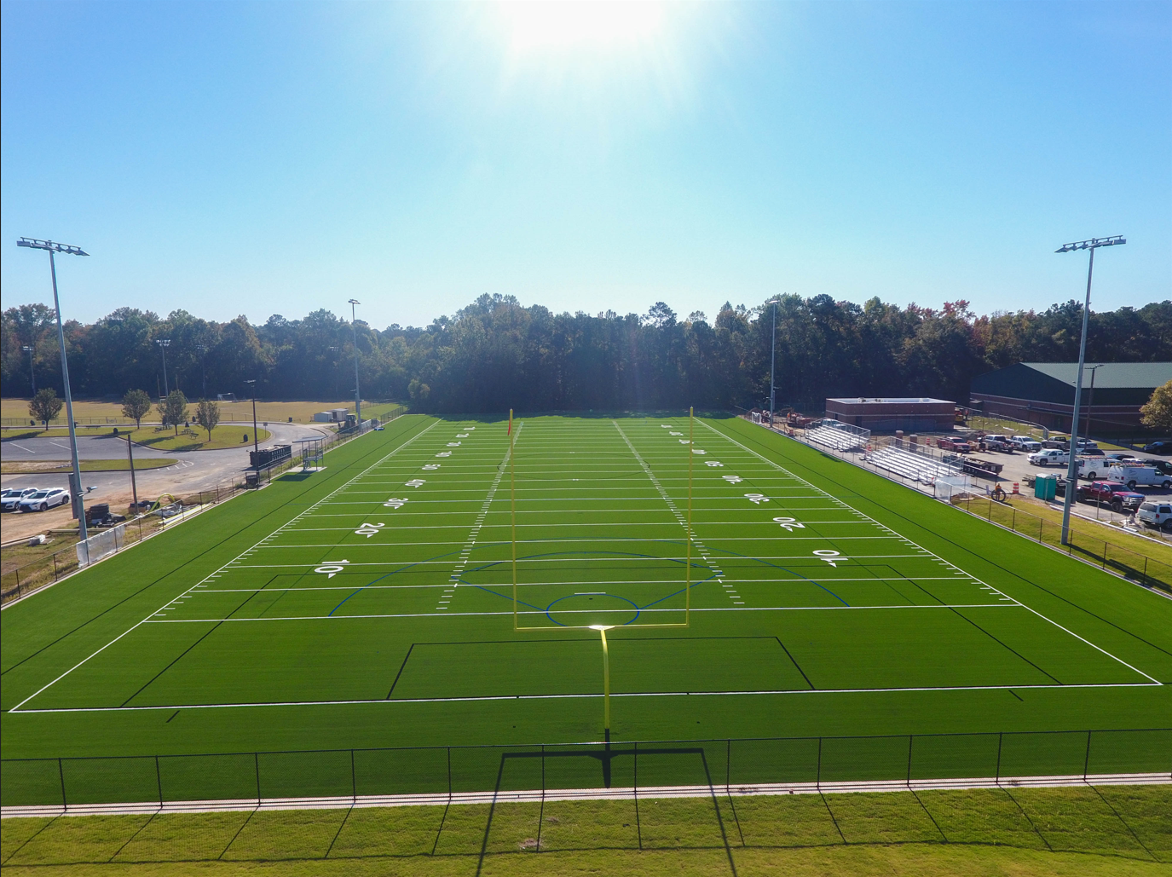
Midland Middle School Athletic Field Upgrade
Estimated Completion: Winter 2024/2025

Slide 14

Additional Projects
Secure Vestibules
  Estimated Completion: (Phase 1):
Winter 2025/2026

Slide 15
E-SPLOST

