Slide 1

Course
Selection
25-26

Slide 2

welcome
MESSAGE
  Complete Course Request Form with all necessary signatures by the due date.
  Review the course catalog for all course prerequisites. You should also review your grades and transcript.
  Students classified as English Learners will be assigned to an ELD course, taking place of one elective.
  AP courses MUST have AP Contracts completed.
  Leadership, AVID and Yearbook require an application!
  TAs or Lab Assistants MUST submit a TA or Lab Assistant permission slip with your course selection form.
  Students cannot request lunch, class period or teachers.
  If your Course Request Form is not turned in by your due date, your counselor will choose for you (courses cannot be changed).
  WHEN YOUR SCHEDULE IS FINALIZED, IT WILL NOT BE CHANGED.
Course Selection Info

Slide 3

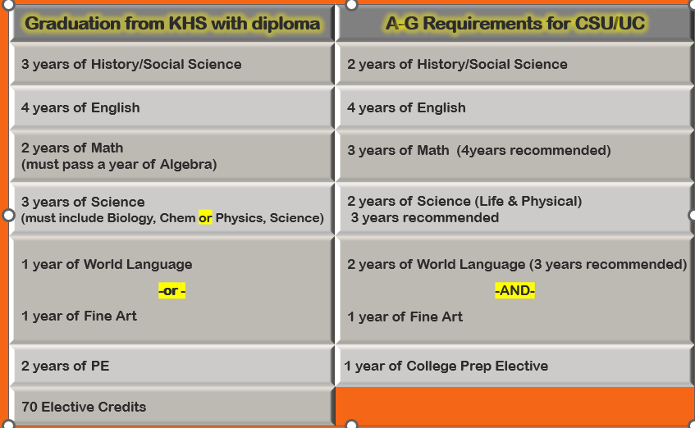
Grad v. A-G

Slide 4
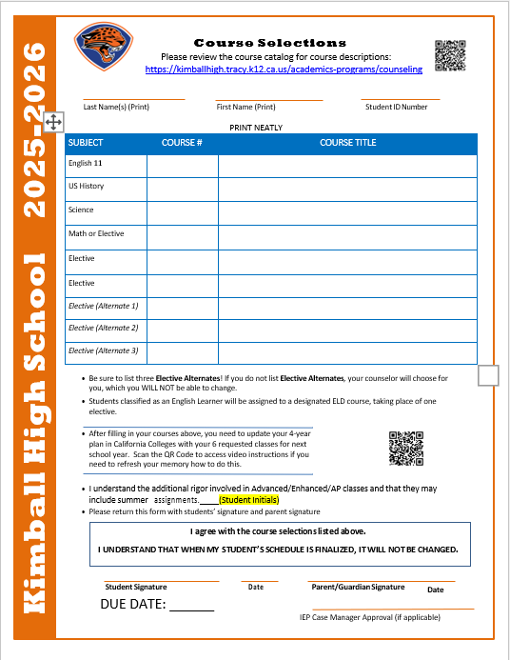

Course Selection Sheet

Slide 5

Requirements by Grade Level
10th Grade
English
World History
Chemistry or Physics
Math
PE
Elective
11th Grade
English
US History
Science
Elective
Elective
Elective
12th Grade
English
Econ/Govt
Elective
Elective
Elective
Elective

Slide 6

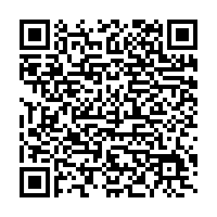
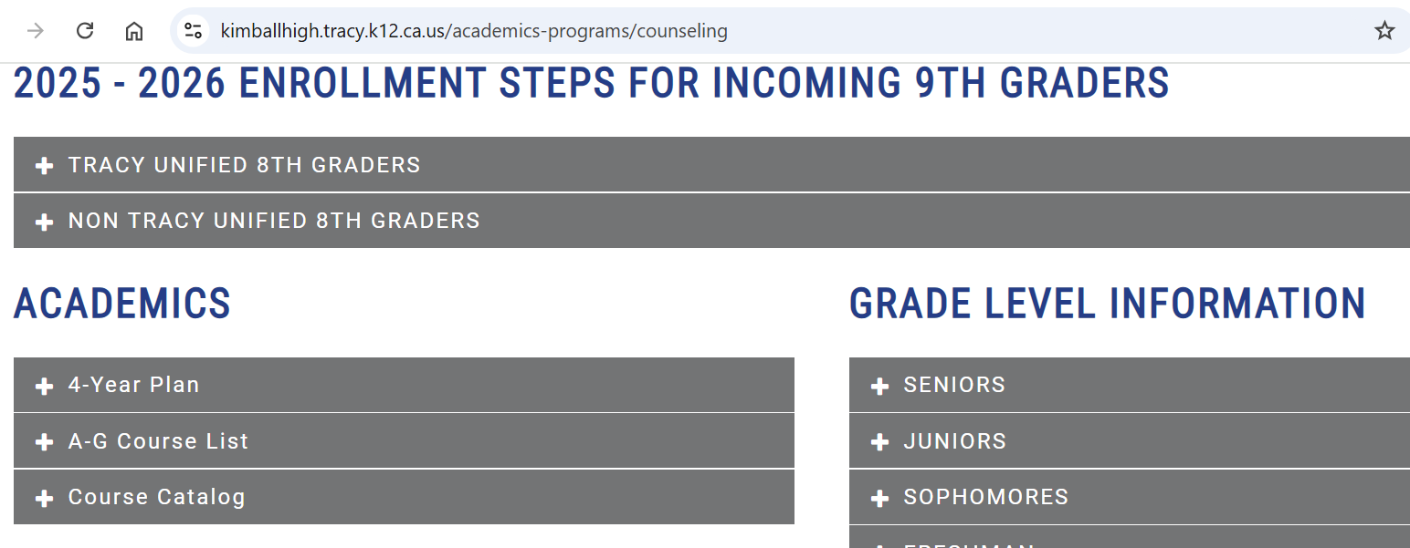
Course
GUIDE

Slide 7

New Classes
AP MUSIC THEORY
SPANISH 4
ADV PIANO
DIGITAL PHOTOGRAPHY 2
DANCE CHOREO
EMR
ACCOUNTING PRIN

Slide 8



Credit Recovery
Minimum Credits as of now
10th grade – 40 credits
11th grade – 100 credits
If you are missing credits…
- Summer School
- Edgenuity
- Online @ BYU or SVHS
- Adult School 11th/12th
-Stein High School
*All options require prior counselor approval*

Slide 9

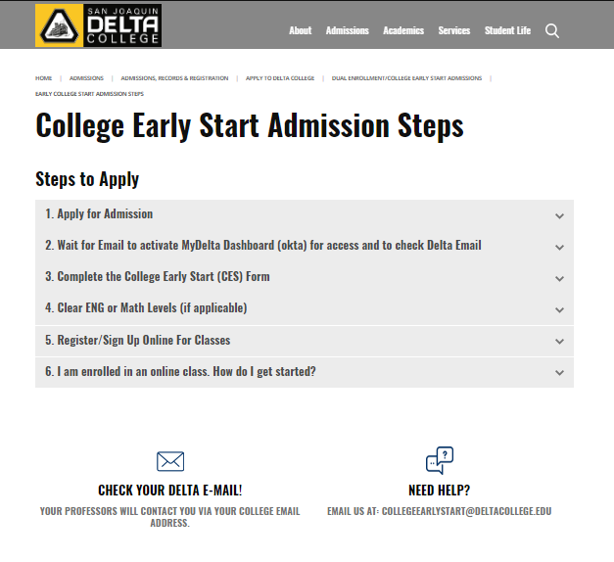
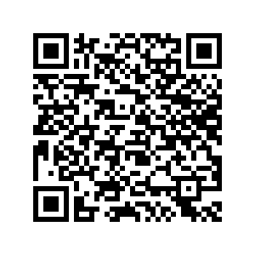
Can I take
College Classes?

Slide 10

Pick Up
Juniors - Tuesday, Jan 14th
Sophomores - Wednesday, Jan 15th
Freshmen - Thursday, Jan 16th
**Bring your laptop**
*You will come to the library with your English classes

Slide 11


Follow KHS Counseling on Instagram

