Slide 1
Piedmont Unified School District
2018-19 Adoption Budget
Public Hearing
Board of Education
June 13, 2018

Slide 2
Impact to Piedmont Unified School District : Difference between January Proposal vs. May Revision
Item | January Budget for 2018-19 | May Revision for 2018-19
LCFF Gap Funding Percentage - Two years ahead of schedule of full funding LCFF | 100% | 100%
CCOLA PUSD | 2.51% | Statutory 2.71% + .29% additional LCFF Funding
Increase of LCFF funding over 2017-18 | Impact to PUSD: $565,028 | Impact to PUSD: $663,688 ($98,660 increase since January)
One-time Discretionary Funds | $1.8 billion $295/ADA | $2.02 billion $344 per ADA Impact to PUSD: $124,359

Slide 3
Highlights of the 2018-19 Publication Budget
1. Incorporated increase of LCFF and one time funds
2. Incorporated the 2% increase of School Parcel Tax in 2019-20 and 2020-21
3. A 3% salary increase for APT and APSA has been included in the 2018-19 Budget, at $600k and $80k respectively
4. Funds raised by PEF at $2,708,421 and Parent Clubs/Support Groups at $303,770, $276k or a 10% increase over last year
5. District enrollment is projected at 2,623, 69 students fewer than 2017-18; ADA is less by 33.01.
6. Reduction of $687k in personnel costs due to declining enrollment, attrition and program needs
    4.30 FTEs from Certificated
    7.43 FTEs from Classified
7. Reduction of $53k in contract services
  2019-20 and 2020-21:
  Additional budget reductions of $50k each from “Books and Supplies” and
  Services/Operating Expenditures”

Slide 4
2019-20 and 2020-20: Reserve Fund Balance
  2019-20:
  $24,687 over the minimum 3% Reserve to be applied in 2020-21
  2020-21:
  $478,909 or 1.16% short of the minimum 3% Reserve requirement ;
  Reserve is projected to be 1.84% or $762,279.

Slide 5
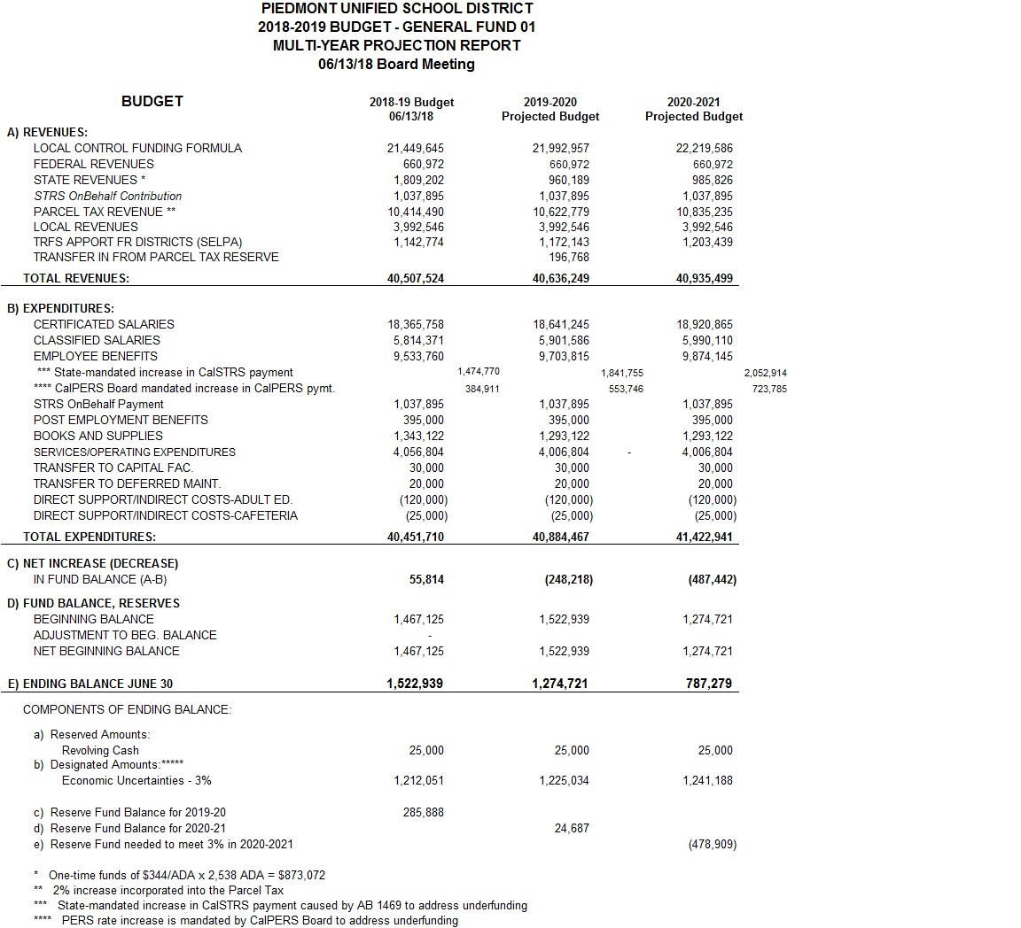

Slide 6
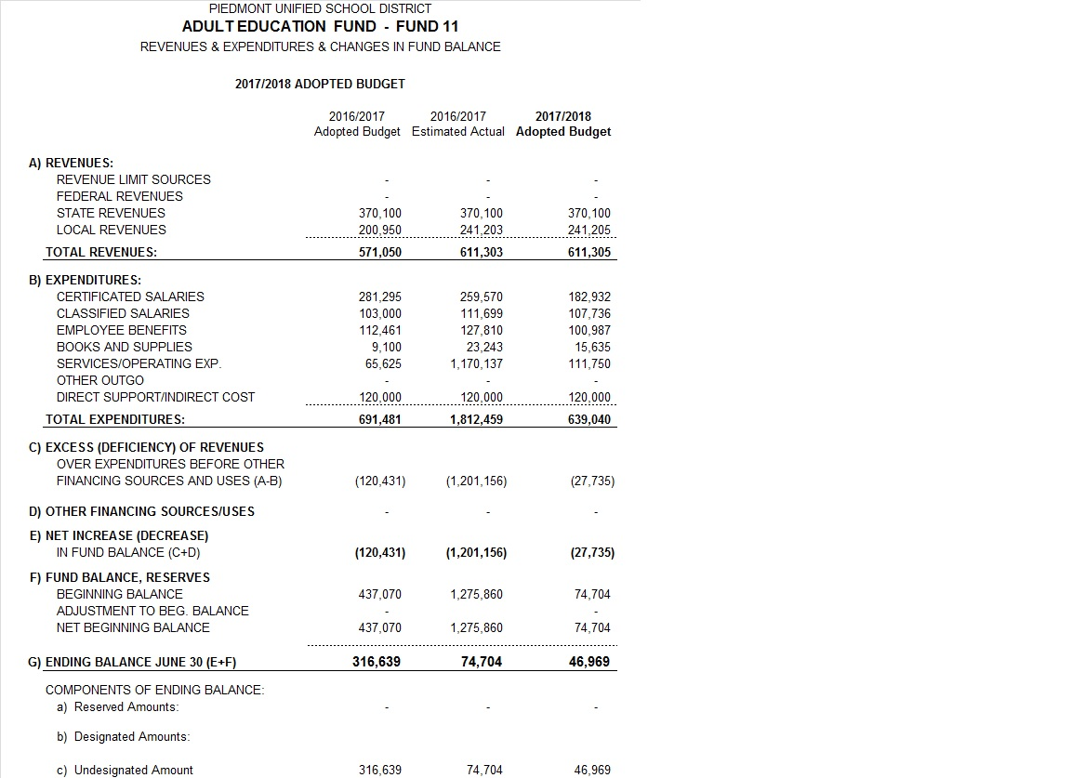

Slide 7
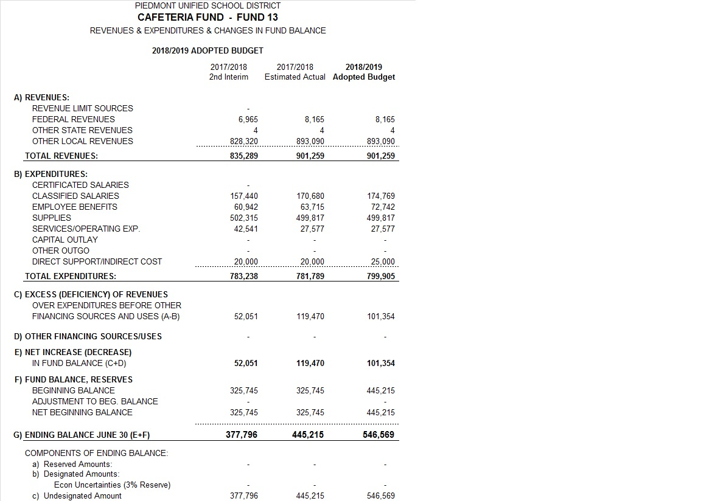

Slide 8
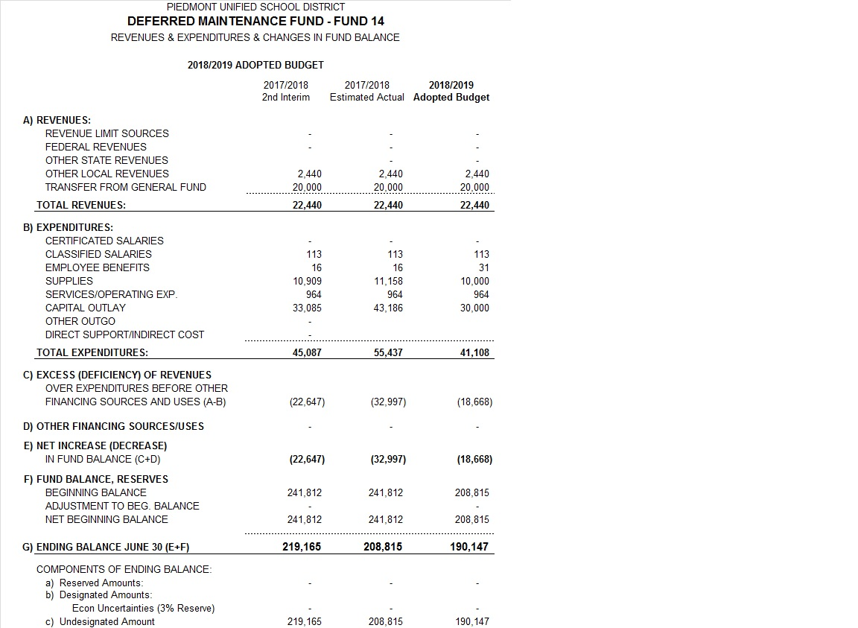

Slide 9
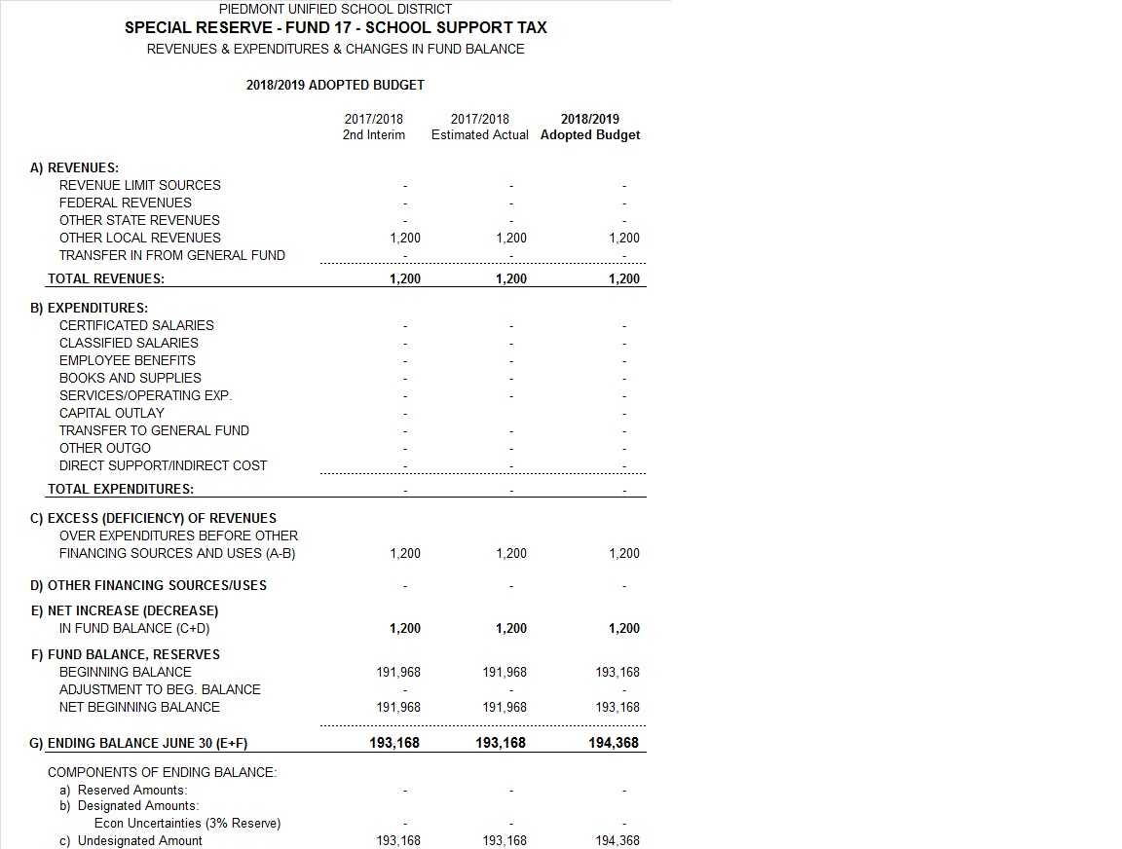

Slide 10
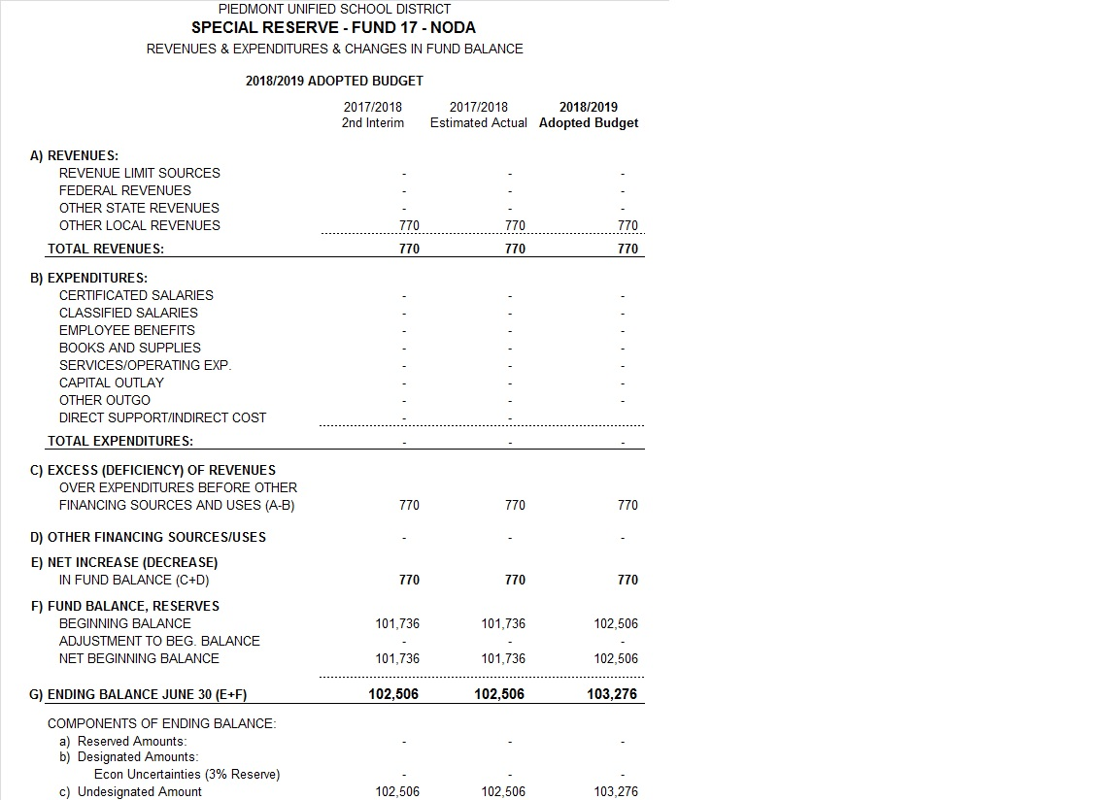

Slide 11
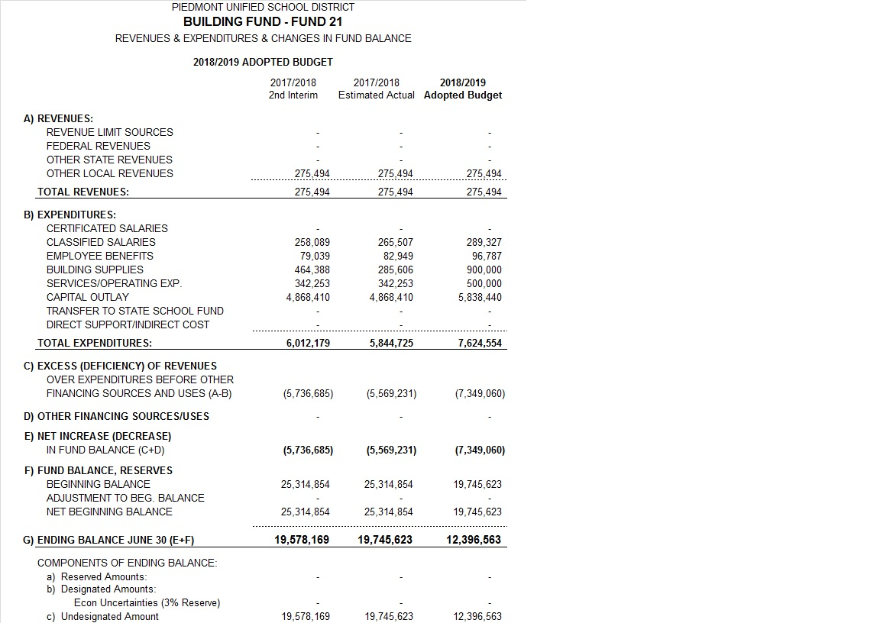

Slide 12
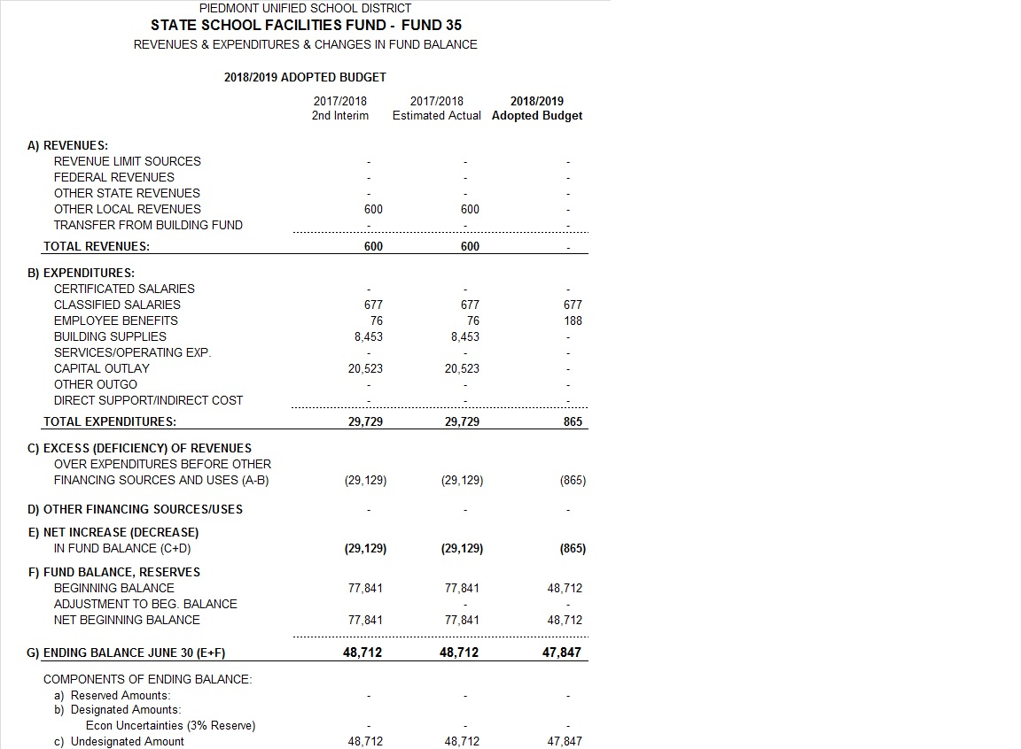

Slide 13
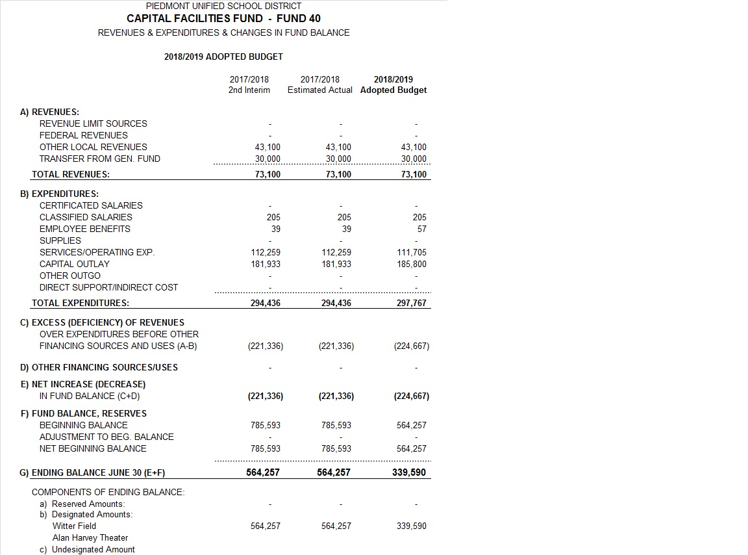

Slide 14
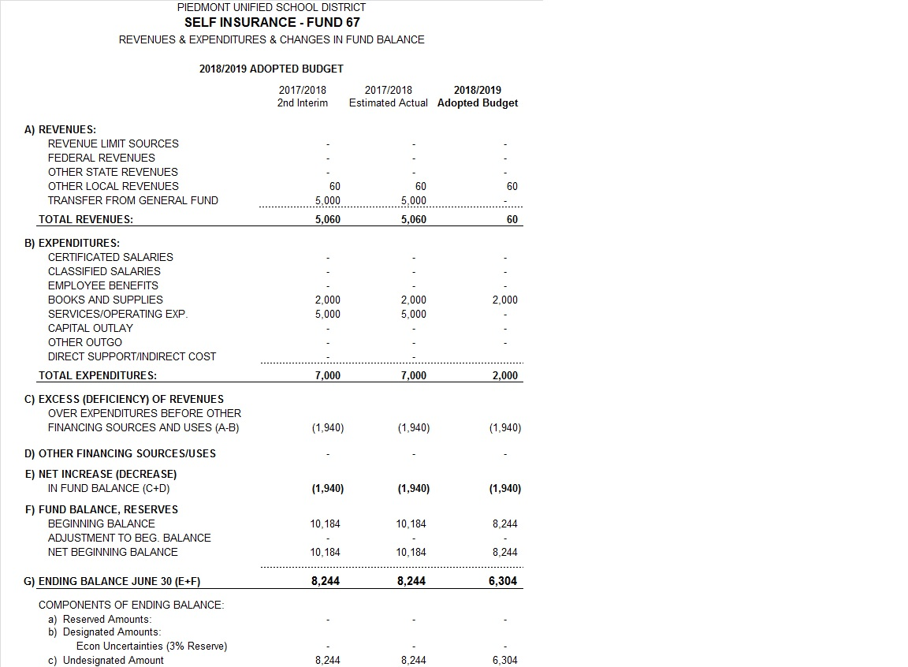

Slide 15
Recommendation: Action
Conduct public hearing on the District General Fund budget for 2018-19 and all other budgets operated by the District, and solicit public opinion on budget implications for the Local Control Accountability Plan (LCAP)

