Slide 1

Title I: Annual SCIP Meeting
& Mid-Year School Report
SPPS Online School
WINTER
Dec. 19, 2024

Slide 2

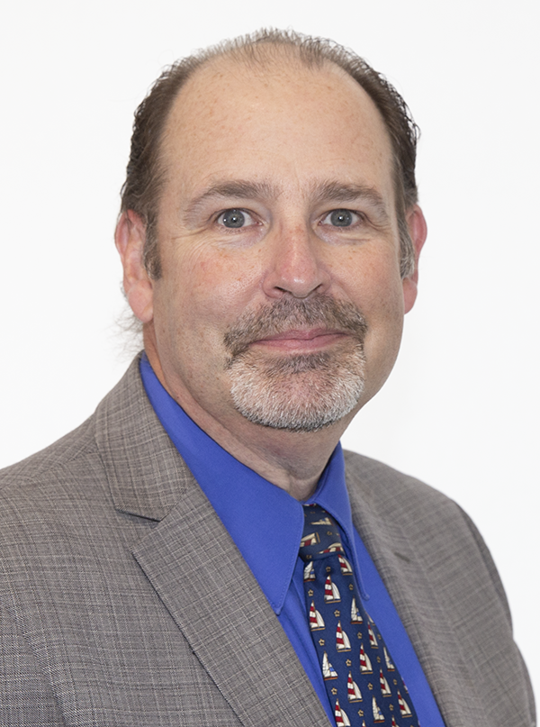
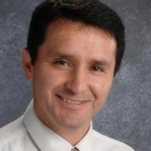
Admin Team
SUBHEADING
Jeffrey Bush
K-12 Principal
John Osorio
Assistant Principal

Slide 3


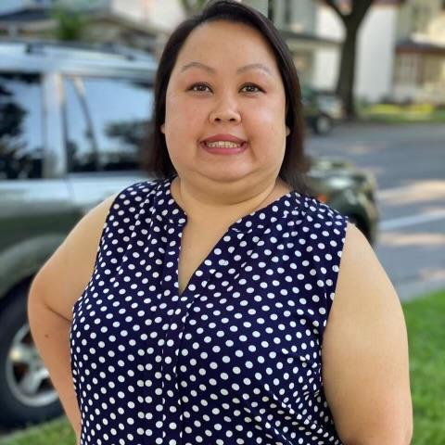
Staff Support
Mai Kia Lee
OHS Lead Clerk
Belinda Vang
OES Lead Clerk
Kaunou Vang
OMS/OHS Attendance Clerk

Slide 4
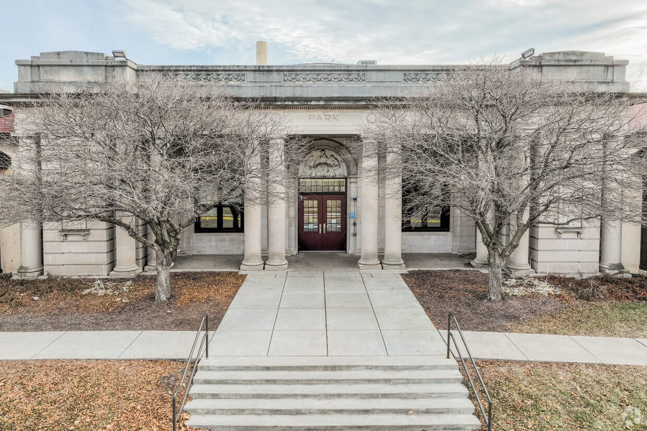
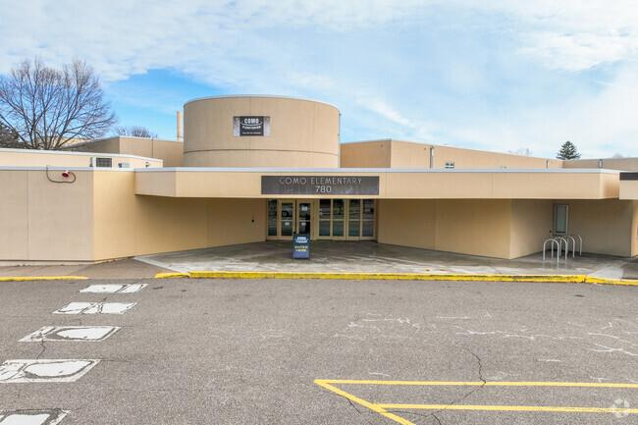
SPPS Online School
SPPS Online School Headquarters:
Como Park Elementary
High School Clerk:
Mai Kia Lee
maikia.lee@spps.org
School Line: (651) 325-2588
Direct Line: (651) 744-6432
Elementary/Middle School Clerk
Belinda Vang
belinda.vang@spps.org
School Line: (651) 325-2588
Elementary Attendance Line: 651-744-4707
Direct Line: (651) 744-2081
OSS Attendance/Records Clerk:
Kaunou Vang
kaunou.vang@spps.org
School Line: 651-325-2588
Online Secondary Attendance Line: 651-744-4711
Direct Line: 651-744-6827
School Address:
780 W. Wheelock Pkwy Ave., Saint Paul, 55117

Slide 5
Title I Annual SCIP Meeting & School Mid-Year Report
Agenda
12-19/2024
SPPS Online School
Title I
Online School SCIP
FAST Assessment
Parent-School Compact
Parent Engagement Plan
PBIS
Parent Feedback

Slide 6

Title I Program
SPPS Online School
The Title I program provides supplemental educational resources to ensure that all children have a fair, equitable, and significant opportunity to obtain a high-quality education. Title I helps schools provide world-class educational opportunities to all students.
Title I Mission:
Recognizing the ability of all students to master challenging academic standards and the necessity of strong family involvement, the Saint Paul Public Schools Office of Title I - Federal Programs ensures increased and improved educational opportunities for all students. The Office of Title I - Federal Programs serves Public and non-public schools with a high incidence of poverty, homeless students, and those residing in Neglected and Delinquent Institutions by
reducing barriers to learning
effectively communicating with parents, community and staff
and by implementing federal and state statutes to achieve strategic goals.
* It is our goal to develop a strong partnership with all OLS parents on behalf of all our children. *

Slide 7

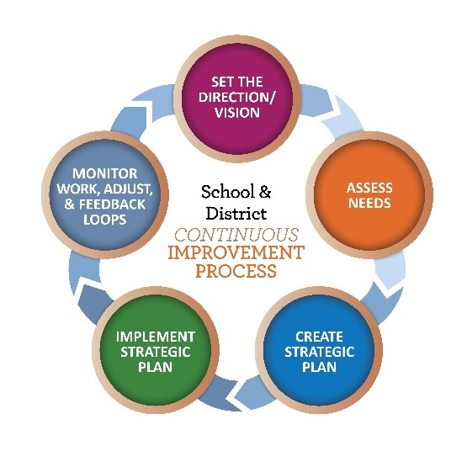
OLS SCIP Plan
SPPS Online School
What’s the School Continuous Improvement Plan (SCIP)?
Continuous improvement is one of our organizational values defined as 'Pursuing excellence by identifying and strengthening what is working well and being flexible to change what is not.'
At the school level, a major tool in the improvement process, the School Continuous Improvement Plan (SCIP), serves as a strategic, living-breathing, and evolving document that continuously guides and informs the improvement priorities of our schools.
CLIMATE SURVEY
MATH
READING
EQUITY

Slide 8
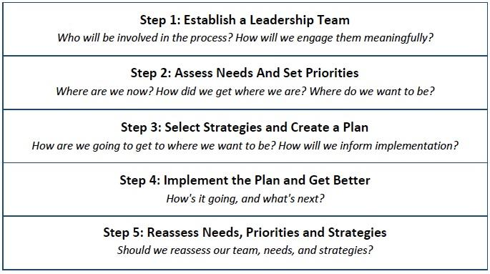
OLS SCIP Plan
SPPS Online School
What’s the School Continuous Improvement Plan (SCIP) Process?
1. Leadership
2. Assessment
3. Strategies/Plan creation
4. Implementation
5. Reassessment

Slide 9

OLS SCIP Plan Goals 2024/25
SPPS Online School
Student Climate Survey
1) At least 85% of all students in grades 3-5 and 6-12 will participate in the Student Climate Survey in the Fall 2024 and in the Spring of 2025, and
2) All student groups (3-5) will score at least '3' on questions 1, 4, 6, and 11 and will show an overall mean score of '3' or above by Spring of 2025.
(Link to the Survey)
All student groups (6-12) will score at least '3' on questions 4, 6, and 7 by Spring of 2025.
(Link to the Survey)
Reading
The percentage of all grades 3-5 students scoring proficient or higher in reading will increase by at least 5% pts. as measured by the MCA III Reading Assessment administered in April 2025.
Math
The percentage of grades 3-5 students scoring proficient or higher in mathematics will increase by at least 5% pts. as measured by the MCA III Mathematics Assessment administered in April 2025.

Slide 10

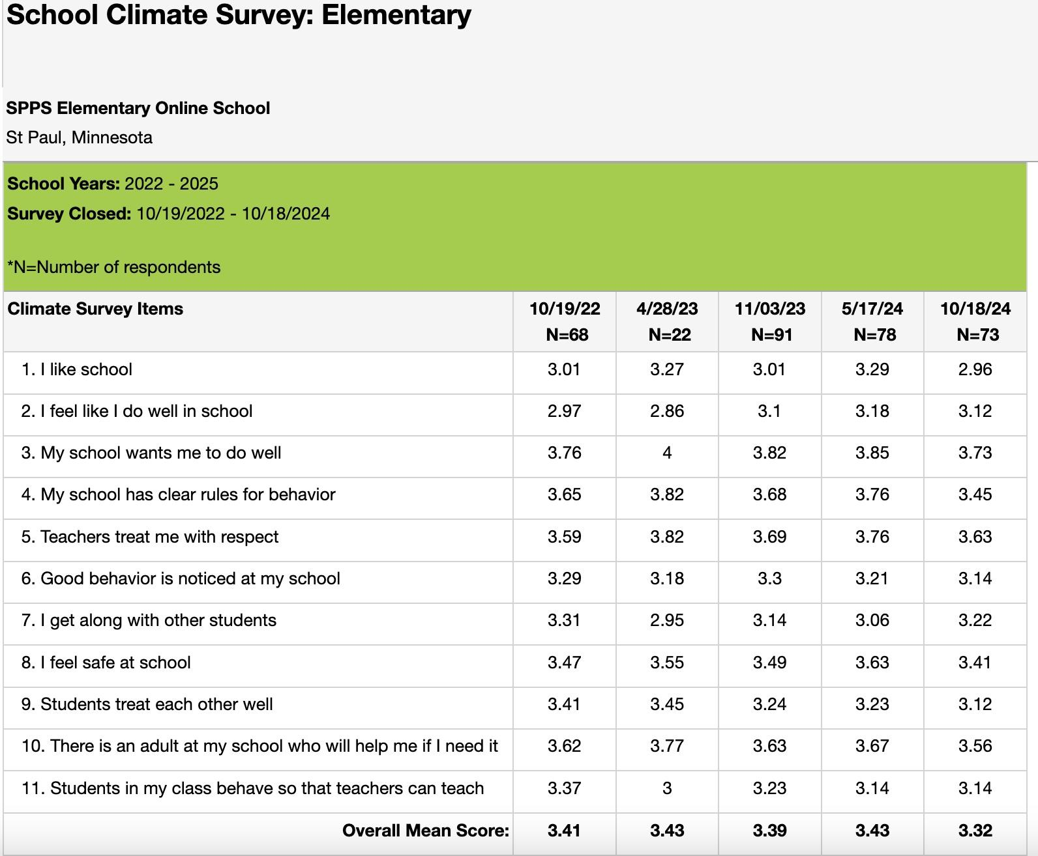
SPPS Online School
OES Student Climate Survey Sample

Slide 11
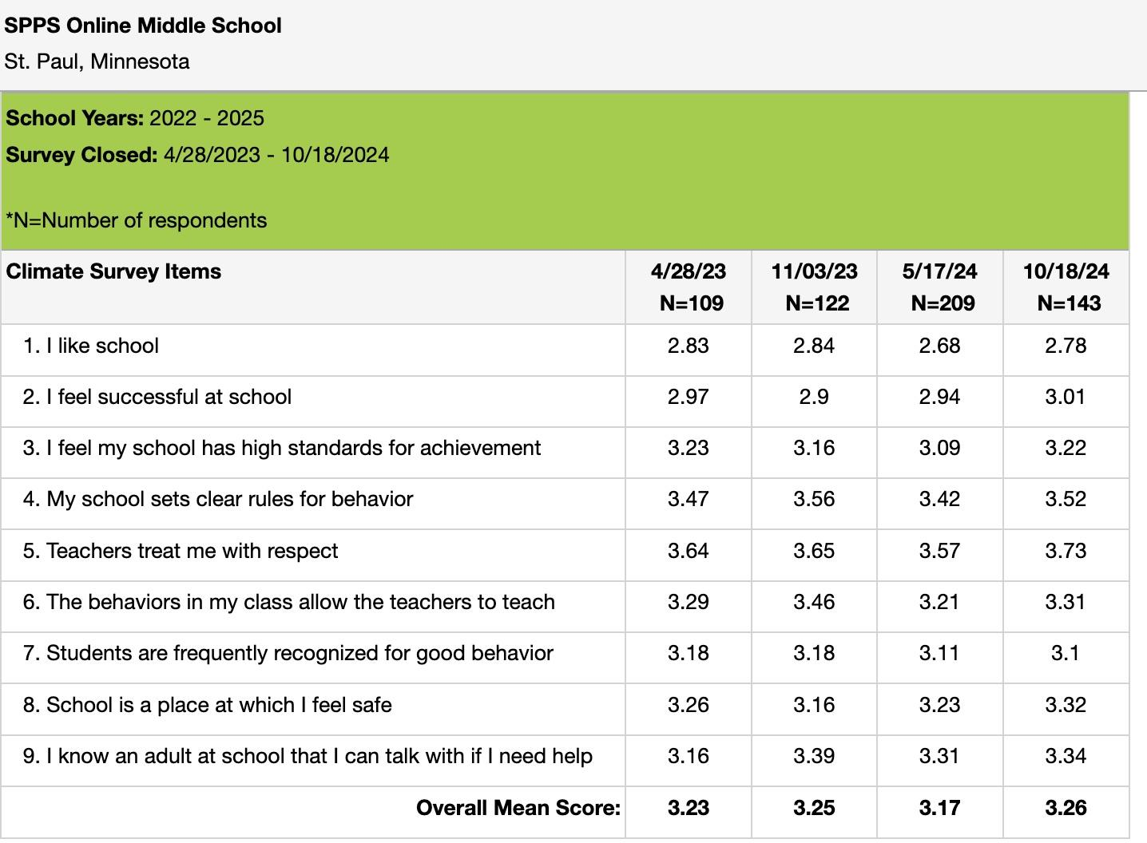

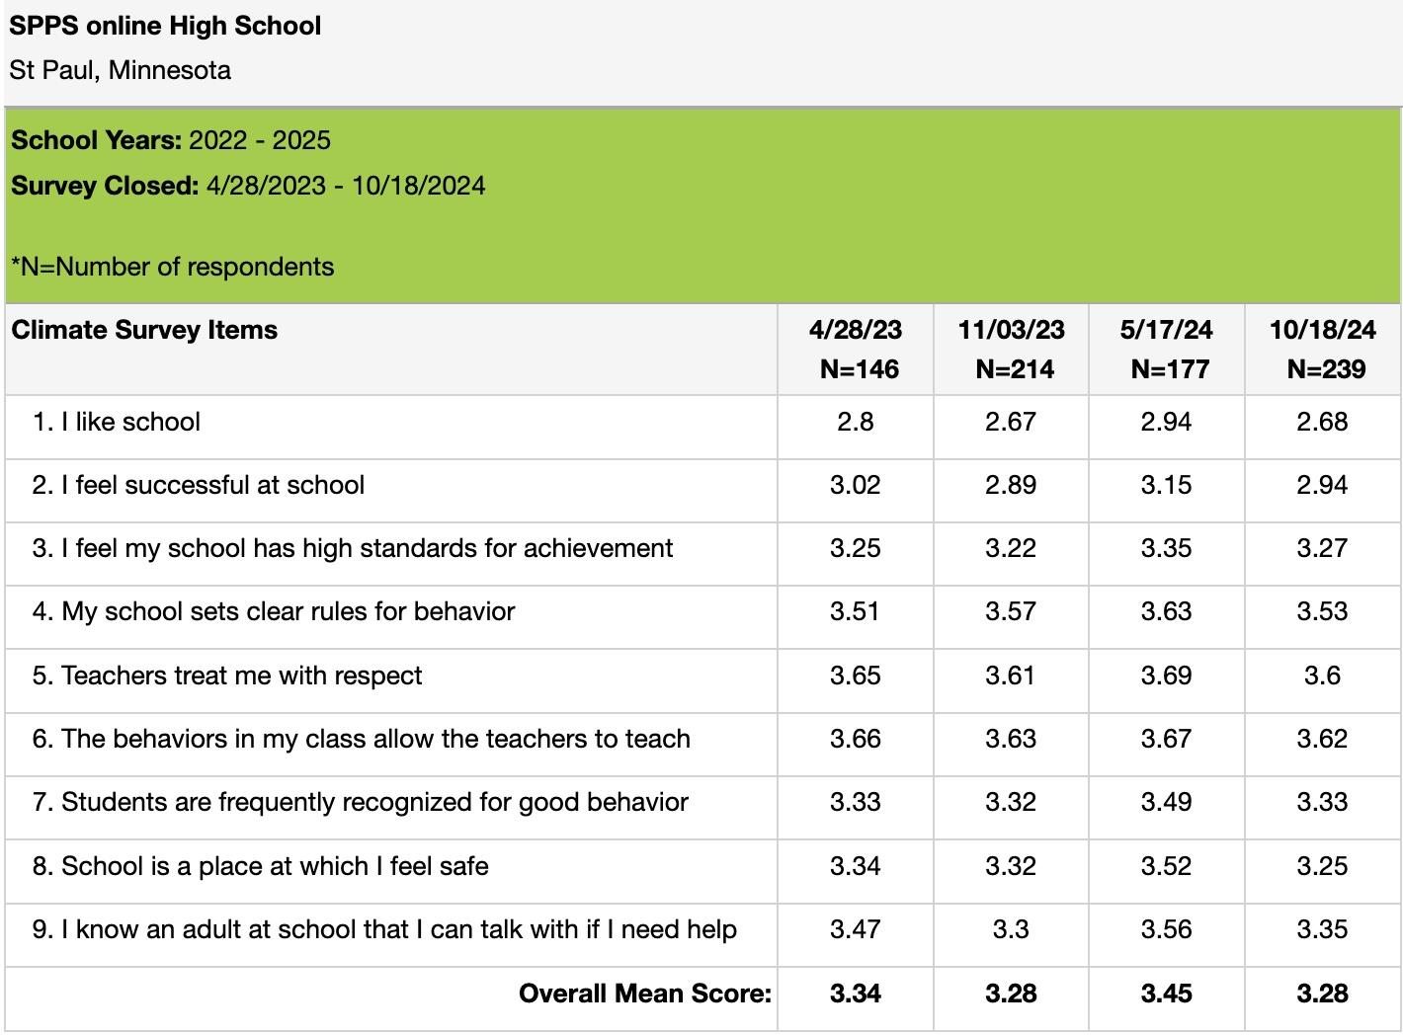
SPPS Online School
Student Climate Survey Results

Slide 12

SPPS Online School
Student Climate Survey Results
Our initial goal was 85%.
OES: 73 of our 76 3rd–5th graders completed the Climate Survey
96% of our student population took the survey.
Our results exceeded our SCIP goal of 85%.
Goals
At least 85% of all students in grades 3-5 and 6-12 will participate in the Student Climate Survey in the Fall 2024 and in the Spring of 2025, and
All student groups (3-5) will score at least '3' on questions 1, 4, 6, and 11 and will show an overall mean score of '3' or above by Spring of 2025. (Link to the Survey)
All student groups (6-12) will score at least '3' on questions 4, 6, and 7 by Spring of 2025.(Link to the Survey)
Initial goal of 3.00 in the overall Mean Score Survey
Student Climate Survey Mean Score by School:
  OES: 3.32
  OMH: 3.26
  OHS: 3.28
All 3 schools exceeded the goal of 3.00
Question | OMS | OHS
4 | 3.52 | 3.53
6 | 3.31 | 3.62
7 | 3.1 | 3.33

Slide 13
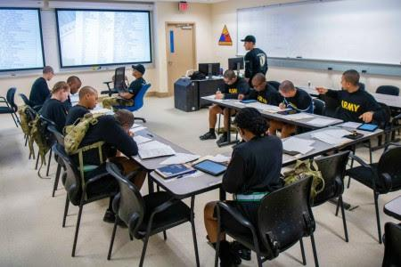

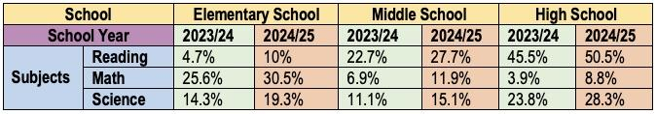
SPPS Online School
MCA Academic Goals
Reading
The percentage of all grades 3-5 students scoring proficient or higher in reading will increase by at least 5% pts. as measured by the MCA III Reading Assessment administered in April 2025.
Math
The percentage of grades 3-5 students scoring proficient or higher in mathematics will increase by at least 5% pts. as measured by the MCA III Mathematics Assessment administered in April 2025.

Slide 14
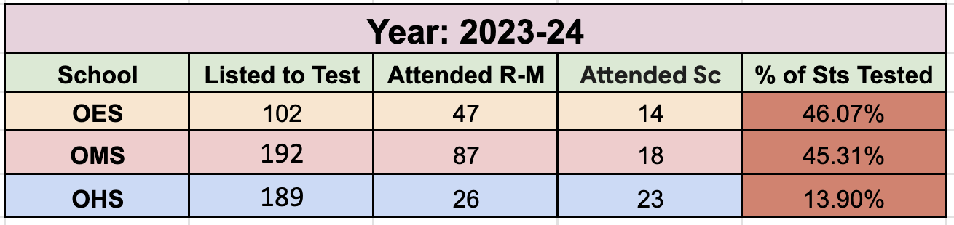
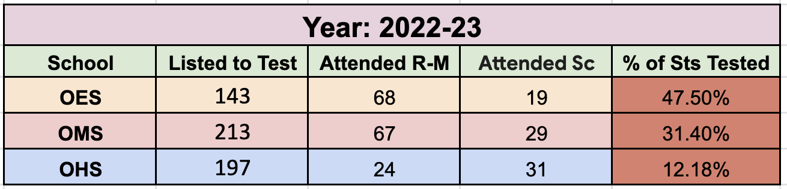
SPPS Online School
MCA Participation & Academic Growth

Slide 15
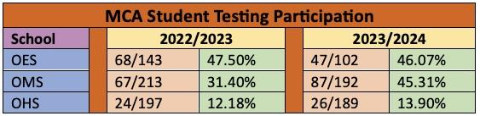
SPPS Online School
MCA and School Attendance
MCA Attendance:
According to district and state regulations, 95% of students in grades 3–12 must take the MCA exam.

Slide 16
SPPS Online School
FAST Assessment
The Formative Assessment System for Teachers (FAST) is an online assessment tool.
SPPS uses FAST’s aReading, earlyReading, and aMath assessments as universal screeners as part of the SPPS MTSS framework.
The assessments are aligned to Common Core Standards and MN K-12 Standards.
Assessment results can be used to identify students in need of additional instructional support or advanced differentiation.
Fall
Winter
Spring
Fall:
Sept. 9 to Sept. 27, 2024
Winter:
Jan. 6 to Jan 29, 2025
Spring:
May 5 to may 23, 2025

Slide 17
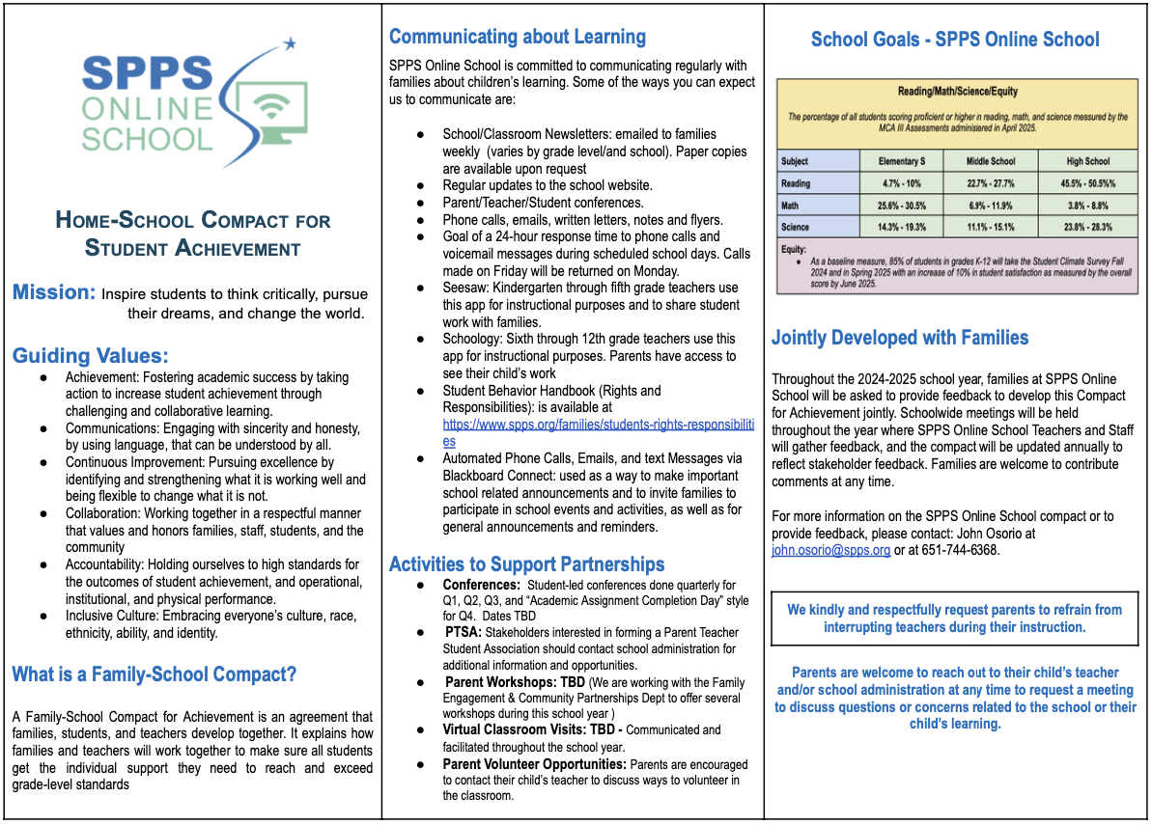
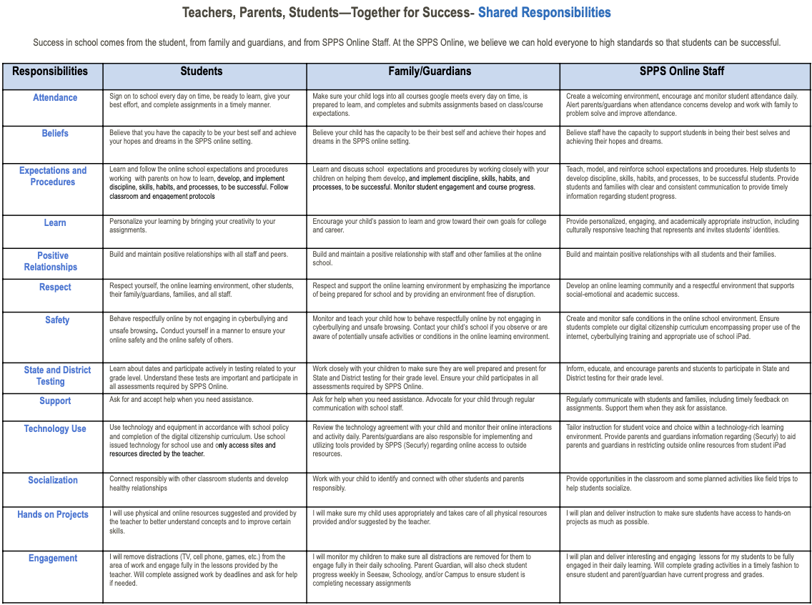
Parent-School Compact
SPPS Online School
Link to the Home-School Compact for Student Achievement: Online School Website

Slide 18
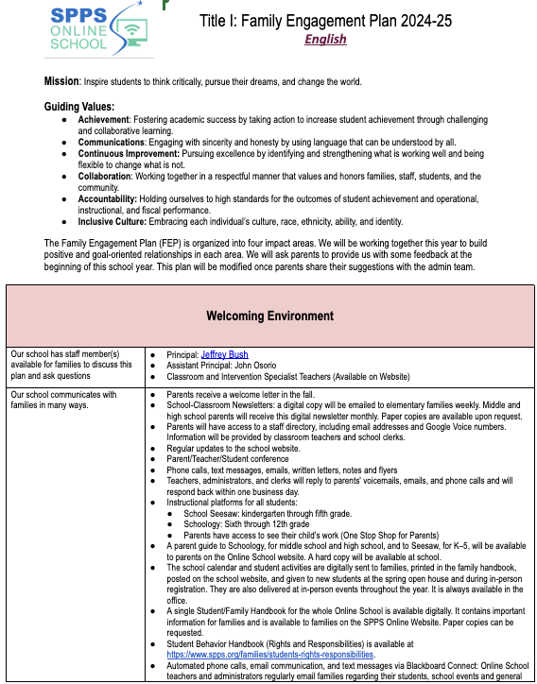
Family Engagement Plan
SPPS Online School
Link to the Family Engagement Plan:
Online School Website

Slide 19
Positive Behavior Interventions and Supports.
SPPS Online School
PBIS stands for Positive Behavioral Interventions and Supports, which is a school-wide framework that aims to create a safe and effective learning environment for all students.
What it is
PBIS is an evidence-based framework that supports students' behavioral, academic, social, emotional, and mental health. It's designed to:
Reduce problem behaviors
Reduce in- and out-of-school suspension rates
Enhance school climate
Improve academic performances
Support all students based on their level of need
Focus on students' strengths and build on their confidence
Assemblies
Student Recognition
3Rs Behavior Matrix
Behavior Management

Slide 20
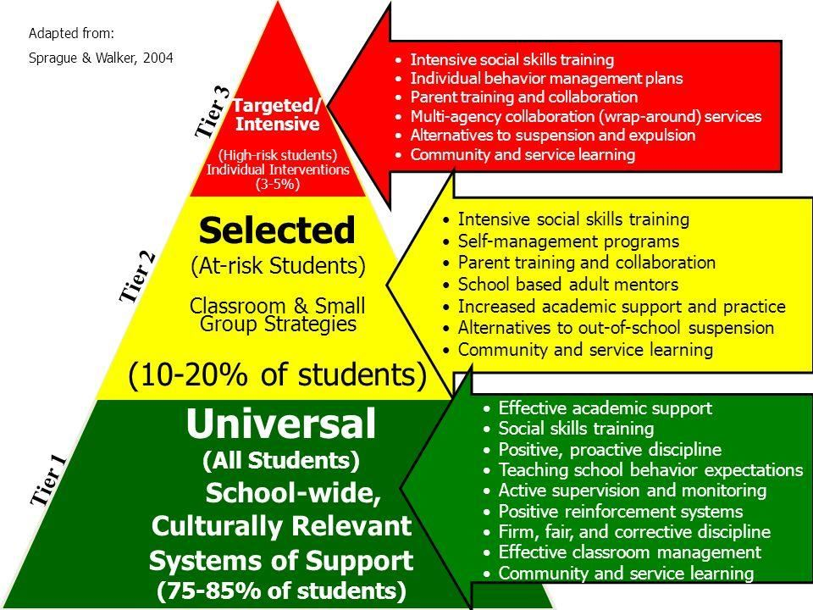

SPPS Online School
Behavior Management
Please access these links:
Discipline Behavior Management 24-25 Flowchart.
ODR Form: OES - OMS - OHS
Fix-It Plan
OLS Behavior Contract

Slide 21
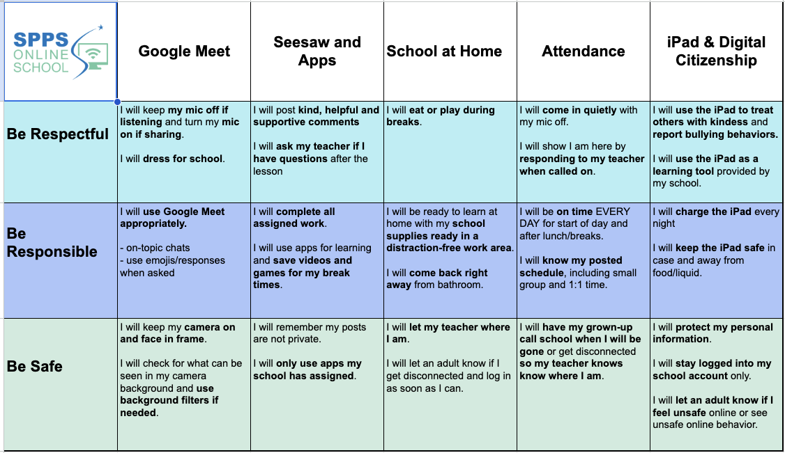
SPPS Online School
3Rs Behavior Matrix

Slide 22

SPPS Online School
School Daily Attendance
Attending school regularly beginning in preschool and kindergarten will help students to:
  Gain early reading and math skills.
  Build relationships.
  Develop good attendance habits throughout your student’s school career.
Missing less than nine days of school each year helps students to stay engaged, experience success in their schoolwork, and keep on track to graduate on time.
https://www.spps.org/academics/office-of-school-support/school-attendance-matters
School | Last Year | This Year
Elementary Sch. | 62% | 59%
Middle Sch. | 54% | 54%
High Sch. | 41% | 36%

Slide 23

Opportunities for Growth
SPPS Online School
Attendance:
Please make sure your child is on time for their daily classes in the morning and afternoon.
  Google Meet log-in for each class
Testing:
Please send your child for MCA testing. Testing dates will be shared with all parents in January 2025.
Communication:
Maintain close communication with your child’s teacher. Ask questions and request support for your child if needed.
FAST/HMH Testing:
Make sure your child is taking the FAST/HMH assessments this January.
Enrollment:
Maintain your child’s enrollment in the Online School by making sure your child is attending school daily.

Slide 24

SPPS Online School
Parent Feedback
Please provide us with some feedback to improve our SCIP plan and other areas you may consider important.

Slide 25
Thank You!
HAVE A WONDERFUL BREAK

