Slide 1

An Introduction to Legal Aid

Slide 2
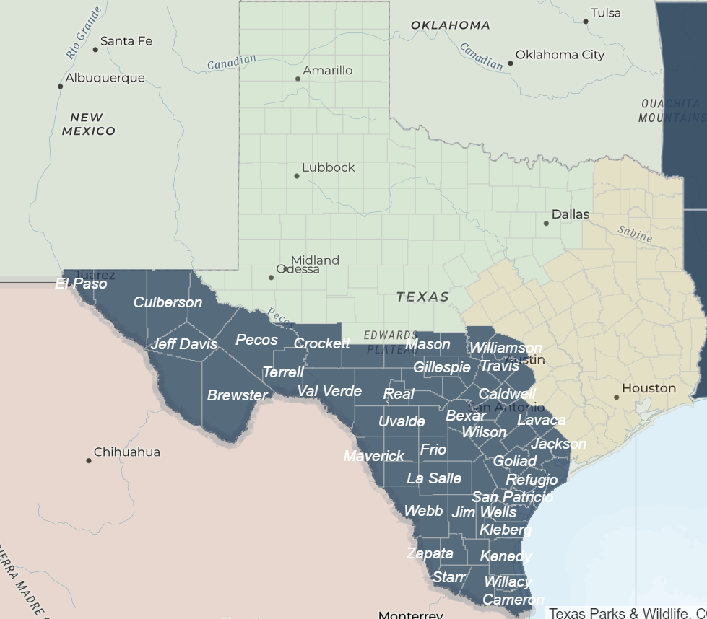
Texas RioGrande Legal Aid
A nonprofit legal services provider serving 68 Texas counties, including the entire border region
Working with clients with legal issues from over 45 practice areas, including family, employment, housing, and more!

Slide 3
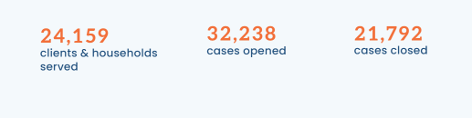
What We Do
Direct Representation
Advice and information
Presentations of legal information for community members
Presentations (like this one) about resources and best practices for serving our shared client populations for service providers

Slide 4
What We Do NOT Do
Take every single case for every single person who applies
Charge our clients for our services
Take criminal law cases (in most cases)
Take many personal injury cases (including car accident, slip-and-fall, and medical malpractice)

Slide 5
Practice Areas
Family
Housing
Employment
Civil Rights
Consumer Protection
Disaster Benefits
Environmental Justice
Estate and Probate
Immigration
Public Benefits
AND MORE!

Slide 6
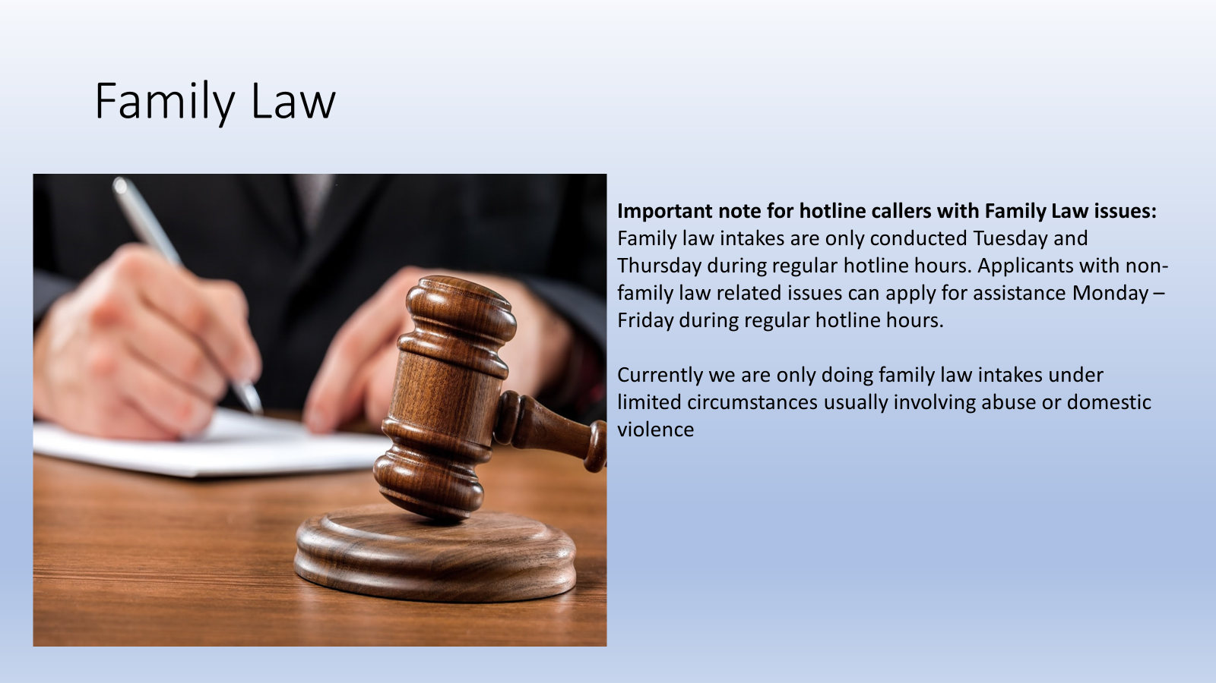

Slide 7
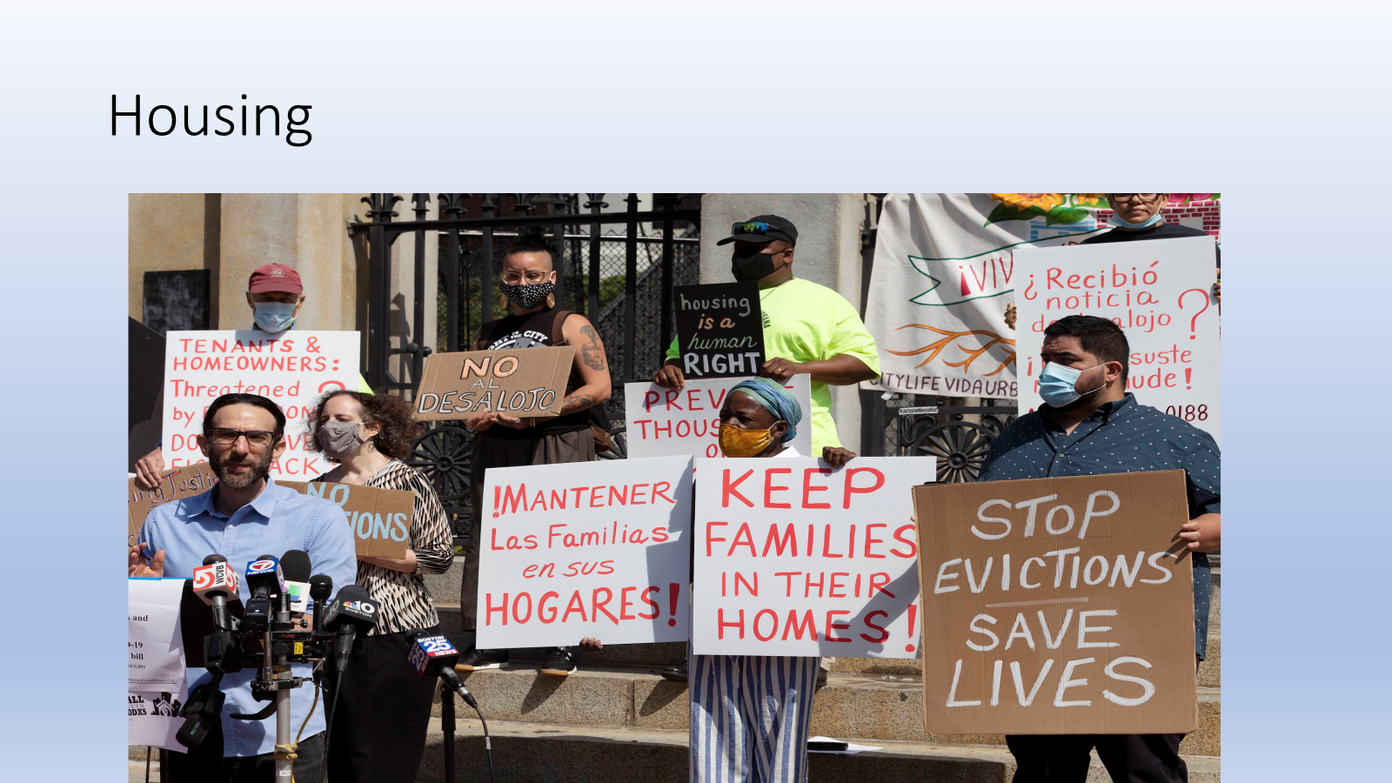

Slide 8


Slide 9
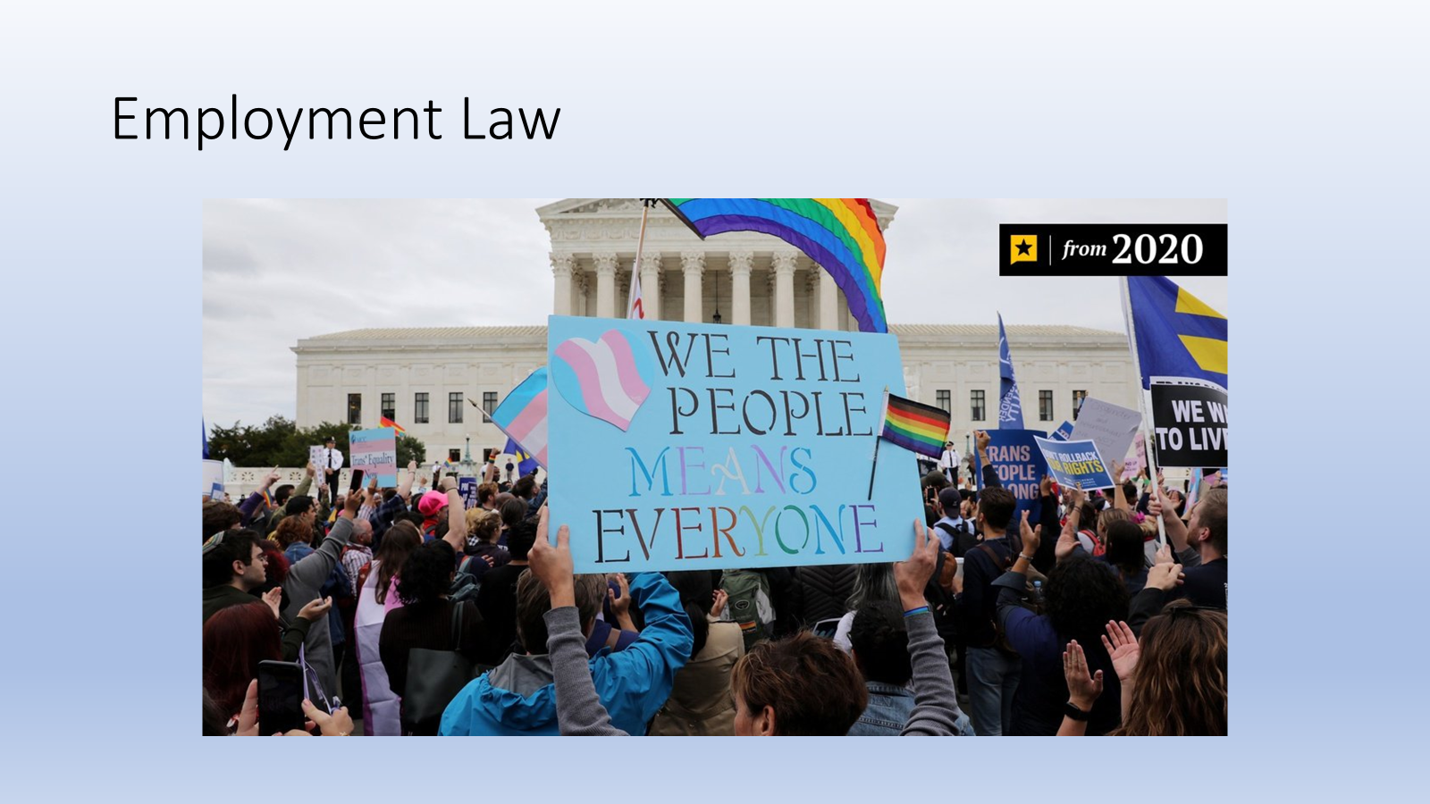

Slide 10
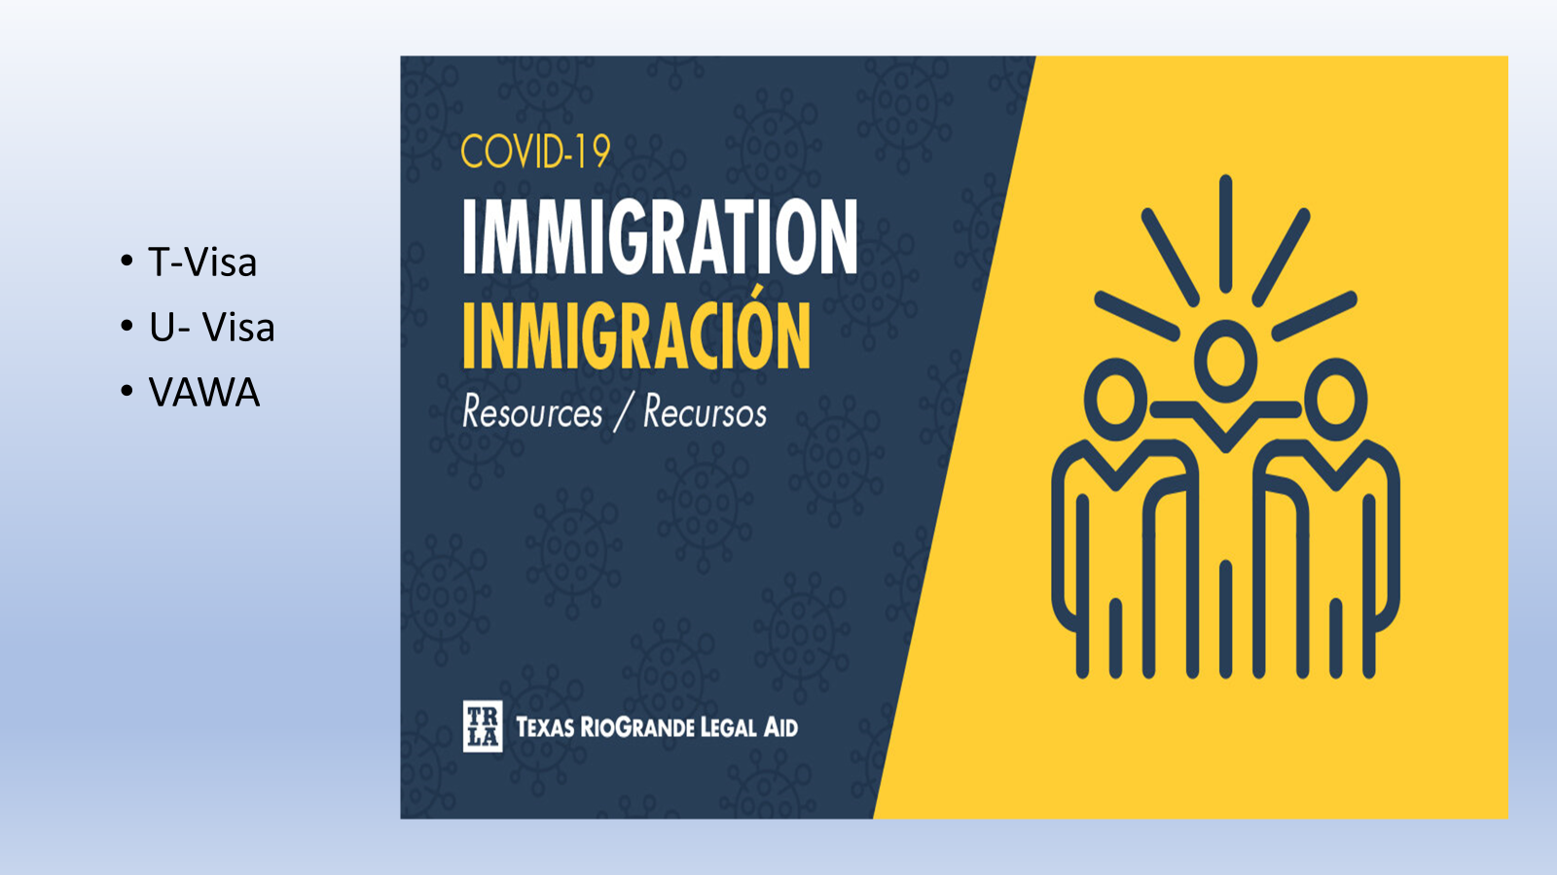

Slide 11
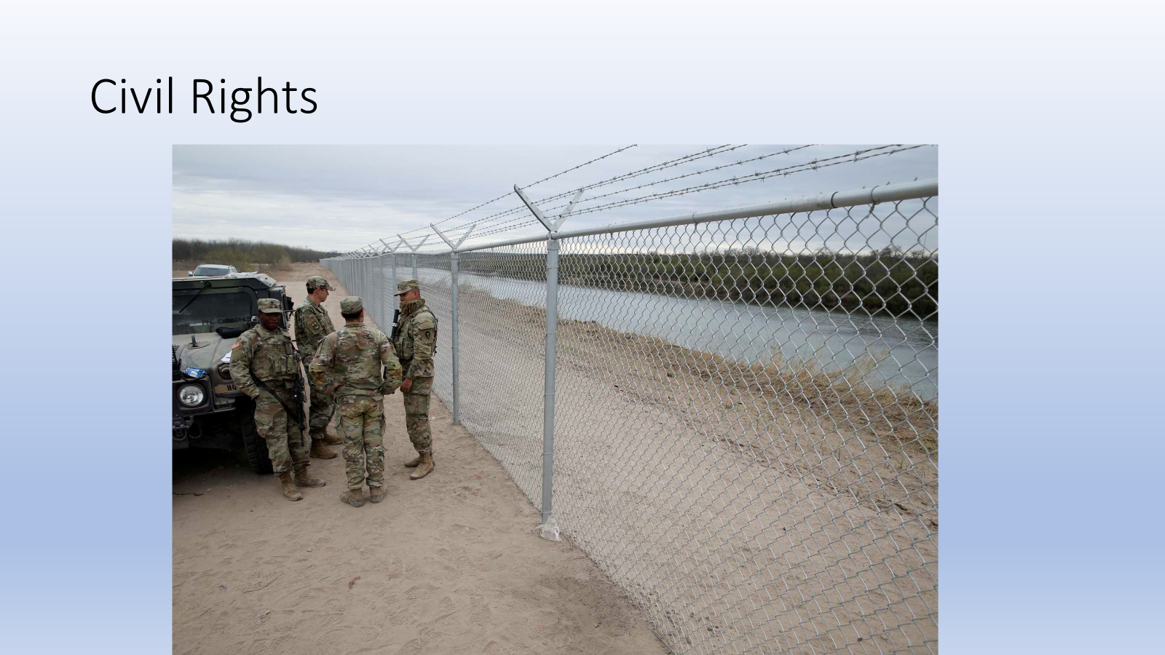

Slide 12
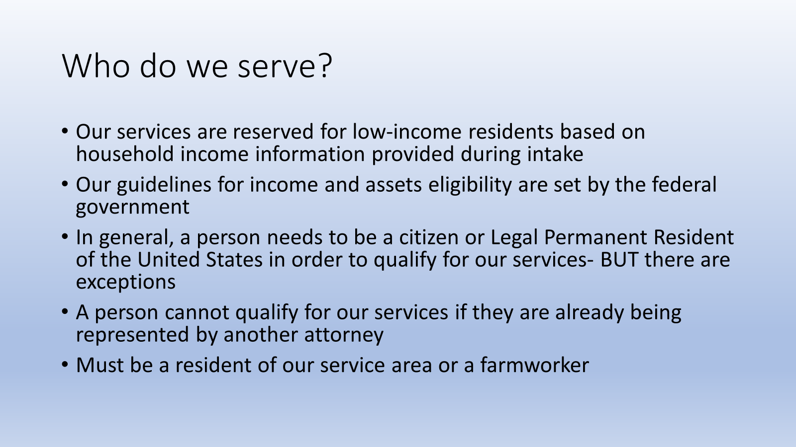

Slide 13
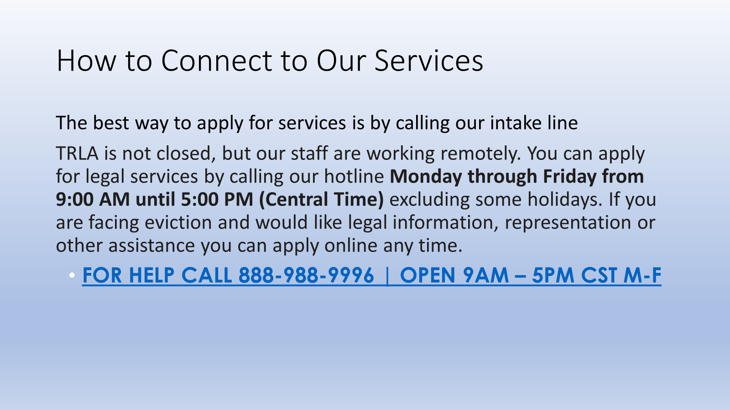

Slide 14
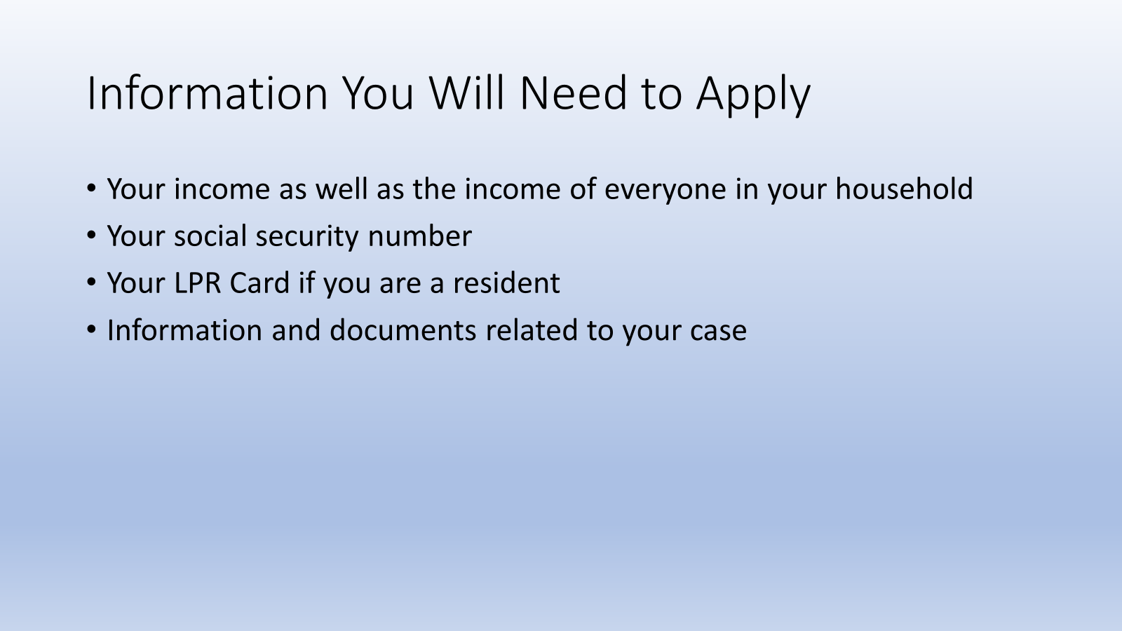

Slide 15
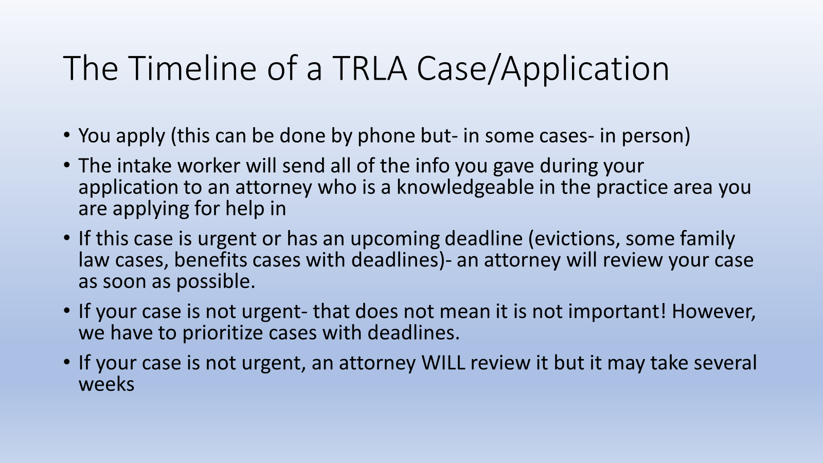

Slide 16
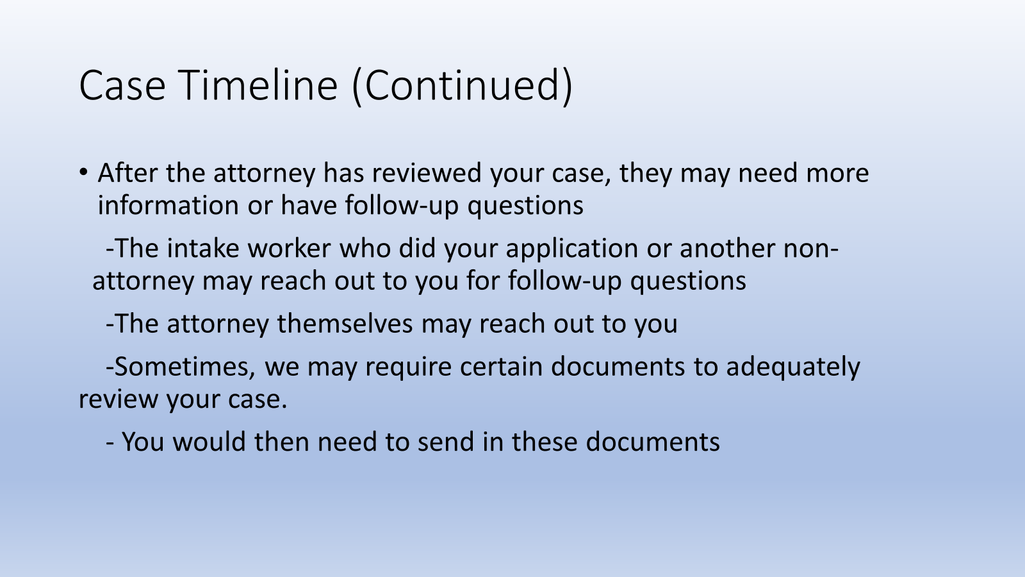

Slide 17
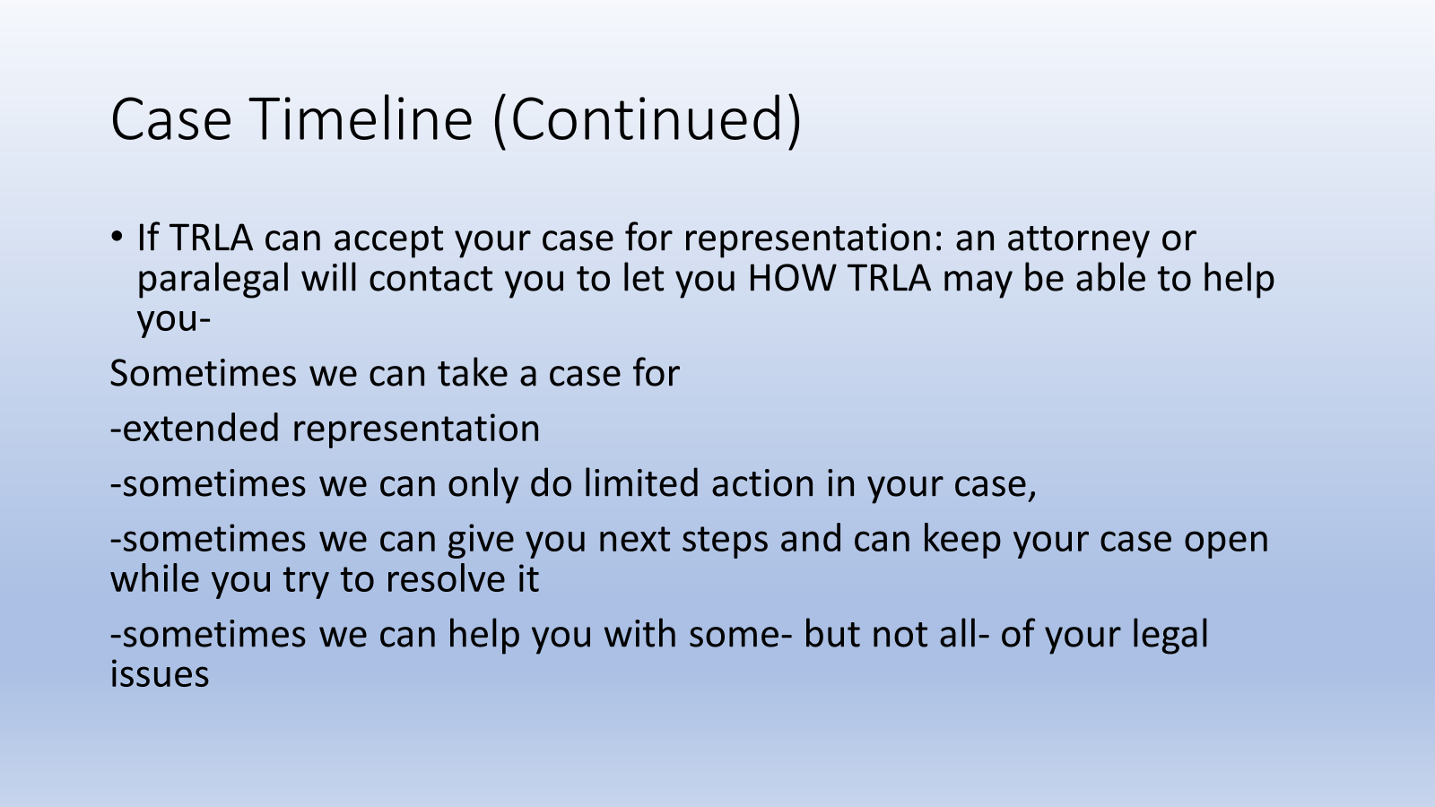

Slide 18






What happens when you turn 18 in Texas?

Slide 19

BUT…
What if a person has a disability that affects their ability to make these adult decisions?
What if a person is not able to take care of themselves at the age of 18?

Slide 20
Making Decisions
The Texas law presumes all adults have the capacity for decision-making – this applies to everyone, including people with disabilities.
Decision-making is a learned skill – people with disabilities need opportunity, experience and support to learn to make well informed decisions.
There are other legal ways to assist people with decision-making that do not restrict, limit, or remove individual rights.

Slide 21
What is a Guardian?
A guardian is someone who has a legal authority to protect the interests of another person. If you have a guardian, he or she can decide the following:
- Where you live
- Where (and whether) you work
- What you wear
- What you eat
- Where/when you go to the doctor
- What medical procedures you receive
- How you can spend your money
- Whether you can purchase property, etc.
Notes:
Legal decision by a judge that someone 18 or older is incapacitated in one or more areas of life functioning.
Incapacity=because of condition, substantially unable to (a) provide food, clothing or shelter (b) care for health, or (c) manage financial affairs. TEC Sec. 1002.017
Removes the person’s freedoms of choice, self-determination and independence.
Assigns decision-making to a third party.
Requires ongoing court oversight.
History of Gship – primarily told by schools they had to get one, overly restrictive and paternalistic
Until legislated SDM and revision of Gship (including BOR for Wards)
Pros – feels safe, clearer, widely known, decision by a judge
Cons – loss of freedom, not flexible, no opportunity for growth, expensive, burdensome, strain on relationships, lack of good Gs on parents’ death, also important for parents to know that if applying for Gship their child will have AAL

Slide 22
What is a guardianship?
Under a guardianship, a GUARDIAN makes all decisions for a WARD
A guardianship can be over a person, an estate, or both
A judge makes the decision regarding whether a guardianship is necessary.
If a person wants to pursue a guardianship, they must go in front of a judge to determine if the proposed individual is truly incapacitated.
The person seeking to become a guardian must also prove that all other alternatives to guardianship are not feasible, and that they are the best individual for the job.

Slide 23
Guardianship
Chooses guardian
Monitors
guardian
Notes:
SOMETIMES ALTERNATIVES DON’T WORK, AND THAT’S OK,
Some people with disabilities that make it hard for them to understand or communicate might need a guardianship- where another person can make decisions for them.
GUARDIANSHIP IS ALWAYS AN OPTION IF ALTERNATIVES DON’T WORK. IF THE INDIVIDUAL WILL NEVER BE ABLE TO TAKE CARE OF HERSELF BC OF A DISABILITY AND THERE IS NOTHER WAY TO MEET HER NEEDS, GUARDIANSHIP IS PROBABLY APPROPRIATE

Slide 24
Who Needs a Guardian?
Guardianships are intended for individuals 18 years of age or older who are substantially unable to do the following, even with supports and services:
(a) provide food, clothing or shelter for themselves;
(b) care for their own health, or
(c) manage their financial affairs.
The guardian must prove that all alternatives to guardianship are not viable for their loved one. This includes Supported Decision-Making Agreements (SDMAs), Medical Powers of Attorney (MPOAs), Durable Powers of Attorney (DPOAs), and many more.

Slide 25
Who Decides if You Need a Guardian?
A judge makes the decision regarding whether a guardianship is necessary.
This means that if a person wants to pursue a guardianship, they must go in front of a judge to determine if the proposed individual is truly incapacitated.
The person seeking to become a guardian must also prove that all other alternatives to guardianship are not feasible, and that they are the best individual for the job.
This process requires a large time commitment and can be very expensive.

Slide 26
Guardianship Process
Lawyer – to file the paperwork
Doctor – to evaluate the person
Notice – to family members
Background check
1-hour Training
Lawyer for the person with a disability
Court hearing
Bond
Reporting – every year
Notes:
Why not guardianship “just in case”?
Interferes with person’s right to make own decisions.
Hard to un-do.
The law says you must consider guardianship alternatives before a court will grant a guardianship.
Guardianship is always an option if alternatives don’t work.

Slide 27
Why Should We Hesitate Before Pursuing a Guardianship?
Reduced Self-Determination =
Less self-esteem
Increased passivity
Decreased functioning
It is extremely difficult to undo a guardianship. The court only restores competency in very rare instances, and the burden of proving competency falls on the individual with disability.

Slide 28
What happens when someone calls us asking for a guardianship?
Intake (determines eligibility and gets more information about client)
Review by attorney
Capacity Assessment
Meeting with family to determine their needs and what works best for them
TRLA meets with family to draft and execute documents
OR
TRLA represents or provides legal advice

Slide 29
Why should we wait before telling someone that they need a guardianship ?
Guardianships take away a person’s civil rights
Guardianships can be hard to undo later
There is potential for abuse
Guardianships stop someone from practicing and developing decision making skills
Cost
The requirements for a guardian can be difficult to keep up with
The law requires that guardianship be a last resort

Slide 30
What do we take into account when determining if a person needs a guardianship?
What is a person’s capacity?
Can this person communicate in some way?
Is there someone in their life who they trust to help them with making decisions?
How are their needs being met now?
Is there anything that they can’t do right now without a guardianship?

Slide 31
You do not need a guardianship to….
Be present at an ARD meeting
Go to a doctor’s appointment with someone if they want you there
Manage someone’s Social Security check or other benefits
Help someone make medical decisions
Make a plan for who will care for a person with a disability when you no longer can
Help a person understand and communicate day-to-day decisions

Slide 32
You can not get a guardianship only because you want to…
Make it easier or more convenient for you
Force someone into a treatment program
Involuntarily commit someone to a hospital or institution
Control who a person is friends with or dates
Manage someone’s money because you don’t agree with how they are spending it

Slide 33
What alternatives are there to a guardianship?
Supports and Services
Supported Decision Making Agreement
Representative Payee
HIPAA Release/Medical POA
Statutory Durable Power of Attorney
Psychiatric Advanced Directives

Slide 34
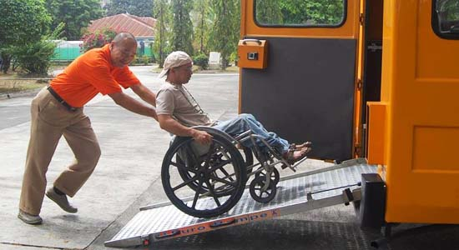

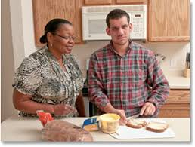
Supports and Services
Notes:
-If you receive Social Security, and need help with managing your money, you can choose a representative payee.
-If you need help with Medicaid, you can choose an authorized representative.
-care management
-technology assistance
-friends helping friends
-free transportation
-direct deposit
-shared bank accounts
-home care provider

Slide 35
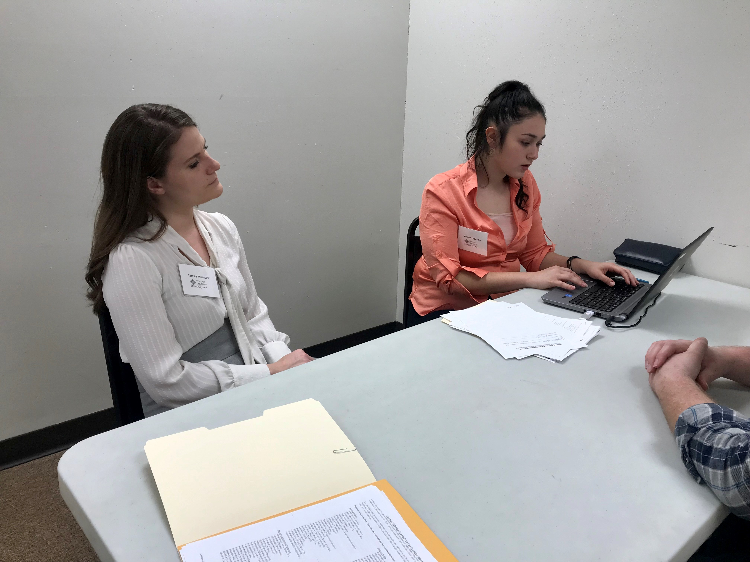

Supported Decision Making Agreement
Notes:
If you need help making other choices, getting information or understanding your options, you can sign a supported decision-making agreement and choose a supporter. You can choose a person who you feel comfortable talking to and who has helped you make decisions in the past.
-SDMA: legal document that allows the individual with a disability to choose a person to help them obtain info, understand options, and make decisions. Ex: helping Katie know her housing options

Slide 36
What is Supported Decision Making?
Person with Disability
Chooses Supporter
To Help Self Make Decisions

Slide 37
Who Can Be the Supporter?
Any Adult
  There are no legal restrictions on which adult can be chosen as a suproter.
  The person making the decision should chose a person that they trust.
  The supporter is usually a relative such as a parent or sibling or a close friend.

Slide 38
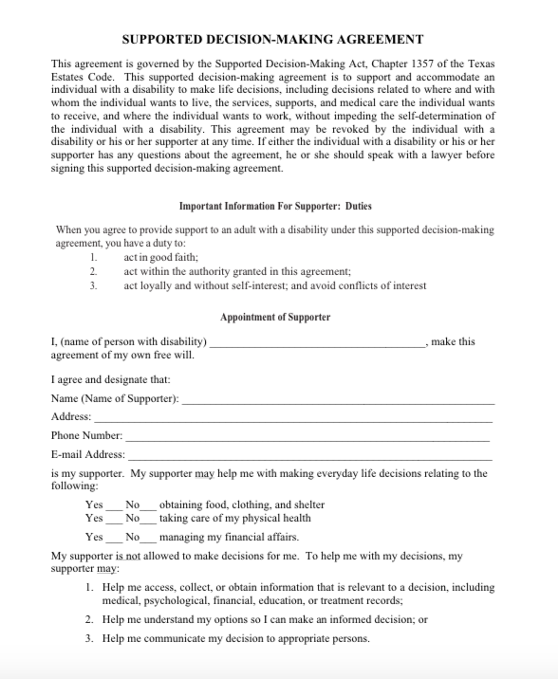
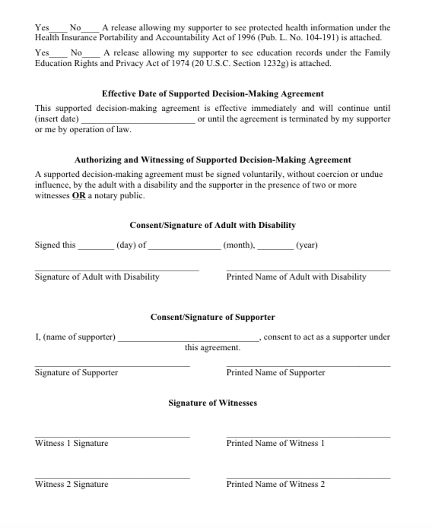

Slide 39
What is Supported Decision-Making?
Supported Decision-Making is a process of supporting and accommodating an adult with a disability to enable the adult
to decide things like:
  WHERE SHOULD I LIVE?
  WHAT SERVICES SHOULD I ACCEPT?
  WHO WILL LIVE WITH ME?
  WHERE SHOULD I WORK?
Importantly, Supported Decision-Making allows the adult with disability to receive supports while making these decisions, WHILE FOSTERING THEIR SELF-DETERMINATION.

Slide 40
What is a Supported Decision-Making Agreement (SDMA)?
An SDMA is a legal document that allows an adult with disability to authorize a chosen supporter to:
Give INPUT as a continuing influence once the individual with disability has turned 18,
ACCESS private information otherwise protected by FERPA/HIPPA (including school transcripts, medical documents, etc.) in order to help collect/organize information, where authorized, and
RELAY decisions for the individual with disability where requested.
SDMAs are flexible and do not require interference from a judge. An adult with disability may have multiple SDMAs, and they can be created, modified, or terminated at any time and without any costs.

Slide 41
What does the law say about Supported Decision-Making?
  A person shall rely upon the original or a copy of the supported decision-making agreement. TEC Sec. 1357.101(a).
  A person is not subject to criminal or civil liability or professional misconduct for an act or omission done in good faith and in reliance upon the supported decision-making agreement. TEC Sec. 1357.101(b). New language re: duty!
  SDMA terminates if DFPS/criminal court finds abuse or neglect. TEC Sec. 1357.053.

Slide 42
Who Can Benefit from an SDMA?
It’s easy – almost everyone!
Transition-age youth (ages 18-22) may find SDMAs helpful as they begin their transition into adulthood.
Elderly people also use SDMAs to reaffirm and maintain their independence during their later years.
Everyone in between—including supporters—benefits from flexing those decision-making muscles, while fostering independence and self-determination.

Slide 43
What does a Supported Decision-Making Agreement (SDMA) NOT do?
An SDMA does NOT permit the supporter to:
Make decisions for the adult with disability, or
Give input, access private information, or relay decisions without specific authorization from the adult with disability.

Slide 44
STOP!
What’s the most important thing an SDMA does?
A Supported Decision-Making Agreement allows for the person with a disability to retain his/her own decision-making power.

Slide 45
What about a POA (Power of Attorney)?
(Substitution of Judgment)
Under POA, agent must make decision he/she believes signer would make.
POAs do not allow for the same kind of skills development, unless they are used carefully in conjunction with an SDMA.
MPOA (Medical Power of Attorney) or POA triggered by incapacity may be used consistent with goals of SDMA statute.
Notes:
Have they done this?
42 Our parents
One of the most commonly used tools to avoid guardianship, the Medical Power of Attorney, only becomes effective if the principal is unable to make his own decision.
A Medical Power is not automatically revoked upon the appointment of a guardian. The court may choose to suspend or revoke the power or to leave it in place as a less restrictive alternative.
Nursing homes and hospitals may be reluctant to accept Medical Powers executed close to the time they are needed, so they should be executed well before any perceived need.
A Durable Power of Attorney allows an agent to act generally or specifically for the principal.
It may provide that it survives the incapacity of the principal, thus serving as the most common guardianship-avoidance tool.
If the Proposed Ward still has enough capacity to grant the power, this is virtually a “no-brainer”.

Slide 46
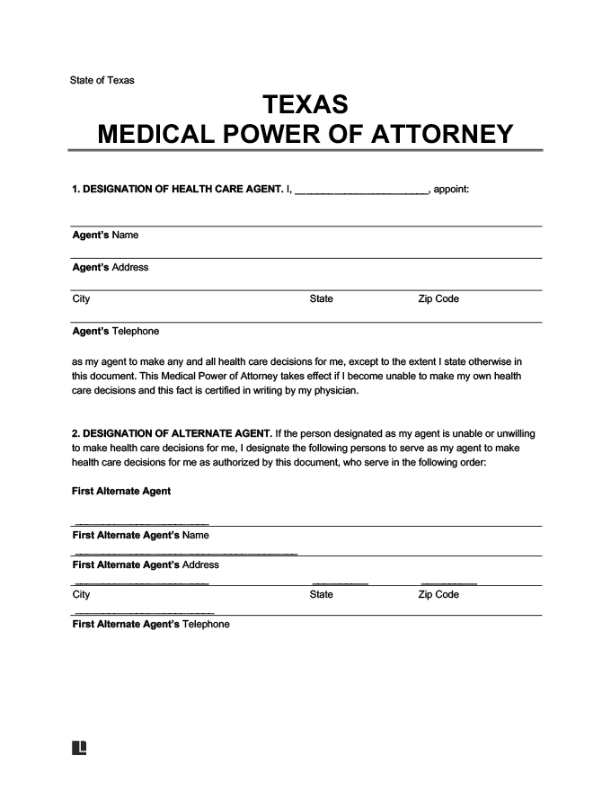
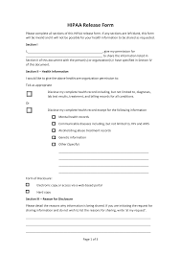
HIPAA RELEASE/Medical Power of Attorney

Slide 47
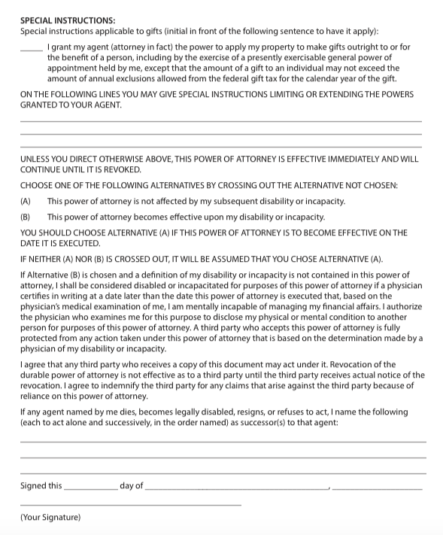
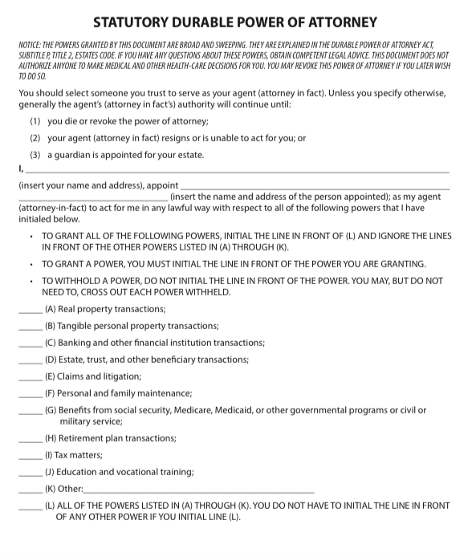
Statutory Durable Power of Attorney

Slide 48
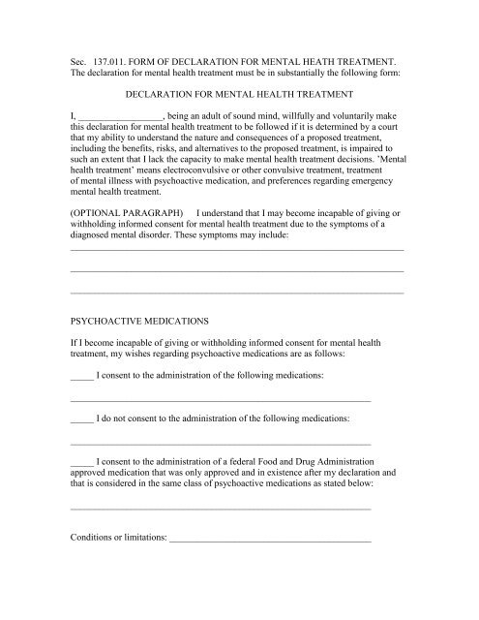
Psychiatric Advanced Directives

Slide 49
Why should we avoid telling people they need a guardianship (and what can we say instead)?
Guardianships are not appropriate for everyone
“I understand you are worried about what might happen when your child turns 18”
“There are lots of different ways that you can help your loved one with making decisions”
“TRLA can help you and your family find out more about your options and what might work for you”
“Every child is different and different plans might work for different people”

