Slide 1
KICK-OFF TO COLLEGE APPS
Class of 2025

Slide 2

Overview
Application Process
Transcripts/test scores
Essay tips
Scholarships
Financial Aid
Senior timeline
And more……….

Slide 3
ADMISSIONS UPDATES

Slide 4

DIRECT ADMIT WISCONSIN
CONGRATULATIONS STOUGHTON HIGH SCHOOL
YOU ARE A DIRECT ADMIT WISCONSIN HIGH SCHOOL!
FIRST UP…CLASS 2025 JUNIORS!
Notes:
Direct Admit Letters can be viewed in the Campus Portal under Documents tab. A second round of direct admit will come out at the end of September for students who did schedule changes.

Slide 5
UW-GREEN BAY UW-RIVER FALLS
UW-MILWAUKEE UW-STEVENS POINT
UW-OSHKOSH UW-STOUT
UW-PARKSIDE UW-SUPERIOR
UW-PLATTEVILLE UW-WHITEWATER
NOTE: Some universities are participating with main and/or branch campuses.
PARTICIPATING UNIVERSITIES
Notes:
Do not have to apply for acceptance, but have to log in to the direct admit portal to express interest and provide some additional information.

Slide 6
WISCONSIN GUARANTEE
TOP 5% OF GRADUATING CLASS = GUARANTEED ADMISSION TO UW MADISON (must apply by early action deadline Nov. !)
TOP 10% OF GRADUATING CLASS = ADMISSION TO THE UNIVERSITIES OF WI SYSTEM SCHOOL OF YOUR CHOICE
THIS PROGRAM REQUIRES AN APPLICATION TO THE SCHOOL OF YOUR CHOICE
Notes:
Must apply to UW Madison by their early action deadline to qualify for Direct Admit

Slide 7
Deciding Where to Apply
there is no “magic number”
an on-going sorting and selecting process
if you are applying to schools where you are likely to get admitted, then final list can be small
the best final list should include combination of:
  reach/dream schools
  probable/likely admits
  financially safe
Don’t hold off on applying because of indecision
Notes:
If undecided, continue with campus visits and meet with college reps
Don’t hold off on applying because of indecision, get applications in and then do additional research needed to make the decision.

Slide 8
When to apply
Most colleges are accepting applications now
MATC typically starts accepting applications on September 15th
Advantages to applying early
Decision does not need to be made until enrollment deposit is due (usually spring)
Pay attention individual college deadlines and admissions practices and policies
Note that campus based scholarship deadlines can be earlier than the admissions deadline.
Notes:
Getting admitted to 1 or 2 schools takes the pressure off
Applying early ensures you won’t miss deadlines
Some colleges campus based scholarships have earlier deadlines than their admission deadlines. Applying early ensures you don’t miss those deadlines
Housing preference at some campuses is based on when enrollment is confirmed.

Slide 9
Admission Options (most common)
Regular Decision - Applicants receive full consideration until a specified date, usually mid winter.
Rolling Admission – institution will take applications until full.
Priority – Apply by specified date. Applications sent after that date are considered on a space available basis
Notes:
Priority admissions is most typical in UW system, although a few do rolling admissions.
Tech colleges in the state typically do rolling admissions. However, some high demand programs have early and firm deadlines. They can develop wait lists (Nursing).
You can apply to MATC now, but they typically do not start processing applications until October.

Slide 10
Admission Options (less common)
Early Action - apply in fall, receive decision in early winter. Student has until May 1 to decide, non binding.
Early Decision - apply in fall, receive decision early spring, binding commitment to attend if admitted and financial aid is adequate. Can only apply to 1 school early decision. Must withdraw other applications if admitted.
**NOT ALL SCHOOLS OFFER ALL ADMISSION OPTIONS
Notes:
Mostly private colleges and highly competitive schools. Can only submit one application for early decision.
Early decision provides an advantage in the admissions process. Spots are limited after early decisions are granted admission. Not need blind.
UW Madison and MN twin cities have an Early Action deadline and a regular decision deadline
MN twin cities has the following deadlines: Early Action 1: Nov 1st, Early Action 2: Dec 1st and regular decision deadline of Jan 1st.

Slide 11
When will you hear back?
Most UW schools respond in 1 to 2 weeks after receiving all materials
Exceptions: UW Madison, UW Milwaukee and UW La Crosse
Highly selective schools usually notify by March 1st
Madison College can take longer depending on the program

Slide 12

Admission Decisions
Admit
Deferred: Applicants who are deferred are neither admitted nor denied. The college would like to review mid-year grades and other supporting material prior to making a final decision.
Waitlisted: Students who are offered a spot on waitlist are neither admitted nor denied. Will be admitted if space is available.
Denied (can be appealed)
Notes:
Deferred: more dependent on how the student does during senior year (need more info)
Waitlisted: more dependent on enrollment numbers

Slide 13
Popular Application Sites
apply.wisconsin.edu
a. good for all UW schools
b. free except for Madison ($70) and La Crosse and Eau Claire ($25)
www.commonapplication.org
a. one application good for over 900 schools
b. consider waiving FERPA rights
c. fee varies
http://madisoncollege.edu/apply-nowregister
  Apply early to wait list programs
  No application fee
Notes:
Recommendations have more weight when FERPA right are waived (Family Education Rights and Privacy Act)
UW app, same for all UW schools (Mad and LAX have 1 additional admission essays)
If not using one of these sites, can find the application on college website.
Common app is a lengthy application. Recommend using it only if you have many schools.

Slide 14

Information needed to complete applications
demographic information
social security number
activities and community service
work experience (dates)
senior year schedule
residency information and history
ACT score and date(s) taken (if submitting)
essays or personal statement (not required by all schools)
Debit or credit card

Slide 15
What is a complete application?
Submitted Application (online preferred)
Official Test scores received (ACT or SAT) - if required
  These must come from the testing agency to be considered official: www.actstudent.org
3. High School Transcript received: www.parchment.com
4. Application fee paid
5. Letters of recommendation if required (not required by most)
Notes:
Some schools will take an unofficial score initially, but will require an official score prior to registration. Because of this we encourage all students to send official score reports.
Can upload a pdf of your transcript into the UW application.
UW waiving fees again this year. Exception: UWL and UWEC $25, Madison is $70

Slide 16

Transcript Requests
all colleges require official transcripts (eventually)
register with www.parchment.com
create username and password
1st step is to select high school
can skip the profile information and go directly to ordering transcripts
parents must sign form electronically if student is under 18
Free self-view of transcript. Costs $4.15 per transcript to send to a college
do not use school email
fee waivers available for families who qualify
Notes:
UW schools will accept a pdf of an unofficial transcript uploaded into the application, but we still encourage setting a Parchment account because an official final transcript will be required at the end of the year. The final transcript must be sent through Parchment.

Slide 17

Should you send your ACT?
While not required, most colleges will still consider your ACT score.
Is your score at or above the posted ACT average for the college?
Would it add something to your application or demonstrate a strength?
Does your college consider ACT for merit based scholarships?
Does the score complement or elevate your GPA?
Are you applying to a selective college?
UW schools will not use ACT score against students

Slide 18
Test Scores
ACT/SAT scores must come from the testing agency in most cases
www.actstudent.org or www.collegeboard.com (SAT)
order soon….can take 2- 3 weeks for scores to arrive
colleges will always take the highest test score
ACT is also now offering superscored reports.
Notes:
Some colleges will take unofficial ACT initially, but will need an official ACT in order to register for classes so sending an official ACT initially is best.

Slide 19
Test Scores Continued….
Should I retake the ACT?
57% increase their composite score
21% have no change in their composite score
22% decrease their composite score
Retesting can be good if your student had a circumstance that prevented them from doing their best on a test. It can also be advantageous for merit based scholarships. Superscoring increases the odds of getting a better overall score.
Notes:
Next test is October 22rd. Registration deadline is September 16th.

Slide 20
Essays
designed to help colleges get to know you
provides a writing sample
essays are more critical if you are borderline for admission or you if are applying to a highly competitive school
some schools also use admission essays when evaluating for scholarships

Slide 21

Essay Tips
don’t repeat things that can be found in other parts of your application
proofread
not too long
answer the question
use good grammar
use spell check
be authentic
“show, don’t tell”

Slide 22

Recommendations
NOT required by most colleges
should talk to the recommender first to see if they are willing to write the recommendation
share a resume or “brag sheet” of accomplishments during high school
give recommenders a 2 week notice
usually no more than 2 needed
say “thank you”

Slide 23

UW Madison
the only UW school that requests letters of recommendation.
electronic recommendation forms available and preferred
Early action apply by November 1st, get a decision by end of January.
Regular Decision apply by January 15th, get a decision by the end of March.
Must apply by Early Action date of Nov. 1st to qualify for Wisconsin Guarantee
(materials deadline 1 week later)
Notes:
Prefer academic recommendations (teachers versus coach, or counselor)
Link to online recommendation form
NOTE the change

Slide 24

Tuition Programs
Bucky’s Tuition Promise
Covers tuition and segregated fees for incoming freshmen with an adjusted family gross income of $65, 000 or less
Families must complete the FAFSA by the stated priority date
Good for 8 consecutive semesters
Bucky’s Pell Pathway
Cover full financial need for any students who are Pell eligible (including room and board)

Slide 25

Wisconsin Tuition Promise
Returning in 2025
FAFSA required each year
Must be a Wisconsin resident
Attending full time
Provides up to 4 years of tuition and fee funding for families with adjusted gross income of $55, 000 or less
Applies to all UW campuses except Milwaukee and Madison
UW Milwaukee promise is $62,000 or less.
Notes:
Further information from UW Systems will be available later this year. We don’t have all the details yet. We encourage to contact the financial aid offices of the UW schools you are considering. We will send more information in Enews as we get updates.

Slide 26

Financial Aid Reminders
Free Application for Federal Student Aid (FAFSA)
www.fafsa.ed.gov
Financial Aid Night at SHS in October (date TBD)
Soft rollout this year, should be available to all by Dec 1st.
Use personal email (not school)
Loans, grants, work study
can get an estimate now at www.fafsa4caster.ed.gov
never pay for financial aid searches!!!
look for information and dates on College Goal Wisconsin in Enews

Slide 27

Scholarships
Primary ways to search:
scholarship search sites: cappex.com, fastweb.com, scholarships.com
Monthly scholarship newsletter
college based scholarships
SHS scholarship app
Some local churches
Rotary Club (HS and college) June 1st
Bryant Foundation (once in college) - January
Notes:
Keep applying once in college: Rotary, Bryant and college based scholarships
Merit scholarships (screened upon admission), foundation applications typically have to apply for

Slide 28

Fee Waivers
fee waivers are available for application fees, ACT/SAT testing fees, transcripts and other college related expenses
please see counselor if there is financial hardship

Slide 29
Once admitted….
Set up college email and check it frequently
Complete and submit FAFSA
Housing application and deposit
Enrollment deposit
Schedule placement testing (spring)
Schedule registration/orientation session (spring)
Notes:
Enrollment deposits are refundable until a certain date. Should submit housing and enrollment deposit as soon as a decision is made.

Slide 30
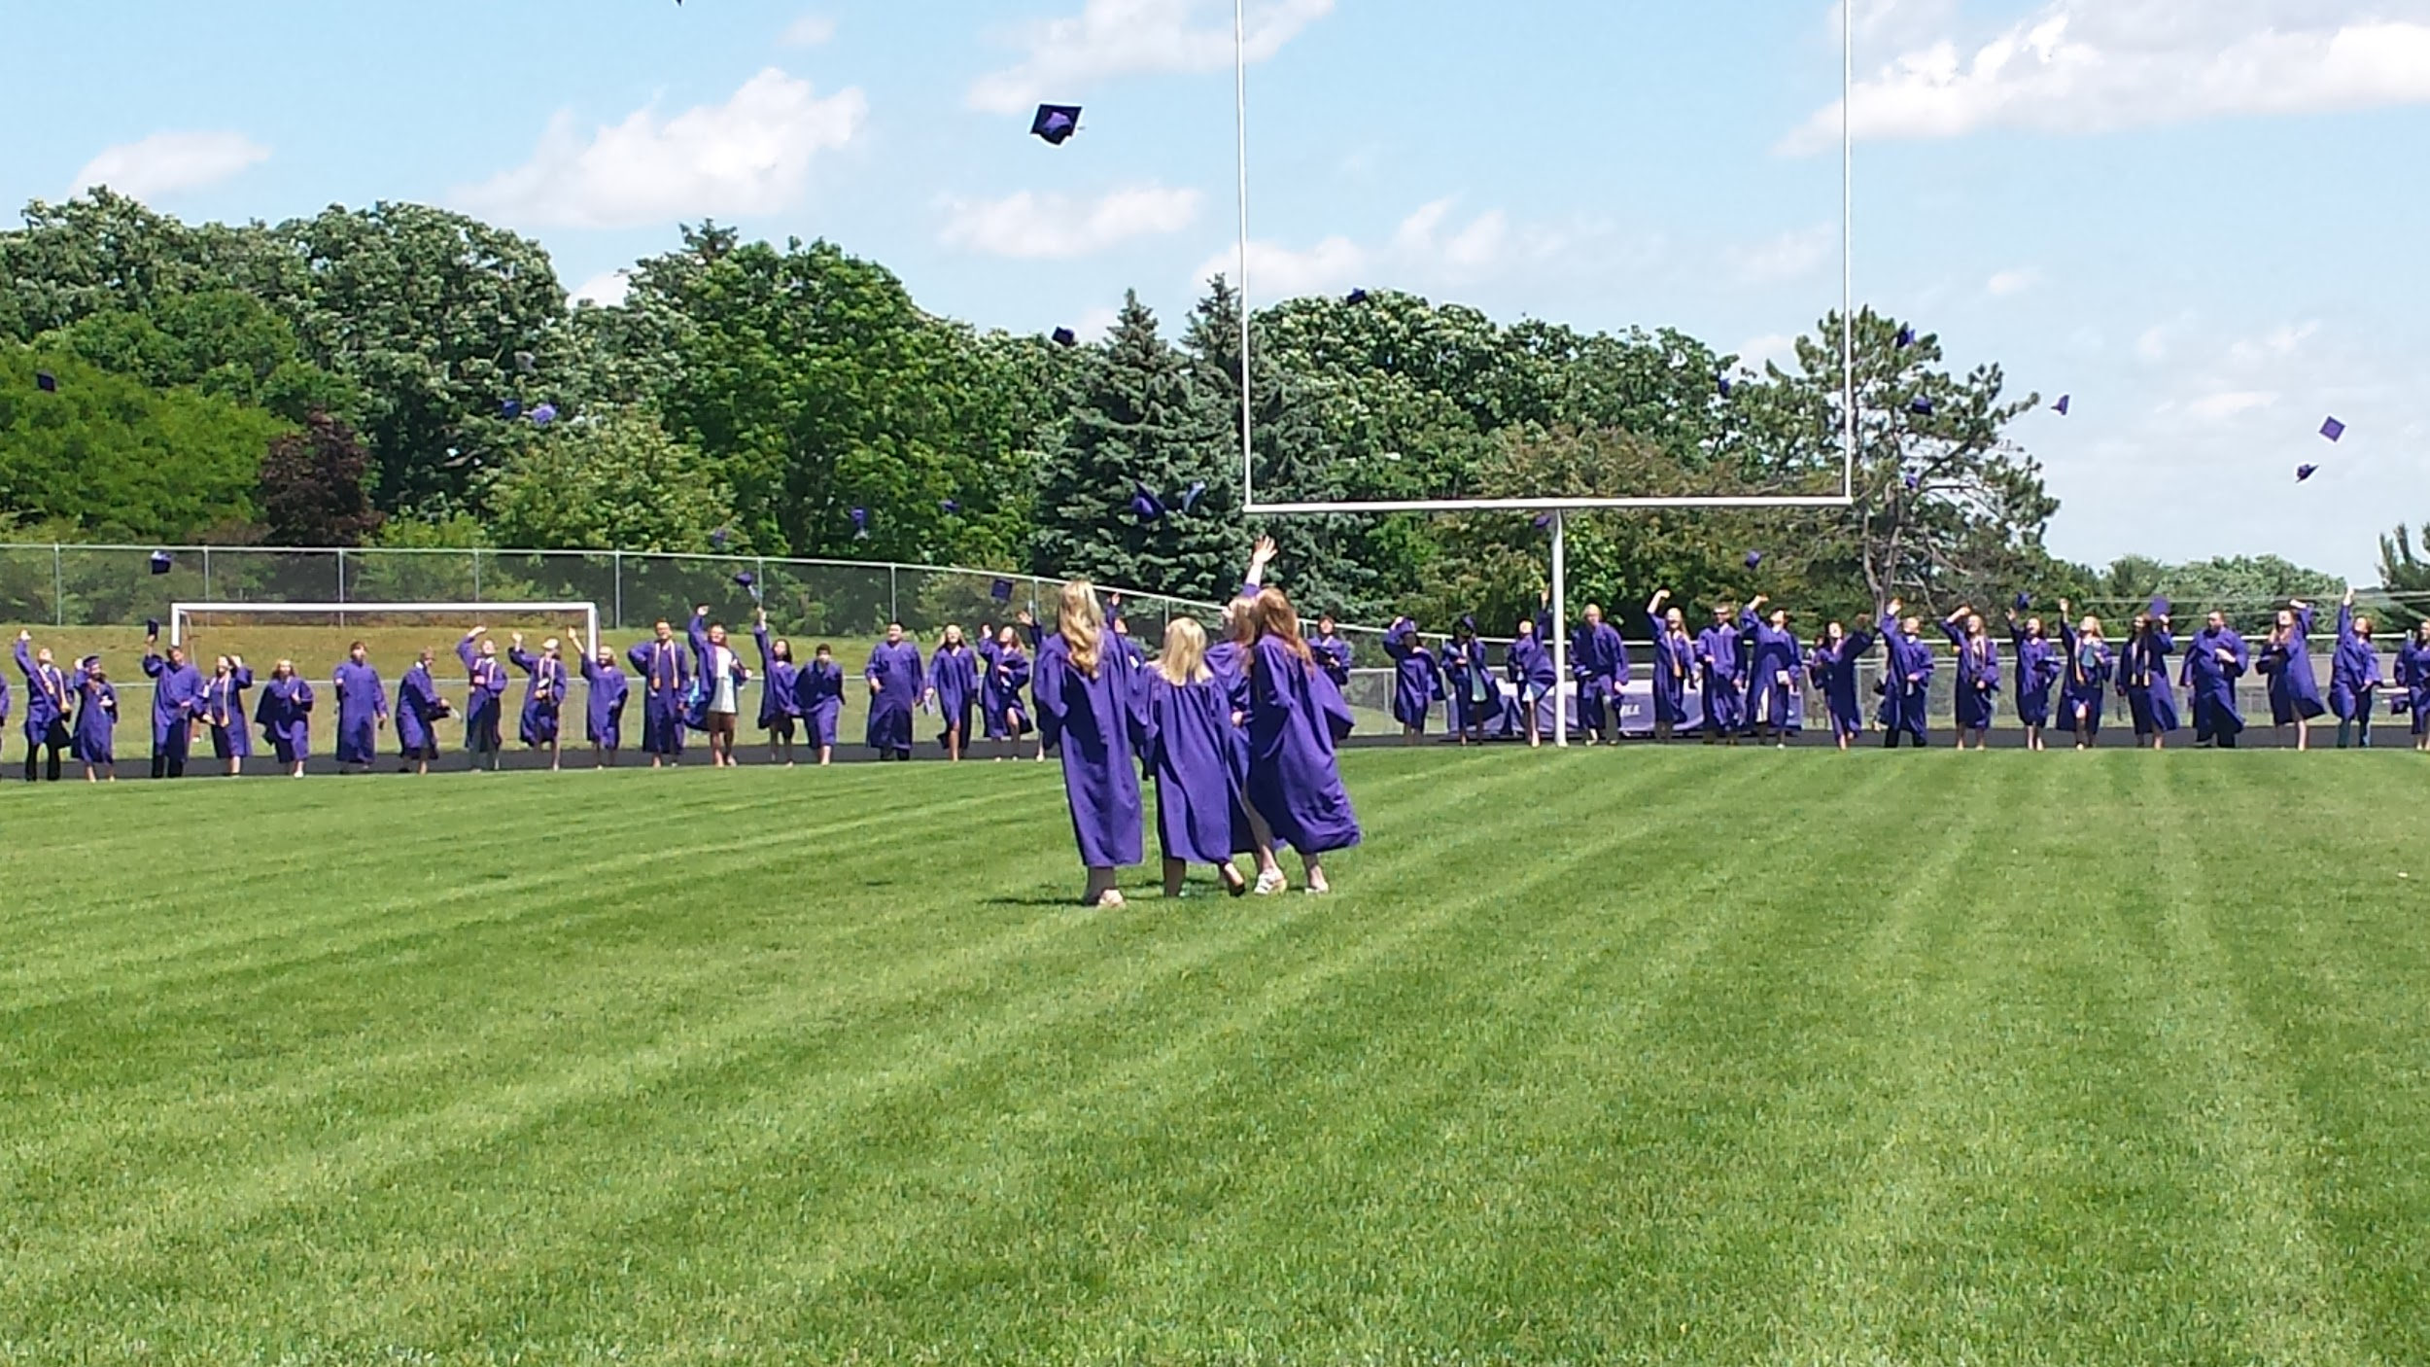
Senioritis
senior year courses and grades matter!
all offers of admission are contingent upon successful completion of senior year courses
offers of admission can be rescinded
once admitted, students must run all schedule changes by the college

Slide 31
Senior Appointments
The counselors will be holding individual senior appointments in early September. We will go over the information provided tonight with your senior and answer any specific questions they may have.

Slide 32

Questions….

