Slide 1
Budget Advisory Committee
December 16, 2024 Meeting
Tumwater School District

Slide 2
Agenda Topics
Update – Where Are We At Financially
    Review Key Finance Indicators
    Interfund Loan Proposal
Statewide & District Trends
Discussing Different Reduction Options
Discussion

Slide 3
FY 2024 Year-End Financial Review “Fast Facts”
Total Budget: $134.3 million in expenditures
  $114.5 in the General Fund
Total Enrollment: 6,518.4 FTE
  5,892.6 FTE when excluding Running Start, New Market S.C., and Open Doors
Total staff: 738.24 FTE
  Certificated staff: 447.5 FTE (S-275 State Report)
  Classified staff: 290.74 (S-275 State Report)
Spending & Funding
  75% of Revenue is from the State
  80.5% of Spending on Compensation-Related Items

Slide 4
-$4.52 million

Slide 5
September 2024 was lowest September cash balance in the last 6 years; October was second lowest October. November is back to lowest.

Slide 6
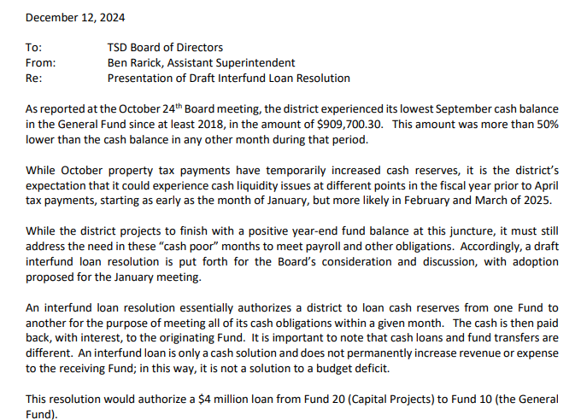
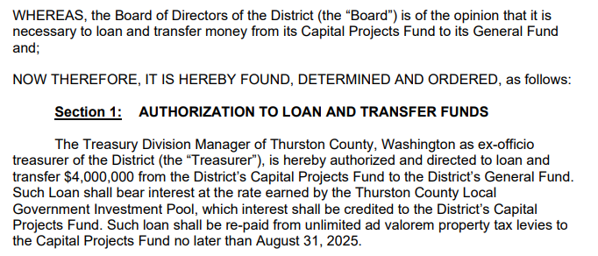
The Purpose of an Interfund Loan
Temporarily bolster cash reserves in revenue-lean months (typically March, June)
Source: Tumwater School District - Meeting Information (12/14/2024)

Slide 7
Statewide Trends

Slide 8
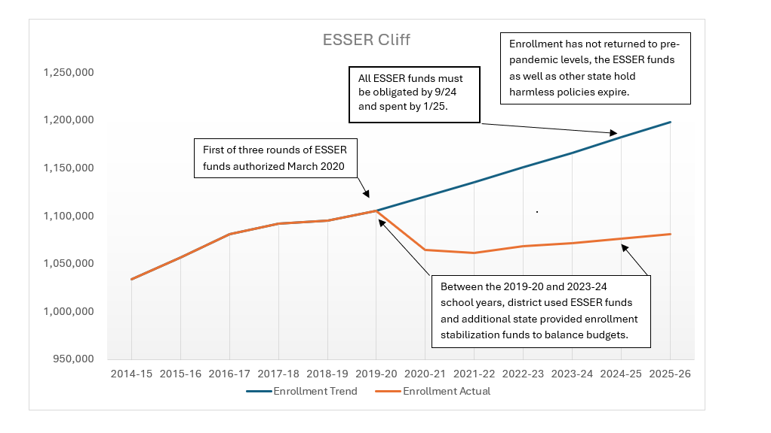
Funding gap filled by ESSER and one time state funds.
16

Slide 9
Inflation Adjusted K–12 Spending & Funding Per Student
K–12 Spending
Funding Per Student
Source: Office of Superintendent of Public Instruction

Slide 10
Tumwater Trends

Slide 11
The Impact of ESSER/CARES Funding
Funds are non-renewing, creating a budget ‘hole’

Slide 12
Certificated Staff since 2014
S-275 Report

Slide 13
TSD Classified Staff since 2014
From S-275 Report

Slide 14
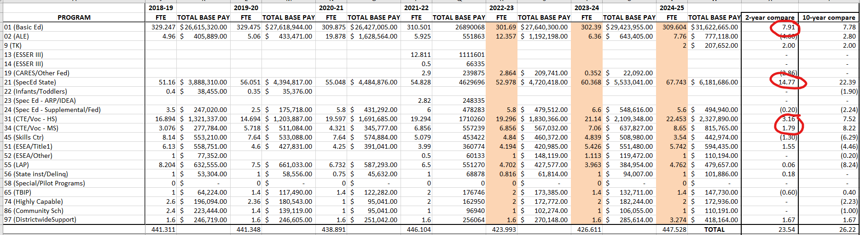
Certificated staff by Program
Disaggregated 6 year look-back

Slide 15
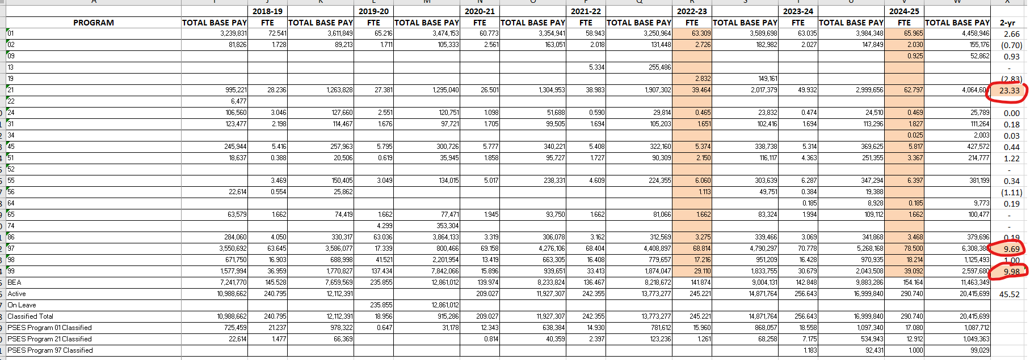
Classified staff by program
Disaggregated, 6 year look-back

Slide 16
TSD Enrollment
Growth in the brown (NMSC) and green (running start) can obscure the slow decline of orange (students served in TSD elem. & secondary schools)

Slide 17
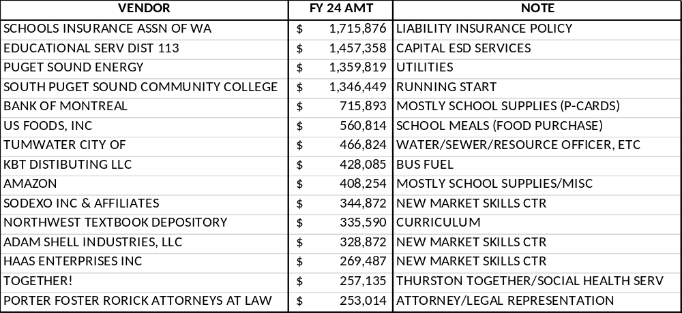
LARGEST NON-SALARY VENDORS IN TSD
FISCAL YEAR 2024

Slide 18
Budget options

Slide 19
Budget Options – A Primer
Budget options are derived from the best current information available.
The Concept is to ground your reduction efforts in a philosophy or specific goal, rather than something that lacks a strategic grounding.
The size of a budget problem is necessarily fluid and is very likely to change based on bargaining, the outcome of the state legislative session, enrollment, and other factors.

Slide 20
Budget Option A
Option A – “Stop Digging”
  Eliminate the budget deficit, but unlikely to make up any ground toward building back the fund balance.
  Approximately $4.5 million

Slide 21
Budget Option B
Option B – “Avoid the Interfund Loan”
  Eliminate the budget deficit, and, in theory, build a modest operating surplus to avoid needing monthly cash loans to meet payroll/warrant obligations.
  Approximately $6 million

Slide 22
Budget Option C
  Option C – “Compliance with Board Policy in 1 Year”
  Eliminate the budget deficit, and, in theory build a larger operating surplus to get to a 6% unassigned fund balance.
      Unassigned means we are counting only those pots of fund balance which are unrestricted by state and federal categorical requirements (Exclusionary examples: New Market Skills Center, Non-spendable fund balance/inventory)
  Approximately $8.5 million

Slide 23
Questions?

