Slide 1
Budget Advisory Committee
Tumwater School District
November, 2024

Slide 2
-$4.52 million

Slide 3

“Three Sisters” Mountain Range in Oregon
Three ‘peaks’ in a fiscal year. Concentrate on the valleys (Sept, March, June), not the peaks (Oct, April).

Slide 4
September 2024 was lowest September cash balance in the last 6 years; October was second lowest October.

Slide 7
(COVID)
Notes:
Post your comments here

Slide 9
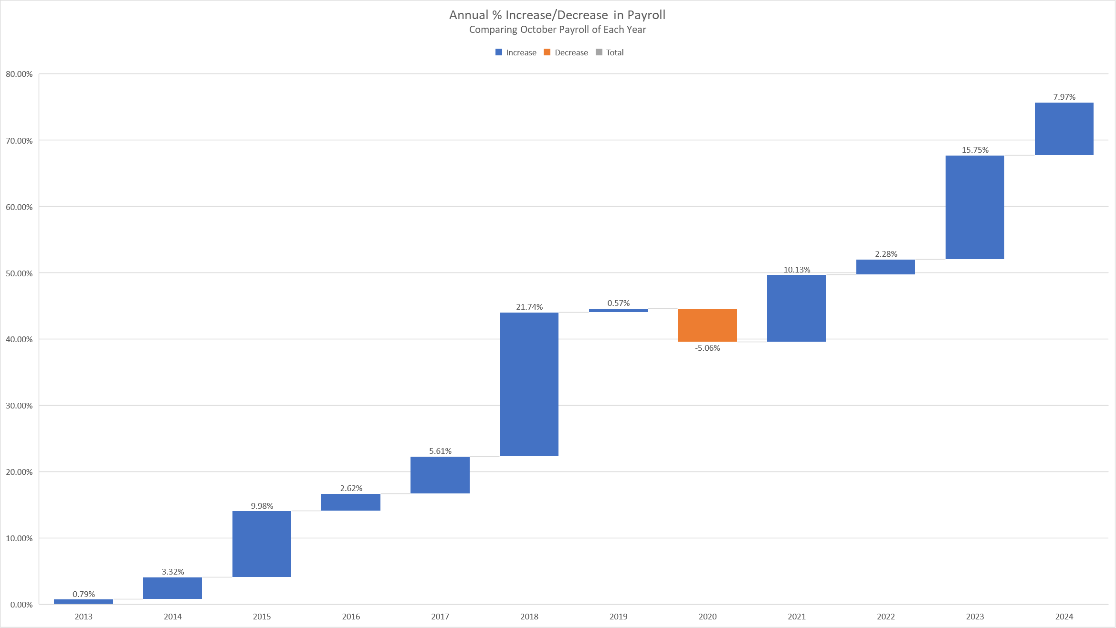

Slide 10
Tsd historical enrollment from ospi 1251 reports
Growth in the blue (NMSC) and orange (running start) can obscure the slow decline of green (students served in TSD schools)

Slide 11
TOTAL EST. EXPENSE: $1.82 MILLION
Notes:
Collapse 613 & 614 & TAP Extra

Slide 12
TOTAL EST. EXPENSE: $3.85 MILLION
Notes:
Time-sheeted site team could go into curriculum rate (different rates)
Per diem by program – actual rate
Categorized extra time

Slide 13
Questions?

Slide 18
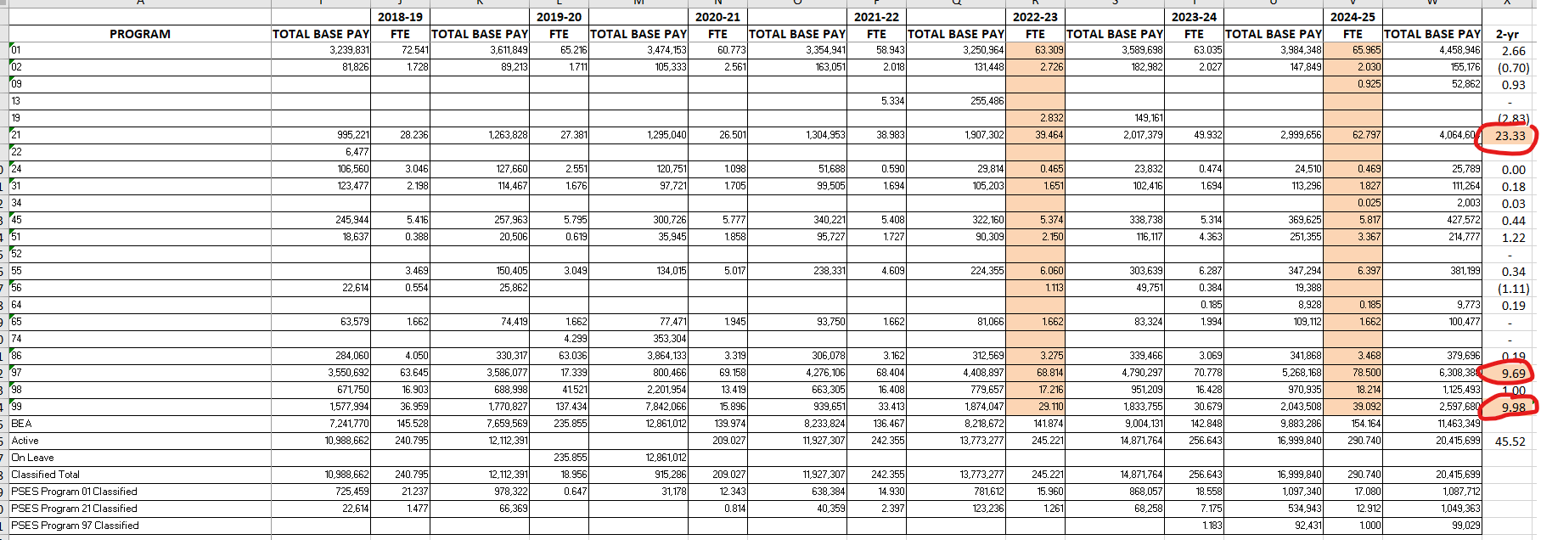
classified staff by program
6 yr look-back

Slide 19
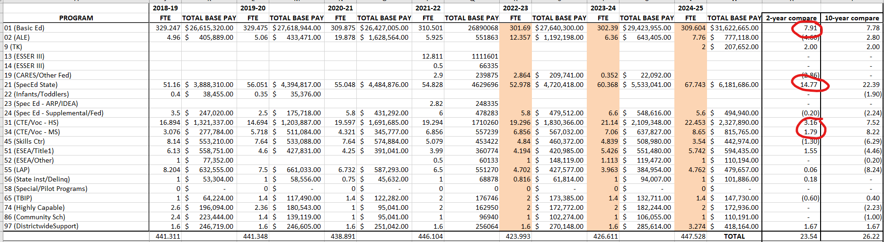
certificated staff by program
6 yr look-back

