Slide 1









January Character Trait
PUNCTUALITY
PUNCTUALITY

Slide 2







Teachers…
In the presentation, students will learn what it means to have PUNCTUALITY in different situations.
Each slide will contain interactive activities and guided questions for “Bringing Out The Best” PUNCTUALITY Character Trait
for grades 6-8.
PUNCTUALITY

Slide 3





Campus Matrix
PUNCTUALITY

Slide 4









Lesson Objectives
Define what it means to be PUNCTUAL
Examples of PUNCTUALITY
Identify ways to be PUNCTUAL at home and school
Self-Reflect on ways being PUNCTUAL helps me
PUNCTUALITY

Slide 5






Definition of
Punctuality
Punctuality is consistently being on time.
PUNCTUALITY

Slide 6
District Video
PUNCTUALITY

Slide 7









Video Reflection
Share any reflections you may have after watching this video about what Punctuality.
Can you think of a time you or someone else showed Punctuality?
Discuss what happened.
PUNCTUALITY

Slide 8




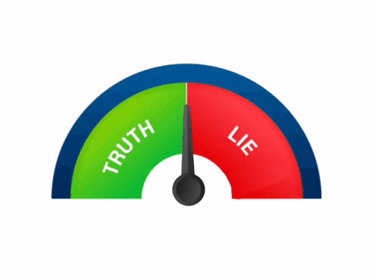
Toddler Class Adviser
TRUE OR FALSE?
'Students will answer questions that are TRUE or FALSE.
Students will stand if they believe the statement is TRUE and remain seated if they believe the statement is FALSE.
Teachers will ask for feedback after each statement.
PUNCTUALITY
Notes:
You can also have students raise a hand if it true.

Slide 9
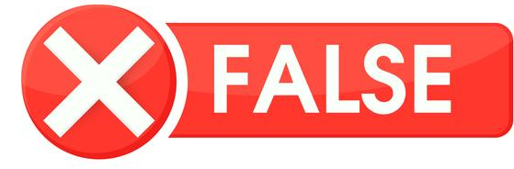

Toddler Class Adviser
TRUE OR FALSE?
If a student states they were in the restroom after the tardy bell, they should not be counted as tardy…
2. A student visits another teacher and is tardy to class without a pass. They should be marked tardy.
3. Students arriving late to class do not affect the learning environment…
PUNCTUALITY

Slide 10

Toddler Class Adviser
TRUE OR FALSE?
4. Turning in your assignment past the due date, should not have points deducted…
5. In the future, being late to your job everyday may cause you to be fired…
6. Being on time to class, shows respect and honoring others time…
7. Being late to class, does not cause a student to miss instruction...
PUNCTUALITY

Slide 11





RISE and FALL of PUNCTUALITY
Here is a list of possible benefits of punctuality.
The teacher will read each one.
Students will RISE (stand up) if they think this is a benefit and FALL (sit) if it is not a benefit.
Teachers will ask for feedback and discuss after each statement.
People think you are responsible.
You get full credit for your work.
People think you are inconsistent.
You gain self-confidence.
People think you do not care.
You have more stress.
People think you are self-motivated.
It hurts your reputation.
People respect you more.
PUNCTUALITY

Slide 12
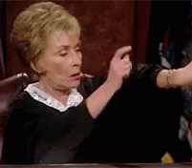
THINK-PAIR-SHARE
Rate yourself 1-5 on punctuality. 1 being late to class everyday and 5 being on time everyday.
Why do you think punctuality is important? Provide an example.
Now that you know what punctuality means, is there a time or situation where you could have been more punctual? Explain
PUNCTUALITY
Notes:
Ask students to think-pair-share their thoughts about punctuality.

Slide 13
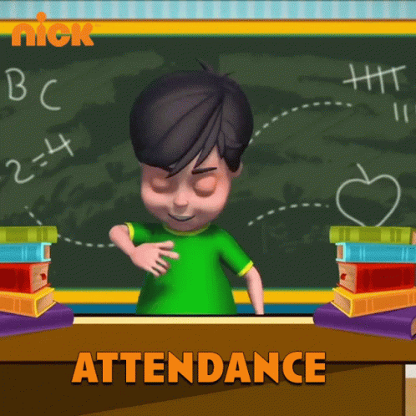
Home Activities
  PROVIDE AN EXAMPLE WHEN YOU DISPLAYED PUNCTUALITY AT SCHOOL OR AT HOME. PUNCTUALITY PROVIDES AN “I CARE” ATTITUDE AND WILL INSTILL PROFESSIONALISM IN THE FUTURE.
  DISCUSS PUNCTUALITY WITH YOUR PARENT. SET UP A SCHOOL SCHEDULE WITH YOUR PARENT AND INCLUDE DUE DATES FOR ASSIGNMENTS.
  WHY IS HAVING PUNCTUALITY IMPORTANT? DISCUSS WITH YOUR PARENT THE IMPORTANCE OF COMING TO SCHOOL ON TIME.
PUNCTUALITY

Slide 14


Extension Lessons
WANT ANOTHER ACTIVITY TO CONTINUE
OUR TRAIT OF THE MONTH?
1. CREATE A COMPETITION BETWEEN EACH CLASS PERIOD THAT IS SHOWING PUNCTUALITY. PROVIDE THE CLASS WITH PBIS REWARDS
2. CLICK HERE ON WORD CLOUD CHOOSING WORDS WITH THE CLASS THAT DEFINES PUNCTUALITY IN THEIR OWN WORDS.
3.CREATE A CLASS SPOTIFY LIST HERE BASED ON THE CHARACTER TRAIT: PUNCTUALITY
PUNCTUALITY

