Slide 1

Punctuality
PK-2
January 2025

Slide 2
Punctuality
Define:
Identify:
Apply:
We will identify examples of punctual behavior.
We will demonstrate how to be punctual at school.
We will define punctuality.

Slide 3
Punctuality
Consistently being on time

Slide 4
Insert District Video Here:

Slide 5
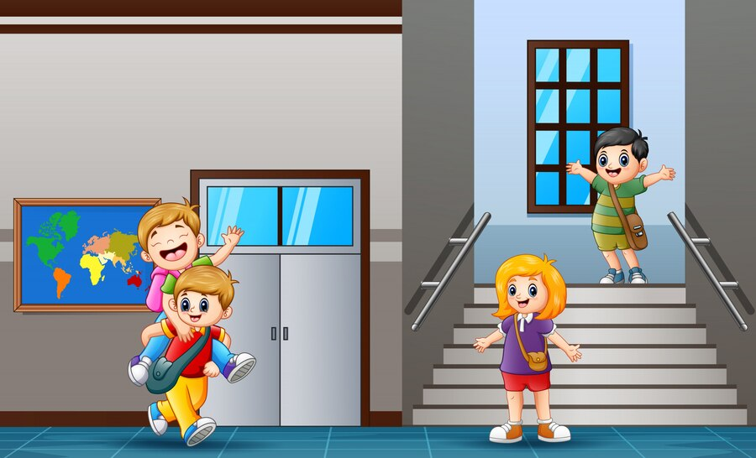
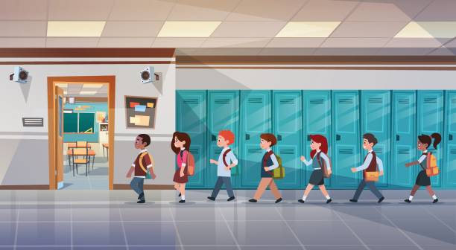
Which picture shows punctuality?
(Discuss which picture shows punctuality and explain why)
OR

Slide 6


Which picture shows punctuality?
(Discuss which picture shows punctuality and explain why)
OR

Slide 7


Which picture shows punctuality?
(Discuss which picture shows punctuality and explain why)
OR

Slide 8
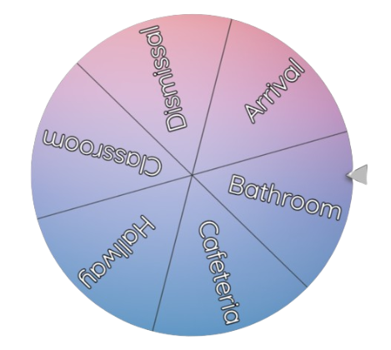

Spin the wheel to discuss how to be punctual at school.

Slide 9
Home Activity
Discuss ways to show punctuality outside of school.
Possible discussion points:
morning routine
night time routine
after school/weekend activities

