Slide 1

Mission, Vision & “Circle of Courage” Values

Slide 2

To create new and innovative school choice opportunities in Central Texas
Mission Statement

Slide 3
To be a leader in the school choice movement
Vision Statement

Slide 4
Values
Circle of Courage
Philosophy
Belonging
Mastery
Independence
Generosity

Slide 5

State of Public Ed at Federal Level

Slide 6

State of Public Ed in Texas

Slide 7

State of Public Ed at Orenda

Slide 8

Strategic Plans for 2019-20 & Beyond

Slide 9

Sweet Spot for Max Efficiency
2,000 Students & $20 M Operating Budget

Slide 10
School Year 2019-20 Goals
District Wide Enrollment Reaches 1,900

Slide 11
School Year 2019-20 Goals
District Wide Enrollment Reaches 1,900
Raise $600,000 in charitable contributions

Slide 12
School Year 2019-20 Goals
District Wide Enrollment Reaches 1,900
Raise $600,000 in charitable contributions
Implementation of Leadership Succession Plan

Slide 13
School Year 2019-20 Goals
District Wide Enrollment Reaches 1,900
Raise $600,000 in charitable contributions
Implementation of Leadership Succession Plan
Successfully implement phase 2 of our distance learning innovation project

Slide 14
School Year 2019-20 Goals
District Wide Enrollment Reaches 1,900
Raise $600,000 in charitable contributions
Implementation of Leadership Succession Plan
Successfully implement phase 2 of our distance learning innovation project
Complete the written Master Plan & secure funding for the new Gateway south campus

Slide 15
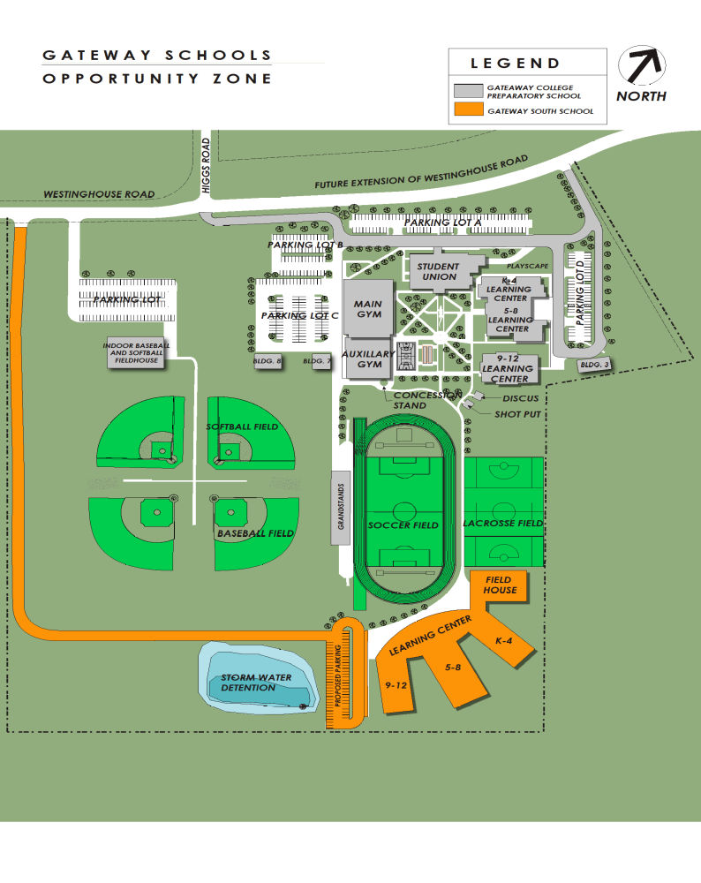

Slide 16
Key Targets

Slide 17
STAAR scores better than nearest ISD public school

Slide 18
STAAR scores better than nearest ISD public school
Gateway Prep ranked in top 50 in Texas by US News and World Report, top 10 in Austin area

Slide 19
STAAR scores better than nearest ISD public school
Gateway Prep ranked in top 50 in Texas by US News and World Report, top 10 in Austin area
100% of our graduating seniors from our college prep campuses pass at least one AP exam

Slide 20
STAAR scores better than nearest ISD public school
Gateway Prep ranked in top 50 in Texas by US News and World Report, top 10 in Austin area
100% of our graduating seniors from our college prep campuses pass at least one AP exam
SAT ave. score of 1200 for all college bound seniors

Slide 21
STAAR scores better than nearest ISD public school
Gateway Prep ranked in top 50 in Texas by US News and World Report, top 10 in Austin area
100% of our graduating seniors from our college prep campuses pass at least one AP exam
SAT ave. score of 1200 for all college bound seniors
ACT ave. score of 25 for all college bound seniors

Slide 22
“Superior Achievement” - F.I.R.S.T. rating

Slide 23
“Superior Achievement” - F.I.R.S.T. rating
BBB + Standard & Poor’s global bond rating

Slide 24
“Superior Achievement” - F.I.R.S.T. rating
BBB + Standard & Poor’s global bond rating
First charter school to win the UIL “Lone Star Cup” or Austin American-Statesman “Breazeale Cup” for athletic achievements

Slide 25
Strategic Plans for 2020 and Beyond

Slide 26
Strategic Plans for 2020 and Beyond
August 2020 > Secure financing and finalize the plans for Gateway South campus

Slide 27
Strategic Plans for 2020 and Beyond
August 2020 > Secure financing and finalize the plans for Gateway South campus
March 2021 > Begin construction of the new Gateway South campus

Slide 28
Strategic Plans for 2020 and Beyond
August 2020 > Secure financing and finalize the plans for Gateway South campus
March 2021 > Begin construction of the new Gateway South campus
August 2022 > Open Gateway South campus

Slide 29
Strategic Plans for 2020 and Beyond
August 2020 > Secure financing and finalize the plans for Gateway South campus
March 2021 > Begin construction of the new Gateway South campus
August 2022 > Open Gateway South campus
Five years from now > Operate 6 campuses w 3,000 students

Slide 30
Strategic Plans for 2020 and Beyond
August 2020 > Secure financing and finalize the plans for Gateway South campus
March 2021 > Begin construction of the new Gateway South campus
August 2022 > Open Gateway South campus
Five years from now > Operate 6 campuses w 3,000 students
Ten years from now > Operate 7 campuses w 4,000 students

Slide 31
Promoting Courage In Our Students

