Slide 1
2018-2019 Testing Coordinator Training
Student Assessment division
Texas education Agency
October 2018

Slide 2

Agenda
  Welcome and Introductions
  Student Assessment Updates
    Policy Updates
    Test Administration
    Test Security
  Lunch
    Accessibility
    STAAR ALT 2 Updates
    TELPAS Updates
    TELPAS ALT Updates
  STAAR Assessment Management System
  STAAR ALT 2 Administration
  TELPAS Administration
  TELPAS ALT Administration

Slide 3
Welcome and Introductions

Slide 4

Student Assessment Updates
Policy Updates
Test Administration
Test Security
Accessibility
STAAR Alternate 2
TELPAS
TELPAS Alternate
This Photo by Unknown Author is licensed under CC BY

Slide 5

Policy and Communications Updates
Changes in Commissioner’s Rule
STAAR Substitute Assessments
TAKS Graduation Requirements
Coding for Former TAKS Examinees
STAAR Writing Prompt Field Test
Communications

Slide 6
Changes in Commissioner’s Rules
TAC §101.3011, Implementation and Administration
  Requires districts to use SAT or ACT to meet federal testing requirements for students who take STAAR EOC assessments prior to high school.
  Posted for public comment August 24 through September 24, 2018.
  Proposed effective date is November 25, 2018.
TAC §101.4002, STAAR End-of-Course Substitute Assessments
  Provides updates and clarifications for the use of substitute assessments.
  Proposed posting for public comment is October 19 through November 19, 2018.
  Proposed effective date is January 21, 2019.
TAC §101.3031, Required Test Administration Procedures
  Updates the rule by removing the Security Supplement and adding a Test Security Policy.
  Posting for public comment is planned for October or November.
  Effective date is planned for February 2019.

Slide 7
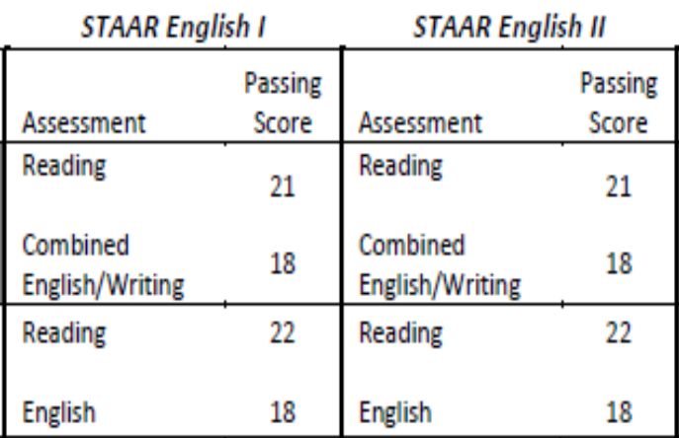
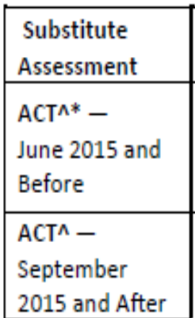
STAAR Substitute Assessments—Overview
TAC §101.4002 Requirements
  A student elects to use a substitute assessment for graduation purposes.
  A student takes a substitute assessment and receives a passing score as indicated in the chart.
  Substitute assessments include ACT, AP, and IB.
  *In most cases, a score on a substitute assessment can be used for only one STAAR EOC assessment.
  ACT can be used for either English I or English II but not both.
  Additionally, ACT can be used for Algebra I and Biology.
  *See TSI slide, paragraph 1.
English I OR English II
NOT both

Slide 8
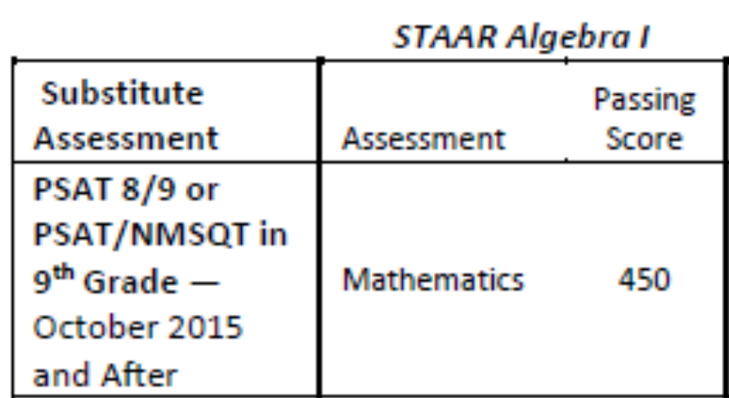
STAAR Substitute Assessments—SAT and PSAT
SAT
  SAT can be used for either English I or English II but not both.
  Additionally, SAT can be used for Algebra I.
  SAT Subject Tests can be used for Algebra I, Biology, and U.S. History.
PSAT
  PSAT can be used for English I and Algebra I.
  PSAT 8/9 taken in grade 8 can be used.

Slide 9
STAAR Substitute Assessments—TSI
Texas Success Initiative (TSI) Assessment
  Students may qualify to use TSI as indicated in TAC §101.4002 subsection (d) paragraph (1) or (2).
Paragraph 1
  A student must be enrolled in a college preparatory course (CP110100 and CP 111200).
  A student must have taken the TSI at the end of that course.
  If a student meets all three ELA scores, TSI can be used for BOTH English I and English II.
  Additionally, a student can use TSI for Algebra I.
Paragraph 2
  A student must have taken EOC assessment and failed at least two times.
  If a student meets all three ELA scores, TSI can be used for English II only.
  Additionally, a student can use TSI for Algebra I.

Slide 10
STAAR Substitute Assessments—Verification
TAC §101.4005, Verification of Results
  A student is responsible for providing to the district an official copy of his or her scores from a substitute assessment.
  A district must verify that the official scores meet the passing score listed in the substitute assessment chart.
  Verification must occur prior to the student taking the test during that administration.

Slide 11
Graduation Requirements for Former TAKS Examinees
Former students for whom TAKS is a graduation requirement, including former TAAS and TEAMS examinees, may pursue either of the following options to receive a Texas high school diploma.
Request a district decision.
  Contact school district last attended.
  Provide information to see if he or she qualifies to graduate and receive a diploma.
  Refer to TAC §74.1027 for additional information.
  Call the Curriculum Standards and Student Support Division with questions → 512-463-9581.
  Achieve satisfactory performance on an alternate assessment.
  Includes SAT, ACT, TSI, and STAAR.
  Refer to TAC §101.4003 for additional information.
  Call the Student Assessment Division with questions → 512-463-9536.

Slide 12
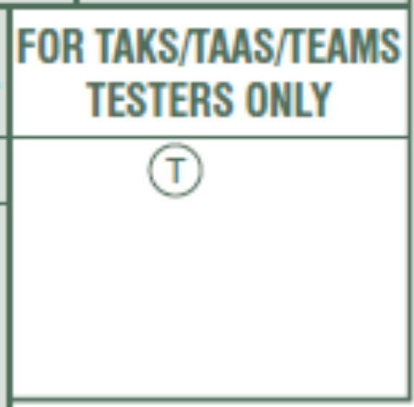
Coding for Former TAKS Examinees
If a former TAKS, TAAS, or TEAMS examinee chooses to take a STAAR test to fulfill his or her assessment graduation requirements, then district staff will need to mark the appropriate bubble on the STAAR answer document.
  English I, English III, and Algebra II cannot be used as an alternate assessment.
  For Algebra I, mark “T” if an eligible examinee is taking this test as an alternate for TAKS, TAAS, or TEAMS mathematics.
  For Biology and U.S. History, mark “T” if an eligible examinee is taking the test as an alternate for TAKS science or social studies, respectively.

Slide 13

Coding for Former TAKS Examinees (cont.)
If a former TAKS, TAAS, or TEAMS examinee chooses to take a STAAR test to fulfill his or her assessment graduation requirements, then district staff will need to mark the appropriate bubble on the STAAR answer document.
  For English II, mark
    “T” if an eligible examinee is taking this test as an alternate for TAKS ELA.
    “R” if an eligible examinee is taking only the reading section of this test as an alternate for TAAS or TEAMS reading.
    “W” if an eligible examinee is taking only the writing section of this test as an alternate for TAAS writing.
    “RW” if an eligible examinee is taking both the reading and writing sections of this test as an alternate for TAAS reading and writing.

Slide 14
STAAR Writing Prompt Field Test
Stand-alone field test for writing prompts at
  Grade 4 English and Spanish
  Grade 7
  English I
  English II
Administered on paper only during a testing window, February 11–14, 2019.
If campus is selected, need to test all eligible students.

Slide 15
Communications Updates
Bi-Weekly Vendor Emails
  Working to streamline information so the emails aren’t so long.
  Working to post detailed information in a more convenient location.
Student Assessment Newsletter
  Will be sending a newsletter out later this fall.
  Please let us know what is and is not helpful.
Student Assessment Website
  Look at TEC and TAC References for the Texas Assessment Program.
  Posting student assessment emails at https://tea.texas.gov/student.assessment/correspondence/.
  Will be working to make organizational structure user based instead of program based.

Slide 16
Break

Slide 17

Test Administration
Testing Calendar
Calendar of Events
New District and Campus Coordinator Resources
Manuals and Resources
Collection of Oaths for Spring-June 2018
Oaths for 2018-2019 School Year
Answer Documents Updates
New Online ADPL
Medical Exclusions Policy for 2018-2019
Participation Counts
STAAR Calculator and Dictionary Policy

Slide 18
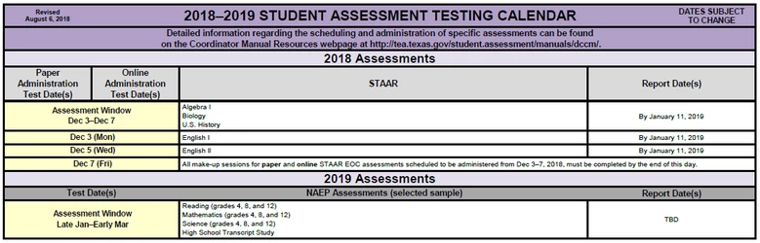
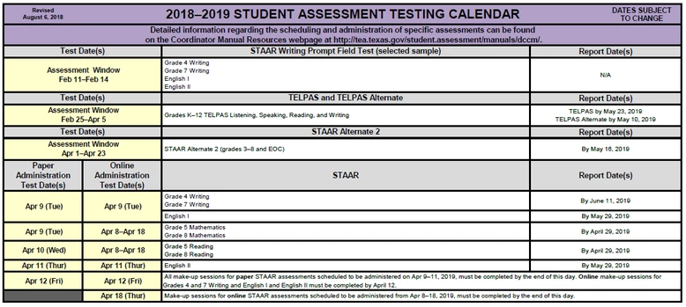
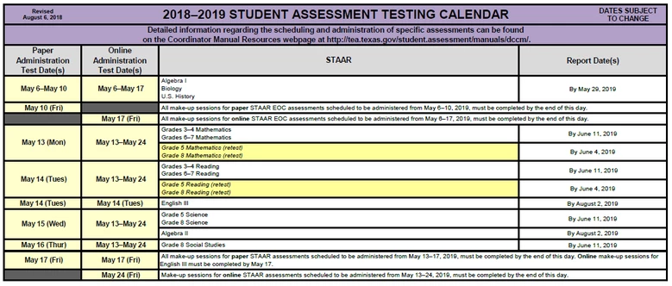
Testing Calendar
  In order to provide districts with more flexibility to administer online tests, additional time has been added to the assessment window for multiple choice assessments administered online.
  Districts are encouraged to take advantage of this additional time.
  The Testing Calendars can be found at: https://tea.texas.gov/student.assessment/calendars/

Slide 19
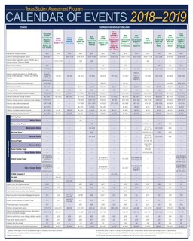
Calendar of Events
  The Calendar of events for the 2018-2019 School year has already been posted to allow districts to begin planning their assessment activities
  The Calendars of events can be found at: https://tea.texas.gov/student.assessment/calendars/
  Poster-sized copies of the CoE have been shipped to districts
  Also available on the new District and Campus Coordinator Resources

Slide 20
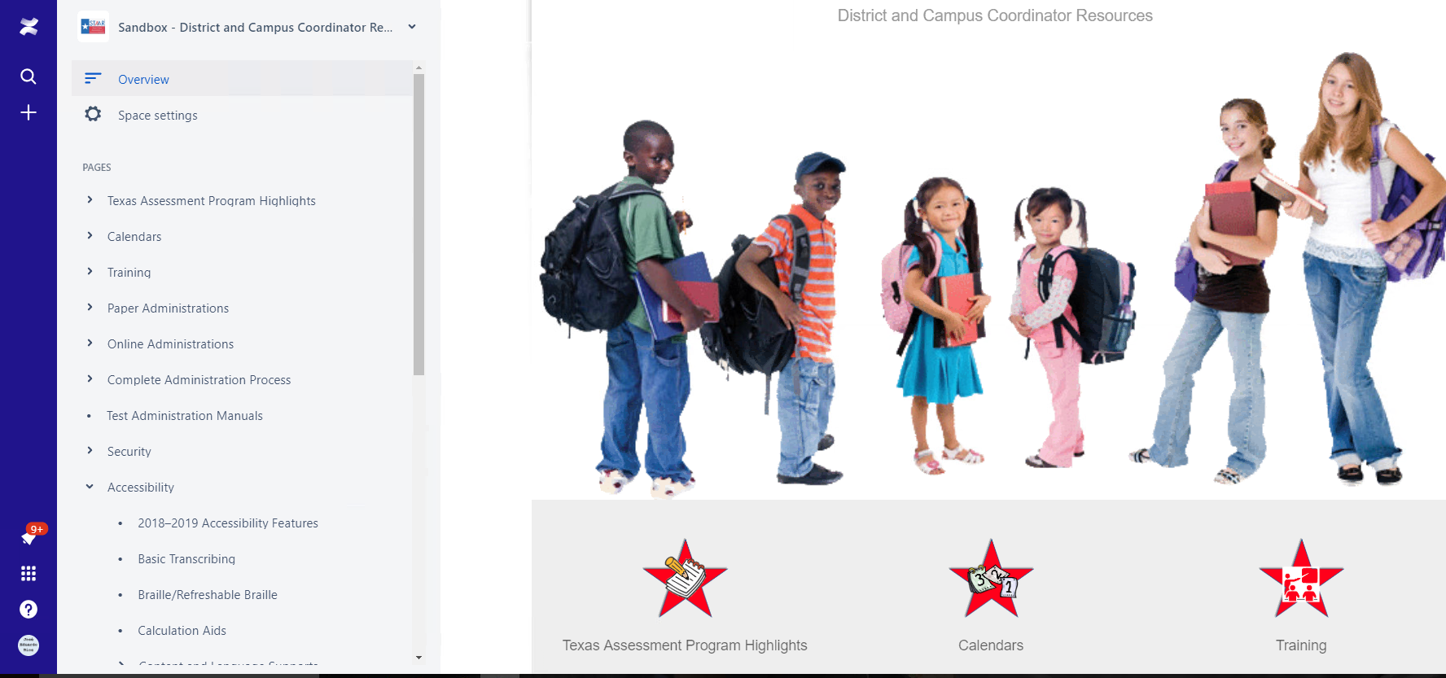
District and Campus Coordinator Resources (DCCR)
To improve the testing coordinators’ user experience, the Texas Education Agency (TEA) will be providing a new digital District and Campus Coordinator Resources (DCCR)
Replaces the previous printed manual. This resource will not be printed and shipped
Separated into sections to find information more efficiently
Mobile web version available
The new DCCR is available at:
http://txetests.com/dccr

Slide 21
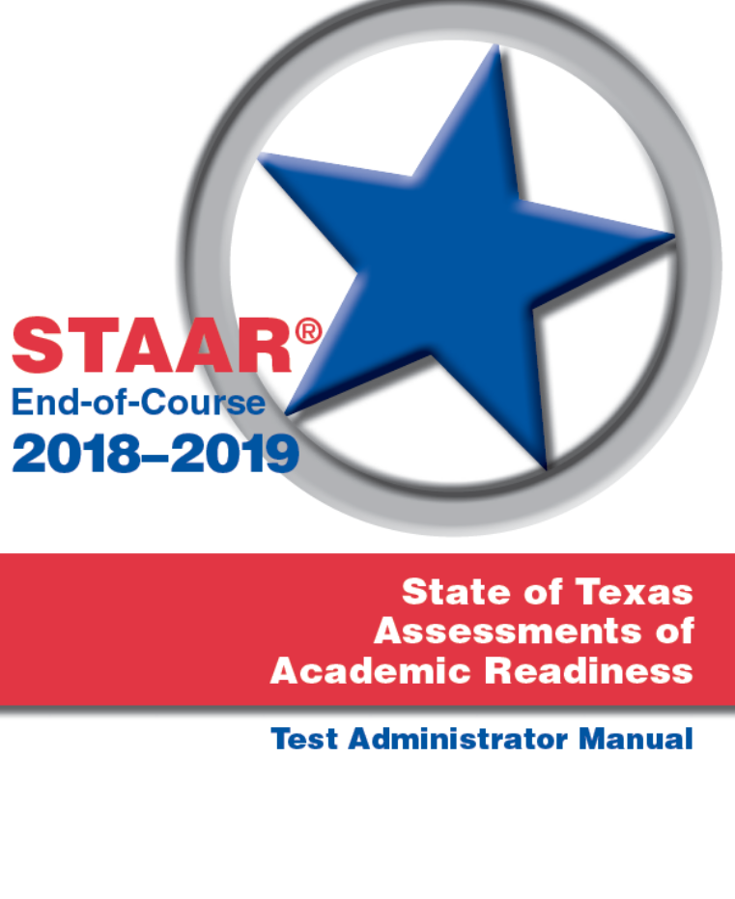
Manuals and Resources
  December 2018 test administrator manual (TAM) will be shipped with the all the December administration testing materials
  Valid for all 2018-2019 school year
  New TELPAS Manual for Raters and Test Administrators
  As they become available, all administration manuals will be posted in the new District and Campus Coordinator Resources

Slide 22
Collection of Oaths for Spring-June 2018
  As we transition to align our policies with the school year calendar, District Testing Coordinator and District Superintendent/Chief Administrative Officer oaths of Test Security and Confidentiality for spring 2018 and June 2018 will be due by the end of November 2018.
  Signed copies of the oaths for District Coordinator and District Superintendent/Chief Administrative Officer for Spring 2018 and June 2018 can be returned by mail, or districts can submit an electronic copy (scanned copy) by email. Districts can also use the new interactive oath included in the new District and Campus Coordinator Resources.

Slide 23
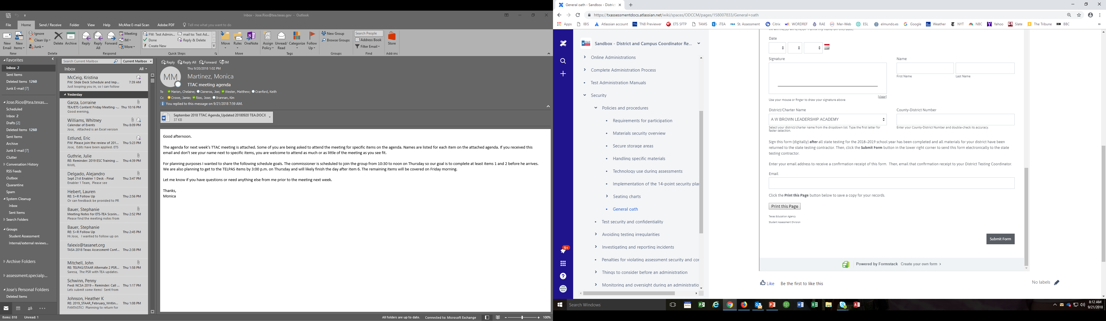
Oaths for 2018-2019 School Year
  Beginning with the December 2018 administration, only three oaths of Test Security and Confidentiality will be available:
    District Testing Coordinator
    District Superintendent/Chief Administrative Officer
    General oath (for all other roles involved in the Texas assessment program).
  District Coordinator and the District Superintendent/Chief Administrative Officer oaths will need to be submitted by end of summer 2019.
  Signed General Oaths don't have to be submitted to the testing contractor; however, districts
  are required to securely maintain copies of
  these documents.
  The new District and Campus Coordinator
  Resources includes the interactive oath
  that will allow districts to submit signed oaths
  directly from the resource.

Slide 24
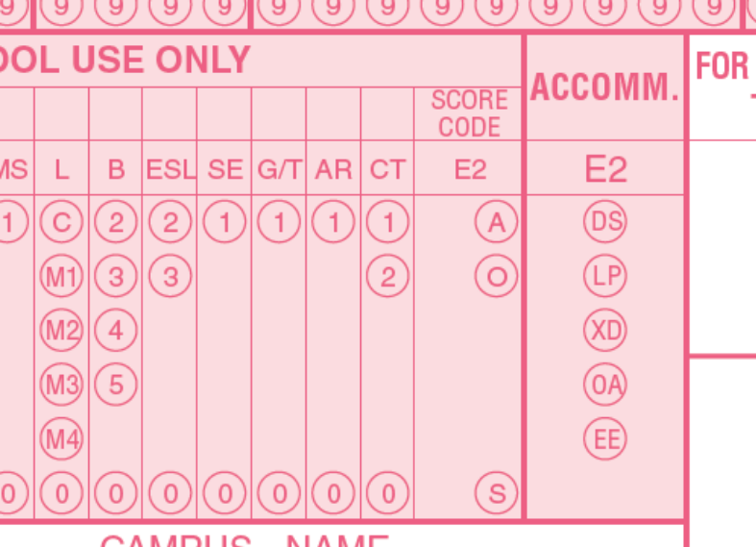
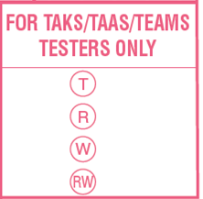
Answer Documents Updates
  LEP field has been expanded to include
  M3 and M4
  New accommodation codes
  New TAKS/TAAS/TEAMS TESTERS ONLY field,
    (will no longer require the Agency Use field)
  Test date field has been removed

Slide 25
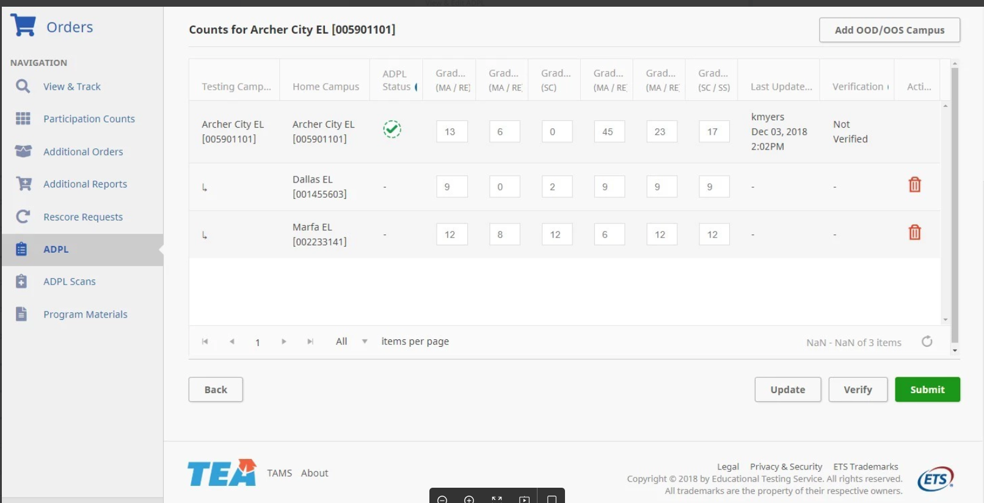
New Online ADPL
  A new answer documents packing list (ADPL) feature in the STAAR Assessment Management System allows districts and campuses to enter final paper counts online and submit these counts electronically.
  Beginning with December 2018 administration.
  District level users can view and update information for all the campuses in their district.
  Campus level users can view and update their own campuses only.

Slide 26
Medical Exclusion Policy for 2018-2019
Student must meet eligibility criteria throughout the whole testing window.
The district or charter school must review, verify, and maintain a copy of the medical documentation (e.g., licensed physician’s note).
To request a medical exclusion, the district testing coordinator must complete a Medical Exclusion Request form for each student who qualifies.
The form must be submitted for each STAAR administration.
A new form will be available before the December administration. Link will be available in the new District and Campus Coordinator Resources.
The student's answer document should be marked "A" for Absent.
TEA will conduct an audit at the end of the 2018-2019 school year to validate accuracy of submissions.

Slide 27
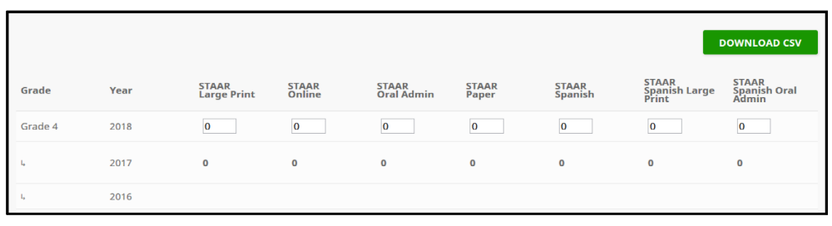
Participation Counts
History displays by actual tests taken by mode.
Default count equals prior year actual testers by subject/grade/mode.
Online and oral administration can be increased or decreased.
Paper and large print may not be increased over default count.
Counts do not reflect 10% district overage included with every shipment.
Additional materials can be ordered during additional materials order window.

Slide 28
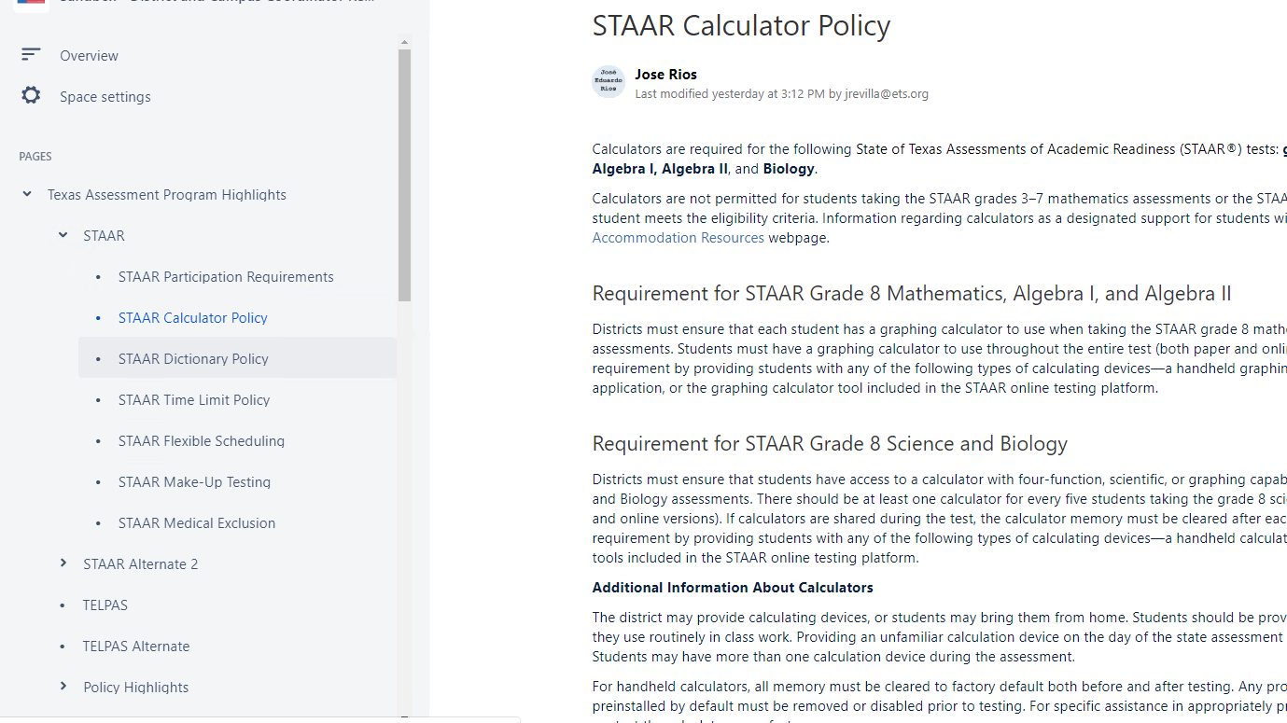
STAAR Calculator and Dictionary Policy
  Updated STAAR Calculator and STAAR Dictionary policies available in the new District and Campus Coordinator Resources and the STAAR Resources page.
  STAAR Calculator policy added language to remind districts about device functionality that may compromise the assessment.​
  STAAR Dictionary policy allows the use ​of dictionary applications on a tablet, laptop, or desktop.
  New Dictionary tool for online ​assessments.

Slide 29
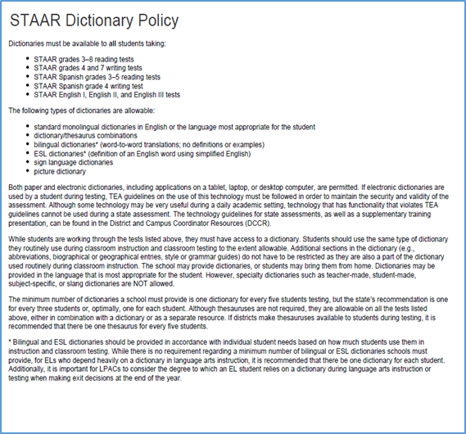
STAAR Dictionary Policy-Applications
  All technology use guidelines must be followed.
  Disable features during testing (e.g., access to the camera; browsing capability; access to email, text, social media, or games; ability to view videos, animations, or extensive text to explain a definition).
    More information to come in the technology guidelines training PPT.
  NOTE: Bilingual dictionary applications are NOT allowable as an Accessibility Feature.

Slide 30

Security
Maintaining the security and confidentiality of the Texas student assessment program is critical for ensuring fair and equal testing opportunities for all students. Given the high stakes associated with student performance and the need to assure parents, students, and the public that test results are meaningful and valid, it is imperative that individuals participating in the program preserve the integrity of all test content and student data through strict adherence to the instructions and procedures contained in the test administration manuals and resources.

Slide 31

Test Security and Confidentiality
Test security involves accounting for all secure materials before, during, and after each test administration. This includes:
  Identifying who can handle secure materials
    Individuals qualified to participate must:
      Be trained
      Sign a security oath
  Properly storing materials
    Consider location
    Limit access
  Tracking the chain of custody
    Document the transfer of materials through each stage
    of an administration
  Maintaining the integrity of tracking documentation
    Store securely
    Audit periodically

Slide 32
Test Security and Confidentiality
Confidentiality involves protecting all secure test content. Instruments that contain this content include:
  Test booklets
  Online assessments
  Online test tickets
  Completed answer documents
  STAAR Alternate 2 stimulus images and text
  TELPAS calibration activities and components for holistically rating student performance
  Compliance with confidentiality requirements involves:
  Training testing personnel on their obligations concerning confidentiality
  Monitoring administrations to ensure all assessments are administered in strict accordance with the test administration procedures
  Investigating and reporting any alleged or confirmed breaches

Slide 33
Testing Irregularities
Incidents resulting in a deviation from documented testing procedures are defined as testing irregularities. Test irregularities fall into one of two categories—serious or procedural.
  Serious Irregularities
  Constitute severe violations of test security or confidentiality
  Must be immediately investigated by the district testing coordinator
  Must be reported to TEA as soon as the district testing coordinator is made aware of a possible or confirmed violation
  Can result in the individual(s) responsible being referred to the TEA Educator Certification and Standards Division for consideration of disciplinary action

Slide 34
Testing Irregularities
  Serious Irregularities
  Conduct that constitutes a serious testing irregularity may include, but is not limited to, the following:
  directly or indirectly assisting students with responses to test questions
  tampering with student responses
  falsifying holistic ratings or student responses
  viewing secure test content before, during, or after an administration unless specifically authorized by TEA or by the procedures outlined in the test administration manuals
  discussing or disclosing secure test content or student responses
  scoring student tests, either formally or informally
  duplicating, recording, or electronically capturing confidential test content unless specifically authorized by TEA or by the procedures outlined in the test administration manuals

Slide 35
Testing Irregularities
  Serious Irregularities
  responding to secure test questions
  fraudulently exempting or preventing a student from participating in the administration of a required state assessment
  receiving or providing unallowable assistance during calibration activities (e.g., taking notes, providing answer sheets, or sharing answers)
  encouraging or assisting an individual to engage in the conduct described in the items listed above or in any other serious violation of security and confidentiality
  failing to report to an appropriate authority that an individual has engaged or is suspected of engaging in conduct described in the items listed above or in any other serious violation of security and confidentiality

Slide 36

Testing Irregularities
  Procedural Irregularities
  Reflect minor errors or deviations in testing procedures
  Do not represent severe breaches in security or confidentiality
  Do not require a call to TEA unless guidance is needed by the district
  Do not require supporting documentation to be submitted with the district’s incident report.

Slide 37
Penalties
Violations of test security and confidentiality can result in the individual(s) responsible being referred to the TEA Educator Standards and Certification Legal Division for consideration of disciplinary action.
Any person who violates, assists in the violation of, or solicits another to violate or assist in the violation of test security or confidentiality, as well as any person who fails to report such a violation is subject to the following penalties:
  placement of restrictions on the issuance, renewal, or holding of a Texas educator certificate, either indefinitely or for a set term
  issuance of an inscribed or non-inscribed reprimand
  suspension of a Texas educator certificate for a set term
  revocation or cancellation of a Texas educator certificate without opportunity for reapplication for a set term or permanently

Slide 38
Reporting
All confirmed testing irregularities must be reported to TEA within 10 working days via the Online Incident Report Form.
All reports must:
  explain what happened and how it occurred,
  clearly outline the sequence of events,
  include information about how the problem was resolved or remedied,
  include a district determination regarding the irregularity,
  provide a Plan of Action that the district will put into effect to prevent the incident from reoccurring, and
  include the name of the individual who assisted you (if TEA was contacted.)

Slide 39
Reporting
All serious violations require:
  TEA to be notified as soon as the district coordinator is made aware of an alleged or confirmed violation
  A prompt investigation to be conducted
  Additional documentation to be collected and submitted, including but not limited to:
    Signed and dated statements from the individuals involved
    A district determination regarding all violations allegedly committed
    Interview notes
    Any analyses conducted in support of the district findings
    Oaths and training confirmation for the individual(s) involved
    Any punitive actions taken against the individual(s) involved

Slide 40
2018 Recap
Most common irregularities reported in 2018 | Number
Accommodation not provided | 494
Exempt or ineligible student tested | 285
Unmonitored/improperly secured test material | 255
Failed to detect/prevent improper student behavior | 242
Provided unallowable accommodation | 230
Accepted blank answer document | 181
Issued incorrect test | 166
Eligible student not tested | 143

Slide 41
Lunch

Slide 42

Accessibility
What is accessibility?
Ensuring that each student can interact appropriately with the content, presentation, and response mode of the test.
Assessments should allow all test takers to demonstrate their knowledge of the content being tested without the format of the assessment, non-tested language, or the type of response needed to answer the questions being barriers.
In order to meet this goal, various features and supports are made available on paper and online tests to students who use the same or similar supports during classroom instruction.

Slide 43
2018-2019 Accessibility Updates
  Recording notes in the margins per student directions has been moved to Basic Transcribing
  For students taking the STAAR grade 4 writing test online, typing the response is an allowable accessibility feature for any grade 4 student who needs the assistance.
  Scientific and graphing calculators may not be used as a calculation aid for grades 3-7 math and science.
  Beginning with the spring 2019 writing tests, oral administration of revising passages and items on paper tests is allowable.

Slide 44
2018-2019 Accessibility Updates
  The eligibility for English learners (ELs) to receive an oral administration has changed to read, “The student is a current EL and takes a STAAR test in English.”
  Additional online Personal Needs and Preferences (PNPs) and tools available in spring 2019: refreshable braille, signed videos, basic calculator, Spanish with embedded supports, and dictionary tool.
  Only Unified English Braille (UEB) (contracted and uncontracted) available for STAAR braille tests.
  STAAR with Embedded Supports Paper Administration Guides include braille instructions. Separate Specific Braille Instructions (SBIs) for content and language supports is no longer needed.

Slide 45
Accessibility Features
  Can be found in the District and Campus Coordinator Resources and the Accommodations Resources webpage
  Available to any student who regularly benefits from the use of these procedures or materials during instruction
  No need to document use of accessibility features in student paperwork, the answer document, or in the Texas Assessment Management System.
  A student may need to complete the test in a separate setting in order to eliminate distractions to other students and to ensure that the security and confidentiality of the test is maintained.
  A student cannot be required to use them during testing.
  Coordinators are responsible for ensuring that test administrators understand the proper implementation of these procedures and use of these materials.

Slide 46
Accessibility Features
  Signing test administration directions
  Translating test administration directions
  Bilingual dictionary (word-to-word translations; no definitions or examples) for mathematics, science, and social studies assessments
    Bilingual dictionary applications on a tablet, laptop, or desktop are not allowable as an Accessibility Feature
  Read test aloud to self (e.g., PVC pipe, recording device)
  Reading aloud or signing the expository or persuasive writing prompt
  Reading assistance on the grade 3 mathematics test
  Scratch paper (or any medium that can be erased or destroyed)
  Color overlays or online color setting
  Blank place markers or online guideline tool
  Magnifying devices or online zoom feature

Slide 47
Accessibility Features
  Highlighters (including online tool), colored pencils, or crayons
    Tools to minimize distractions or to help maintain focus (e.g., stress ball, headphones, instrumental music)
    Individual or small-group administrations
    Reminding students to stay on task
    Online sticky notes tool
    Use of amplification devices (e.g., speakers, frequency-modulated [FM] systems)
    Use of projection devices (e.g., closed-circuit televisions [CCTVs] or liquid crystal display [LCD] projectors for online tests)
    Typing a student’s response to the writing prompt into the online test for any grade 4 student who is taking STAAR writing online and cannot type proficiently

Slide 48
Accessibility Features - STAAR Online Grade 4 Writing
  Typing a student’s response to the writing prompt into the online test for any grade 4 student who is taking STAAR writing online and cannot type proficiently:
  Eligibility for Basic Transcribing does NOT need to be determined; however, the procedures for Basic Transcribing MUST be adhered to. The Basic Transcribing policy document can be found on TEA’s Accommodation Resources webpage.
  Students taking the grade 7 writing test, English I, English II, or English III must meet the eligibility requirements for Basic Transcribing if this type of support is needed.
NEW

Slide 49
Locally Approved Designated Supports
  These include twelve supports that may be made available to students who meet eligibility criteria.
  Eligibility decisions are made by the appropriate team of people at the campus level based on the eligibility criteria and are documented in the appropriate paperwork.
  Each policy document is organized the same way
    Description of Accommodation
    Assessments
    Student Eligibility Criteria
    Authority for Decision and Required Documentation
    Examples/Types
    Special Instructions/Considerations

Slide 50

Locally Approved Designated Supports
  Basic Transcribing
  Braille/Refreshable Braille
  Calculation Aids
  Content and Language Supports
  Extra Time
  Individual Structured Reminders
  Supplemental Aids
  Large Print
  Manipulating Test Materials
  Mathematics Manipulatives
  Oral/Signed Administration
  Spelling Assistance
This Photo by Unknown Author is licensed under CC BY-SA

Slide 51
Locally Approved Designated Supports
The following designated supports have no changes for 2018-2019:
Extra Time
Individual Structured Reminders
Math Manipulatives
Large Print
Supplemental Aids
Policy documents located on the DCCR and Accommodation Resources website

Slide 52
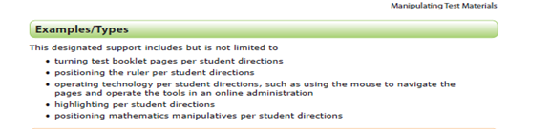
Manipulating Test Materials
A student may receive this support if served by an ARD committee, Section 504 committee, RTI committee, or student assistance team.
If the student is not receiving special education or Section 504 services, the decision should be based on consistent academic struggles in the specific area even after intensive instruction and remediation.
If a student is an EL with a disability, the decision is made by the ARD committee in conjunction with the student’s LPAC.
Eligibility is routinely and effectively uses the support in classroom instruction and testing
Change for 2019:
Recording notes in the margins per student directions has been moved to the Basic Transcribing policy.

Slide 53
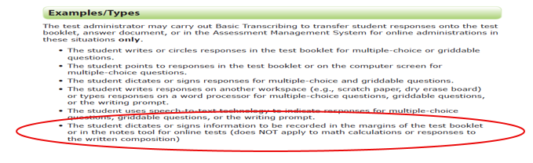
Basic Transcribing
  A student may receive this support if served by an ARD committee, Section 504 committee, LPAC, RTI committee, or student assistance team.
    If the student is not receiving special education or Section 504 services, the decision should be based on consistent academic struggles in the specific area even after intensive instruction and remediation.
  Eligibility is routinely and effectively uses the support in classroom instruction and testing.
  If the student uses speech-to-text technology to indicate responses for multiple-choice questions, griddable questions, or the writing prompt, please refer to our Technology Use Guidelines document.
  Change for 2019:
  The student dictates or signs information to be recorded in the margins of the test booklet or in the notes tool for online tests (does NOT apply to math calculations or responses to the written composition).

Slide 54
Basic Transcribing- Special Instructions/Considerations
  The student must be given the full time allotted to complete the entire test. It is allowable for the student to review the transcription and make any edits within the time constraints of the assessment.
    This means that the student can change his or her response ONLY within the time limit of the test (i.e., 4 hours, 5 hours, or extra time).
  If the test administrator transfers the student’s final responses onto the answer document/online testing platform after the testing period has ended, the student may not edit his or her response.
  It is recommended that the test administrator ensure that he or she can read and understand the student’s intended response prior to the student leaving the testing room.

Slide 55
Braille/Refreshable Braille
  A student may receive this support if served by an ARD committee, Section 504 committee, RTI committee, or student assistance team.
    If a student is an EL with a disability, the decision is made by the ARD committee in conjunction with the student’s LPAC.
  Eligibility is routinely and effectively uses the support in classroom instruction and testing.
  Specific information about administering braille tests is available in the General Instructions for Administering Braille State Assessments document, located on the TEA’s Accommodation Resources webpage.
  For braille administrations, there is no need submit an Accommodation Request Form to request "Extra Day". (Included in "General Instructions for Administering Braille State Assessments".)

Slide 56
Braille/Refreshable Braille
  Changes for 2019:
  The state will provide both contracted and uncontracted braille test materials in UEB ONLY (begins with the December 2018 administration).
  Online screen reader support for refreshable braille displays will be available in Spring 2019 in reading/language arts and social studies assessments.
  For students who take a braille test and are also eligible for Content and Language Supports, a request for a paper version of STAAR with Embedded Supports should be submitted to TEA.
  Accommodations specific to braille test takers will be provided in the STAAR with Embedded Supports Paper Administration Guide accommodation tables and identified for the test administrator as “Braille Instructions ONLY.” Samples of how these accommodations will appear will be provided in the non-secure front matter of the STAAR with Embedded Supports Paper Administration Guide.
October 2018

Slide 57
Calculation Aids
  A student may receive this support if served by and ARD or Section 504 committee.
    If a student is an EL with a disability, the decision is made by the ARD committee in conjunction with the student’s LPAC.
  Grade-specific eligibility must be met for a student who receives Section 504 or special education services and routinely and effectively uses the support in classroom instruction and testing.

Slide 58
Calculation Aids- Examples/Types
  Changes for 2019:
  Scientific and graphing calculators are no longer listed as allowable Example/Types for 2018-2019.
    Basic (i.e., four-function) handheld calculator or calculator application, including large-key or speech-output
    Basic calculator available as an online embedded support on STAAR
    Abacus or Cranmer modified abacus
    0-9 addition grid without special number (e.g., even numbers) indicated
    Grade-appropriate multiplication grid without special numbers (e.g., perfect squares) indicated
  Beginning with the spring 2019 administrations of math and science for STAAR and STAAR Spanish, the basic calculator (i.e., four-function) will be offered as an embedded PNP support on the STAAR online assessment for students who meet the eligibility in grades 3-7. For questions about the functions allowed on a basic calculator, refer to the calculator tool in the online 2018 STAAR released tests and technology guidelines training PPT.

Slide 59
Content and Language Supports
  A student may receive this support if served by an ARD committee, Section 504 committee, or LPAC committee.
    If a student is an EL with a disability, the decision is made by the ARD committee in conjunction with the student’s LPAC.
  A student is eligible for this support if the ARD committee, Section 504 committee, or LPAC committee determines he/she uses the support routinely and effectively in classroom instruction and testing.
  Students for whom the LPAC recommends the use of these supports for any reading or writing assessment, may not be considered for reclassification at the end of the school year.
  New for 2019:
  STAAR Spanish online available with text-to-speech (TTS), Content and Language Supports, Spelling Assistance, basic calculator, and dictionary tool.
  STAAR Spanish with embedded supports paper version available through the Special Paper Administration Process.

Slide 60
Oral/Signed Administration
A student may receive this support if served by an ARD committee, Section 504 committee, LPAC, RTI committee, or student assistance team and a determination is made that the student meets eligibility criteria.
  If the student is not receiving special education or Section 504 services, the decision should be based on consistent academic struggles in the specific area even after intensive instruction and remediation.
  If a student is an EL with a disability, the decision is made by the ARD committee in conjunction with the student’s LPAC.
  Students for whom the LPAC recommends the use of this support for any reading or writing assessment may not be considered for reclassification at the end of the school year.

Slide 61
Oral/Signed Administration
  Eligibility
    routinely and effectively uses in class
    meets at least one of the following: EL and takes English test; dyslexia or related disorder; documented evidence of reading difficulties
  Evidence of reading difficulties can be caused by various reasons, including (but not limited) to a
    learning disability in reading
    ADD/ADHD
    behavioral or emotional problem
    processing or memory issue

Slide 62
Oral/Signed Administration
  New for 2019:
  ASL videos as an online PNP option for STAAR
  For STAAR Spanish online, TTS is offered as a tool for oral reading support
  Beginning spring 2019, the revising passages and revising test questions and answer choices can be read aloud on STAAR and STAAR Spanish PAPER writing assessments. Title page in test booklet will identify revising section.
  Change for 2019:
  Student Eligibility Criteria has been clarified for ELs who take the English version of STAAR:
  “The student is a current EL and takes the English version of STAAR.”
  A student who is taking a Spanish test may still receive an oral administration if they meet one of the other eligibility criteria.

Slide 63
Oral/Signed Administration-
For Students who are Deaf or Hard of Hearing
  For students who are deaf or hard-of-hearing who are eligible for Content and Language Supports, AND Oral/Signed Administration
  Signing of allowable test content is allowed.
  ASL videos are available as an embedded PNP support; however, these are not available for Content and Language Supports. A test administrator will need to sign this information for the student.
    IF a student does not use ASL or needs signing support, test administrator may sign.
  Required training: Oral/Signed Administration Guidelines and the specific guidelines for signing test content included in the General Instructions for Administering State Assessments to Students Who are Deaf or Hard of Hearing.
  Proctor codes available to district testing coordinators and assistants in the STAAR Assessment Management System to download and distribute to test administrators providing a signed administration of an online STAAR test.

Slide 64
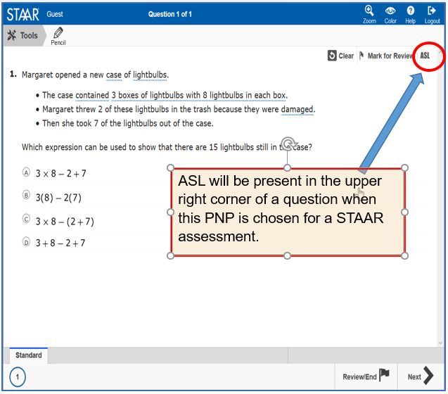
American Sign Language (ASL) Videos
Available on STAAR online as a PNP for students eligible for Oral/Signed Administration
Beginning spring 2019 administrations
Questions and answer choices signed in ASL for all subjects (not available for Content and Language Supports).
Closed-Captioning
Mini practice test with a few samples to practice using functionality scheduled for fall

Slide 65
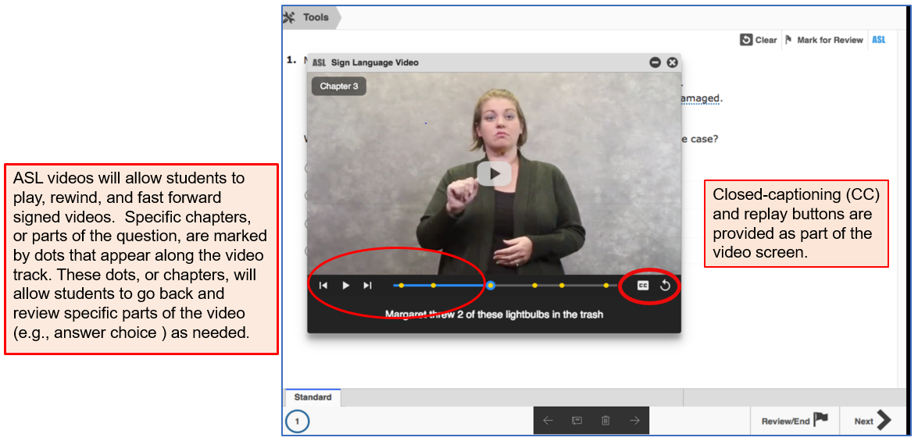
American Sign Language (ASL)

Slide 66
Spelling Assistance
  A student may receive this support if served by an ARD committee or Section 504 committee.
    If a student is an EL with a disability, the decision is made by the ARD committee in conjunction with the student’s LPAC.
  Eligibility must be met for a student who receives Section 504 or special education services and routinely and effectively uses the support in classroom instruction and testing.
  A student should be capable of organizing and developing ideas and understands the basic function and use of written language conventions (e.g., sentence structures, irregular verbs) BUT has a disability that is so severe that he or she cannot apply basic spelling rules or word patterns (e.g., silent letters, base words with affixes) to written responses.

Slide 67
Spelling Assistance
  Available as an online embedded PNP support on STAAR writing (composition) if a student routinely uses a similar tool during class instruction.
    For example, if a student uses a frequently misspelled word list or speech-to-text, then do NOT activate the online spelling assistance PNP. The student will use what he or she routinely uses in class.
  New for 2019:
  Available on the STAAR Spanish online as an embedded PNP support for grade 4 writing.

Slide 68
Designated Supports Requiring TEA Approval
  These include supports that may be made available to students who have a TEA-approved accommodation request form.
  Eligibility decisions are made by the appropriate team of people at the campus level based on the eligibility criteria, and then an Accommodation Request Form is sent to TEA for determination.
  Other determinations should be made in conjunction with the testing coordinator prior to submitting to ensure appropriateness.
Complex Transcribing | Mathematics Scribe
Extra Day | Other

Slide 69
Accommodation Request Process
Online Accommodation Request Forms should only be submitted for designated supports requiring TEA approval (i.e., complex transcribing, math scribe, extra day, other).
Open: October 2018
Link to form and training document: Accommodation Resources webpage
Expiration date of approved requests: June 30, 2019

Slide 70
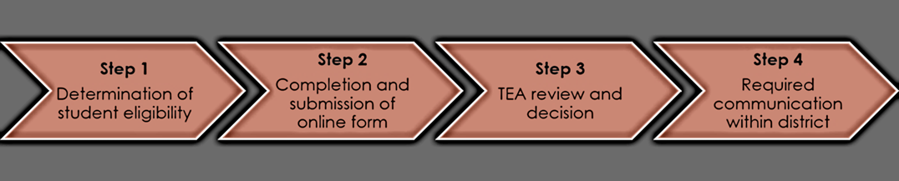
Accommodation Request Process
Accommodation requests must be approved before a student can use the accommodation on a state assessment. Documentation in the appropriate paperwork should state "Pending TEA approval.“
Accommodation Request Forms must be received by TEA at least one week prior to testing. Late requests will NOT be processed unless circumstances involving the student change after the deadline. Refer to the submission deadlines document
Do NOT include confidential student information (e.g., student’s first and last name, Social Security numbers, pages from an IEP, medical documents). Request will be deleted and you will be asked to resubmit.

Slide 71
Special Administration Requests
Because English and Spanish Content and Language Supports are embedded PNP accommodations presented in an online format, replicating these features in a paper version is not always possible.
Technology-based supports enable most students to test online; however, in instances in which the use of an accommodation is not feasible or appropriate, or if the administration of an online test is inappropriate due to a student’s particular disability, a special request may be made to TEA for approval to administer a paper test booklet.
    This process also applies to TELPAS reading.
    For students taking TELPAS Listening and Speaking, a special request may be made to TEA for approval to assess holistically.

Slide 72
Special Administration Requests
  Example situations when a request for a special administration of STAAR with Embedded Supports paper test is appropriate.
  seizures or migraines from looking at computer screen and frequent breaks do not work
  After multiple attempts throughout the year to acclimate the student to online testing, student becomes agitated or violent when beginning any practice test due to his or her disability.
  No access to technology because student is homebound with no internet connection available or student is in a juvenile detention facility and county does not allow online test application to be downloaded onto computers.

Slide 73
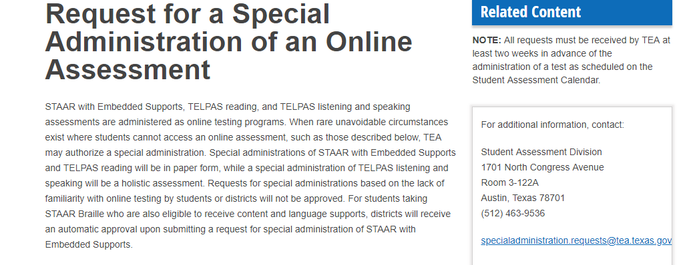
Special Administration Requests
Form will be located on the District and Campus Coordinator Resources webpage under the link of Special Administration of an Online Assessment.
Form is currently being updated and is due to be open for submissions for the 2018-2019 school year in October.

Slide 74
LPAC Decision-Making Requirements
Designated supports decisions should be made as close as possible to the assessment to account for student’s progress in acquiring the English language.
Making a determination for a student the previous year may not take into account this progress and must be revisited.

Slide 75
RTI (and similar) Committee
Decision-Making Requirements
Depending on local policies for these committees (i.e., what time of year they meet),
  if the documented designated supports in place for the student are still valid, there is no reason to meet again.
  if the documented designated supports in place for the student are not valid, this should be corrected.

Slide 76
Section 504 Committee
Decision-Making Requirements
Section 504 committees should ensure that a student's accommodation plan is current for the school year.
  If the documented designated supports in place for the student are still valid, there is no reason to meet again.
  If the documented designated supports in place for the student are not valid, this should be corrected.

Slide 77
ARD Committee
Decision-Making Requirements
The responsibilities of the ARD committee do not change simply because the state assessment accommodation policy has changed. The purpose of an IEP is to document current and correct information. Any part of that document that is no longer true and valid should be updated.
  The ARD committee does not have to meet again regarding state assessment accommodations if decisions made at the annual meeting still apply to the current school year.
  The ARD committee would need to meet again regarding state assessment accommodations if decisions made at the annual meeting do not apply to the current school year.

Slide 78
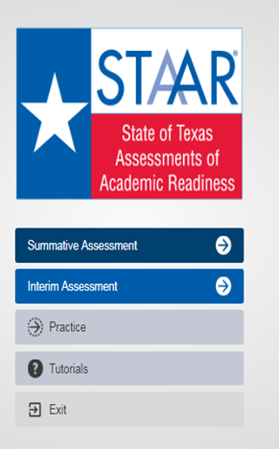
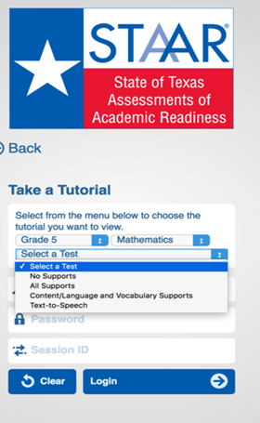
STAAR Online Tutorials
  When you open the STAAR Online Testing Platform (SOTP), you will see a menu of options, including “Tutorials.”
  Once you select “Tutorials,” you will be taken to a screen with several drop-down menus.
  Choose the grade, subject, and test (i.e., available supports) you want to view.

Slide 79
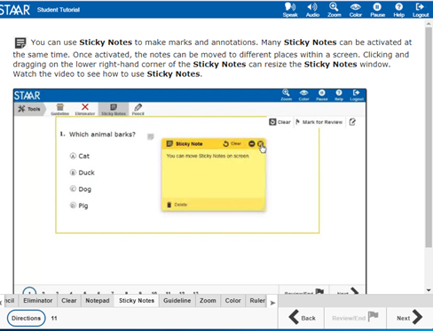
STAAR Online Tutorials
  Tabs at the bottom of the screen act as a table of contents. Each tab contains a page that explains the online feature/tool and provides a short video.
  Videos do not have sound except for the Speak and Audio videos, which only read aloud the text on the screen.
  The second page of each tab has a question that can be used to practice with the feature/tool you just learned about.
  The questions do NOT contain tested content but are only intended to practice using the feature/tool.

Slide 80

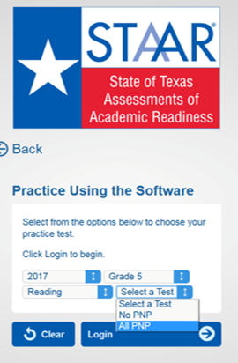
STAAR Online Practice
  When you open the STAAR Online Testing Platform (SOTP), you will see a menu of options, including “Practice.”
  Here you will find released tests for 2017 and 2018.
  All PNP will include the following supports:
    Text-to-Speech (when available)
    Spelling Assistance (writing compositions only)
    Content and Language Supports

Slide 81


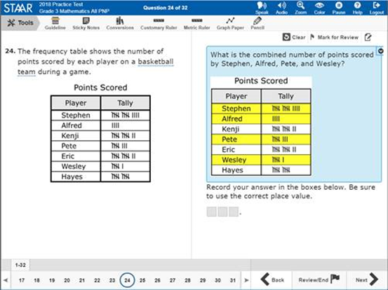
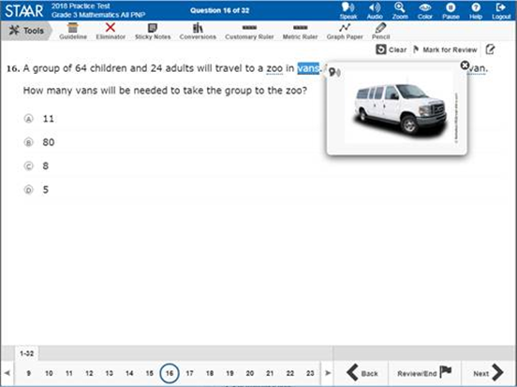
STAAR Online Practice

Slide 82


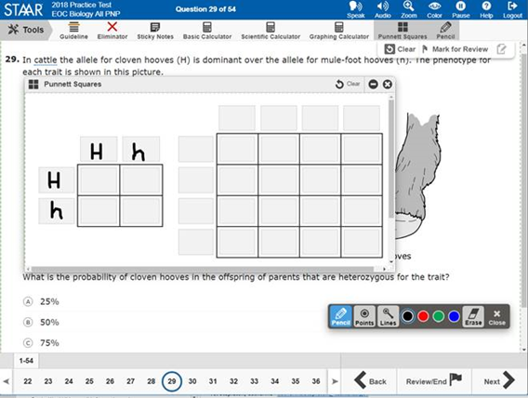
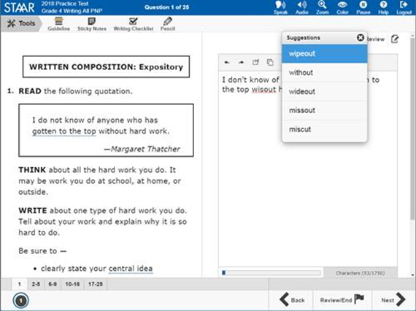
STAAR Online Practice

Slide 83


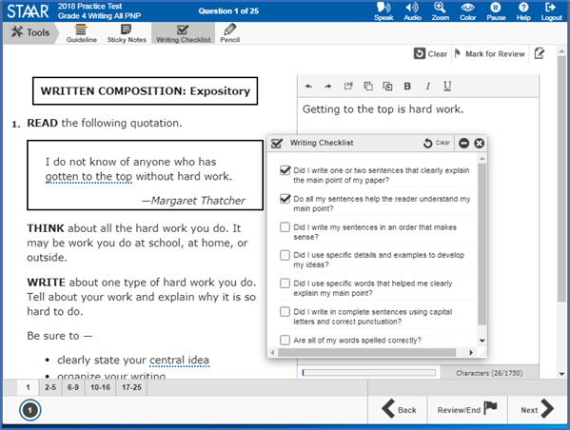
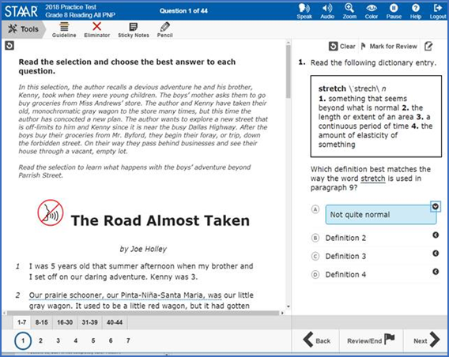
STAAR Online Practice

Slide 84

STAAR Alternate 2
Texas definition of a student with a significant cognitive disability:
exhibits significant intellectual and adaptive behavior deficits in their ability to plan, comprehend, and reason, and ALSO indicates adaptive behavior deficits that limit their ability to apply social and practical skills such as personal care, social problem-solving skills, dressing, eating, using money, and other functional skills across life domains;
is NOT identified based on English learner designation or solely on the basis of previous low academic achievement or the need for accommodations; and
requires extensive, direct, individualized instruction, as well as a need for substantial supports that are neither temporary nor specific to a particular content area.

Slide 85
STAAR Alternate 2 Eligibility Decisions
  NEW Participation Requirements
  The STAAR Alternate 2 Participation Requirements were revised to
    clarify the scope of students who are taking STAAR Alternate 2 and
    satisfy requirements of ESSA
      District wide systems for collecting students made eligible by ARD may be helpful when reviewing district wide data
        Most up-to-date testing decision – annual decision
        New enrollment collection procedure

Slide 86
STAAR Alternate 2 Key Dates
Enrollment Window and Registration “New Process”
10/22/2018-11/9/2018
Testing Window
4/1/2019-4/23/2019
Preview Window
3/18/2019-3/29/2019
STAAR Alternate 2 key dates are referenced in the Test Administrator Manual & District and Campus Coordinator Resource.

Slide 87
STAAR Alternate 2 Key Dates
Students Who Enroll On or AFTER April 1, 2019
  Students who transfer/move to a new district after the first day of the STAAR Alternate 2 testing window do not have to be tested.
  Students who transfer within the same district after the first day of the STAAR Alternate 2 testing window still must be tested by the district where the student is enrolled.

Slide 88
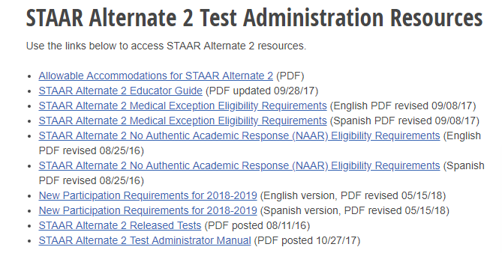
STAAR Alternate 2 Resources
  Most of the documents referred to in this portion of the presentation can be found on TEA’s STAAR Alternate 2 Resources webpage.
https://tea.texas.gov/student.assessment/special-ed/staaralt/

Slide 89
STAAR Alternate 2 Webpage Updates
  OCTOBER POSTINGS
  Updated STAAR Alternate 2 Educator Guide
  NEW revised Medical Exception Eligibility Requirements (English and Spanish)
  NEW revised No Authentic Academic Response (English and Spanish)
  Updated Instructional Terms Lists
  Updated Essence Statements
  Revised STAAR Alternate 2 Test Administrator Manual (non-secure portion)
NEW

Slide 90
STAAR Alternate 2
Science Resource Documents
  Updated Science Vertical Alignment and Curriculum Framework documents for STAAR Alternate 2
  Includes streamlined science TEKS for grades 5 and 8 and for Biology
  Effective August 27, 2018
  Implemented in classrooms beginning with the 2018-2019 school year
  Look for an October posting at https://tea.texas.gov/student.assessment/special-ed/staaralt/

Slide 91
STAAR Alternate 2
Training Topics for Test Administrator Sessions
  Roles and Responsibilities
  Test Security
  Scheduling Test Administrations
  Preparing for Test Administrations
  Testing with Accommodations
  Monitoring Test Administrations
  Returning Materials to District Coordinator
  References for training materials:
  STAAR Alternate 2 section in the DCCR, STAAR Alternate 2 Test Administrator Manual non-secure, STAAR Alternate 2 Educator Guide

Slide 92
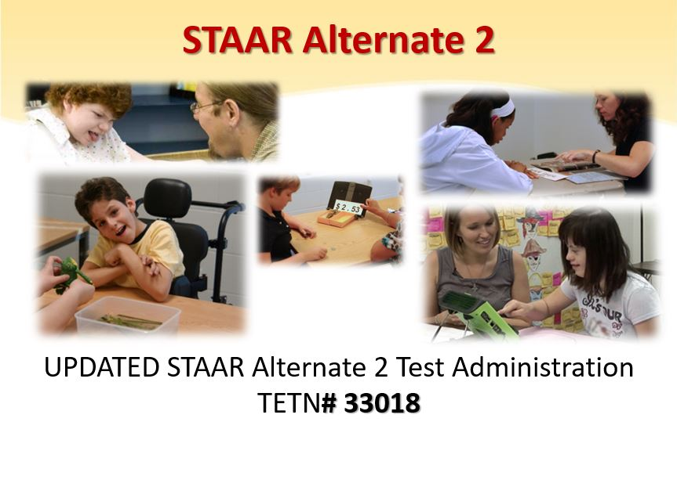
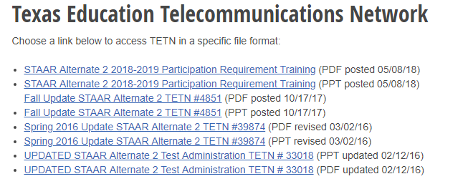
Guidance on Administering
STAAR Alternate 2

Slide 93
STAAR Alternate 2
Roles/Responsibilities of Test Administrator
  Who should administer STAAR Alternate 2?
  Ideally, the student’s teacher for the subject being tested who has a high level of familiarity with the student so that
    Accommodations can be prepared appropriately and
    The student’s typical response mode can be understood
      Paraprofessionals may serve as test administrators supervised by a certified professional on the same campus throughout the administration. (See other options in the District and Campus Coordinator Resources.)
        Paraprofessionals may serve as test administrator assistants and assist in preparation of the test IF they are trained in test administration procedures and sign the oath.

Slide 94
STAAR Alternate 2
Test Security-Preview Window Procedures
  Practice reading the script and following the presentation instructions for test.
  Review the Scoring Instructions for test questions and plan teacher assistance for items 2 and 3 in each cluster.
  Review the student booklet and image cards to plan and prepare accommodations for any student who may need an accommodation according to the guidelines outlined in the “Accommodations” section of the test administrator manual.
  Any presentation of materials or introduction of concepts or topics to a student prior to the administration of the test is considered a serious irregularity and should be reported as such.

Slide 95
STAAR Alternate 2
Oaths for 2018-2019 School Year
  Beginning with the 2018-2019 school year, the general oath will no longer be found in the back of STAAR Alternate 2 Test Administrator Manual.
  The new online DCCR includes the new interactive oath.

Slide 96
STAAR Alternate 2
Scheduling-Test Administration Calendar
  No verification window this year.
  NEW Each district is responsible for developing a local schedule for the STAAR Alternate 2 assessments during the designated test administration window specified in the Calendar of Events.
  District or campus coordinator should communicate the schedule that test administrators should follow.
NEW

Slide 97
STAAR Alternate 2
Scheduling-Test Administration Sessions
  STAAR Alternate 2 is an untimed assessment, and the test does not have to be given in one session. Some timing options include
  Administering the assessment at a time that is most appropriate for a student;
  Allowing breaks, as necessary;
  Administering the test over several days with several sessions per day; or
  Administering the test over several days, one session each day.
  Items are best tested with the entire four-item cluster in tact, one cluster at a time. However, frequent breaks within the 4-item cluster may be required and necessary for some students.

Slide 98
STAAR Alternate 2
Preparing Test Materials
  Presentation Instructions
  Bolded text in the Presentation Instructions can be
  stated as written,
  signed,
  translated into any other language routinely used with the student in instruction,
  provided in written form, or,
  paired with tactile or picture symbols.
    Information in the reading passages and text of Stimulus A and B cannot be paraphrased, simplified, or shortened and must be presented as they appear in the stimulus.

Slide 99
STAAR Alternate 2
Preparing Test Materials
  Image Cards
  2018 Test Administrator survey indicated overwhelming support of image cards.
  Survey responses indicated 85% of test administrators reported a significant reduction in prep time.
  Test administrators comments included
    “Loved the color pictures!”
    “a big help and an improvement over past years”
    “greatly cut down on the time I had to prepare tests”
    “great for students who need to be presented with answer choices one at a time”

Slide 100
STAAR Alternate 2
Preparing Test Materials
  Image Cards
  STAAR Alternate 2 must be administered with the student booklet.
  Image cards are optional.
  A test administrator may use image cards for multiple students:
    NO appearance of reuse whatsoever - no accommodations applied (e.g. highlighting, coloring, cropping, etc.)
    Examples of ways “clean” image cards may be used for multiple students
      Pairing with text
      Presenting answer choices one at a time

Slide 101
STAAR Alternate 2
Preparing Test Materials
  Image Cards
  Test administrators should utilize image cards in the same way they previously accommodated the student booklet page.
  EXAMPLES of accommodations that image cards may replace:
    Photocopying and then cutting apart answer choices in order to present answer choices one at a time
    Photocopying and then cutting out an image to pair with text
    Other accommodations that required photocopying and then making a “card” to assist with test administration
    Image cards have a number stamp on the back to correspond with test items.
    On rare occasions, test items do not have an accompanying image card due to nature of the stimulus.

Slide 102
STAAR Alternate 2
Preparing Test Materials
  Student Booklets
  Survey results revealed overwhelming positive responses to color images in the STAAR Alternate 2 student booklet.
  2019 Administration: student booklet images will be in full color except for
    historical photos; and
    Images where color is found to be distracting (e.g. multiple sets of geometric shapes, line drawings that appear simpler in black and white, etc.).

Slide 103
STAAR Alternate 2
Preparing Test Materials
  Bundling
  Standard size student booklet
    Set of image cards
    Secure STAAR Alternate 2 test administrator manual
  Large print student booklet
    Set of image cards
    Secure STAAR Alternate 2 test administrator manual
  *Test materials will be packaged this year so that the bar code is accessible without requiring plastic packaging to be opened.

Slide 104
STAAR Alternate 2
Testing Environment
  Test administrators must prepare the environment for the administration of STAAR Alternate 2.
  STAAR Alternate 2 is administered to students in a one-on-one setting.
  Test sessions
    must be conducted under the best possible conditions with minimal distractions
    and in a setting that is arranged to maintain confidentiality of test material and responses of individual students.
  Districts with cameras in self-contained classrooms should use locally-developed policy which includes “penalties for prohibited conduct” in the event that a request is made to view video that was recorded during a test administration session.

Slide 105
STAAR Alternate 2
Entering Responses Online
  Students taking the STAAR Alternate 2 administration communicate answers directly to the test administrator.
  The test administrator records the student’s response on the STAAR Alternate 2 Scoring Document based on scoring information provided for each item.
  The students’ responses are then entered into the Assessment Management System.
  The district coordinator, campus coordinator, or other authorized personnel who have completed training and signed oath will enter scoring information into an online system.

Slide 106
STAAR Alternate 2
Returning Test Materials
  Once the testing window has closed, test administrators should return all secure materials to the campus coordinator, including:
  used and unused student booklets, including large-print test booklets;
  used and unused image cards;
  secure STAAR Alternate 2 test administrator manuals;
  STAAR Alternate 2 Scoring Documents; and
  photocopies or any other type of reproduction of secure test materials, if used.

Slide 107

ESSA 1% Waiver
TEA’s 2018 request for a limited waiver to assess more than 1% of students using an alternate assessment in the 2017-2018 school year in reading/language arts, science and mathematics was approved by the United States Department of Education (USDE) in March, 2018.
Based on state assessment data for 2017-2018, TEA will again be requesting a waiver for the 2018-2019 school year.

Slide 108
STAAR Alternate 2
Waiver Request (2nd Year)
  Districts should only have very few (if any) students who have been identified as eligible for the No Authentic Academic Response (NAAR) and Medical Exception (ME) exception from STAAR Alternate 2.
  As of June 2018, many other states who were denied their waiver request failed to show that at least 95% of all students and 95% of students with disabilities participated in reading/language arts, mathematics, and science assessments
  Districts should closely adhere to eligibility requirements for NAAR and ME.

Slide 109
Waiver Request (2nd Year)
Based on 2017-2018 Data | Number | Percent
Alternate 2 Tests, All Students Mathematics | 40,646 | 1.4%
All Students, STAAR Mathematics | 2,804,047
Alternate 2 Tests, All Students Reading/ELA | 45,392 | 1.3%
All Students, STAAR Reading/ELA | 3,487,018
Alternate 2 Tests, All Students Science | 16,780 | 1.3%
All Students, STAAR Science | 1,271,379
2016-2017 1.2%
2016-2017 1.2%

Slide 110
STAAR Alternate 2
Waiver Request (2nd Year)
  A state may not prohibit a district from assessing more than 1% of its assessed students with an alternate academic assessment.
  In order to complete the waiver request, school districts/charter schools will be required to submit information justifying the need of the school district/charter school to assess more than 1% of its assessed students with STAAR Alternate 2.
  School districts/charters will provide assurances that if they will assess more than 1% of students using STAAR Alternate 2, they have followed all State guidelines determining eligibility and that they will address any subgroup disproportionality in the percentage of students taking STAAR Alternate 2.
  States will make the information submitted by an school districts/charter schools publicly available.

Slide 111
STAAR Alternate 2
Waiver Request (2nd Year)
  How to submit:
  School districts/charters will receive an email notification indicating that based on 2017-2018 data the LEA assessed more than 1% of its assessed students with STAAR Alternate 2.
    Email will include a PDF attachment of district/charter specific STAAR Alternate 2 participation data
    Email will include a link to complete the waiver form.
  Email notification will be sent to the Superintendent of the school district or the Chief Administrative Official of the charter school and copied to DTCs.
  Districts/charters will receive an email acknowledgement that the district’s waiver information has been received.

Slide 112
STAAR Alternate 2
Plan for Monitoring 1% Threshold
  In order to demonstrate substantial progress towards achieving each component of the USDE plan and timeline:
  TEA along with Texas educators created a definition for significant cognitive disability.
  TEA along with Texas educators revised Participation Requirements for STAAR Alternate 2.
  TEA is currently working to revise the data validation monitoring plan for districts over 1%.
  TEA will be requesting information from districts over the 1% threshold for the 2018-2019 waiver.
  TEA is providing specific 1% Waiver Training on October 2 at the ESC training.
  TEA is developing additional training for districts.

Slide 113

TELPAS
TELPAS annually assesses the progress that English learners (ELs) make in learning the English language.
All K-12 students classified as LEP in the Public Education Information Management System (PEIMS) are required to participate in TELPAS, including those who have parents who have declined bilingual/English as a Second Language (ESL) program services.

Slide 114
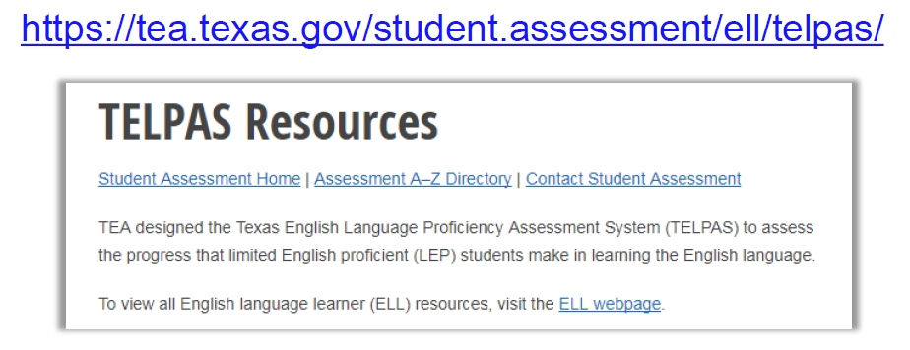
Resources
  Most of the documents referred to in this portion of the presentation can be found on TEA’s TELPAS Resources webpage.

Slide 115
TELPAS Components
Grades K-1 | Grades 2-12
Holistically-rated assessments in listening, speaking, reading, and writing Classroom observations and student interactions | Online tests for reading, listening, and speaking Holistically-rated student writing collection

Slide 116
Exceptions
There are exceptions to an EL being assessed in one or more language domain.
An EL receiving special education services
  Decision must be made by ARD committee in conjunction with the LPAC.
  Participation must be considered on a domain-by-domain basis.
  Reason for not assessing student must be well-supported and documented.
An EL from another Texas school district, state, or country who enrolls on or after the first day of the TELPAS testing window
  Will not be assessed by receiving district in the holistically-rated domains.
  Is required to take the TELPAS reading test and the listening and speaking test.

Slide 117
Special Administration of TELPAS
In rare circumstances that prevent a student from testing online, TEA may grant approval for a special administration of a TELPAS online test (reading or listening and speaking) for grades 2–12.
  Accommodations cannot be applied
  Technology access is precluded
The decision to recommend a special administration of TELPAS must be determined by the appropriate team of people at the campus level (e.g., RTI team, student assistance team, 504 team).
TELPAS reading requests are for paper versions, while TELPAS listening and speaking requests are for holistic assessments that require training and calibration to administer.
  Note: Special administration of TELPAS is dependent upon TEA approval.
Notes:
In rare circumstances that prevent a student from testing online, TEA may grant approval for a special administration of a TELPAS online test (reading or listening and speaking) for grades 2–12.
Accommodations cannot be applied
A student may need a testing accommodation that is not possible to provide in an online setting.
Prior to requesting a special administration of the assessment, consideration should be given to accessibility features, locally-approved designated supports, and designated supports requiring TEA approval.
Technology access is precluded
Districts must make every effort to administer STAAR, TELPAS reading and TELPAS listening and speaking online.
In rare situations where computers or technology are absolutely not available, districts may seek permission for a special administration.
The decision to recommend a special administration of TELPAS must be determined by the appropriate team of people at the campus level (e.g., RTI team, student assistance team, 504 team).

Slide 118
TELPAS Holistic Rater Training
The Grades 2-12 Online Basic Training Course and calibration activities only include the domain of writing.
A separate holistically-rated listening and speaking rater training for those educators that will be assessing a student with a special administration of listening and speaking test.
  Instructions will be sent to district testing coordinators with all approved special administration requests.
After completing the modules and practice activities, certificates of completion will be available to print in the scoring summary tab. Certificates are also automatically emailed upon successful completion, but may take up to 24 hours to be delivered.

Slide 119
Online Training and Calibration
Calibration must be completed in a monitored setting.
Raters have two opportunities to calibrate.
Local procedures must be established for verifying the completion of online courses and calibration activities.
The TELPAS Online Training Center does not save training histories or certificates. Accounts and certificates will be purged from training site at the end of each training window.
Raters need to print and retain a copy of their training and calibration certificates.

Slide 120
TELPAS Manual for Raters and
Test Administrators
The rater manual and test administrator manual will be combined.
It is not a required that every rater have a rater manual. However, raters must be trained and have the appropriate resources for training and rating purposes.
Rater resources can be accessed from the online version of the TELPAS Manual for Raters and Test Administrators.

Slide 121
TELPAS Rater Resources – Training Purposes
 | K-1 Raters | 2-12 Raters
For training purposes: | K-12 Listening PLDs K-12 Speaking PLDs K-1 Reading PLDs K-1 Writing PLDs | 2-12 Writing PLDs If approved for a special administration of listening and speaking test, 2-12 raters will also need: K-12 Listening PLDs K-12 Speaking PLDs

Slide 122
TELPAS Rater Resources – Rater Purposes
 | K-1 Raters | 2-12 Raters
For rating purposes: | K-12 Listening PLDs K-12 Speaking PLDs K-1 Reading PLDs K-1 Writing PLDs TELPAS Student Rating Roster | 2-12 Writing PLDs TELPAS Student Rating Roster Writing Collection Cover Sheet Writing Collection Verification Checklist If approved for a special administration of listening and speaking test, 2-12 raters will also need: K-12 Listening PLDs K-12 Speaking PLDs

Slide 123
TELPAS Composite Score
  In spring 2018, the assessments for three of the four TELPAS domains changed.
    Reading test was redesigned to be shorter with reduced blueprint.
    Listening and speaking tests were administered as item-based standardized assessments for the first time.
  After receiving feedback from various stakeholders, it was determined that there would be a change to the language domains for the composite score, as shown below.
Language Domain | Previous Weight | Current Weight
Listening | 10% | 25%
Speaking | 10% | 25%
Reading | 50% | 25%
Writing | 30% | 25%

Slide 124
TELPAS Composite Score and ELs with Disabilities
ESSA requires States to develop a set of parameters and procedures to obtain a composite score based on performance in the remaining domains of the English language proficiency assessment.
Students with results for at least two domains will receive a composite score.
    This is ONLY applicable to students who have an ARD decision to not be evaluated in one or two domains.
    This does NOT apply to students who were absent, received a score code of “O” for other, or an “E” for extenuating circumstances.

Slide 125
TELPAS Writing Audit – Spring 2019
  The purpose of the writing audit is to provide ongoing evidence of the validity and reliability of the holistically-rated writing component of TELPAS. The primary audit activities will include:
  evaluating the extent to which the writing English language proficiency ratings assigned by teacher raters match those assigned by state audit raters,
  gathering feedback from teacher raters on the quality of their training for writing, and
  examining how well educators followed state-defined administration procedures to rate writing performance.

Slide 126
TELPAS Writing Audit – Spring 2019
Students will be sampled in grades 2–12 from across the state, including all 20 regions.
The target sample size is 2,000 students, spread equally across grade bands and proficiency levels.
Questionnaires will be given to district testing coordinators, campus testing coordinators, and to raters and will be used to gather information about the training and qualification procedures.
Districts will receive notification after the TELPAS window if they have been selected for the writing audit.

Slide 127
TELPAS Grade Clusters
Reading Tests | Listening Tests
Grade 2 | Grades 2-3
Grade 3 | Grades 4-5
Grades 4-5 | Grades 6-8
Grades 6-7 | Grades 9-12
Grades 8-9
Grades 10-12

Slide 128
Enrolled Grade Reclassification during
TELPAS Test Administration
For the purpose of TELPAS administration, the reclassification of a student’s grade level will not be allowed during the TELPAS window.
It causes an issue within the Assessment Management System when student’s grade levels change within the window.
All the TELPAS components (holistic, reading test, listening & speaking test) should be assessed in the same grade level.

Slide 129
TELPAS Tutorials and
Listening and Speaking Practice Sets
TELPAS Tutorials
  Help students become familiar with online testing
  Show students how to move through a test, use tools in the test, and work with different types of items
Listening and Speaking Practice Sets
  Are two different practice sets (one for elementary and one for secondary)
  Are solely for students to practice on listening and speaking items
  Should not be used for diagnostic purposes
It is recommended that you perform the headset test prior to starting the TELPAS tutorial to ensure the headset is set up correctly.
  Headset test is located in the TestNav app under the “Practice Tests” link.

Slide 130
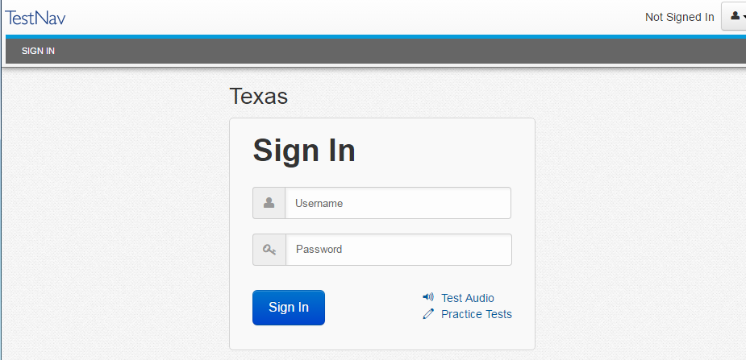
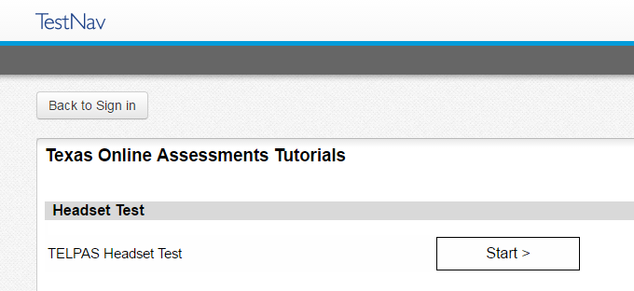
TELPAS Headset Test from TestNav App

Slide 131
TELPAS Parent Resources
  New TELPAS parent resources will include the following:
    TELPAS Student Report Cards (K-1 and 2-12)
    TELPAS FAQs (English and Spanish)
    Parent Tips (English and Spanish)
  The parent resources will soon be posted on the TELPAS and TELPAS Alternate Resources webpage.

Slide 132
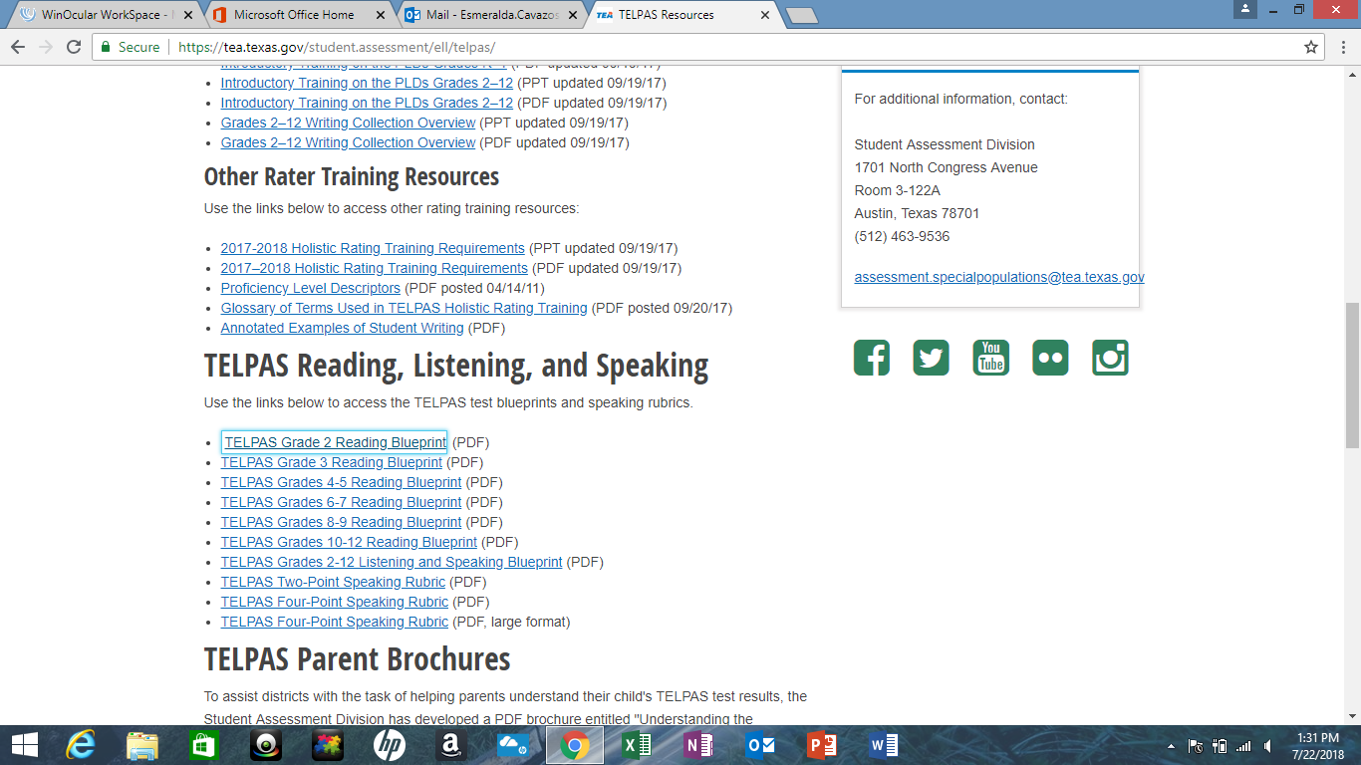
TELPAS Blueprints and Speaking Rubrics
  The TELPAS Reading Blueprints, Listening and Speaking Blueprint, and the Speaking Rubrics can be found on the TELPAS and TELPAS Alternate Resources webpage.

Slide 133
TELPAS Listening, Grades 2-12
The text of the stimulus and/or prompt is not available on screen.
Students will be using “click on the correct answer” and drag-and-drop functionalities, as well as responding to multiple-choice questions for passage-based and non-passaged-based items.
Students will need to wear headsets.
Audio is provided for the stimulus/task.
  All audio is recorded in a studio; no text-to-speech audio is used.

Slide 134
TELPAS Speaking, Grades 2-12
Some speaking prompts are intended to solicit shorter responses; others are intended to solicit longer responses.
  For simple prompts, students have 45 seconds to respond.
  For open-ended, more complex prompts, students have 90 seconds.
  The student’s response to the prompt determines the student’s proficiency level.
Students have two opportunities to record a response.
  To interact with speaking items, students will
    use audio capture functionality to record a response,
    listen to the response, and delete, and
    re-record if not satisfied with their first response.

Slide 135
TELPAS Speaking, Grades 2-12
Some speaking prompts are intended to solicit shorter responses; others are intended to solicit longer responses.
Two-point item types are fairly simple, such as making a prediction based on a picture stimulus or using a simple map to provide directions.
Four-point item types are more open ended, such as using a series of pictures to explain a multi-step process, comparing and contrasting, or taking a position on an issue and defending that position.

Slide 136
TELPAS Speaking Rubrics
Developed to determine the score points that should be ascribed to a student’s response based on his or her performance on each speaking test item.
Derived from the TELPAS proficiency level descriptors (PLDs).
Should not replace the Texas English Language Proficiency Standards (ELPS) or PLDs.
Should not be used in isolation.
Can be found on the TELPAS and TELPAS Alternate webapage.

Slide 137
“Uncertain Cases”
Scoring system may not be confident about certain tests that include responses with the following characteristics:
  Technical issues (such as too much static)
  Loud background speech or noise
  Mumbled or faint speech
  Foreign languages
  Not represented by those used to train the scoring engine
Sent to human scorers for final rating

Slide 138
Headset List
Pearson compared multiple headsets in test-like settings using ideal spacing to analyze the appropriateness of each headset for speaking/listening items.
Based on the comparison, the following three headsets were considered by Pearson to be the most appropriate for speaking/listening items.
Headset | Jack/USB | Operating Systems
Kidz Gear wired headphones for Kids | Jack | iOS 9, iOS 10 Android 6.0
Avid AE-36 | Jack | iOS 9, iOS 10 Android 5.0
Logitech USB headsets H390 | USB | macOS 10.9-10.12 Windows 7, 10

Slide 139
TELPAS Online Assessments: Reading
2018 TELPAS Reading Testing Time (in minutes)
Grade Band | # of Students | Mean | 25th Percentile | Median | 75th Percentile | 90th Percentile
Grade 2 | 104217 | 26 | 17 | 23 | 31 | 42
Grade 3 | 105532 | 36 | 23 | 31 | 42 | 59
Grades 4-5 | 182871 | 46 | 29 | 40 | 55 | 75
Grades 6-7 | 132285 | 44 | 28 | 39 | 54 | 73
Grades 8-9 | 102022 | 49 | 29 | 42 | 62 | 85
Grades 10-12 | 84350 | 48 | 28 | 42 | 61 | 84

Slide 140
TELPAS Online Assessments: Listening and Speaking
2018 TELPAS Listening and Speaking Testing Time (in minutes)
Grade Band | # of Students | Mean | 25th Percentile | Median | 75th Percentile | 90th Percentile
Grades 2-4 | 210220 | 47 | 33 | 42 | 56 | 74
Grades 4-5 | 182673 | 56 | 38 | 50 | 67 | 90
Grades 6-8 | 186066 | 55 | 35 | 48 | 66 | 91
Grades 9-12 | 134872 | 57 | 34 | 49 | 72 | 99

Slide 141

TELPAS Alternate
Every Student Succeeds Act (ESSA), requires each state to administer an alternate English language proficiency (ELP) assessment for ELs with the most significant cognitive disabilities who cannot participate in the general ELP assessment, even with allowable accommodations.
This Photo by Unknown Author is licensed under CC BY-SA

Slide 142
TELPAS Alternate
TEA worked with stakeholders to develop the TELPAS Alternate for grades 2-12 to evaluate students
receiving special education services identified in PEIMS as LEP, and
have also been identified with a significant cognitive disability.

Slide 143
Who will be assessed with TELPAS Alternate?
Students tested with TELPAS
Students projected to be tested with TELPAS Alternate based on 2016-2017 data

Slide 144

TELPAS Alternate and ELs in Grades K-1
  All ELs in grades K-1 will take the TELPAS K-1 holistically-rated assessment for all four language domains.
Why will ELs in grades K-1 be assessed with the general TELPAS holistically-rated assessment and not with an alternate English language proficiency assessment?
Based on feedback from various stakeholders, the holistically-rated assessment was appropriate for this student population since:
  K-1 students are not yet identified as having significant cognitive disabilities.
  We don’t want to underestimate a child’s potential at such a young age.

Slide 145
TELPAS Alternate and ELs in Grades 2-12
Grade 2:
Participation requirements are similar to STAAR Alternate 2.
ARD/LPAC committees required to make assessment determination for TELPAS Alternate.
Grades 3-12:
ELs eligible to take STAAR Alternate 2 will take TELPAS Alternate.
  Grade 2-12 ELs have to meet participation requirements.
  TELPAS Alternate Participation Form will be posted on the TELPAS and TELPAS Alternate webpage.

Slide 146
TELPAS Alternate: Participation Requirements
  ARD committees will have to make assessment decisions for students in grades 2-12 using the TELPAS Alternate Participation Requirements.
  For Grade 2:
    The ARD, in conjunction with the LPAC, must review the six Yes or No questions in the participation form.
    To be eligible for TELPAS Alternate, the answer to all 6 questions must be Yes and each Yes response will require justification that contains evidence that the student meets the criterion.
    If the answer to any one of the questions is No, the student must be assessed with TELPAS.
  For Grades 3-12:
    If the student entering grades 3-12 has been identified in PEIMS as LEP and is eligible for STAAR Alternate 2, the students will be assessed with TELPAS Alternate.
    The ARD committee does not have review the six Yes or No questions in the participation form.

Slide 147
TELPAS Alternate Participation Requirements –
Questions and Justification
Is the student identified in PEIMS as LEP?
Does the student have a significant cognitive disability?
Does the student require specialized, extensive supports to access the grade-level curriculum and environment?
Does the student require intensive, individualized instructions in all instructional settings?
Does the student access and participate in the grade-level TEKS through prerequisite skills?
Is the assessment determination based on the student’s significant cognitive disability and English learner status and NOT an extenuating factors?

Slide 148
TELPAS Alternate – NAAR and ME
  No Authentic Academic Response (NAAR) and Medical Exception (ME) will be addressed differently for TELPAS Alternate.
  For Grade 2:
    If the ARD committee determined that the student met the eligibility criteria for TELPAS Alternate and also qualifies for NAAR or ME, the student will not be required to participate in TELPAS Alternate.
  For Grades 3-12:
    If the ARD committee determined that the student met the eligibility criteria for STAAR Alternate 2 and also qualifies for NAAR or ME, the student will not be required to participate in TELPAS Alternate.

Slide 149
TELPAS Alternate Pilot Test and Cognitive Lab
Pilot Test
  Administered over a 10-day window from April 23-May 4, 2018, to students in grades 2 through 12 who were eligible to participate
  Preliminary study to evaluate the effectiveness and feasibility of this new assessment
  Approximately 2,112 students tested
Cognitive Lab
  Conducted April 30-May 4, 2018
  21 school districts visited

Slide 150
Cognitive Lab and Pilot Feedback
  Observable behaviors
    More space needed for teachers to take notes or a separate note-taking document
    Examples of student scenarios needed for clarity (to aid understanding of observable behaviors for each domain)
  Test Administrators
    Training earlier in the year
    More time with the materials
    Post Observable Behaviors in the fall

Slide 151
Overview: TELPAS Alternate Observable Behaviors
The “questions” are called observable behaviors.
  Each observable behavior describes characteristics that students with significant cognitive disabilities learning English demonstrate as they gain proficiency.
  Observable behaviors were written and reviewed by educators.
Based on teacher feedback, a notes section will be added to each observable behavior.
  Educators will be able to take notes throughout the school year.
    However, students may not be evaluated until the assessment window.
Observable behaviors and additional training material will be posted soon.

Slide 152
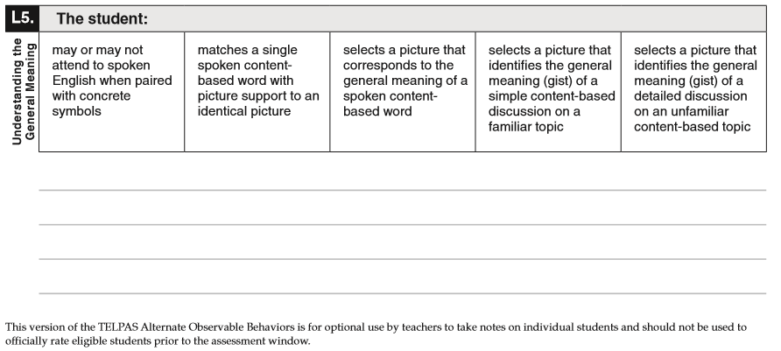
TELPAS Alternate Observable Behaviors

Slide 153
TELPAS Alternate Training
TELPAS Alternate test administration manual
Several short PPTs will provide more specific information about assessing students with TELPAS Alternate.
  PPTs can be reviewed by teachers in about 10-15 minutes.
  PPTs for each domain (listening, speaking, reading, and writing) will include authentic classroom examples written by educators.
Additional training presentations will be provided (e.g. TETN, webinars).

Slide 154
Coming Soon
Participation requirements
Observable behaviors
Test administration manual
Multiple, short training PPTs for parents and educators
Additional resources as needed based on feedback from the field

Slide 155
Break

Slide 156

STAAR Assessment Management System
The STAAR Assessment Management System allows families, educators, and administrators comprehensive access to STAAR resources.

Slide 157
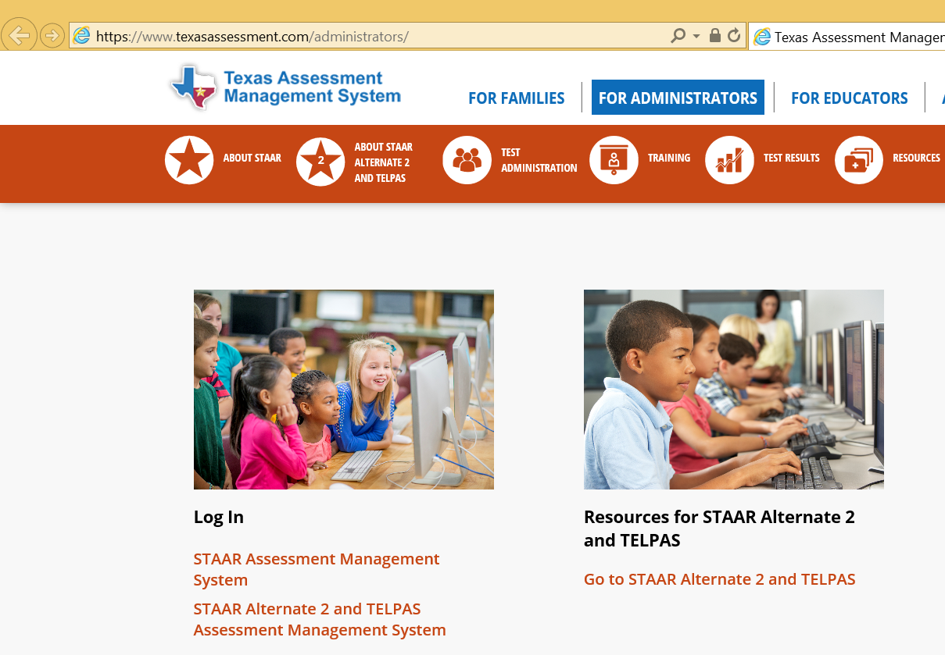
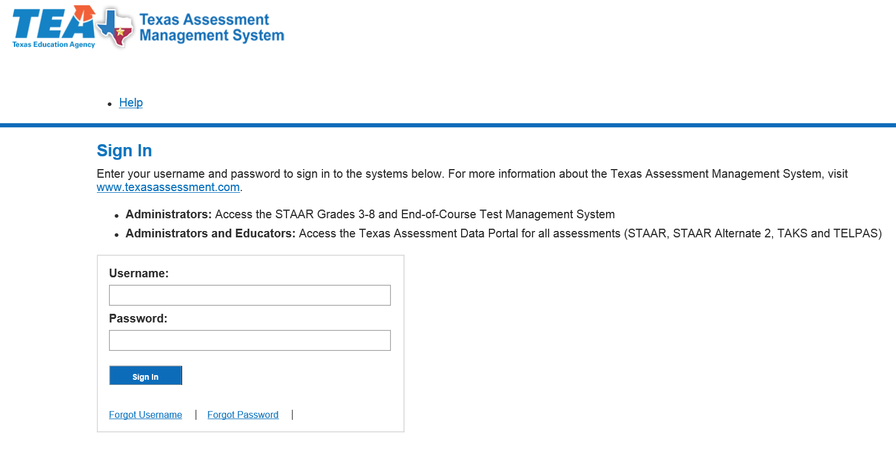
Accessing the STAAR Assessment Management System
https://www.texasassessment.com/administrators
http://www.texasassessment.com/STAAR

Slide 158
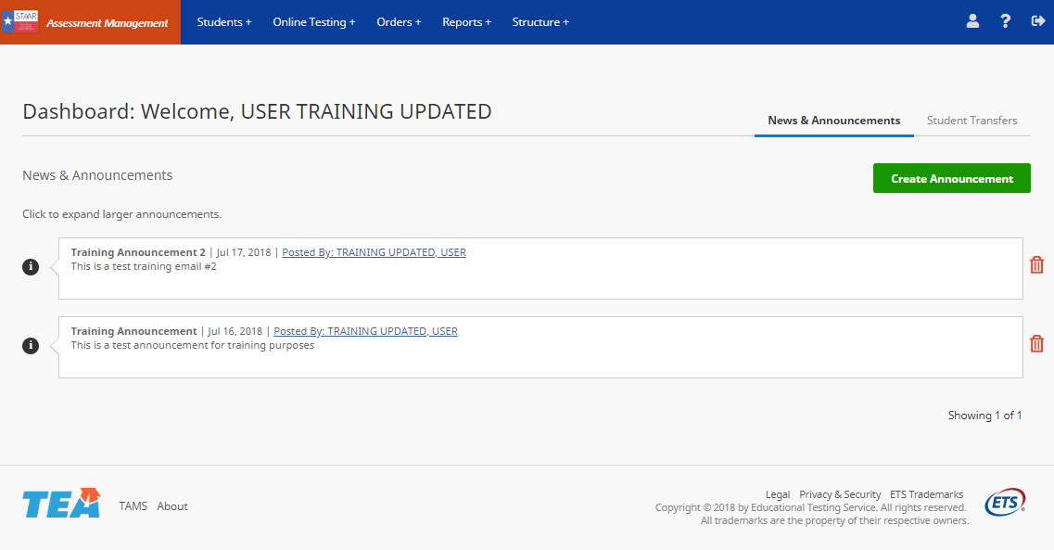
Assessment Management System Framework
New Look and Feel
  Same functionality
  Streamlined navigation
  Improved performance

Slide 159
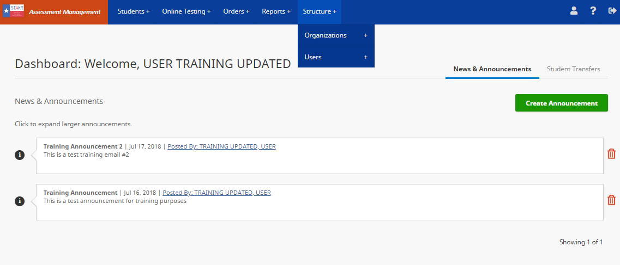
Assessment Management System Framework
Changes:
  Organization and Users tabs moved under Structure menu
  Top menu expands when hovering
  Click Assessment Management System to return to Dashboard

Slide 160

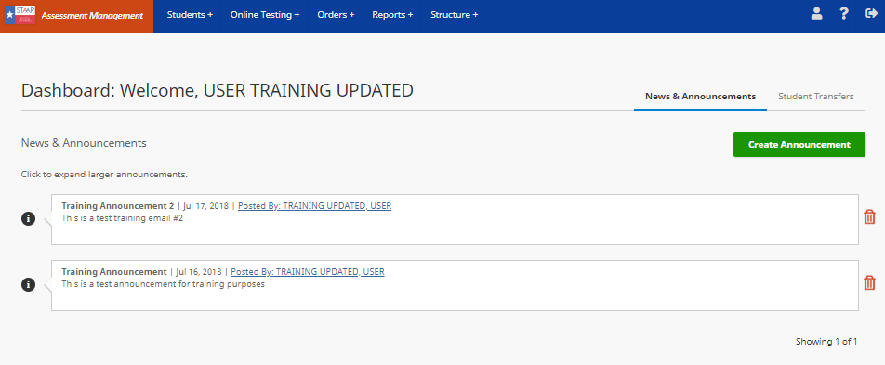
Assessment Management System Framework
Changes
  Top navigation menu icons
    Profile
    Help Documentation
    Logout

Slide 161
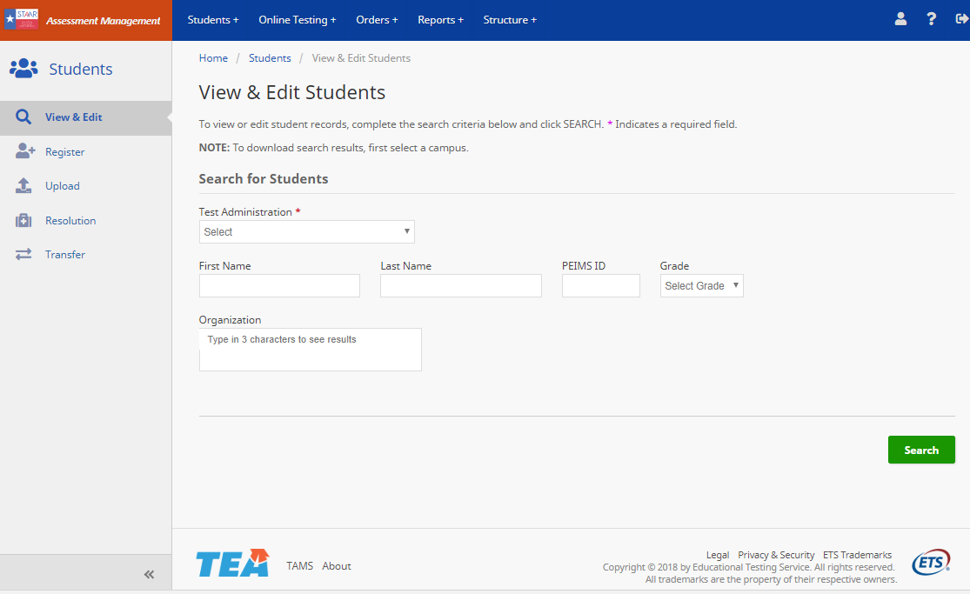
Assessment Management System Framework
Changes
  New Features
  Side menu displays after selection from top navigation
  Minimize side menu for additional space

Slide 162
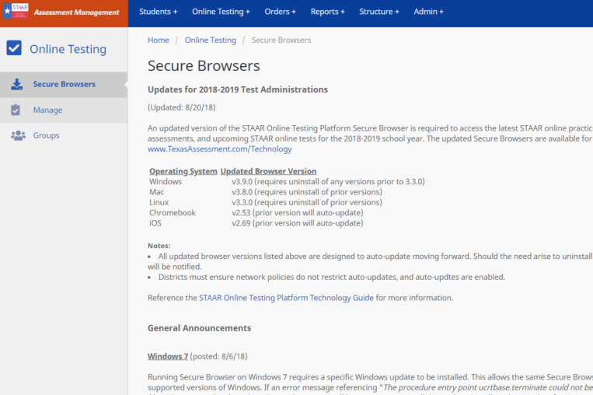
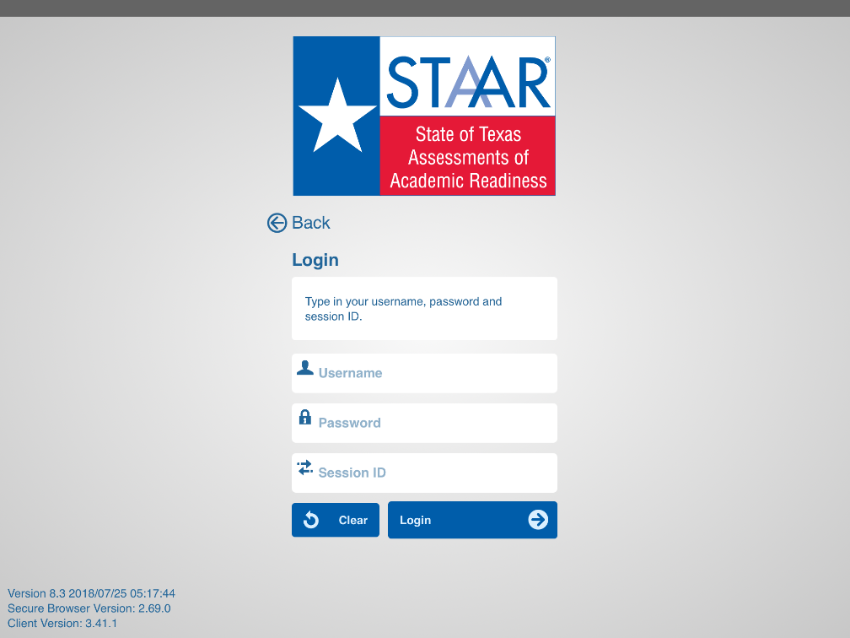
Assessment Management System Framework
New Secure Browser Page
  Contains current information regarding secure browsers
  Information also available in the STAAR Online Testing Platform Technology Guide available at
    https://www.texasassessment.com/administrators/technology

Slide 163
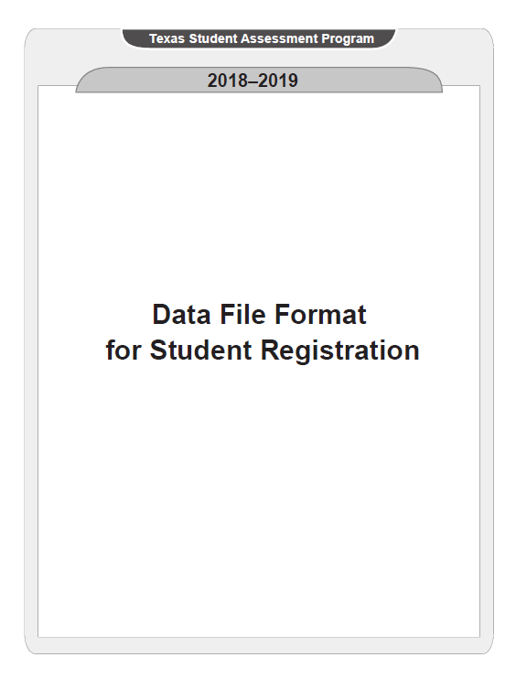

Changes to STAAR Data File Uploads
All Summative Programs
  New TX-Unique-Student-ID (TSDS Student UID) field
  Expanded LEP indicator codes
  Updated field header names

Slide 164

Changes to STAAR Data File Uploads
STAAR Grades 3–8
  Updated Test Version Codes
    New PNP spring 2019
  New language fields for online testing
  New, optional, TX-Unique-Staff-ID field (primary administrations)
  New Test Format fields

Slide 165

Changes to STAAR Data File Uploads
STAAR End-of-Course
  Updated Test Version Codes
    New PNP spring 2019
  New, optional, TX-Unique-Staff-ID field (primary administrations)

Slide 166
Changes to STAAR Data File Uploads
Registration Upload File Template – Texas Unique Student ID (TSDS Student UID)
  Beginning transition from PEIMS ID to Texas Student Data System as student unique identifier
  December 2018
    Retesters TSDS Student UID auto-populated from PEIMS submission
  Required field for registering manually or upload
  Not available on answer document
  TSDS Student UID may not be updated once established
    Delete registration
    Re-register with correct ID
  System will verify TSDS UID against the student directory
    Mismatches will display error message – district will need to correct or us another value for the student

Slide 167
Changes to STAAR Data File Uploads
Registration Upload File Template – Texas Unique Staff ID
  New TX-Unique Staff-ID fields
    Indicate student’s teacher staff ID
    Used for subject-specific lead teacher
  Optional field
  Allow teacher level reporting in Teacher Portal
  Primary administrations only
    May not be added or updated for spring retest administrations

Slide 168
Changes to STAAR Data File Uploads
Registration Upload File Template – PNP Options
  Test Version Codes (PNP Options) – available for December 2018
    E – spelling assistance
    R – content and language supports
    T – text-to-speech
  Test Version Codes (PNP Options) – beginning spring 2019
    B – refreshable Braille display and screen reader
    M – basic calculator
    V – American Sign Language (ASL) signed videos

Slide 169
Participation Counts
  2 year history displayed by campus (actual tests taken by mode)
  Current year default count equals prior year actual
  Counts do not include 10% district overage
  Online and oral administration can be increased or decreased
  Paper and large print may not exceed default count
  Additional needs can be handled during additional materials order window
  Window in spring to update May and June re-test administrations
    Move retesters from paper to online
    Remove counts for campuses not testing during June administrations

Slide 170

Participation Counts – Updating Manually
  Default counts based on prior year’s test taker counts by mode
  Oral administration counts default to zero – update as needed

Slide 171



Participation Counts
  Warnings displayed for unallowable count
  Error message displayed if count in warning not corrected

Slide 172
Answer Document Packing List (ADPL)
  Moving online beginning December 2018
  Webinar: November 8, 2018 from 1:30 p.m. – 3:00 p.m.
  Values will be entered via the STAAR Assessment Management System
    Districts will no longer send a paper ADPL in the box with the scorable shipment
Notes:
No blank paper version available

Slide 173

Answer Document Packing List (ADPL)
  Orders > ADPL

Slide 174

Answer Document Packing List (ADPL)

Slide 175


Answer Document Packing List (ADPL)
District (000000000)
Campus (000000001)
Campus (000000001)
District (000000000)
Campus (00000000)
Campus (00000000)

Slide 176
Answer Document Packing List (ADPL)
  New: CTCs will enter counts for their campus and then Update and Submit.
    Information entered by CTCs is editable by the DTC.
    Update allows CTCs to make changes saving their work as they go prior to submission.
    Submit allows CTCs to send final counts for the DTC to view and verify.
    If the CTC forgets to press Submit, it will not stop the DTC from finalizing counts.
  DTCs will then Update and Verify prior to the scorable shipping date listed on the Calendar of Events.
    Update allows DTCs to make changes saving their work as they go.
    Verify prevents CTCs from making changes; DTCs can continue making changes until the window closes.
    Counts cannot be edited after the date noted above.

Slide 177
Answer Document Packing List (ADPL)
  A downloadable version of the final ADPL will be available once the window above has closed
  Districts will be able to see the number of documents scanned by ETS.

Slide 178
Texas Assessment Support Center
Chat
  The Texas Assessment Support Center is now offering support via chat.
  Chat will be available Monday through Friday from 8:00 a.m.–5:00 p.m.
  Access chat through the Texas Assessment Management System.
    Help Documentation
Co-Browse
  The Texas Assessment Support Center will add a new co-browse feature for districts in the coming months.
  Co-browse will allow a user to give a Customer Service Representatives permission to view their screen.
    View only (no control)

Slide 179

Texas Assessment Support Center

Slide 180
Break

Slide 181
Assessments Overview
STAAR Alternate 2
April 1 – 23, 2019
TELPAS
Feb 25 – Apr 5, 2019
TELPAS Alternate
Feb 25 – Apr 5, 2019
For eligible students (new eligibility standards) who have significant cognitive disabilities and also receive special education services.
Same grades and subjects as STAAR:
Grades 3 and 6: mathematics and reading
Grades 4 and 7: mathematics, reading, and writing
Grade 5: mathematics, reading, and science
Grade 8: mathematics, reading, science, and social studies
EOC: Algebra I, English I, English II, biology, and U.S. history
Students respond to questions asked by a trained test administrator in a one-on-one setting. These responses are entered in PearsonAccess^{next}.
For limited English proficient (LEP) students.
Grades K-1: holistically rated listening, speaking, reading, and writing. Ratings based on classroom observations; entered in PearsonAccess^{next}.
Grades 2-12: online tests for listening, speaking, and reading, delivered through TestNav and holistically rated student writing collections.
New! For ELs with the most significant cognitive disabilities who cannot participate in TELPAS, even with allowable accommodations
Grades 2-12: holistic inventory of listening, speaking, reading, and writing domains.
Test administrators, based on their knowledge of a student’s English language skills over a period of time, will make holistic judgments across all four domains using alternate ELP-aligned observable behaviors. These observations are entered in PearsonAccess^{next}.
Key Dates
Processes
Reports
Materials

Slide 182
2018-2019 Assessment Updates
Students can be moved at the district level as long as they have not started a test.
PEIMS and TSDS will be required fields for all student registrations.
TELPAS Alternate new; pilot administered Apr 23 – May 4, 2018 TELPAS
  Create test sessions through SRI
  Added mic detection for online listening and speaking assessment
STAAR Alternate 2
  Updated student eligibility requirements
  Assessment window extended; no verification window
  Submit student registration during enrollment window

Slide 183

STAAR Alternate 2 Administration
Key Dates
Processes
Reports
Materials

Slide 184
STAAR Alternate 2 Key Dates
Districts Receive Test Materials
3/4/2019-3/8/2019
Districts Ship all Nonscorable Materials
4/26/2019
Enrollment Window and Registration
*New Process
10/22/2018-11/9/2018
Reports Posted to PearsonAccess^{next}
5/16/2019
Preview Window
3/11/2019-4/12/2019
Material List Available
3/1/2019
Districts Order Additional Materials
3/11/2019-4/12/2019
STAAR Alternate 2 Assessment Window
4/1/2019-4/23/2019

Slide 185

Assessment Management System
tx.pearsonaccessnext.com

Slide 186








STAAR Alternate 2 Process
Step 1: Submit enrollment
counts for Large Print
Step 2 : Submit student registration data
Step 3 : Review materials list
Step 4 : Order additional materials, if necessary
Step 5: Administer STAAR Alternate 2 assessment
Step 6: Enter student responses
Step 7: Verify info
Step 8: Return materials

Slide 187



Submit Large Print Enrollment Counts
10/22/18 – 11/9/18
From Setup > Organizations
Check box next to campus
Open task and select “Edit Enrollment Counts”
Click Start
Enter counts and click Save

Slide 188


View Materials List
Go to Reports > Published Reports
Open List
Posted 3/1/19

Slide 189


Order Additional Materials
From Setup > Orders & Shipment Tracking
Select “Create/Edit Orders”
Add items
Select Create
3/11/19 – 4/12/19

Slide 190


Enter Student Responses
From Testing > Student Tests,
Select student(s)
Check “Score Alternate Student Tests” and Start
4/1/19 – 4/23/19

Slide 191


STAAR Alternate 2 Operational Reports
4/1/19 – 4/23/19
From Reports > Operational Reports
Select “Students & Registrations” under Report Categories
View report

Slide 192
STAAR Alternate 2 Operational Reports
Use the Alternate Test Details report to confirm student test status.
4/1/19 – 4/23/19
Report Test Status | Student Test Screen Status | Status Description
Extracted | Attempt | Test has been pulled and cannot be updated.
In Progress | Testing | Some questions have been answered, but not all.
Completed | Testing | All questions have been answered but not submitted
Not Started | Assignment | Test has been assigned, score entry screen has been visited, but nothing has been entered.**
- Blank - | Assignment | Test has been assigned, but score entry screen has NOT been visited, and nothing entered.**
** This includes students who have a score code marked on the Manage Student Test screen (i.e., NAAR, Medical Exp., etc) and nothing on the score entry screen. Districts should check each of these. Student tests that are Not Started or Blank will not be reported unless a Score Code has been set.

Slide 193




STAAR Alternate 2 Materials
Student booklet
(regular size and Large Print available)
Image card set
Test Administrator Manual for each grade
Scoring document

Slide 194



STAAR Alternate 2 Resources
Educator Guide
Provided to familiarize educators with the STAAR Alternate 2 assessment.
DCCR
Contains chronological checklist for District and Campus Coordinators.
TEA
Manuals, training presentations, new student eligibility requirements.

Slide 195

TELPAS Administration
Key Dates
Processes
Reports
Materials

Slide 196
TELPAS Key Dates
Districts Submit Registrations
1/9/2019-4/5/2019
Districts Ship all Nonscorable Materials
4/15/2019
Districts select data collection/registration option (PEIMS) or district supplied
11/12/2018-12/14/2018
Proctor Caching Available
2/18/2019
Reports Posted to PearsonAccess^{next}
5/23/2019
Districts receive test administrator and rater manuals
1/7/2019-1/11/2019
Test Session Setup Begins
1/9/2019
TELPAS Assessment Window
2/25/2019-4/5/2019

Slide 197






TELPAS Process
Step 1
Select registration option
Step 2
Submit student registration data
Step 3
Create test sessions
Step 4
Administer TELPAS assessment
Step 5
Enter holistic ratings
Step 6
Verify student info
Step 7
Return materials

Slide 198



Select Registration Option
11/12/18 – 12/14/18
From Setup > Organizations
Check box next to district
Select task and check Manage Participation
Click Start
Select organization and choose “Yes” or “No”
Click Save

Slide 199
Create Test Sessions through File Upload
  TELPAS Session Name is an optional field. If it is populated, this field will be used to create and place student test assignments into sessions. The session names will be the value in this field with the test code appended.
  For example if a TELPAS student is being registered for TELPAS using TELPAS CODE= A, and Session Name field (20 character limit) is set to "Hansen’s Gr 4", the test assignments will be placed into the following three sessions:
      Listening and Speaking test assignment -"Hansen’s Gr 4 - p04ls"
      Reading test assignment - "Hansen’s Gr 4 - p04re"
      Writing test assignment - "Hansen’s Gr 4 - p04wr.
  If the field is left blank, student test will not be put into a session. If the field is populated and at the time of the import it is determined that session should not be auto created, you may select “Don’t Auto Create Test Sessions” when performing the student registration import and the session field will be ignored.
1/9/19 – 4/5/19

Slide 200
Test Session Creation
Test sessions are created by grade level.
Grades K-1
Create test session for holistic ratings
Grades 2-12
Create test session for reading
Create test session for listening and speaking
Create test session for holistic writing
Special Admin
Create test session to transcribe approved paper administration of reading
Create test session to enter listening and speaking holistic ratings
1/9/19 – 4/5/19

Slide 201


TELPAS-Enter TELPAS Holistic Ratings
2/25/19 – 4/5/19
From Testing > Students in Sessions,
Locate student
Select Launch Test from the Answer Input column
NOTE: Users must be assigned the district testing coordinator, district testing assistant, campus testing coordinator, or the transcribe assistant role within the Assessment Management System to launch the TestNav online rating forms.

Slide 202

Enter TELPAS Holistic Ratings
2/25/19 – 4/5/19
The student test will launch in TestNav. Click the Start button.
Enter proficiency ratings and rater information.

Slide 203

View TELPAS Operational Reports
From Reports > Operational Reports
Select “Online Testing” under Report Categories
View report
2/25/19 – 4/5/19

Slide 204


TELPAS Combined Status Report
Sample TELPAS Combined Status Report
2/25/19 – 4/5/19

Slide 205

Download Data Files
Use third party software to upload data files, or
Save as text file, then open with Excel using Text
Wizard to format the columns

Slide 206



TELPAS Online Testing Components
TestNav
Headsets
ProctorCache
Student test delivery engine
App downloaded to student device
AppCheck
Unified Minimum System Requirements
Recommendations list posted in Avocet
Pearson-supplied software that reduces bandwidth usage
Optional

Slide 207
Technology Updates
Updated Unified Minimum System Requirements
If proctor caching, support ending for OS X/macOS, only provided for Windows PCs
Support also ending 2018-2019 School Year for:
Operating Systems:
    Chrome OS versions 57-66
    iOS versions 10.2 and 10.2.1
    mac OS versions 10.9 and 10.10

Slide 208
TestNav Patch
Pearson has released a TestNav 8.10 patch to block the TestNav Android app on Android devices and on Chrome OS due to a potential security issue.
Customers can continue secure testing on Chrome OS only with the TestNav Chrome app.
Customers can continue taking practice tests on Android devices in a browser.

Slide 209

Verify Minimum System Requirements
https://www.texasassessment.com/uploads/unified-system-reqs.pdf

Slide 210

Headphone and Microphone Requirements

Slide 211

Technology Setup Checklist
and TestNav Online Support
Configure firewall, proxy server, content and spam filters.
Identify the testing locations and the number and kind of testing devices to be used.
Identify the proctor caching location and install ProctorCache software, if applicable.
Complete the App Check tests to verify testing device readiness and proctor caching connection.
Update testing workstations to comply with TestNav 8 hardware/software requirements.
Enter TestNav configuration in the Assessment Management System.
Pre-cache test content from the Assessment Management System, if applicable.
Conduct an end-to-end infrastructure trial (dress rehearsal).
Plan your technical support during the online assessment.
https://support.assessment.pearson.com

Slide 212

Infrastructure Trial
The Infrastructure Trial test administration in the PearsonAccess^{next} Training site can be used to practice online test setup activities and to assess your technology infrastructure.

Slide 213



TELPAS Resources
New this year-TELPAS rater and test administrator manual will be combined
Educator Guide
Serves to support effective implementation of the Texas English Language Proficiency Standards (ELPS).
DCCR
Contains chronological checklist for District and Campus Coordinators.
TEA
Links to manuals, training presentations and additional resources.

Slide 214

TELPAS Online Training Center
http://www.texasassessment.com/TELPASTrainingCenter
Reminders:
Users must create a new account each year; accounts purged in July.
District Testing Coordinators will receive an e-mail in the fall containing additional information for account set-up.
No coordinator reports provided.
Pearson and TEA do not have access to prior year certificates.
Certificates will be available to print immediately after successful course/calibration completion but it may take up to 24 hours for emailed certificates to arrive in a user’s inbox.
TELPAS Online Training Center
Used to access:
Online basic training courses
Calibration activities
Verifying Grades 2-12 writing collection course

Slide 215

TELPAS Alternate Administration
Key Dates
Processes
Reports
Materials

Slide 216
TELPAS Alternate Key Dates
Districts submit Enrollment Counts
10/22/2018-11/9/2018
Reports Posted to PearsonAccess^{next}
Initial- 5/10/2019
Final- 8/2/2019
Districts Submit Registration
1/9/2019-4/5/2019
TELPAS Assessment Window
2/25/2019-4/5/2019
Districts receive Test Administrator Manuals
1/7/2019-1/11/2019

Slide 217



TELPAS Alternate Process
Step 1
Submit participation
counts
Step 2
Submit student registration data
registration data
Step 3
Administer TELPAS Alternate Assessment
Step 4
Enter holistic inventory
Step 5
Verify student info

Slide 218


Enter TELPAS Alternate Holistic Inventory
From Testing > Student Tests
Search for and select the student(s) whose information you want to enter.
Select Score Alternate Student Tests from the Start drop-down menu.
2/25/19 – 4/5/19

Slide 219

Enter Holistic Inventory
Indicate the student-level description for each of the observable behaviors by clicking on the correct radio button.
Click Save.
Repeat steps for each student listed.
2/25/19 – 4/5/19

Slide 220
View Operational Reports
From Reports > Operational Reports
Select “Students & Registrations” under Report Categories
View report
2/25/19 – 4/5/19

Slide 221
TELPAS Alternate Materials
Test Administrator Manuals
Contain perforated set of observable behaviors that districts will tear out and copy for each student
Printed copies of the observable behaviors will also be shipped with each manual.

Slide 222


TELPAS Alternate Resources
DCCR
Contains chronological checklist.
TEA
Manuals, training presentations, participation requirements.

Slide 223
STAAR Alternate 2, TELPAS, and TELPAS Alternate Additional Resources and Support

Slide 224
STAAR Alternate 2, TELPAS, and
TELPAS Alternate User’s Guide
A helpful resource for performing tasks in the system is the STAAR Alternate 2, TELPAS, and TELPAS Alternate Assessment Management System User’s Guide.
This guide is posted in Avocet and also located under Top Resources on the Support page.

Slide 225

TestNav Support Page
https://support.assessment.pearson.com/display/TN/TestNav+8+Online+Support

Slide 226


TELPAS Student Resources
Access from the TestNav Sign In screen

Slide 227
Support
  ETS
  (855) 333-7770
  STAAR3-8@ets.org
  STAAREOC@ets.org
  http://texasassessment.com
  Pearson
  (800) 627-0225
  https://tx.pearsonaccessnext.com

Slide 228
Contact Information
  TEA Student Assessment
  (512) 463-9536
  Email:
  student.assessment@tea.texas.gov
  assessment.specialpopulations@tea.texas.gov
  testsecurity@tea.texas.gov
  test.calendar@tea.texas.gov
  Website:
  https://tea.texas.gov/student.assessment/

Slide 229
Disclaimer
These slides have been prepared by the Student Assessment Division of the Texas Education Agency. You are encouraged to use them for local training.
If any of the slides are changed for local use, please remove any TEA logos, headers, or footers. (You may need to edit the Master slide.)
This training is not intended to replace any materials or additional information on the TEA website.

Slide 230

Questions?

Slide 231
Thank you for all you do for
Texas public school students!
Section Break Slide

