Slide 1
2018 Testing Coordinator Training
Student Assessment Division
Texas Education Agency
January 2018

Slide 2
Agenda
Welcome and Introductions
Student Assessment Overview
Policy Updates
Test Administration
Test Security
Lunch
Accessibility and PNP
STAAR Assessment Management System
Updates for STAAR Alternate 2 and TELPAS
STAAR Alternate 2 and TELPAS Assessment Management System
Scoring and Reporting

Slide 3
Welcome and Introductions

Slide 4
Introductions
TEA
ETS
Pearson
ESC
REMINDER: This training does not take the place of reading the appropriate manuals.

Slide 5

Student Assessment Overview

Slide 6
New Organizational Structure
Curriculum Standards
Student Assessment
Performance Reporting

Slide 7
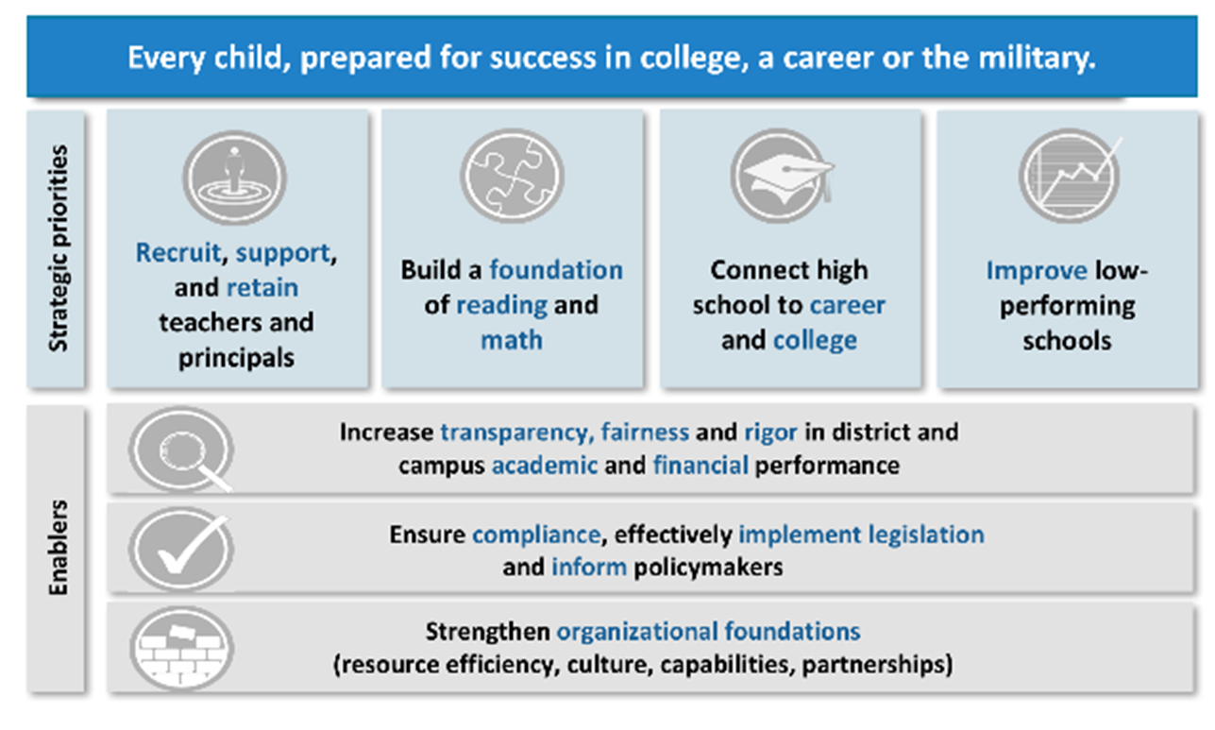
Strategic Plan

Slide 8




Texas Assessment System
Classroom/ Formative Assessments
Interim Assessments
Summative Assessments

Slide 9
Interim Pilot
The STAAR Interim Assessment System is an optional TEA tool to help districts identify students’ strengths and weaknesses and help predict student performance on STAAR.
The STAAR Interim Assessment System is available for districts at no cost through the STAAR Online Testing Platform, and the interims are not tied to accountability.
Items for the STAAR Interim Assessments are developed with Texas teachers and fully aligned to the Texas Essential Knowledge and Skills (TEKS).

Slide 10

Interim Pilot
Grade 3–8 mathematics and reading in year one.
Uses STAAR Online Testing Platform.
Two-section design allows for a shorter overall test —sections are interactively selected for each student by an algorithm.
Administration flexibility throughout year for two testing opportunities.
Provide teachers with actionable information to tailor instruction to meet student’s needs.

Slide 11
Interim Pilot
Key Dates for Year 1 (Spring 2018)
TAA and Information packet posted January 5th.
Training webinars on interim assessments are January 8 and 9, 2018.
Online registration begins January 9, 2018.
Year 1 online interim assessment window is January 29–March 23, 2018.

Slide 12
Interim Future Plans
Year 1 pilot participation – email the Student Assessment Division at StudentAssessment@tea.texas.gov
  Pilot participation includes feedback opportunity to guide future development
Year 2 operational launch – 2018-2019
  Includes 2 test opportunities with longer administration windows available in the fall and spring
  Additional content areas – English I, English II and Algebra I
  Spanish versions will be available for grades 3-5
  Content and language supports will be available
  More robust online reporting suite

Slide 13

Assessment Future Plans
TEA is working to improve the summative assessment experience over the next five years. Included:
Interim Assessments
Working group feedback
  Writing pilot
  Online Assessments
  Technology Enhanced Items

Slide 14
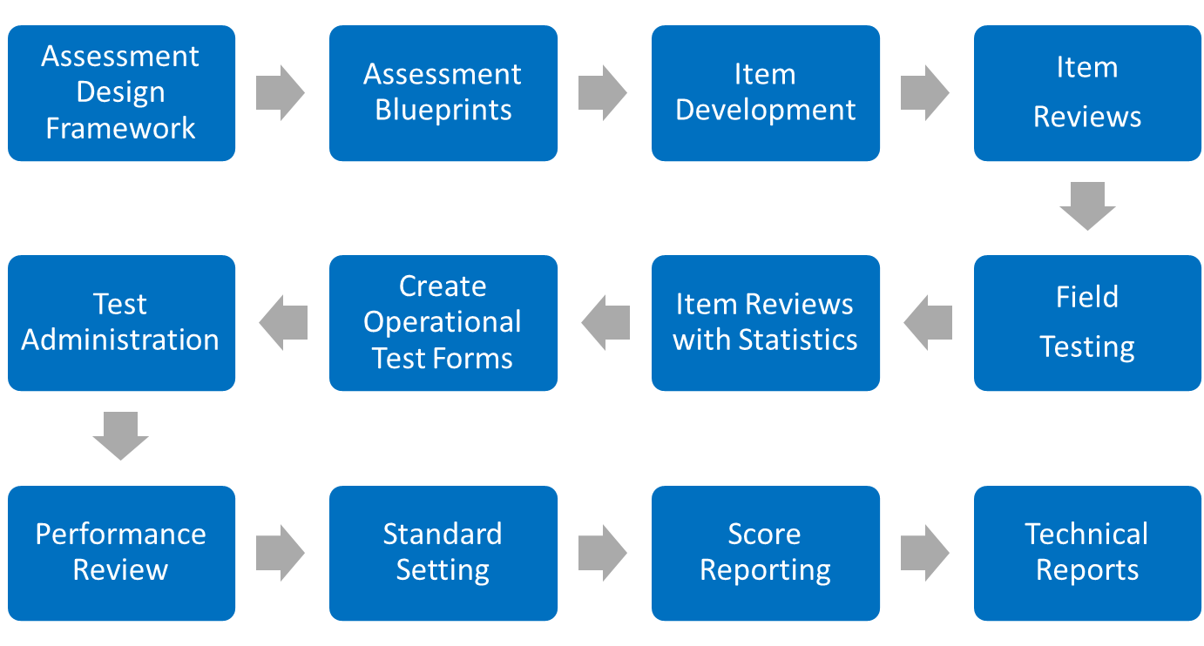
Assessment Lifecycle

Slide 15
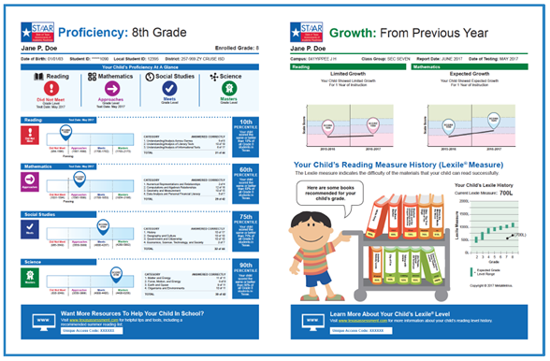
Online Assessments
STAAR Alternate 2 and TELPAS—currently provided online only
STAAR—available online for ALL students
  Greater accessibility options
  More flexibility in testing schedules
  Students are more engaged—digital learners
  Eliminates inventory management
  No more bubble sheets
  Faster test results

Slide 16
Technology Enhanced Items
Pilot—Spring 2018
  OPTIONAL section after the online STAAR assessments
  Only available to online testers
  Sample items—not specifically aligned to TEKS
Purpose
  Allows for higher order thinking
  Creates more engaging content
Item Types
  Drag-and-Drop
  Hot Text
  Multiple Select
  Constructed Response/Equations

Slide 17

Policy Updates

Slide 18
Student Success Initiative (SSI)
Given the impact of Hurricane Harvey, the commissioner has removed some SSI requirements for all districts in the 47 county Presidential Disaster Declaration.
  Waived the requirement for the creation of a Grade Placement Committee.
  Waived the requirement to provide a 3rd testing opportunity in June. However, districts will be able to continue to administer the June test if they believe it to be in the best interest of their students.
Districts will have local discretion on whether each student should advance to the next grade.
The district testing coordinator must provide written notification to ETS by May 4, 2018 indicating that his or her district does not wish to participate in the in the June 2018 STAAR grades 5 and 8 retest administration.
More information on the procedures involved is available at this link.

Slide 19
Student Success Initiative (SSI)
For a student receiving special education services who fails STAAR the first time he or she takes it, an Admission, Review, and Dismissal (ARD) committee meeting* MUST be held before the student is administered STAAR for the second time.
The ARD committee MUST determine
  how the student will participate in an accelerated instruction program and
  whether the student will be promoted or retained based upon the ARD committee determination that the student has made sufficient progress in the measurable academic goals in the student’s IEP. If promoted, retesting is not required.

Slide 20
Student Success Initiative (SSI)
If the student retests in a subsequent administration of STAAR and does not meet the passing standard, then the ARD committee must document in the IEP (through an ARD committee meeting or an agreement to amend the IEP)
  additional accelerated instruction,
  whether the student will retest, and
  whether the student will be promoted or retained.
*IDEA allows that “When conducting [ARD committee] meetings...the parent of a child with a disability and a public agency may agree to use alternative means of meeting participation, such as video conferences and conference calls.” (34 CFR §300.328). However, for the meeting required after the first time a student takes and fails STAAR, a meeting does not include an agreement to amend the IEP.

Slide 21
Updated Dictionary Policy
The dictionary policy is being extended to include grades 3–5.
Districts must ensure that dictionaries are available to all students taking
  STAAR grades 3–8 reading;
  STAAR grades 4 and 7 writing;
  STAAR English I, English II, and English III;
  STAAR Spanish grades 3–5 reading; and
  STAAR Spanish grade 4 writing.
The updated STAAR Dictionary Policy is posted on TEA’s Student Assessment Division website.

Slide 22
Updated Calculator Policy
Calculators now will be required for STAAR grade 8 science.
Districts must ensure that students have access to a calculator with four-function, scientific, or graphing capability when taking the STAAR grade 8 science assessment.
The updated Calculator Policy is posted on TEA’s Student Assessment Division website.

Slide 23
Braille Tests
Based on the implementation date established by the Braille Authority of North America (BANA), braille versions of STAAR will be offered in Unified English Braille (UEB), as well as English Braille American Edition (EBAE), beginning with the April 2018 administration.
Contracted and uncontracted braille test materials in both UEB and EBAE will be available.
Districts will indicate the correct braille format in the Assessment Management System for each student taking a braille version of STAAR.

Slide 24
TAKS Examinees
Beginning with the 2017–2018 school year, the Texas Assessments of Knowledge and Skills (TAKS) tests will no longer be administered.
Former TAKS examinees (including former Texas Assessment of Academic Skills [TAAS] and Texas Educational Assessment of Minimal Skills [TEAMS] examinees) have the option to take an alternate assessment, including STAAR EOC assessments, to fulfill their graduation testing requirements. See TAC §101.4003.
These former examinees also have the option of a district decision. The commissioner rules for the district decision should be posted later this month from the Curriculum Division.
More information is available on the TAKS webpage on TEA’s Student Assessment Division website.

Slide 25
Student Assessment Newsletter
Plan to produce prior to major school/testing events, i.e.:
  January, beginning of spring semester
  March, prior to first round of spring tests
  May, prior to second round of spring tests
  August, beginning of school year/fall semester
  November, prior to December tests
First edition was published in October 2017.
Next edition will be published in January 2018.

Slide 26
Student Assessment Newsletter
Sent via GovDelivery to
  Superintendents
  District testing coordinators
  Student assessment listserv
Posted on the following webpages
  What’s New in Student Assessment
  Student Assessment Correspondence with Districts
Link being provided in the upcoming CAO newsletter scheduled to launch in late January 2018 to ensure that CAO’s will have the same info as DTCs.

Slide 27
Other Communication
Emails
  One weekly update
    Vendor updates for next two weeks
    ETS/Pearson every other week
  Special emails sent to specific districts (e.g., those that have not returned testing materials)
  Emails from TEA regarding policy changes
TETNs
Webinars

Slide 28
Next Steps in Development
For the 2018–2019 school year
  The assessment year will shift from a calendar year to an academic year
Online Coordinator Manual
  Updated in August for academic year
  Indexed and Searchable
Online User Guide
Digital Calendar of Events

Slide 29
Online ADPL
Provide better data validation
Spring 2018 – district input through DWG and TSNAP events
Revised process in 2018-2019 DCCM
Better data validation for better reporting
State
District
School
Class

Slide 30

Test Administration

Slide 31
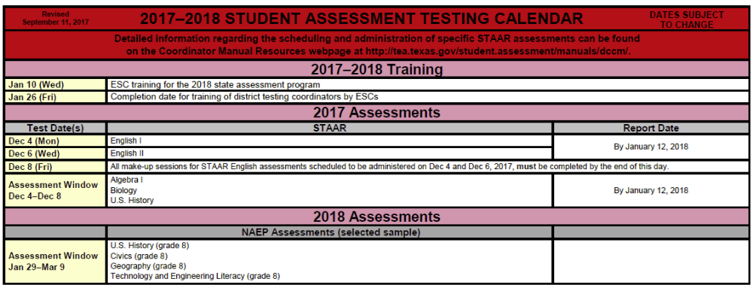
2017–2018 Testing Calendar
Posted online at 2017-2018 School Year.
Revised version sent and posted on September 11, 2017.

Slide 32
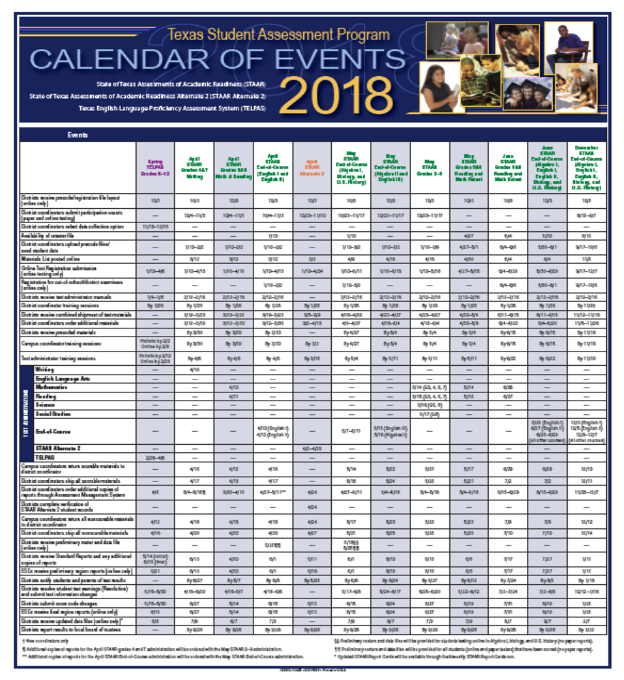
2018 Calendar of Events
Posted online at
https://tea.texas.gov/student.assessment/manuals/dccm/.
Can be found in the Coordinator Manual.
Poster version delivered with the Coordinator Manual.

Slide 33

Manuals and Resources
The 2018 District and Campus Coordinator Manual is posted online and scheduled to be sent to districts this week.
https://tea.texas.gov/student.assessment/manuals/

Slide 34
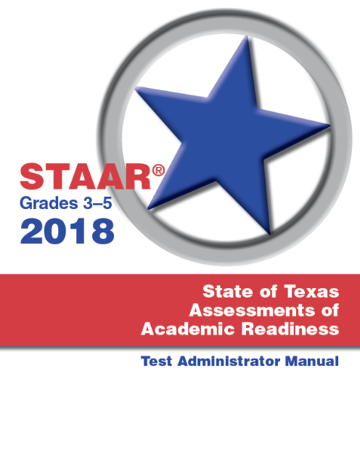

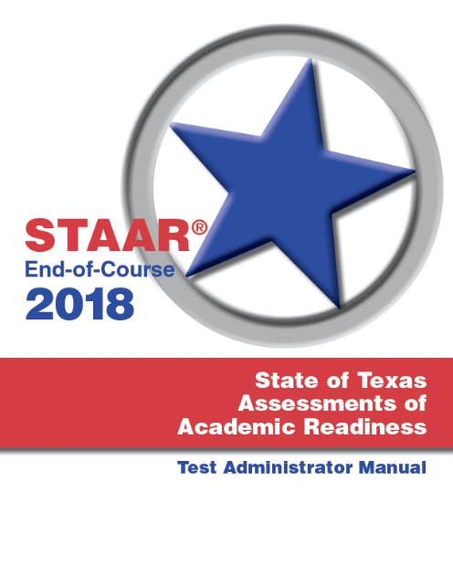
Manuals and Resources
The 2018 STAAR Test Administrator Manuals are scheduled to be posted online in January and sent to districts in February.
https://tea.texas.gov/student.assessment/manuals/

Slide 35
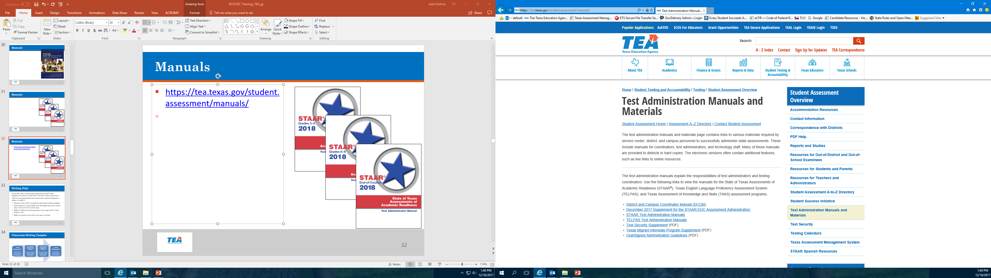
Manuals and Resources
Additional manuals and other resources have been/will be posted.
https://tea.texas.gov/student.assessment/manuals/

Slide 36
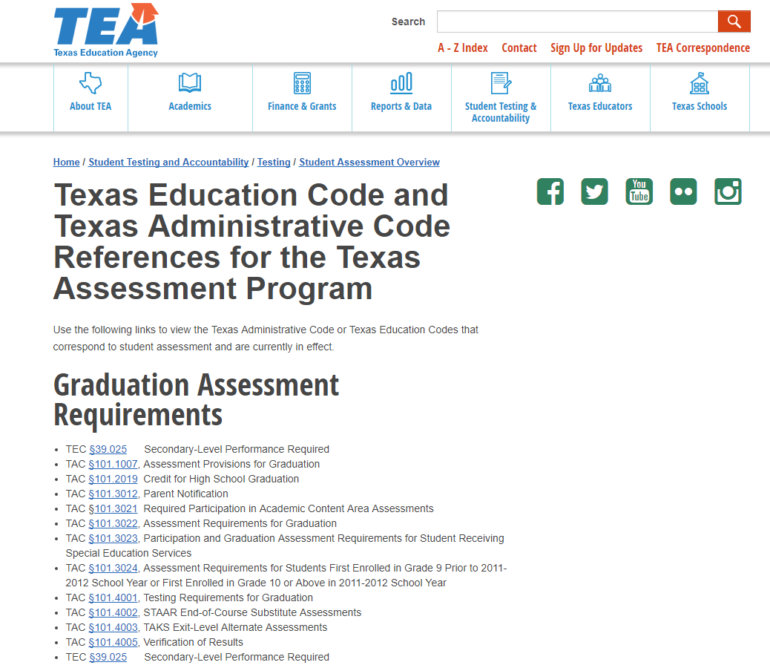
Manuals and Resources
The Student Assessment Division has created a new webpage that includes links to the Texas Education Code (TEC) and the Texas Administrative Code (TAC) that pertain to the Texas assessment program.
http://tea.texas.gov/student.assessment/Code_references/

Slide 37
Writing Pilot
House Bill 1164—2-year project passed by the 84th Texas Legislature in 2015 for 2016–2017 and 2017–2018 school years.
Calls for a proposed alternative assessment method designed to assess a student’s:
Mastery of the TEKS in writing through timed writing samples;
Improvement in writing skills from the beginning of the school year to the end of the school year;
Ability to follow the writing process from rough draft to final product; and
Ability to produce more than one type of writing.

Slide 38
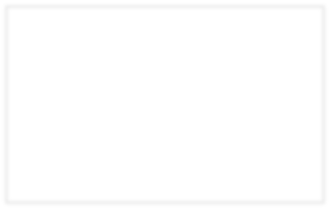
Classroom Writing Samples
Timed Writing Sample 1
Instructional Writing Process Sample 1
Instructional Writing Process Sample 2
Timed Writing Sample 2
(final product produced in one class period from a list of prompts)
(planning, drafting, revising, editing, publishing, and final product)
(planning, drafting, revising, editing, publishing, and final product)
(final product produced in one class period from a list of prompts)
School Year

Slide 39
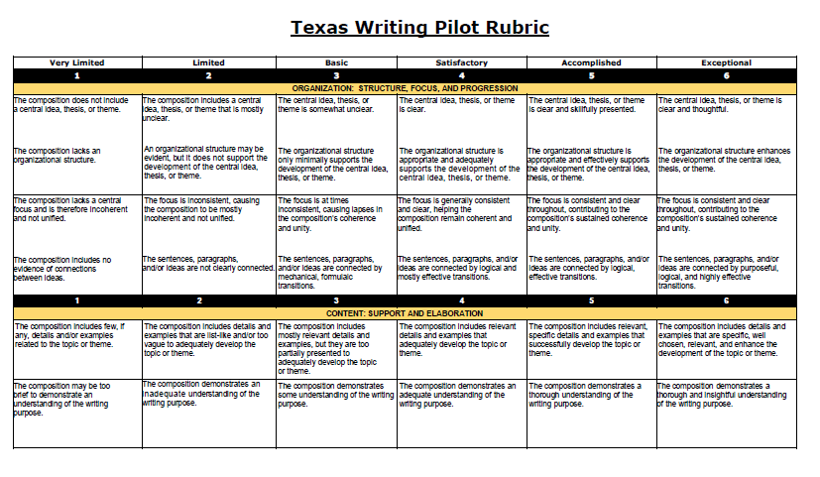
New Rubric
Analytic 6-point rubric
Designed by Texas teachers
Roll out in January 2018
Creates opportunity for additional participants
Provides more actionable feedback for teachers and students

Slide 40
Pilot feedback
Plan to create a TEKS correlation document and resources links to Gateway.
Districts will be provided with year-end data that shows the calibration of raters, distribution of scores across the campus/district, and other points of interest.
Educators involved in the pilot will have the opportunity to participate in ongoing professional development and statewide conversations focused on writing instruction.
Grades 4 and 7 are not required to participate in STAAR. This will not affect accountability.

Slide 41
Constructed Response Scoring
New Processes
  Rangefinding with Texas Educators
  TEA Staff Back Reads
Double Blind Holistic Scoring
2017-2018 Rescore Requests

Slide 42

Test Security

Slide 43
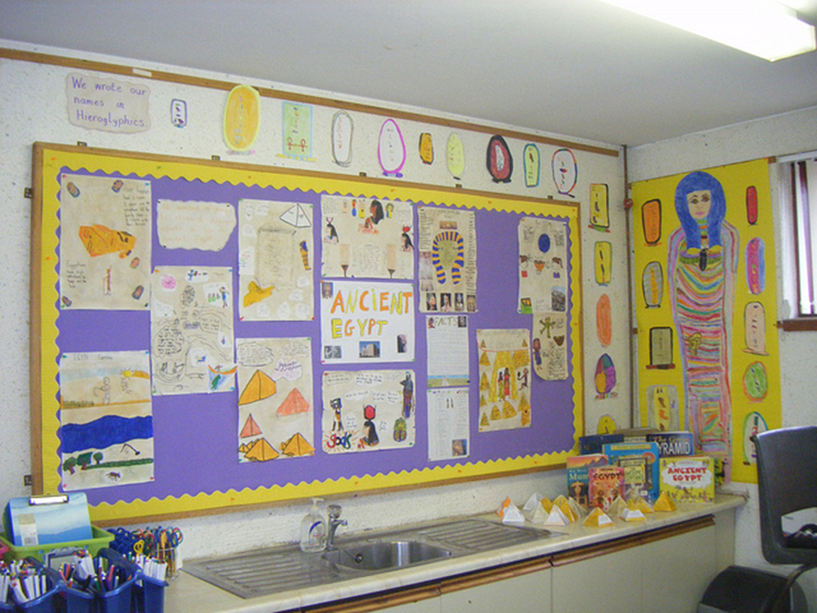
Testing Environment
Testing
≠
Stopped Instruction

Slide 44
Administration Guidelines
Create a secure, positive environment for testing.
  Turn off all communication devices.
  An instructional environment should be maintained during testing windows. It is not necessary to conceal or remove instructional or reference materials in the testing area, the classroom, or hallways unless they could provide a direct source of answers for the subject-area assessment being administered.
Examples of content-specific materials:
  Math tables for addition, subtraction, multiplication, and division facts during mathematics assessments.
  Graphics containing tested information such as moon phases, the water cycle, or human body systems during appropriate grade level science assessments.
  Historical timelines or lists of historical figures and their accomplishments during social studies assessments.

Slide 45
Administration Guidelines
Confirm each student has his or her own precoded answer document or online testing ticket if testing online.
Once a student has completed testing, you must collect their testing materials. Then, you may allow them to leave the area or provide them with an instructional activity (i.e., guided reading activity) while other students continue testing.

Slide 46
Material Handling Guidelines
Contaminated documents
  Securely transcribe to a clean document if possible.
  It is NOT NECESSARY to keep or return contaminated documents to the test vendor.
  Note the bar code information for test booklets or answer documents.
  Securely DESTROY the contaminated document.
  Notify the assessment vendor of the destroyed documents (see DCCM for additional details).
Ensure careful inventory of all test booklets and answer documents.
Students may have clean, blank scratch paper during all assessments.
  Scratch paper may be lined, unlined, or graph paper and should be collected and securely destroyed after each testing session.

Slide 47
Test Administration Materials
Procedures for maintaining the security and confidentiality of assessments are specified in the following guides.
  District and Campus Coordinator Manual
  Test Administrator Manuals
  Test Security Supplement

Slide 48
Changes in 2018 Test Security Supplement
Removed test booklet seals.
Added references to STAAR Alternate 2 test item image cards.
Added requirement to review any allowed or approved technology to ensure it does not violate test security or confidentiality.
Added new security oath for individuals proctoring the TELPAS Rater Training Calibration activity.

Slide 49

Testing Irregularities
Incidents resulting in a deviation from documented testing procedures are defined as testing irregularities. Test irregularities are viewed by TEA as falling into one of two categories—serious or procedural.

Slide 50
Penalties for Violation of Security
A person who engages in conduct prohibited by the Test Security Supplement or other test administration materials may be subject to the following penalties:
placement of restrictions on the issuance, renewal, or holding of a Texas teacher certificate;
issuance of an inscribed or non-inscribed reprimand;
suspension of a Texas teacher certificate for a set term; or
revocation or cancellation of a Texas teacher certificate.

Slide 51
Procedural Irregularities
  Reflect minor errors or deviations in testing procedures
  Do not represent severe breaches in security or confidentiality
  Do not require a call to TEA unless guidance is needed by the district
  Do not require supporting documentation

Slide 52
Serious Irregularities
  Constitute severe violations of test security or confidentiality.
  Must be investigated by the district testing coordinator.
  Must be reported to TEA as soon as the district testing coordinator is made aware of the situation.
  Can result in the individual(s) responsible being referred to the TEA Educator Certification and Standards Division for consideration of disciplinary action.

Slide 53
Serious Irregularities
Conduct that constitutes a serious testing irregularity may include, but is not limited to, the following:
  directly OR indirectly assisting students with responses to test questions
    providing, suggesting, or indicating a test question response
    aiding or assisting a student with a response or an answer to a secure test question
    identifying incorrect responses for students

Slide 54
Serious Irregularities
Conduct that constitutes a serious testing irregularity may include, but is not limited to, the following:
  tampering with student responses
    changing or altering a student’s response or answer to a secure test item
  falsifying TELPAS holistic ratings or STAAR Alternate 2 student responses
  viewing secure test content before, during, or after an assessment unless specifically authorized to do so
  discussing or disclosing secure test content or student responses

Slide 55
Serious Irregularities
Conduct that constitutes a serious testing irregularity may include, but is not limited to, the following:
  scoring students’ tests, either formally or informally
  duplicating, recording, or electronically capturing confidential test content unless specifically authorized to do so
  fraudulently exempting or preventing a student from participating in the administration of a required state assessment
  receiving or providing unallowable assistance during the TELPAS calibration activities

Slide 56
Serious Irregularities
Conduct that constitutes a serious testing irregularity may include, but is not limited to, the following:
  encouraging or assisting an individual to engage in the conduct described previously or in any serious violation of test security and confidentiality
  failing to report to an appropriate authority that an individual engaged in any of the events listed previously or in any other serious violation of security and confidentiality

Slide 57
Reporting Serious Testing Irregularities
Investigate and report serious testing irregularities to TEA as soon as the district coordinator is made aware of the situation.
Conduct a prompt investigation.
Submit an Online Incident Report.
Submit any other required information to Student Assessment within 10 working days.

Slide 58
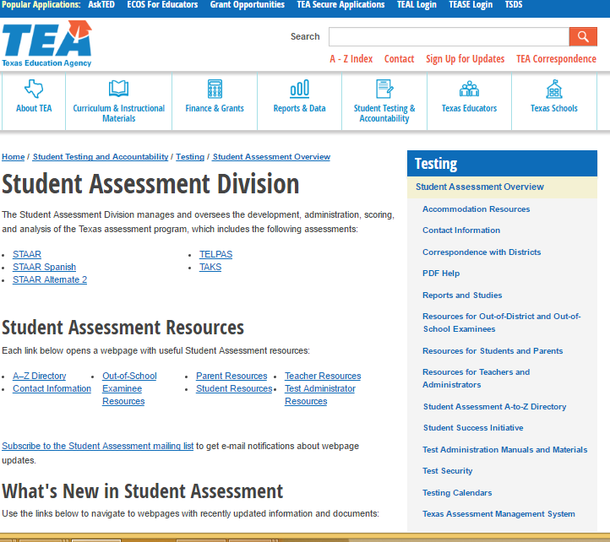
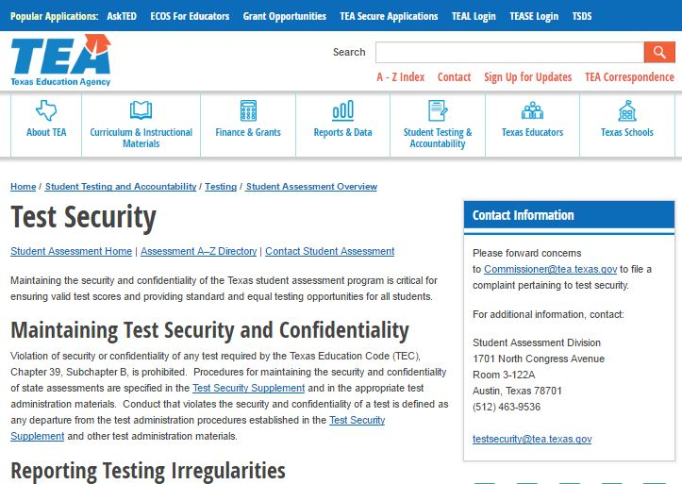
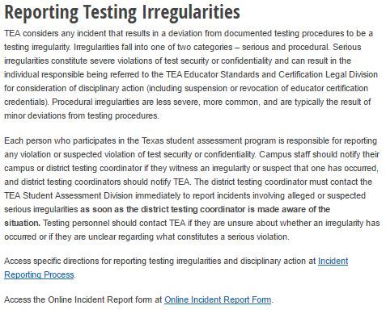
Reporting Online
Accessing the Online Incident Report Form

Slide 59
Questions?

Slide 60
Accessibility and PNP

Slide 61
New For 2018: STAAR Accessibility
Dictionaries for reading and writing in grades 3-5 are no longer a designated support, but part of the STAAR Dictionary Policy.
Projection devices and amplification devices moved to accessibility features.
Sticky notes tool added and pencil functionality expanded in the online test.
Authority for decision for math manipulatives and supplemental aids has been expanded to include additional campus-level teams.
Content and language supports have been combined into one and new specific braille instructions for students who take STAAR braille and are eligible for these supports have been created.

Slide 62
New For 2018: STAAR Accessibility
TELPAS added to Spelling Assistance and Complex Transcribing policies.
Online spelling assistance tool added as a new embedded support.
Photocopy now part of Large Print and Other designated supports.
“GA” accommodation bubble on answer documents changed to “DS.”
New email address for assessments for special populations team is assessment.specialpopulations@tea.texas.gov.

Slide 63
Accessibility Features -
  can be found in the District and Campus Coordinator Manual and on the Accommodations Resources webpage
  are available to any student who regularly benefits from the use of these procedures or materials during instruction
  do not need to be documented in student paperwork or answer document/STAAR Assessment Management System
  may require the student to complete the test in a separate setting in order to eliminate distractions to other students and ensure that security and confidentiality of the test is maintained
  cannot be required for use during testing
Coordinators are responsible for ensuring that test administrators understand the proper implementation of these procedures and use of these materials.

Slide 64
Accessibility Features
Signing test administration directions
Translating test administration directions
Bilingual dictionary (word-to-word translations; no definitions or examples) for mathematics, science, and social studies assessments
Read test aloud to self (e.g., PVC pipe, recording device)
Reading aloud or signing the expository or persuasive writing prompt
Reading assistance on the grade 3 mathematics test
Scratch paper (or any medium that can be erased or destroyed)/Sticky notes tool
Color overlays or online color setting
Blank place markers/online guideline tool
Magnifying devices/online zoom feature
Highlighters (including online tool), colored pencils, or crayons
Tools to minimize distractions or to help maintain focus (e.g., stress ball, headphones, instrumental music)
Individual or small-group administrations
Reminding students to stay on task
Amplification devices (e.g., speakers, frequency-modulated [FM] systems)
Projection devices (e.g., closed-circuit televisions [CCTVs] or LCD projectors for online tests)

Slide 65
Locally-Approved Designated Supports
These include twelve supports that may be made available to students who meet eligibility criteria.
Eligibility decisions are made by the appropriate team of people at the campus level based on the eligibility criteria and are documented in the appropriate paperwork.
Each document is organized the same way.
  Description of Accommodation
  Assessments
  Student Eligibility Criteria
  Authority for Decision and Required Documentation
  Examples/Types
  Special Instructions/Considerations

Slide 66
What is the Purpose of Designated Supports?
Designated supports are intended for students who are approved to use them based on the decisions of the appropriate committee (e.g., ARD committee, 504 committee, LPAC, RTI committee, or student assistance team).
When RTI committees or student assistance teams make decisions, they should be aimed at addressing a student’s consistent academic struggle in a specific area even after intensive instruction and remediation.
For example, supplemental aids should not be confused with common study aids used by students who are not struggling academically.

Slide 67
Locally-Approved Designated Supports
Basic Transcribing
Braille
Calculation Aids
Content and Language Supports
Extra Time
Individualized Structured Reminders
Large Print
Manipulating Test Materials
Mathematics Manipulatives
Oral/Signed Administration
Spelling Assistance
Supplemental Aids

Slide 68
Basic Transcribing: Grade 4 Writing
For any grade 4 student who is taking the STAAR writing test online, the test administrator may transcribe (i.e., type) the student’s response to the writing prompt into the online test. The student does not have to be eligible for Basic Transcribing to receive this assistance and it does not need to be documented in the Assessment Management System.
  Note: This is not a requirement of the administration and decisions regarding this provision must be based on individual student need.
The test administrator transcribing the student’s response must do so in accordance with guidelines for Basic Transcribing found on TEA’s Accommodations Resources webpage.
Students in all other grades and subjects must meet the eligibility requirements for Basic Transcribing if this accommodation is needed.
TEA is considering adding this policy to the list of Accessibility Features for the 2018-2019 school year.

Slide 69
Basic Transcribing: #7 Special Instructions/Considerations
The student must be given the full time allotted to complete the entire test. It is allowable for the student to review the transcription and make any edits within the time constraints of the assessment.
  This means that the student can change his or her response ONLY within the time limit of the test (i.e., 4 hours, 5 hours, or extra time).
If the test administrator transfers the student’s final responses onto the answer document/STAAR Assessment Management System after the testing period has ended, the student may not edit his or her response.
It is recommended that the test administrator ensure that he or she can read and understand the student’s intended response prior to the student leaving the testing room.

Slide 70
Calculation Aids:
Student Eligibility Criteria
Disability that affects math calculations (grades 5-7)
  This is a problem adding, subtracting, multiplying, and dividing using paper and pencil that can be caused by various reasons, including (but not limited to) a
    learning disability in mathematics calculation
    ADD/ADHD
    behavioral or emotional problem
    processing or memory issue
  The ARD or Section 504 committee should review the student’s current documentation and instructional supports and determine if this evidence indicates that the student’s disability causes him or her to have a problem calculating with pencil and paper.
    If the student is currently receiving this accommodation in classroom instruction, there should be documented evidence of why this is necessary.

Slide 71
Calculation Aids: #2 Special Instructions/Considerations
The use of a calculation aid as a designated support on STAAR should not replace the teaching of basic computation skills as outlined in the TEKS. If a student is using a certain calculator (e.g., scientific, graphing) during classroom instruction, it is important to be aware of any functions on that device that could compromise the teaching of those skills. As such, district and school personnel should give careful consideration before recommending the use of these devices for the assessment.

Slide 72
Calculation Aids
TEA is considering changing the calculator policy for the 2018-2019 school year by disallowing scientific and graphing calculation aids. Consideration is being given to adding a four-function calculator to the online tests as an additional embedded support. Don’t forget that four-function calculator applications could also be used.
Make sure that the student has learned the skill and uses the calculator only as an accommodation.
  For instance, the student may demonstrate knowledge of the skill without the use of the calculator on a few questions/assignments and uses the calculator for the remainder.

Slide 73
Content and Language Supports
During the 2017 administrations, the majority of students taking an online test with embedded supports (i.e., content supports, language and vocabulary supports, text-to-speech) received ALL supports. Therefore, content and language supports are combined into one embedded support for the 2018 administrations.
Documentation (e.g., IEP, IAP) that still lists these as two separate supports may be amended; however, this is not required. For instance, if the paperwork says the student will receive content supports. The student WILL receive content supports… as well as language supports. Just make sure all parties are aware of the changes.

Slide 74
Oral/Signed Administration
Evidence of reading difficulties
  This is a problem with reading that can be caused by various reasons, including (but not limited to) a
    learning disability in reading
    ADD/ADHD
    behavioral or emotional problem
    processing or memory issue
  The appropriate team of people at the campus level (i.e., RTI team, Section 504 committee, ARD committee) should review the student’s current documentation and instructional supports and determine if this evidence indicates a reading difficulty.
    If the student is currently receiving this accommodation in classroom instruction, there should be documented evidence of why this is necessary.

Slide 75
Oral/Signed Administration
For students who are deaf or hard-of-hearing who are eligible for
  Content and Language Supports, AND
  Oral/Signed Administration (but are not able to access text-to-speech)…
A signed administration is allowed for those parts of the test that can be read aloud. Test administrators should be trained using the Oral/Signed Administration Guidelines and also read the specific guidelines for signing test content included in the General Instructions for Administering State Assessments to Students Who are Deaf or Hard of Hearing document.

Slide 76
Oral/Signed Administration
Similar to 2017 administrations, proctor codes will be available to district testing coordinators and assistants in the STAAR Assessment Management System to download and distribute to test administrators providing a signed administration of an online STAAR test.
TEA is planning to administer STAAR online with the additional embedded support of signed videos (base test only) in the 2018-2019 school year.

Slide 77
Designated Supports Requiring TEA Approval
These include supports that may be made available to students who have a TEA-approved accommodation request form.
Eligibility decisions are made by the appropriate team of people at the campus level based on the eligibility criteria and then a request is sent to TEA for determination.
Complex Transcribing | Mathematics Scribe
Extra Day | Other

Slide 78
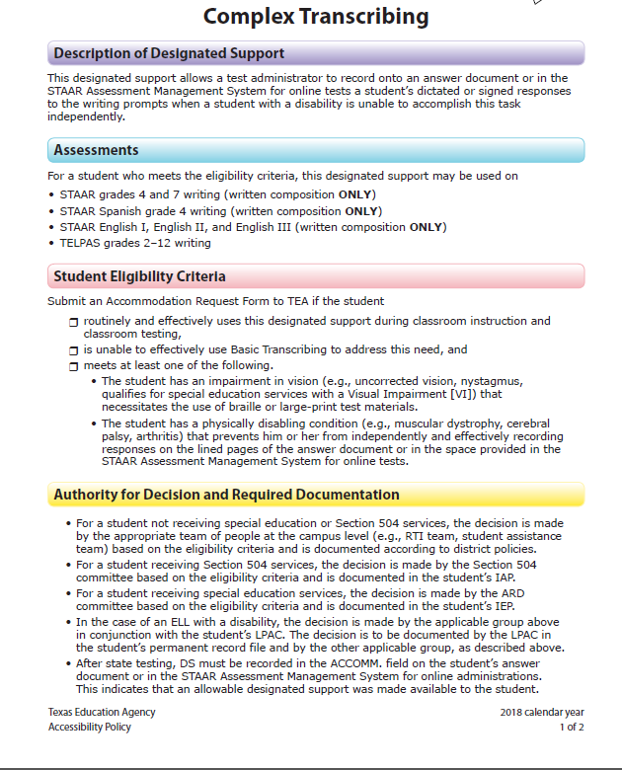
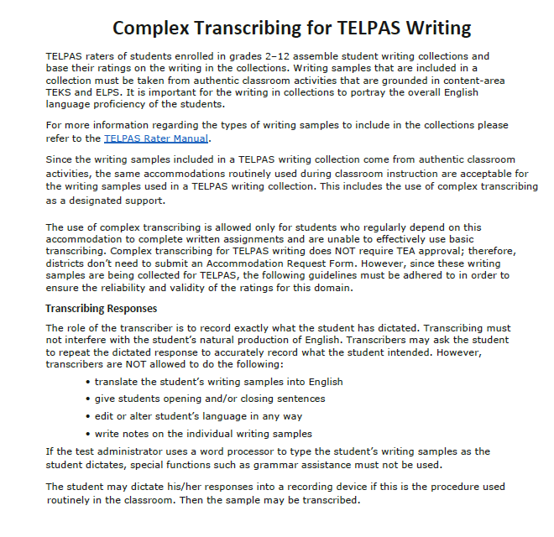
Complex Transcribing: #8 Special Instructions/Considerations
For grades 2–12 TELPAS writing, an Accommodation Request Form does not need to be submitted for a student that meets the eligibility criteria for Complex Transcribing.
Complex Transcribing Guidelines found on Accommodation Resources webpage should be followed when using this designated support.

Slide 79
Photocopying Test Materials
If a student needs secure test material photocopied because he or she requires a print larger than what the state provides, then follow instructions in the General Instructions for Administering Large-Print State Assessments document, located on the TEA’s Accommodation Resources webpage. No Accommodation Request Form needs to be submitted.
If a student needs photocopies for any other reason, then an Accommodation Request Form for “Other” must be submitted.

Slide 80
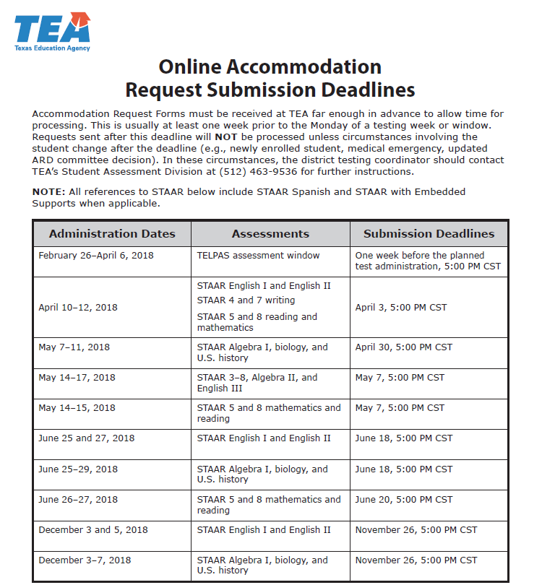
Accommodation Request Process
Accommodation Request Forms should only be submitted for designated supports requiring TEA approval (i.e., complex transcribing, math scribe, extra day, other).
The link to the online Accommodation Request Form for 2018 will be on the Accommodation Resources webpage along with a training document in January.
Accommodation Request Forms must be received by TEA at least one week prior to testing. Late requests will NOT be processed unless circumstances involving the student change after the deadline. Refer to the Online Accommodation Request Submission Deadlines document.

Slide 81
Accommodation Request Process
Accommodation requests must be approved by TEA before a student can use the accommodation on a state assessment. Documentation in the appropriate paperwork should state, “pending TEA approval.”
Do NOT include confidential student information (request will be deleted and you will be asked to resubmit).
  Example: student’s first and last name, Social Security numbers, pages from an IEP, medical documents
Step 1
Determination of student eligibility
Step 2
Completion and submission of online form
Step 3
TEA review and decision
Step 4
Required communication within district

Slide 82
Special Administration of STAAR with Content and Language Supports
Technology-based supports enable most students to test online; however, in those rare circumstances that prevent a student from testing online a special request may be made to TEA for approval to administer paper test booklet.
A link to the instructions and request form for a special administration is posted on the TEA’s District and Campus Coordinator Manual Resources webpage.
All requests must be received by TEA at least two weeks prior to testing so that testing materials can be ordered and shipped to districts.
If a student also needs a designated support requiring TEA approval, include it on this form. Do NOT submit a separate online accommodation request form.

Slide 83
Special Administration of STAAR with Content and Language Supports
Examples of situations when a request for a special administration of STAAR with content and language supports is appropriate.
  Accommodations cannot be applied
    Student has seizures or migraines from looking at computer screen.
    Even after multiple attempts throughout the year to acclimate the student to online testing, student becomes agitated or violent when beginning any practice test due to his or her disability.
  Technology access is precluded
    Student is homebound, and there is no internet connection at home.
    Student is in juvenile detention facility and county does not allow online test application to be downloaded onto computers.

Slide 84
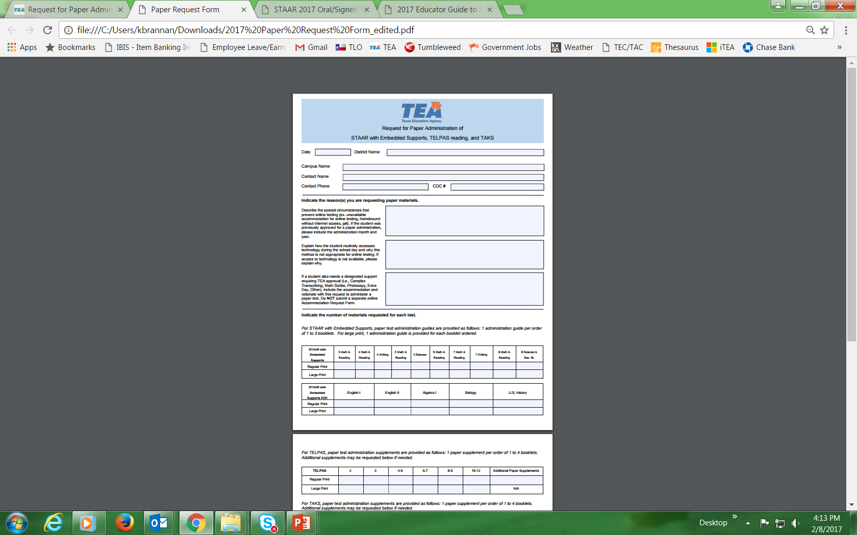
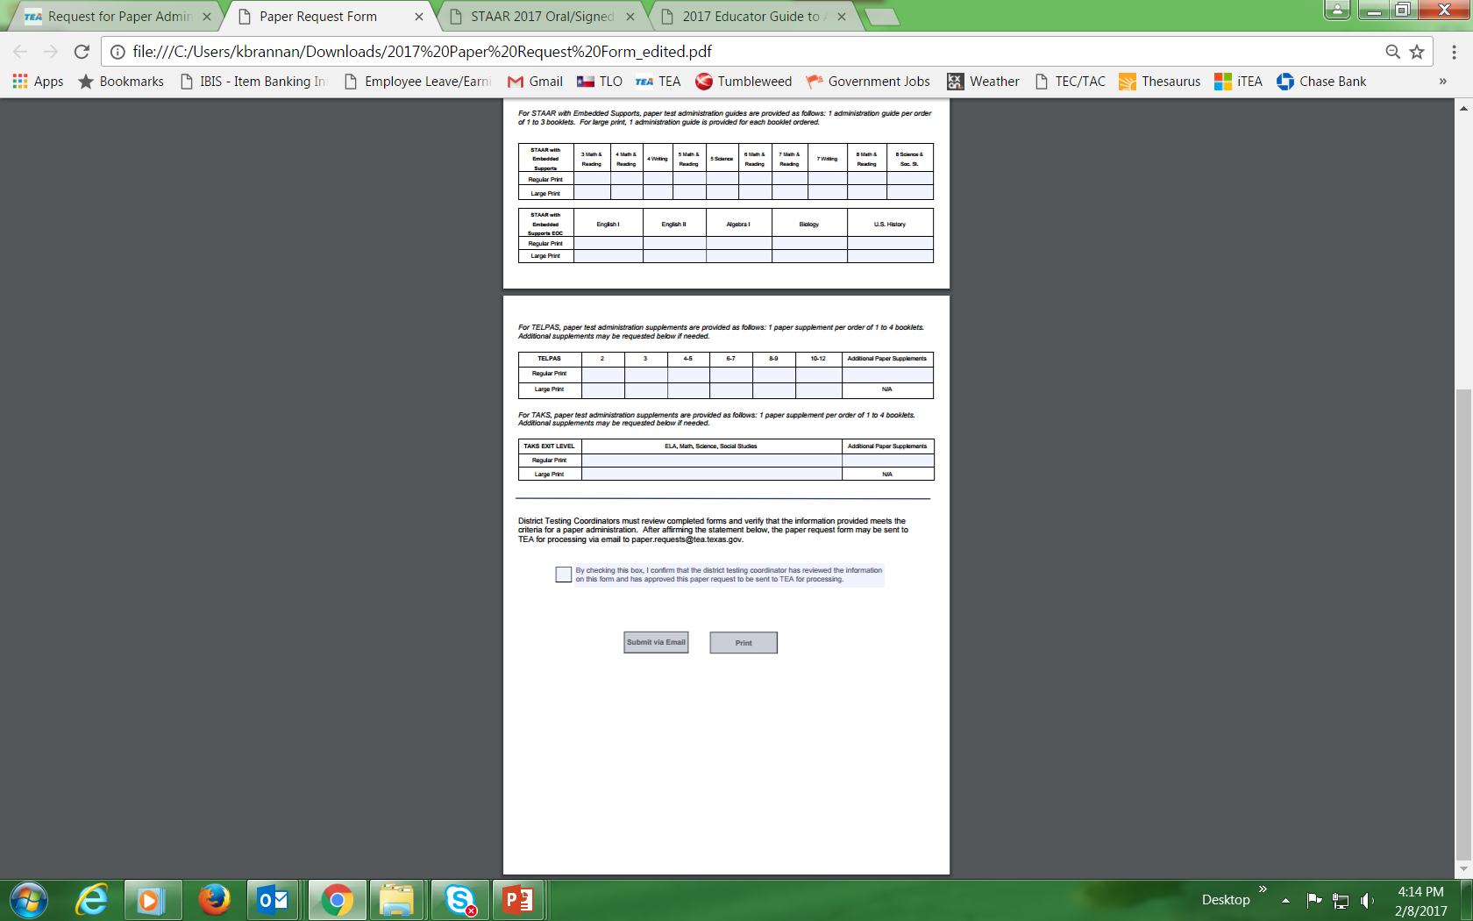
Special Administration of STAAR with Content and Language Supports
New email address for submission of all special requests: specialadministration.requests@tea.texas.gov
Form will go live in January 2018

Slide 85
Special Administration of STAAR with Content and Language Supports
Requests for a special administration of STAAR with content and language supports are automatically approved for students taking STAAR braille.
Specific Braille Instructions for Content and Language Supports are available on the STAAR Assessment Management System.
  Contains descriptions of pictures/images used as content and language supports and graphs/tables/charts that may be reproduced in braille or other forms that are more accessible to the test taker.
  Must be used in conjunction with 1) the appropriate specific braille instructions for the test being administered and 2) the supports tables in paper administration guide for STAAR with Embedded Supports.

Slide 86
Accommodations in Unexpected and Emergency Situations
When an unexpected or emergency situation (e.g., broken arm, lost eyeglasses) occurs just prior to or on the day of the state assessment, it may or may not be necessary to contact TEA. After testing, document the accommodation used on the answer document or in the STAAR Assessment Management System.
After the test administration, the appropriate accommodation code should be recorded on the student’s answer document or in the STAAR Assessment Management System for online administrations.

Slide 87
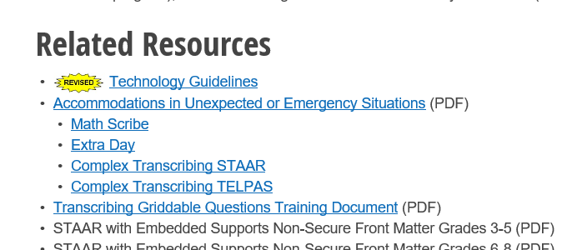
Accommodations in Unexpected and Emergency Situations
  If approved for Complex Transcribing, Extra Day, or Mathematics Scribe, follow the guidelines posted on the Accommodation Resources webpage to administer the assessment with these designated supports.

Slide 88
Accommodations in Unexpected and Emergency Situations
Step 1: No need to contact TEA
  Make available accessibility features which are allowed for any student.
Step 2: No need to contact TEA
  Make available locally-approved designated supports. Consideration should be given to accommodations that the student can independently use.
Step 3: Contact TEA
  If the student’s needs cannot be met with Step 1 or 2, contact a member of the Accommodations Task Force. The district testing coordinator may need to submit an Accommodation Request Form.

Slide 89
Accommodation Recommendations for Reading and Writing: Impact on Exit Criteria for ELLs
Students for whom the LPAC recommends the following designated supports for any reading or writing assessment may not be considered for exit at the end of the school year.
  Oral Administration
  Content and Language Supports
  Extra Time
Use of dictionaries on reading and writing assessments is no longer an accommodation since STAAR Dictionary Policy expanded to include these grades.
  The use of dictionaries on grades 3-5 reading and writing assessments does not prevent exit; however, it is important for LPACs to consider the degree to which an ELL student relies on a dictionary during language arts instruction or testing when making exit decisions at the end of the year.

Slide 90
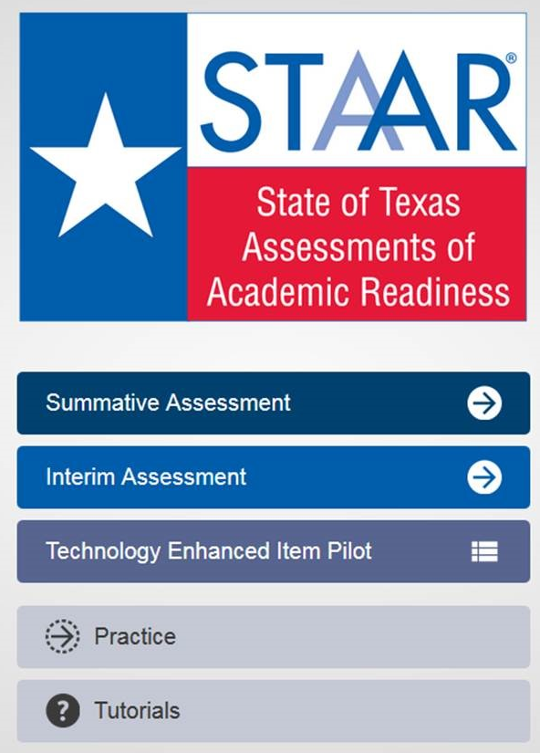
Online Tutorials and Practice Tests
When you open the STAAR online testing platform, you will see a menu of options, including “Practice” and “Tutorials.”
In the drop down menus, choose the assessment and the supports you want to view.
Tutorials provide a short video showing how the feature is used, while the practice provides an opportunity for students to use each feature on a released test.

Slide 91
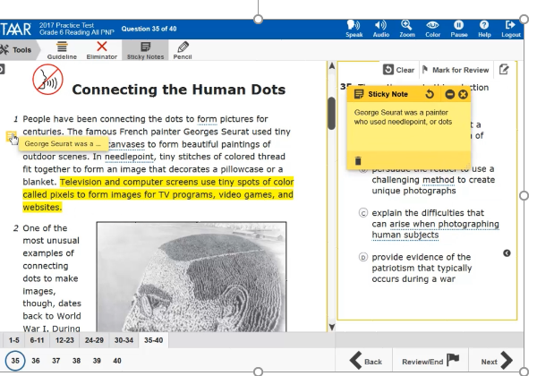
New Online Tool: Sticky Notes
Sticky notes-
  are available for all selections and questions
  can be moved around the screen
  can be minimized
  can be resized

Slide 92
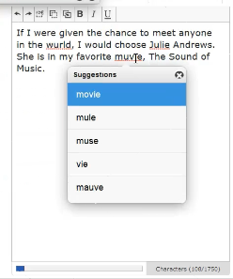
New Online Embedded Support:
Spelling Assistance
Spelling Assistance:
  It is only available on the essay portion of the grade 4 and 7 writing tests and English I and II tests.
  Will be available on English III in 2019 (Note this change in DCCM page O-3; Spelling Assistance designated support policy document has been updated).
  When a word is not found on the grade appropriate Merriam-Webster dictionary, it will be flagged.
  The system will provide up to five suggestions.
  The system evaluates the words independent of the context.
  It will be available as a stand-alone practice.

Slide 93
Preferences (PNPs) Expansion Plans 2019 and Beyond
Currently working on three new online embedded supports targeted for spring 2019administrations.
  Four-function calculator (grades 3-7)
  Signed videos (available for base test items only for first year)
  Screen Reader support for refreshable braille display devices (reading, writing, English I, English II, and Social Studies for first year)
  STAAR Spanish with Embedded Supports (grades 3-5)

Slide 94
Questions?

Slide 95
STAAR Assessment Management System

Slide 96
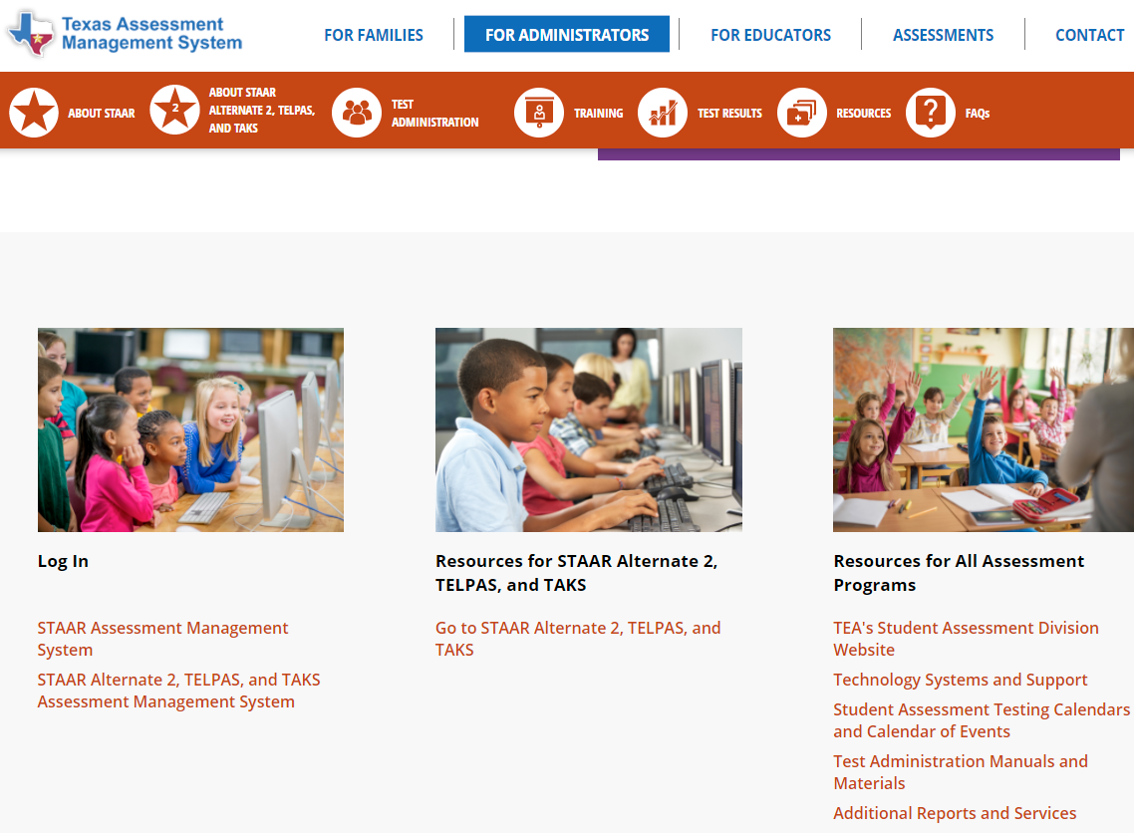
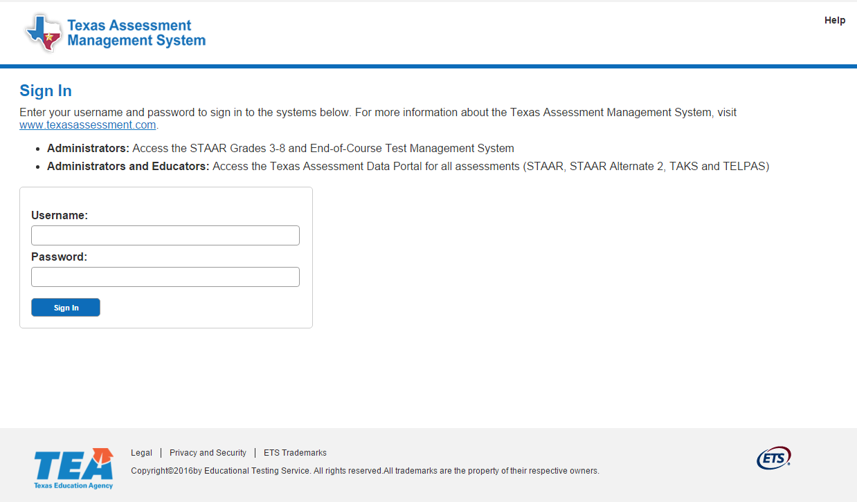

Accessing the STAAR Assessment Management System
https://www.texasassessment.com/administrators/
http://www.TexasAssessment.com/STAAR/

Slide 97
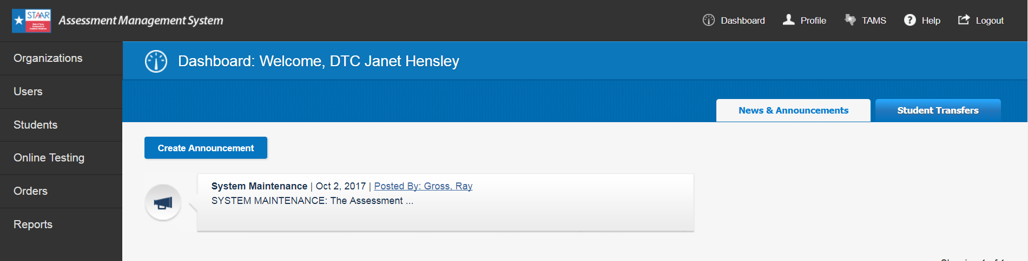
Help
STAAR
PDFs of test administration resources available for download.
Interim
Pilot
Zip files of test materials available for download.
? Help
Change for 2018 Interim Pilot

Slide 98
Interim Pilot – Key Points
Grades 3–8 mathematics and reading (Year 1)
  Year 2 to include additional subjects
Offered online through the STAAR Online Testing Platform
No paper materials or shipping
  Paper versions available for special populations as needed
Multi-section design
Items for the STAAR Interim Pilot Assessments are developed with Texas teachers and fully aligned to TEKS
Change for 2018 Interim Pilot

Slide 99
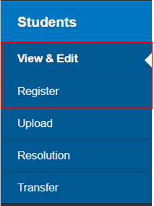
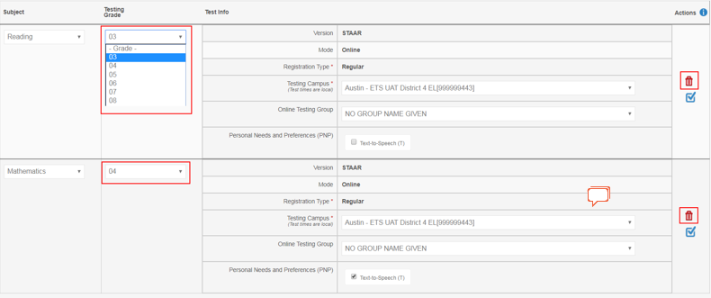
Students > View & Edit/Register > Tests
Interim Pilot
  Testing grade can be edited by subject.
  Individual subjects can be deleted.
Change for 2018 Interim Pilot

Slide 100
Students > Upload
Interim Pilot
  Upload creates both a MA and RE online registration for the enrolled grade for each student.
  All registrations are online.
  MATHEMATICS TEST VERSION CODE
    Enter Personal Needs and Preferences (PNP) that is valid for Interim: t or T
    Enter “i” or “I” to indicate Interim administration
    No need to enter “O” for online. All registrations will be online.
  READING TEST VERSION CODE
    Enter PNP that is valid for Interim: t or T
    Enter “i” or “I” to indicate Interim administration
    No need to enter “O” for online. All registrations will be online.
Change for 2018 Interim Pilot

Slide 101
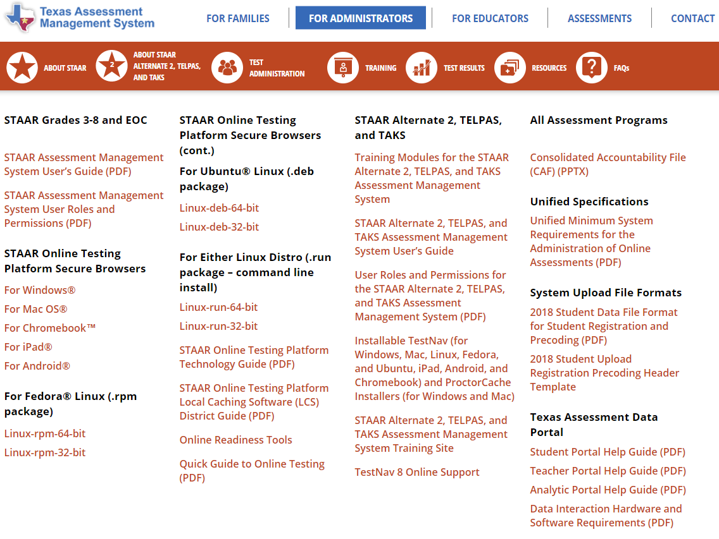
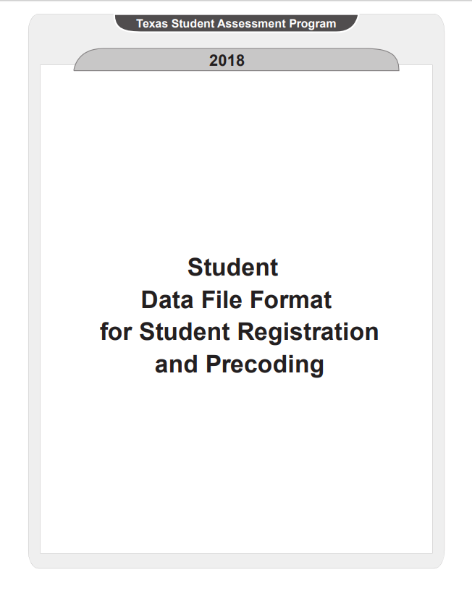
Changes to STAAR EOC Data File Uploads
The GROUP NAME field (column E) should only be used to organize paper or online test takers into groups; otherwise, the field should be left blank.
For online testing, the STAAR EOC TEST VERSION CODE field (column AW) has been updated to reflect the 2018 PNP accommodation codes and now includes an option for districts to indicate Designated Supports (formerly General Accommodations) for students taking an online test only.
The CAREER-AND-TECHNICAL-ED-IND-CD field (Column AA) has been updated to include only values 1, 2, and 0. A value of 3, “Participant in district’s tech prep program,” is no longer a valid value for this field.

Slide 102
Changes to STAAR 3–8 Data File Uploads
The GROUP NAME field (column E) can be used to specify a group name for tests being delivered on paper as well as online. This field should only be used to organize test takers into groups; otherwise, the field should be left blank.
For online testing, The READING TEST VERSION CODE, MATHEMATICS TEST VERSION CODE, SCIENCE TEST VERSION CODE, SOCIAL STUDIES TEST VERSION CODE, and WRITING TEST VERSION CODE fields (columns BD–BI) have been updated to reflect the 2018 PNP accommodation codes and now include an option for districts to indicate Designated Supports for students taking an online test only.
The CAREER-AND-TECHNICAL-ED-IND-CD (column AA) has been updated to include only values 1, 2, and 0. A value of 3, “Participant in district’s tech prep program,” is no longer a valid value for this field.

Slide 103
Changes to STAAR 3–8 Data File Uploads
Grades 5 and 8 Retest
  Two columns have been added for the STAAR Assessment Management System to indicate a grade 5 or 8 retester who has previously passed one of the two retest subjects (mathematics or reading). These columns are RETESTER INDICATOR-MA (column BO) and RETESTER INDICATOR-RE (column BP) (P = Previously met passing standard).
  These fields are not updatable by districts if the retester file is modified and re-uploaded.

Slide 104
Student Uploads – PNP for STAAR 3–8
The Mathematics Test Version Code, Reading Test Version Code, Writing Test Version Code, Science Test Version Code, and Social Studies Test Version Code fields will be used to indicate the following for STAAR grades 3–8:
PNP accommodation codes:
  E = Spelling Assistance (delivered online for grades 4 and 7 writing only)
  R = Content and Language Supports (delivered online)
  T = Text-to-Speech (delivered online; includes click word)
Online test with no accommodations:
  O = Student will test online with no PNP accommodations
Designated Supports (online testers only):
  D = Designated supports for a student testing online
Change for Spring 2018 STAAR

Slide 105
Student Uploads – PNP for STAAR EOC
The STAAR EOC Test Version Code will be used to indicate the following for STAAR EOC:
  PNP accommodation codes:
    E = Spelling Assistance (delivered online for English I and English II only)
    R = Content and Language Supports (delivered online; not available for Algebra II or English III)
    T = Text-to-Speech (delivered online; includes click word)
  Designated Supports (online testers only):
    D = Designated Supports for a student testing online
Change for Spring 2018 STAAR

Slide 106
Student Uploads – Groups
Update registrations via upload without compromising groups
  Once a group name has been established for a student registration (by text entry, by default, or with the “Groups” feature), a null (blank) will not override the group name with the value NO GROUP NAME GIVEN.
  Once a group name value has been established for a student registration, a user must use a new value to override the existing group name.
  To move a student to NO GROUP NAME GIVEN, a user must either use the “Groups” feature or upload a file with the value NO GROUP NAME GIVEN entered in the appropriate GROUP NAME field (not case sensitive).
Change for Spring 2018 STAAR

Slide 107
Student Registration – Reminders
Districts may add or edit existing student registrations, including switching between paper and online tests, through the end of the testing window.
Changes made to student registrations after the precode window closes (paper registration period) will not be reflected in precoded materials received.
Student registrations associated with a precode cannot be deleted after the precode window closes.
NOTE: Changes to student registrations will not be allowed for up to three days after the precode window closes while precode files are being processed – all related system functionality will be disabled during this time.

Slide 108
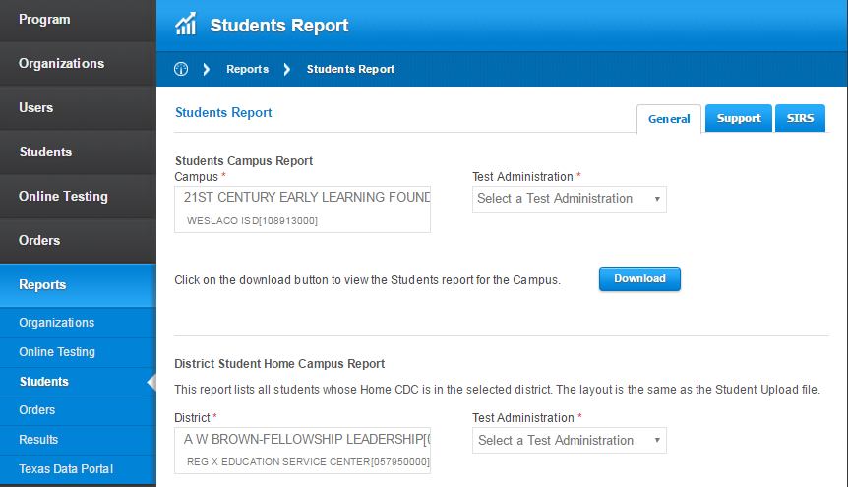
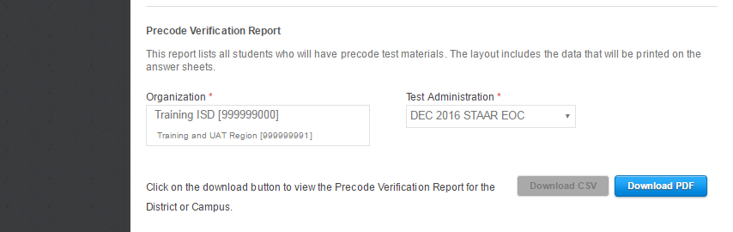
Precode Verification Report
Download CSV is available prior to the close of the precode window.
  Lists all paper test registrations and corresponding precode data
  Can be used to verify precodes, allowing districts to make corrections prior to the close of precode window, as needed
  Updated nightly
Download PDF is available after the close of the precode window.
  Official list of all precodes district is scheduled to receive (including OOD/OOS)

Slide 109
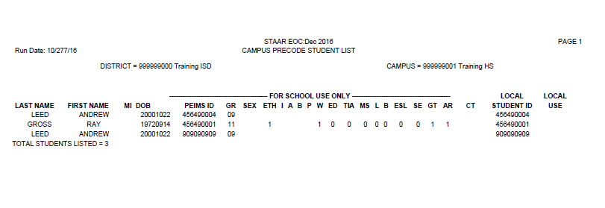
Precode Verification Report (PDF version)
Lists all paper-based test registrations at the close of the precode window - one record for each precoded answer document that the district is scheduled to receive (serves as official record) – available at the campus level
Organized by campus, subject, student (alpha order)
NOTE: The CSV version of the Precode Verification Report is not available for download after the precode window closes. Districts wishing to have a CSV version of their precode report must save a copy prior to the precode deadline.

Slide 110
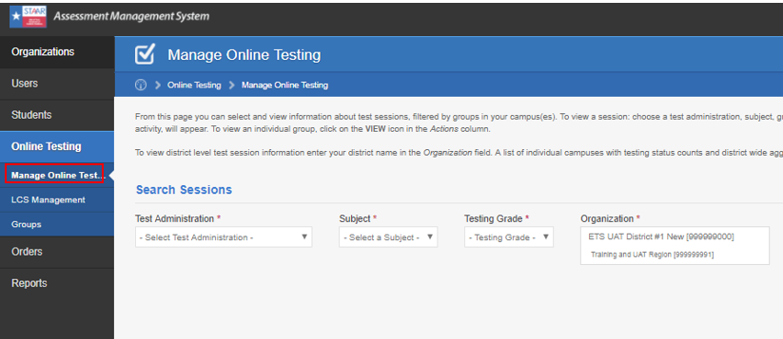
Online Testing > Manage Online Testing
Changes to online test attributes can be made for one additional business day beyond the close of the test administration window (until 7:00 p.m. CT).
All online testing activity will still close at the scheduled end of the test administration window.
Monitor Session button added to Sessions at a Glance page to display a list of all students in all groups.
“All Groups” option added to group selection.
Change for Spring 2018 STAAR

Slide 111
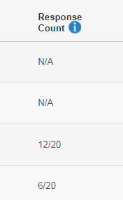
Online Testing > Manage Online Testing
Update response count as students respond to items
Refresh page to update
N/A = Not Available (student has not yet tested or has not yet responded to any questions)
X/Y = Number of Questions with Responses/Number of Total Questions

Slide 112
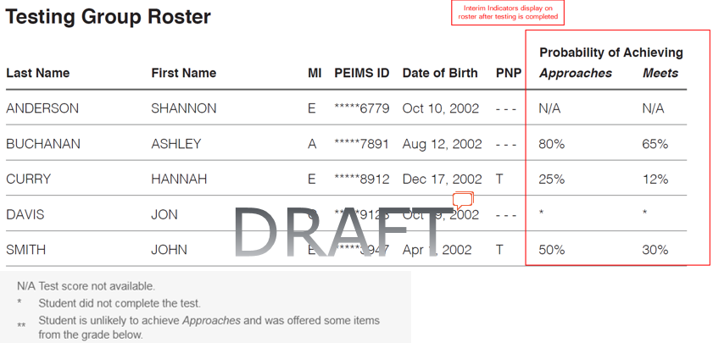
Online Testing > Manage Online Testing
PNP filter and column will display settings applicable for the Interim pilot.
Added columns will display Interim indicators.
  Probability of Achieving Approaches
  Probability of Achieving Meets
Change for 2018 Interim Pilot

Slide 113
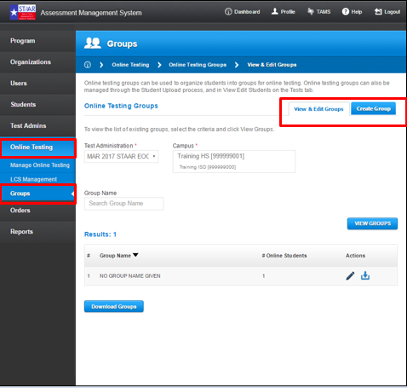
Manage Online Testing Groups
Edit existing online testing groups
Create online testing groups
NOTE: Grades 3‒8 students can be assigned to different testing groups by subject.

Slide 114
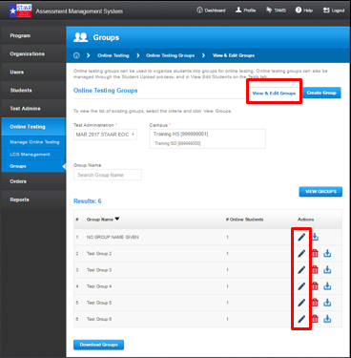
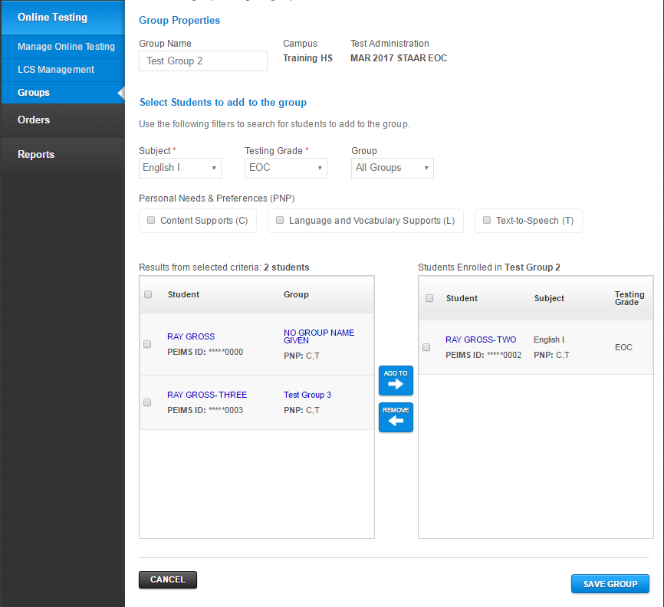
Edit Existing Online Testing Groups
Edit/Manage student groups via Online Testing > Groups > View & Edit Groups
Click the edit icon to move students between groups

Slide 115
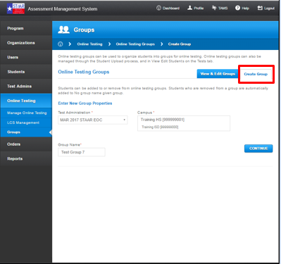
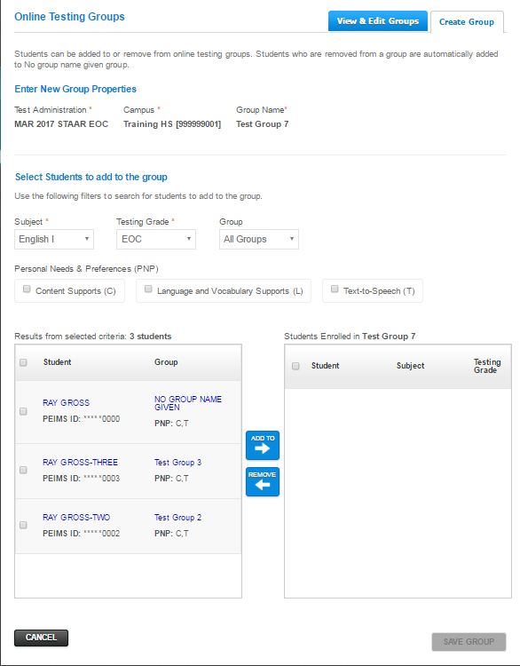
Create New Online Testing Groups
New groups can be created via Online Testing > Groups > Create Group.
Click the CONTINUE button to create new group and add students

Slide 116
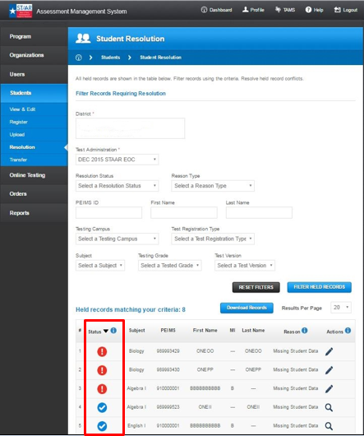


Student Uploads – Groups
Multi-step resolution process:
  Step 1 - match records
  Step 2 - correct records and submit
  Unresolved held record – click edit icon to resolve
  Resolved held record – click view icon to see resolved held record details
  Flagged – click edit icon if updated information is available to resolve the record

Slide 117
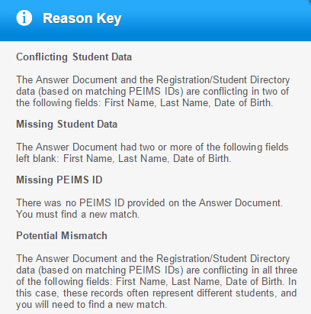
Student Resolution
Held Records – Reasons
Hand-gridded answer document contains:
Conflicting student data (with directory)
Missing student data
Missing PEIMS ID
Potential mismatch (with directory)

Slide 118

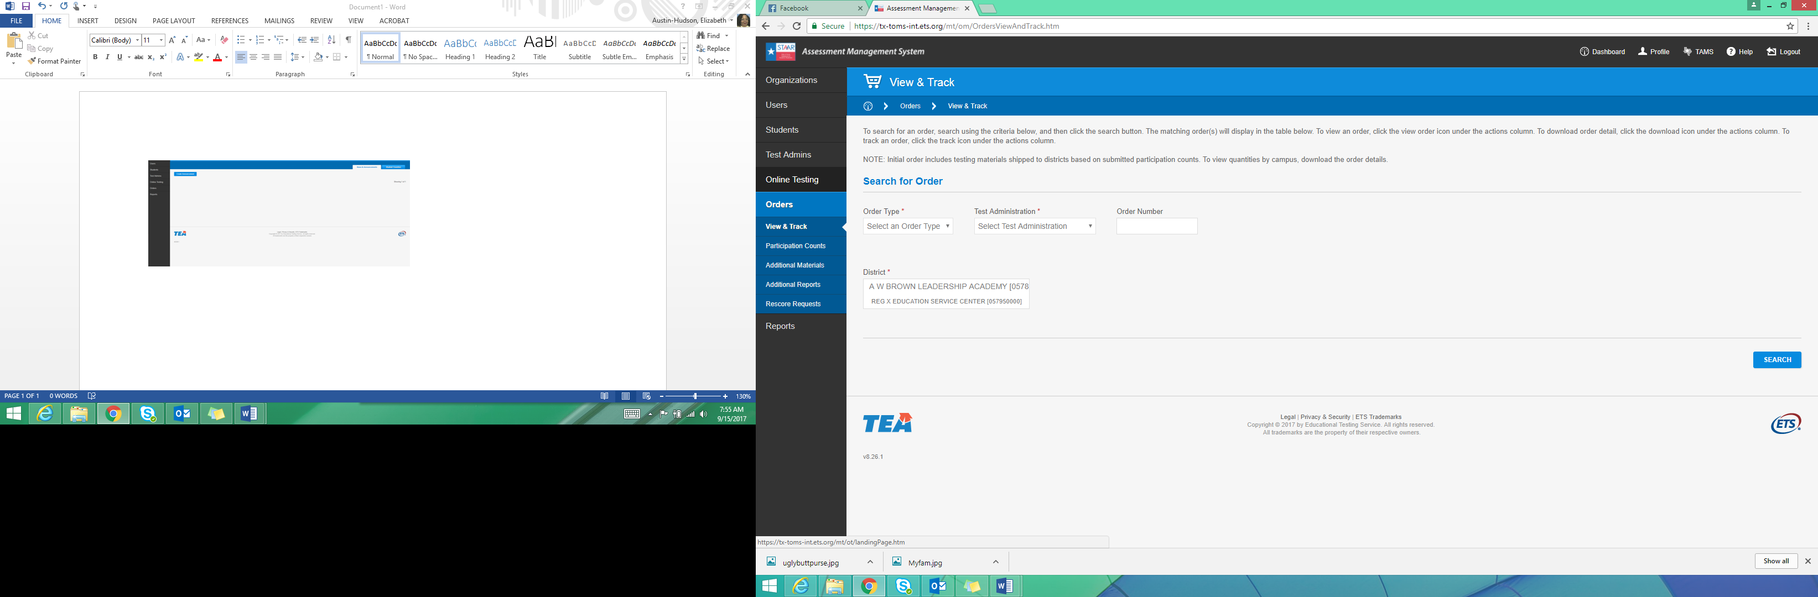
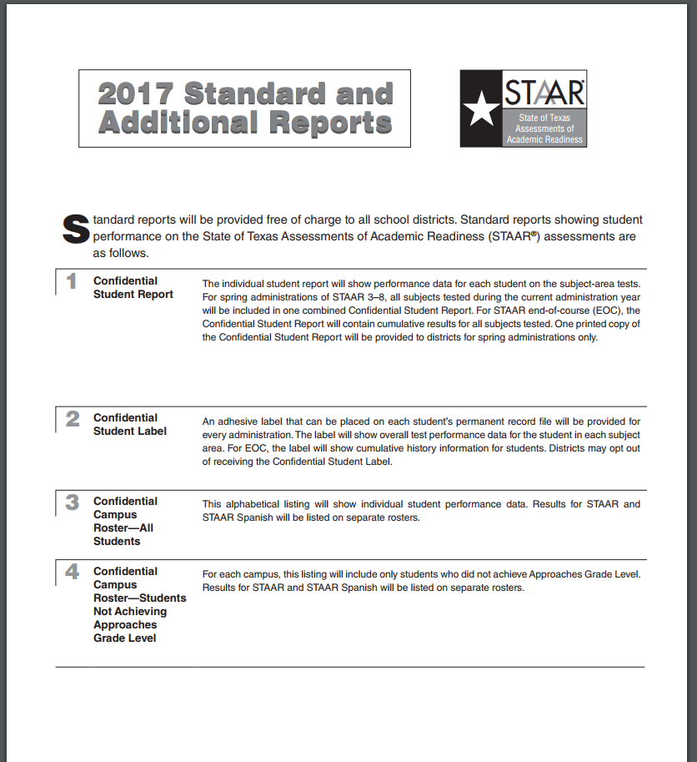
Additional Orders
Only authorized district users can submit orders for additional reports.
All orders must include PO number for billing.
No fax or paper orders will be accepted.
Additional printed paper copies of STAAR Report Cards (SRCs) will be available only for administrations that currently produce paper copies (spring administration only).
Orders submitted after deadline will be assessed additional late fees.
Confidential Student Labels can be ordered for any current administration.
Districts can also opt not to receive labels.

Slide 119
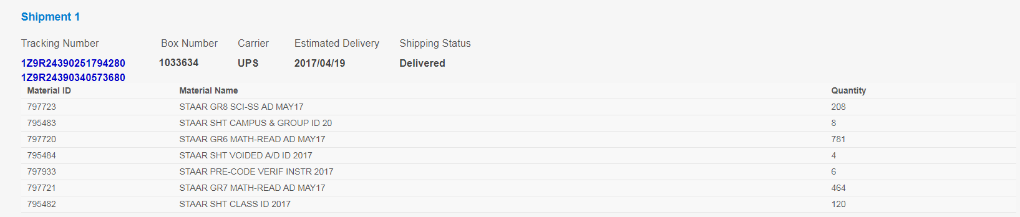
View and Track Order
Campus testing coordinators can view initial order information.
  Test materials list
  Precoded answer document quantities
Change for Spring 2018 STAAR

Slide 120
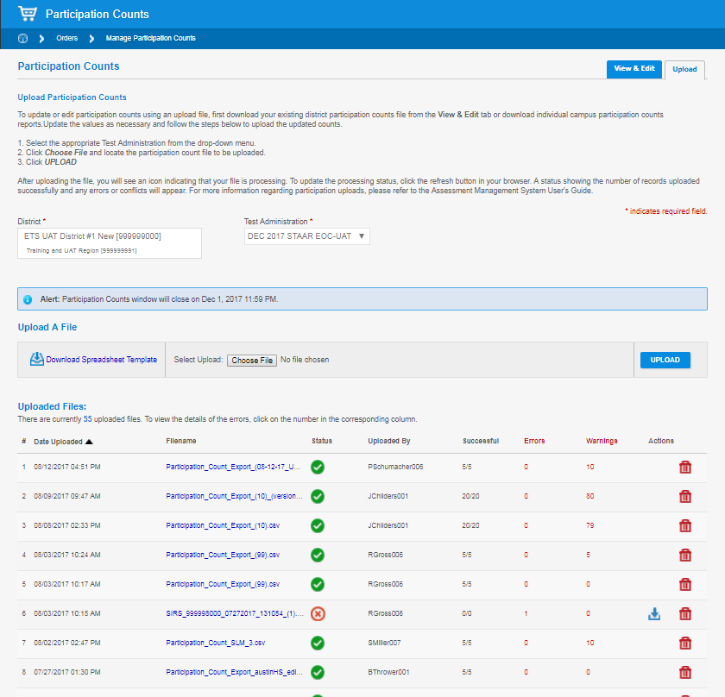
Participation Counts
Updating Participation Counts (Upload)
Counts status and downloadable files are updated immediately after update.
BEST PRACTICE: Download existing participation counts from View & Edit tab, make updates, and upload file back into the system.
Change for Spring 2018 STAAR

Slide 121
Reports: Online Testing
District Test Status Report
  Contains online testing status of all online test registrations, including PNP indicators, in the district.
  Report updated mid-morning, mid-afternoon, and each evening.
Campus Test Status Report
  Contains online testing status of all online test registrations, including PNP indicators, at a specific campus.
  Report updated mid-morning, mid-afternoon, and each evening.
New!
  Columns will display score codes and PNP settings.
  Report updated mid-morning, mid-afternoon, and each evening.
Change for Spring 2018 STAAR

Slide 122
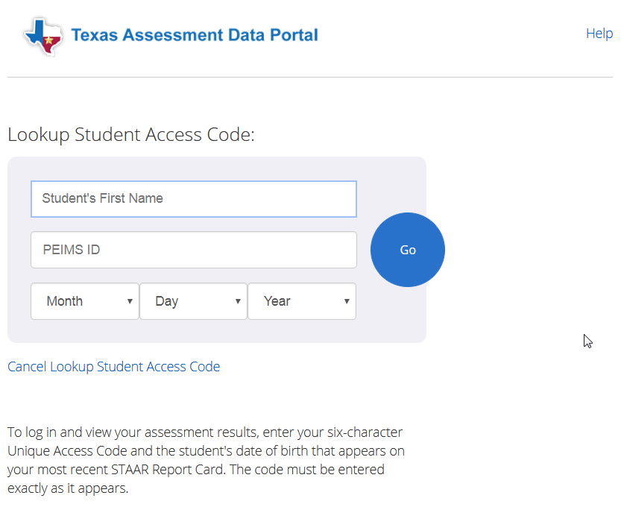
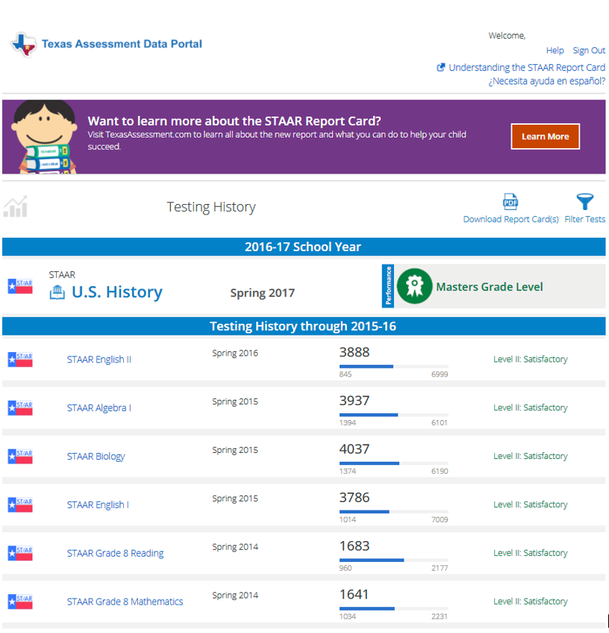
Reports: Online Testing
Student Assessment History Report
  Now links to Student Portal
  Click “Lookup Access Code” and enter the student’s first name, PEIMS ID, and date of birth to view student history.
Change for Spring 2018 STAAR

Slide 123


Reports: SIRS
Uploads are checked for data errors.
  All errors must be corrected for request to process.
No match students will be returned with response files.
Response files are grouped with uploaded request.
SIRS_152906000_10242016_155807_E_1314

Slide 124

Reports: Report Access
New Report Access functionality allows authorized district users to open Reports > Results access to campuses.
  Campus access will default to closed.
  Access can be granted to campuses one-by-one or in bulk.
Change for Spring 2018 STAAR

Slide 125

Online Testing Preparation: Review Updated Documentation

Slide 126

Unified Minimum System Requirements

Slide 127



Secure Browser Auto Update
Windows
  Secure Browser version 2.47 and later automatically updates to the latest version upon launch.
    Ensure network policies do not restrict auto-updates.
    Be sure that the user launching the secure browser has sufficient permissions to update software.
    Check appropriate version of browser is on all computers prior to testing.
  No uninstall/reinstall required.
MAC
  Secure Browser uninstall/reinstall is not required on devices that were used for December testing.
  It will automatically update for subsequent releases.
    Check that auto-updates are not restricted.
    Check appropriate version of browser is on all computers prior to testing.
iPad and Chromebook
  Secure Browser automatically updates to the latest version.
    If auto-update is disabled, update via the app/web store.
    Check appropriate version of browser is on all computers prior to testing.
Secure browser will be updating in early January.

Slide 128

Support for Interim and Technology Enhanced Item Pilots
Change for Spring 2018 STAAR
Change for 2018 Interim Pilot

Slide 129

System Check
Updated Security Configuration check messages

Slide 130

Tools
Pencil Tool
  Ability to create points and lines has been added to options.
Tool Window Resizing
  Tools displayed in windows, such as the Writing Checklist, can be resized.
Sticky Notes
  Allows the test-taker to annotate items to assist him/her in answering the questions.
Spelling Assistance (PNP)
  Checks for misspelled words and offers up to five suggestions.
  Available for written responses.

Slide 131
Questions?

Slide 132
STAAR Alternate 2

Slide 133

STAAR Alternate 2 Test Administration Resources
Most of the documents referred to in this portion of the presentation can be found on TEA’s STAAR Alternate 2 Resources webpage.

Slide 134
STAAR Alternate 2
STAAR Alternate 2 is a standardized paper-based assessment for students with the most significant cognitive disabilities who:
exhibit significant intellectual and adaptive behavior deficits in their ability to plan, comprehend, and reason, and ALSO indicate adaptive behavior deficits that limit their ability to apply social and practical skills such as personal care, social problem-solving skills, dressing, eating, using money, and other functional skills across life domains;
are NOT identified based on English learner designation or solely on the basis of previous low academic achievement or the need for accommodations; and
require extensive, direct, individualized instruction, as well as a need for substantial supports that are neither temporary nor specific to a particular content area.

Slide 135

STAAR Alternate 2 Participation Requirements
2018-2019 participation requirements revised and posted soon!

Slide 136
STAAR Alternate 2 Participation Requirements
Above-grade testing is not allowed on STAAR Alternate 2, as students who meet eligibility for STAAR Alternate 2 would not perform at an instructional level that is above the student’s enrolled grade.
  For example, students who are enrolled in grade 8 taking STAAR Alternate 2 may not be assessed with Algebra I.
  This clarification will be reflected in the 2018-2019 participation requirements.
2018-2019 participation requirements will also have clarifying language (i.e., more specific language) defining significant cognitive disability.

Slide 137


Medical Exceptions and No Authentic Academic Response (NAAR)
In rare cases, due to the nature of a student’s disability or a serious medical condition, it may be inappropriate to assess an eligible student with STAAR Alternate 2. In these cases, ARD committees should review the requirements for Medical Exceptions or NAAR designation found on TEA’s STAAR Alternate 2 Resources webpage.
New language!

Slide 138

STAAR Alternate 2 Administration
The STAAR Alternate 2 testing window is April 2-20, 2018. Districts may choose when to administer each subject and grade-level test within the window.
The tests will be administered in the same grades and subjects as STAAR.

Slide 139
STAAR Alternate 2 Late Enrollees
Students who enroll AFTER April 2, 2018
  Students who transfer/move to a new district after the first day of the STAAR Alternate 2 testing window do not have to be tested.
  Students who transfer within the same district after the first day of the STAAR Alternate 2 testing window still must be tested by the district where the student is enrolled.

Slide 140
STAAR Alternate 2 New for 2018
Improvements to STAAR Alternate 2 administration materials have been implemented to reduce burden on teachers for photocopying and preparation of images.
  Photocopying policy has not changed.
Test administrators should use these features as needed in the same way they previously accommodated student booklet.
  Examples: photocopying and then cutting apart answer choices in order to present answer choices one at a time; coloring or highlighting images; enlarging images and text
Improvements
  Student booklets with limited color images (includes large print and image card sets)
  Large print student booklets
  Image card sets
Feedback from exit survey and analysis of student performance will be used to gauge test administrator satisfaction with improvements and impact of new format on student performance.

Slide 141
STAAR Alternate 2 New for 2018
There is a new field in the online transcription form to collect data regarding the number of assessments being translated into a language other than English.
The new individual student report card (formerly known as “Confidential Student Report”) will show performance data for each student on the subject-area tests and resources will be included for parents of students with significant cognitive disabilities.

Slide 142
Every Student Succeeds Act (ESSA):
1% Threshold
In an effort to make assessments … inclusive of all students, the ESSA imposed a cap to limit, to 1.0 percent of the total number of students who are assessed in a State in each assessed subject, the number of students with the most significant cognitive disabilities whose performance may be assessed with an alternate assessment aligned with alternate academic achievement standards (AA-AAAS).

Slide 143
Statewide STAAR Alternate 2 Participation Rates
For 2016-2017, the number of students assessed statewide using STAAR Alternate 2 out of the total number of students who were assessed was
  1.4% in mathematics
  1.2% in reading
  1.2% in science

Slide 144

Waiver Request
Texas is requesting a limited waiver, so that the State's assessment system may have slightly more than 1.0% of students taking STAAR Alternate 2 for each subject during the 2017–2018 school year.
  Some school districts/charter schools received a letter of notification, questionnaire, and district-specific data to assist the State in submitting the waiver to the United States Department of Education.
Information located on TEA’s
STAAR Alternate 2 webpage.

Slide 145
Waiver Request
There are reasons for a district/charter school to assess more than 1.0% of their total students with an alternate assessment. Districts/charter schools were asked to submit information regarding special programming that may give reasons for being over the 1.0% threshold.
REMEMBER: ESSA calculates the 1.0% threshold at the STATE level by subject, not at the district level by grade/subject.
TEA will provide additional information in the coming months regarding strategies districts can use to ensure appropriate assessment decisions.

Slide 146
TELPAS

Slide 147

TELPAS Resources
Most of the documents referred to in this portion of the presentation can be found on TEA’s TELPAS Resources webpage.

Slide 148

Texas English Language Proficiency Assessment System-TELPAS
TELPAS assesses the progress that limited English proficient (LEP) students make in learning the English language.
All K-12 students classified as LEP in PEIMS are required to participate in TELPAS, including those who have parents who have declined bilingual/ESL program services.

Slide 149
Exceptions
In rare cases, it may be necessary for the ARD committee, in conjunction with the LPAC, to determine that an ELL receiving special education services should not be assessed in reading, writing, listening, and/ or speaking for reasons associated with the student’s particular disability.
  Participation must be considered on a domain-by-domain basis.
  The reason for not assessing the student must be well-supported and documented in the student’s IEP by the ARD committee and the student’s permanent record file by the LPAC.
An ELL from another Texas school district, state, or country who enrolls on or after the first day of the TELPAS testing window will not be assessed by the receiving district in the holistically-rated domains.
  Newly enrolled students in grades 2-12 are required to take the TELPAS reading test and the listening and speaking test.

Slide 150
TELPAS New for 2018
New shorter test blueprints for TELPAS grades 2-12 reading and brand new test blueprints for listening and speaking. Test blueprints are located on TEA’s TELPAS Resources webpage.
TELPAS Holistic Rating Training
  Grades 2-12 Online Basic Training Course and calibration activities only include writing.
  Practice activity is outside of the modules.
  Certificates of completion will be available to print in the scoring summary tab.
Calibration Proctor Oath
  Calibration proctor oath has been developed for those designated to serve as a proctor for monitored calibration sessions.
  Any person who has more than one assessment role (e.g., TELPAS calibration proctor who also serves as TELPAS test administrator) must sign an oath for each role.

Slide 151

TELPAS Holistically-Rated Assessments: Training Requirements
* New raters and returning raters who have not completed calibration activities within the last 3 school years are required to complete the online basic training course before calibrating.

Slide 152
TELPAS Holistically-Rated Assessments: Rater Requirements
Each teacher selected to rate an ELL must:
  have the student in class at the time of the spring assessment window;
  be knowledgeable about the student’s ability to use English in instructional and informal settings;
  hold valid Texas education credentials, such as a teacher certificate or permit;
  be appropriately trained in the holistic rating process; and
  rate the student in all eligible language domains.
Raters may include bilingual teachers, ESL teachers, general education teachers, special education teachers, gifted and talented teachers, and teachers of enrichment subjects.
  Paraprofessionals may not be designated as raters.

Slide 153

TELPAS Online Assessments: Reading
Students took only about 1½ -2 hours for the longer reading test last year.

Slide 154

TELPAS Online Assessments:
Listening and Speaking
Students took only about 1 ½ -2 hours for the listening and speaking test during the pilot.

Slide 155
TELPAS Online Assessments:
Listening
Students will need to wear headsets.
Text of the stimulus or prompt is not available on screen, although audio is provided and can be played as many times as the student needs. All audio is recorded in a studio, not via text-to-speech functionality.
Students will respond to test items in the following ways:
  click on the correct answer
  drag-and-drop
  multiple-choice

Slide 156
TELPAS Online Assessments:
Speaking
Students will need to wear headsets with a microphone.
Text of prompt is available on the screen for students to read and in an audio file for students to listen to as many times as they need.
Students will record their response, listen to their response, and delete and re-record if not satisfied with their first response.
  Up to 90 seconds of recording time for a response
  Two opportunities to record a response
Speaking prompts are scored on a 2 or 4 point rubric depending on the item type - simple versus open-ended.

Slide 157
Special Administration of TELPAS
In rare circumstances that prevent a student from testing online, the district may submit a request to TEA for a special administration of TELPAS grades 2-12 online tests.
  For the online reading test, the request is for a paper administration.
  For the online listening and speaking test, the request is for the student to be holistically rated.
Examples of situations when a request for a special administration of TELPAS is appropriate:
  Accommodations cannot be applied
    Student has seizures or migraines from looking at computer screen.
    Student is exempt from listening due to disability but not from speaking, so could participate in the holistically-rated speaking assessment.
  Technology access is precluded
    Student is homebound, and there is no internet connection at home.
    Student is in juvenile detention facility and county does not allow online test application to be downloaded onto computers.
Specific instructions and the request form can be found on TEA’s District and Campus Coordinator Manual Resources webpage.

Slide 158
TELPAS Test Results
The 2018 TELPAS raw score results for Listening and Speaking (online) and Reading (online and paper transcription) will be available on May 14, 2018.
The scale score results for Listening and Speaking and Reading will be available on August 15, 2018. (Note this change on page v of the TELPAS Test Administrator Manual and the TELPAS Rater Manual Calendar of Events).
Standard setting must be conducted in the summer based on the data from the operational listening and speaking tests and reading tests. Once standards are approved, student report cards will be provided to districts.

Slide 159
TELPAS Test Results: Impact on Exit
LPACs should still conduct end-of-year (EOY) LPAC meetings for all ELLs that are possible candidates for exit from bilingual or ESL programs, even if TELPAS results are not yet available.
LPAC documentation should note that the student is pending exit from the bilingual or ESL program until TELPAS test results are received.
  TEA LPAC forms: Notation should be made in TELPAS section of LPAC Review form and on the second page of Parental Report on Student Progress (Bilingual or ESL) Program form.
  District-made LPAC forms: Include information that student is pending exit until TELPAS test results received.

Slide 160
TELPAS Test Results: Impact on Exit
Remember, this process applies only to students who have met all other exit criteria and are awaiting TELPAS test results.
Once the LPAC documents have been completed, the district can then follow up with letters of exit approval to parents whose students met exit criteria.
Please be sure that an LPAC representative that will be in the district or on the campus when results are sent knows about this process so that it can be completed.

Slide 161
TELPAS Test Results: Impact on Exit
At the beginning of the 2018-2019 school year, students who were pending exit at the EOY should remain in a bilingual or ESL program until TELPAS test results are received.
If the student does not meet the exit criteria, he or she should remain in the bilingual or ESL program.
If the student does meet the exit criteria, he or she will no longer be required to be in the bilingual or ESL program. The LPAC is not required to meet again to discuss an ELL’s exit decision.

Slide 162
Every Student Succeeds Act (ESSA) : Alternate English Language Proficiency (ELP) Assessment
34 CFR §200.6(h)(5) requires that a State administers an alternate ELP assessment for English learners with the most significant cognitive disabilities who cannot participate in the ELP assessment even with appropriate accommodations.
The U.S. Department of Education has said that a State may develop alternate ELP achievement standards for the alternate ELP assessment. (Letter on June 12, 2017)

Slide 163
TELPAS Alt
Texas is creating a holistic inventory to assess English language proficiency to
  satisfy the alternate ELP assessment requirement for students with the most significant cognitive disabilities, and
  reduce exemptions from specific language domains on the general TELPAS.

Slide 164
Eligibility for TELPAS Alt
Grades
K-1
All ELLs will take the same K-1 holistically-rated assessment for all 4 language domains, so no eligibility determination is needed.
Grades
2-12
Grade 2: Participation requirements will be created (similar to STAAR Alternate 2), and ARD committees will be required to make an assessment determination for TELPAS.
Grades 3-12: ELLs who are eligible to take STAAR Alternate 2 will take TELPAS Alternate.
2016 data shows that approximately 4,590 students identified as LEP took STAAR Alternate 2 in grades 3-high school.

Slide 165

Development of TELPAS Alt
Summer 2017- Spring 2018
Convene multiple advisory committees and teacher committees to collect feedback from the field and write observational criteria.
Develop alternate PLDs and observational criteria for each language domain.
TEA to solicit district volunteers to participate in cognitive lab.
Conduct alternate ELP assessment cognitive lab.
Summer 2018-Summer 2019
Collect and analyze cognitive lab survey and results.
Conduct training and administer operational TELPAS Alt assessment during TELPAS window.
Conduct standard setting.

Slide 166
Questions?

Slide 167

STAAR Alternate 2 and TELPAS Assessment Management System

Slide 168

Assessment Management System Launch Page
tx.pearsonaccessnext.com

Slide 169



New Features

Slide 170


Avocet
http://avocet.pearson.com/TX/Home

Slide 171

Login Screen

Slide 172

Home Page

Slide 173



Tasks

Slide 174


Support Page

Slide 175




Submit Data Files

Slide 176



Import/Export Data
Same process for user accounts, student data, and TELPAS SCORE CODE field and TEST TAKEN INFO changes

Slide 177



Import/Export Student Data

Slide 178

View Registered Students

Slide 179

Update Student Data Directly

Slide 180

Create/Edit Student Information

Slide 181

Register Students

Slide 182


Manage Student Tests

Slide 183

Manage Groups

Slide 184

Manage Enrollments

Slide 185


Score Codes
If directed by your campus coordinator, assign score codes on the Test Details screen. Some score codes are determined by the ARD committee and must be documented in the student’s IEP.
Notes:
The Student Test Details screen is found by selecting the student and going to Manage Student Test task.

Slide 186
Accommodations
If a student was provided accommodations, the accommodations must be indicated in the Accommodations menu on the Test Details screen.
TELPAS:
  Designated Supports
  Large Print
  Extra Day
STAAR Alternate 2:
  Color or highlight
  Color overlays
  Photographs or objects
  Textured materials
  Demonstrate
  Raise or darken outline
  Enlarge
  Braille
Described images
Provide images or text separately
Isolate images
Picture representations
Use calculator, manipulatives, or math tools
Reread text
Provide structured reminders

Slide 187

View Published Reports
Test Results will be posted under Reports > Published Reports

Slide 188
STAAR Alternate 2 Administration

Slide 189

STAAR Alternate 2 Key Dates

Slide 190

Test Administrator Training
Is based on the non-secure front matter of the STAAR Alternate 2 Test Administrator Manual located on TEA’s STAAR Alternate 2 Resources webpage.

Slide 191
STAAR Alternate 2 Test Administration Process
Register Students and Verify Test Assignments
Assess Students/Enter Student Responses
Enter Test Details into the Assessment Management System
Return Test Material to Campus Coordinator
1
2
3
4
Coordinators or assigned staff will register students and verify test assignments.
This can be done through student registration import.
After students are assessed, authorized users will enter student responses from the scoring document into PearsonAccess^{next}.
  All entries will be on one page.
  Staff will enter scoring information by selecting the appropriate bubble.
If directed by coordinator, score codes and accommodations will need to be entered.
  Some score codes are determined by the ARD committee and must be documented in a student’s IEP
  If a student was provided accommodations, it must be indicated
  Must also indicate “Yes” or “No” for translated student materials.
The test administrator must return all test materials to the campus coordinator.
  Return all manuals, booklets, scoring documents, and photocopies of secure test materials.
  Accompanying pictures, objects, textured materials, or instructional tools do not need to be returned.

Slide 192


STAAR Alternate 2 Materials List
Review Materials List
Posted in the Assessment Management System March 2, under Reports > Published Reports

Slide 193
STAAR Alternate 2 Test Materials
STAAR Alternate 2 test administrators will be provided with the following materials per student for each grade/subject or course tested.
One secure STAAR Alternate 2 Test Administrator Manual
One student booklet
One image card set
One scoring document (found in back of TA Manual, Resources tab, Avocet)

Slide 194
STAAR Alternate 2 Test Administrator Manual
─ Contains instructions that explain the responsibilities of
test administrators.
─ Contains scripted questions and guidelines for how to
administer the test and score each item.

Slide 195
Student Booklets
─ Contains stimulus images and text needed for the
student to select answers.
─ 2018 will have limited color images for the first time.
─ A survey, to be sent separately at the end of the test administration, will be used to gauge test administrator
satisfactions with color format.

Slide 196

Large-Print Student Booklets
─ Spring 2018: Introduced for the first time.
─ Ordered through the enrollment collection process.
─ Districts must have entered a number to receive large-print tests. The
count in the Assessment Management System was defaulted to zero.
─ Number of large-print booklets ordered should be based on students who
require an accommodation of enlarged text or images.
─ Each large-print booklet will come with a standard test booklet kit, which includes a standard test administrator manual, standard student test booklet, and a set of image cards.
─ Refer to the font and point size matrices on TEA’s Accommodation
Resources webpage.

Slide 197
Image Card Sets
─ Spring 2018: Introduced for the first time
─ One card set per standard size student booklet
─ Cards contain the same images that appear in the
student test booklet.

Slide 198

Image Card Sets
─ Perforated cards: Four cards on an 8 ½ X 11 page
─ Test administrators are NOT required to use Image Card
sets.
─ Image cards will have number stamp on the back to
correspond with test items.

Slide 199

Scoring Document
─ Test sessions do not have to be created.
─ Student responses from the Scoring Document will be
entered online.
─ New Translated Student Materials selection to match
online form.
─ Testing personnel must be trained and have a signed
oath on file.

Slide 200

Transcribe Student Responses
In the Assessment Management System, from Testing > Student Tests:
❹
❸
❶
❷

Slide 201

Transcribe Student Responses
Select student test, enter responses, and select the Save button:
❺
❼
❻

Slide 202
Enter Test Details
Score Codes:
A = Absent
M = Medical Exception
N = No Authentic Academic Response (NAAR)
O = Other, Student Not to Be Scored
Accommodations, if necessary
Translated Student Materials:
Select “Yes” or “No” to indicate whether the bold text in
the Presentation Instructions was translated into a
language other than English. Default is “No”.

Slide 203
STAAR Alternate 2 Survey
Survey link will be shared with districts.
Survey results will guide the test features of future STAAR Alternate 2 development.

Slide 204
Verification Window
The verification window is intended to ensure the accuracy and completeness of all data submitted in the Assessment Management System and the collection of secure documents.
If it is discovered during the verification process that a student’s data has been omitted, the data should be entered during the verification window.
If it is discovered during the verification process that a student who is eligible for STAAR Alternate 2 has not been tested, the student should be tested and data entered during the verification window.

Slide 205
Return Test Materials to the Campus Coordinator
Return used and unused nonscorable materials:
  secure STAAR Alternate 2 test administrator manuals
  student test booklets grouped by grade for grades 3–8
  student test booklets grouped by course for EOC assessments
  STAAR Alternate 2 Scoring Document
  complete image card sets
  photocopies of secure test materials, if used

Slide 206
Return Test Materials to the Campus Coordinator
Return nonscorable materials:
  Pack STAAR Alternate 2 materials either by campus or by district. If packing by campus, be sure that all the materials for a single campus are grouped together and packed in the box before adding materials from another campus.
  Do not mix STAAR Alternate 2 materials with STAAR or TELPAS materials in the same shipment.

Slide 207
TELPAS Administration

Slide 208

Key Dates
*TELPAS extended one week; no verification window

Slide 209
TELPAS Online Training Center

Slide 210

TELPAS Rater Resources
The instructions in this manual explain the responsibilities of raters for the spring 2018 TELPAS administration. Testing coordinators and other personnel with oversight roles should be familiar with the contents of this manual, the 2018 TELPAS Test Administrator Manual, and the TELPAS information in the 2018 District and Campus Coordinator Manual.

Slide 211
TELPAS Rater Responsibilities
Complete the state-required training and calibration activities.
Assess the English language proficiency of students and assign one of four ratings: beginning, intermediate, advanced, or advanced high.
Record the students’ ratings and related information on the TELPAS Student Rating Roster.
Enter the students’ ratings and related information into an online rating entry form in TestNav, if directed to do so by the campus coordinator.

Slide 212
TELPAS Online Training Center Reminders
The TELPAS Online Training Center does not save training histories or certificates. Accounts and certificates are purged from the training site at the end of each training window.
Pearson and TEA do not have access to previous year certificates; campus coordinators or district coordinators should maintain a record of completed rater training.
District coordinators will receive an email containing the keyword users need to create an account for this year.

Slide 213
TELPAS Online Training Center Updates
Each training course will now have a practice activity outside of the modules.
After completing the modules and practice activities, certificates of completion will be available to print in the scoring summary tab. Testing coordinators will no longer need to print certificates.
The Grades 2–12 Online Basic Training Course and calibration activities will now only include the domain of writing.
A separate holistically-rated listening and speaking rater training will be available for the rare circumstances in which a student cannot access the online listening and speaking assessment.

Slide 214

TELPAS Online Training Center Log In/Sign Up
TexasAssessment.com/TELPASTrainingCenter
Notes:
Verify computers and devices meet the minimum system requirements for the Online Training Center.
Enable pop-ups if pages do not load correctly.

Slide 215


Create Account
Coordinators will receive a keyword for users to create an account.
All fields are required. Check box for Rater Agreement and click the Submit button.

Slide 216


Educator Homepage

Slide 217

Choose Your Training
Raters must know their assigned grade cluster to select the appropriate online training.
Raters should consult with their campus coordinator if they are unsure of their training requirements.

Slide 218


Holistically Rated Listening and Speaking Training
TEA approval required to holistically rate a student in listening and speaking.
Passcode will be provided with TEA approval.

Slide 219

Writing Training Course

Slide 220

Listening and Speaking Course

Slide 221

Practice Sample

Slide 222
Monitored Calibration Sessions
Both new and returning raters must complete calibration in a monitored session that has been established by the campus or district.
Raters will be given a passcode by the session proctor in order to access calibration.
Most raters will need one to two hours to complete a calibration set.
Raters must finish a calibration set once it is started. They will not be able to save their progress and return later to complete the set.

Slide 223
Sufficient Calibration
For K–1, each set contains ten students to be rated. Raters must rate at least 70 percent of the students correctly.
For 2–12 grade clusters, each set contains ten writing collections to be rated. Raters must rate at least 70 percent of the collections correctly.
For 2-12 listening and speaking, each set contains six students to be rated. Raters must rate at least 67 percent of the collections correctly.

Slide 224
Coordinator Resources for TELPAS Holistic Rating Training
A document containing important online rater training resources for coordinators includes:
─ Daily calibration passcode for each set (the
passcodes are updated weekly)
─ Sample monitored calibration session roster
template
Should only be shared with other designated personnel acting as district coordinator assistants.
Can be accessed within the Published Reports section of the TELPAS Assessment Management System.

Slide 225

Sample Calibration

Slide 226


Review Calibration Set and Submit for Scoring

Slide 227

Sample Completed Calibration

Slide 228

Scoring Summary
Notes:
Sample scoring summary. This is where raters will be able to print their certificates. They will also be able to send their certificate to their email address.
As a reminder, a rater’s training history will not be kept in the TELPAS Online Training Center. Raters will create a new account in the TELPAS Online Training Center each year. Accounts and certificates will be purged from the training site at the end of each training window. It is important for raters to keep their training certificates and submit copies to testing coordinators as proof of completed training.

Slide 229




Sample Certificates
K–1 Basic Training Course 2–12 Writing Course
Assembling and Verifying Calibration
Writing Collections

Slide 230
TELPAS Online Tasks

Slide 231
TELPAS Test Administration Process
Register Students and Verify Test Assignments
Create Online Test Sessions
Administer Listening and Speaking Test and Reading Test/Enter Holistic Ratings
Enter Score Code and Accommodation Information
1
2
3
4
Test assignments:
  K–1: Holistic rating tests
  2–12: Holistic rating writing test; online listening and speaking test and reading test
  Must also update years in U.S. schools.
Coordinators or assigned staff will need to create and manage sessions.
  K–1 holistic rating sessions
  2–12 holistic rating writing session
  2–12 online listening and speaking sessions and reading sessions
Administer and monitor listening and speaking sessions and reading sessions for students in grades 2–12.
Authorized administrators will launch test and enter holistic ratings.
  .
If directed by coordinator, score codes and accommodations will need to be entered.
  Some score codes are determined by the ARD committee and must be documented in a student’s IEP.
  If a student was provided accommodations, it must be indicated.

Slide 232

TELPAS Test Sessions
After sessions are created and before the session is started, users can prepare the session. This step takes the information provided when users created sessions to assign students to their test forms.
Users should prepare sessions a week before testing when they are proctor caching.

Slide 233


Create Test Sessions

Slide 234


Enter Session Details
TELPAS Holistic Ratings Grade 10
TELPAS Reading Grade 10 Sp 18
TELPAS Listening & Speaking
Grade 10 Sp 18
Pearson Computer
Notes:
Next, you will enter the session details,
such as session name, and test assignment.
Remember to select the correct test. (click) Tests will be displayed by single grade for TELPAS Holistic Ratings, Reading and Listening & Speaking tests.
You will also enter your scheduled start date.
Your Pre caching computer option should be available to select
and you can also add students assigned to the selected test from this screen.

Slide 235

Prepare Sessions
Go to Testing > Students in Sessions

Slide 236

Prepare Session
Select the correct session from the Session List and then select the Prepare Session button. If your session is not in the Session List, click the Add a Session button, enter the search criteria, select your session, and click the Add Selected button.
Notes:
While the prepare process is running, sessions will appear in “Preparing” status. Once the process is complete, the session will appear in “Ready” status. The session is now ready to start.

Slide 237


Prepare Multiple Sessions
Prepare multiple sessions at once by choosing the “Combined View” option and selecting the Prepare All Sessions button.

Slide 238
Unlock Sessions
After a session is prepared and a user clicks the Start button, sessions must be unlocked before students can access their tests in TestNav.
Tests will NOT be automatically unlocked when the Start button is clicked.
After a test session is started, the user must unlock the test sessions.
If a student is added to a session, the new test will be added as locked.

Slide 239



Unlock All or Selected Students
To unlock all students’ tests in a session, click the correct session, and then click the unlock icon.
Locked students appear with a lock symbol next to “Ready” in the Student Test Status column. To unlock the test, click the dropdown menu in the Student Test Status column and select the “Unlock” option.
TELPAS Gr 9 Reading
TELPAS Gr 9 Reading (10 Student Tests)
10
TELPAS Gr 9
Reading (TELPAS
Reading Grade 9)

Slide 240

Print Student Test Tickets

Slide 241


Print Options

Slide 242


Launch TELPAS Holistic Ratings Test

Slide 243

Enter Holistic Ratings
The student test will launch in TestNav. Click the Start button. Enter proficiency ratings and rater information.

Slide 244


Move Tests Between Organizations
Notes:
If you have to move a test, you can do so from Setup and then select (click) Move Tests Between Organizations (click). Search for the student you’d like to move, place a check (click) in the box next to the student and then select the task to (click) Move Tests Between Organizations and Start (click).

Slide 245


Move Tests Between Organizations
Notes:
Here you will see the status of the reading test for the student. The system will show whether it is "Assigned," "In Progress," or "Complete.“ If the test is in “Assigned” status, select the organization(click) to which you are moving the student test, select the checkbox next to the test to be moved (click) and select Move Tests (click). You should receive a green Success Changes Saved message.

Slide 246

Testing Irregularities
If there is a testing irregularity that requires the online test to be marked as Do Not Report, the district coordinator will be able to do that directly in the Assessment Management System. Do Not Report is available under the Setup > Students, Manage Student Tests task.
For tests that need to be unsubmitted, the district must contact Pearson. Pearson can unsubmit tests as long as the tests have been exited for no longer than two hours. If it has been longer than two hours since the student has exited the test, the district must contact TEA.

Slide 247

TELPAS Online Training Coordinator Resources Information

Slide 248
TELPAS Operational Reports
From Reports > Operational Reports > Select Online Testing under Report Categories
TELPAS Summary Report (District and Campus Level)
This report displays the status of the entry of K-12 TELPAS holistic rating information and grades 2-12 listening & speaking and reading tests for a district and the campuses within that district. The report indicates the number of students with each status (Not Started, Incomplete, and Completed) for each portion of the assessment. This report can be used to track the progress of a district or campus throughout the testing window.
TELPAS Combined Status Report (District and Campus Level)
This report displays the status of the K-12 TELPAS holistic rating entry and grades 2-12 listening & speaking and reading test for each student registered within a selected organization. This allows coordinators to verify holistic ratings and rater information, completion of TELPAS listening & speaking and reading tests for grades 2-12, and entry of Years in U.S. Schools information. Certain key elements must be completed before the system will acknowledge a record as complete.
Notes:
Operational reports are canned reports available for tracking shipments and orders and student data like if you are looking for any and all students who fit a specific category, such as students who are registered for a test but who are not yet in an online test session.

Slide 249
TELPAS Online Testing

Slide 250
Online Testing Components
Assessment Management System
TestNav
ProctorCache
  Manage student data and online test sessions
  Blue Secure site and brown Training site
  Technology Staff role
  Student test delivery engine
  App Check - App-based tool for assessing readiness
  Early Warning System
  Pearson-supplied software
  Works with TestNav to reduce bandwidth requirements
  Encrypted test content stored locally
Notes:
Before we talk about how to prepare for online testing, it’s important to understand the different components that make up online testing.
The Assessment Management System is what administrators use to manage student data, set up and schedule online tests, and manage test sessions. This is also where TestNav is configured and tests are precached. There is also a training site of the management system that can be used to practice test set up activities like creating sessions and configuring TestNav.
[CLICK] TestNav is the secure testing engine that student’s will use to take the online test. AppCheck is a tool in the TestNav app that is used to determine system readiness. Behind the scenes, an inner-component of TestNav called the Early Warning System maintains test security and student responses during the test.
[CLICK] ProctorCache is free software that works with TestNav to reduce the overall bandwidth requirement for online testing, by pre-downloading the entire test content that your students need, and storing it locally in an encrypted format, allowing you to serve test content at local speeds versus internet download speeds.

Slide 251

Headphone and Microphone Requirements
Notes:
This document also has the headset requirements for the TELPAS Listening & Speaking test.

Slide 252
Headphone and Microphone Recommendations
Lightweight and durable design
Clear audio through the headphones
Clear recorded audio quality
Ambient noise cancellation functionality of microphone (when the microphone detects ambient noise, it filters out that noise from the speaker’s voice)
Adjustable plastic boom microphone for easy cleaning
Leatherette ear pads for easy cleaning
Ambidextrous headset design
No in-line volume control or mute button that could negatively impact testing (e.g., accidental raising/lowering of volume during test)

Slide 253

TELPAS Headset Recommendations
Pearson compared multiple headsets in test-like settings using ideal spacing to analyze the appropriateness of each headset for listening and speaking questions.
Based on the comparison, the following headsets are recommended as the most appropriate for listening and speaking questions on TELPAS.

Slide 254


Listening and Speaking Headset Test – TestNav App
Notes:
With TestNav installed, you can run a quick TELPAS Listening & Speaking Headset Test by selecting the Practice Tests link on the TestNav Sign In screen.

Slide 255

Training Site Headset Test and Infrastructure Trial
Notes:
You can also use the assessment management system Training site to test the headsets that will be used for TELPAS listening & speaking. The Infrastructure Trial Instructions link lists the steps for running the headset test or an Infrastructure Trial test in the Training site.

Slide 256
Technology Setup Checklist
Configure firewall, proxy server, content and spam filters.
Identify the testing locations and the number and kind of testing devices to be used.
Identify the proctor caching location and install ProctorCache software.
Complete the App Check tests to verify testing device readiness and proctor caching connection.
Update testing workstations to comply with TestNav 8 hardware/software requirements.
Enter TestNav configuration in the Assessment Management System.
Pre-cache test content from the Assessment Management System.
Conduct an end-to-end infrastructure trial (dress rehearsal).
Plan your technical support during the online assessment.

Slide 257


TestNav Online Support
https://support.assessment.pearson.com

Slide 258
Online User’s Guide
Includes steps for configuring TestNav and ProctorCaching

Slide 259

TELPAS Speaking Test Scoring Development

Slide 260

TELPAS Speaking Test Operational Scoring

Slide 261
“Uncertain Cases”
Scoring system may not be confident about certain tests
Tests that include responses with the following characteristics:
Technical issues (such as too much static)
Loud background speech or noise
Mumbled or faint speech
Foreign languages
Not represented by those used to train the scoring
engine
Sent to human scorers for final rating

Slide 262

Validation

Slide 263
Validation: Machine Scores and Human Scores
As a validity and reliability check, 5,000 students will be rescored by human raters.
Comparisons are made between machines scores and human scores of the same responses.
Measures used to compare reliability of machines scores and human scores
Internal consistency
Candidate-level (total score) correlations and agreement rate
Item-level correlations and agreement rate

Slide 264

Test Reliability Analysis (Student Level)

Slide 265
Questions?

Slide 266

Scoring and Reporting

Slide 267

Student Data
It’s all about the demographics….

Slide 268
Coding Information
Column A—Time-to-Test
Column B—Time-to-Test
Column C—Homeless and Harvey
Column D—Former TAKS, TAAS, TEAMS
Column E—Other Accommodations

Slide 269
Homeless and Harvey Coding
If PEIMS crisis code information for students affected by Hurricane Harvey or other hurricanes was NOT included in PEIMS before the data upload, district staff will need to complete the AGENCY USE field for these students.
Completing the appropriate information in column C of the AGENCY USE field will help identify and track these students properly so any potential adjustments to accountability may be made.

Slide 270
Homeless and Harvey Coding
Column C—Homeless and Harvey
  ‘1’ to indicate a student was enrolled or was eligible to enroll in an LEA impacted by Hurricane Harvey, and the student enrolled in a different LEA (TSDS/PEIMS Crisis Code 5A)
  ‘2’ to indicate a student was enrolled or was eligible to enroll in an LEA impacted by Hurricane Harvey, and the student enrolled in another campus in the same LEA (TSDS/PEIMS Crisis Code 5B)
  ‘3’ to indicate a student is identified as homeless because of Hurricane Harvey but has remained enrolled in their home campus (TSDS/PEIMS Crisis Code 5C)
  ‘4’ to indicate a student enrolled in a Texas public school as a result of being displaced from their residence by any other hurricane labeled as such by the National Hurricane Center, other than Harvey (TSDS/PEIMS Crisis Code 6)

Slide 271

Homeless and Harvey Crisis Coding
Required Coding—
all homeless students must be reported in TSDS PEIMS in order for the agency to determine the total number of students who are homeless because of Hurricane Harvey.

Slide 272
Homeless and Harvey Crisis Coding
Crisis Code 5A
This code identifies students who had to change LEAs either because their home campus was damaged or they had to move to another LEA because their home was impacted.
  Non-homeless students that enrolled at a different LEA due to Hurricane Harvey would receive a 5A Crisis Code.
  Homeless students that enrolled at a different LEA due to Hurricane Harvey would receive a 5A Crisis Code and TSDS PEIMS Homeless Indicator Code.

Slide 273
Homeless and Harvey Crisis Coding
Crisis Code 5B
This code identifies students who had to change campuses either because their home campus was damaged or they had to move to another campus attendance zone within the same LEA because their home was impacted.
  Non-homeless students that enrolled at another campus at the same LEA due to Hurricane Harvey would receive a 5B Crisis Code.
  Homeless students that enrolled at another campus at the same LEA due to Hurricane Harvey would receive a 5B Crisis Code and TSDS PEIMS Homeless Indicator Code.

Slide 274
Homeless and Harvey Crisis Coding
Crisis Code 5C
This code should be used to identify students who became homeless per the McKinney Vento definition by Hurricane Harvey but have not had to change campuses.
  Non-homeless students—this code does not apply.
  Homeless students—the students who were identified as homeless due to Hurricane Harvey but were able to remain at their home campus during the 2017–2018 school year would receive a 5C Crisis Code and TSDS PEIMS Homeless Indicator Code.

Slide 275
Former TAKS, TAAS, TEAMS Coding
Column D—Former TAKS, TAAS, TEAMS
  ‘1’ to indicate a former
    TAKS, TAAS, or TEAMS examinee is taking Algebra I
    TAKS examinee is taking biology
    TAKS examinee is taking U.S. history
    TAKS examinee is taking English II (both reading and writing)
  ‘2’ to indicate a former TAAS or TEAMS examinee is taking English II (reading only)
  ‘3’ to indicate a former TAAS examinee is taking English II (writing only)
  ‘4’ to indicate a former TAAS examinee is taking English II (BOTH reading AND writing)

Slide 276

Questions?

Slide 277
Contact Information
  TEA Student Assessment
  (512) 463-9536
  Email:
  student.assessment@tea.texas.gov
  assessment.specialpopulations@tea.texas.gov
  testsecurity@tea.texas.gov
  test.calendar@tea.texas.gov
  Website:
  https://tea.texas.gov/student.assessment/

Slide 278
Contact Information
  ETS
  (855) 333-7770
  STAAR3-8@ets.org
  STAAREOC@ets.org
  http://texasassessment.com
  Pearson
  (800) 627-0225
  https://tx.pearsonaccessnext.com

Slide 279
Disclaimer
These slides have been prepared by the Student Assessment Division of the Texas Education Agency. You are encouraged to use them for local training.
If any of the slides are changed for local use, please remove any TEA logos, headers, or footers. (You may need to edit the Master slide)
This training is not intended to replace any materials or additional information on the TEA website.

Slide 280
Thank You

