Slide 1
Truth in Taxation 2024 Levy Payable in 2025
Kristen Hoheisel
Chief Financial Officer
December 3, 2024

Slide 2
Land Acknowledgement
We acknowledge Robbinsdale Area Schools is located on the homelands of the Dakota and Ojibwe people.
We recognize the painful history of genocide and forced assimilation of the Indigenous inhabitants of this land.
We honor and respect the many Indigenous peoples who live on and hold sacred these lands, and we stand with members of these Nations to fight injustice in all of its forms.
We uphold the preservation of Dakota and Ojibwe languages, land based education, and tribal sovereignty.

Slide 3
Mission
The mission of Robbinsdale Area Schools is to inspire and educate all learners to develop their unique potential and positively contribute to their community.
Notes:
DO NOT MODIFY. Hide if needed

Slide 4
Truth in Taxation Requirements
            Discussion of proposed property tax levy for taxes payable in 2025
            Current year budget must be discussed
            Levy may be adopted at same meeting
            Must allow for public comment and question
- Minnesota Statute 275.065
Notes:
Minnesota Statute 275.065, which was revised in 2009, requires that:
That the district must hold a public meeting, or hearing to discuss
Proposed property tax levy for taxes payable in 2023, and
The districts current year adopted budget
We’re also required to adopt proposed levy, and
Allow for public comment and questioning immediately after presenting

Slide 5
School District Budget
Current School Year
2024-2025
Notes:
Minnesota Statute 275.065, which was revised in 2009, requires that:
That the district must hold a public meeting, or hearing to discuss
Proposed property tax levy for taxes payable in 2023, and
The districts current year adopted budget
We’re also required to adopt proposed levy, and
Allow for public comment and questioning immediately after presenting

Slide 6
2024-2025 Revenue by Source
 | 2023-2024 Revised | 2024-2025 Preliminary Budget
General Fund
Property Taxes | $48,843,569.00 | $45,192,245.00
Federal Sources | $10,321,023.00 | $10,603,894.00
State Sources | $140,361,587.00 | $138,814,101.00
Local Revenue | $4,771,607.00 | $5,593,789.00
Total General Fund | $204,297,786.00 | $200,204,029.00
Food Service | $7,766,361.00 | $8,454,976.00
Community Service | $11,038,934.00 | $11,164,110.00
Building Construction | $20,410,680.00 | $19,754,500.00
Debt Service | $20,736,408.00 | $22,538,584.00
Internal Services | $21,000,000.00 | $21,275,000.00
OPEB Trust | $550,000.00 | $750,000.00
OPEB Debt Service | $2,750,000.00 | $1,681,423.00

Slide 7
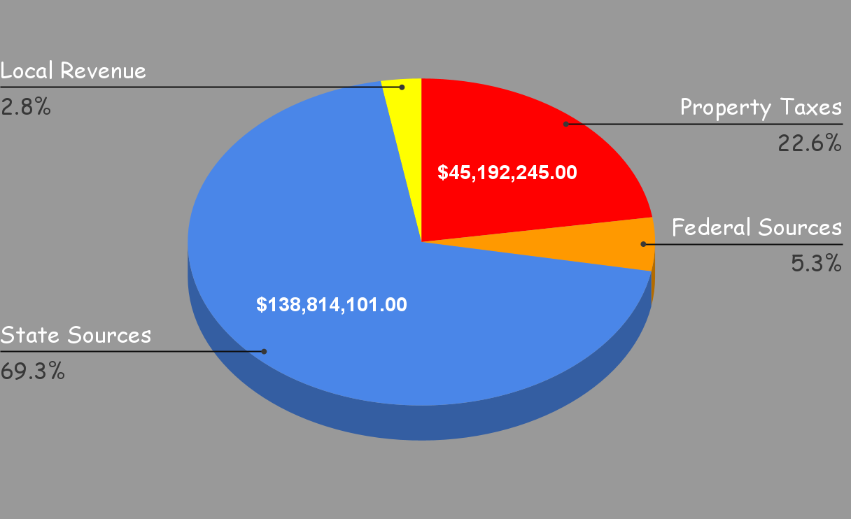
General Fund Revenue by Source

Slide 8
2024-2025 Expenditure by Program Area
 | 2023-2024 Revised | 2024-2025 Preliminary Budget
EXPENDITURES
Administration | $8,635,038.00 | $7,848,267.00
District Support | $10,458,560.00 | $9,838,638.00
Regular Instruction | $88,555,238.00 | $85,134,448.00
Voc Ed Instruction | $1,486,965.00 | $1,554,374.00
Special Ed Instruction | $34,380,946.00 | $37,191,551.00
Instructional Support | $15,475,778.00 | $11,965,514.00
Pupil Support | $26,862,511.00 | $28,030,229.00
Sites and Buildings | $18,756,041.00 | $18,425,061.00
Fiscal and Other Fixed Costs | $1,507,234.00 | $807,000.00
Total General Fund Expenditures | $206,118,311.00 | $200,795,082.00

Slide 9
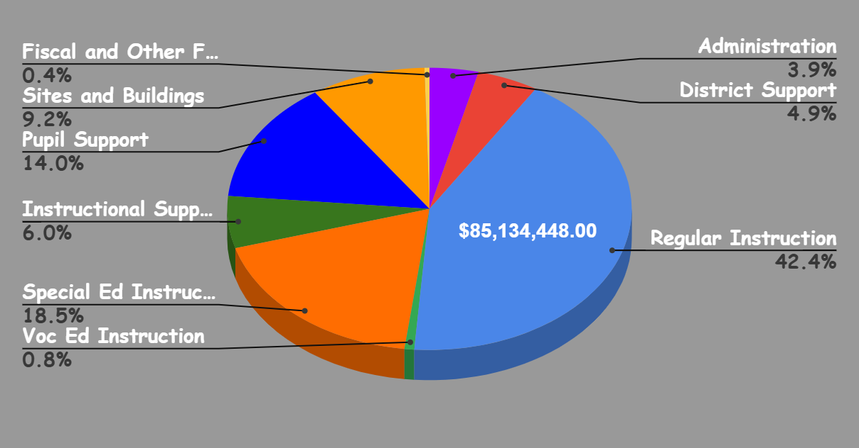
2024-2025 Expenditure by Program Area

Slide 10
Authority for School Levies
A School District Tax Levy May Be Either:
Set by State Formula
or
Voter Approved
Notes:
The two different Levy Authorities for school districts
Voter Approved – Referendum, Capital Projects, Building Bonds
Set by State Law – Lease Levy, Safe Schools, Health and Safety

Slide 11
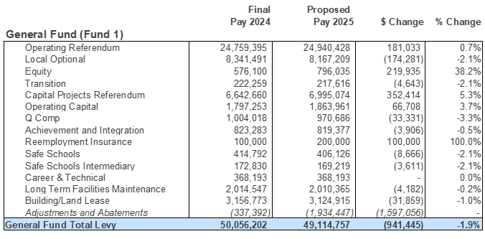
General Fund Levies
Notes:
RMV = Operating Referendum, Local Optional, Equity, Transition and adjustments for those categories

Slide 12
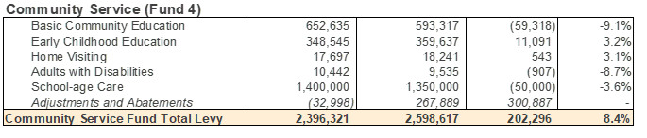
Community Service Levies

Slide 13
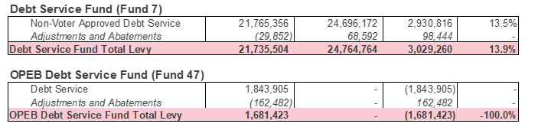
Debt Service Levies

Slide 14
Totals
 |  | Final | Proposed
 |  | Pay 2024 | Pay 2025 | $ Change | % Change
General Fund |  | $50,056,201.56 | $49,114,756.79 | -$941,444.77 | -1.88%
Community Service Fund |  | $2,396,321.37 | $2,598,617.26 | $202,295.89 | 8.44%
Debt Service Fund |  | $21,735,503.92 | $24,764,763.92 | $3,029,260.00 | 13.94%
OPEB Debt Service Fund |  | $1,681,423.36 | $0.00 | -$1,681,423.36 | -100.00%
TOTAL LEVY |  | $75,869,450.21 | $76,478,137.97 | $608,687.76 | 0.80%

Slide 15
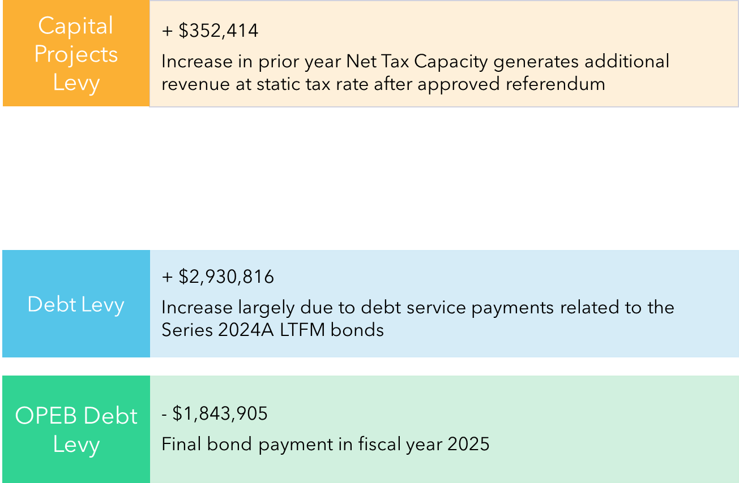
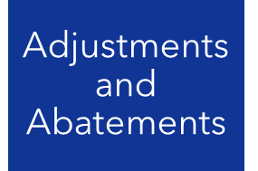
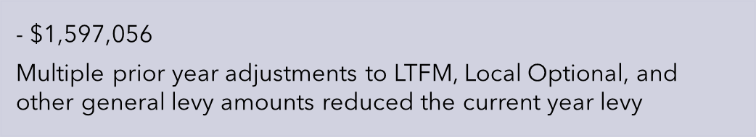
Major Changes

Slide 16
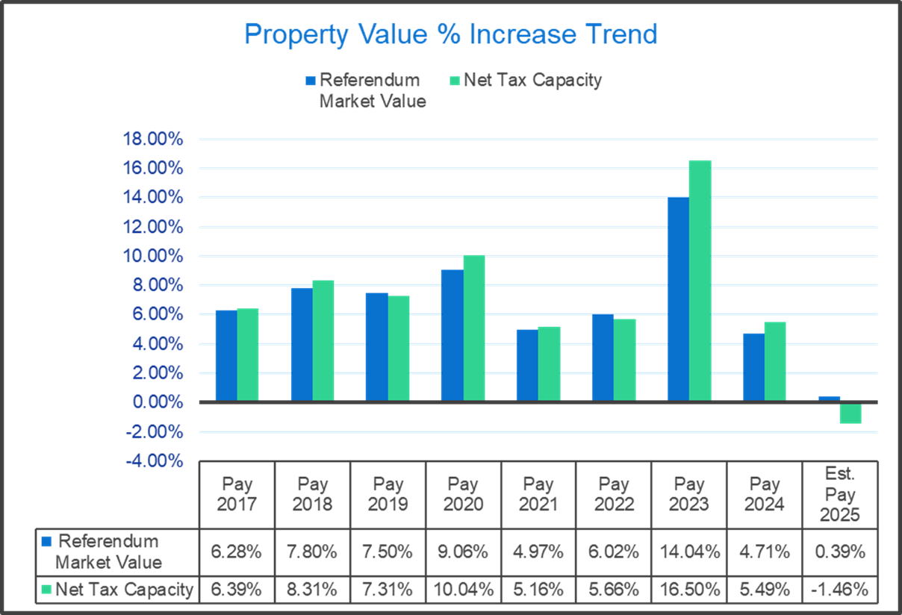
Referendum Market Value
$ 34,516,459
Excludes Ag Land and Seasonal Recreational property
Net Tax Capacity
$ 41,961,679
Most all property types pay on this amount

Slide 17
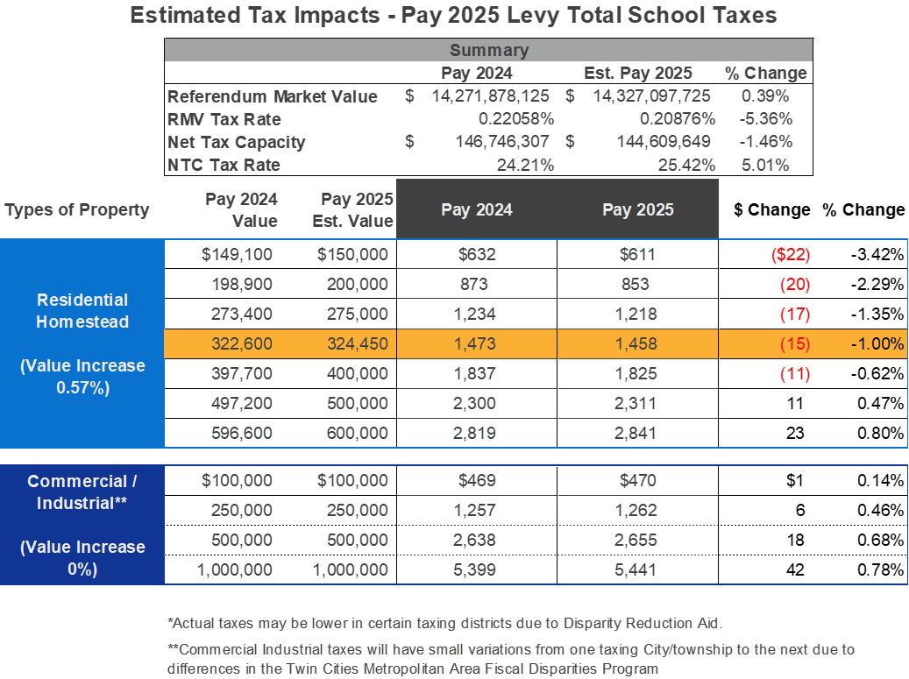

Slide 18
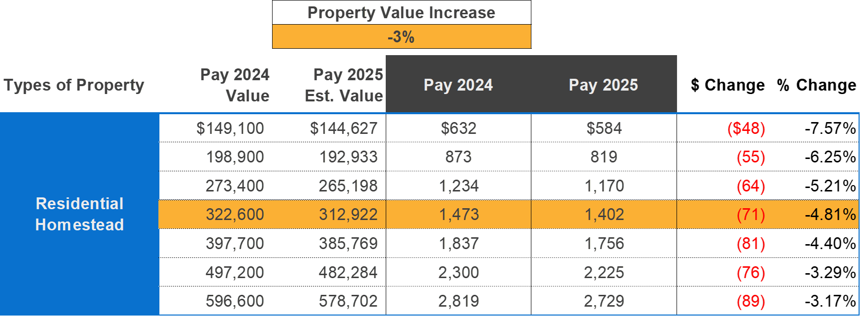

Slide 19
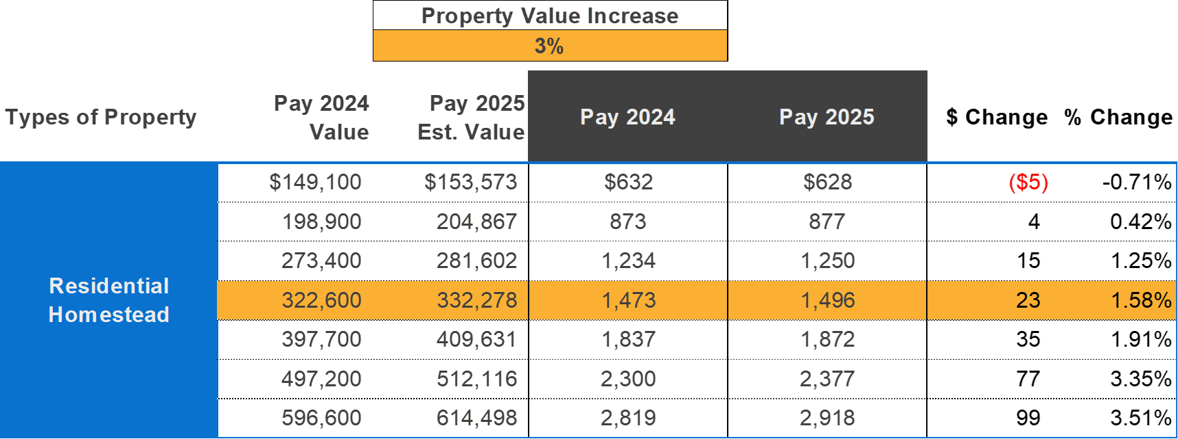

Slide 20
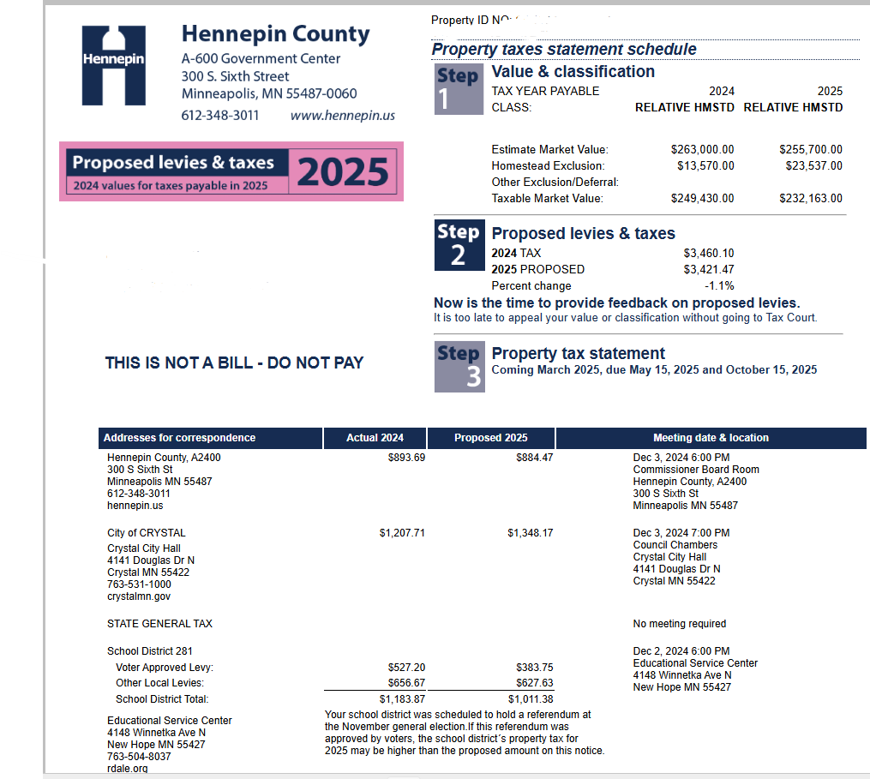
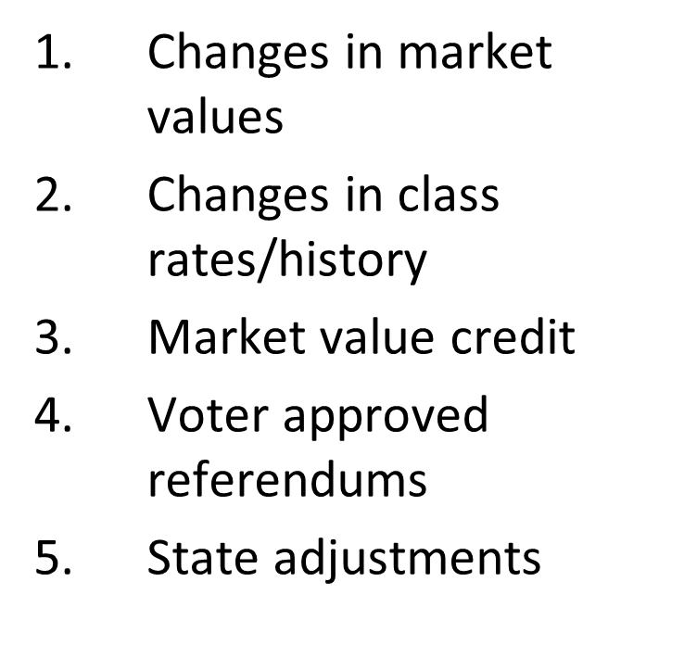

What Variables May Cause Property
Tax Increases and Decreases

Slide 21
Comments or Questions?
Notes:
Question on home value increases/decreases please contact your county assessor

