Slide 1


Slide 2
East Ridge High School
Park High School
Construction Update

Slide 3
Bond Summary
Question 1 ($160 million) | Question 2 ($40 million)
Cottage Grove Middle School: Secure front entry/office: $3.8 million Lake Middle School: Secure front entry/office: $3.8 million Oltman Middle School: Construction of classroom additions and cafeteria expansion: $25.8 million Woodbury Middle School: Construction of new secure entry and new bus road and conversion of pool area to classroom space: $9.2 million East Ridge: Construction of new classroom addition, cafeteria expansion, expansion of CTE, biomed and STEM spaces: $35.8 million Park: Construction of new cafeteria and kitchen, expansion and renovation of CTE, Robotics, STEM, biomed and learning spaces: $38.6 million Woodbury High School: Construction of new cafeteria and kitchen, additional science classrooms, expansion and renovation of CTE, STEM, biomed and robotics spaces, and creation of multipurpose learning spaces: $42.7 million | Bailey Elementary: Construction of classroom addition and new cafeteria and kitchen: $8.7 million Grey Cloud Elementary: Construction of classroom addition and new cafeteria and kitchen: $9.4 million Pine Hill Elementary: New classroom additions, gym space addition and new bathrooms: $10.9 million Red Rock Elementary: Construction of new classroom addition: $4.3 million Construction of new bathrooms at Crestview, Hillside, Pullman and Royal Oaks elementary schools: $6.9 million
Notes:
Julie
Would you consider the others in one of your two top priorities? Can’t live without? Second tier?

Slide 4
Construction Plan Phasing

Slide 5
Construction Plan Phasing
Last year we started the design and planning process for the first tier of 15 construction projects across the district.
The first tier of construction projects consists of the highest priority items in the bond election focusing on safety and security and overcrowding in our secondary schools.
Architects have been meeting with groups of staff to gather input, feedback and to start the design work for additions and renovations at all four of our middle schools, as well as East Ridge, Park and Woodbury high schools.
In January 2025, design and planning work will begin for our elementary school construction projects at Bailey, Crestview, Grey Cloud, Hillside, Pine Hill, Pullman, Red Rock and Royal Oaks elementary schools.
Notes:
TB

Slide 6
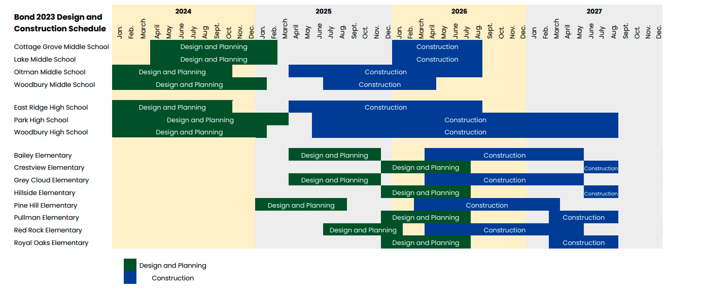
Construction Plan Phasing
Notes:
TB

Slide 7
East Ridge High School

Slide 8
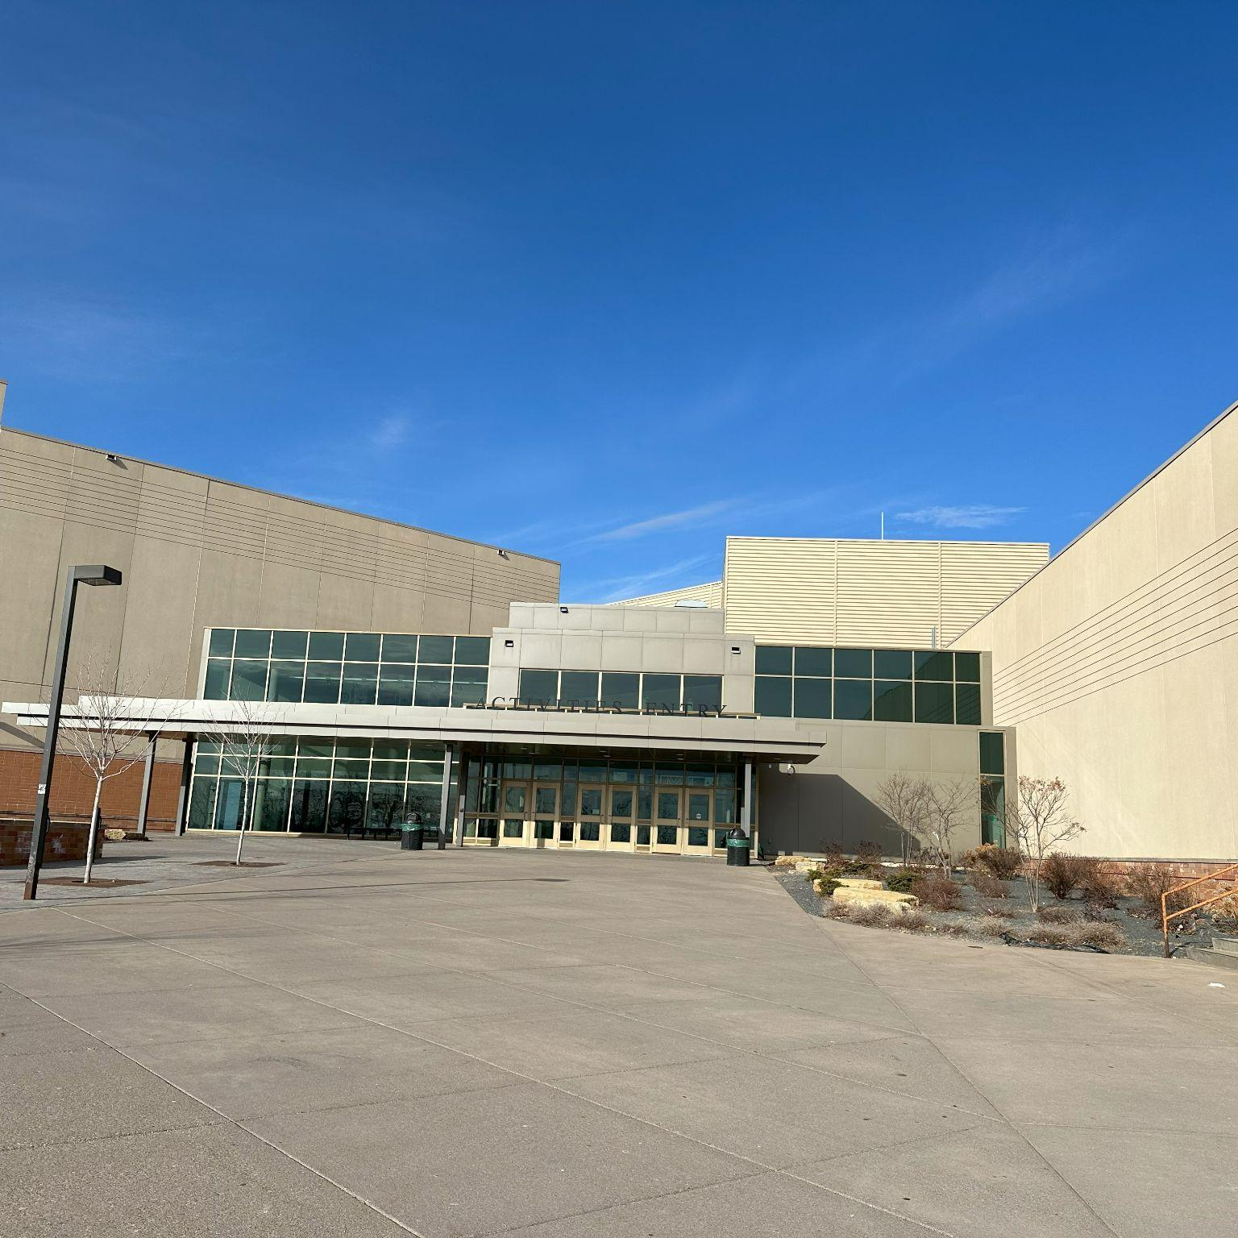
East Ridge High School
PROJECT SCOPE
Construction of a two-story classroom and storm shelter addition for new classrooms;
Construction of an addition to the existing Career and Technical Education space to expand the Construction program offerings;
Expansion of the existing cafeteria and kitchen to serve future student population growth;
Renovation of existing spaces to expand and enhance Special Education and Online learning;
Reconfigured drive lanes and parking lot to enhance traffic flow and safety for parent pickup and drop off.
Notes:
Dan Hines

Slide 9
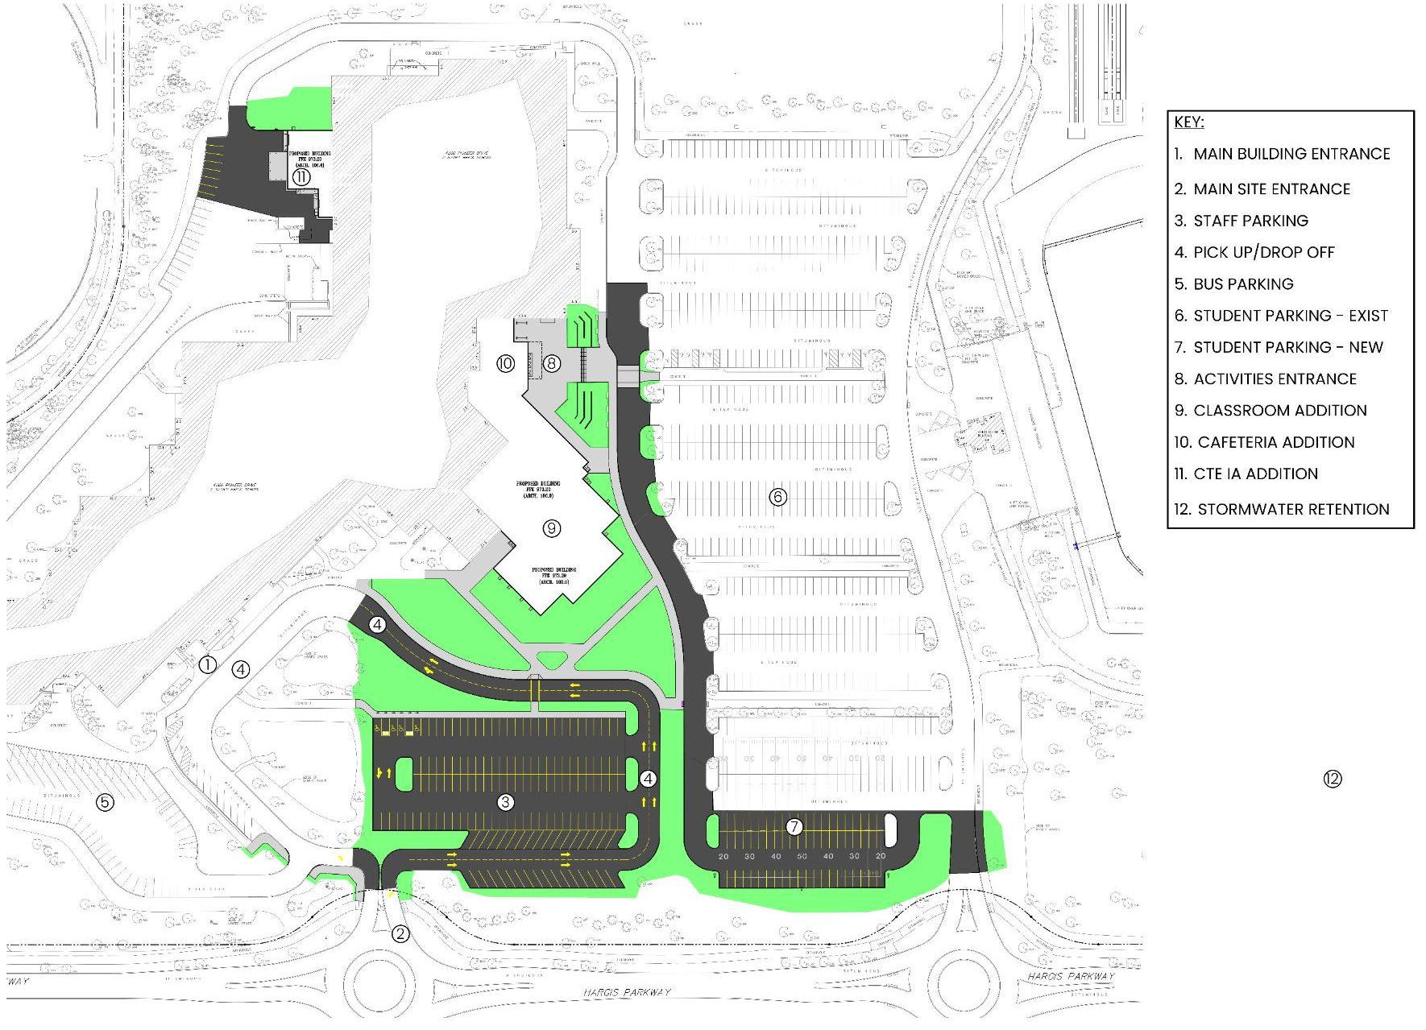
Overall Site Plan

Slide 10
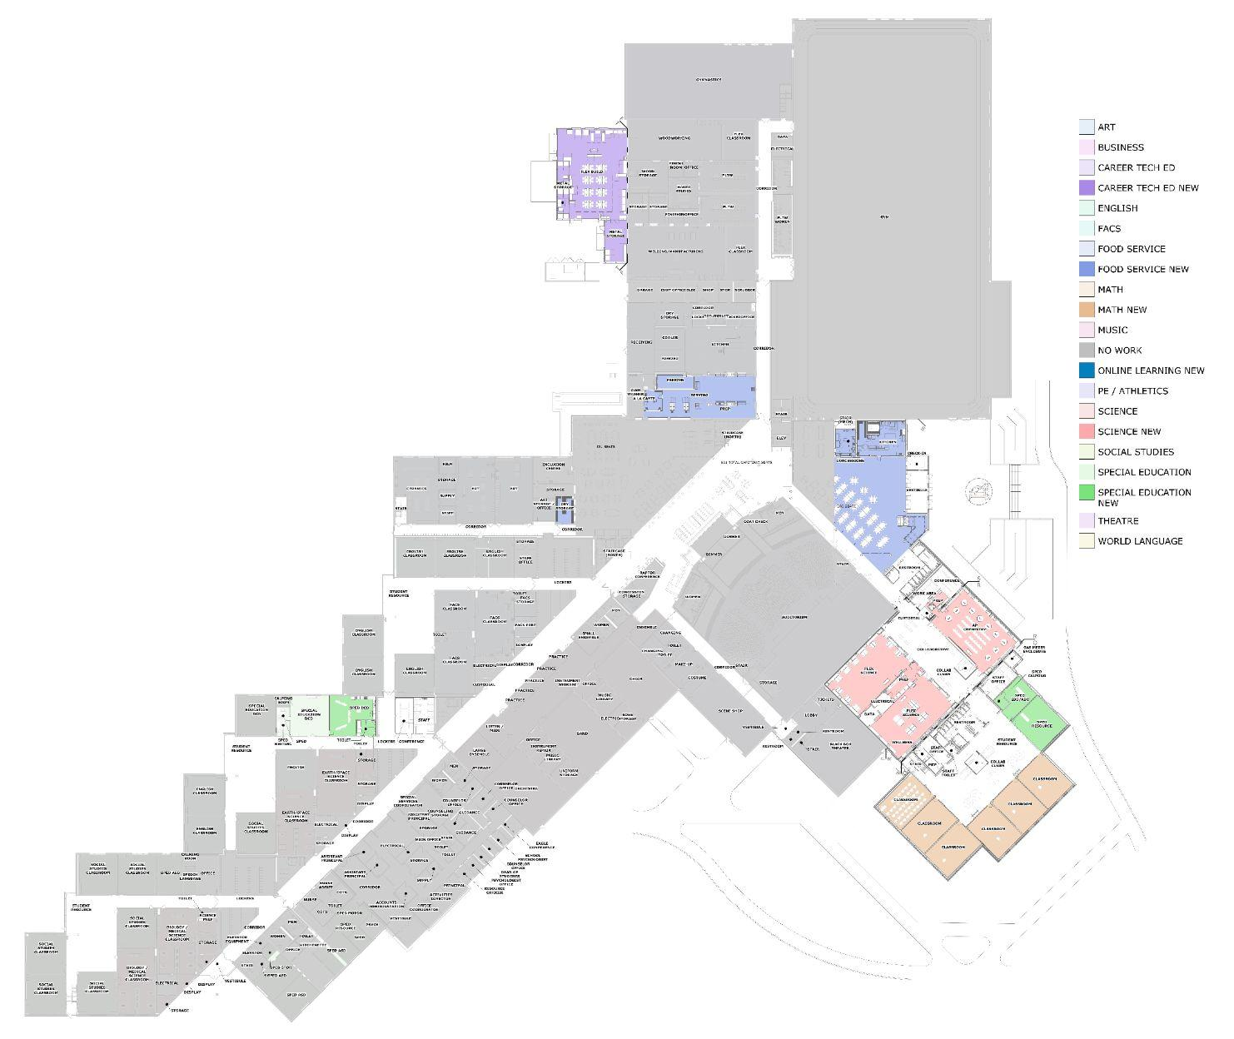
Overall Floor Plan - First Floor

Slide 11
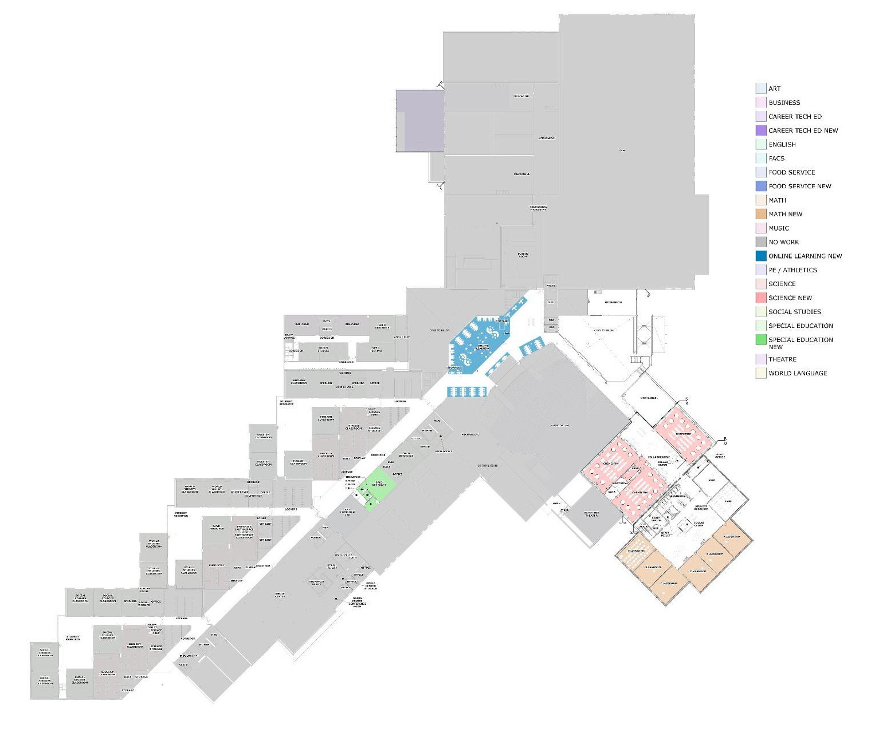
Overall Floor Plan - Second Floor

Slide 12
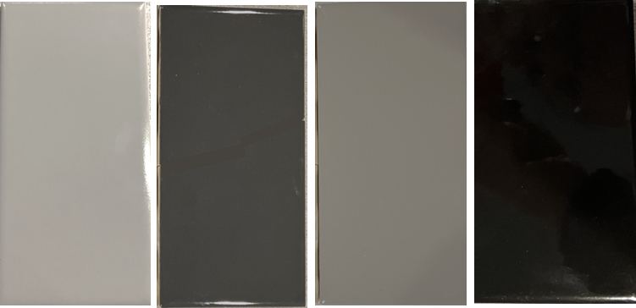
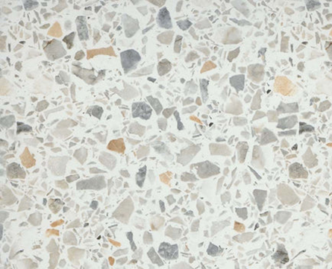

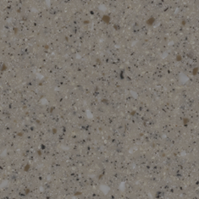



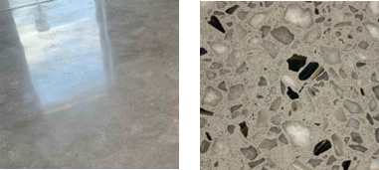
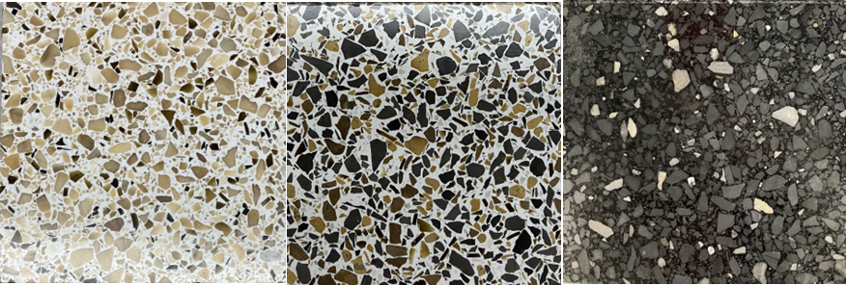
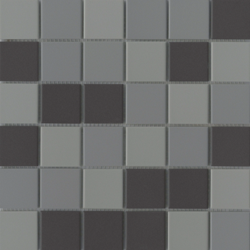
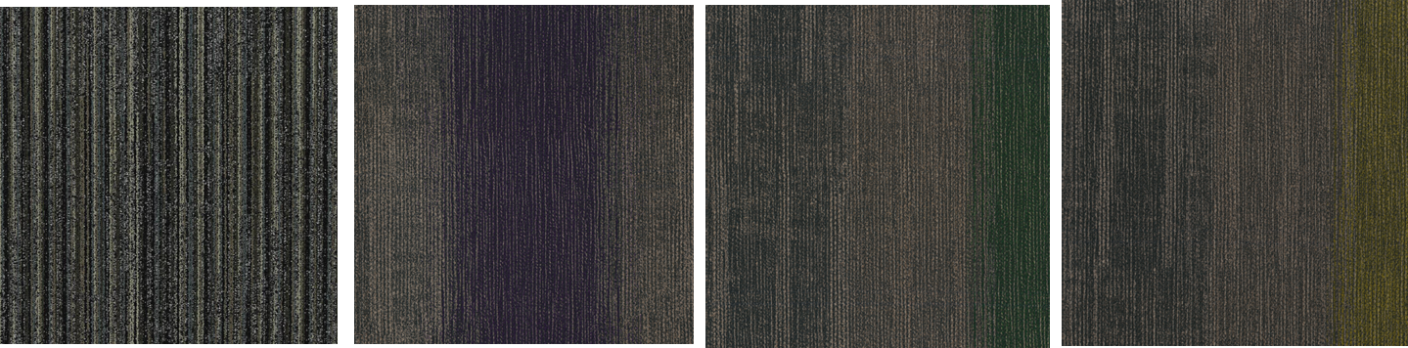

Interior Finishes and Materials
WALLS
SURFACES
Ceramic wall tile
Porcelain wall tile
Paint
Solid surface
Plastic laminate
FLOORS
Marmoleum Composite Tile (MCT)
Quarry Tile
Polished Concrete
Terrazzo
Porcelain floor tile
CEILINGS
Walkoff carpet
Kinetex carpet
Acoustic ceiling tile

Slide 13
Activity Entrance/ Cafeteria/Kitchen

Slide 14
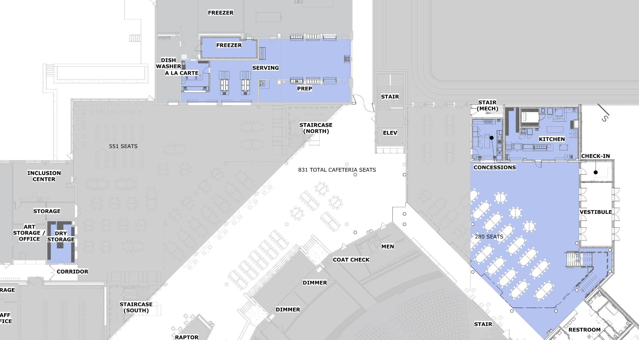
Activity Entrance/Cafeteria/Kitchen Plan

Slide 15
Interior Cafeteria Addition

Slide 16
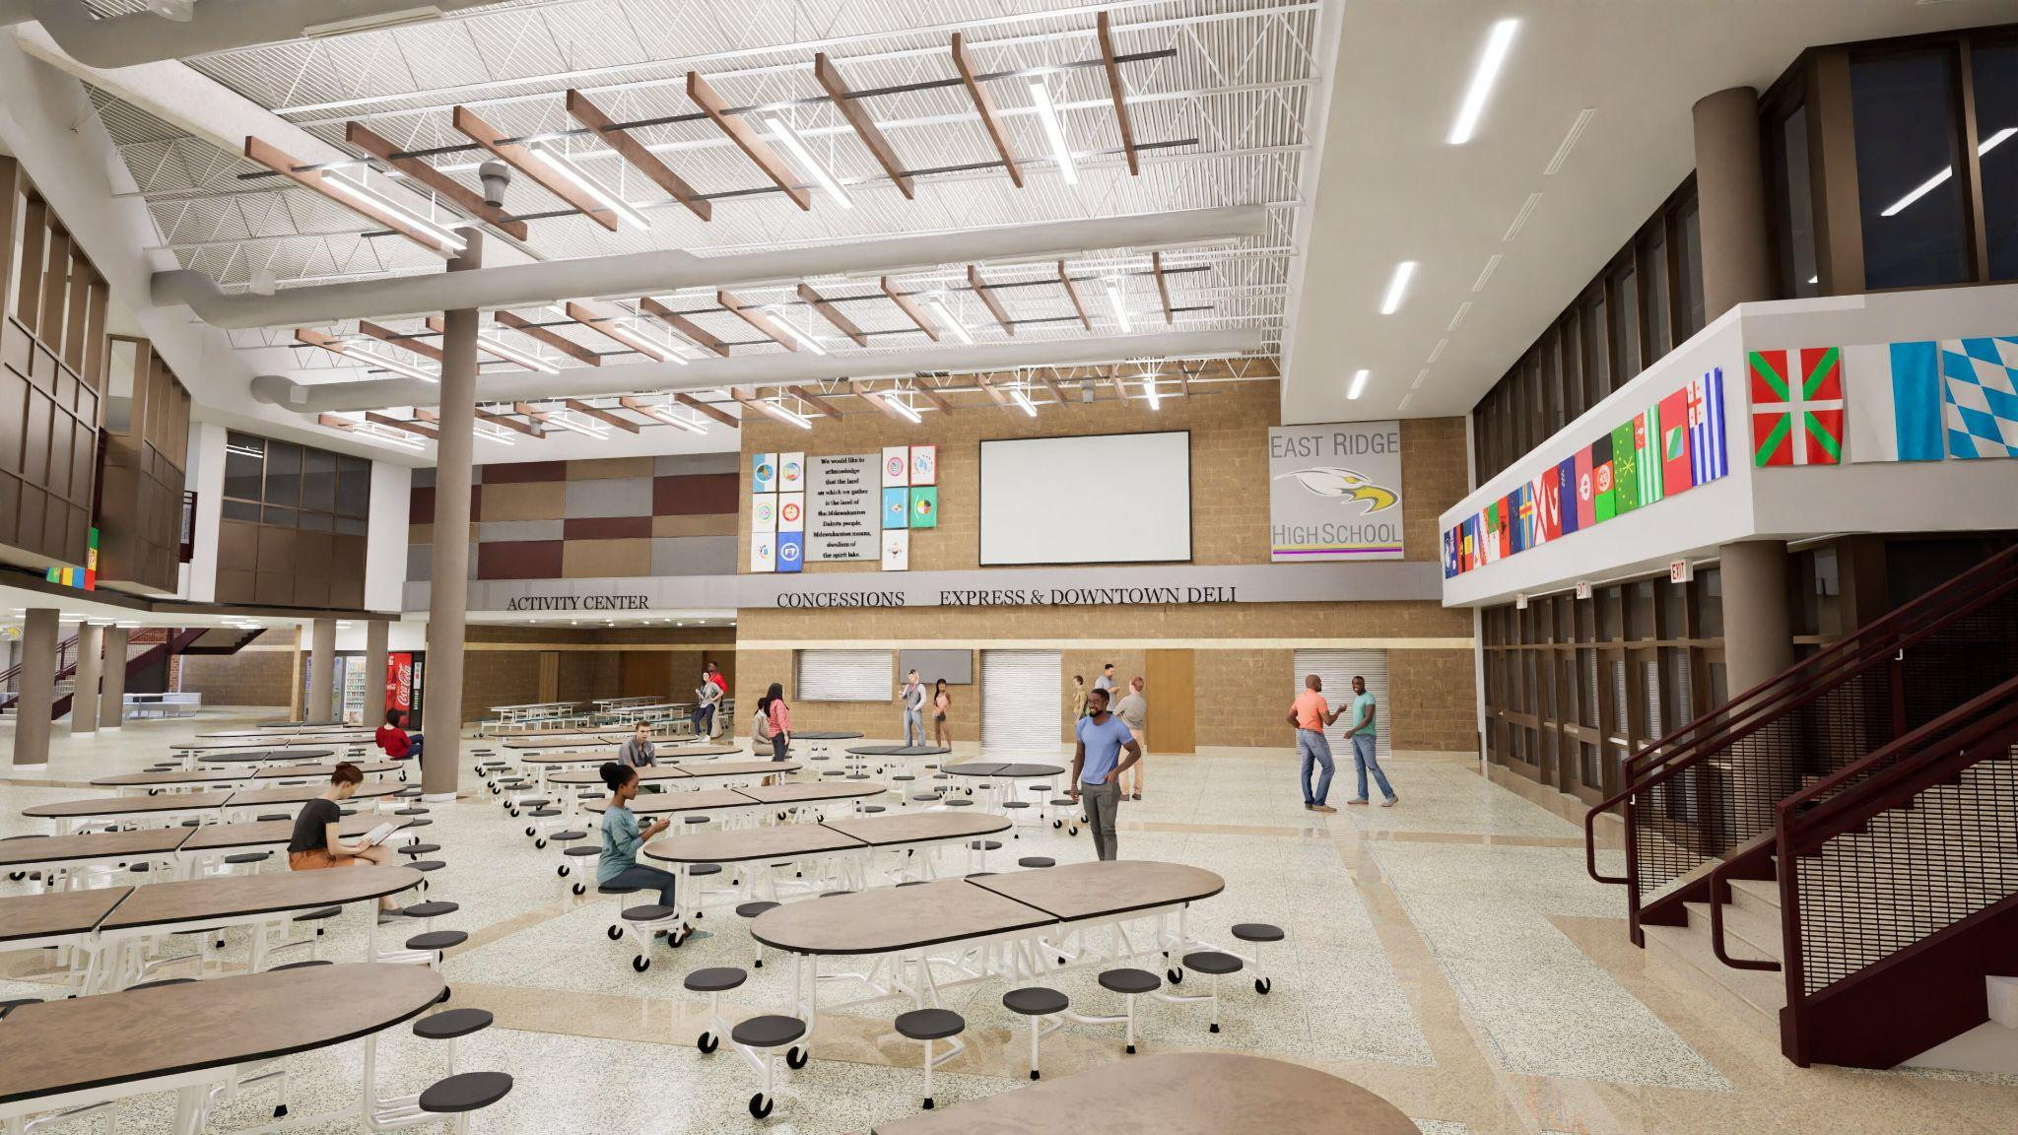
Interior Cafeteria Addition

Slide 17
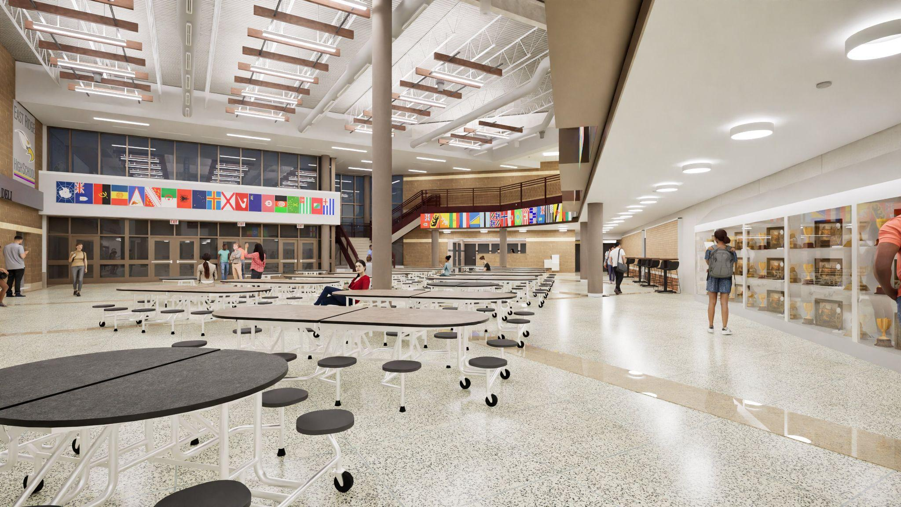
Interior Cafeteria Addition

Slide 18
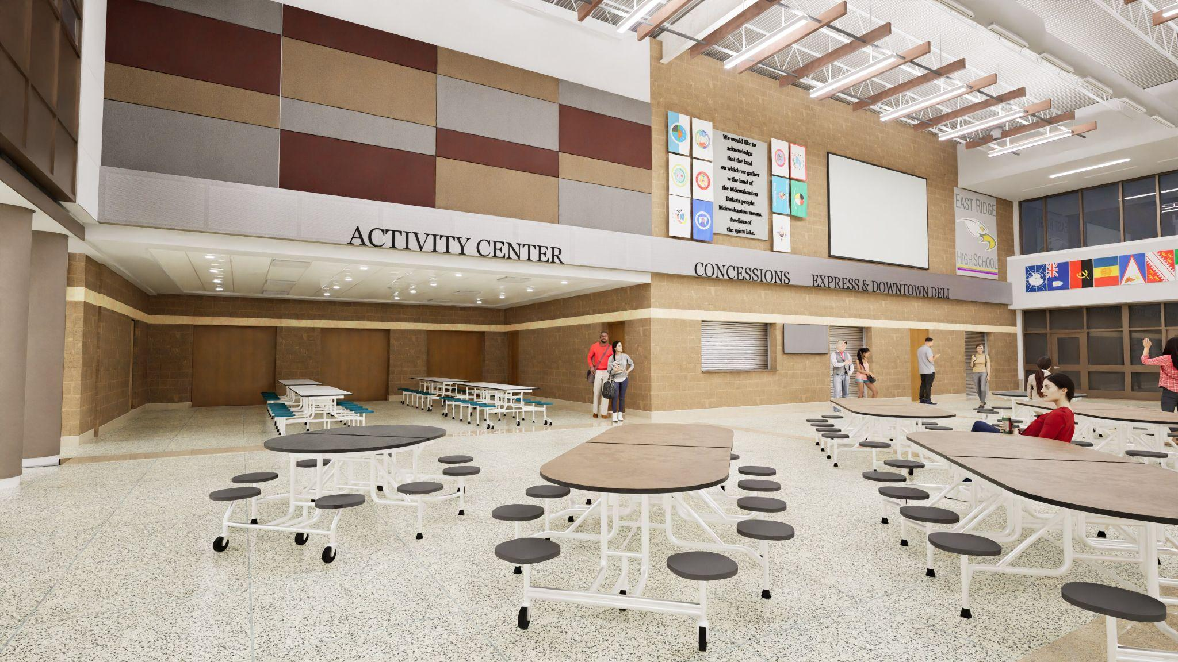
Interior Cafeteria Addition

Slide 19
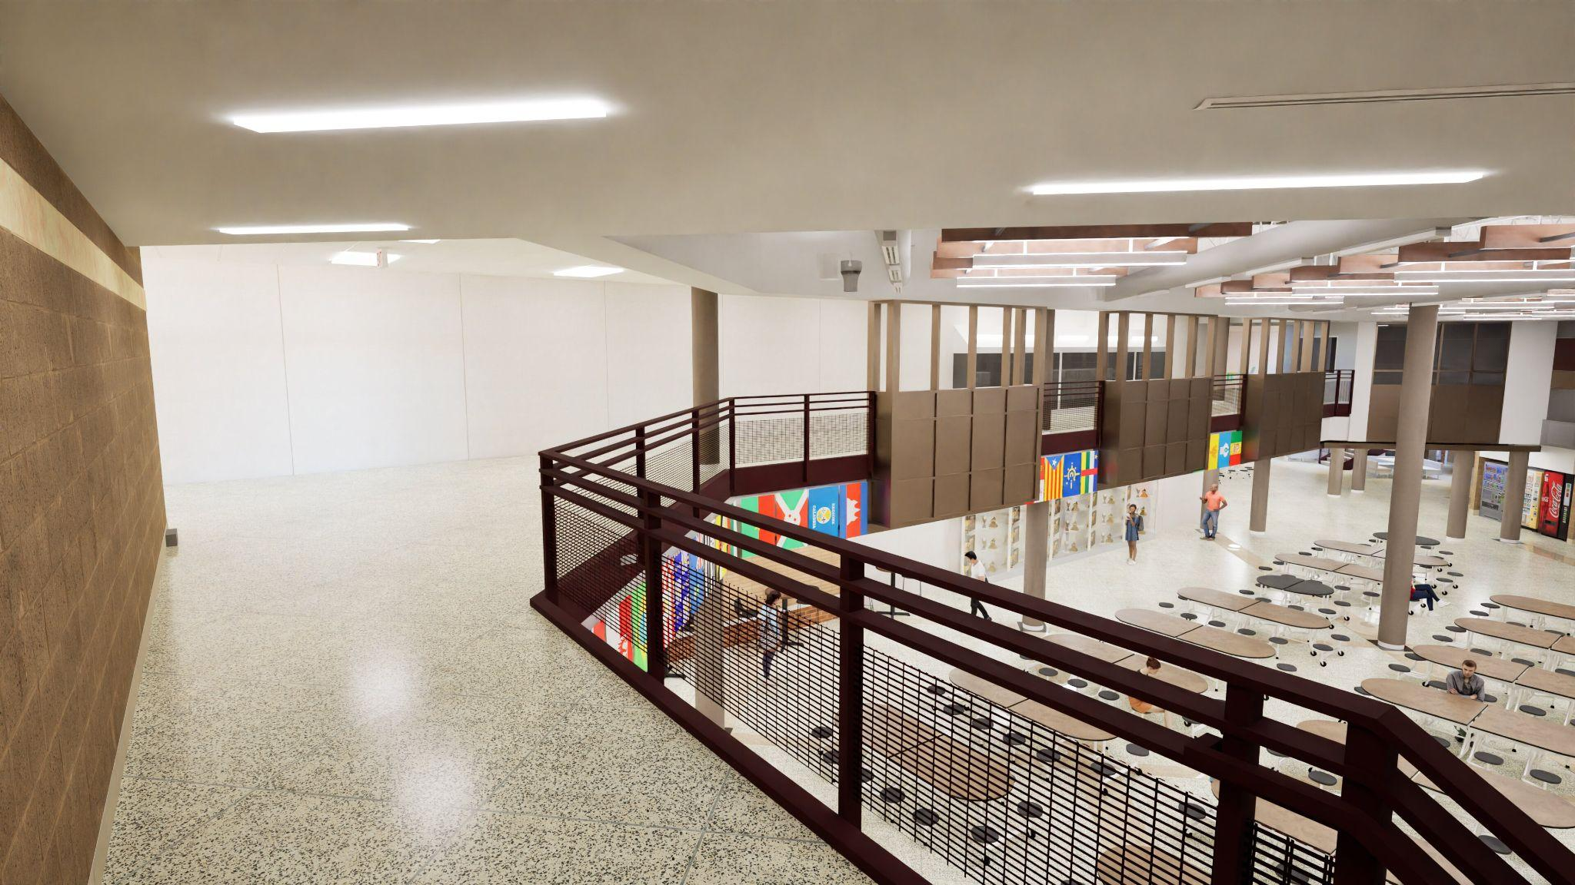
Interior Cafeteria Addition

Slide 20
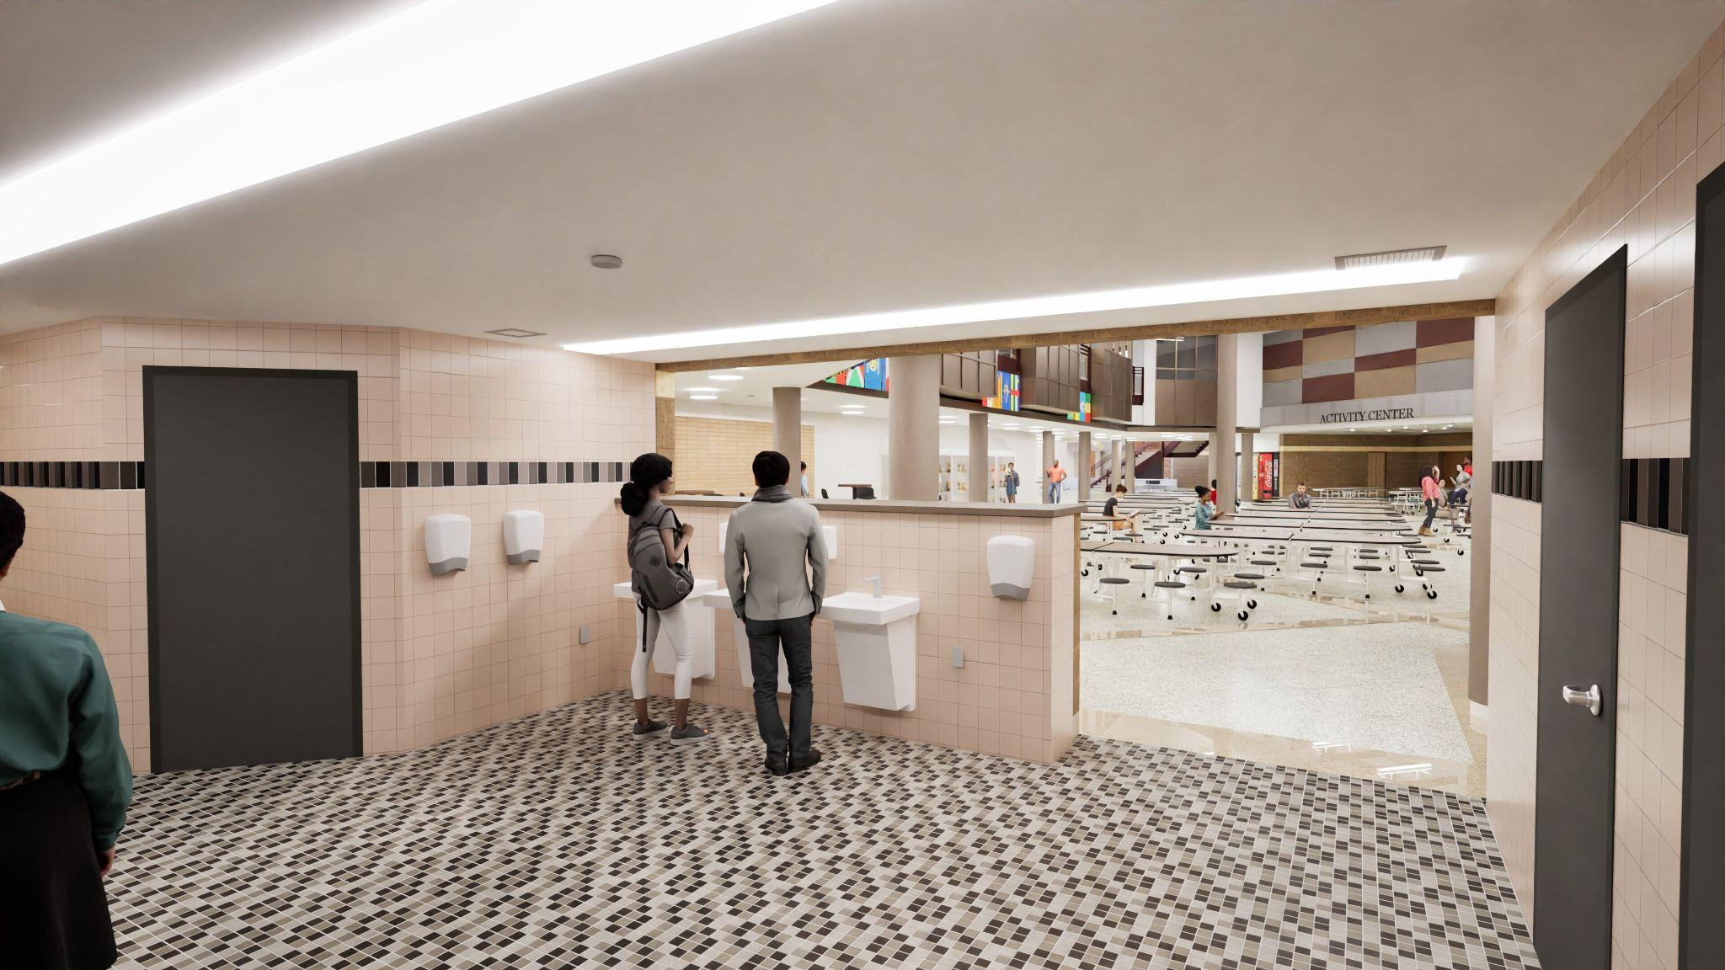
Interior Universal Restroom Areas

Slide 21
Career and Technical Education

Slide 22
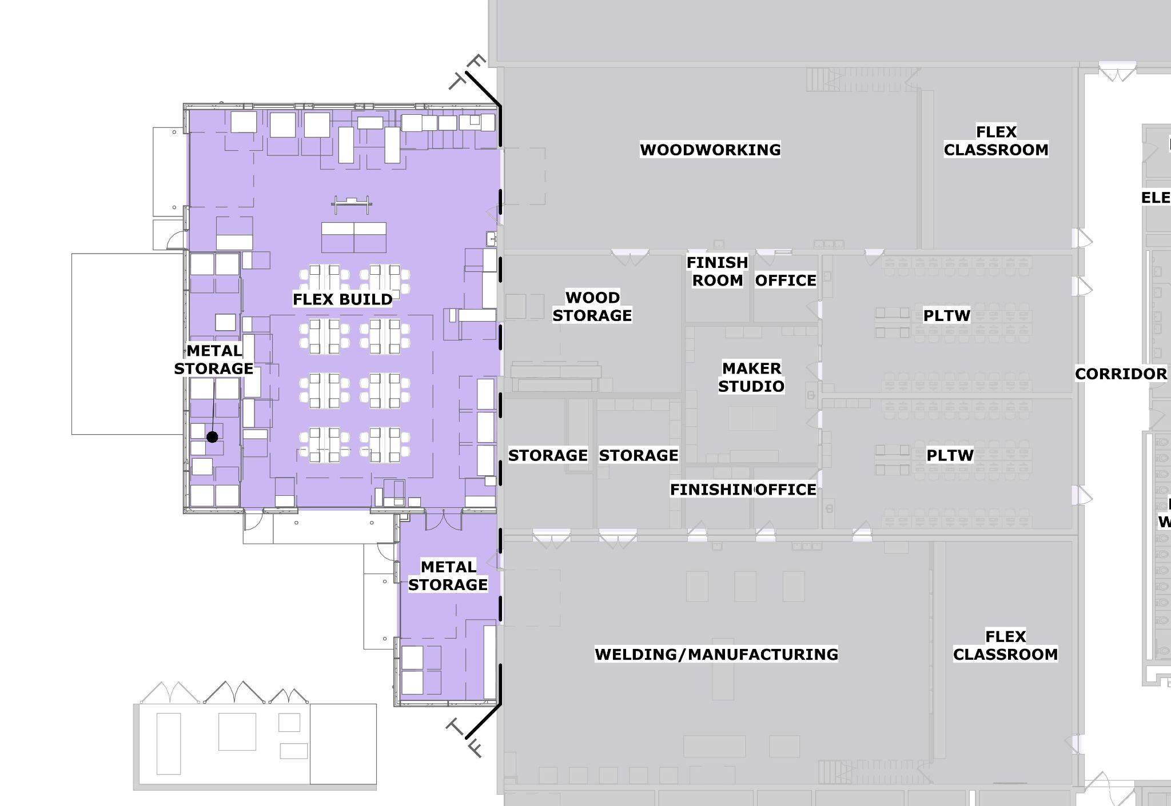
CTE IA Expansion Plan

Slide 23
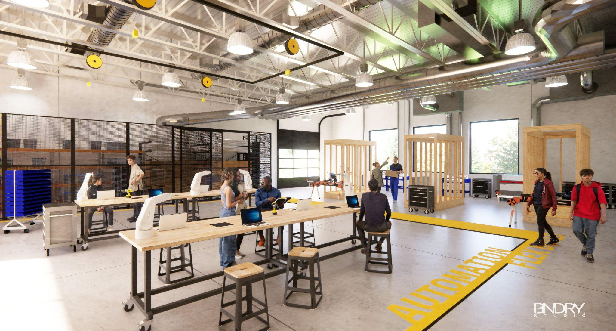
New CTE IA Flex Build

Slide 24
Classroom Addition
Science, General Ed, Special Ed

Slide 25
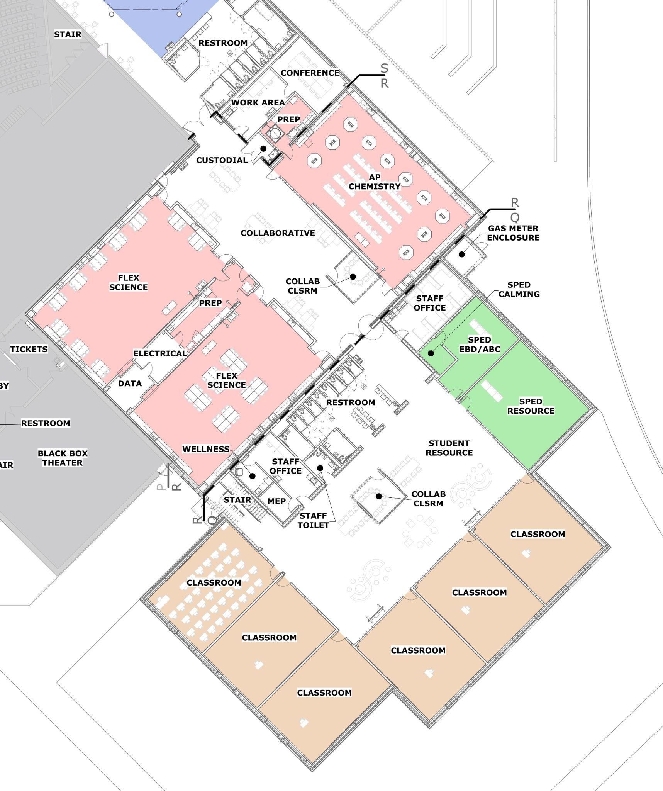
Classroom Addition Plan - First Floor

Slide 26
Classroom Addition Plan - Second Floor

Slide 27
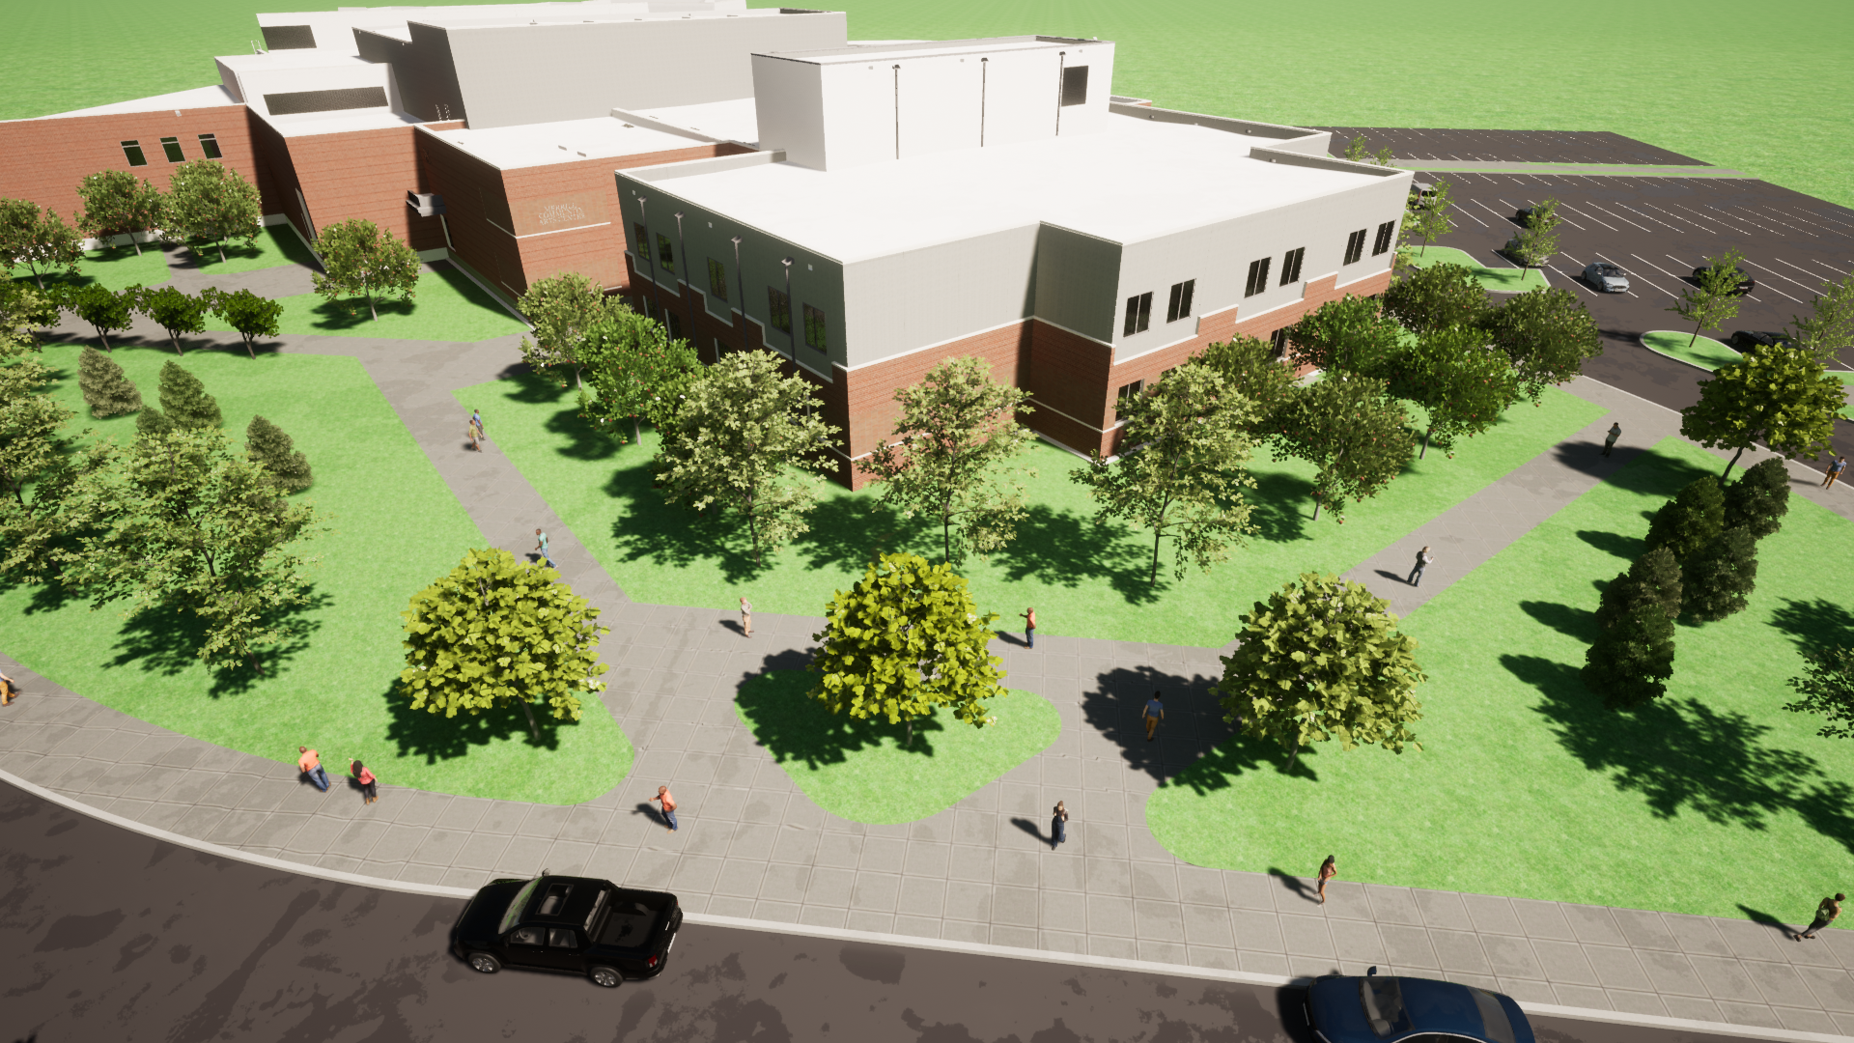
Exterior Classroom Addition

Slide 28
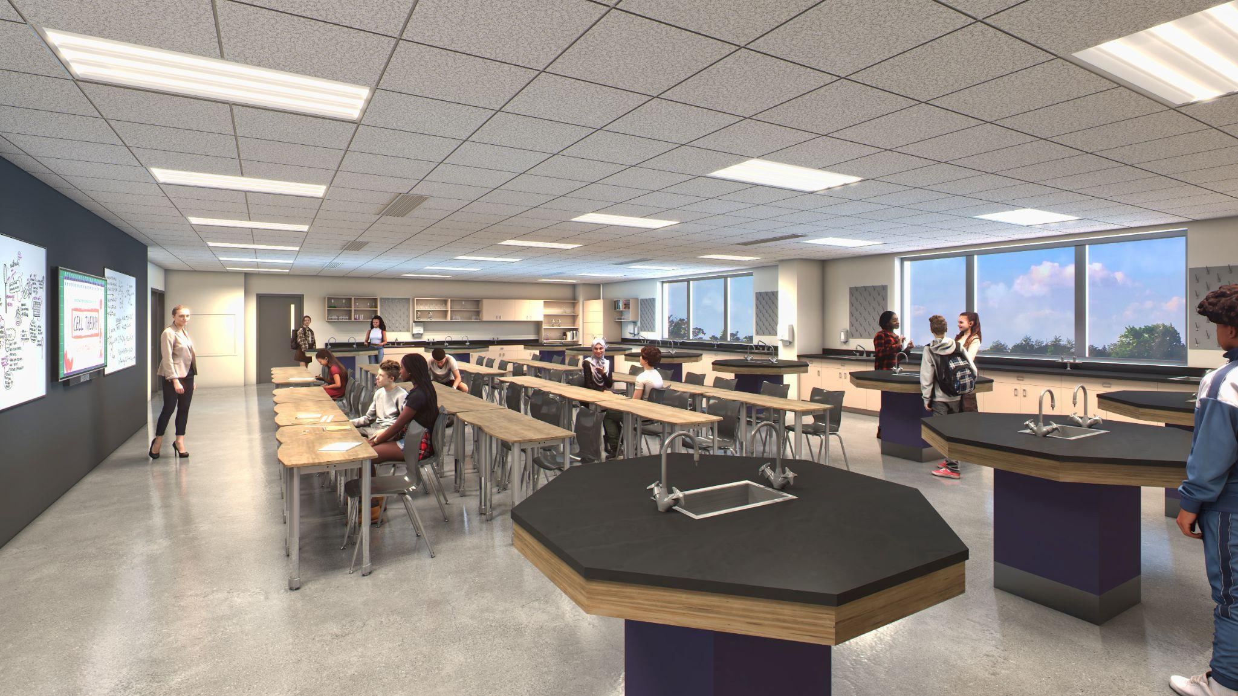
Interior New Science Room

Slide 29
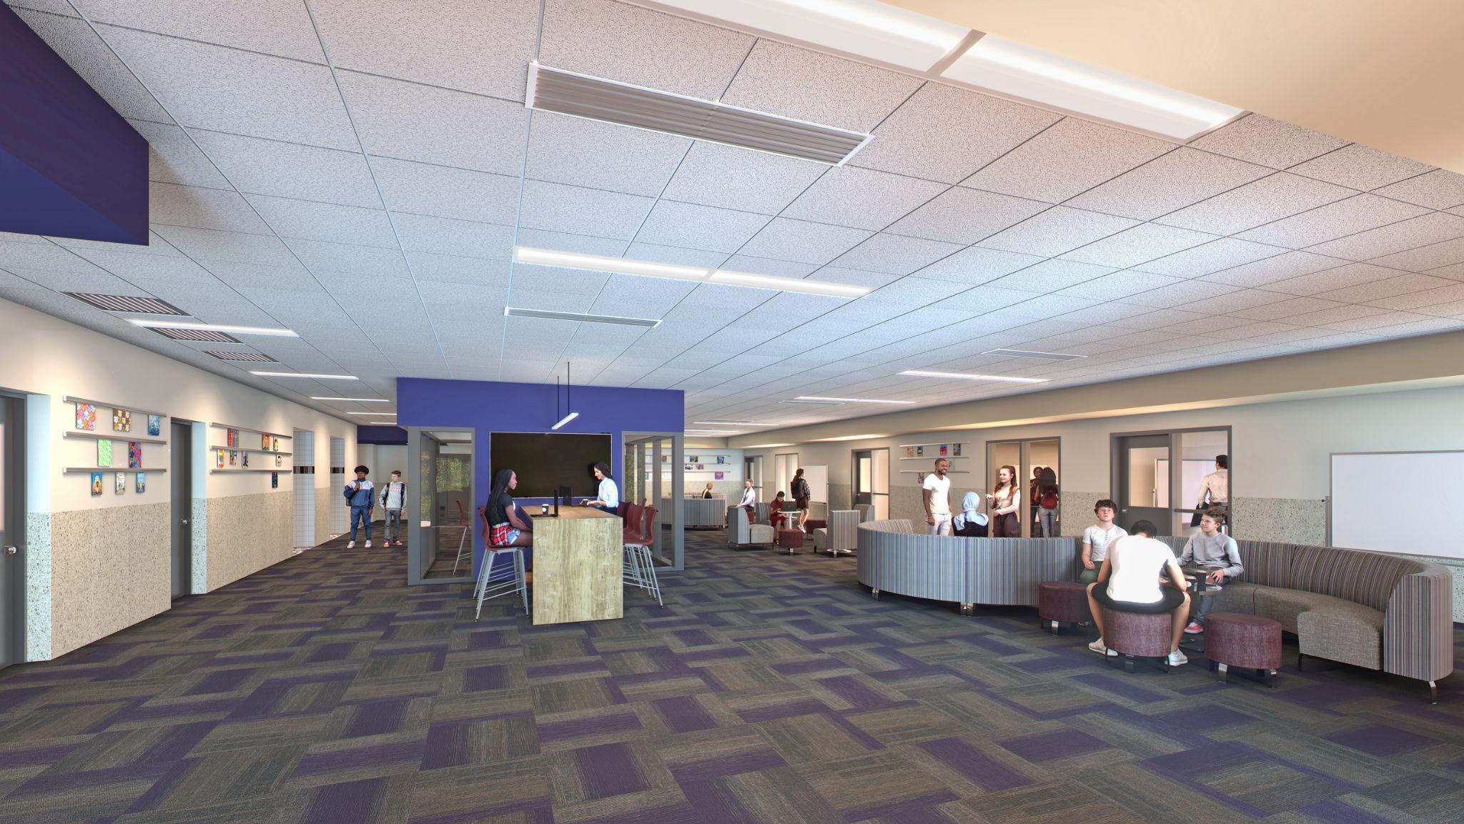
Interior Collaboration Areas

Slide 30
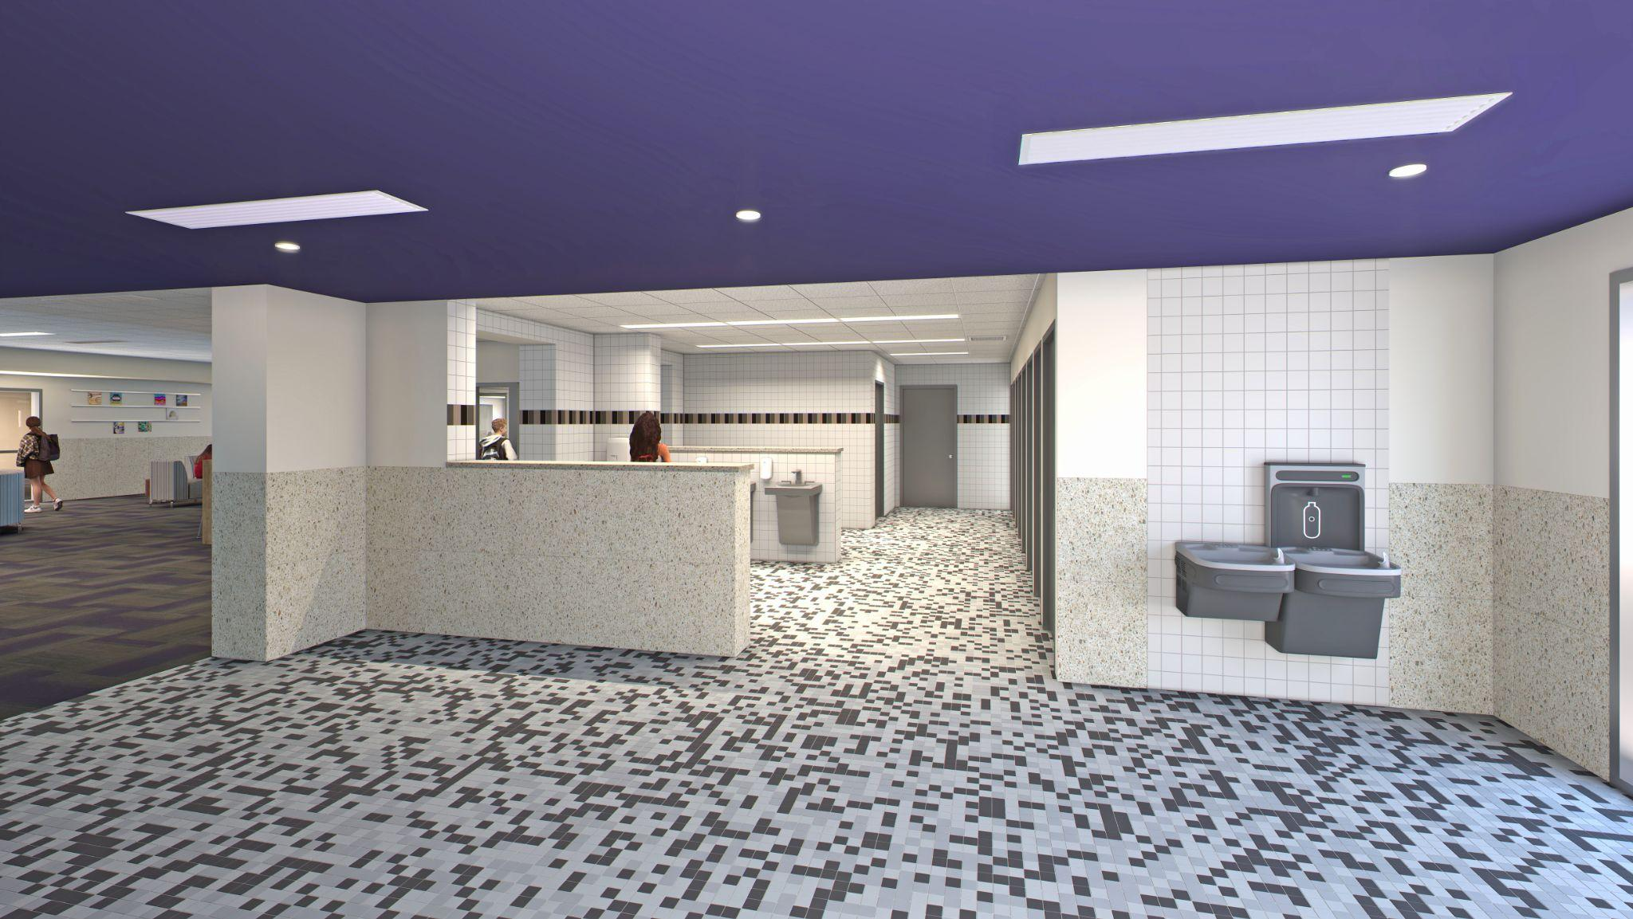
Interior Universal Restroom Area

Slide 31
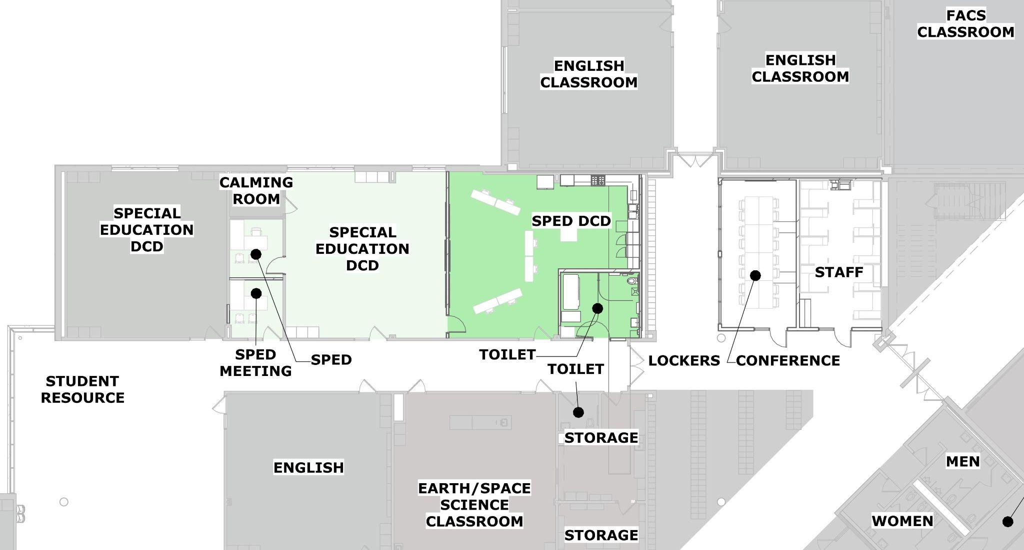
Special Education - First Floor

Slide 32
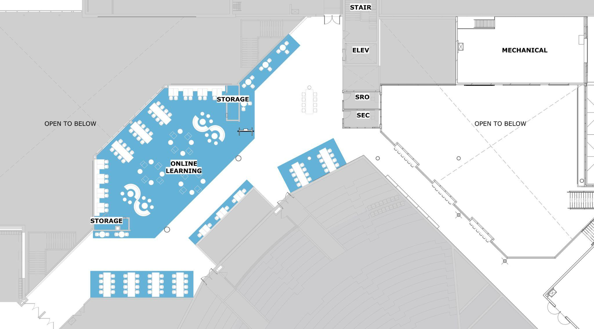
Online Learning - Second Floor

Slide 33
Site Improvements

Slide 34
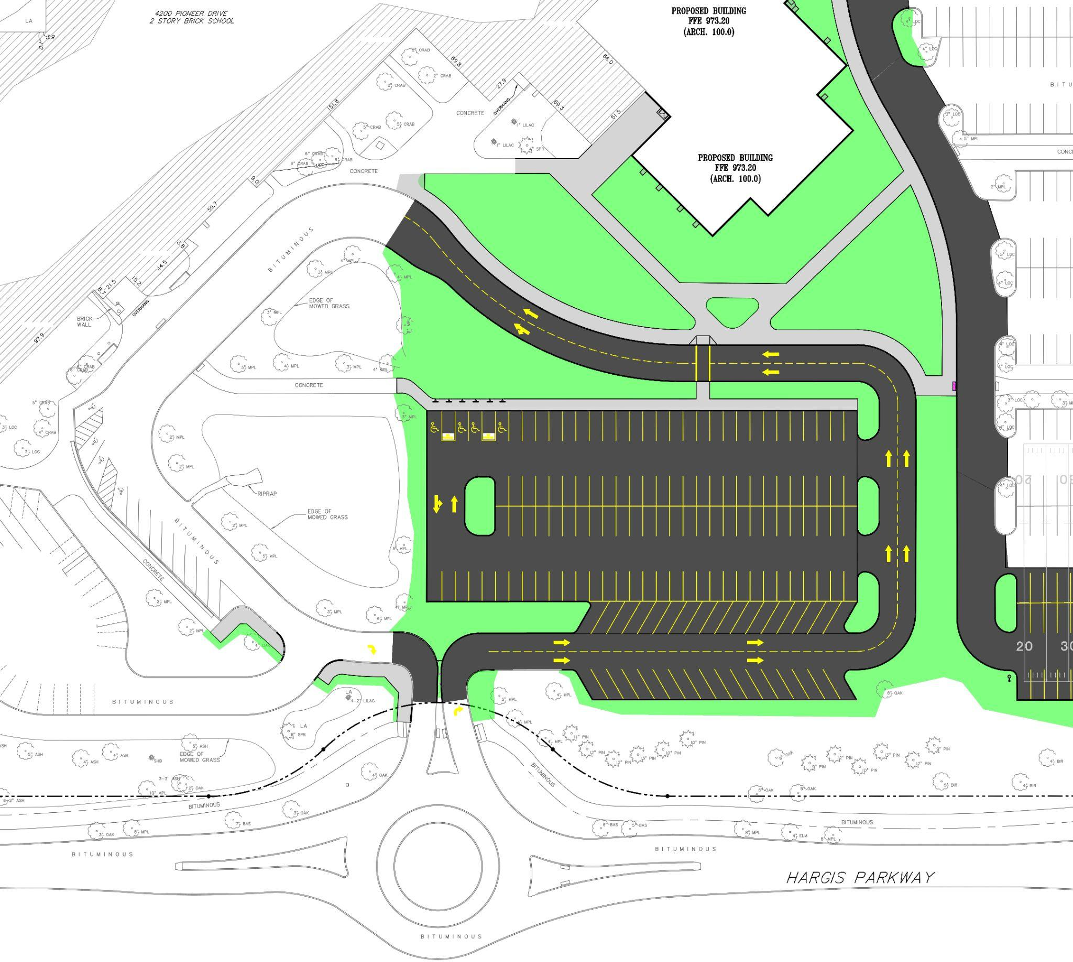
Enlarged Traffic Flow Plan

Slide 35
Exterior Plaza

Slide 36
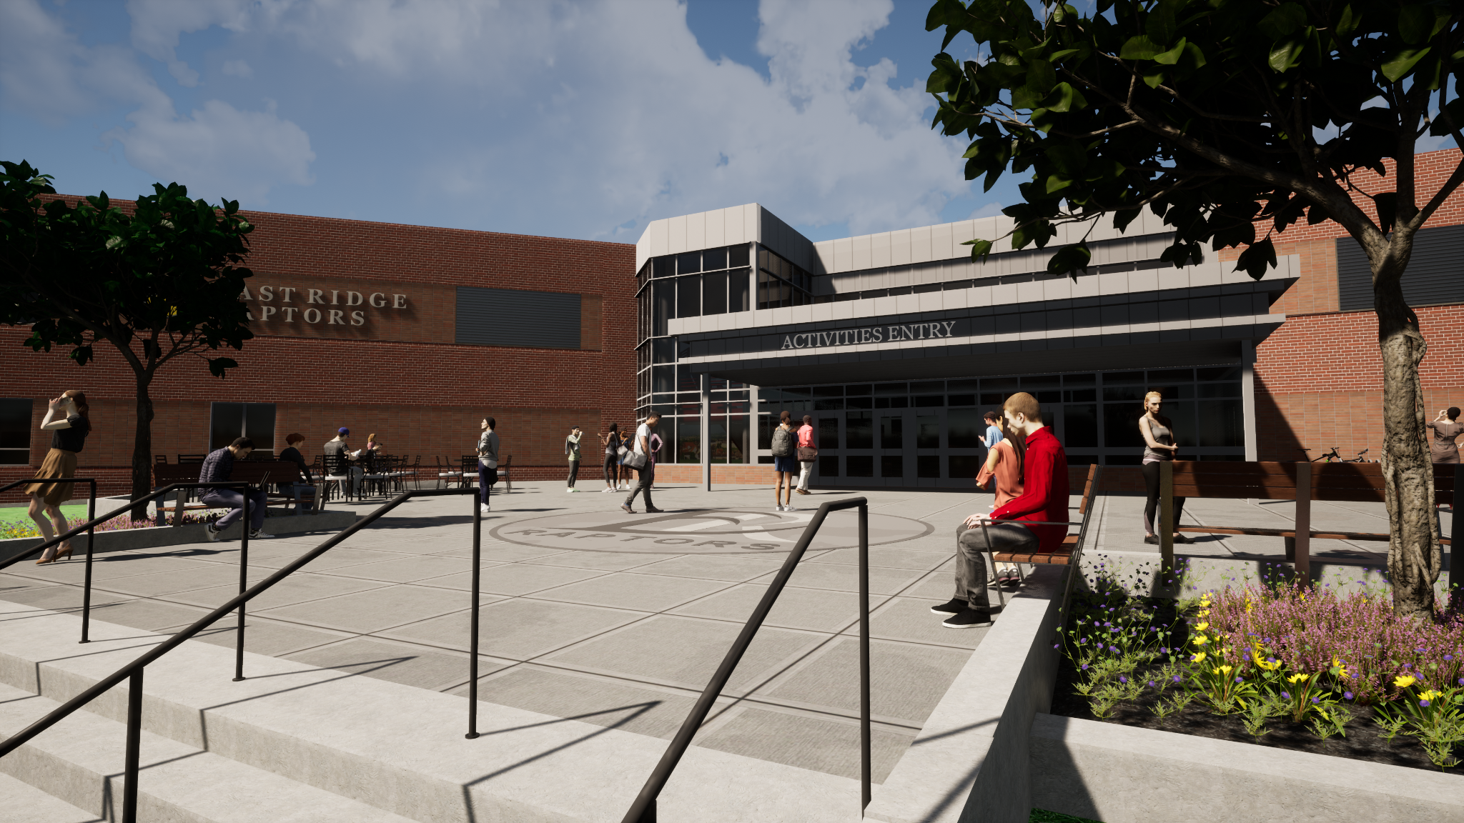
Exterior Plaza

Slide 37
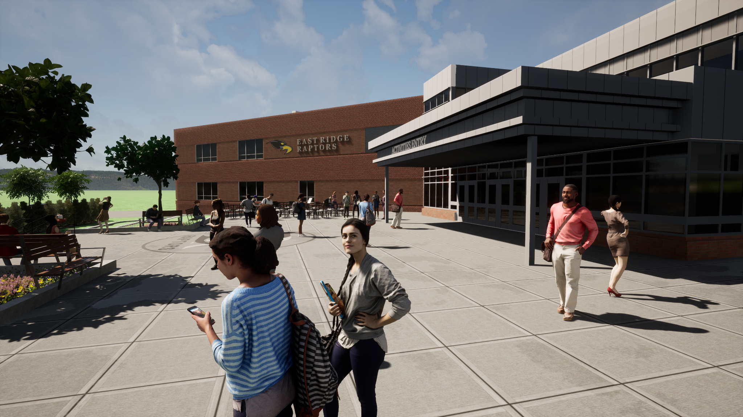
Exterior Plaza

Slide 38
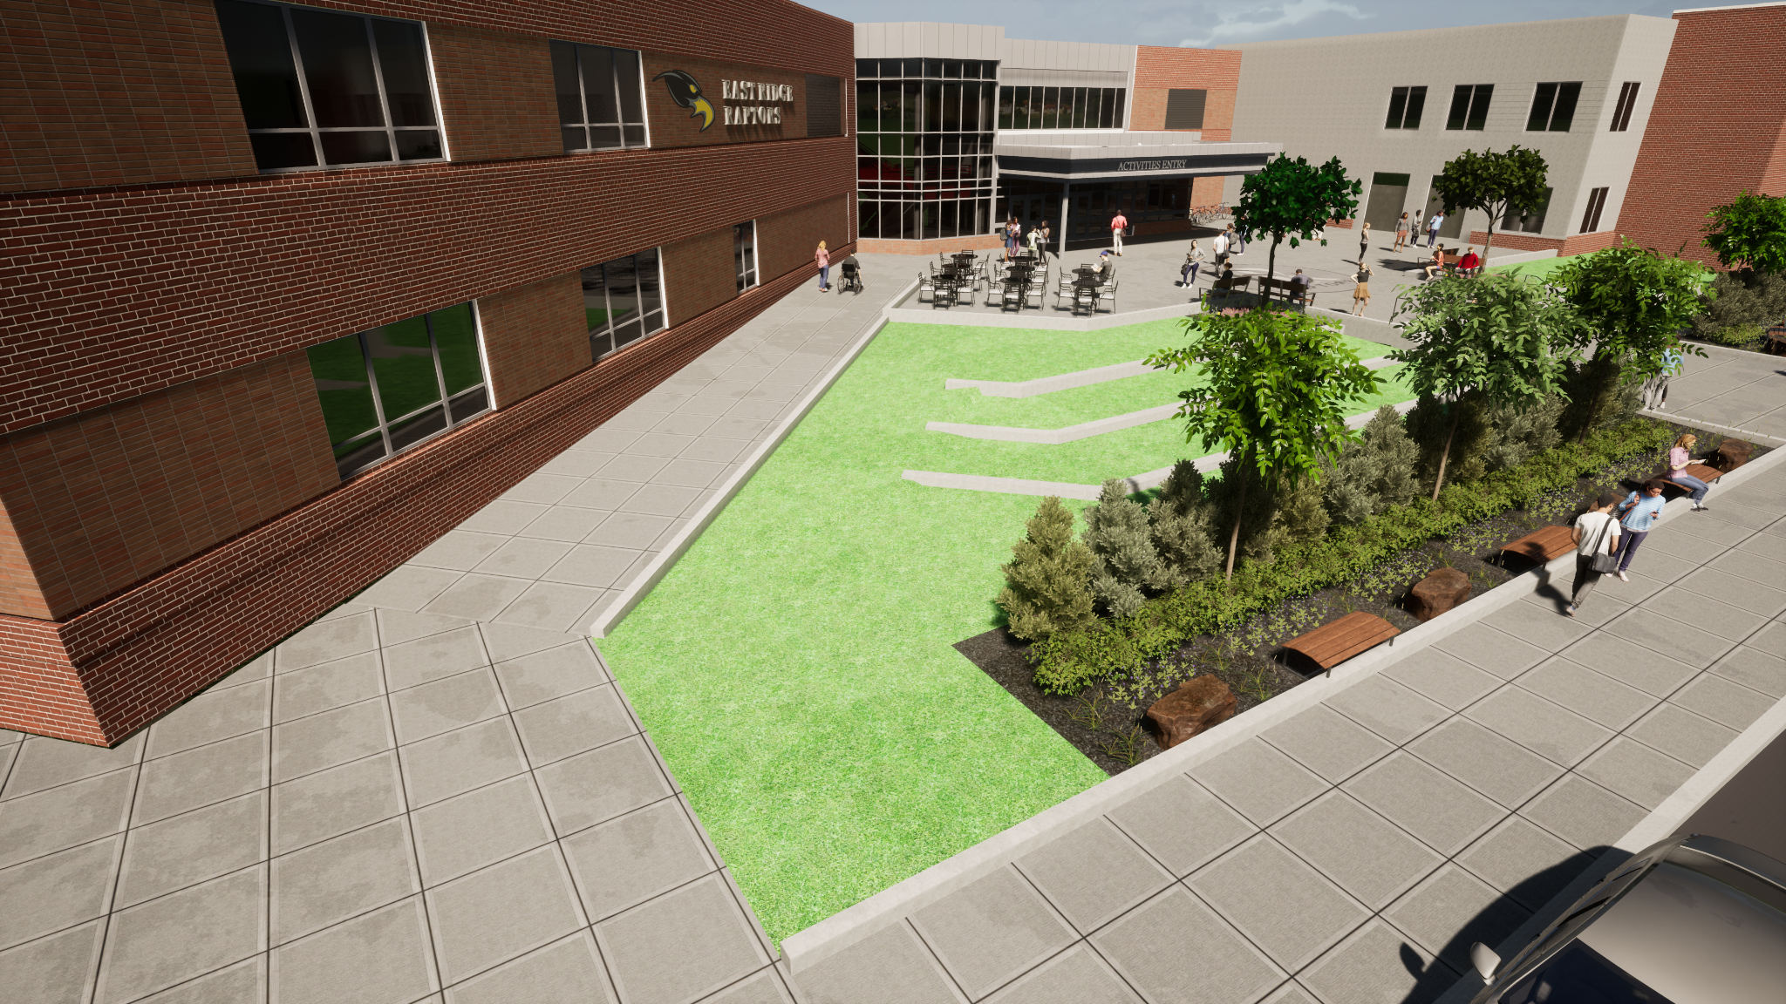
Exterior Plaza

Slide 39
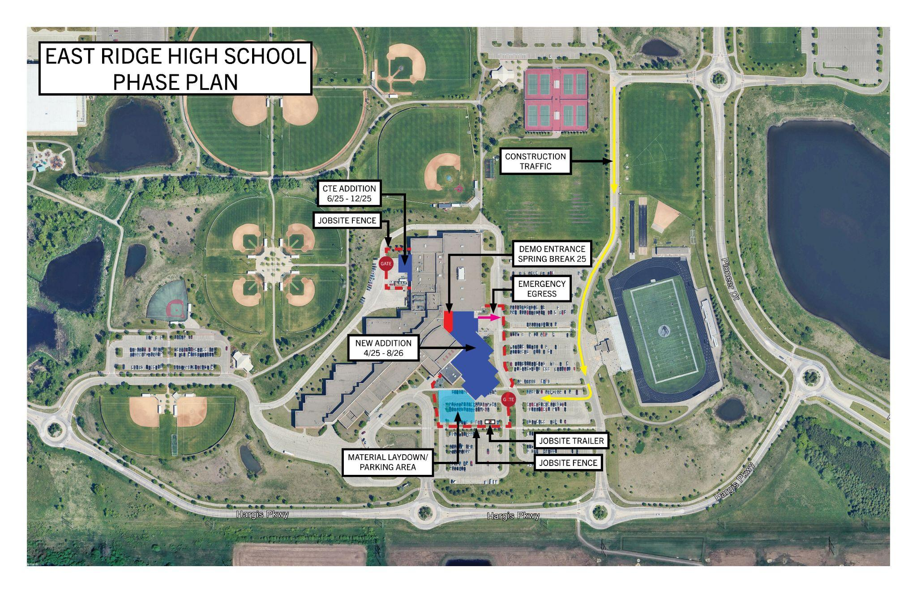
East Ridge High School - Construction Phasing Plan

Slide 40
East Ridge High School
SCHEDULE
Design: December 2023 – October 2024
Bidding: Nov-Dec 2024
Construction: Mar 2025 – August 2026
Notes:
Kristine

Slide 41
East Ridge HS - Next Steps
December:
  Bids due/review/selection of contractors
January:
  Bid Approval at School Board Meeting (Jan 16)
February:
  Pre-construction meetings
March:
  Construction begins (Spring Break)
Updates and important information will be shared at SoWashCo.org/construction
Notes:
Kristine

Slide 42
Park High School

Slide 43
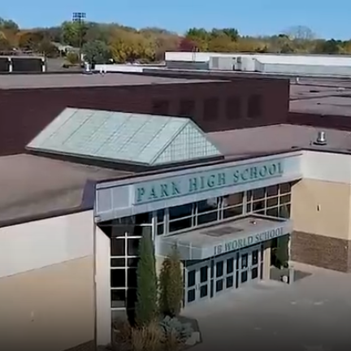
Park High School
PROJECT SCOPE
Construction of a secured entry and consolidated space for the main office and student services;
Construction of a new cafeteria and kitchen addition to serve future student population growth;
Renovation of existing spaces and construction of new Career and Technical Education and Science, Technology, Engineering and Math (STEM) spaces to support growth and curricular offerings;
Reconfigured roadway to enhance traffic flow and safety for parent pickup and drop off entryways for Park High School and Crestview Elementary.
Notes:
Dan Hines

Slide 44

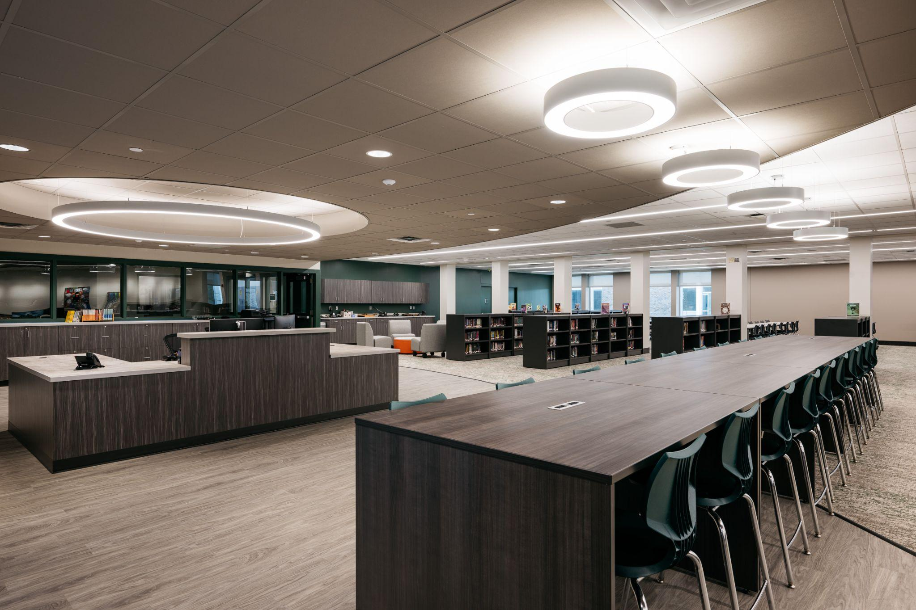
Park High School - Design Cues
1965 - Original Mural
2022 - Media Center Remodel
Notes:
Dan Hines

Slide 45
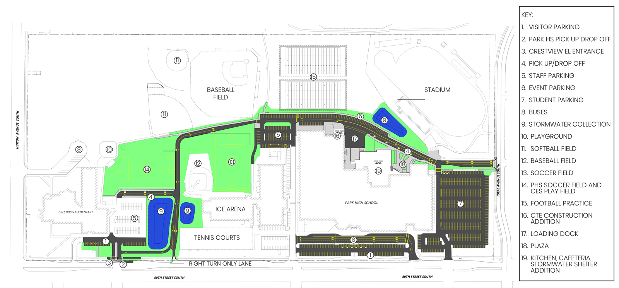
Park High School - Overall Site Plan
Notes:
Dan Hines

Slide 46
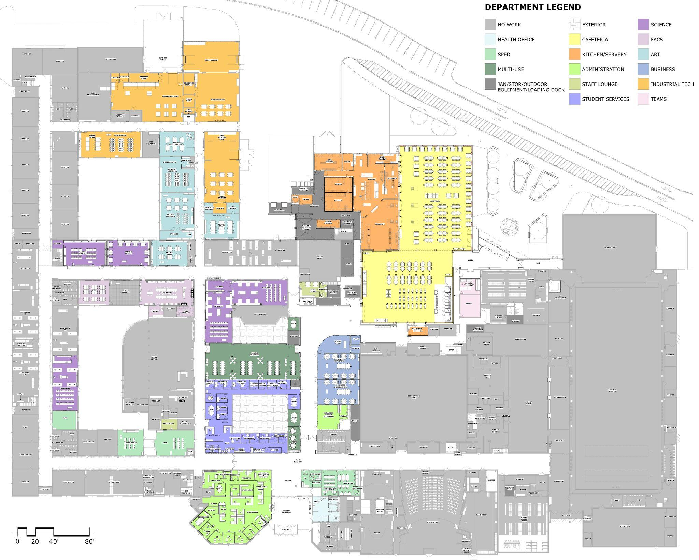
Park High School - Overall Floor Plan
Notes:
Dan Hines

Slide 47
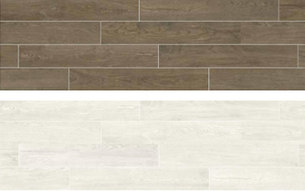








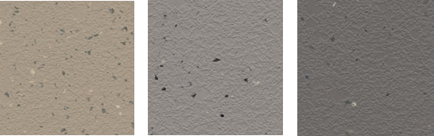
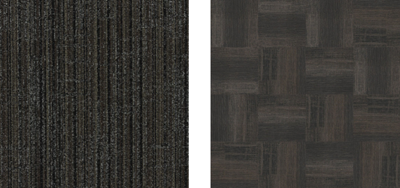


Interior Finishes and Materials
WALLS
SURFACES
Ceramic wall tile
Porcelain wall tile
Paint
Solid surface
Plastic laminate
Butcher block
Frosted vinyl on glass
FLOORS
Marmoleum Composite Tile (MCT)
Urethane Concrete
Quartz Epoxy
Polished Concrete
Terrazzo
Rubber
CEILINGS
Walkoff carpet
Kinetex carpet
Luxury Vinyl Tile (LVT)
Carpet
Acoustic ceiling tile

Slide 48
Secured Entries
and
Main Office

Slide 49
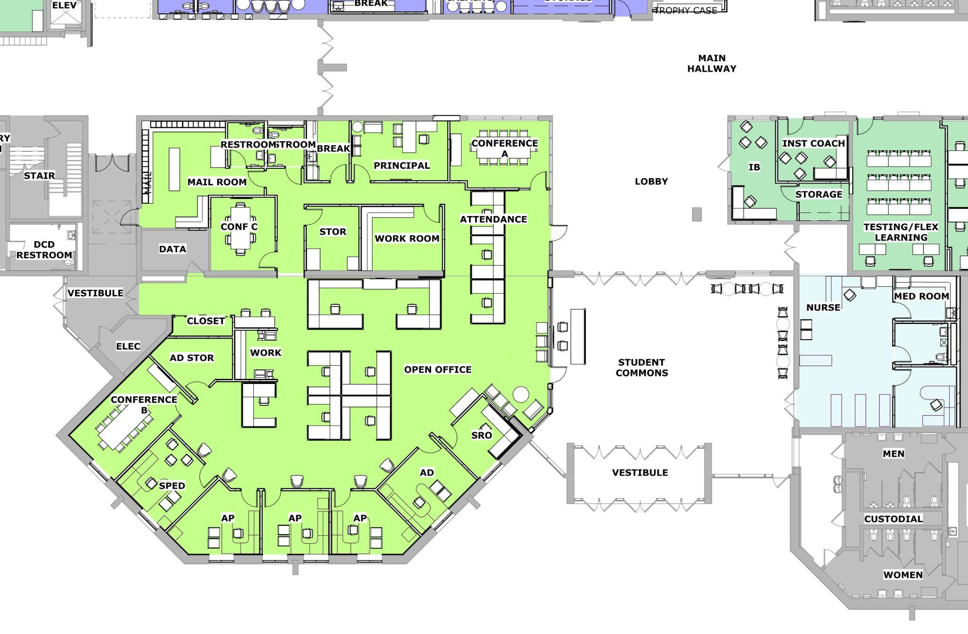
Park High School - Secure Entry/Main Office - South
GREETER
SECURE AREAS
ENTRY
Notes:
Dan Hines

Slide 50
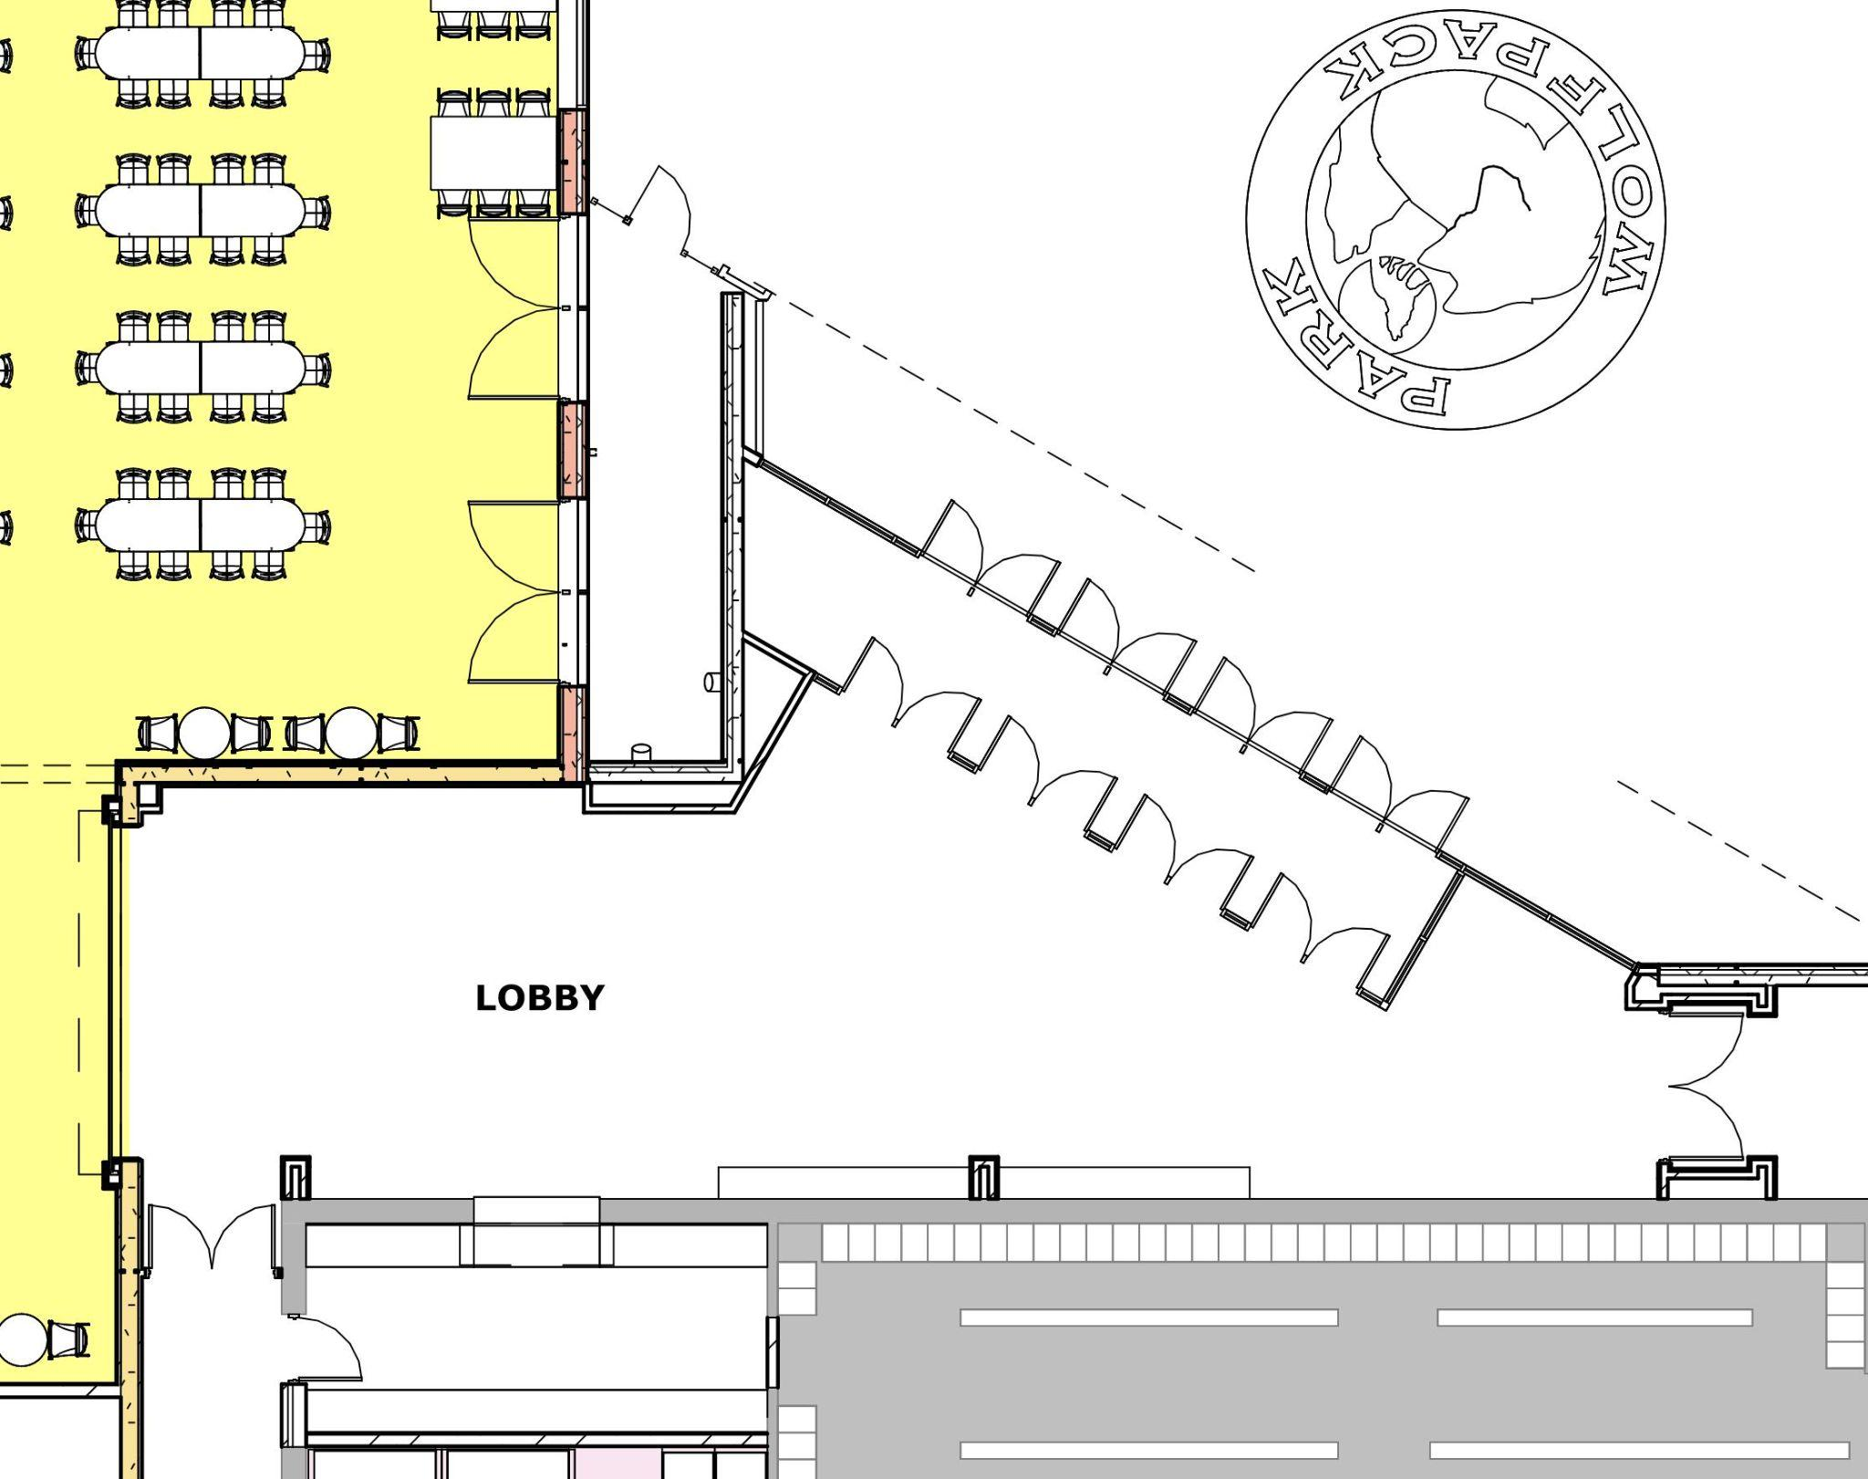
Park High School - Secure Entry - North
ENTRY
SECURE AREAS
GREETER
Notes:
Dan Hines

Slide 51
Student Support

Slide 52
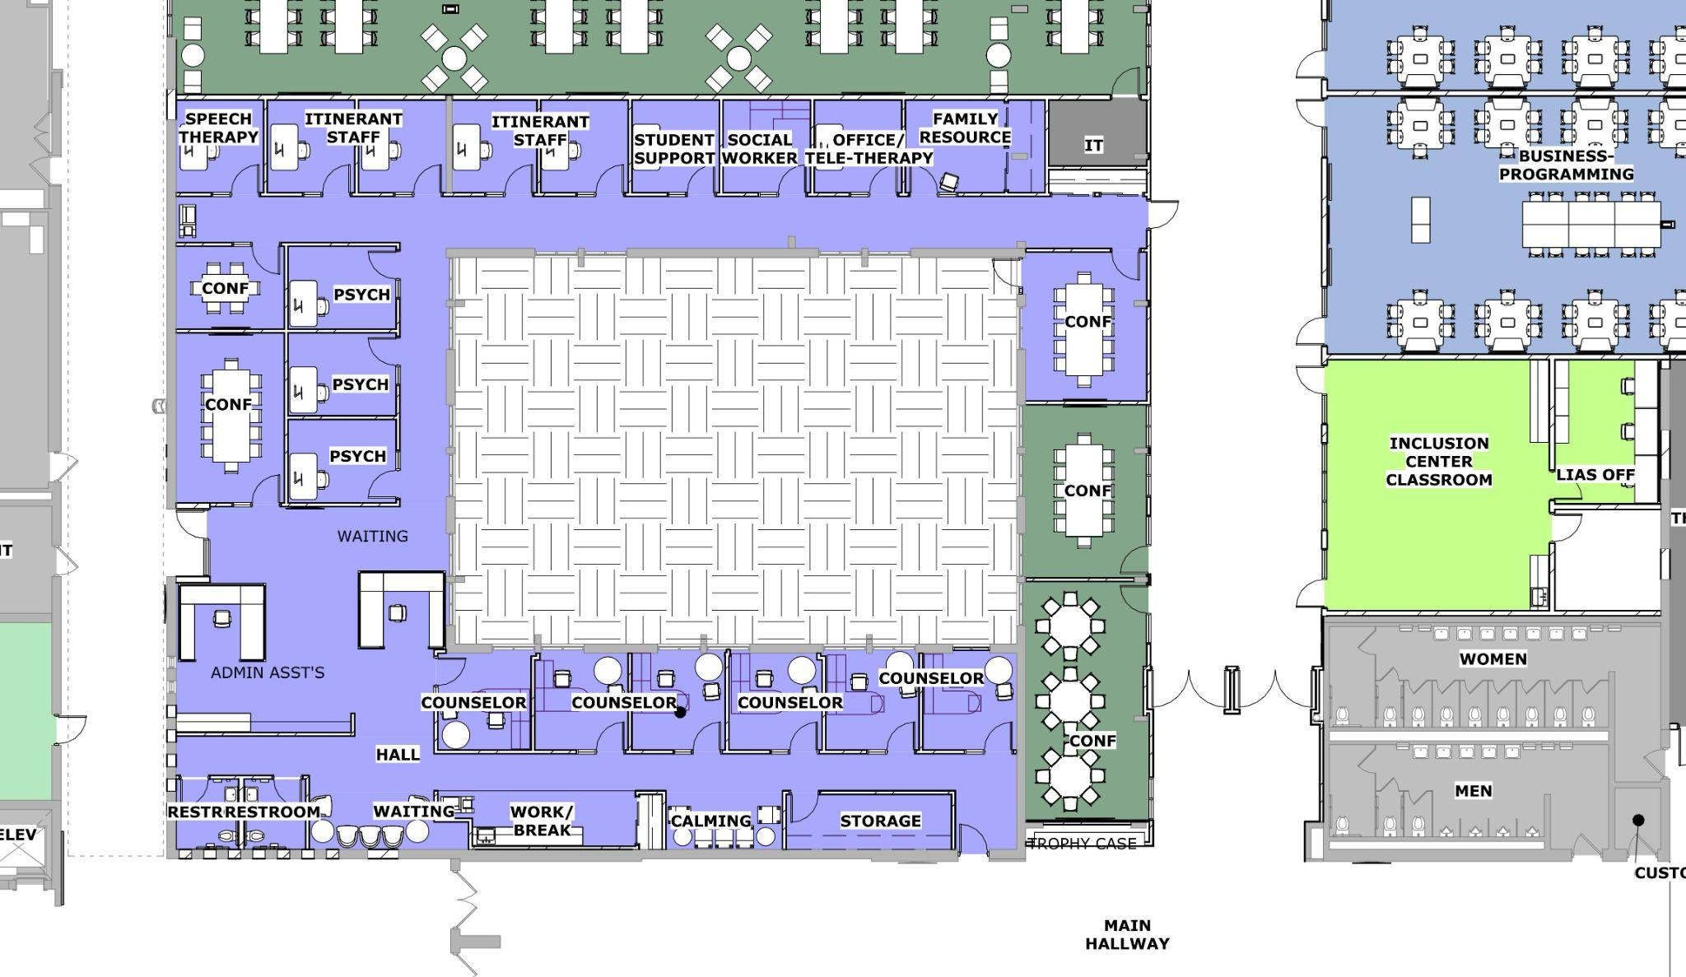
Park High School - Student Support
Notes:
Dan Hines

Slide 53
New Cafeteria and Kitchen Addition

Slide 54
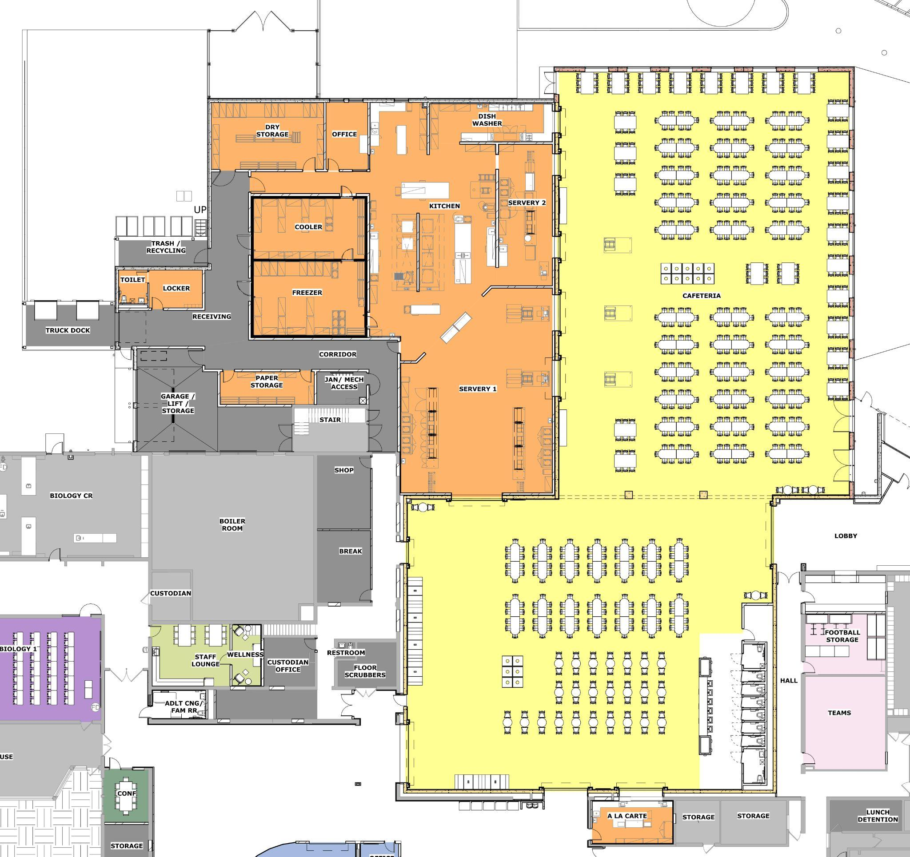
Park High School - New Kitchen and Cafeteria/Storm Shelter
STORM SHELTER
Notes:
Dan Hines

Slide 55
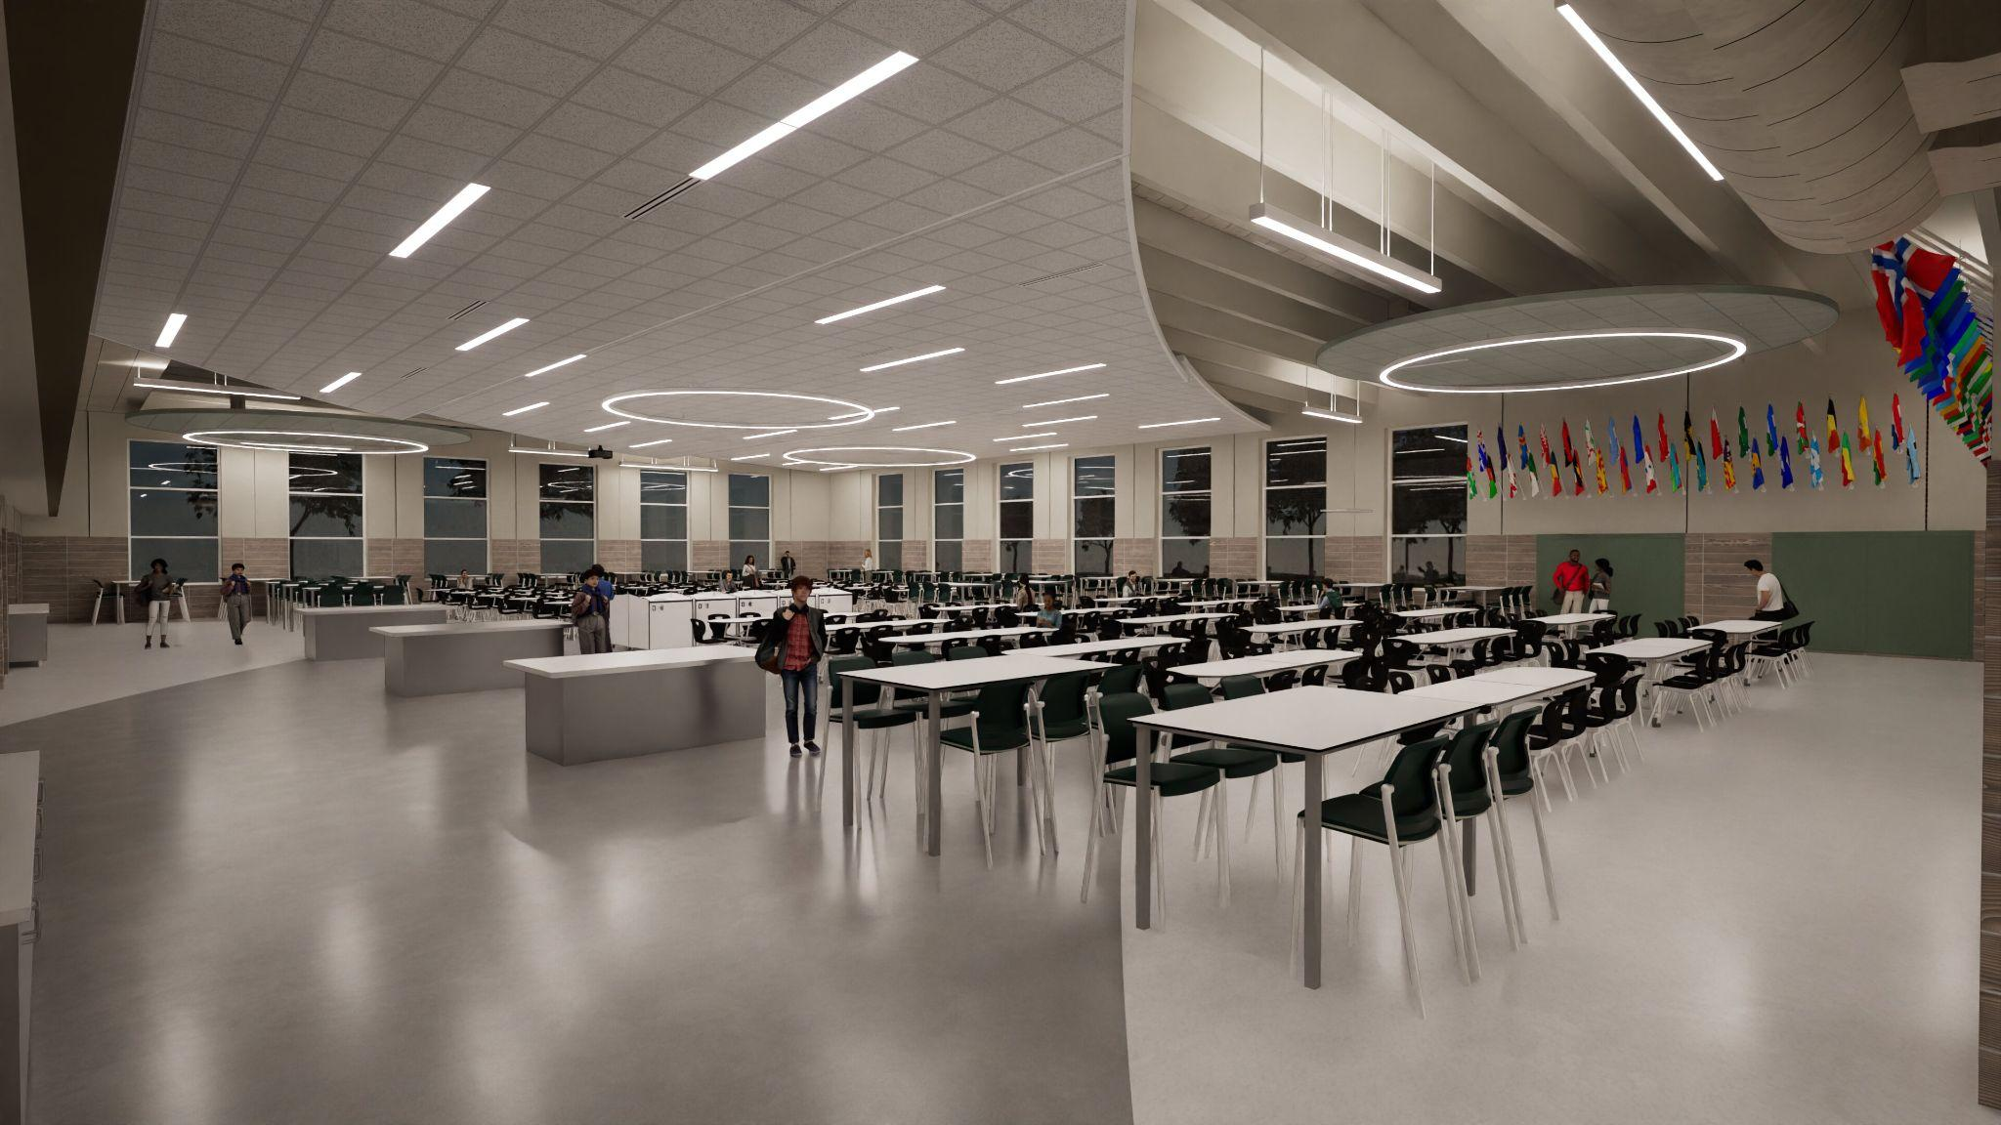
Park High School - New Cafeteria
Notes:
Dan Hines

Slide 56
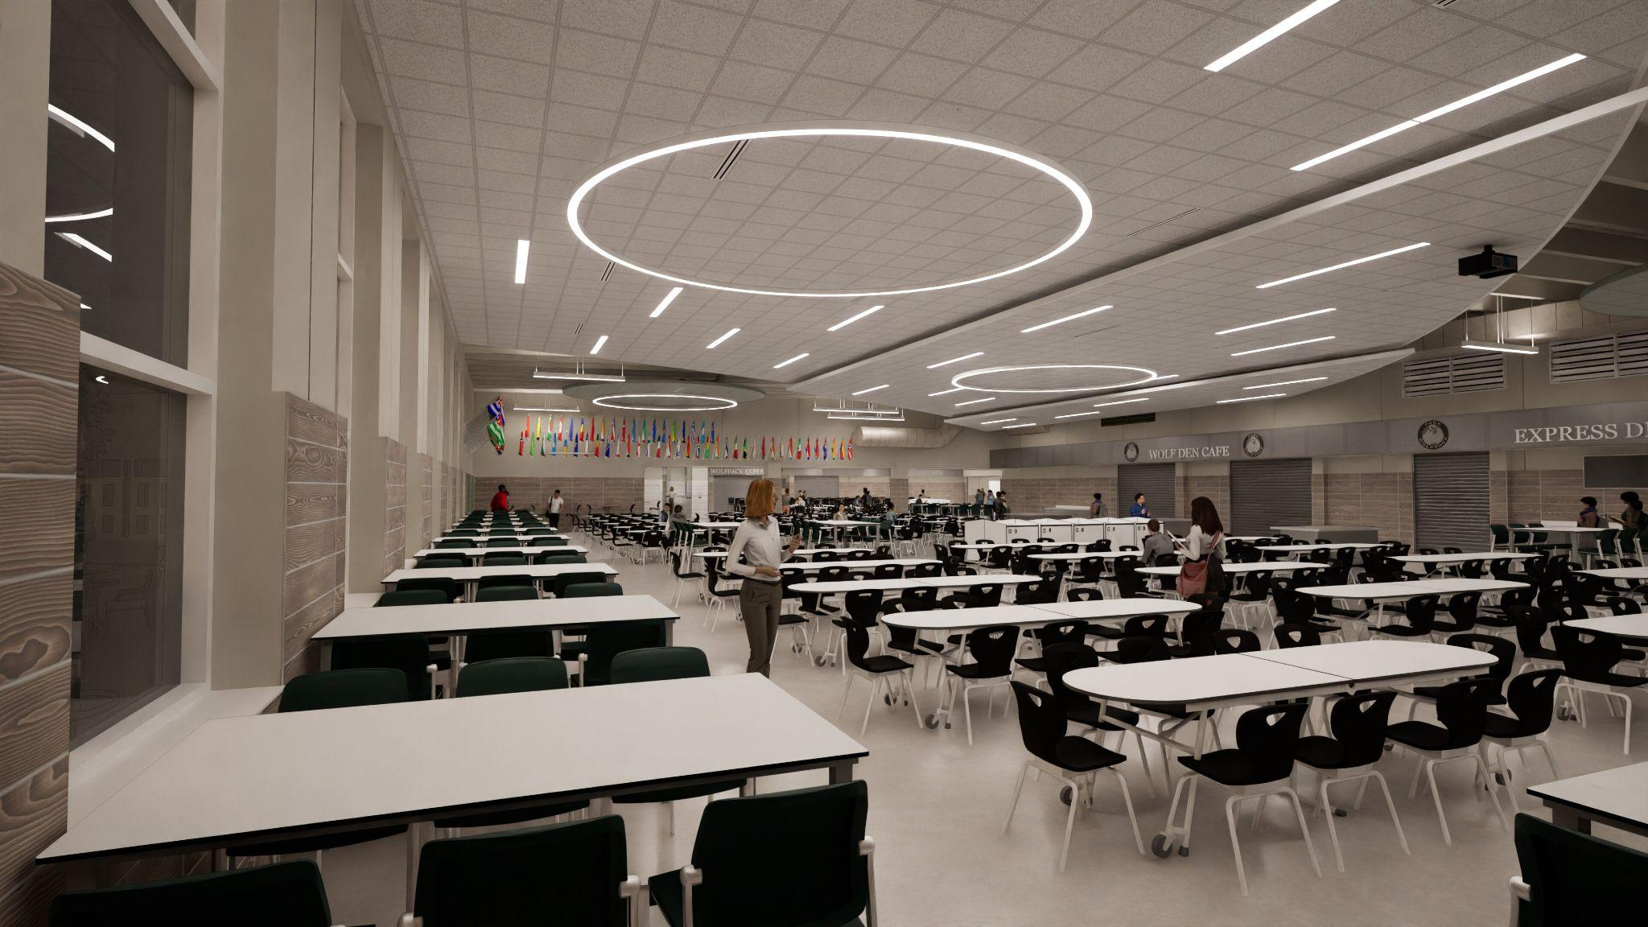
Park High School - New Cafeteria
Notes:
Dan Hines

Slide 57
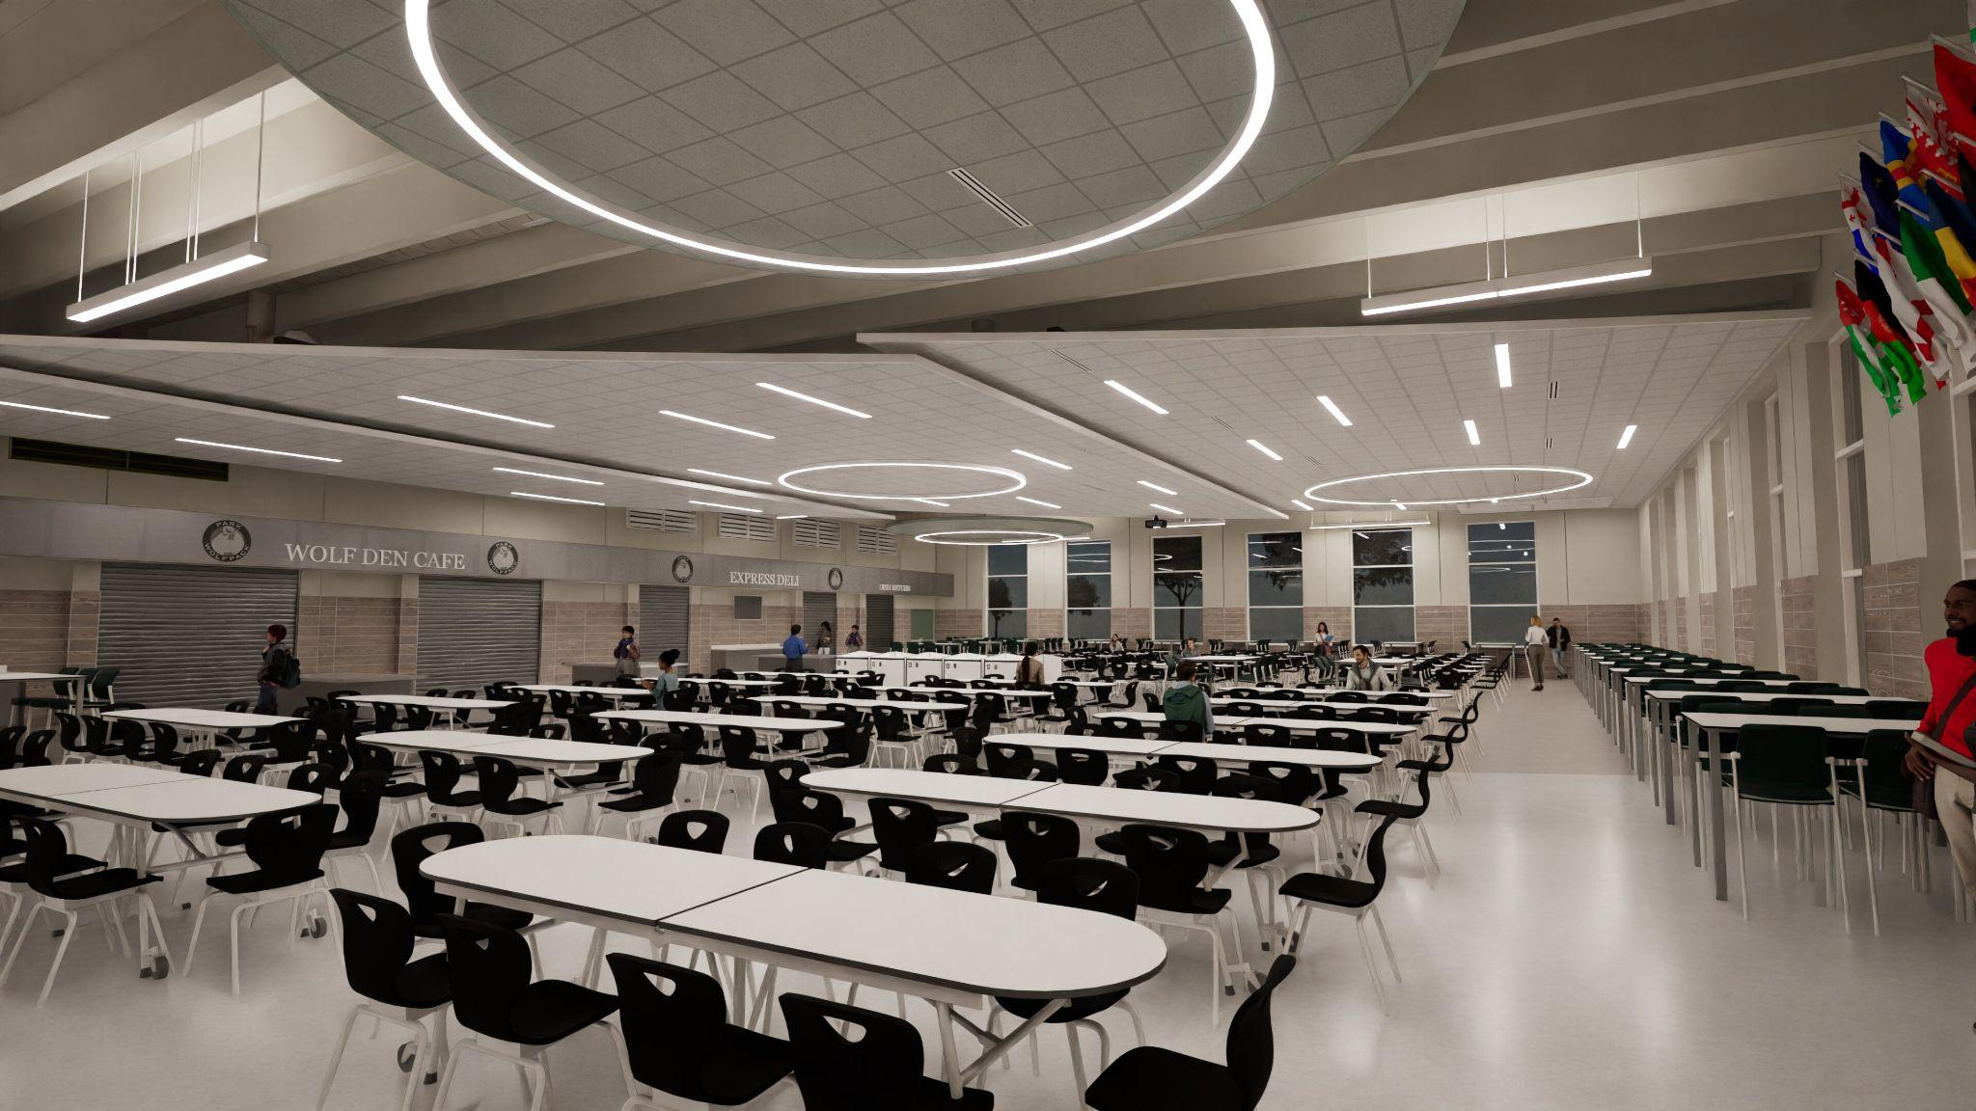
Park High School - New Cafeteria
Notes:
Dan Hines

Slide 58
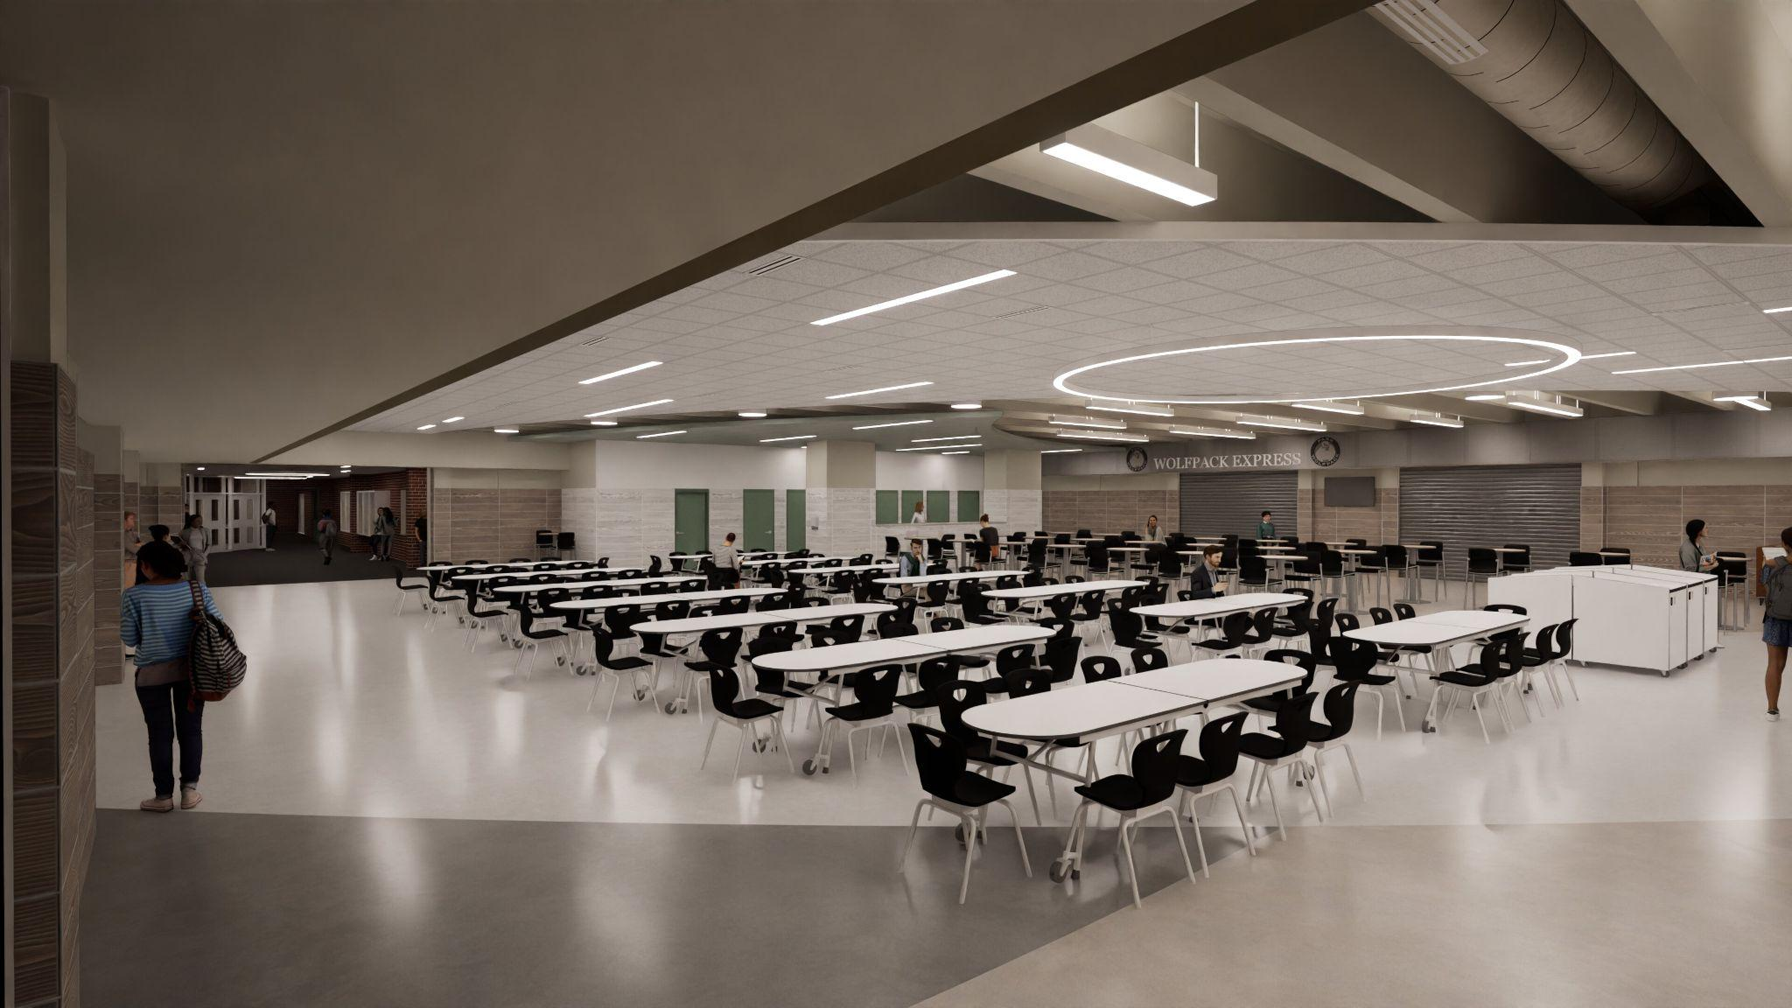
Park High School - New Cafeteria
Notes:
Dan Hines

Slide 59
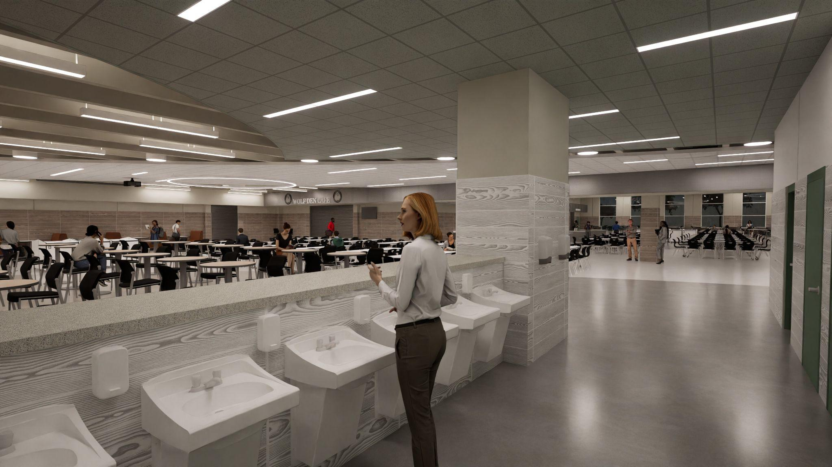
Park High School - New Cafeteria and Universal Restrooms
Notes:
Dan Hines

Slide 60
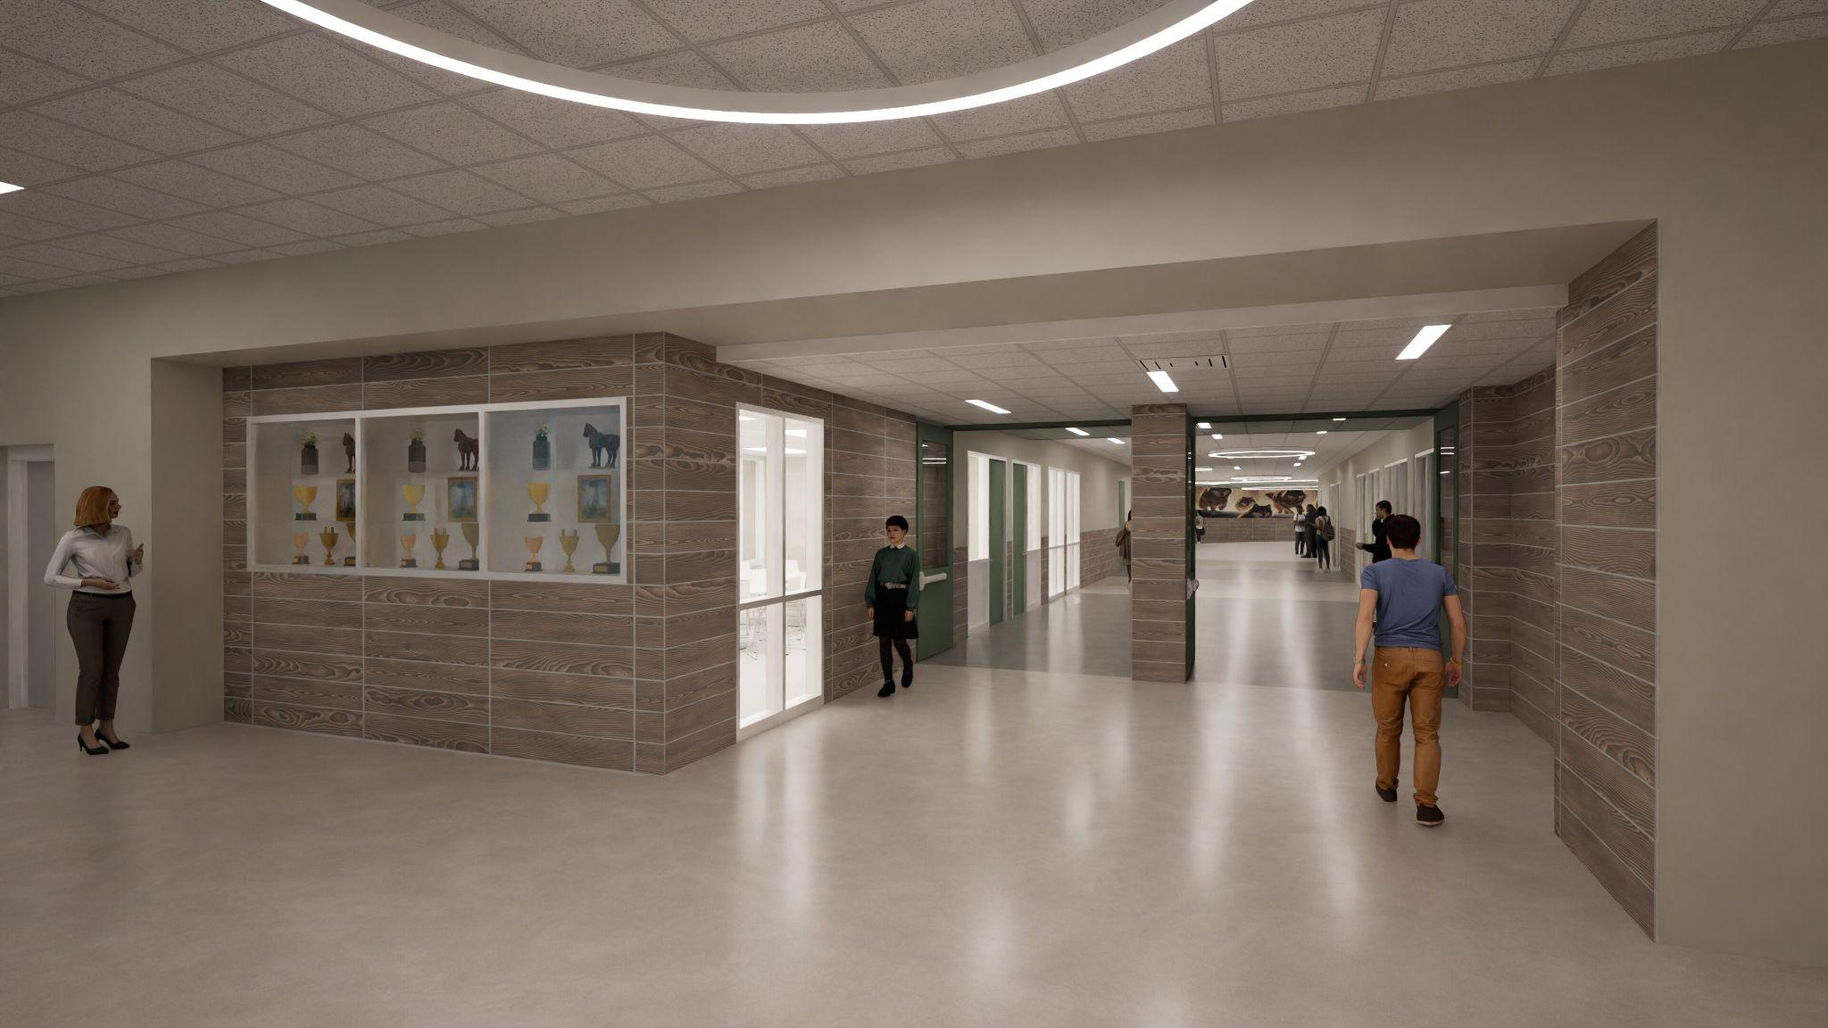
Park High School - Main Street - South End
Notes:
Dan Hines

Slide 61
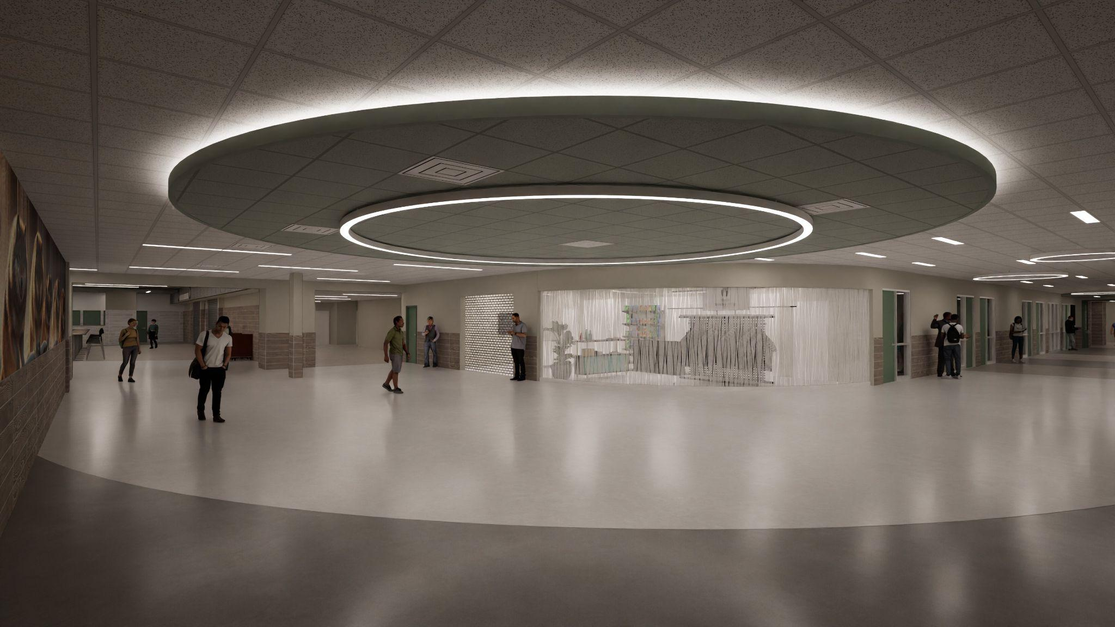
Park High School - Main Street - School Store
Notes:
Dan Hines

Slide 62

Park High School - Main Street - North End
Notes:
Dan Hines

Slide 63
Classroom Additions and Renovations

Slide 64



Park High School - Science Classrooms
Notes:
Dan Hines

Slide 65

Park High School - Art Rooms
Notes:
Dan Hines

Slide 66

Park High School - CTE IA Classrooms
Notes:
Dan Hines

Slide 67

Park High School - Business Classrooms and School Store
Notes:
Dan Hines

Slide 68
Park High School - FACS
Notes:
Dan Hines

Slide 69

Park High School - Biology
Notes:
Dan Hines

Slide 70

Park High School - CTE Industrial Arts - Construction
Notes:
Dan Hines

Slide 71

Park High School - Online Learning
Notes:
Dan Hines

Slide 72

Park High School - Online Learning
Notes:
Dan Hines

Slide 73
Exterior Plaza

Slide 74

Park High School - Exterior Plaza

Slide 75

Park High School - Exterior Plaza

Slide 76
Park High School - Exterior Plaza

Slide 77

Park High School - Exterior Plaza

Slide 78

Park High School - Exterior Plaza

Slide 79

Park High School - Exterior Plaza

Slide 80
Reconfigured Roadway to Enhance Traffic Flow and Safety

Slide 81

Park High School - Roadway and Traffic Diagram

Slide 82

Park High School - Construction Phasing Plan - Site

Slide 83

Park High School - Construction Phasing Plan - Building

Slide 84
Park High School
SCHEDULE
Design: December 2023 – February 2025
Bidding: March 2025
Construction: June 2025 – August 2027
Notes:
Kristine

Slide 85
Park HS -Next Steps
December:
  Bid Package 1 (Civil/Structural) - Bidding
January:
  BP 1 - Bids Due (Jan 2)
  BP 1 - Bid Approval at School Board Mtg (Jan 16)
  Bid Package 2 (Arch, Mech, Elec) due (Jan 31)
February:
  BP 2 - Bidding
March:
  BP 2 - Bid Approval at School Board Mtg (Mar 27)
April:
  Construction begins
Updates and important information will be shared at SoWashCo.org/construction
Notes:
Kristine

Slide 86
Questions?

