Slide 1


2025-2026
Course Selection
December 11th

Slide 2
Registration Timeline
Registration Window Opens
8th Grade Registration Presentations
December 10th
December 20th
December 5th
December 11th
Curriculum Fair
Registration Closes at 3:30pm

Slide 3
Curriculum Fair
Our Curriculum Fair was December 10th at the high school.
Thank you for those that were able to attend!

Slide 4
Some Information about RHS

Slide 5
Link Crew 1st Day
Each of you will be assigned two link crew students that will be your “mentor” for the year.
On the first day freshmen, new students in grades 10-12, and link crew members are the only students who begin the day at 8:00am. You are given a tour, enjoy games and activities to get your nerves out.

Slide 6
Semester & Daily Schedule
School time runs from 8:00-2:50
Passing time is 5 minutes long
We have 3 lunches - A, B and C
  Lunches are mixed grade levels and are based on the class you have during that block
Students take 7 academic classes per semester, with a total of 14 classes for the year

Slide 7
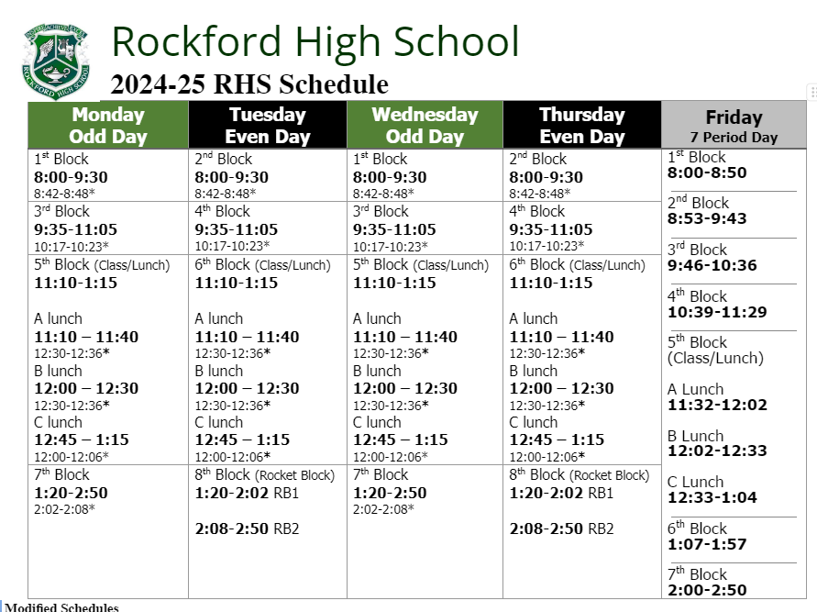
Monday/Wednesday are Odd Classes
Tuesday/Thursday are Even Classes
Friday is all 7 classes aside from Rocket Block
Tech Breaks

Slide 8
Rocket Block
There are 2- 40 minute Rocket Block sessions each Tuesday & Thursday
Tuesdays- Static Rocket Block. Students go to the same rooms every Tuesday
Thursdays- Students sign up for sessions based on academic needs and personal interests
  Academic Rocket Blocks - Quiet Study Hall, Collaborative Study Hall, Test Retakes
  Personal Interests - Weight Lifting, Fantasy Football, Open Gym, Broadway Shows, Movies, Crafts, Board Games, etc.

Slide 9
Grades matter in high school
What is GPA?
Why is it important?
What is a college or university going to want to see?

Slide 10
What happens if you get an F in high school?
Grades matter in high school
  Grades earned in high school will go on your official transcript.
  A transcript is a document that will be important for your post-high school plans. Colleges and future employers often review your transcript for admittance criteria - - What do you want them to see?
If you get an F in high school, you will need to repeat the class, make it up in night school, or summer school
If you get an F in high school, it will stay on your transcript
Make sure to keep track of your grades and your transcript. You don’t want to repeat a freshman level course as a senior

Slide 11
Graduation Requirements
Total of 50 Required Credits
8 English
7 Social Studies
6 Science
6 Math
2 Fine Arts
1 Health
1 Phy Ed
1 CTE
1 Personal Finance
17 Electives
*Starting with the Class of 2029 there will be a new system to recognize high academic achievement
*If you are pursuing the Full Diploma program, we strongly recommend that you follow the Fine Arts, Personal Finance, and Gym/Health Recommendations for when you should take those

Slide 12
What is IB?

Slide 13

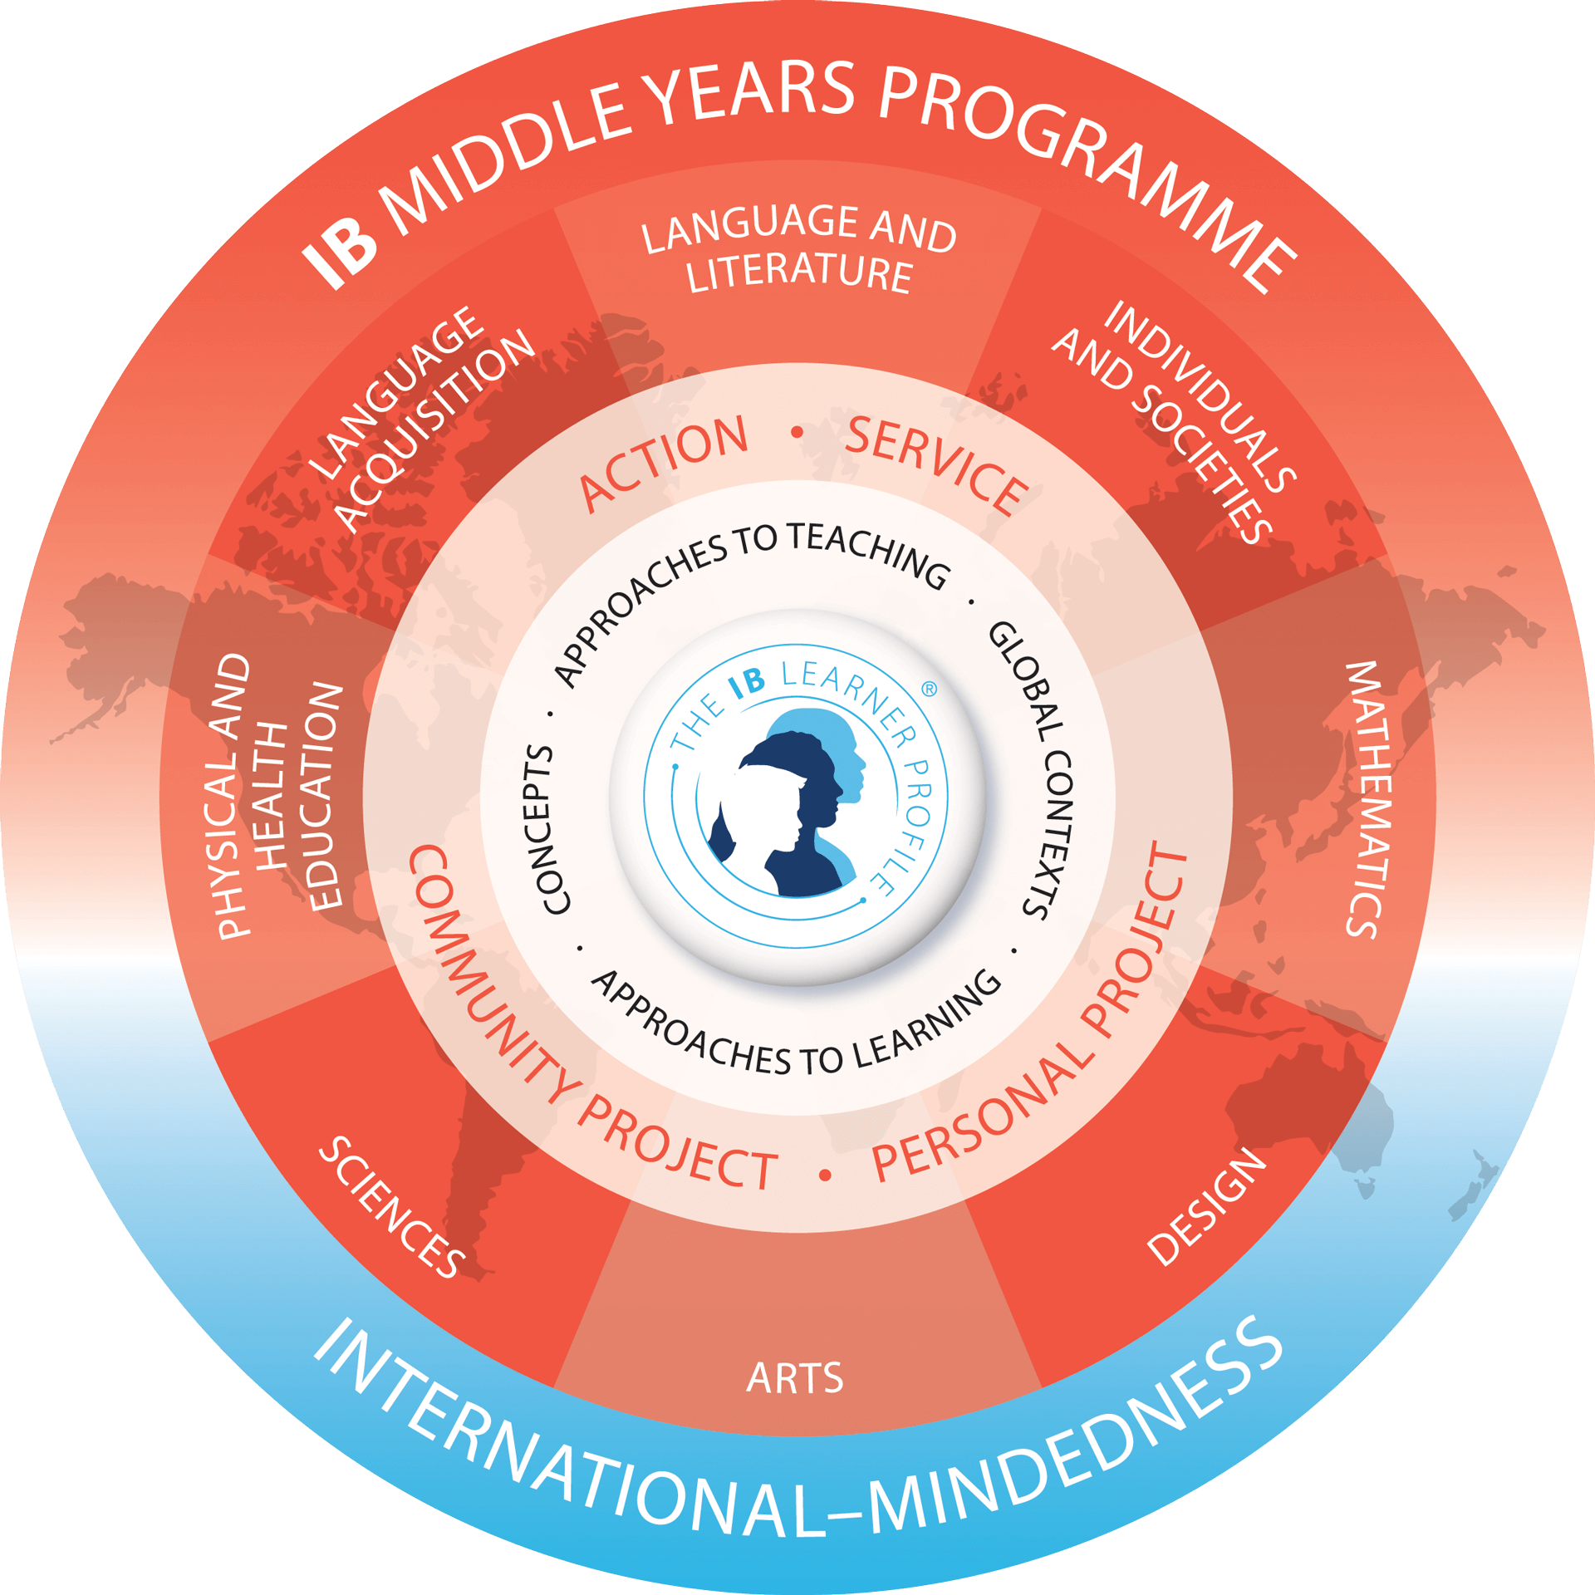
Students in Grades 9 & 10 are apart of the Middle Years Programme

Slide 14

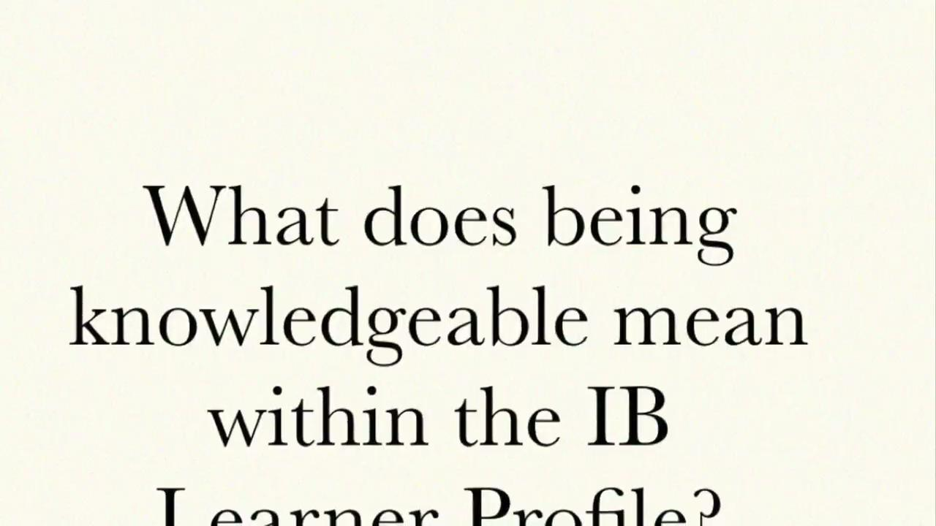
At Rockford High School , all members of our community are learners, and strive for growth in the
IB Learner Profile traits
Notes:
Video on being Knowledgeable

Slide 15
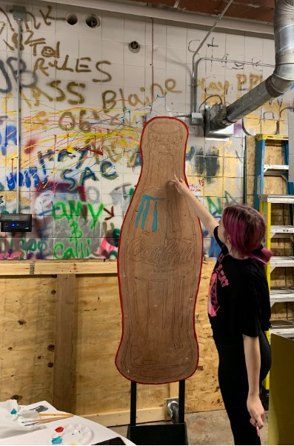
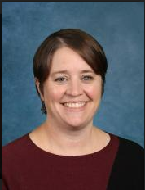
The Personal Project
The Personal Project is a required project for students in year 5 (10th grade) of the MYP program. It is an opportunity for students to guide their own learning in a project driven by their interests based on experiences within the school or outside of school.
The personal project is an opportunity for students to:
Inquire (Planning stage of project): Explore an interest that is personally meaningful and investigate individual interests.
Act (Apply skills stage of project): Transfer and apply skills in pursuit of a learning goal and creation of the product.
Reflect (Reflection stage of the project): Recognize and provide evidence of personal growth and development.
Personal Project Coordinator-
Kathy Mattson

Slide 16

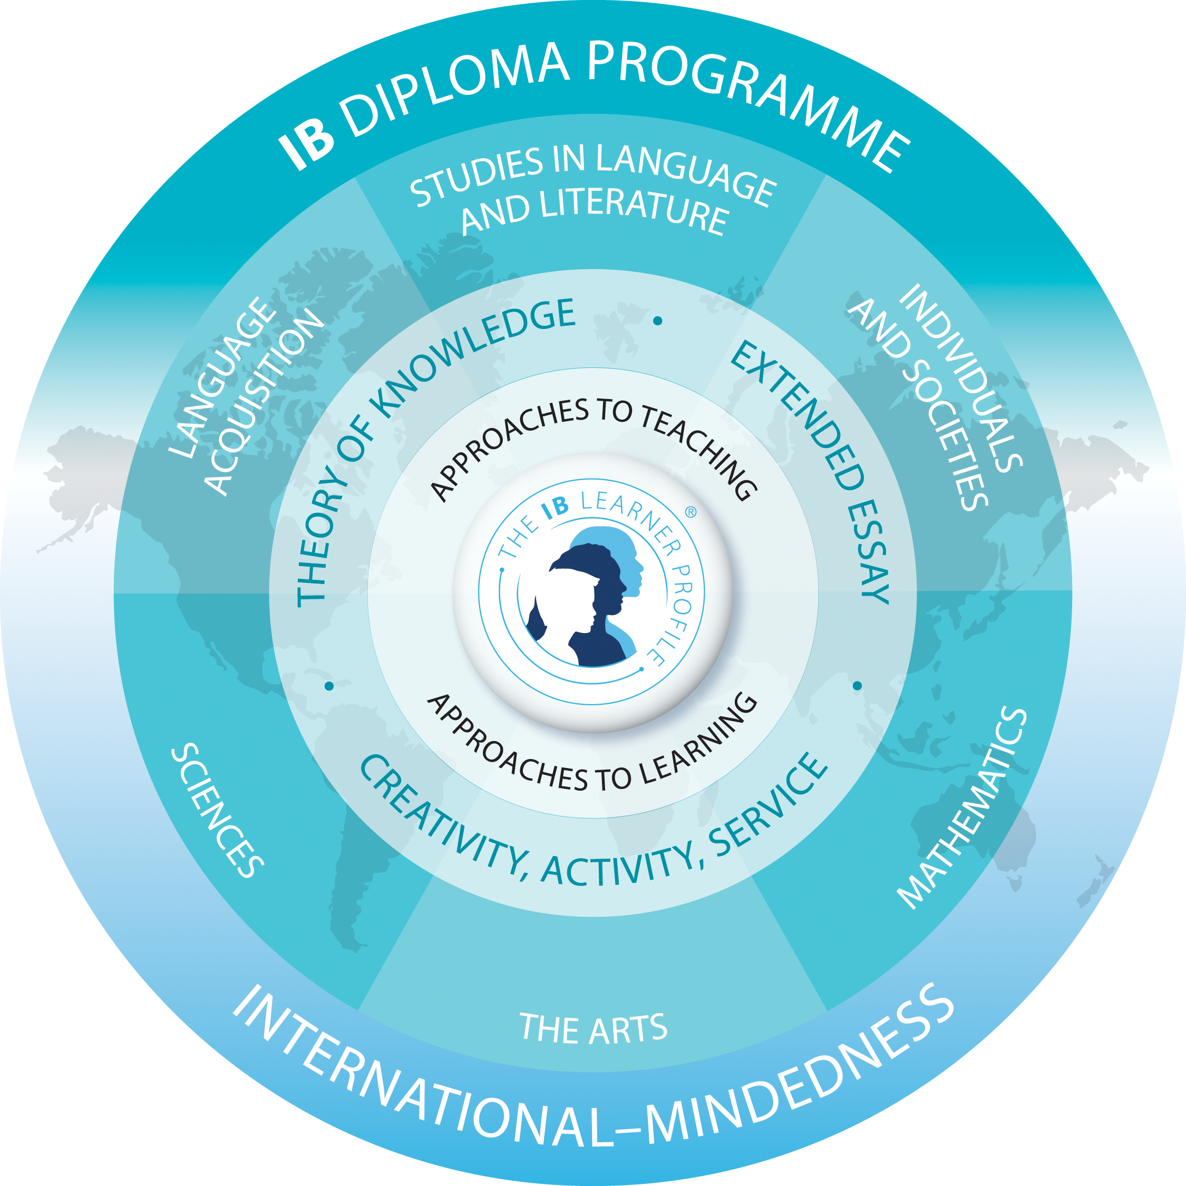
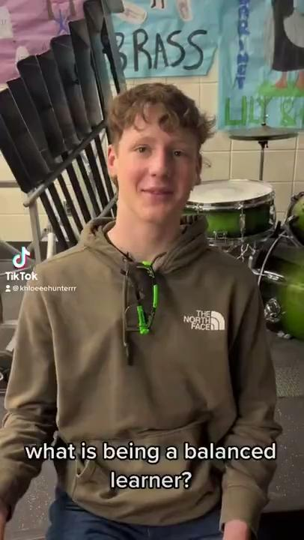
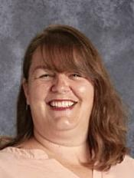
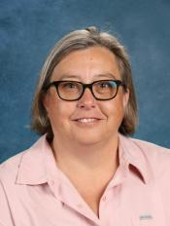
Additional Programs in the International Baccalaureate- Specific to 11th and 12th grade
CAS Coordinator/ TOK Teacher-
Caroline Young
Extended Essay Coordinator -
Julie Merila
Notes:
Paul

Slide 17
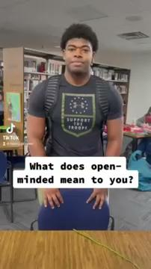
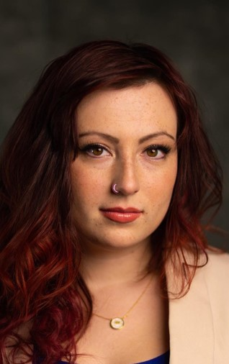
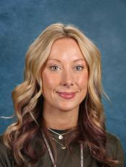
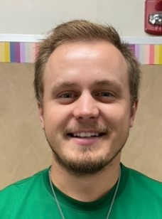
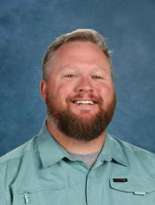
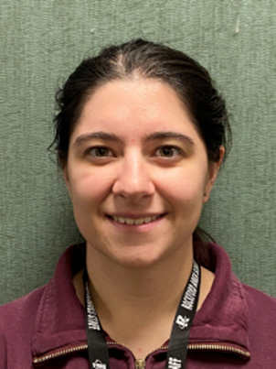
Designed for students interested in pursuing a career-related education. It provides them with an excellent foundation to support their further studies, as well as ensure their preparedness for success in the workforce.
Performing Arts/ Theater Teacher- Alicia Ehleringer
CNA instructors- Becca Morgan & Jack McCoy
Business Teacher- Josh Westgaard
AG/Tech Ed Teacher (Vet Tech & Craftsmanship) Monica Pinkerman

Slide 18
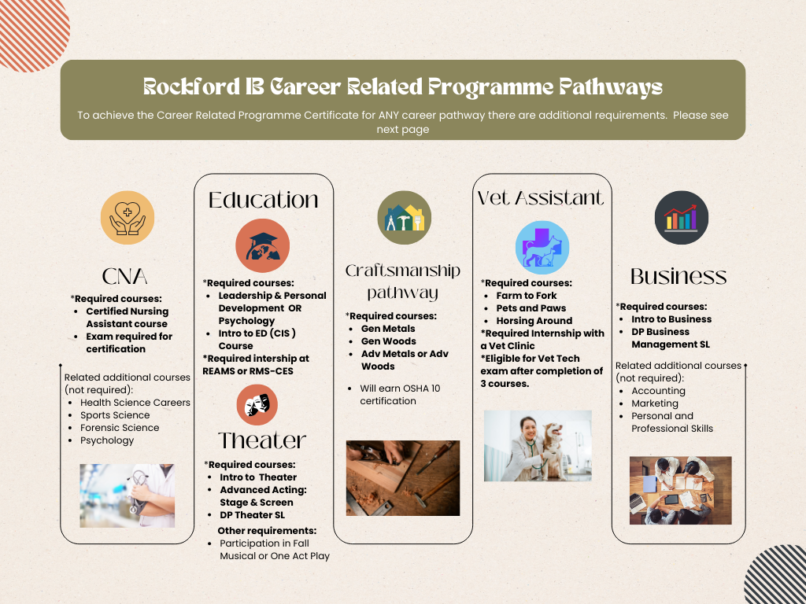


Slide 19
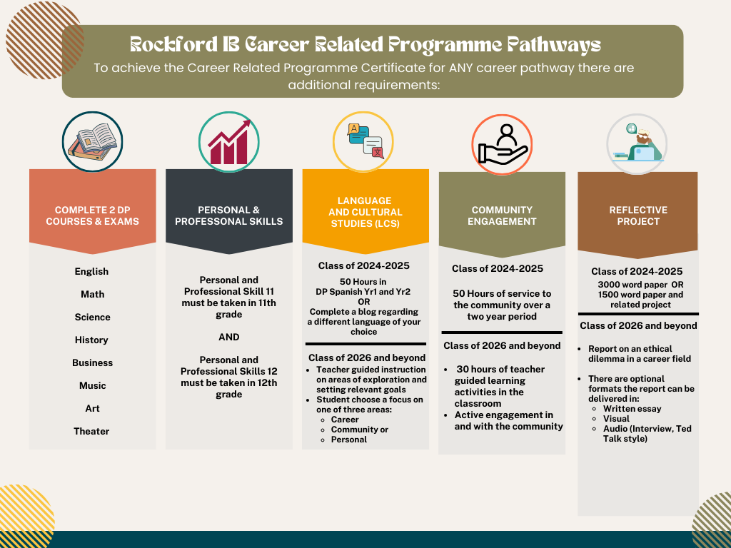

Slide 20
Registration for the 2025-2026 school year

Slide 21

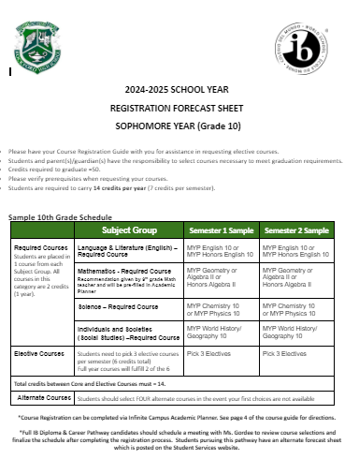
Registration Materials
Course Guide - Lists the graduation requirements, course descriptions and a full list of offerings
Registration Worksheet - Tool to complete your online registration. Lists classes and electives required for next year

Slide 22
Courses
Semester 1 | Semester 2
MYP English 9 | MYP English 9
U.S. History 9 | U.S. History 9
MYP Science 9 | MYP Science 9
**Math | **Math
***Elective - Recommended Art | ***Elective - Recommended Art
***Elective - Recommended Spanish | ***Elective- Recommended Spanish
***Elective | ***Elective
Each student will have 7 classes on their schedule per semester
4 of these classes are your Core Classes
  MYP English 9
  MYP Science 9
  MYP US History 9
  MYP Non Linear Algebra or MYP Geometry (Based on your teachers recommendation)
3 of these are your Elective Classes
  AVID
  Agriculture
  Arts: Fine Art, Band, Choir
  Business
  CTE: Tech Ed, Agriculture, Business
  Health/Phy Ed
  Spanish
  Limited Core Electives

Slide 23
World Language Requirement
Most 4-year colleges in the state of Minnesota require 2 years of a language
If you are interested in pursuing the full IB Diploma, you will need to take Spanish I in Grade 9

Slide 24
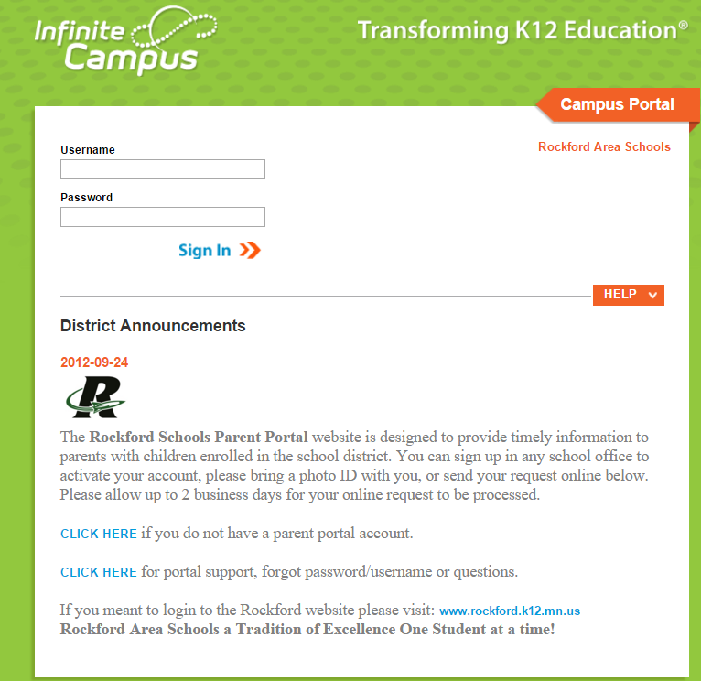
Students will register using the Academic Planner in Infinite Campus. The first step will be to login to your account

Slide 25
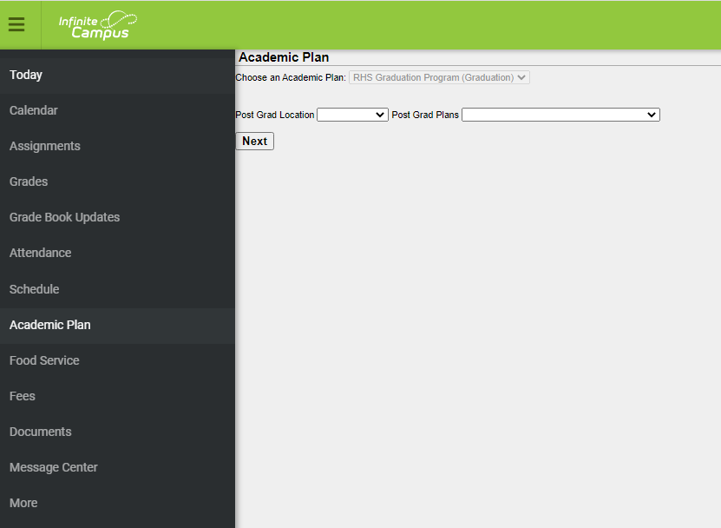
Online Directions
Login to your Infinite Campus Student Portal Account
Enter the students Username & Password
Select “Academic Plan” in the menu on the left hand side
2 Post Grad Plans questions will appear. These are optional . Click on “Next”
Have your 2025-26 Course Description Guide available for course descriptions and pre-requisite courses

Slide 26
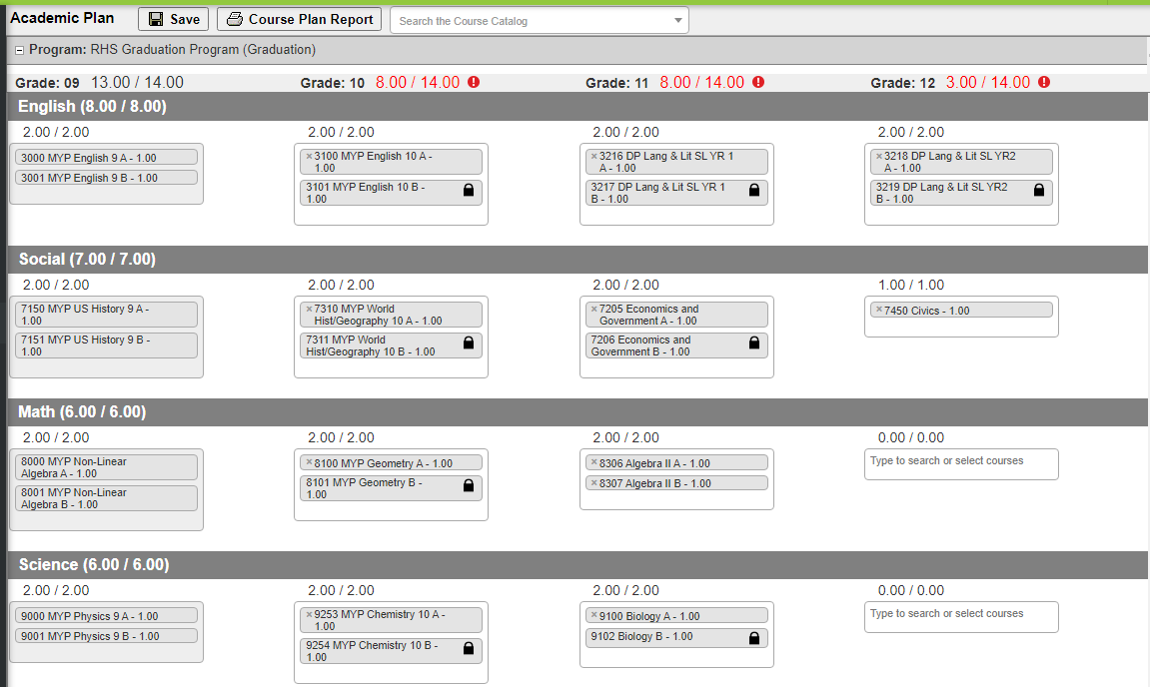
How to register
Review each subject for the upcoming grade you are registering for.
If a course number is entered in error, click on the (x) by the course name to remove it.

Slide 27
Core Classes
Some Core Classes will be pre-filled and some will be based on your choosing. For the courses you can choose, review the course guide to determine the best fit for you.
 | 9th | 10th | 11th | 12th
English | Prefilled with MYP English 9 | English 10 OR Honors English 10 | DP Lang & Lit SL OR DP Lang & Lit HL | DP Lang & Lit SL OR DP Lang & Lit HL
Math | Prefilled with MYP NonLinear Alg OR MYP Geometry | Prefilled with MYP Geometry OR Honors Alg II OR Alg II | Prefilled with Algebra II OR Teacher Recommendation | Optional
Science | Prefilled with MYP Science 9 | MYP Chem 10 OR MYP Physics 10 | Biology OR DP Biology HL | Optional
Social Studies | Prefilled with MYP US History 9 | Prefiled with MYP World Hist/Geography 10 | Economics & Gov OR DP Economics SL OR DP European History HL | Civics OR DP European History HL

Slide 28
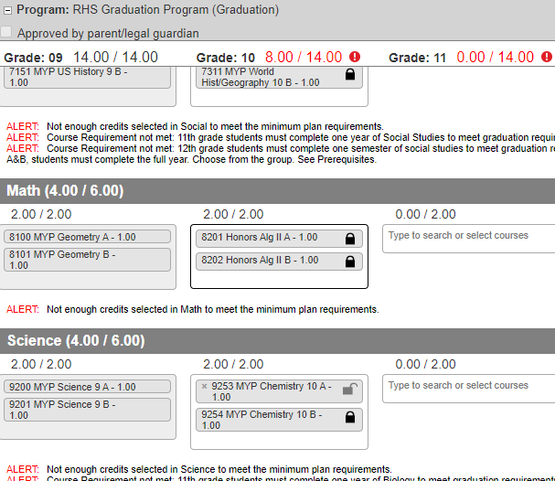
How to Register:
For Courses:
With a lock icon, these are pre-determined based on teacher recommendation and cannot be changed during the registration process.
That are not pre-filled click within the box and a drop down list of available courses will appear. Select the course you wish to enroll in. If you select an “A” semester course, the “B” course will auto fill. If it does not, make sure to select the “B” semester course as well.

Slide 29
Non Pre-filled courses
When a course is not pre-filled, click within the box and a drop down list of available courses will appear. Select the course you wish to enroll in. If you select an “A” semester course, the “B” course will auto fill. If it does not, make sure to select the “B” semester course as well.

Slide 30
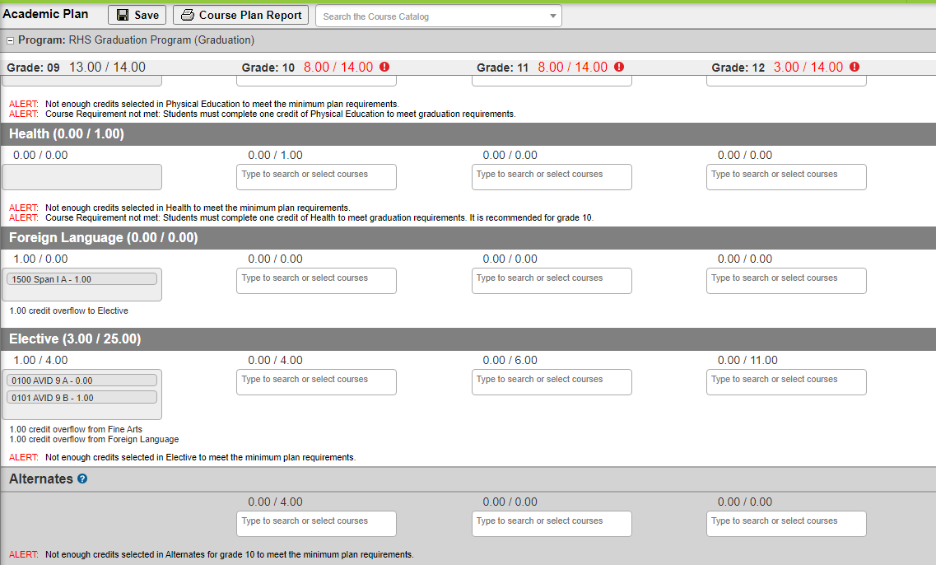
Electives & Alternates
You can register electives & alternates in 2 ways.
Search the course by name under “Course Catalog”
Click on the Elective category to search the options
If you select an “A” semester course, the “B” course will auto fill. If it does not, make sure to select the “B” semester course as well.
Pick 3-5 alternates or back up classes in case one or more of your elective choices is not available

Slide 31
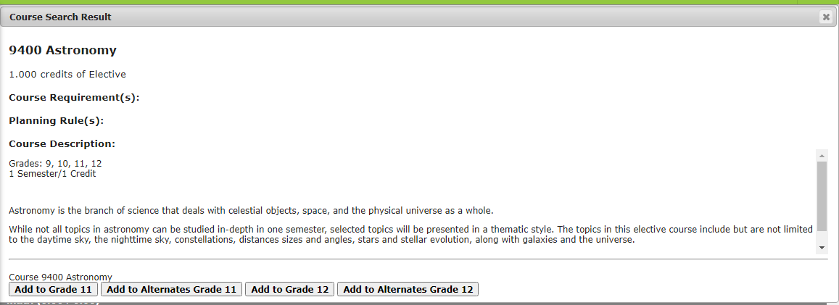
Searching for a Course

Slide 32
FINAL STEPS!
You are finished when you have 14.0/14.0 Credits at the top of the column AND the required credits from each subject area are met.
  You only need to register for next school year, you can plan future years if you would like
  Courses for next year will be locked on 12/20 at 3:30pm
  You can still make changes to future years, just not the courses for the 2025-26 school year
Review your Course Plan
Click “SAVE” in the top menu bar. It should say “Course Plan Saved”. You may come back and review your choices at any time.
Congratulations! Your registration is complete!
IMPORTANT: Final schedules are based on student demand. Courses that did not have enough interest may not be offered and you may be asked to select an alternative course.

Slide 33
Thank you for your time!
If you need additional help with registration, please contact someone from the Guidance Office for help, or stop down!
Ms. Bloom - samantha.bloom@rockford883.org
Ms. Engstrom - ellie.engstrom@rockford883.org
Ms. Roehl - aimee.roehl@rockford883.org
Registration will close on Friday December 20th at 3:30!

