Slide 1
Welcome to Financial Aid
2025-2026
Presenter: Stan Werne
Vincennes University
Financial Aid Counselor
and Member of
Indiana Student Financial Aid Association

Slide 2

Your key to federal & state financial aid:
FAFSA
Free Application for Federal Student Aid
  Available Dec. 1

Slide 3

Why Free Application for Federal Student Aid (FAFSA) is key:
Student & parent information is used to calculate the Student Aid Index (SAI).
Why needed?
Required for HS graduation in
Indiana (with opt-outs possible).
Determines official financial need related to financial aid.

Slide 4
Financial Aid Need Calculation
U.S. Department of Education
Definition of Financial Aid Need
  Cost of Attendance (COA)
  Varies from school to school
  Minus
  Student Aid Index (SAI)
  Same for all schools--result of your FAFSA
  Minus
  Scholarships & other resources
  Equals
  Financial Aid Need

Slide 5

Part of Financial Need Calculation
Cost of Attendance (VU 2024-2025)
Direct costs = what appears on the bill
Tuition & fees ($7126 – 30 credits/year)
On-campus housing & food ($13,118 avg.)
Program expenses (vary by major)
*********************************
Indirect costs = other expenses
(At-home “housing & food” ($2944))
Books & supplies ($1332)
Transportation ($2600)
Personal expenses ($1364)
Loan fees ($64)
Total: $25,607/$15,430

Slide 6
Sample Aid Package #1
Suppose student lives on campus:
Full COA $25,608 Direct cost = $20,244
SAI - 0 - 0
$25,608 $20,244
Pell grant (2425) - 7,395 - 7,395
$18,213 $12,849
O’Bannon grant - 5,300 - 5,300 $12,913 $ 7,549
Subsidized loan - 3,464 - 3,464
$ 9,449 $ 4,085
Unsubsidized - 1,980 - 1,980
$ 7,469 $ 2,105
(Student loan interest rate 2024-25 = 6.53%)

Slide 7
Sample Aid Package #2
Suppose SAI = 7,000
Full COA $25,608 Direct cost = $20,244
Subsidized loan - 3,464 - 3,464 $22,144 $16,780
Unsubsidized - 1,980 - 1,980
$20,164 $14,800
Many schools offer federal parent PLUS loans.
2425 Interest rate = 9.08%; processing fee = 4.228%
(Denial of PLUS app = up to $4000 in unsubsidized student loan)
Consider co-signing a student non-federal alternative loan.
  Shop at INvestED Marketplace or FASTChoice.
  Most non-federal lenders do not have processing fee.

Slide 8
https://studentaid.gov
2025-26 FAFSA on the Web will be available Dec. 1, 2024.
Uses 2023 income & tax info.
State Grant deadline: April 15, 2025
2024-25 FAFSA still available until June 30, 2025 for current school year.
Uses 2022 income & tax info.
Best to use Chrome browser

Slide 9
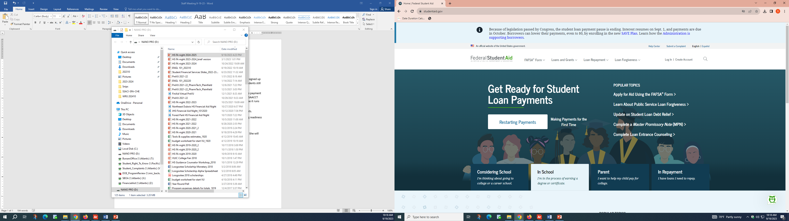
studentaid.gov
Step 1: Create FSA ID
DO this as soon as you can.
Must have FSA ID 2-3 days before starting FAFSA.

Slide 10
FSA ID
Student & at least 1 parent each need an FSA ID.
Each requires a unique email.
  Students should NOT use high school email.
Social security number (SSN) is a data point.
  Parents without SSN will be asked credit bureau questions.
  Do NOT enter ITIN.
Username is not case sensitive
Password IS case sensitive.
  Cannot include your name, SSN, date of birth.
Verify your email address and mobile phone #. Record back-up code.

Slide 11
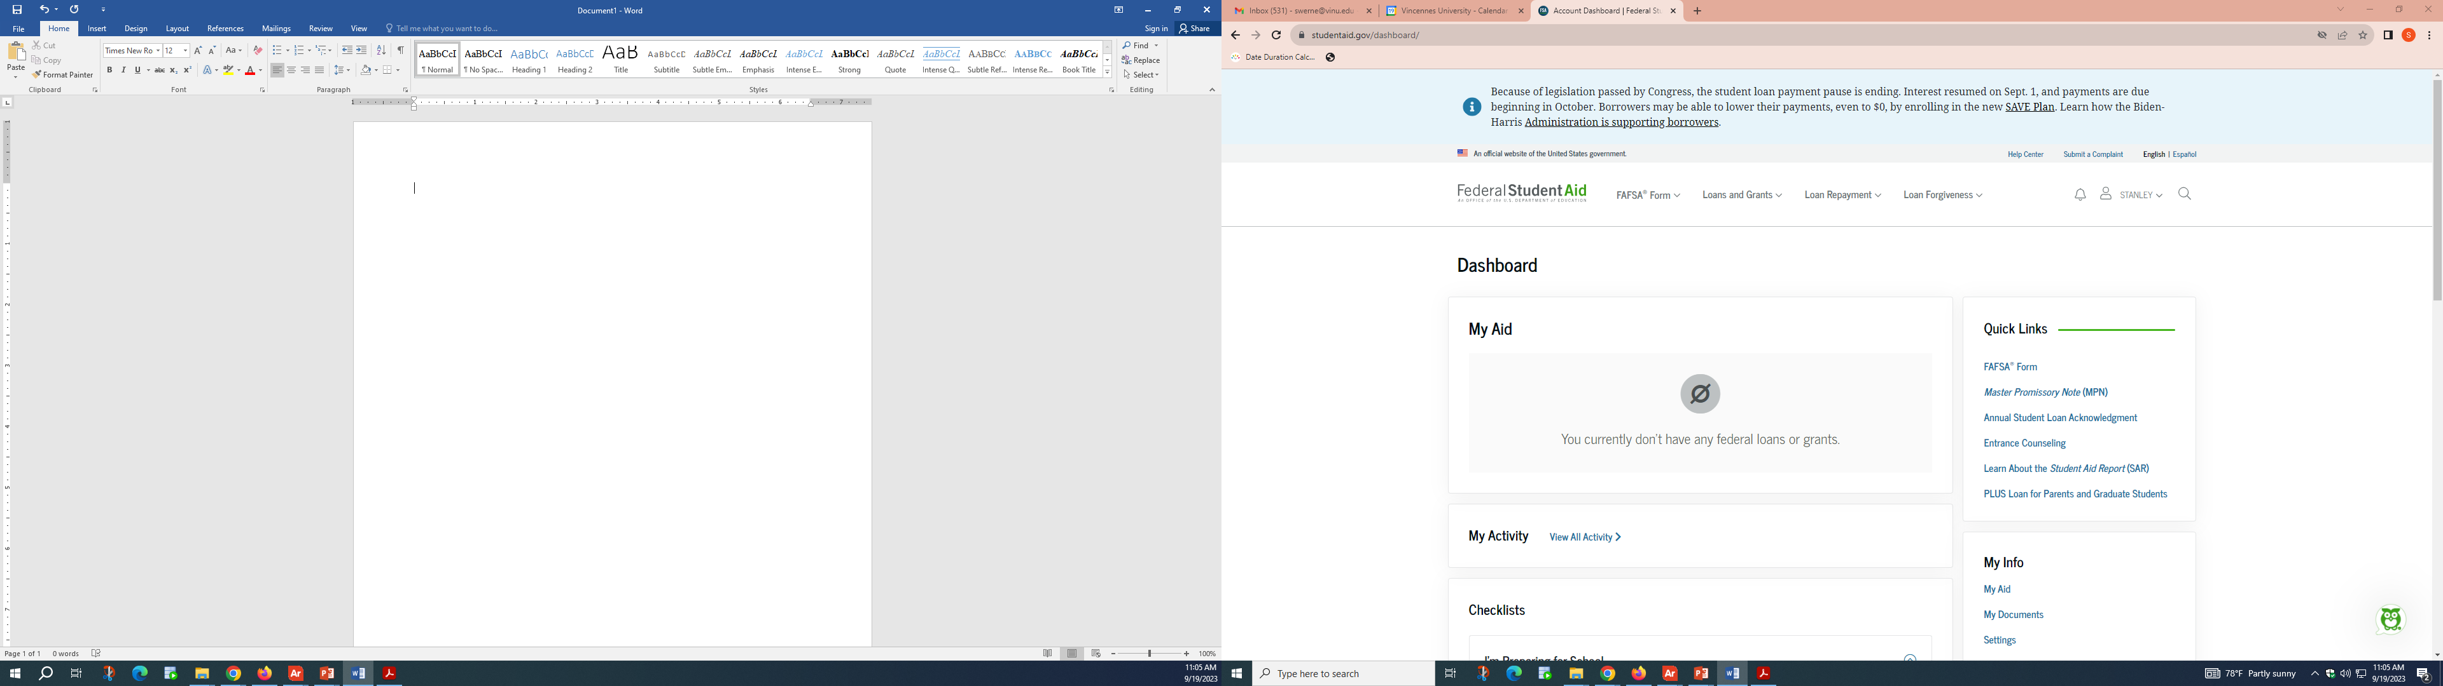
Click on a “FAFSA Form” link

Slide 12
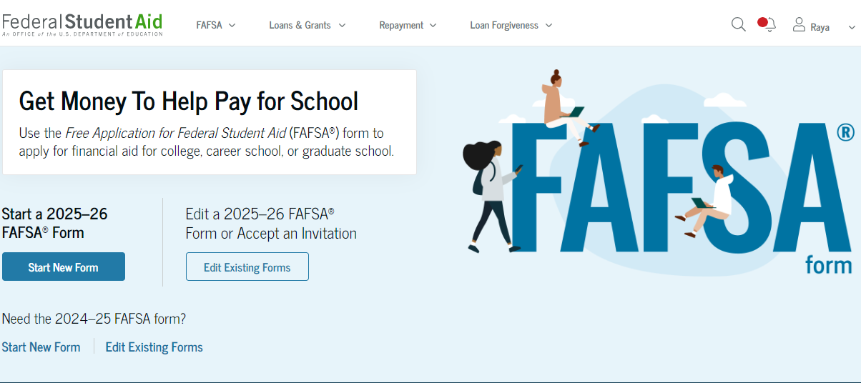
“Start New Form”

Slide 13
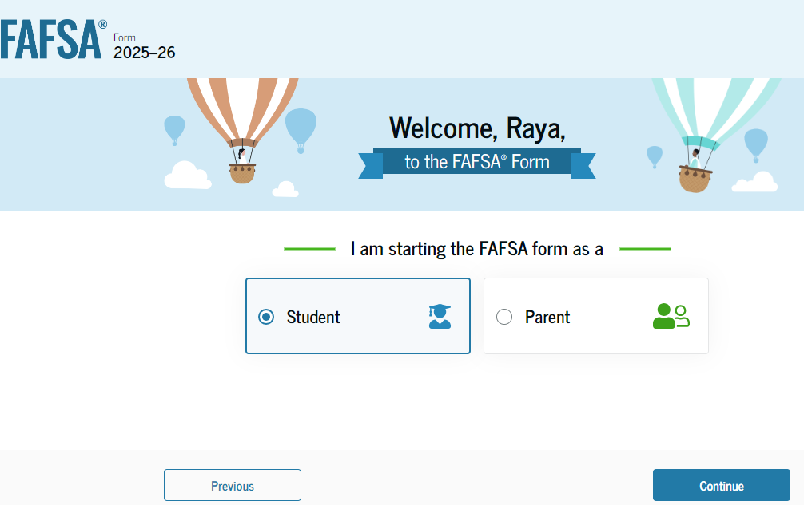
Each person who provides data to the FAFSA is a “contributor” of information. Each must provide consent.
Student or parent can enter information for the other person, but NOT recommended due to consent requirement.

Slide 14
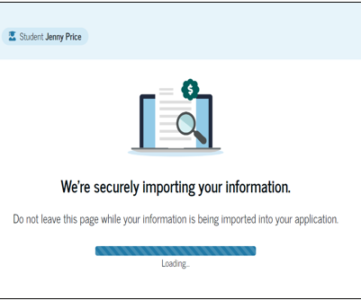
After consent is given, this screen appears. Pay attention.
Do not leave this page until import is complete.

Slide 15
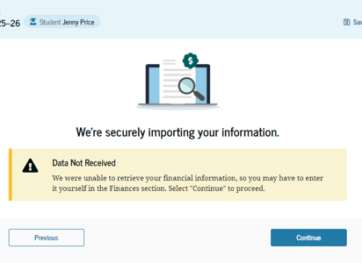
If you didn’t file a 2023 tax return or 2023 filing status is different than FAFSA marital status.
Click “Continue” and manually fill in information.
DO NOT manually enter data unless asked!

Slide 16
Student’s Personal Circumstances
Answer of “No” to all = “Dependent” student and other contributors of information are needed.
Married?
  College plans & grade level for 2025-26?
Veteran/active duty?
Supports children or other dependents?
Orphan, ward of the court, or foster care?
Emancipated minor?
Legal guardianship?
Unaccompanied or homeless youth?

Slide 17
Student’s Unusual Circumstances
Do unusual circumstances prevent contacting parent(s) or does contacting parent(s) pose a risk to the student?
“Yes” to this question = Student is provisionally “independent.” Colleges will notify student of their process for confirmation.

Slide 18
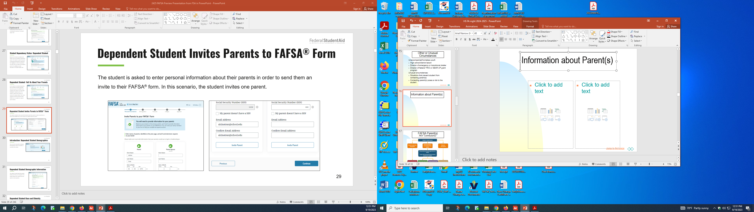
Student invites parent contributor(s)
Student provides name, DOB, mailing address, & email address of parent.

Slide 19
Student invites parent contributor(s)
At least one parent must be invited. Answers by that parent determine if another contributor is needed.
The invitation is sent via email with a link to the log in for parent’s FSA ID so they can do their section of the student’s FAFSA.
Email provides student name.
  Confirms that providing information does NOT make the contributor financially responsible.
  Notes student is not eligible for federal student aid without the contributor’s consent & information.

Slide 20
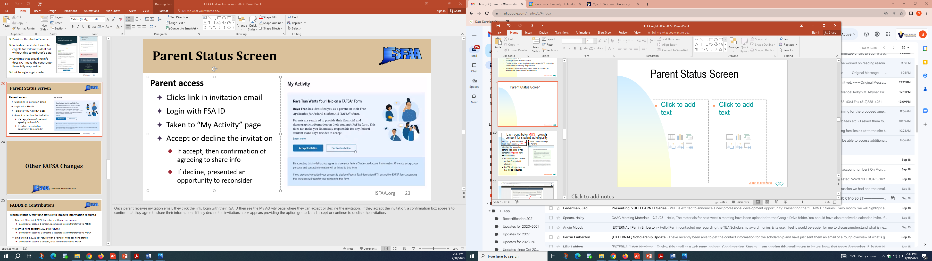
Parent Status Screen

Slide 21
FAFSA Parent(s) aka “Contributor(s)”
Biological or adoptive parents
Married or unmarried living together
Divorced, separated or unmarried and not living together
Widowed & not remarried
Who provided more financial support prior 12 months?
If equal, parent with greater income & assets in past 12 months.
Both parents on FAFSA
If parent single, only 1 on FAFSA
Remarried: step-parent also on FAFSA
Only parent on FAFSA

Slide 22
Which parents need
FSA ID?
Parents still married who filed 2023 IRS as married filing jointly: only 1 parent needs FSA ID & provides consent.
Parents who filed 2023 IRS as married filing separately: BOTH contributors to FAFSA. Both need FSA ID.
Parent now divorced/separated who filed 2023 IRS married filing jointly: Needs FSA ID. Provide consent but will manually enter own share of income & tax data.
Parent who remarries after filing 2023 tax return: Stepparent is also a contributor. Both need FSA ID.
FAFSA available for 45 days between each contributor.
Last person to contribute information submits FAFSA.

Slide 23
Parent Information
Current marital status
State of legal residence
2023 income and tax via FADDX or manually
  Receive certain federal benefits?
  Family size correct on 2023 tax return?
  Assets = Cash, savings, checking. Net worth of business / farm / investments. Child support received.
(Not retirement accounts or value of family home.)
DO NOT manually enter data unless prompted.

Slide 24
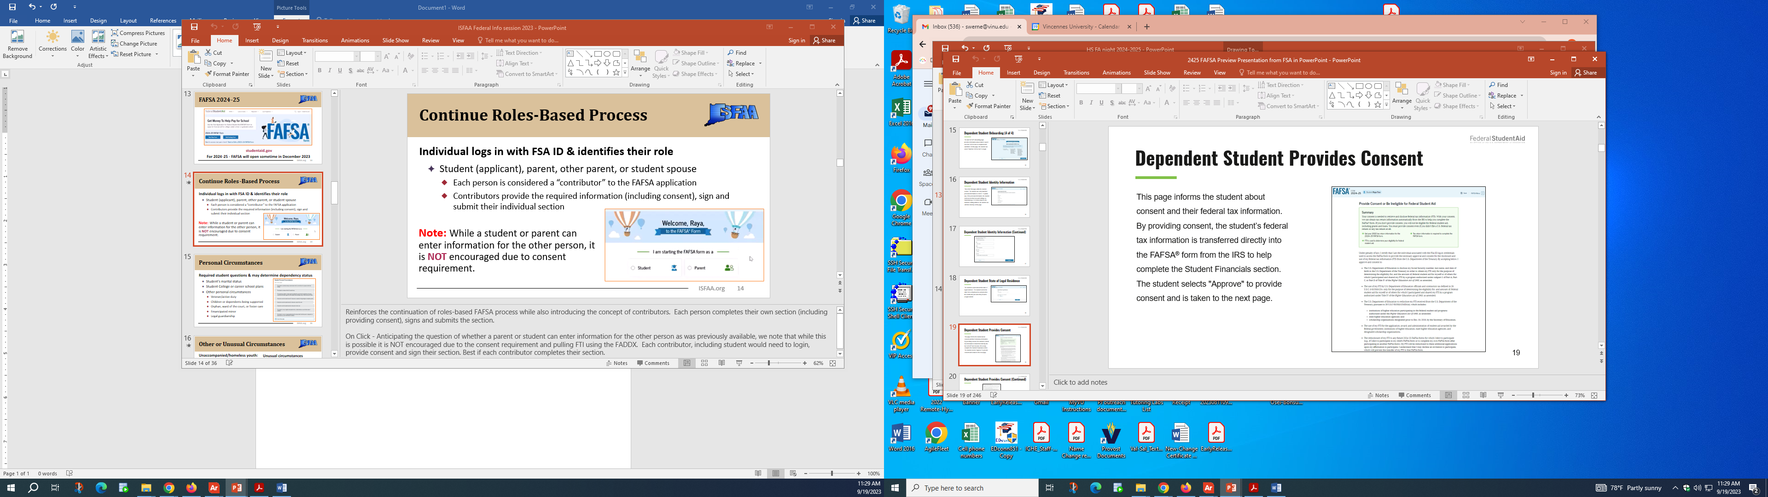
Each contributor MUST provide consent for student aid eligibility.
Future Act Direct Data Exchange (FADDX)
IRS data direct to US Dept. of Education
Whether the student or parents filed taxes or not, consent is required from each contributor.
NO consent = NO federal or state financial aid eligibility.
FAFSA will reject and no SAI will be calculated.

Slide 25
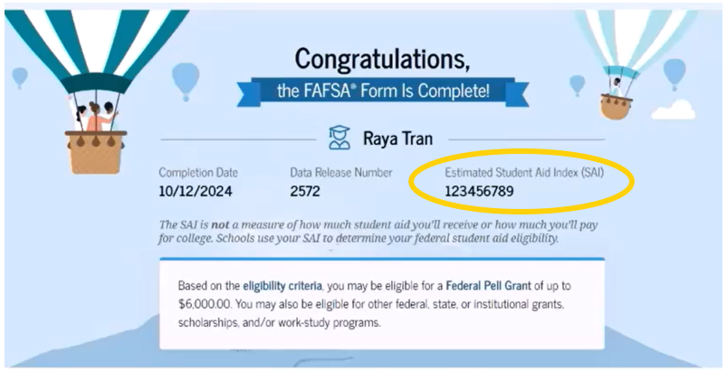
FAFSA is complete!
Student receives email confirmation!
Check that Estimated Student Aid Index is not blank. If it is, something has gone wrong.
Read FAFSA comments or contact financial aid office.

Slide 26
FAFSA filed. Then what?
One of three results at college’s end:
SAI without verification
OR
FAFSA reject/no SAI: major error
OR
FAFSA processing center identifies student for verification.
  Submit documentation as required by school.

Slide 27
But my tax return is misleading because…. What can I do?
Ask at school to request consideration of special circumstances.
Submit verification and other supporting documentation as requested.
Financial aid officers can make professional judgments.
Maybe grant or subsidized loan eligibility can result.

Slide 28
Other Sources of Aid
Check in.gov/che for special state aid
  Child of deceased/disabled veterans/public service officers
  Grants & scholarships for education majors
  National Guard tuition remission
Check your community foundation website.
Check if parent/student employers offer scholarships.

Slide 29
Other Sources of Aid – cont.
Register on a free search site like fastweb.com.
  Consider setting up a separate scholarship email.
Google websites associated with your major.
  National retail stores
  Professional associations
Private education loan with parent co-signer.
Research: INvestED Marketplace

Slide 30
Help is available
Don’t pay a fee to file the Free Application for Federal Student Aid.
Contact any financial aid office for questions.
  College Goal Sunday:
  Feb. 23, 2025
  VU or VUJ, 2:00-4:00

Slide 31

Good Luck!

Slide 32


Slide 33
Contact information for questions:
Do not worry about where your student is going to go to college. I’ll help in whatever way I can.
Stan Werne
Office: 812-888-6999
Leave message with your name & number if I can’t pick up.
Email: swerne@vinu.edu
Now working out of VUJasper office.

