Slide 1


PHARR-SAN JUAN-ALAMO INDEPENDENT SCHOOL DISTRICT
Cesar Chavez Elementary School
Campus Improvement Plan
2024-2025
Board Approved:

Slide 2

Cesar Chavez Elementary School
Vision
Cesar Chavez Elementary will provide all students with a quality education that teaches students responsibility, builds character education, promotes global awareness, and embraces cultural diversity.
Mission
As a Cesar Chavez Elementary School Community, we will empower students to become self-disciplined biliterate problem solvers and critical thinkers with a heightened social-emotional awareness. This will be achieved by working collaboratively, setting common goals, and high expectations in a safe student-centered environment.
2020 & 2022 ESEA Distinguished School
2018 National Blue Ribbon School
“A” Rated Campus

Slide 3

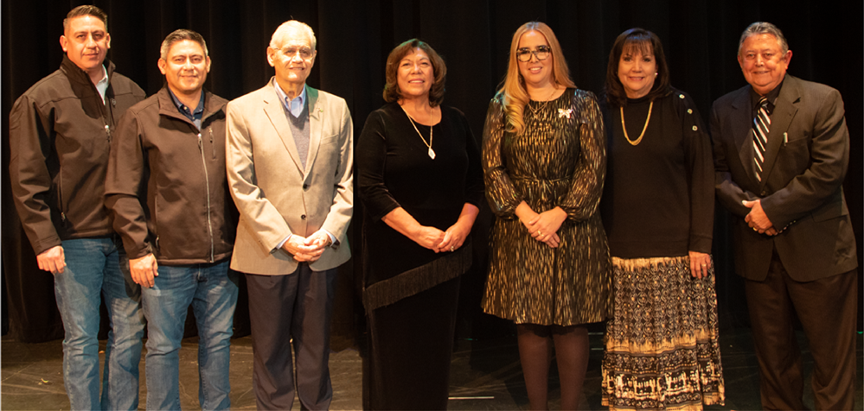
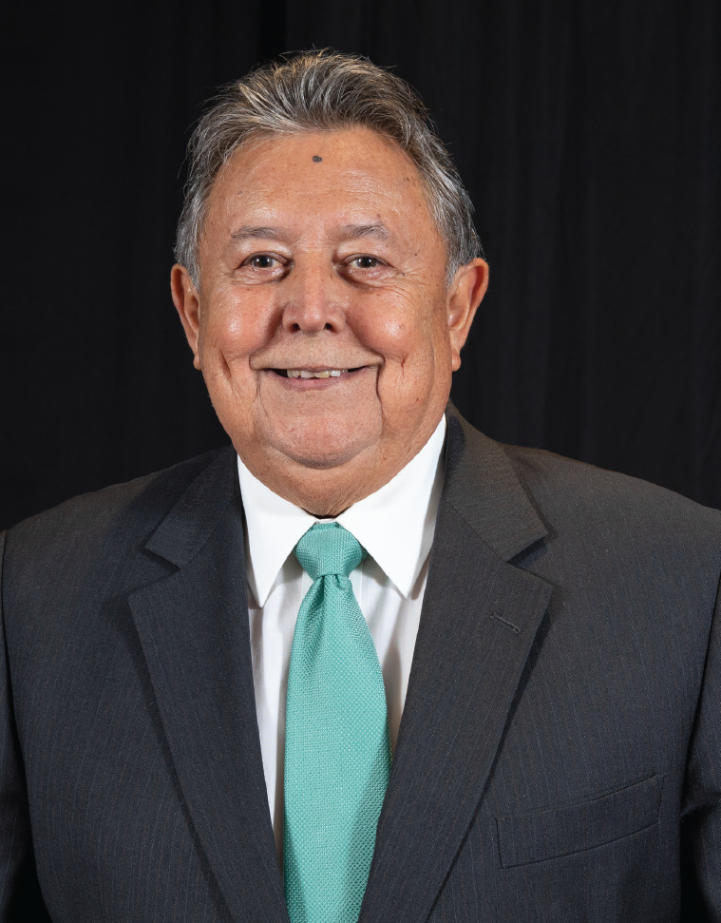

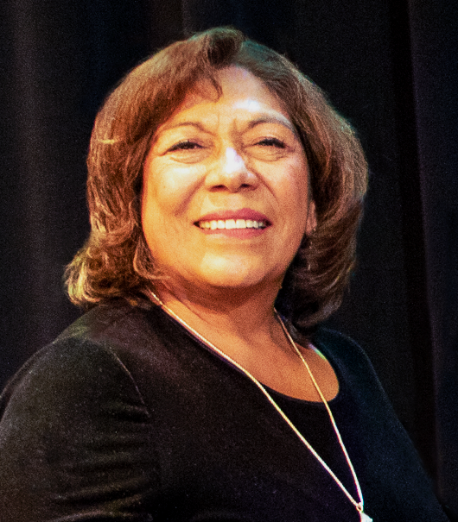
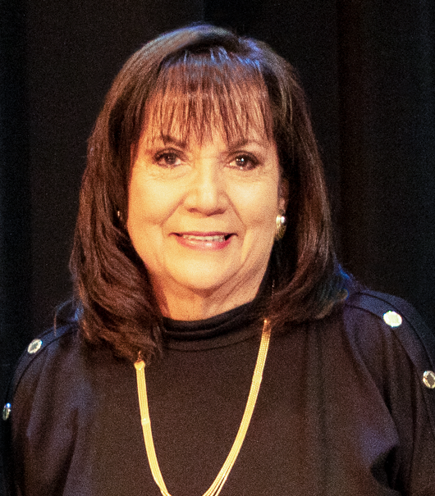
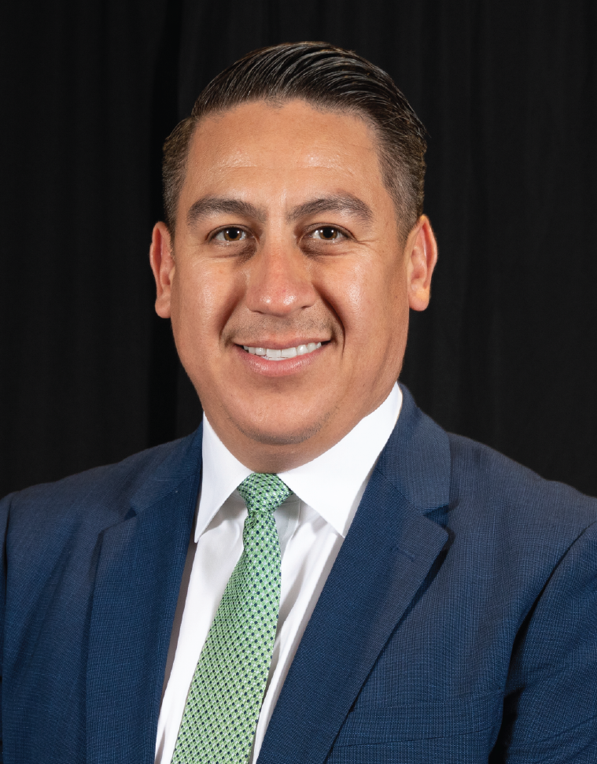
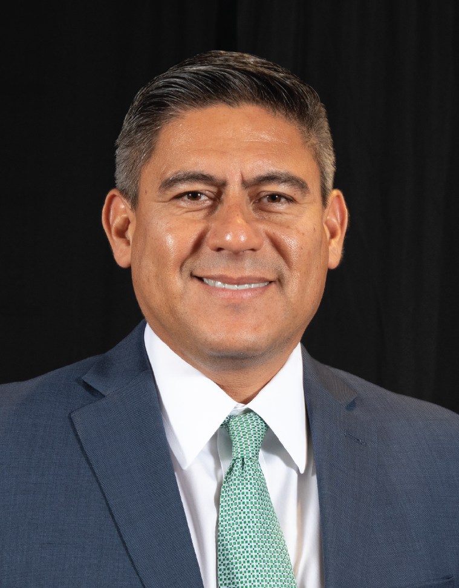

PHARR-SAN JUAN-ALAMO INDEPENDENT SCHOOL DISTRICT
2024-2025 School Board Members
Member
Secretary
Vice-President
Member
Member
President

Slide 4
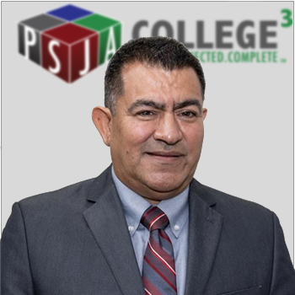
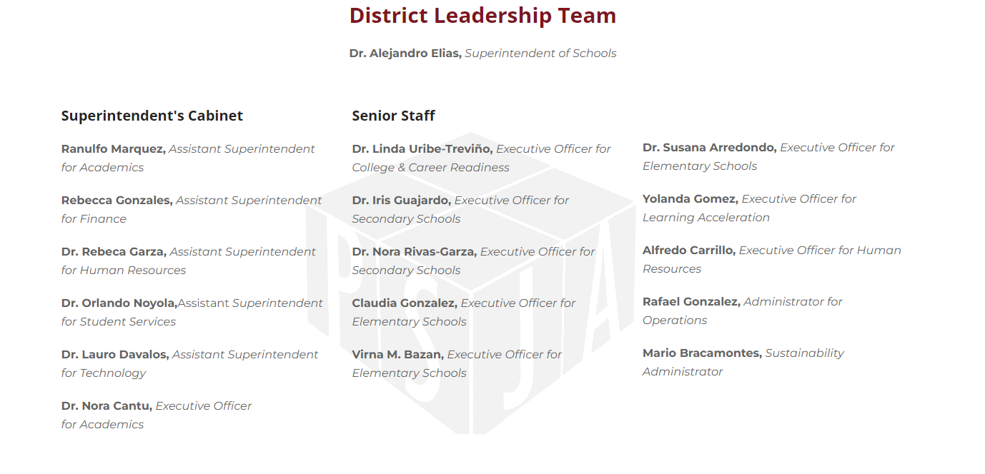
PHARR-SAN JUAN-ALAMO INDEPENDENT SCHOOL DISTRICT
2024-2025 Superintendent Cabinet and Senior Staff
Dr. Alejandro Elias
Superintendent Of Schools

Slide 5
PSJA ISD Mission Statement
PHARR-SAN JUAN-ALAMO INDEPENDENT SCHOOL DISTRICT
As educational leaders, the PSJA team is engaged and empowered to connect all students with innovative instruction, outstanding facilities, technology, skills, and social-emotional support while prioritizing health and safety for all-from early childhood through their chosen career.
As one PSJA family, we build on our legacy of academic excellence, renowned college and career readiness, biliteracy and extracurricular programs, and our multicultural heritage to ensure every student has the experiences and resources necessary to achieve the highest levels of success.

Slide 6
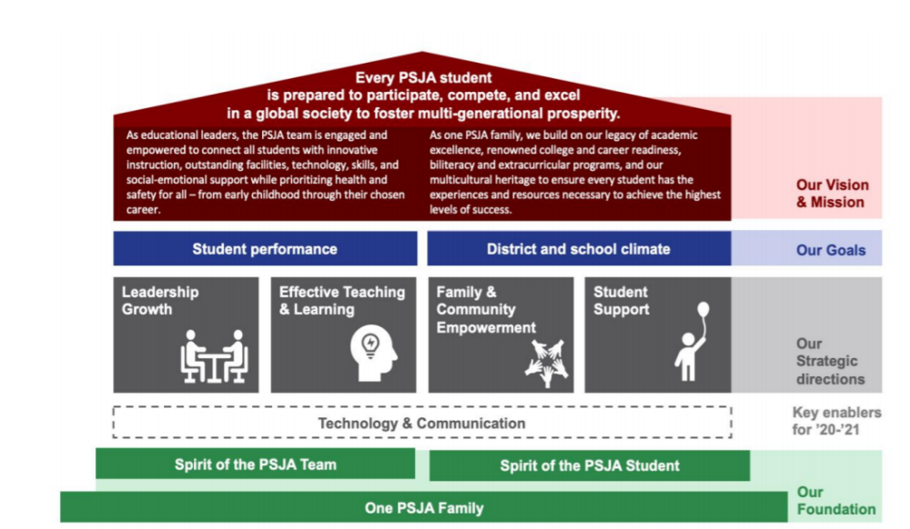
PHARR-SAN JUAN-ALAMO INDEPENDENT SCHOOL DISTRICT

Slide 7


Campus SBDM Committee
Principal, Erika G. Reyes
Asst. Principal, Sandra Gutierrez
Collaborative Leader, Ruby Lopez/ Reading Coach, Erica Estrada
Lead Teachers:
C. Keefer, P. Ortiz, M. Valls, O.Aldana, L.Robles, P. Herrera, A. Gonzalez.
Counselor, Crystal Cervantes
Community
Carolina Llanes

Slide 8

Site-Based Decision-Making Committee
SBDM will address the following areas:
Planning
Budgeting
Curriculum
Staffing patterns
Staff development
School organization

Slide 9

Site-Based Decision-Making Committee
Operating Procedures: The SBDM serves as the key committee in the Campus Intervention Team to assist the campus principal with the development, review, and revision of the CIP. All SBDM information must be included on the campus website. The organizational structure of the school’s SBDM including subcommittees, membership, and operating procedures of the subcommittees and should include the meeting schedule for both the SBDM and subcommittees. The SBDM shall be involved in decisions in the areas of planning, budgeting, curriculum, staffing patterns, staff development, and school organization.
A list of meeting dates, committee members, agendas and minutes for each meeting must be on the campus website. The campus website homepage must include the link to the SBDM page for easy access. Campuses must post SBDM agenda and minutes to the campus website within 10 days following meeting.
Scheduled Meeting Dates: September 6, 2024, November 8, 2024, January 17, 202 May 23, 2025
Committee Roles and Responsibilities:
  Chair – prepares committee meeting agendas with the assistance of the principal, guide meetings, and encourage input from all members
  Vice-Chair – performs Chair’s duties in his/her absence; serves as chair of the Evaluation and Modification Committee
  Scribe/Recorder – prepare and maintain minutes of committee meetings, committee membership roster and by-laws
  Facilitator/Timekeeper – monitors committees' energy and interaction, keep committee on track, and ensures activities are completed in a timely manner

Slide 10

Site-Based Decision-Making Committee
Procedures and processes for addressing SBDM action items and decision making:
1. Announcement of SBDM meeting announced to staff 2 weeks before the meeting.
2. Committee representative submits a request to SBDM chairperson.
3. One week before meeting SBDM meeting, the chairperson meets with the campus administration to
discuss topics.
4. Selection of topics to be covered will be determined by the administration and SBDM chairperson.
5. If a topic is not going to be addressed, SBDM chairperson and administration will provide further information for not taking
the topic to SBDM. Topic may be resolved via conference with teacher and/or grade level team.
An outline of the method of submitting items for the agenda which indicates whether submission procedures are the same or different for school personnel, parents, and community representatives. This section should describe the method of communicating SBDM decisions to non-SBDM members, including other school staff members, parents, and community members.

Slide 11
Executive Summary
Campus Improvement Plan: School Year 2024-2025
Campus Name: Cesar Chavez Elementary
School Overview:
Demographics Summary: Cesar Chavez Elementary is (CCE) is located 7 miles north of the Mexican border. As a suburban Title 1 school with a large Hispanic population, CCE students and families face many economic challenges. Many in the community are economically disadvantaged, live below the poverty line, and reside in subsidized housing. With a familial atmosphere, it is the goal of CCE to make the students feel safe and protected. CCE houses both general education and a self-contained special education classroom. The campus serves 427 students ranging from PK to 5th grade. Of these students, 66.8 % have been identified as Limited English Proficient, 98.07 % have been identified as economically disadvantaged and qualify for free or reduced lunch. Also, 92 % of the students have been identified as at risk of not graduating from high school. The student population consists of 99% Hispanic and 1% reporting another ethnic background. Cesar Chavez Elementary is a 2018 National Blue-Ribbon School and 2020 & 2022 ESEA National Distinguished School awardee.
Comprehensive Needs Assessment Summary: Cesar Chavez received an overall grade “B” for the 2023-2024 school year of 88. STAAR assessment participation for 2024 consisted of 100% STAAR performance was 74, Academic growth 88 %, School Progress Raw Component Score for Relative Performance was 84 and Closing the Gaps % Indicator Academic Achievement Status is 88%.
Curriculum/ Instruction and Assessment: Cesar Chavez Elementary is a Two-Way Dual Language Campus. Students are provided content area instruction in English and Spanish by highly qualified and certified bilingual teachers. The goal of the program is for the students to become bilingual, and bicultural, and to be able to achieve a high degree of bi-literacy and academic achievement in both languages. Cesar Chavez Elementary strives for success in all areas. Students are followed through their school careers and showcased in the front of the school as Chavez alumni. The expectations are high, but the reward is great. CCE endeavors to produce 21st-century leaders who will carry their community into the future. Chavez Elementary believes in achieving success through innovation and excellence. To ensure that students are mastering the TEKS, teachers continuously reflect upon their instructional methods and interventions by collaboratively interpreting assessment data during their weekly CLC (Collaborative Learning Communities) meetings. This approach has impacted their ability to close achievement gaps, which is evident in the growth of their students. Recognizing the need to engage students in authentic reading and meaningful practice, also providing Social Emotional lessons to all our students.

Slide 12
Executive Summary
Campus Improvement Plan: School Year 2024-2025
Campus Name: Cesar Chavez Elementary
School Initiatives: Cesar Chavez’s goal is to better the instruction, deepen the learning, and increase our achievement by improving our professional development trainings and CLC’s to strengthen teachers’ expertise.
Increase student achievement by 5% - strengthening fundamental Math and Reading skills targeting focus TEKS
Increase our percentage of Closing the Gaps by 5% strengthening fundamental Math and Reading skills targeting focus
Increase TELPAS Scores increasing and monitoring Summit K12 usage reports, identifying at risk students not hitting progress indicators and by embedding Listening, Speaking, Reading, and Writing in all subjects.
Incorporate sustainability goals

Slide 13
Executive Summary
Campus Improvement Plan: School Year 2024-2025
Campus Name: Cesar Chavez Elementary
Cesar Chavez Elementary brings awareness into the Social and Emotional needs of our students, staff, and community by incorporating the five core emotional competencies:
Self-awareness — Recognizing emotions and thoughts, understanding how they influence behavior and assessing personal strengths and weaknesses.
Self-management — Regulating thoughts, emotions and behaviors. Setting goals, controlling impulses and managing stress.
Social awareness — Understanding the perspective of others, showing empathy for diverse groups of people and finding support through family, school and community relationships.
Relationship skills — Communicating, cooperating, resisting negative pressure and offering help. Building and maintaining healthy relationships.
Responsible decision-making —Making ethical and respectful choices about personal behavior and relationships and evaluating the consequences of decisions.
Providing SEL guidance lessons to our students
Incorporating SEL activities campus wide for students and staff
Individual sessions with student focus groups

Slide 14
Executive Summary
Campus Improvement Plan: School Year 2024-2025
Campus Name: Cesar Chavez Elementary
Cesar Chavez’s created a culture of literacy. Creating a literacy culture where children and even family members, are engaged in literacy experiences not just during school hours, but after school. Develop a collaborative, community building approach to literacy, incorporating social, cultural, and family interests into activities.
Campus environment with students writing and other creations related to books.
Literacy related events (literacy nights)
Authors visits
Enhance library with an emphasis on diverse and culturally relevant materials.
Cesar Chavez’s involve parents in their children’s academic success by establishing a positive partnership.
Parent engagement activities, donuts with dudes, muffins with mom, etc.
Super Star student rally
Curriculum nights
Award assemblies
Student performances

Slide 15
Executive Summary
Campus Improvement Plan: School Year 2024-2025
Campus Name: Cesar Chavez Elementary
Names and grade level of highly effective teachers
Andrea Gonzalez, 2nd grade
Norma Garza, 3rd grade
Erica Estrada, 5th grade
Abel Martinez, 5th grade
Aminta Leal, Sped resource
Miguel Chapa, 5th grade
Monica Valls, 1st grade
Mirna Uribe, 1st grade
Name and Type of Trainings New Teachers have participated in to support their developmental process
New teacher institute
Mentoring cycles
Curriculum development trainings
Bilingual trainings
TTESS trainings
Campus procedures
New Teacher sUmmary:
New Teachers (0-2)
Names of teachers new (0-2) to the campus by grade level
Melissa Gonzalez, Pre-Kinder
Monica Ramirez, Pre-Kinder 3
Jessica Torres, 4th Grade
Janelie Maldonado, Music Teacher
Cindy Martinez Corrick , Special Education Teacher
Names of new teachers (0-2) to the grade level by grade level
Pre-Kinder: Melissa Gonzalez
Kinder: Ariana Davila and A. Arriaga
1st grade: Aylin Quintanilla
2nd grade: Olga Aldana
3rd grade: Lesly Robles and Patricia Ortiz
4th grade: Brenda Jerez
5th grade: Andrea Gonzalez

Slide 16
Executive Summary
Campus Improvement Plan: School Year 2024-2025
Campus Name: Cesar Chavez Elementary
PERFORMANCE INDEX REPORT:
PERFORMANCE TARGETS
Domain | Domain Score Earned /Target Score |  |  |  |  | Root Cause(s) (if index missed)
 | 2019 | 2021 2022 |  | 2023 | 2024
Domain 1 | 61 | 21 | 49 | 57 | 47 | Professional development training geared to integrating technology with our instruction Student attendance Student reading below grade level (foundational skills) Student Math competencies below grade level
Domain 2 | 92 | N/A | 96 | 91 | 88 | Not all students met growth
Domain 3 | 100 | N/A | 96 | 94 | 88 | TELPAS composite score ( minimal growth)
Target Area | Plan of Action
Areas of Needed Improvement with Regards to Special Populations: Special Education 18.5% population and Emergent Bilingual students 67% of population. | Align student goals and objectives outlined in IEP with TEKS being assessed on STAAR, STAAR Online and STAAR-Alt 2. Special Education Staff will be included in all Professional Development (PD) provided by the campus/district in the areas that are to be addressed by individual students.
Areas to Improve our MASTERS performance and address Giftedness | Improve our master students in Reading, Math, and Science by 10 % by providing differentiation activities through CLC’s. Teachers will be able to apply within the classroom, providing students with the best environment for having their academic needs met.
Obtaining Distinctions | Focusing on the instructional core and consistently monitoring and adjusting our instructional practices based on our data through CLC’s, data meetings, grade level meetings, progress monitoring, and observations.

Slide 17
Executive Summary
Campus Improvement Plan: School Year 2024-2025
Campus Name: Cesar Chavez Elementary
3-YEAR STAAR PERFORMANCE (USE 2018, 2019, 2022 & BM2 DATA TO COMPLETE THIS REPORT INCLUDING PROJECTIONS
 | Math | Reading | Science | Writing
2024 STAAR | Approaches: 76% Meets: 52% Masters: 21% | Approaches: 80% Meets: 43% Masters: 22% | Approaches: 67% Meets: 44% Masters: 15%
2023 STAAR | Approaches: 83% Meets: 64% Masters: 37% | Approaches: 83% Meets: 56% Masters: 26% | Approaches: 84% Meets: 59% Masters: 24 %
2022 STAAR Data | Approaches: 78% Meets: 49% Masters: 20% | Approaches:78% Meets: 50% Masters: 27% | Approaches: 72% Meets: 40% Masters: 13%
2019 STAAR Data | Approaches: 93% Meets: 63% Masters: 33% | Approaches: 90% Meets: 52% Masters: 27% | Approaches: 94% Meets: 78% Masters: 38% | Approaches: 87% Meets: 59% Masters: 33%
2018 STAAR Data *Baseline | Approaches: 90% Meets: 63% Masters: 32% | Approaches: 86% Meets: 52% Masters: 23% | Approaches: 94% Meets: 66% Masters: 31% | Approaches: 76% Meets: 50% Masters: 13

Slide 18
Executive Summary
Campus Improvement Plan: School Year 2024-2025
Campus Name: Cesar Chavez Elementary
Action Steps and Progress Monitoring Systems:
Providing high quality instruction
Supplemental instruction
Targeted Math and Reading intervention to all students.
Monitor usage for Imagine Math and Istation Reading
Revisit Reading intervention rotations “levels on Voyager”
Data driven Instructional practices using Lead4ward
Working within a continuous improvement framework to provide a path forward.
Use high yield instructional strategies encouraging critical thinking in teachers and students.
STAAR progress data collection
RTI, 504, and SPED data analysis reviewing accommodations and instructional practices.
Academic Need(S):
Math interventions and differentiation
Reading interventions and differentiation
Fluency and decoding
Social and emotional lessons and support
Framing of lesson plans Forde Ferrier
TTESS Training
Motivational Reading trainings
Phonics trainings
RTI framework and research-based interventions

Slide 19
Cesar Chavez Elementary
SCHOOL PROFILE
Cesar Chavez Elementary (CCE) is located 7 miles north of the Mexican border. The school was established in 1999 as the only school in the rural community of " Las Milpas." Translated from Spanish, "Las Milpas" means the cornfields. CCE opened its doors in 1999 to serve students from the local migrant community. The school was appropriately named to honor the Mexican-American labor leader Cesar E. Chavez who used non-violent methods to fight for the rights of migrant farm workers in the United States.
The campus serves 427 students ranging from PK- 5th grade. Of these students, 66.8% have been identified Limited English Proficient, and 99.8 % have been identified as economically disadvantaged and qualify for free or reduced lunch. Also, 92 % of the students have identified at risk of not graduating from high school. The student population consists of 99% Hispanic and 1% reporting another ethnic background.
Cesar Chavez Elementary strives for success in all areas. Students are followed through their school careers and showcased in front of the school as Chavez alumni. The expectations are high, but the reward is great. CCE endeavors to produce 21st-century leaders who will carry their community into the future.

Slide 20

Comprehensive Needs Assessment
Data Resources Reviewed
2023-2024 STAAR Campus Summary Report
2023-2024 Attendance
Discipline Referrals
PEIMS Demographics
Walk-through Data
Parental Involvement Data
TTESS Teacher Evaluations
Professional Development Plan
Teacher Certifications
TELPAS Scores (2019-2024)
Technology Inventories (purchases made)
STAAR (Spring 2024)
LEP progress monitoring
Special population participation and performance
Campus report card

Slide 21
Comprehensive Needs Assessment
Demographics
Demographics Summary: The campus serves 427 students ranging from PK- 5th grade. Of these students, 66.8% have been identified Limited English Proficient, and 100% have been identified as economically disadvantaged and qualify for free or reduced lunch. Also, 96 % of the students have identified at risk of not graduating from high school. The student population consists of 99% Hispanic and 1% reporting another ethnic background.
Special Education:
The following accountability sources were used to review the Special Education data by the Campus Site-Based Decision-Making Committee (SBDM): State of Texas Assessments of Academic Readiness (STAAR) results, Performance Based Monitoring Assessment System (PBMAS) and State Performance Plan (SPP) indicators to determine strengths and needs of our Special Education students. In addition, the Special Education Department was very involved in the curriculum writing and revision for grades K-5 during the summer to ensure that the general curriculum meets the needs of our special education students. Professional development is also coordinated with the curriculum and instruction department to ensure that all general education teachers are well versed in best practices that support the learning of special education students.
Needs:
Align student goals and objectives outlined in IEP with TEKS being assessed on STAAR, STAAR Online and STAAR-Alt 2.
Personnel Needs:
Campus Administrators will work closely with Human Resources (HR) to ensure the selection of highly qualified employee(s) holding valid state issued certification.
Professional Development Needs:
Special Education Staff will be included in all Professional Development (PD) provided by the campus/district in the areas that are to be addressed by individual students. The Special Education Department will work closely with the Campus and provide PD in the area of co-teaching to implement the inclusion model effectively.

Slide 22
Comprehensive Needs Assessment
Comprehensive Needs Assessment
Demographics 2023-2024
Demographics Summary Continued:
Emergent Bilingual (EB):
The following accountability sources were used to review the Bilingual Education/Dual Language (BE/DL) Department data by the SBDM Committee: State of Texas Assessments of Academic Readiness (STAAR) results, Performance Based Monitoring Assessment System (PBMAS) and TELPAS indicators to determine strengths and needs of our EL students. The BE/DL Department was very involved in the curriculum writing and revision for grades K-5 during the summer to address the needs of our EL students and align the curriculum between English and Spanish Language Arts that led to a more coherent and consistent bi-literacy program. Professional development was also coordinated with the curriculum and instruction department to ensure that all general education teachers utilize best practices that support the learning of EL students.
Needs:
As evidenced in the STAAR assessments, the results are as follow:
Reading 77%
Math 73%
Science 36%
In Reading, the achievement gap between EB and All students 2023 -2024 is -2%.
In Math, the achievement gap between EB and All students 2023 -2024 is -1%.
In Science, the achievement gap between EB and All students 2023 -2024 is -2%.

Slide 23
Comprehensive Needs Assessment
Demographics 2023-2024
Demographics Summary Continued:
Special Education
The following accountability sources were used to review the Economically Disadvantaged data by the SBDM: State of Texas Assessments of Academic Readiness (STAAR) results, and System Safeguards to determine strengths and needs of our Economically Disadvantaged Students.
Needs:
As evidenced in the STAAR assessments , the results show an achievement gap as follows:
Reading 79%
Math 74%
Science 65%
In Reading, the achievement gap between SPED and All students 2023 -2024 is -10%.
In Math, the achievement gap between SPED and All students 2023 -2024 is -7%.
In Science, the achievement gap between SPED and All students 2023 -2024 -32 %.

Slide 24
Comprehensive Needs Assessment
Comprehensive Needs Assessment
Demographics 2023-2024
Demographics Summary Continued:
Economically Disadvantaged
The following accountability sources were used to review the Economically Disadvantaged data by the SBDM: State of Texas Assessments of Academic Readiness (STAAR) results, and System Safeguards to determine strengths and needs of our Economically Disadvantaged Students.
Needs:
As evidenced in the STAAR assessments , the results show an achievement gap as follows:
Reading 79%
Math 74%
Science 65%
In Reading, the achievement gap between Eco Dis and All students 2023 – 2024 is 0%.
In Reading, the achievement gap between Eco Dis and All students 2023 – 2024 is 0%.
In Science, the achievement gap between Eco Dis and All students 2023 – 2024 0%.

Slide 25
Comprehensive Needs Assessment Continued: Goal 1-8 Summary of Findings
DOMAIN | Area Reviewed | Summary of Strengths | Summary of Needs | Root Cause | Priorities
1 | Domain 1: Effective Teaching and Learning | 2022 All Subjects Approaches: 77% Meets: 48% Masters: 22% 2023 All Subjects Approaches: % Meets: % Masters: % 2024 All Subjects Approaches: % 76 Meets: % 47 Masters: % 19 | 2019 Campus overall Domain 1 score 90%. 2022 Campus overall Domain 1 Score 77%, 2023 Campus overall Domain 1 score 86 % 2024 Campus overall | Professional development training geared to integrating technology with our instruction Student attendance Student reading below grade level (foundational skills) Student Math competencies below grade level | Improve student learning outcomes in : 4th Grade Reading and Math 3rd Grade Reading/Math 5th Grade Science/Reading 4th Grade Writing
2 | Domain 2: Student Support Student Progress Part A Student Progress Part B | Domain 2 Part A performance was higher than Part B. 2022 Part A: 96% Part B: 86% 2024 Part A: 88 Part B: 84 | Address the needs of all students in each student group. Identify the student's previous performance and set specific goals by individual's students. Goal for Part A is 90 or above Goal for Part B is 90 or above. | Teachers will continue to monitor students.. virtually or face to face Steps will be made to address the SEL of students (Social Emotional Learning) | Address the needs of identified students to meet the progress measure in 2023-24 in Reading and Mathematics.
3 | Domain 3: Family and Community Empowerment | Campus had 88% of students’ gap closed. | Goal is to perform at 100. Focus is to have SPED population perform at MEETS or above. | Continue to work on TELPAS component: Monitor the rest of groups English Language Proficiency Status 2024: Target 36% Progress rate 48% | Special population groups SPED EB’s
Campus Total | Cesar Chavez received 3 distinction designations in Top 25% Academic Growth Top 25% Closing Gaps Post Secondary readiness | Cesar Chavez Elementary MET STANDARD. Cesar Chavez Elementary went from an overall score of 90% in 2018 to a 96% in 202. | Final campus score was 88%. Goal is to have a 90% or higher for Spring 2025. Goal for 2024 to earn all 6 distinctions in core content areas . | Students will continue to work on intervention programs. Voyager Herman Method IREADY Fluency Tutoring Estrellitas Sing Spell Read and Write | Improvement in 2024-2025 STAAR Performance Raw score 47 -52

Slide 26
Summary of Findings
GOAL | Area Reviewed | Summary of Strengths | Summary of Needs | Problem & Root Cause | Priorities
5 | Family and Community Involvement | Neighborhood outreach/ARISE Communication in both English and Spanish Parental involvement Parent Center Business Partnerships Parent Advisory Committee (PAC) | Increase parent involvement Increase number of parents participating in the special programs offered by PSJA ISD Increase volunteer hours | Lack of parental participation/involvement in school. Low average of parents with high school diplomas and /or postsecondary education | Create opportunities for parents to receive postsecondary training/education (Valley Interfaith) (ARISE) Initiate parent academic conferences through DE Program
6 | Technology | Availability of technology resources for students and teachers CIT training is readily available | Need access to ipads for school Purchase covers for ipads Printer ink is limited Further New Line boards training to create presentations Need student device for 1-1 | Integration of technology in instruction and increase the use of student technology for instructional rigor | CIT/ Librarian will provide training on the implementation of technology integration ; increase on-line resources
7 | School Culture and Climate | Respect Skills Student attendance Customer Service Collaborative Learning Communities (CLC’s) | Extra planning periods to finish RTI’s/504 Consistency of essential agreements across campus. | Implement a campus – wide consistency committee to address solutions to everyday scenarios | Communicate with community Reading concerns and language . Provide a safe learning environment for students
8 | Staff Quality, Recruitment, and Retention | Highly Qualified Staff New Teacher Academy McREL Evaluation Tool Mentorship CLL, Grade Level Chair and Admin | New teachers are overwhelmed with district initiatives Not enough time throughout the day to finish everything…. | New teachers lack basic understanding of the instructional process and TEKS- Curriculum-Assessment Alignment | Schedule time for new teachers to observe and work with experienced teachers on a weekly basis

Slide 27

CAMPUS DEMOGRAPHICS 2023- 2024
 | ALL | SPED | LEP | MIGRANT | ECD | GT
Number | 427 | 39 | 272 | 5 | 427 | 13
Percent | 100 | 19.9 | 66.8 | 1.2 | 99.8 | 3.2
 | ALL | HISPANIC | ASIAN | BLACK | WHITE | AMERICAN INDIAN/ALASKAN
Number | 407 | 404 | 0 | 0 | 3 | 0
Percent | 100 | 99.3 | 0 | 0 | 0.74 | 0

Slide 28

2024-2025 Campus Achievement and Goals
3rd Grade Reading
% of Items Needed to Meet State Performance Standard | % of Students Passing State Assessment | Goal
 | 2024 | 2025
Approaches | 79% | 85%
Meets | 39% | 45%
Masters | 11% | 23%
4th Grade Reading
% of Items Needed to Meet State Performance Standard | % of Students Passing State Assessment | Goal
 | 2024 | 2025
Approaches | 81% | 90%
Meets | 44% | 60%
Masters | 21% | 30%
5th Grade Reading
% of Items Needed to Meet State Performance Standard | % of Students Passing State Assessment | Goal
 | 2024 | 2025
Approaches | 78% | 98%
Meets | 47% | 85%
Masters | 29% | 45%

Slide 29
2024-2025 Campus Achievement and Goals
3rd Grade Mathematics
% of Items Needed to Meet State Performance Standard | % of Students Passing State Assessment | Goal
 | 2024 | 2025
Approaches | 57% | 80%
Meets | 25% | 50%
Masters | 7% | 25%
4th Grade Mathematics
% of Items Needed to Meet State Performance Standard | % of Students Passing State Assessment | Goal
 | 2024 | 2025
Approaches | 79% | 85%
Meets | 58% | 60%
Masters | 23% | 27%
5th Grade Mathematics
% of Items Needed to Meet State Performance Standard | % of Students Passing State Assessment | Goal
 | 2024 | 2025
Approaches | 93% | 95%
Meets | 81% | 95%
Masters | 32% | 60%
4th Grade Mathematics District

Slide 30

2024-2025 Campus Achievement and Goals
5th Grade Science
% of Items Needed to Meet State Performance Standard | % of Students Passing State Assessment | Goal
 | 2024 | 2025
Approaches | 66% | 90%
Meets | 37% | 65%
Masters | 12% | 30%

Slide 31
THE BOARD OF EDUCATION GOALS AND PROGRESS MEASURE
Goal 1: The percent of students in grade 3 who perform at meets grade level or above on STAAR Reading will increase from 46% to 55% by June 2025.
Goal Progress Measure 1.1: The percent of grade 3 students who reach above the 60th percentile by End of Year Assessment will increase from 25% to 34% by 2025.
Goal Progress Measure 1.2: The percent of grade 2 students who reach above the 60th percentile by End of Year Assessment will increase 25% to 34% by 2025.
Goal Progress Measure 1.3: The percent of grade 1 students who reach above the 60th percentile by End of Year Assessment will increase from 23% to 32% by 2025
Goal Progress Measure 1.4: The percent of grade kindergarten students who reach above the 60th percentile by End of Year Assessment will increase 15% to 23% by 2025
Goal 2: The percent of students in grade 3 who perform at meets grade level or above on STAAR Mathematics will increase from 56% to 65% by June 2025.
Goal Progress Measure 2.1: Proficiency in grade 3 students on Imagine Math Beginning of Year Assessment will increase from 7% to 16% by 2025.
Goal Progress Measure 2.2: Proficiency in grade 2 students on Imagine Math Beginning of Year Assessment will increase from 33% to 42% by 2025.
Goal Progress Measure 2.3: Proficiency in grade 1 students on Imagine Math Beginning of the Year Assessment will increase from 11% to 19% by 2025.
Goal Progress Measure 2.4: Proficiency in grade kindergarten on Imagine Math Beginning of the Year Assessment will increase from 1% to 10% by 2025
Goal 3: The percent of students in grades 5-8 who perform at meets grade level or above on STAAR Reading will increase from 45% to 55% by June 2025.
Goal Progress Measure 3.1: The percent of students in grade 5 at meets level on STAAR Reading will increase from 53% to 60% by June 2025.
Goal Progress Measure 3.2: The percentage of students in grade 6 at meets level on STAAR Reading will increase from 26% to 30% by June 2025.
Goal Progress Measure 3.3: The percent of students in grade 7 at meets level on STAAR Reading will increase from 37% to 42% by June 2025.
Goal Progress Measure 3.4: The percent of students in grade 8 at meets level on STAAR Reading will increase from 42% to 47% by June 2025.
Goal 4: The percent of graduates who are College, Career and Military Ready will increase from 70% to 80% by June 2025.
Goal Progress Measure 4.1: The percent of graduates earning an industry-based certification will increase from 4% to 30% by June 2025.
Goal Progress Measure 4.2: The percent of graduates earning 3 college hours in ELA or Math or 9 hours in any other course will increase from 51% to 60% by June 2025.
Goal Progress Measure 4.3: The percent of graduates earning a Level I or Level II certificate will increase from 6% to 10% by June 2025.

Slide 32
PHARR-SAN JUAN-ALAMO INDEPENDENT SCHOOL DISTRICT
Goals
Goal Area 1: Effective Teaching and Learning
Goal Area 2: Student Support
Goal Area 3: Family and Community Empowerment
Goal Area 4: Leadership Growth

Slide 33

GOAL AREA PRESENTATION
Goal Area 1:
Effective Teaching and Learning

Slide 34
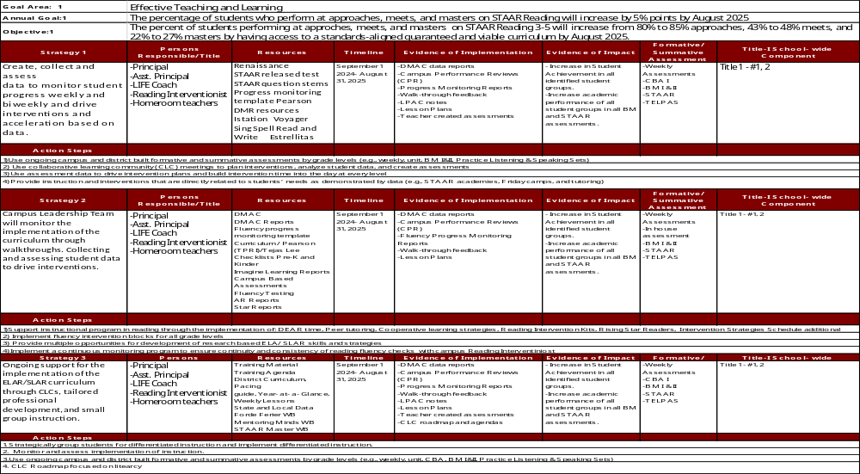
Cesar Chavez Elementary

Slide 35
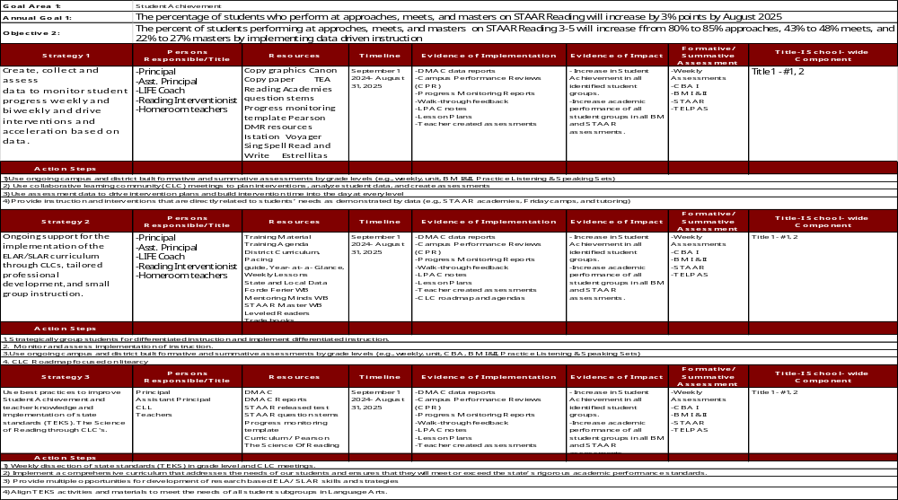
Cesar Chavez Elementary

Slide 36
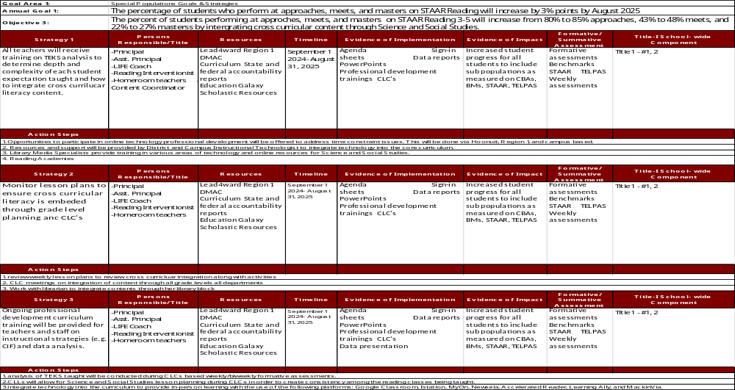

Slide 37
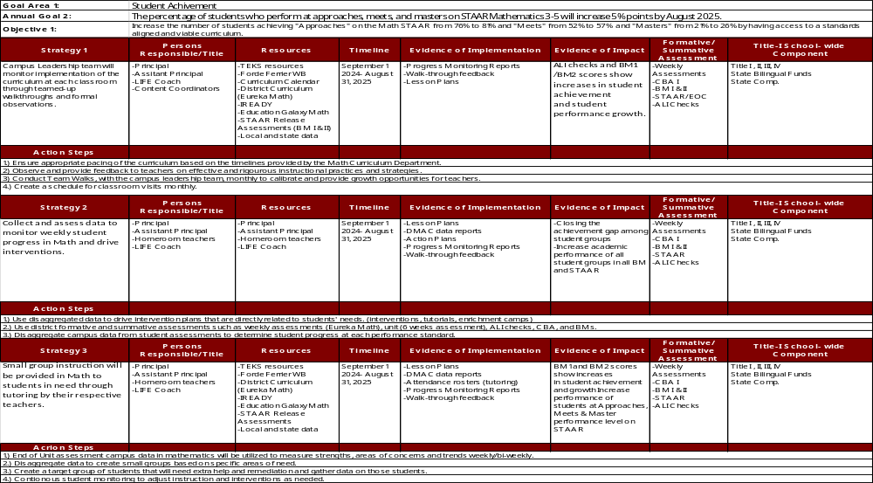

Slide 38
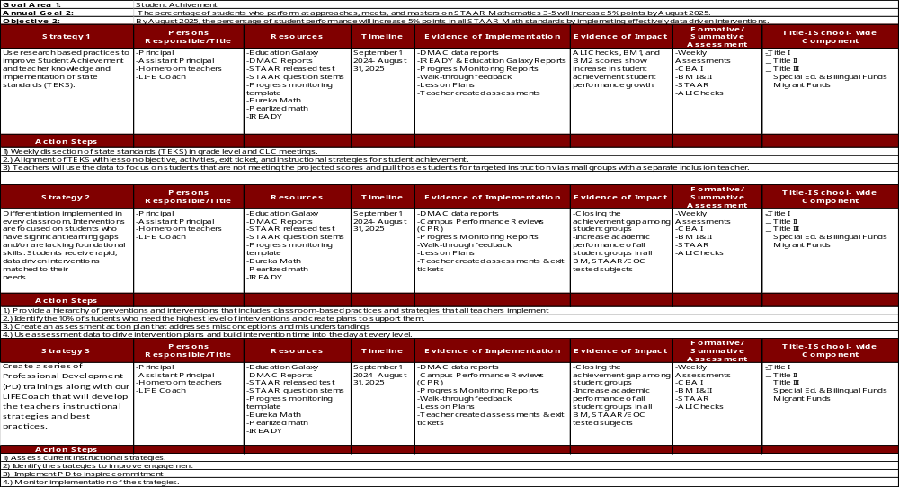

Slide 39
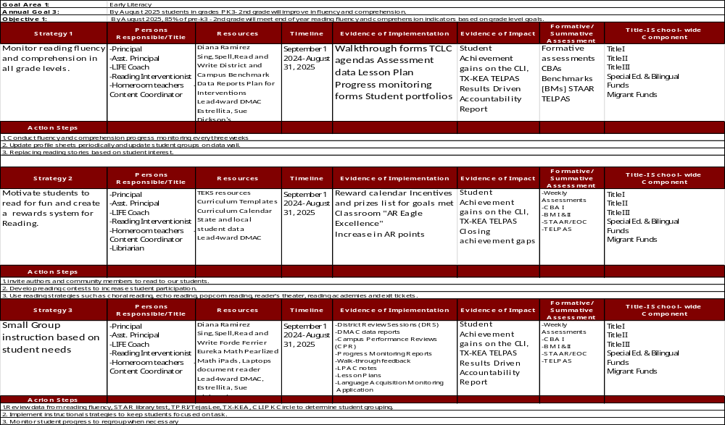

Slide 40
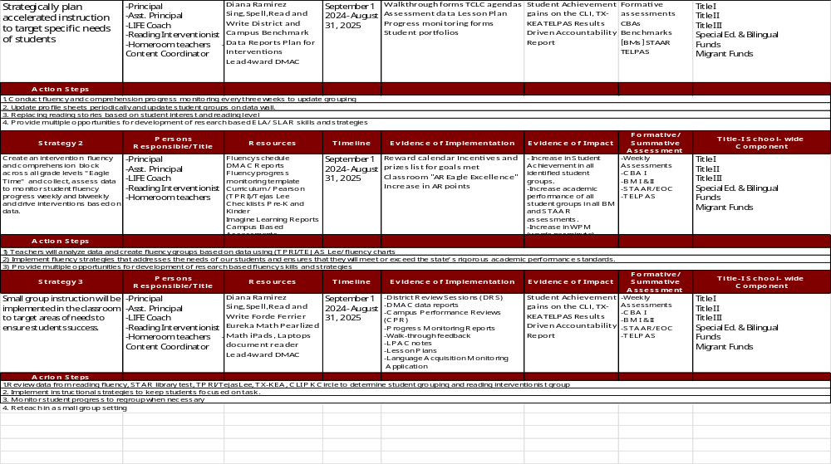

Slide 41
GOAL AREA PRESENTATION
Goal Area 2:
Student Support

Slide 42
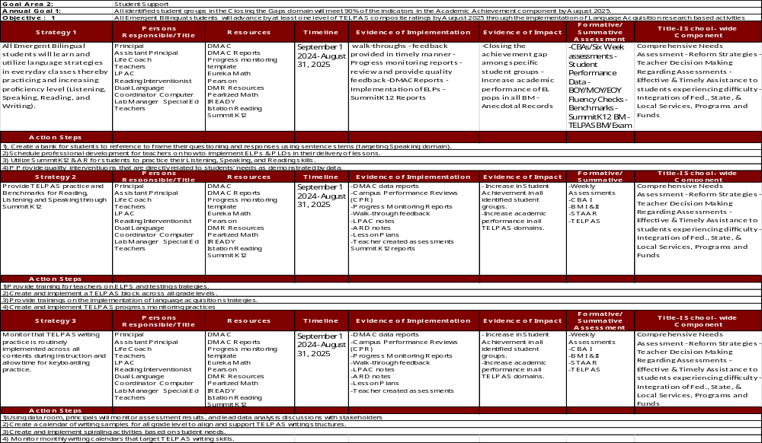

Slide 43
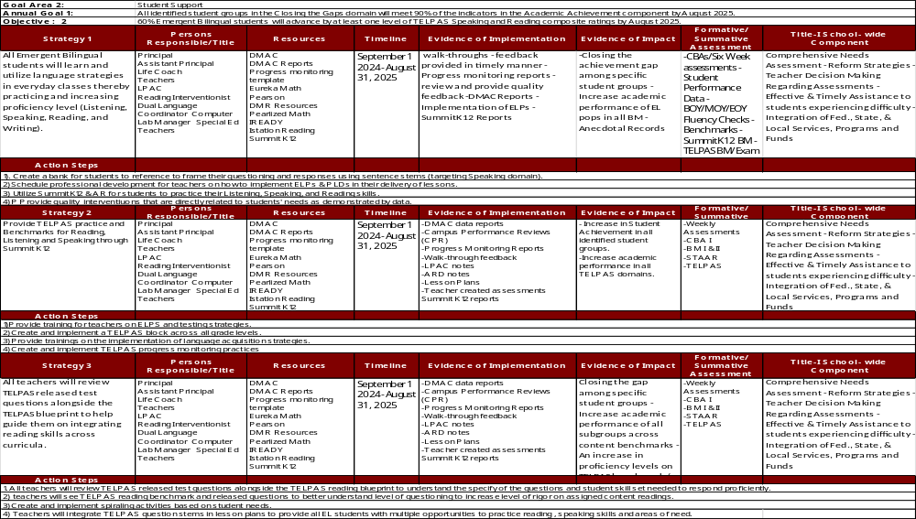

Slide 44
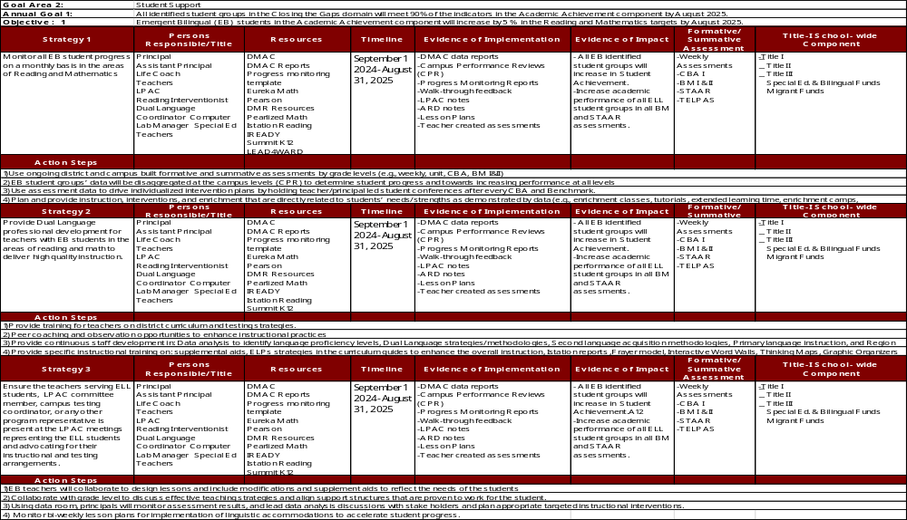

Slide 45
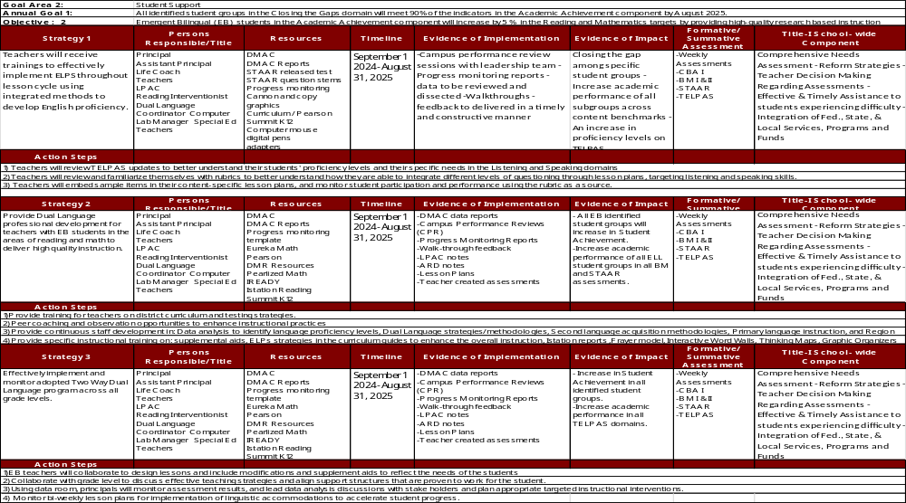

Slide 46
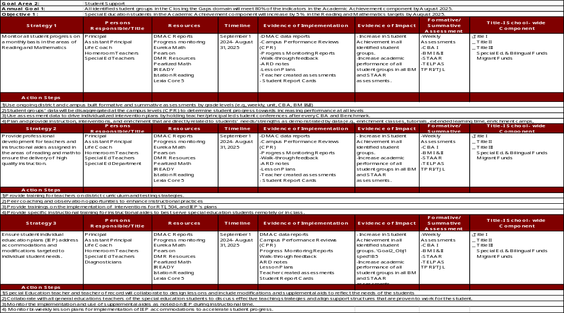

Slide 47
GOAL AREA PRESENTATION
Goal Area 3: Family & Community
Empowerment

Slide 48
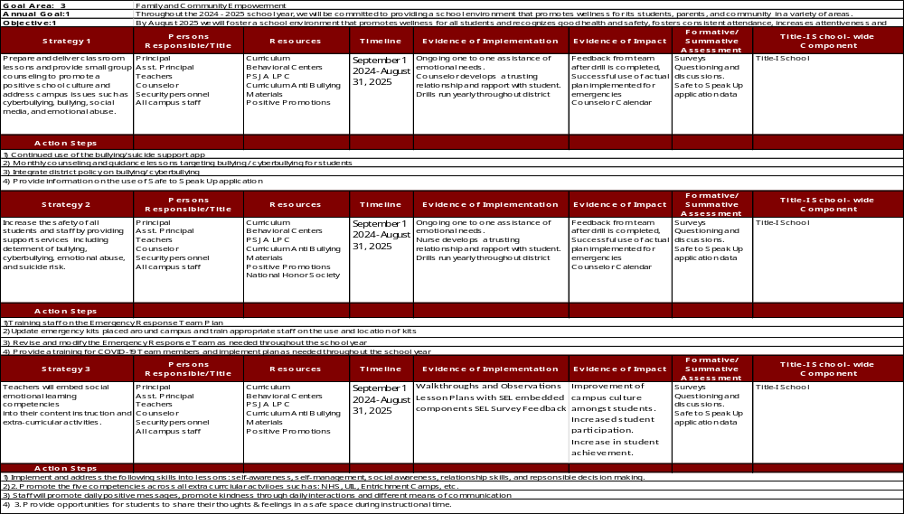

Slide 49
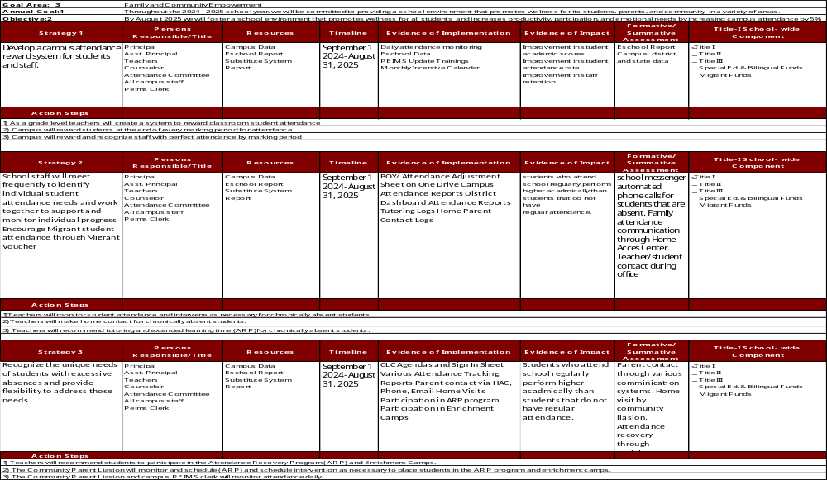

Slide 50
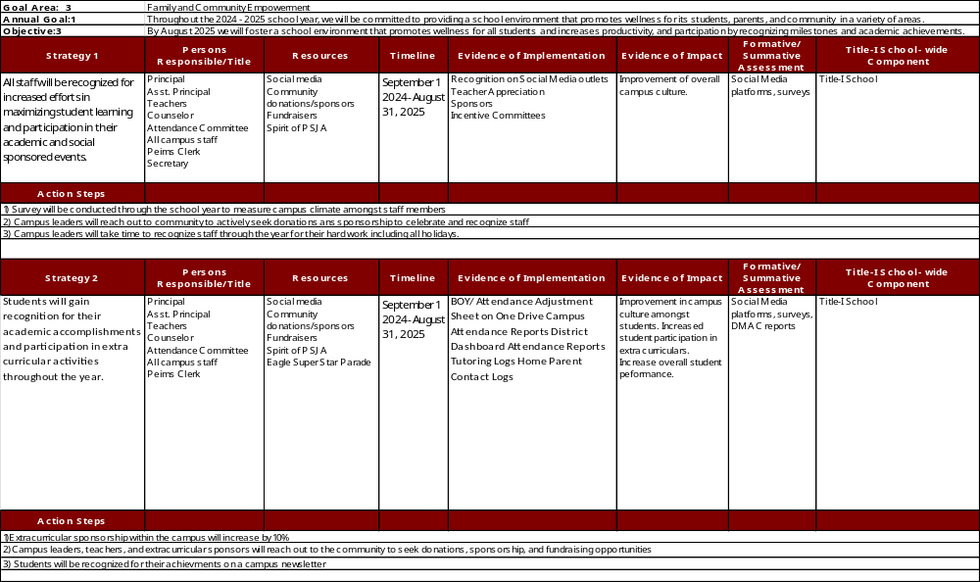

Slide 51
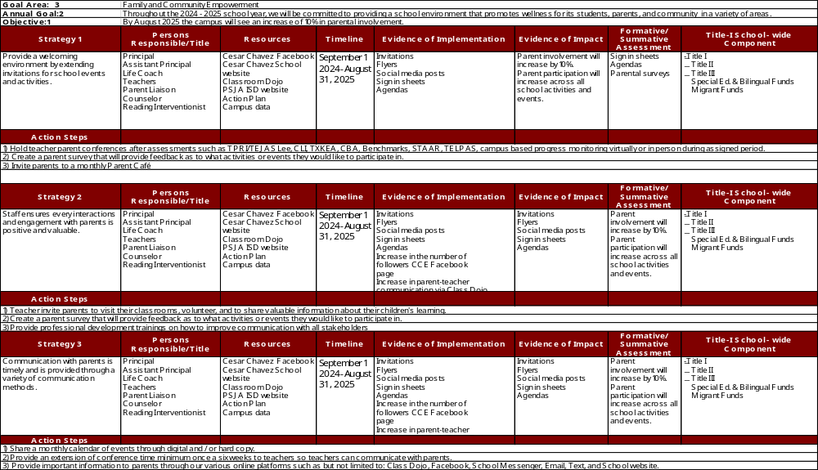

Slide 52
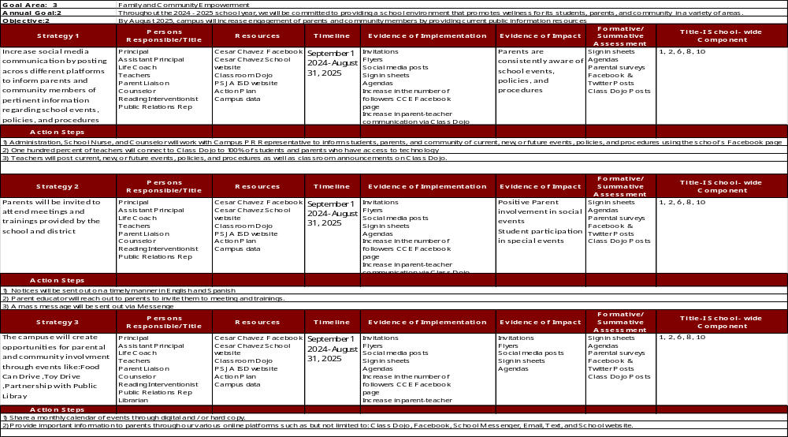

Slide 53
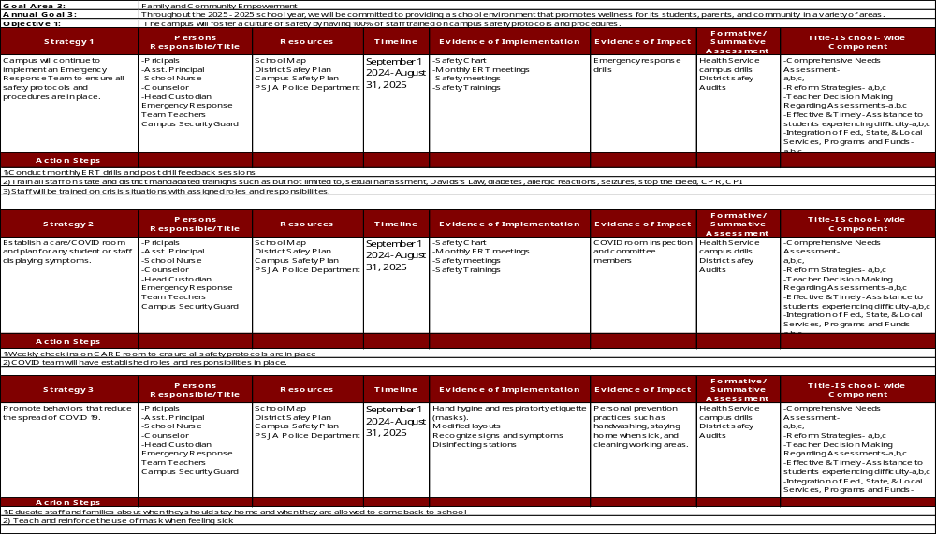

Slide 54
GOAL AREA PRESENTATION
Goal Area 4.:
Leadership Growth

Slide 55
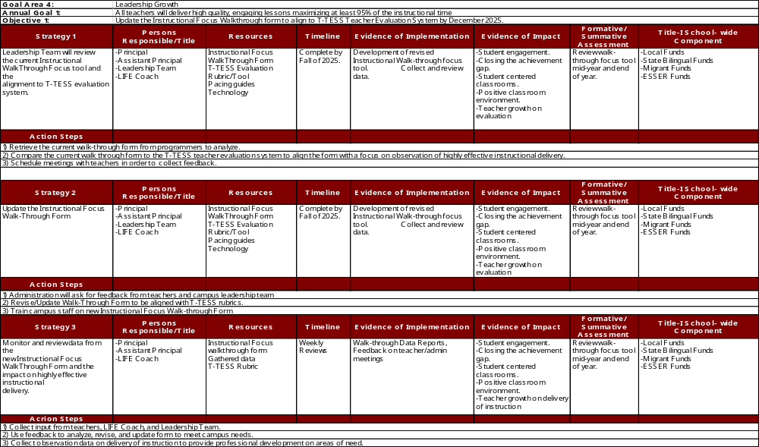

Slide 56
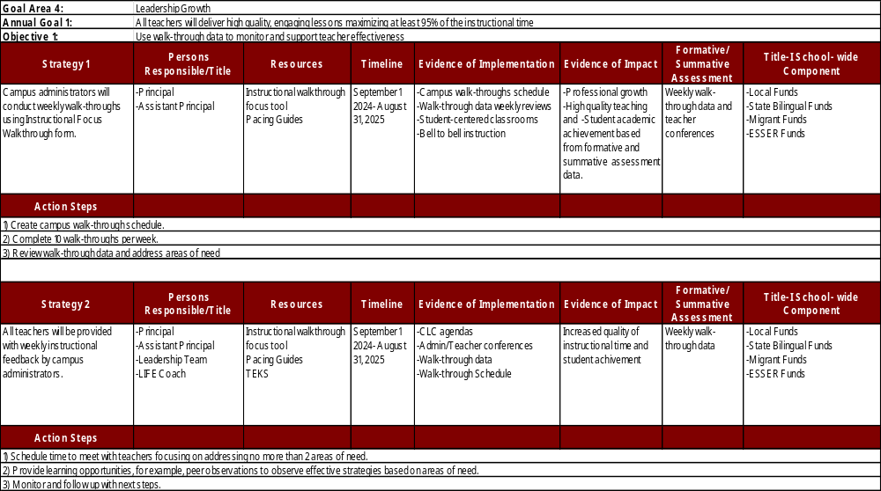

Slide 57
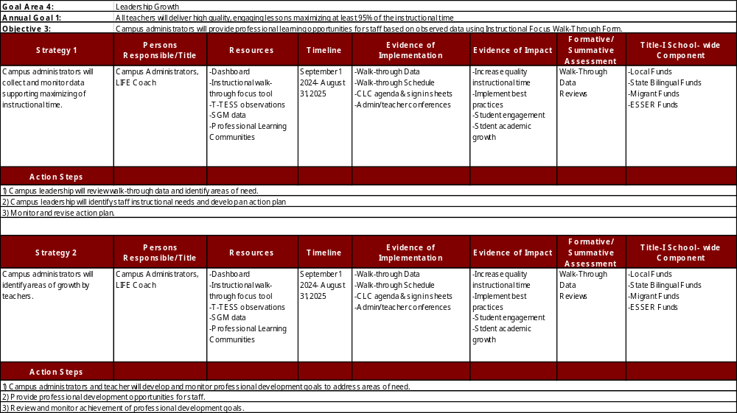

Slide 58
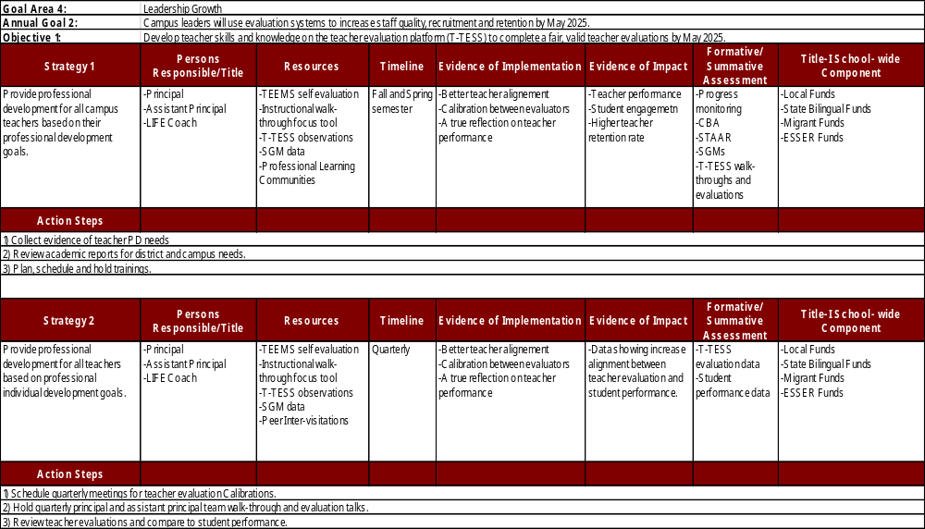

Slide 59
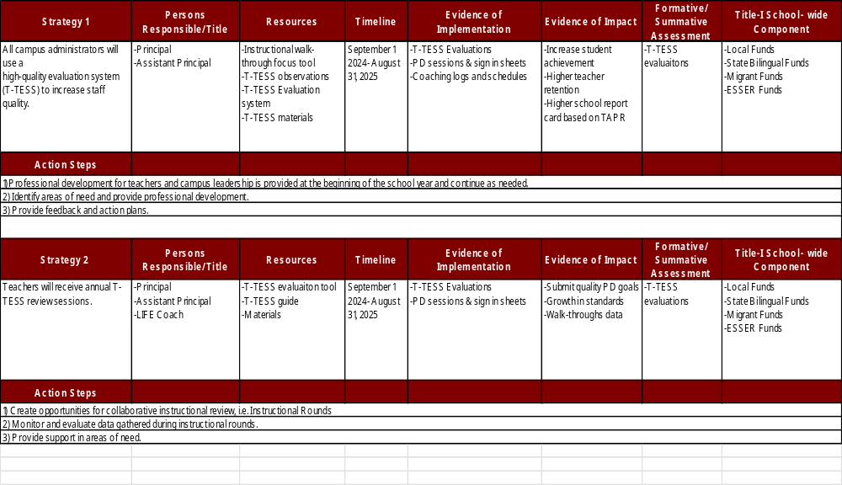

Slide 60
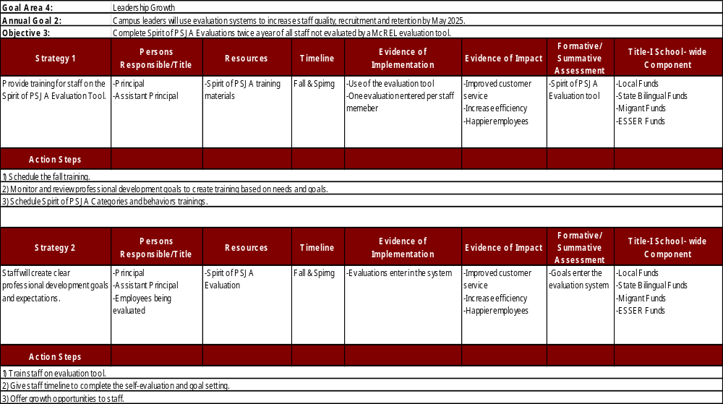

Slide 61
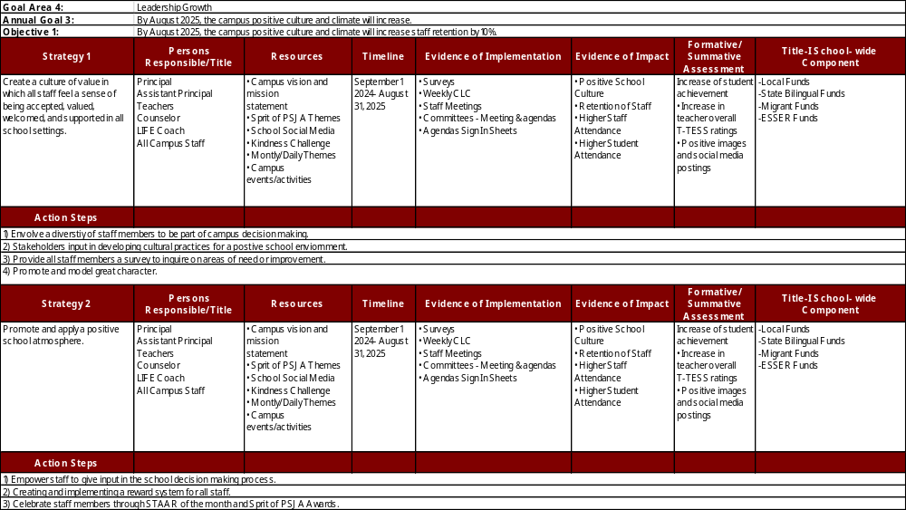

Slide 62
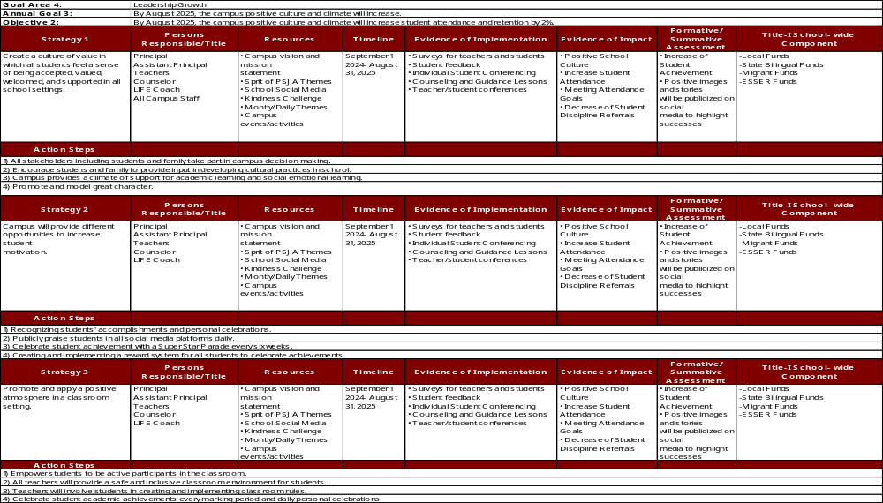

Slide 63
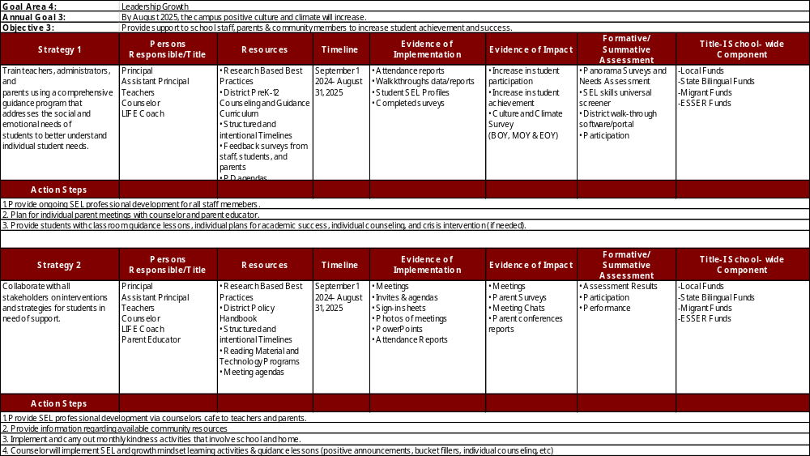

Slide 64
Cesar Chavez Elementary Professional Development Plan
EAGLES

Slide 65
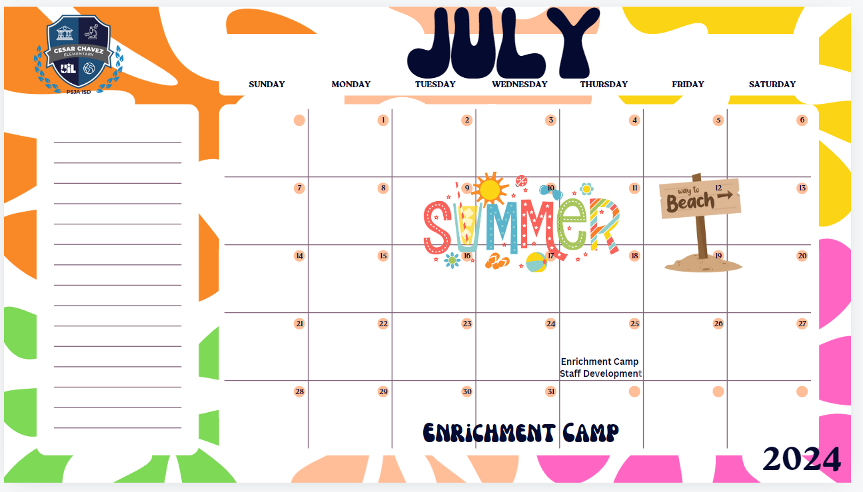

Slide 66
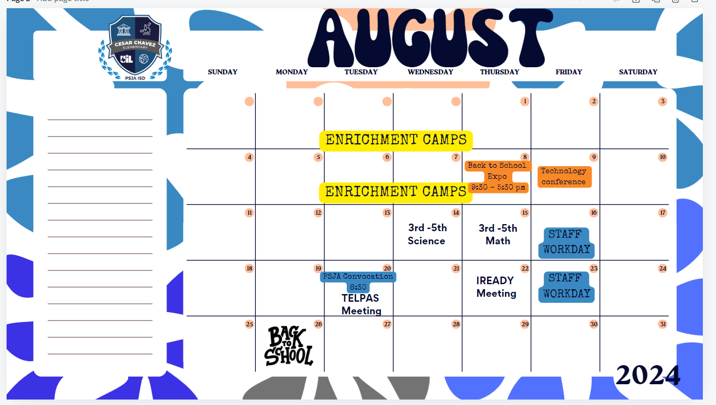

Slide 67
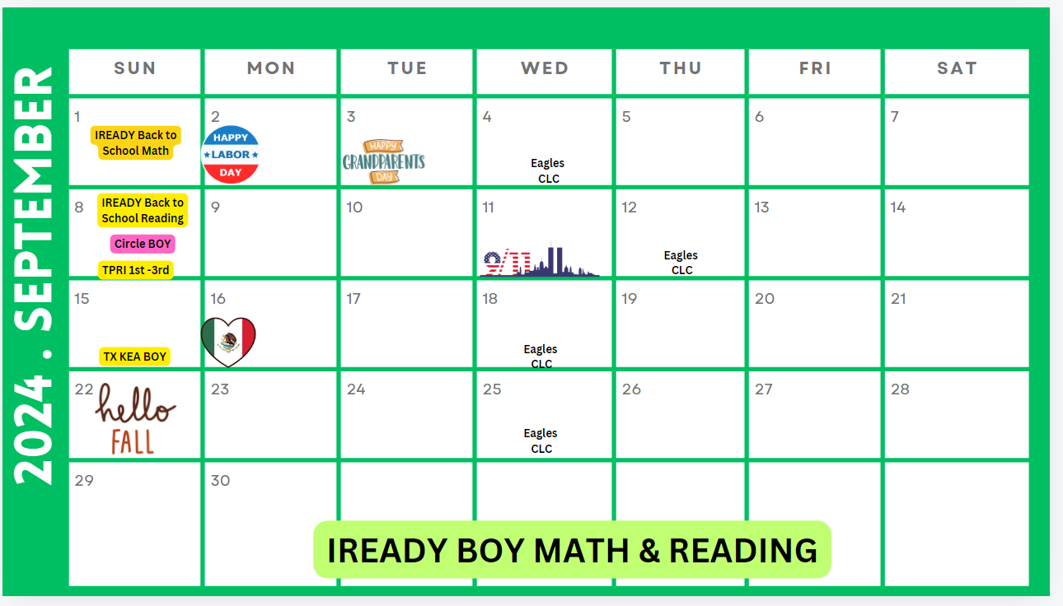

Slide 68


Slide 69
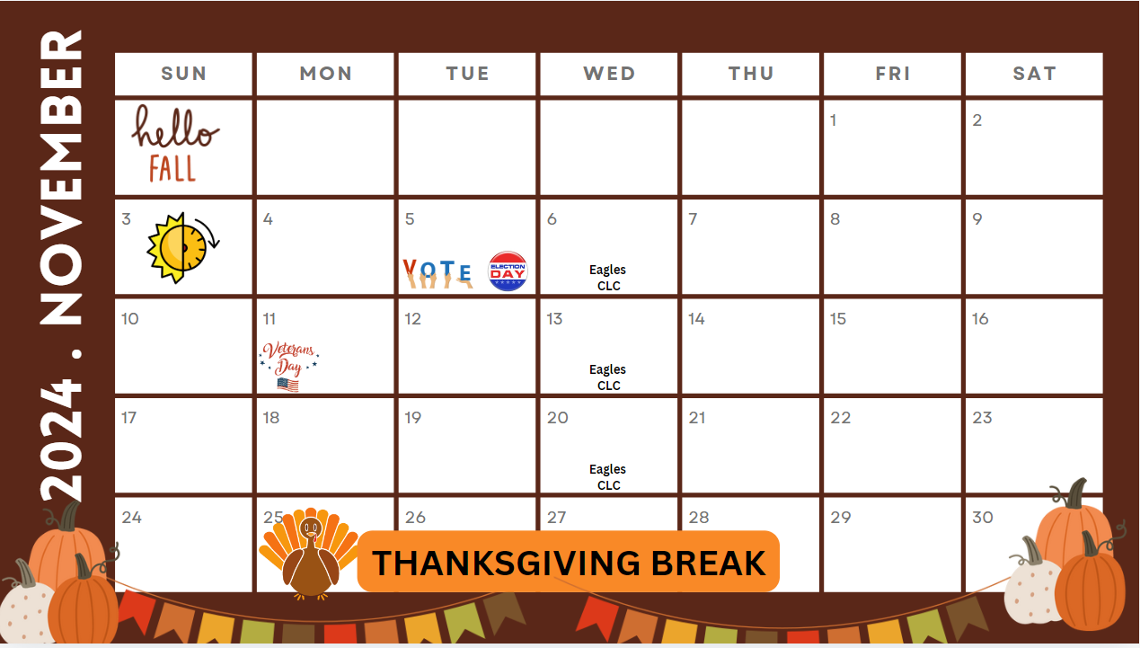

Slide 70


Slide 71
Title 1, Part A School Wide
Title I, Part A
School wide Components:
1. A comprehensive needs assessment of the entire school(including taking into account the needs of migratory children as defined in section 1309(2))
that is based on information which includes the achievement of children in relation to the State academic content standards and the State student
academic achievement standards described in section 1111(b)(1).
2. School wide reform strategies that provide opportunities for all children to meet the State’s proficient and advanced levels of student academic
achievement, use effective methods and instructional strategies that are based on scientifically based research, and that include strategies to address
the needs of all children in the school, but particularly the needs of low-achieving children and those at risk of not meeting the State student academic
achievement standards who are members of the target population of any program that is included in the school wide program.
3. Instruction by highly qualified teachers.
4. In accordance with section 1119 and subsection (a)(4), high-quality and ongoing professional development for teachers, principals, and
paraprofessionals and, if appropriate, pupil services personnel, parents, and other staff to enable all children in the school to meet the State’s student
academic achievement standards.
5. Strategies to attract high-quality teachers to high-need schools.
6. Strategies to increase parental involvement in accordance with section 1118, such as family literary services.
7. Plans for assisting preschool children in the transition from early childhood programs, such as Head Start, Even Start, Early Reading First, or a Staterun
preschool program, to local elementary school programs.
8. Measures to include teachers in the decisions regarding the use of academic assessments described in section 1111(b)(3) in order to provide
information on, and to improve, the achievement of individual students and the overall instructional program.
9. Activities to ensure that students who experience difficulty mastering the proficient or advanced levels of academic achievement standards required
by section 1111(b) (1) shall be provided with effective, timely additional assistance which shall include measures to ensure that student difficulties are
identified on a timely basis and to provide sufficient information on which to base effective assistance.
10. Coordination and integration of Federal, State, and local services and programs, including programs supported under this Act, violence prevention
programs, nutrition programs, housing programs, Head Start, adult education, vocational and technical education, and job training.

