Slide 1
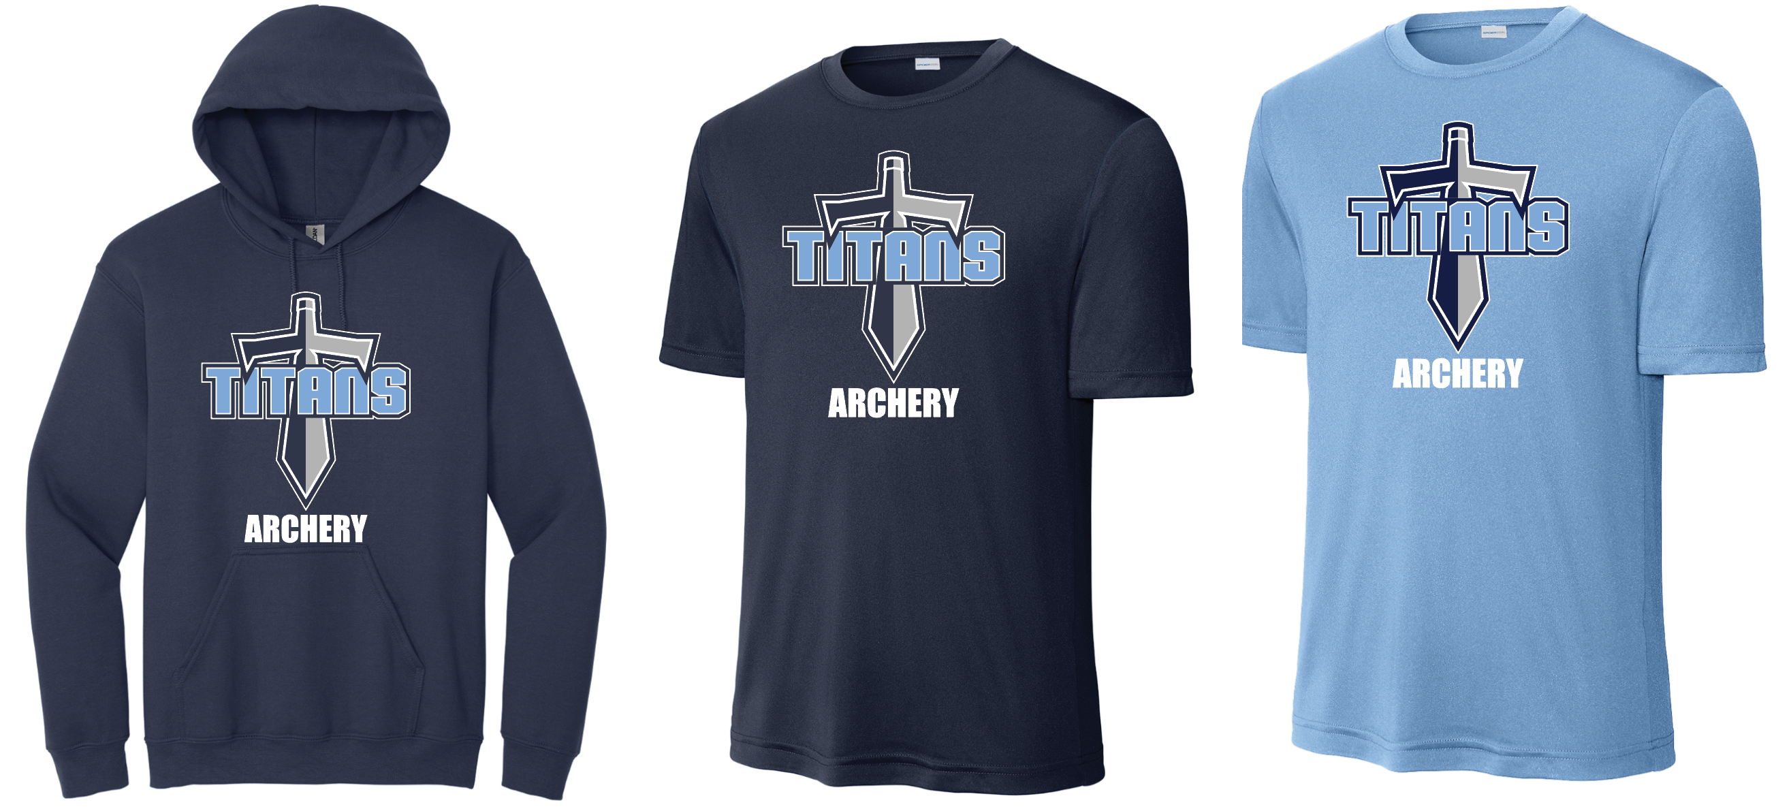
Hoodies
Sm-xl $25
2x and up $28
Archery shirts
Dri-fit T-shirts
Sm-xl $18
2x and up $21
Make checks payable to RHS Athletic booster club, bring cash to Coach Deer or pay online at https://form.jotform.com/232676686581168
If you pay online send Coach Deer an email (cdeer@madison-schools.com) with your size and t-shirt color.
ALL ORDERS DUE BY DECEMBER 16TH

