Slide 1

peer-to-peer support for internationals relocating to NL

Slide 2
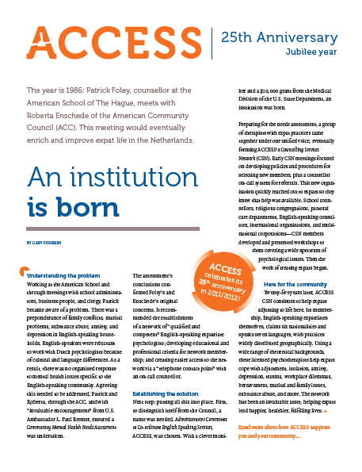
What is ACCESS
Dynamic not-for-profit volunteer run support organisation for internationals by internationals answering questions people have when moving to a new country
Around 120 volunteers from 40+ countries
All ‘expats’ here, or have been elsewhere
Started by, and for ‘expats’, in 1986
Nationally working, based in The Hague
Partner with cities of Amsterdam, The Hague, Utrecht and Amstelveen

Slide 3
The HOW
Website with 300+ FAQs
  www.access-nl.org
Helpdesk – for your questions / volunteering
  helpdesk@access-nl.org
Counselling Network – on call for referrals
  on-call.access-nl.org
Training Network – with variety of skills
  www.access-nl.org/what-we-do/meet-the-trainers/
Magazine – with wealth of information
  magazine.access-nl.org
Programmes for employers (such as Lunch&Learn)

Slide 4
Impossible task 😉
About 30mins to cover some information on:
Healthcare
Insurances
Dual Careers
Needless to say – questions will remain. We can discuss, or if very detailed, these can be mailed to helpdesk@access-nl.org

Slide 5
Healthcare - https://access-nl.org/healthcare-netherlands/
Family Doctor/General Practitioner(huisarts)
  register before you need a doctor
  Become ‘Dutch’ – ask question again if required, be bit more demanding than you might be normally
  10min norm
Specialists – by referral
  Possible to do so without BUT waiting times may be longer, and insurance coverage could be an issue
Age group 0-4 monitored cared for through consultatiebureau –
  where your child will be registered automatically when you register with Municipality, or when they are born here
Mental Health/wellbeing –
  check aanvullende in insurance & refer through GP

Slide 6
Medical Insurances – https://access-nl.org/healthcare-netherlands/medical-insurances/
Within 4 months of registering with municipality
  there will be back pay – but you are covered in this period
  employer may have collective discount
Things to be aware of
  zorgtoeslag (healthcare allowance) – income dependent
  polisvoorwaarden (policy) – see below
  natura polis (in-kind policy) – pre-approved lists of Doctors/services
  restitutie polis (restitution policy) – more freedom, more cost
  *basisverzekering (basic health insurance)
  aanvullende verzekering (additional insurance) – several levels
  eigen risico (deductible) – may raise and then have lower monthly rate/fees
  can change provider in December of each year, must be done by 1 Jan
  Compare insurances: https://www.independer.nl/zorgverzekering/info/health-insurance

Slide 7
Dual Careers - https://access-nl.org/dual-careers-netherlands/
Many other language, other national network groups
Professional as well as cultural/social
Multiple opportunities to study, follow an educational programme in English
Relatively easy to start own business/freelance
Many international employers in the region – for those looking for employment
Much support to above: career counsellors; job portals; business networks
Increasing opportunities to do volunteer work in many fields
Currently: stats indicate there are 114 positions open for every 100 unemployed

Slide 8
Dual Careers - cont https://access-nl.org/access-magazine/2023-issue-2-your-career-whats-next/
Prepare – for local market
  LinkedIn role in NL
  CV expectations
Network – let others know what looking for
  Around 70% market remains ‘hidden’
Adjust – covering letters
Research – not ALL platforms will have ALL openings
Keep ‘full time in mind’ – variations / negotiation
Reframe ‘relocation’ experience as skills/talents

Slide 9
Have more questions?
Get in touch. helpdesk@access-nl.org

