Slide 1


PHARR-SAN JUAN-ALAMO INDEPENDENT SCHOOL DISTRICT
Berta Palacios Elementary School
Campus Improvement Plan
2024-2025
Board Approved:

Slide 2



Executive Summary
Campus Improvement Plan: School Year 2023-2024
Campus Name: Berta S. Palacios Elementary School
Principal: Velma Villarreal
Mission: Through a supportive partnership with parents and the school community we, the staff of Berta Palacios Elementary School, are committed to provide all students with a strong foundation for life-long learning through inquiry that will produce internationally-minded and productive bilingual/biliterate, caring, global citizens.
Demographics Summary: The current enrollment of Berta Palacios Elementary as of August 7, 2024, is 495 students. The student population at Berta Palacios Elementary consists of 99.3% Hispanic and 0.7% White. Our students represent low socio-economic status of approximately 99.2% with 12 migrant students 2.4 %. Approximately 16% of our student population receive special education services, while 12 students receive accommodations under 504 in kinder-fifth grade. Our Gifted and Talented population accounts for approximately 3.4% of our student population. The emergent bilingual population is approximately 60.4% where most of the students' home language is Spanish. English proficient students receive Spanish enrichment to support a second language. The attendance rate for the 2023-2024 SY for the campus was 92.07%. Most of our students live in the south Pharr area and the apartment complex Pueblo Dorado, conveniently located next to our campus. In collaboration with the Hidalgo County Head Start Program, Berta Palacios Elementary serves the neediest three and four-year-old students in the county. Students are dually enrolled in the county head start and the PSJA ISD PK program. They are serviced by head start teachers and ISD PK teachers, focusing on school readiness, social emotional skills, health and well-being of the whole child. We have shared this partnership with the HCHSP for nine years.

Slide 3

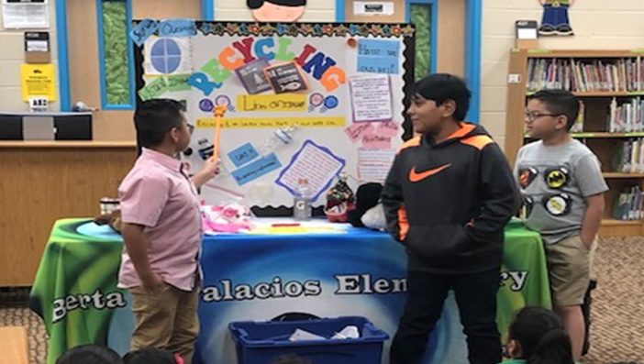
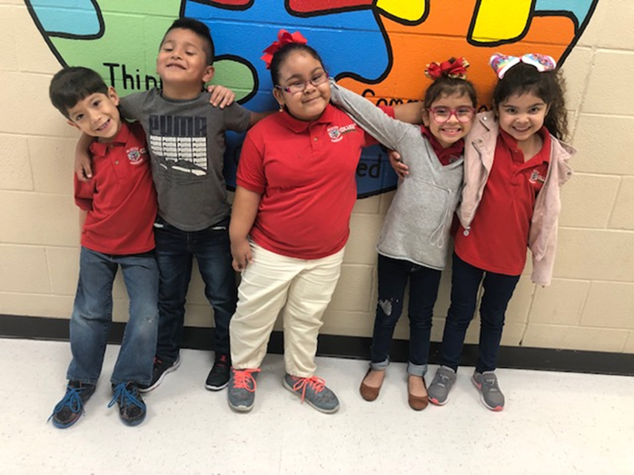
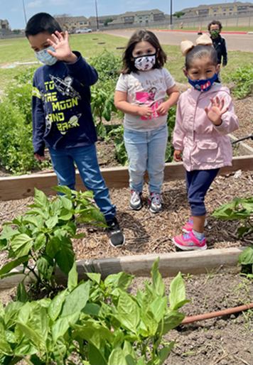
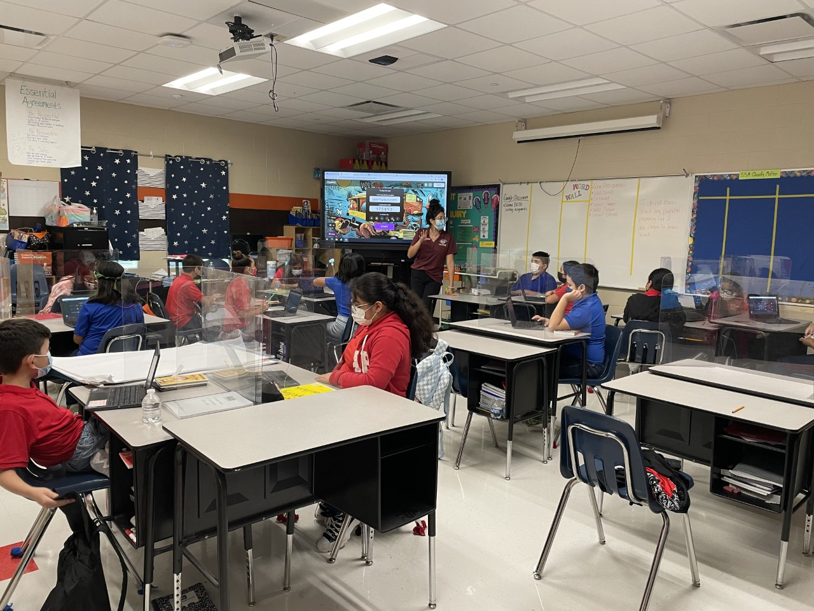
Comprehensive Needs Assessment Summary: Palacios Elementary received an overall grade of 87 out of 100 based on performance in three different domains for 2023-2024. In the Student Achievement domain, Palacios earned a 78, which shows how much students know and can do at the end of the school year. The School Progress Domain II Part 2A Palacios scored a 74 which shows how students perform over time and how that growth compares to similar schools. In Domain 2 Part B, Palacios scored an 88. This domain measures how students perform based on their economically disadvantaged percentage. Palacios scored 86 in Closing Gaps, the domain which shows how well different student groups within a school are performing.
All grade levels and scores combined for STAAR 2024 are as follows:
Approaches Level of Performance: 77%
Meets Level of Performance: 48%
Masters Level of Performance: 23%

Slide 4

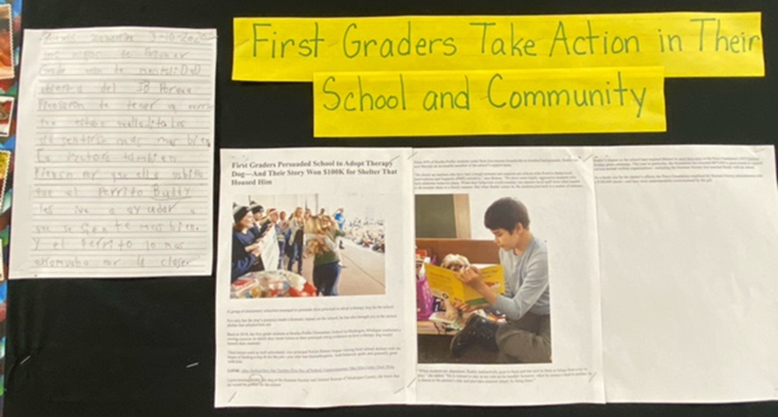
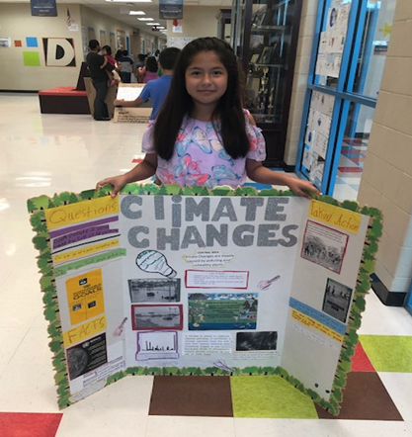
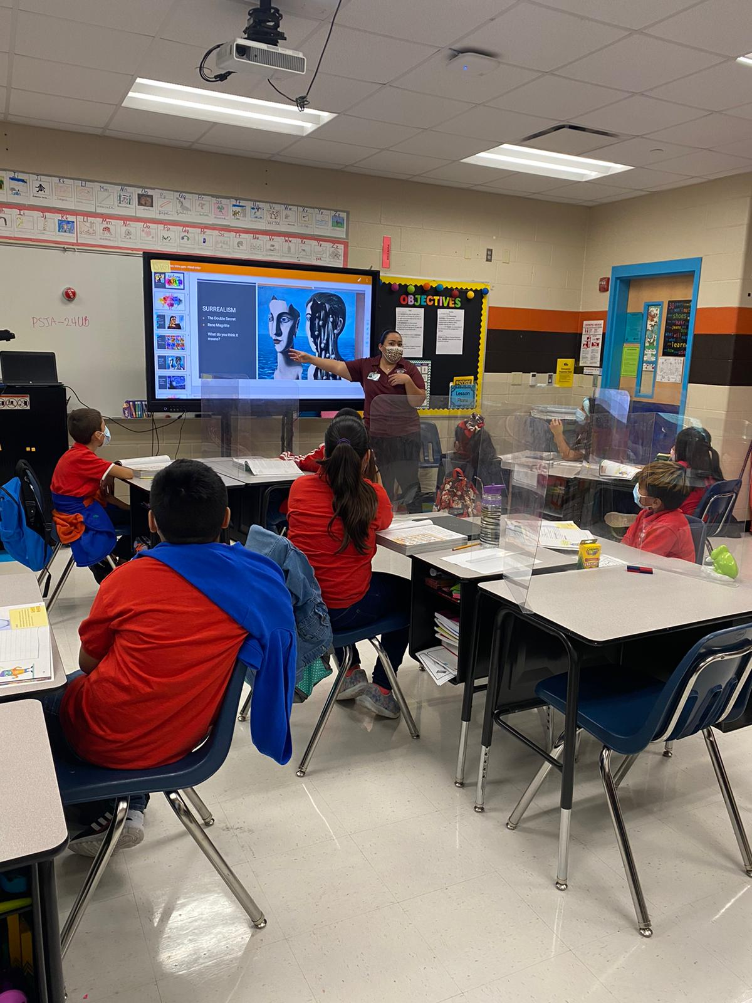
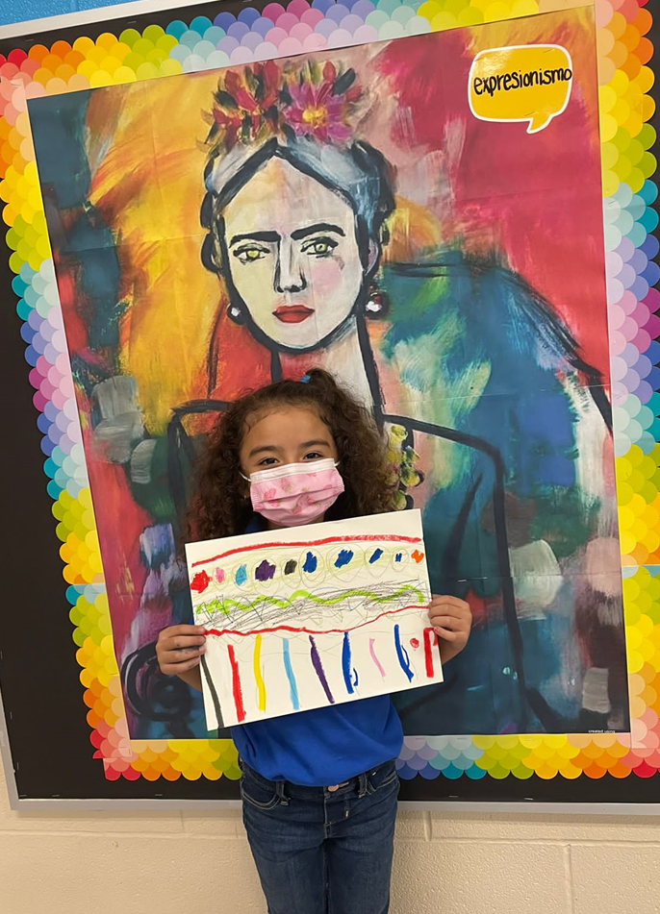
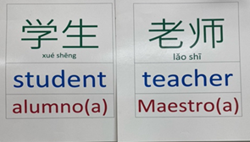
Curriculum/ Instruction and Assessment: Berta Palacios Elementary is an Authorized International Baccalaureate program. The goal of IB is to instill in the students the ten attributes of the learner profile and attitudes to become internationally minded scholars. Through the IB philosophy teachers teach six-unit planners a school year, focused on six transdisciplinary themes primarily related to science and social studies. The IB philosophy focuses on the constructivist approach of learning through inquiry and student agency. Berta Palacios Elementary is a one-way dual language school, providing Spanish enrichment to English Proficient (EP) students. Student participate in the following specialty classes: Physical Education, Music, Chinese Mandarin.
Our focus over the last three years has been to develop strong, fluent readers and writers in our foundational grades for them to be successful in the upper grades. A lot of time is spent equipping teachers with the tools they need to teach the five components of reading (Phonemic Awareness, Phonics, Fluency, Comprehension and Vocabulary) and the writing process. Literature and writing bridges are embedded across all content areas. Teachers receive professional learning on topics aligned to literacy during our CLCs.
Summary of Goals: Overall, Palacios Elementary has struggled with reading performance on the state assessment. Historically, the campus has scored well on math state assessments, however, virtual instruction pushed back math performance across all grade levels. Our goal for Spring 2025 is to accelerate reading and math instruction for all third through fifth grade students. Foundational grades will focus on literacy skills with the Literacy Impact for Excellence (LIFE) initiative to bridge the gap to reading readiness.
Our goal for Domain 2 is to increase the student growth from the 2024 administration to 2025 with participation and performance. This would assist in increasing our overall campus Domain 1 score. Student attendance was greatly affected last school year due to various reasons; therefore, our goal is to meet the 95% attendance rate by June 2025.
To sustain the IB philosophy, teachers will attend authorized Category 1-3 trainings to further develop a transdisciplinary approach to teaching and learning. Implementation of essential elements will develop the approaches to learning necessary for acceleration throughout our Programme of Inquiry. High caliber instruction, project-based learning, and student agency will continue to be promoted to instill a culture of community, multilingualism, and action in a global society.

Slide 5

Mission Statement
PHARR-SAN JUAN-ALAMO INDEPENDENT SCHOOL DISTRICT
As educational leaders, the PSJA team is engaged and empowered to connect all students with innovative instruction, outstanding facilities, technology, skills, and social-emotional support while prioritizing health and safety for all-from early childhood through their chosen career.
As one PSJA family, we build on our legacy of academic excellence, renowned college and career readiness, biliteracy and extracurricular programs, and our multicultural heritage to ensure every student has the experiences and resources necessary to achieve the highest levels of success.

Slide 6
THE BOARD OF EDUCATION GOALS AND PROGRESS MEASURE
Goal 1: The percent of students in grade 3 who perform at meets grade level or above on STAAR Reading will increase from 52% to 60% by June 2025.
Goal Progress Measure 1.1: The percent of grade 3 students who reach above the 60th percentile by End of Year Assessment will increase from 23% to 33% by 2025.
Goal Progress Measure 1.2: The percent of grade 2 students who reach above the 60th percentile by End of Year Assessment will increase 25% to 34% by 2025.
Goal Progress Measure 1.3: The percent of grade 1 students who reach above the 60th percentile by End of Year Assessment will increase from 23% to 32% by 2025.
Goal Progress Measure 1.4: The percent of grade kindergarten students who reach above the 60th percentile by End of Year Assessment will increase 15% to 23% by 2025.
Goal 2: The percent of students in grade 3 who perform at meets grade level or above on STAAR Mathematics will increase from 41% to 53% by June 2025.
Goal Progress Measure 2.1: Proficiency in grade 3 students on Imagine Math Beginning of Year Assessment will increase from 7% to 16% by 2025.
Goal Progress Measure 2.2: Proficiency in grade 2 students on Imagine Math Beginning of Year Assessment will increase from 33% to 42% by 2025.
Goal Progress Measure 2.3: Proficiency in grade 1 students on Imagine Math Beginning of the Year Assessment will increase from 11% to 19% by 2025.
Goal Progress Measure 2.4: Proficiency in grade kindergarten on Imagine Math Beginning of the Year Assessment will increase from 1% to 10% by 2025.
Goal 3: The percent of students in grades 5-8 who perform at meets grade level or above on STAAR Reading will increase from 50% to 60% by June 2025.
Goal Progress Measure 3.1: The percent of students in grade 5 at meets level on STAAR Reading will increase from 40% to 60% by June 2025.
Goal Progress Measure 3.2: The percentage of students in grade 6 at meets level on STAAR Reading will increase from 26% to 30% by June 2025.
Goal Progress Measure 3.3: The percent of students in grade 7 at meets level on STAAR Reading will increase from 37% to 42% by June 2025.
Goal Progress Measure 3.4: The percent of students in grade 8 at meets level on STAAR Reading will increase from 42% to 47% by June 2025.
Goal 4: The percent of graduates who are College, Career and Military Ready will increase from 70% to 80% by June 2025.
Goal Progress Measure 4.1: The percent of graduates earning an industry-based certification will increase from 4% to 30% by June 2025.
Goal Progress Measure 4.2: The percent of graduates earning 3 college hours in ELA or Math or 9 hours in any other course will increase from 51% to 60% by June 2025.
Goal Progress Measure 4.3: The percent of graduates earning a Level I or Level II certificate will increase from 6% to 10% by June 2025.

Slide 7

BERTA PALACIOS ELEMENTARY SCHOOL
an International Baccalaureate School
Vision:
Teachers and staff at Berta Palacios Elementary commit themselves to the fundamental principle that all students can learn. We can make the difference through positive actions. In the course of our endeavor as professional educators, we must provide all students with opportunities to excel to their fullest. Furthermore, our top priority is for students to attain academic recognition in all areas of the curriculum. Commitment from administrators, teachers, parents, and students play an integral part in accomplishing our school vision.
Mission
Through a supportive partnership with parents and the school community we, the staff of Berta Palacios Elementary School, are committed to provide all students with a strong foundation for life-long learning through inquiry that will produce internationally-minded and productive bilingual/biliterate, caring, global citizens.

Slide 8
School Profile
Campus Improvement Plan: School Year 2024-2025
Campus Name: Berta S. Palacios Elementary School
History
Berta S. Palacios Elementary School is named in honor of Berta S. Palacios, an esteemed educator who dedicated almost 50 years of her life to shaping young minds. Her legacy of commitment to education and community service continues to inspire our mission and values. Berta Palacios Elementary opened its doors to students in August 2014. Located at 801 East Thomas Drive, Pharr, Texas, Berta Palacios Elementary serves students from all over the tri-city area.
Demographics
Total Students: 495
Economically Disadvantaged: 99.2%
English Learners (EB): 60.4%
Special Education (Sp. Ed.): 16%
Migrant Students: 2.4%
Gifted and Talented (GT): 3.4%
Highlights
At Berta S. Palacios Elementary School, we are dedicated to fostering a nurturing and inclusive learning environment that empowers every student to achieve academic excellence, develop critical thinking skills, and become responsible global citizens. As an IB campus, we provide a challenging educational framework that encourages students to become active, compassionate, and lifelong learners. Our curriculum is designed to foster intercultural understanding and respect. Our dual language program aims to develop bilingualism and biliteracy in both English and Spanish, promoting academic achievement and cross-cultural competence. In collaboration with the Hidalgo Head Start program, we offer comprehensive early childhood education, health, nutrition, and parent involvement services to ensure our youngest learners are ready for school success.

Slide 9

CAMPUS DEMOGRAPHICS
 | ALL | SPED | LEP | MIGRANT | ECD | GT
Number | 495 | 79 | 299 | 12 | 491 | 17
Percent | 100 | 16% | 60.4% | 2.4% | 99.2% | 3.4%
 | ALL | HISPANIC | ASIAN | BLACK | WHITE | AMERICAN INDIAN/ALASKAN
Number | 495 | 449 | 0 | 0 | 3 | 0
Percent | 100 | 99.3 | 0 | 0 | 0.7 | 0

Slide 10
Campus Leadership Committee
Velma Villarreal, Principal
Sandra Garza, Assistant Principal
Sandra Gonzalez, Counselor
Ashely Clark, CLL
Liliana Lopez, Parent
Maricuz De Anda, Special Education Teacher
Dalia Garcia, Lead Teacher
Giselle Morellius, Lead Teacher
Sandra Castro, Lead Teacher
Vanessa Morin, Para-Professional
Juan C. Moreno, Head Custodian

Slide 11

Site-Based Decision-Making Committee
SBDM will address the following areas:
Planning
Budgeting
Curriculum
Staffing patterns
Staff development
School organization

Slide 12

Site-Based Decision-Making Committee
Operating Procedures: The SBDM serves as the key committee in the Campus Intervention Team to assist the campus principal with the development, review, and revision of the CIP. All SBDM information must be included on the campus website. The organizational structure of the school’s SBDM including subcommittees, membership, and operating procedures of the subcommittees and should include the meeting schedule for both the SBDM and subcommittees. The SBDM shall be involved in decisions in the areas of planning, budgeting, curriculum, staffing patterns, staff development, and school organization.
A list of meeting dates, committee members, agendas and minutes for each meeting must be on the campus website. The campus website homepage must include the link to the SBDM page for easy access. Campuses must post SBDM agenda and minutes to campus website within 10 days following meeting.
Scheduled Meeting Dates: September 4, 2024, November 6, 2024, January 29, 2025, May 30, 2025
Committee Roles and Responsibilities:
  Chair – prepares committee meeting agendas with the assistance of the principal, guide meetings and encourage input from all members
  Vice-Chair – performs Chair’s duties in his/her absence; serves as chair of the Evaluation and Modification Committee
  Scribe/Recorder – prepare and maintain minutes of committee meetings, committee membership roster and bylaws
  Facilitator/Timekeeper – monitors committees' energy and interaction, keeps committee on track and ensures activities are completed in a timely manner

Slide 13

Site-Based Decision-Making Committee
Procedures and processes for addressing SBDM action items and decision making:
1. Announcement of SBDM meeting announced to staff 2 weeks before meeting.
2. Committee representative submits request to SBDM chairperson.
3. One week before meeting SBDM meeting, chairperson meets with campus administration to
discuss topics.
4. Selection of topics to be covered will be determined by administration and SBDM chairperson.
5. If a topic is not going to be addressed, SBDM chairperson and administration will provide further information for not taking
the topic to SBDM. Topic may be resolved via conference with teacher and/or grade level team.

Slide 14
Comprehensive Needs Assessment
Data Resources Reviewed
2023-2024 STAAR Campus Summary Report
TPRI/Tejas LEE Data
2023-24 Attendance
Discipline Referrals
PEIMS Demographics
Walk-through Data
Parental Involvement Data
TTESS Teacher Evaluations
Professional Development Plan
Teacher Certifications
TELPAS Scores (2023-2024)
Technology Inventories (purchases made)
Benchmark 2 (Spring 2024)
EB progress monitoring
Special population participation and performance
Campus report card

Slide 15
Comprehensive Needs Assessment
Demographics
Demographics Summary
Special Education:
The following accountability sources were used to review the Special Education data by the Campus Site-Based Decision-Making Committee (SBDM): State of Texas Assessments of Academic Readiness (STAAR) results, Performance Based Monitoring Assessment System (PBMAS) and State Performance Plan (SPP) indicators to determine strengths and needs of our Special Education students. In addition, the Special Education Department was very involved in the curriculum writing and revision for grades K-5 during the summer to ensure that the general curriculum meets the needs of our special education students. Professional development is also coordinated with the curriculum and instruction department to ensure that all general education teachers are well versed in best practices that support the learning of special education students.
Needs:
Align student goals and objectives outlined in IEP with TEKS being assessed on STAAR, STAAR Online, STAAR-Alt 2 and TELPAS.
Personnel Needs:
Campus Administrators will work closely with Human Resources (HR) to ensure the selection of highly qualified employee(s) holding valid state issued certification.
Professional Development Needs:
Special Education Staff will be included in all Professional Development (PD) provided by the campus/district in the areas that are to be addressed by individual students. The Special Education Department will work closely with the Campus and provide PD in the area of co-teaching to implement the inclusion model effectively. Resource teachers will work collaboratively with homeroom teachers to ensure IEP implementation.

Slide 16
Comprehensive Needs Assessment
Demographics
Demographics Summary Continued:
Emergent Bilinguals(EB):
The following accountability sources were used to review the Bilingual Education/Dual Language (BE/DL) Department data by the SBDM Committee: State of Texas Assessments of Academic Readiness (STAAR) results, Performance Based Monitoring Assessment System (PBMAS) and TELPAS indicators to determine strengths and needs of our EL students. The BE/DL Department was very involved in the curriculum writing and revision for grades K-5 during the summer to address the needs of our EL students and align the curriculum between English and Spanish Language Arts that led to a more coherent and consistent bi-literacy program. Professional development was also coordinated with the curriculum and instruction department to ensure that all general education teachers utilize best practices that support the learning of EL students.
Needs:
As evidenced in the STAAR assessments , the results are as follow:
Reading 77%
Math 78%
Science 68%
TELPAS 71%

Slide 17
Comprehensive Needs Assessment
Demographics
Demographics Summary Continued:
Economically Disadvantaged
The following accountability sources were used to review the Economically Disadvantaged data by the SBDM: State of Texas Assessments of Academic Readiness (STAAR) results, and System Safeguards to determine strengths and needs of our Economically Disadvantaged Students.
Needs:
As evidenced in the STAAR assessments , the results show an achievement gap as follows:
Reading 72%
Math 77%
Science 56%

Slide 18
Comprehensive Needs Assessment Continued: Summary of Findings
DOMAIN | Area Reviewed | Summary of Strengths | Summary of Needs | Priorities
1 | Domain 1: Student Achievement | Campus performed at 73% for all students in all assessments for 2023. 2022-2023 2023-2024 Approaches: 71% 78% Meets: 45% 53% Masters: 19% 21% Decrease from 2021-22 Masters: 29% | Campus overall Domain 1 Score 78%, still below 80%. | Improve student learning outcomes in : 4th Grade Reading 4th Grade Math 5th Grade Math 5th Grade Reading 5th Grade Science SMART Goal: 85% or Higher at Approaches 60% or higher at Meets and Above
2 | Domain 2: Student Progress Part A Student Progress Part B | Domain 2 Part B performance was higher than Part A. Part A: 74 Part B: 88 | Address the needs of all students in each student group. Identify the students previous performance and set specific goals by individuals students. | Address the needs of identified students to meet the progress measure in 2024-25 in Reading and Mathematics.
3 | Domain 3: Closing the Achievement Gap | Domain 3 89 goal is to be at 90 or higher. | Goal is to perform at 100. Focus is to have SPED population perform at MEETS or above. | Special population groups SPED EB’s
CampusTotal | Overall Rating: 87=B | Berta Palacios Elementary MET STANDARD. | Final campus score was 87%. Goal is to have a 90% or higher for Spring 2024. Goal for 2025 is to receive distinctions in core content areas (Math, Reading), student growth, and closing the achievement gap and Telpas. Berta Palacios Elementary went from an overall score of 90 (A) in one school year. | Improvement in RDG 40% @ Meets to 50% MATH 33% @ Meets to 50% by Spring 2025.

Slide 19
STAAR Reading Scores
 | Approaches | Meets | Masters
3rd | 77% | 43% | 25%
4th | 84% | 59% | 33%
5th | 85% | 57% | 27%
Campus | 85% | 57% | 27%

Slide 20
STAAR Math Scores
 | Approaches | Meets | Masters
3rd | 76% | 41% | 6%
4th | 83% | 63% | 33%
5th | 78% | 50% | 18%
Campus | 79% | 53% | 21%

Slide 21
Science Scores
 | Approaches | Meets | Masters
5th | 73% | 47% | 10%

Slide 22

2024-25 Campus Goals
3rd Grade Mathematics
% of Items Needed to Meet State Performance Standard |  | % of Students Passing State Assessment | BM2 | STAAR | Goal
 |  | 2023 | 2023 | 2024 | 2025
Approaches 16-23 | 50-74% | 64% | 73% | 76% | 82%
Meets 24-27 | 75-87% | 43% | 47% | 41% | 53%
Masters 28-32 | 88-100% | 15% | 12% | 6% | 30%
4th Grade Mathematics
% of Items Needed to Meet State Performance Standard |  | % of Students Passing State Assessment | BM2 | STAAR | Goal
 |  | 2023 | 2023 | 2024 | 2025
Approaches 17-24 | 50-73% | 80% | 80% | 83% | 85%
Meets 25-28 | 74-84% | 67% | 59% | 63% | 60%
Masters 29-34 | 85-100% | 38% | 19% | 33% | 35%
5th Grade Mathematics
% of Items Needed to Meet State Performance Standard |  | % of Students Passing State Assessment | BM2 | STAAR | Goal
 |  | 2023 | 2023 | 2024 | 2025
Approaches 17-24 | 47-68% | 75% | 77% | 78% | 85%
Meets 25-29 | 69-82% | 43% | 39% | 50% | 60%
Masters 30-36 | 83-100% | 10% | 9% | 18% | 25%

Slide 23

2024-2025 Campus Goals
3rd Grade Reading
% of Items Needed to Meet State Performance Standard |  | % of Students Passing State Assessment | BM2 | STAAR | Goal
 |  | 2023 | 2023 | 2024 | 2025
Approaches 18-25E | 53-75% | 66% | 76% | 77% | 82%
Meets 26-28E | 75-87% | 43% | 41% | 52% | 60%
Masters 29-34E | 88-100% | 25% | 24% | 21% | 35%
4th Grade Reading
% of Items Needed to Meet State Performance Standard |  | % of Students Passing State Assessment | BM2 | STAAR | Goal
 |  | 2023 | 2023 | 2024 | 2025
Approaches 20-26E | 56-74% | 75% | 90% | 84% | 90%
Meets 27-30E | 75-85% | 48% | 65% | 59% | 60%
Masters 31-36E | 86-100% | 20% | 39% | 33% | 38%
5th Grade Reading
% of Items Needed to Meet State Performance Standard |  | % of Students Passing State Assessment | BM2 | STAAR | Goal
 |  | 2023 | 2023 | 2024 | 2025
Approaches 21-27E | 55-73% | 65% | 63% | 85% | 90%
Meets 28-32E | 74-86% | 40% | 39% | 57% | 60%
Masters 33-38E | 87-100% | 17% | 19% | 27% | 30%

Slide 24

Pharr-San Juan-Alamo Independent School District
2014-2015 Goals
2023-2024 Campus Goals
5th Grade Science
% of Items Needed to Meet State Performance Standard |  | % of Students Passing State Assessment | BM2 | STAAR | Goal
 |  | 2023 | 2023 | 2024 | 2024
Approaches | 58-77% | 71% | 63% | 73% | 75%
Meets | 78-88% | 45% | 239% | 47% | 50%
Masters | 89-100% | 19% | 19% | 10% | 25%

Slide 25

GOAL AREA PRESENTATION
Goal Area 1: Student Achievement

Slide 26
Goal Area 1: | Student Achievement
Annual Goal:1 | By September 1, 2025 all student's overall performance on STAAR will be at 70% at approaches, 40% at meets and 25% at masters in Reading and Math.
Objective 1: Reading | All students will be monitored weekly/bi-weekly to ensure there is progressive attainment to 70 % at approaches, 40% at meets and 25% at masters level of performance by August 31,2025.
Strategy 1 | Persons Responsible/Title | Resources | Timeline | Evidence of Implementation | Evidence of Impact | Formative/ Summative Assessment | Title-I School- wide Component
Data will be used to inform instruction for differentiated lessons to identify spiraled skills and highly tested student expectations. Purchase supplies such as paper, colored paper, sent. Strips, markers, folders,skill boxes, poster boards, chart paper for small group instruction/intervention. Project-based learning act. Tri-folds Copier Machine Materials needed for teachers | Principal, Assistant Principal, LIFE Coach, Teachers | -District Curriculum -Lead4Ward -Istation Reading -CLC Planning Document -Forde-Ferrier, Education Galaxy -Newsela -Scholastic Reading -ESGI/Riverside Data Assessment Tool Summit K-12 -Region 1 | -Sept.2024 -Oct. 2024 -Nov. 2024 Dec. 2024 -Jan. 2025 -Feb 2025 -March 2025 -April 2025 -May 2025 -June 2025 -July 2025 -August 2025 | -DMAC data reports -Lesson Plans -Action/Differentiation Plan -Tutorials/Intervention -Campus Performance Reviews -Walk-Throughs | -MyOn Lexile Scores -STAR Reports -Istation Reading -Progress on weekly assessment, -Imagine Math -BOY, CBA, BM1 & 2, STAAR | -Weekly/Bi-Weekly Progress Monitoring -CBA I -BM1, BM2 -STAAR | 1-Campus Needs Assessment 2-Reform Strategies 8-Teacher Decision-Making Regarding Assessment 9-Effective & Timely Assistance to Students Experiencing Difficulty 10-Coordination of Fed., State & Local Services, Programs and Funds
Action Steps
1. CLC meetings will address lesson planning and the TEKS.
2. Data will be shared with parents regarding their child's level of performance and expected outcome by June 2024 at parent meetings (STAAR, TPRI, Tejas LEE, TXKEA, BM1, BM2, CBA).
3. Conduct data analysis every six weeks by leadership team to monitor root cause, improvement and drive action plans.
4. Attend training on instructional strategies and practices such as Forde-Ferrier, Accelerated Reader, MyOn, iStation, Newsela, Diana Ramirez, TEA Reading Academies, Early Childhood training and Region 1 to address core content areas.
Strategy 2 | Persons Responsible/Title | Resources | Timeline | Evidence of Implementation | Evidence of Impact | Formative/ Summative Assessment | Title-I School- wide Component
Provide supplemental tutorial programs and summer school/enrichment for students identified as at-risk using manipulatives, leveled readers, and supplemental resources to meet the needs of students at each performance level (Approaches, Meets, Masters) and address all five components of reading. Phonemic Awareness Phonics Fluency Comprehension & Vocabulary | Principal, Assistant Principal, LIFE Coach, Teachers | -District Curriculum -Pearson fluency/comprehension passages -TPRI/Tejas LEE, TXKEA -Sing, Spell, Read & Write -Estrellitas Phonics Haggerty -Herman Method A&B -Esperanza Dyslexia - | -Sept.2024 -Oct. 2024 -Nov. 2024 Dec. 2024 -Jan. 2025 -Feb 2025 -March 2025 -April 2025 -May 2025 -June 2025 -July 2025 -August 2025 | -Lesson Plans -Tutoring/Intervention Plans -Fluency Progress Monitoring -Content area Progress Monitoring | -Incremental progress on weekly assessments, CBA, BM1, BM2, STAAR, TELPAS | -Weekly/Bi-Weekly Progress Monitoring -CBA I -BM1, BM2 -STAAR Domain 1 final score | 1-Campus Needs Assessment 2-Reform Strategies 8-Teacher Decision-Making Regarding Assessment 9-Effective & Timely Assistance to Students Experiencing Difficulty 10-Coordination of Fed., State & Local Services, Programs and Funds
Action Steps
1. Data will be used to identify students in need of extended learning opportunities and purchase supplies such as paper, chart tablets ,colored paper, sentence strips, markers, painting supplies for sm group instr/interventions and enrichment camp. (need copier machine/materials for teachers)
2.Implement quality instructional reading programs that focus on the five essential components of a reading program to meet the needs of all students. (Accelerated Reader, purchase books of different genres, SSRW, Estrellitas Phonics practice)
3. Provide compensation for intentional tutoring groups.
Strategy 3 | Persons Responsible/Title | Resources | Timeline | Evidence of Implementation | Evidence of Impact | Formative/ Summative Assessment | Title-I School- wide Component
Reading Renaissance will be utilized by all 1st-5th grade teachers and students to close the fluency and comprehension gap. | Principal, Assistant Principal, Librarian, Teachers | -Accelerated Reader software program and licenses -Library books | -Sept.2024 -Oct. 2024 -Nov. 2024 Dec. 2024 -Jan. 2025 -Feb 2025 -March 2025 -April 2025 -May 2025 -June 2025 -July 2025 -August 2025 | -Classroom teacher AR weekly report -AR Diagnostic Reports -AR STAR BOY,MOY, EOY comparison report on growth | -MyOn Lexile Scores -MyOn Usage for PK & K -Istation Reading -STAR reading inventory | -Weekly word count and AR reports -Progress Monitoring -BM1.BM2 | 1-Campus Needs Assessment 2-Reform Strategies 8-Teacher Decision-Making Regarding Assessment 9-Effective & Timely Assistance to Students Experiencing Difficulty 10-Coordination of Fed., State & Local Services, Programs and Funds
Acrion Steps
1. Librarian will meet with teachers each marking period to review AR diagnostic reports on student performance.
2. Provide incentives for top reading classes and students reaching grade level goals each marking period.
3. Purchase books in English, Spanish and Mandarin, and different genres to meet the needs and interests of students and match ZPDs. ( Purchase Scholastic Storyworks, Newsela, Time for Kids, ABC Mouse)

Slide 27
Goal Area 1: | Student Achievement
Annual Goal:1 | By Aug 2024, all student's overall performance on STAAR will be at 70% at approaches, 40% at meets and 15% at masters in Reading/Language Arts/Writing.
Objective 2: Writing/Language Arts | All students will be monitored weekly/bi-weekly to ensure there is progressive attainment to 70 % at approaches on Reading/Language Arts/Writing by Aug 2025.
Strategy 1 | Persons Responsible/Title | Resources | Timeline | Evidence of Implementation | Evidence of Impact | Formative/ Summative Assessment | Title-I School- wide Component
Writing journals will be implemented to teach students how to brainstorm, plan, revise, edit and publish. Students will need tri-folds to present project -based learning activities. | Principal, Assistant Principal, LIFE Coach, Teachers | -District Curriculum -Lead4Ward -CLC Planning Document -Forde-Ferrier Writing Training | -Sept.2024 -Oct. 2024 -Nov. 2024 Dec. 2024 -Jan. 2025 -Feb 2025 -March 2025 -April 2025 -May 2025 -June 2025 -July 2025 -August 2025 | -DMAC data reports -Lesson Plans -Grade level writing rubric -Campus Performance Reviews -Walk-Throughs | -Progress on weekly assessment, CBA, BM1 & 2, STAAR -Student compositions by grade level | -Weekly/Bi-Weekly Progress Monitoring -CBA I -BM1, BM2 -STAAR -TELPAS Writing | 1-Campus Needs Assessment 2-Reform Strategies 8-Teacher Decision-Making Regarding Assessment 9-Effective & Timely Assistance to Students Experiencing Difficulty 10-Coordination of Fed., State & Local Services, Programs and Funds
1. CLC meetings will address lesson planning and address the TEKS specific to grade level expectations for writing.
2. Grade level writing rubrics will be utilized with writing compositions. (Write From the Beginning)
3. Conduct data analysis based on each grade level's compositions to determine strengths and areas of refinement, .
4. Provide teachers with training and instructional resources on instructional strategies and practices such as Forde-Ferrier, Curriculum Associates, Lead Teacher trainings, district training.
Strategy 2 | Persons Responsible/Title | Resources | Timeline | Evidence of Implementation | Evidence of Impact | Formative/ Summative Assessment | Title-I School- wide Component
Provide professional development to enhance writing scores for all students. | Principal, Assistant Principal, LIFE Coach, Lead Teachers, Teachers | -District Curriculum -Lead4Ward -CLC Planning Document -Write from the Beginning -Thinking Maps | -Sept.2024 -Oct. 2024 -Nov. 2024 Dec. 2024 -Jan. 2025 -Feb 2025 -March 2025 -April 2025 -May 2025 -June 2025 -July 2025 -August 2025 | -Lesson Plans -Writing Rubric -Peer Evaluation Feedback | -Incremental progress on weekly assessments, CBA, BM1, BM2, STAAR, TELPAS | -Weekly/Bi-Weekly Progress Monitoring -CBA I -BM1, BM2 -STAAR Domain 1 final score | 1-Campus Needs Assessment 2-Reform Strategies 8-Teacher Decision-Making Regarding Assessment 9-Effective & Timely Assistance to Students Experiencing Difficulty 10-Coordination of Fed., State & Local Services, Programs and Funds
Action Steps
1. Conduct data analysis every six weeks by leadership team to monitor root cause, improvement and drive action plans.
2. Data will be used to identify students in need of extended learning opportunities and purchase supplies such as paper, colored paper, sentence strips, writing compositions, folders for foldables.
3. Provide writing professional learning on writing, grammar and brainstorming best practices by Forde-Ferrier, Thinking Maps consultant, district coordinators.
Strategy 3 | Persons Responsible/Title | Resources | Timeline | Evidence of Implementation | Evidence of Impact | Formative/ Summative Assessment | Title-I School- wide Component
Monitor student writing samples every six-weeks to make certain writng is occurring throuhgout the curriculum. | Principal, Assistant Principal, LIFE Coach, Lead Teachers, Teachers | -District Curriculum -Lead4Ward -CLC Planning Document -Write from the Beginning -Thinking Maps | -Sept.2024 -Oct. 2024 -Nov. 2024 Dec. 2024 -Jan. 2025 -Feb 2025 -March 2025 -April 2025 -May 2025 -June 2025 -July 2025 -August 2025 | -Lesson Plans -Writing Rubric -Peer Evaluation Feedback | -Incremental progress on weekly assessments, CBA, BM1, BM2, STAAR, TELPAS | -Progress Monitoring -BM1.BM2 -STAAR | 1-Campus Needs Assessment 2-Reform Strategies 8-Teacher Decision-Making Regarding Assessment 9-Effective & Timely Assistance to Students Experiencing Difficulty 10-Coordination of Fed., State & Local Services, Programs and Funds
Acrion Steps
1. Use WFTB writing rubric to score and analyze student writing from PK-5th grade.
2. Purchase writing journals and quality literature (trade books) for teachers to model effective writing strategies and use as mentor texts.

Slide 28

Goal Area 1: | Student Achievement
Annual Goal 1: | By Aug2024, students' overall performance on STAAR will be maintained at 74% at the approaches level.
Objective 3: Science | All students will be monitored weekly/bi-weekly to ensure there is maintenance at 74% at approaches by Aug 2025.
Strategy 1 | Persons Responsible/Title | Resources | Timeline | Evidence of Implementation | Evidence of Impact | Formative/ Summative Assessment | Title-I School- wide Component
Establish classroom environment with materials and resources to meet all student population needs: -Flexible grouping -Small Group Instruction -Cooperative Groups -Learning Centers -Science Camps and Academies -Scientific investigations and hands-on activities | -Principal Assistant Principal -LIFE Coach -Lead Teachers -Teachers -Science Lab Teacher | -District Curriculum -STAAR Release -Summit K12 Science curriculum and classroom materials LIFE materials | -Sept.2024 -Oct. 2024 -Nov. 2024 Dec. 2024 -Jan. 2025 -Feb 2025 -March 2025 -April 2025 -May 2025 -June 2025 -July 2025 -August 2025 | -DMAC data reports -Campus Performance Reviews (CPR) -Progress Monitoring Reports -Walk-through feedback -Lesson Plans | -Progress on wekly assessments, CBA, BM1, BM2 -Growth on Summit K12 | -Weekly Assessments -CBA I -BM I & II -STAAR/EOC -TELPAS | -Comprehensive Needs Assessment- a,b,c, -Reform Strategies- a,b,c -Teacher Decision Making Regarding Assessments-a,b,c -Effective & Timely -Assistance to students experiencing difficulty-a,b,c -Integration of Fed., State, & Local Services, Programs and Funds- a,b,c
Action Steps
1. Teacher representatives will attend CAST, RGVCTA, conference or district professional developmenty to enhance knowledge and skills in science.
2. Use assessment data to drive intervention plans and build intervention time into the day, especially in 5th grade.
3. Campus leadership team will monitor implementation of science instruction via team walk-throughs, CLC sessions geared towards critical thinking in science, and artifact analysis.
4. Purchase a diverse collection of books, materials and resources for campus-wide book studies to monitor and improve instruction and meet all student population needs.
Strategy 2 | Persons Responsible/Title | Resources | Timeline | Evidence of Implementation | Evidence of Impact | Formative/ Summative Assessment | Title-I School- wide Component
-Collect and assess data to monitor student progress and drive interventions | -Principal Assistant Principal -LIFE Coach -Lead Teachers -Teachers -Science Lab Teacher | -District Curriculum -Summit K12 -STAAR Release Assessments (BM I & II) | -Sept.2024 -Oct. 2024 -Nov. 2024 Dec. 2024 -Jan. 2025 -Feb 2025 -March 2025 -April 2025 -May 2025 -June 2025 -July 2025 -August 2025 | -DMAC data reports -Progress Monitoring Reports -Walk-through feedback -Lesson Plans | -Closing the achievement gap among student groups -Increase academic performance of all student groups in all BM, STAAR/EOC tested subjects | -Weekly Assessments -CBA I -BM I & II -STAAR | -Comprehensive Needs Assessment- a,b,c, -Reform Strategies- a,b,c -Teacher Decision Making Regarding Assessments-a,b,c -Effective & Timely -Assistance to students experiencing difficulty-a,b,c -Integration of Fed., State, & Local Services, Programs and Funds- a,b,c
Action Steps
1)Use ongoing district built formative and summative assessments by grade levels (e.g., weekly, unit, CBA, BM I&II, Practice Listening & Speaking Sets)
2)Student groups’ data will be disaggregated at the district level (DRS) and campus levels (CPR) to determine student progress and towards increasing performance at the Meets level and above
3)Use assessment data to drive intervention plans and build intervention time into the day at every level
Strategy 3 | Persons Responsible/Title | Resources | Timeline | Evidence of Implementation | Evidence of Impact | Formative/ Summative Assessment | Title-I School- wide Component
Action Steps

Slide 29

GOAL AREA PRESENTATION
Goal Area 2: Closing the Gaps

Slide 30
Goal Area 2: | Closing the Gaps
Annual Goal 3: | Emmergent Bilingual students will demonstrate 60% or above on progress from one proficiency level to another on TELPAS composite score domain by June 2025.
Objective 1: | All student groups will be monitored weekly to ensure that at least 90% of the indicators in the Closing the Gaps domain are met by June 2025.
Strategy 1 | Persons Responsible/Title | Resources | Timeline | Evidence of Implementation | Evidence of Impact | Formative/ Summative Assessment | Title-I School- wide Component
Monitor implementation of ELPS strategies to accelerate the progress of EBs. | -Teachers -Principal -Assistant Principal/LPAC Administrator -Lead Teacher | -District Curriculum -Istation Reading -REACH Curriculum -ELPS -TELPAS Release Assessments -Biliteracy Benchmarks -Summit K12 | --Sept.2024 -Oct. 2024 -Nov. 2024 Dec. 2024 -Jan. 2025 -Feb 2025 -March 2025 -April 2025 -May 2025 -June 2025 -July 2025 -August 2025 | -DMAC data reports -Campus Performance Reviews (CPR) -Progress Monitoring Reports -Walk-through feedback -LPAC notes -Lesson Plans -(Accelerate) | -Closing the achievement gap among student groups -Increase academic performance of all student groups in all BM, STAAR | -Weekly Assessments -CBA I -BM I & II -STAAR/EOC -TELPAS | -Comprehensive Needs Assessment- a,b,c, -Reform Strategies- a,b,c -Teacher Decision Making Regarding Assessments-a,b,c -Effective & Timely -Assistance to students experiencing difficulty-a,b,c -Integration of Fed., State, & Local Services, Programs and Funds- a,b,c
Action Steps
1. ELPS training will be provided for all staff members to serve the needs of our EB students.
2)Teachers will schedule observations for administration feedback on ELPS implementation.
3)Teachers will provide TELPAS-based assessment practice throughout the school year, embedded throuhgout the curriculum.
4)Teachers and administrators will monitor student growth on proficiency levels and set goals for each students' proficiency level.
Strategy 2 | Persons Responsible/Title | Resources | Timeline | Evidence of Implementation | Evidence of Impact | Formative/ Summative Assessment | Title-I School- wide Component
Monitor the progress of all EB's through district formative assessments. | -Teachers -Principal -Assistant Principal/LPAC Administrator -Lead Teacher -LPAC | -District Curriculum -Istation Reading -REACH Curriculum -ELPS -TELPAS Release Assessments -Biliteracy Benchmarks -Summit K12 | --Sept.2024 -Oct. 2024 -Nov. 2024 Dec. 2024 -Jan. 2025 -Feb 2025 -March 2025 -April 2025 -May 2025 -June 2025 -July 2025 -August 2025 | =F5-DMAC data reports -Campus Performance Reviews (CPR) -Progress Monitoring Reports -Walk-through feedback -LPAC notes -Lesson Plans -Language Acquisition Monitoring Application | -Closing the achievement gap among student groups --Increase academic performance of 60%+ on TELPAS Composite Score | -Weekly Assessments -CBA I -BM I & II -STAAR -TELPAS -Progress Reports -Report Cards | -Comprehensive Needs Assessment- a,b,c, -Reform Strategies- a,b,c -Teacher Decision Making Regarding Assessments-a,b,c -Effective & Timely -Assistance to students experiencing difficulty-a,b,c -Integration of Fed., State, & Local Services, Programs and Funds- a,b,c
Action Steps
1. Leadership Team will monitor LEP students marking period grades each period via Accelerate program.
2.Leadership Team will monitor LEP students via EL Instructional and Assessment Checklist at the Boy, MOY and EOY.
3. Monitor biliteracy journals for attainment towards TELPAS writing growth.
Strategy 3 | Persons Responsible/Title | Resources | Timeline | Evidence of Implementation | Evidence of Impact | Formative/ Summative Assessment | Title-I School- wide Component
Teachers in grades K-2 will use the Footsteps to Brilliance program to implement biliteracy. 3rd-5th grade DL teachers will implement biliteracy curriculum with fidelity. | -K-2 Teachers -Principal -Assistant Principal/LPAC Administrator -Lead Teacher | -District Curriculum -Istation Reading -REACH Curriculum -ELPS -TELPAS Release Assessments -Biliteracy Benchmarks | --Sept.2024 -Oct. 2024 -Nov. 2024 Dec. 2024 -Jan. 2025 -Feb 2025 -March 2025 -April 2025 -May 2025 -June 2025 -July 2025 -August 2025 | =Campus Performance Reviews (CPR) -Progress Monitoring Reports -Walk-through feedback -LPAC notes -Lesson Plans -Language Acquisition Monitoring Application | -Closing the achievement gap among student groups -Increase academic performance of 60%+ on TELPAS Composite Score | -Weekly Assessments -CBA I -BM I & II -STAAR -TELPAS | -Comprehensive Needs Assessment- a,b,c, -Reform Strategies- a,b,c -Teacher Decision Making Regarding Assessments-a,b,c -Effective & Timely -Assistance to students experiencing difficulty-a,b,c -Integration of Fed., State, & Local Services, Programs and Funds- a,b,c
Acrion Steps
1. Leadership Team will conduct periodic walk-throughs for implementation of curriculum in K-5.
2. Leadership Team will monitor biliteracy journals for fidlety of implemementation.

Slide 31
Goal Area 2: | Closing the Gaps
Annual Goal 1: | 80% of students receiving special education services will perform at Meets level of performance on STAAR by June 2025.
Objective 2 | Special education students will be monitored weekly to ensure that at least 80% are making progress towards meet level of performance by June 2025.
Strategy 1 | Persons Responsible/Title | Resources | Timeline | Evidence of Implementation | Evidence of Impact | Formative/ Summative Assessment | Title-I School- wide Component
Collect and assess data to monitor student progress and drive interventions | -Principal -Assistant Principal -Special Education Teacher -Diagnostician -Special Education Coordinator -Teachers | -District Curriculum -Istation Reading -Imagine Math -Individual Education Plans -STAAR Release Assessments (BM I & II) -Forde-Ferreir RTI Resource Eureka | --Sept.2024 -Oct. 2024 -Nov. 2024 Dec. 2024 -Jan. 2025 -Feb 2025 -March 2025 -April 2025 -May 2025 -June 2025 -July 2025 -August 2025 | -DMAC data reports -Campus E12Performance Reviews (CPR) -Progress Monitoring Reports -Walk-through feedback -LPAC notes -Lesson Plans -SPED Coordination Forms -IEP Report Card | -Closing the achievement gap among student groups -Increase academic performance of special education population in all BM, STAAR tested subjects | -Weekly Assessments -CBA I -BM I & II -STAAR | -Comprehensive Needs Assessment- a,b,c, -Reform Strategies- a,b,c -Teacher Decision Making Regarding Assessments-a,b,c -Effective & Timely -Assistance to students experiencing difficulty-a,b,c -Integration of Fed., State, & Local Services, Programs and Funds- a,b,c
Action Steps
1)Resource teachers will utilize coordination forms to plan with teachers and ensure teachers are providing designated supports with fidelity.
2)Special education teachers will provide professional development sessions on student Individual Education Plan and designated supports throughout the school year.
3)Use assessment data to drive IEPs and assessment decisions.
4)Provide instruction and interventions that are directly related to students’ needs as demonstrated by data (e.g., purchase materials for enrichment classes, tutorials, extended learning time, enrichment camps, academies, summer school)
Strategy 2 | Persons Responsible/Title | Resources | Timeline | Evidence of Implementation | Evidence of Impact | Formative/ Summative Assessment | Title-I School- wide Component
Utilize supplemental aids in the curriculum guides to enhance the overall instructional program such as but not limited to: Dictionaries Nonlinguistic Representation Activities Interactive Word Walls Technology applications/technology devices Headphones/headsets with microphones Thinking Maps Graphic Organizers Calculators Colored Overlays Voyager Program | -Principal -Assistant Principal -Special Education Teacher -Diagnostician -Special Education Coordinator -Teachers | -District Curriculum -Istation Reading -Imagine Math -Success Maker -Systems 44 Lexia -STAAR Release Assessments (BM I & II) Eureka | --Sept.2024 -Oct. 2024 -Nov. 2024 Dec. 2024 -Jan. 2025 -Feb 2025 -March 2025 -April 2025 -May 2025 -June 2025 -July 2025 -August 2025 | -DMAC data reports -Campus E12Performance Reviews (CPR) -Progress Monitoring Reports -Walk-through feedback -LPAC notes -Lesson Plans -SPED Coordination Forms -IEP Report Card | -Closing the achievement gap among student groups -Increase academic performance of special education population in all BM, STAAR tested subjects | -Weekly Assessments -CBA I -BM I & II -STAAR/EOC -TELPAS | -Comprehensive Needs Assessment- a,b,c, -Reform Strategies- a,b,c -Teacher Decision Making Regarding Assessments-a,b,c -Effective & Timely -Assistance to students experiencing difficulty-a,b,c -Integration of Fed., State, & Local Services, Programs and Funds- a,b,c
Action Steps
1)Implement six-weeks meetings with classroom teachers servicing students with disabilities to discuss progress, report card grades and recommendations for instructional support.
2)Special education data will be disaggregated at the campus level (CPR) to determine student progress and towards increasing performance at the Meets level and above.
3)Provide professional development for special education teachers, para-professionals and teachers servicing students with disabilities via Region 1, district coordinators.
4) Purchase technology and supplies to support virtual instruction and face to face instruction (ink, cartridges, ipads, desktops, document readers, large-format printer, interactive technology boards, mimio boards, chargers, USB cables,headphones, ipad accessories,lightspped microphones and chargers)
Strategy 3 | Persons Responsible/Title | Resources | Timeline | Evidence of Implementation | Evidence of Impact | Formative/ Summative Assessment | Title-I School- wide Component
Review RtI and 504 students’ performance and progress and provide accommodations and interventions. | -Principal -Assistant Principal -Special Education Teacher -Diagnostician -Special Education Coordinator -Teachers | -District Curriculum -Istation Reading -Imagine Math -Systems 44 -Read 180 -STAAR Release Assessments (BM I & II) Eureka | --Sept.2024 -Oct. 2024 -Nov. 2024 Dec. 2024 -Jan. 2025 -Feb 2025 -March 2025 -April 2025 -May 2025 -June 2025 -July 2025 -August 2025 | -DMAC data reports -Campus E12Performance Reviews (CPR) -Progress Monitoring Reports -Walk-through feedback -LPAC notes -Lesson Plans -SPED Coordination Forms -IEP Report Card | -Closing the achievement gap among student groups -Increase academic performance of special education population in all BM, STAAR tested subjects | -Weekly Assessments -CBA I -BM I & II -STAAR -TELPAS | -Comprehensive Needs Assessment- a,b,c, -Reform Strategies- a,b,c -Teacher Decision Making Regarding Assessments-a,b,c -Effective & Timely -Assistance to students experiencing difficulty-a,b,c -Integration of Fed., State, & Local Services, Programs and Funds- a,b,c
Acrion Steps
1)Use ongoing district built formative and summative assessments by grade levels (e.g., weekly, unit, CBA, BM I&II, Practice Listening & Speaking Sets)
2)Student groups’ data will be disaggregated at the district level (DRS) and campus levels (CPR) to determine student progress and towards increasing performance at the Meets level and above
3)Use assessment data to drive intervention plans and build intervention time into the day at every level

Slide 32
GOAL AREA PRESENTATION
Goal Area 3: Improve Safety, Public Support, Culture & Climate

Slide 33
Goal Area 3: | Improve Safety, Public Support, Culture and Climate
Annual Goal 1: | All students will receive balanced instruction on Social Emotional Learning and implementation of 21st century skills.
Objective 1: | All students will be monitored weekly to ensure that all students receive balanced instruction on Social Emotional Learning and implementation of 21st century skills.
Strategy 1 | Persons Responsible/Title | Resources | Timeline | Evidence of Implementation | Evidence of Impact | Formative/ Summative Assessment | Title-I School- wide Component
Teachers will implement International Baccalaureate's Approaches to Learning throughout the curriculum to address positive social skills. | -Principal -Assistant Principal -Campus IB Coordinator -Lead Teachers -Teachers | -District Curriculum -IB Unit Planners -IB Programme of Inquiry -IB Progress Forms | -Sept.2024 -Oct. 2024 -Nov. 2024 Dec. 2024 -Jan. 2025 -Feb 2025 -March 2025 -April 2025 -May 2025 -June 2025 -July 2025 -August 2025 | -Progress Monitoring Reports -Walk-through feedback -Lesson Plans -IB Student Journals | -IB Verification Report Feedback -IB Authorization | -Unit of Inquiry -Programme of Inquiry | -Comprehensive Needs Assessment- a,b,c, -Reform Strategies- a,b,c -Teacher Decision Making Regarding Assessments-a,b,c -Effective & Timely -Assistance to students experiencing difficulty-a,b,c -Integration of Fed., State, & Local Services, Programs and Funds- a,b,c
Action Steps
1)Embed planning days for each unit of inquiry thrpughout each six-weeks.
2)Complete IB Progress forms on essential elements.
3)Embed unit of planner in science and social studies curriulum.
4)Attend any IB trainings to gain further knowledge on the Enhanced Programme of Inquiry.
Strategy 2 | Persons Responsible/Title | Resources | Timeline | Evidence of Implementation | Evidence of Impact | Formative/ Summative Assessment | Title-I School- wide Component
Campus-wide implementation of Project RESSPECT Skills and SEL curriculum. | -Principal -Assistant Principal -Campus IB Coordinator -Counselor -Lead Teachers -Teachers | -Project RESSPECT -District Guidance Curriculum on SEL | --Sept.2024 -Oct. 2024 -Nov. 2024 Dec. 2024 -Jan. 2025 -Feb 2025 -March 2025 -April 2025 -May 2025 -June 2025 -July 2025 -August 2025 | -Progress Monitoring Reports -Walk-through feedback -Lesson Plans -IB Student Journals -Units of Inquiry | -Guidance Counseling Portal | -Weekly Assessments -CBA I -BM I & II | -Comprehensive Needs Assessment- a,b,c, -Reform Strategies- a,b,c -Teacher Decision Making Regarding Assessments-a,b,c -Effective & Timely -Assistance to students experiencing difficulty-a,b,c -Integration of Fed., State, & Local Services, Programs and Funds- a,b,c
Action Steps
1)School counselor will conduct weekly classes with all grade levels.
2)Project RESSPECT Skill of the Week will be reviewed with students by the counselor during weekly sessions.
3) SEL journal implementation by counselor.
Strategy 3 | Persons Responsible/Title | Resources | Timeline | Evidence of Implementation | Evidence of Impact | Formative/ Summative Assessment | Title-I School- wide Component
Campus-wide implementations of IB Learner profile attributes and attitudes celebrated monthly. | -Principal -Assistant Principal -Campus IB Coordinator -Counselor -Lead Teachers -Teachers | -MyIB -Making the PYP Happen -The Enhanced PYP | -Sept.2024 -Oct. 2024 -Nov. 2024 Dec. 2024 -Jan. 2025 -Feb 2025 -March 2025 -April 2025 -May 2025 -June 2025 -July 2025 -August 2025 | -Progress Monitoring Reports -Walk-through feedback -Lesson Plans -IB Student Journals -Units of Inquiry | -IB Authorization/Verification -Decrease in discipline referrals (district report) | -IB reflection -Unit of Inquiry -Programme of Inquiry | -Comprehensive Needs Assessment- a,b,c, -Reform Strategies- a,b,c -Teacher Decision Making Regarding Assessments-a,b,c -Effective & Timely -Assistance to students experiencing difficulty-a,b,c -Integration of Fed., State, & Local Services, Programs and Funds- a,b,c
Action Steps
1)Teachers and staff will highlight IB Attribute of the Month throughout the curriculum.
2)Students will be recognized and awarded for demonstrating attribute of the month.(Scholar of the Month)

Slide 34
Goal Area 3: | Improve Safety, Public Support, Culture and Climate
Annual Goal 1: | All students will receive balanced instruction on Social Emotional Learning and implementation of 21st century skills.
Objective 1: | All students will be monitored weekly to ensure that all students receive balanced instruction on Social Emotional Learning and implementation of 21st century skills.
Strategy 1 | Persons Responsible/Title | Resources | Timeline | Evidence of Implementation | Evidence of Impact | Formative/ Summative Assessment | Title-I School- wide Component
Implement the following stages of the IB philosophy to all students on campus to promote international-mindedness via science and social studies units of inquiry. -Consideration Stage -Candidate Stage -Authorization Stage -Authorized IB World School -Re-authorization -Yearly IB School Fee | -Principal -Assistant Principal -Campus IB Coordinator -Lead Teachers -Teachers | -District Curriculum -IB Unit Planners -IB Programme of Inquiry -IB Progress Forms | -Sept.2024 -Oct. 2024 -Nov. 2024 Dec. 2024 -Jan. 2025 -Feb 2025 -March 2025 -April 2025 -May 2025 -June 2025 -July 2025 -August 2025 | -Progress Monitoring Reports -Walk-through feedback -Lesson Plans -IB Student Journals | -IB Verification Report Feedback -IB Authorization | -Unit of Inquiry -Programme of Inquiry | -Comprehensive Needs Assessment- a,b,c, -Reform Strategies- a,b,c -Teacher Decision Making Regarding Assessments-a,b,c -Effective & Timely -Assistance to students experiencing difficulty-a,b,c -Integration of Fed., State, & Local Services, Programs and Funds- a,b,c
Action Steps
1. Attend IB --Categories 1,2 and 3 trainings for each of the stages of IB (Consideration, Candidacy, Authorization, Re-Authorization)
2. Embed planning time into weekly CLCs to plan, prepare, implement and re-evaluate units of inquiry. Compensations for IB trainings.
3)Analyze Units of Inquiry assessment and policies for implementation for unit of inquiries (purchase manipulatives and materials for all units and exhibition).
4) Payment of IB yearly fees.
Strategy 2 | Persons Responsible/Title | Resources | Timeline | Evidence of Implementation | Evidence of Impact | Formative/ Summative Assessment | Title-I School- wide Component
Implement the following stages of the NAEYC accreditation for PK students to promote international-mindedness via science and social studies units of inquiry. -Stage 1: Enrollment & Self-Study -Stage 2: Application for Accreditation -Stage 3: Candidacy -Stage 4: Meeting and Maintaining Status -Re-authorization -Yearly IB School Fee | -Principal -Assistant Principal -CLL -Lead Teachers - PK Teachers | -District PK Curriculum -NAEYC Policies | -Sept.2024 -Oct. 2024 -Nov. 2024 Dec. 2024 -Jan. 2025 -Feb 2025 -March 2025 -April 2025 -May 2025 -June 2025 -July 2025 -August 2025 | -Progress Monitoring Reports -Walk-through feedback -Lesson Plans -NAEYC Portfolios | -NAEYC Consultant Report Feedback -NAEYC Accreditation | -Journals | -Comprehensive Needs Assessment- a,b,c, -Reform Strategies- a,b,c -Teacher Decision Making Regarding Assessments-a,b,c -Effective & Timely -Assistance to students experiencing difficulty-a,b,c -Integration of Fed., State, & Local Services, Programs and Funds- a,b,c
Action Steps
1. Attend NAEYC trainings for each of the stages (Enrollment, Application, Candidacy, Meeting and Maintaining)
2. Embed planning time into weekly CLCs to plan, prepare, implement and re-evaluate NAEYC standards. Compensations for trainings.
3)Analyze assessment and policies for implementation for all unit of age-appropriate activities (purchase manipulatives and materials for learning environments).
4) Payment of NAEYC yearly fees.
Action Steps

Slide 35
Goal Area 3: | Improve Safety, Public Support, Culture and Climate
Annual Goal 2: | By June 2025, 100% of staff will be trained on campus safety protocols and procedures.
Objective 1: | All staff will be monitored to ensure 100% are trained on campus safety protocols and procedures.
Strategy 1 | Persons Responsible/Title | Resources | Timeline | Evidence of Implementation | Evidence of Impact | Formative/ Summative Assessment | Title-I School- wide Component
Campus will continue to implement an Emergency Response Team (ERT) and a COVID Team to ensure all safety protocols and procedures are in place. | -Principal -Assistant Principal -School Nurse -Head Custodian -Teachers -Emergency Response Team -Campus Security Guard | -School Map -District Safety Plan -Campus Safety Plan | --Sept.2024 -Oct. 2024 -Nov. 2024 Dec. 2024 -Jan. 2025 -Feb 2025 -March 2025 -April 2025 -May 2025 -June 2025 -July 2025 -August 2025 | -Safety Org, Chart of ERT -Monthly ERT Meetings -Safety Meetings -Safety Trainings | -Emergency Response Team Drills | -Health Service campus drills -District Safety Audits | -Comprehensive Needs Assessment- a,b,c, -Reform Strategies- a,b,c -Teacher Decision Making Regarding Assessments-a,b,c -Effective & Timely -Assistance to students experiencing difficulty-a,b,c -Integration of Fed., State, & Local Services, Programs and Funds- a,b,c
Action Steps
1)Conduct monthly ERT drills and post-drill feedback meetings.
2)Train all staff on state and district-mandated trainings such as, but not limited to, sexual harassment, Leana's Law, David's Law, diabetes, allergic reaction, seizures, stop the bleed, CPR, CPI.
3)Staff will be trained on crisis situations with assigned roles and responsibilities.
Strategy 2 | Persons Responsible/Title | Resources | Timeline | Evidence of Implementation | Evidence of Impact | Formative/ Summative Assessment | Title-I School- wide Component
Establish a Care/Covid Room and plan for any student or staff displaying symptoms. | -Principal -Assistant Principal -School Nurse -Head Custodian -Teachers -Emergency Response Team -Campus Security Guard | -School Map -District Safety Plan -Campus Safey Plan | --Sept.2024 -Oct. 2024 -Nov. 2024 Dec. 2024 -Jan. 2025 -Feb 2025 -March 2025 -April 2025 -May 2025 -June 2025 -July 2025 -August 2025 | -Safety Org, Chart of ERT -Monthly ERT Meetings -Safety Meetings -Safety Trainings | -Covid Room Inspection | -Health Service campus drills -District Safety Audits | -Comprehensive Needs Assessment- a,b,c, -Reform Strategies- a,b,c -Teacher Decision Making Regarding Assessments-a,b,c -Effective & Timely -Assistance to students experiencing difficulty-a,b,c -Integration of Fed., State, & Local Services, Programs and Funds- a,b,c
Action Steps
1)Weekly check-ins on CARE room to make certain all safety protocols are in place.
2) Covid Team will have established roles and responsibilities in place.
3) Purchase safety equipment needed to maintain the cleanlisness and operating safety procedures on campus.
Strategy 3 | Persons Responsible/Title | Resources | Timeline | Evidence of Implementation | Evidence of Impact | Formative/ Summative Assessment | Title-I School- wide Component
Campus will conduct monthly fire drills and lockdowns twice a year. | -Principal -Assistant Principal -School Nurse -Head Custodian -Teachers -Emergency Response Team -Head Start Center Manager -Campus Security Guard | -School Map -District Safety Plan -Campus Safey Plan | --Sept.2024 -Oct. 2024 -Nov. 2024 Dec. 2024 -Jan. 2025 -Feb 2025 -March 2025 -April 2025 -May 2025 -June 2025 -July 2025 -August 2025 | -Safety Org, Chart of ERT -Monthly ERT Meetings -Safety Meetings -Safety Trainings -Monthly Safety Documentation | -Firedrills -Lockdowns -Bus evacuation for Head Start Students -Inclement Weather Drills for Head Start | -Health Service campus drills -District Safety Audits | -Comprehensive Needs Assessment- a,b,c, -Reform Strategies- a,b,c -Teacher Decision Making Regarding Assessments-a,b,c -Effective & Timely -Assistance to students experiencing difficulty-a,b,c -Integration of Fed., State, & Local Services, Programs and Funds- a,b,c
Acrion Steps
1)District and campus security guards will conduct weekly safety audits to ensure safety protocols are in place consistently.
2)Head Custodian will attend district safety meetings.
3) Head Start will conduct safety drills and staffings on student health concerns.

Slide 36
Goal Area 3: | Improve Safety, Public Support, Culture and Climate
Annual Goal: 3 | By June 2025, family involvement and their interaction will increase 25% from PAC meetings.
Objective 1: | All parent meetings and events will be monitored monthly to ensure parent interaction increases 25% from the PAC meetings by June 2025.
Strategy 1 | Persons Responsible/Title | Resources | Timeline | Evidence of Implementation | Evidence of Impact | Formative/ Summative Assessment | Title-I School- wide Component
Provide Parent Orientation Meetings on: -Parent Involvement Policy -supplies for parent education program -Parent/Teacher/Student Compact -STAAR Campus Report Card -Attendance -Title I -Safety -Ways to assist children at home -Drug Awareness -Nutrition -Dual Language Program -Health and Hygiene | -Parent Educator -Parent volunteers -Principal -Assistant Principal -Counselor -Lead Teachers | -Title 1 Department -Parent Educator Coordinator | --Sept.2024 -Oct. 2024 -Nov. 2024 Dec. 2024 -Jan. 2025 -Feb 2025 -March 2025 -April 2025 -May 2025 -June 2025 -July 2025 -August 2025 | -Parent Sign-In Log | -Parent Sign-In Log | Yearly Parent Participation Log | -Comprehensive Needs Assessment- a,b,c, -Reform Strategies- a,b,c -Teacher Decision Making Regarding Assessments-a,b,c -Effective & Timely -Assistance to students experiencing difficulty-a,b,c -Integration of Fed., State, & Local Services, Programs and Funds- a,b,c
Action Steps
1)Establish a Parent Advisory Council (PAC) president and vice-president.
2)Include classroom teacher representatives to conduct meetings, share data and provide make and take sessions to connect home/school learning. 3) Purchase uniform shirts for students.
Strategy 2 | Persons Responsible/Title | Resources | Timeline | Evidence of Implementation | Evidence of Impact | Formative/ Summative Assessment | Title-I School- wide Component
Provide events for parents to feel welcome on campus such as: -Report Card Night -Data Night/STAAR Night -Curriculum Night -Meet the Teacher Night -Open House -Choir presentations -Dance presentations -Exhibition Night (5th grade) -Winter Wonderland | -Parent Educator -Parent volunteers -Principal -Assistant Principal -Counselor -Lead Teachers -Teachers | -Title 1 Department -Parent Educator Coordinator | --Sept.2024 -Oct. 2024 -Nov. 2024 Dec. 2024 -Jan. 2025 -Feb 2025 -March 2025 -April 2025 -May 2025 -June 2025 -July 2025 -August 2025 | -Parent Sign-In Log | -Parent Sign-In Log | Yearly Parent Participation Log | -Comprehensive Needs Assessment- a,b,c, -Reform Strategies- a,b,c -Teacher Decision Making Regarding Assessments-a,b,c -Effective & Timely -Assistance to students experiencing difficulty-a,b,c -Integration of Fed., State, & Local Services, Programs and Funds- a,b,c
Action Steps
1)Teachers will conduct events (virtually or in person) to inform parents of their child's progress and engage them in learning
2) Campus will conduct events to engage the community and family involvement. 3) Purchase snacks for parent meetings and events.
Strategy 3 | Persons Responsible/Title | Resources | Timeline | Evidence of Implementation | Evidence of Impact | Formative/ Summative Assessment | Title-I School- wide Component
Yearly Attendance will improve from 92.7% to 95.0% by June 2025 by implementing the Attendance Recovery Program for students whose attendance falls below 90% or 10 or more absences. Encourage migrant students' attendance through migrant uniforms and vouchers | -Parent Educator -Parent volunteers -Principal -Assistant Principal -Counselor -Attendance Clerk -Teachers -Secretary | -Teacher Access Center -Attendance Recovery App -Parent Educators -Pupil Accounting Dept. -Attendance Liaisons -Migrant, Title 1, Part C | --Sept.2024 -Oct. 2024 -Nov. 2024 Dec. 2024 -Jan. 2025 -Feb 2025 -March 2025 -April 2025 -May 2025 -June 2025 -July 2025 -August 2025 | -Daily Attendance Log -Teacher communication logs -Daily attendance report | Increase of daily attendance Increased student achievement | Yearly increase in average daily attendance | -Comprehensive Needs Assessment- a,b,c, -Reform Strategies- a,b,c -Teacher Decision Making Regarding Assessments-a,b,c -Effective & Timely -Assistance to students experiencing difficulty-a,b,c -Integration of Fed., State, & Local Services, Programs and Funds- a,b,c
Acrion Steps
1) Call parents of students who are absent within first hour of the day.
2) Conduct home visits for students who have a pattern of absences or more than three absences in one week.
3) Provide incentives to classes with highest attendance percentage as a grade level.

Slide 37
GOAL AREA PRESENTATION
Goal Area 4: Increase Staff Quality, Recruitment and Retention

Slide 38
Goal Area 4: | Increase Staff Quality, Recruitment and Retention
Annual Goal 2: | By June 2025, 50% of staff will receive a rating of ACCOMPLISHED or above on T-TESS Dimension 1.4.
Objective 4: | All staff will be monitored to ensure 50% receive a rating of ACCOMPLISHED or above on T-TESS Dimension 1.4.
Strategy 1 | Persons Responsible/Title | Resources | Timeline | Evidence of Implementation | Evidence of Impact | Formative/ Summative Assessment | Title-I School- wide Component
Conduct CLC's on critical thinking in alignment with the T-TESS rubric | -Principal -Assistant Principal -LIFE Coach -Lead Teachers -Teachers | -T-TESS Appraiser Training Guide -TEKS planning guide | -Sept.2024 -Oct. 2024 -Nov. 2024 Dec. 2024 -Jan. 2025 -Feb 2025 -March 2025 -April 2025 -May 2025 -June 2025 -July 2025 -August 2025 | -Walk-throughs | -Lesson Plans -CLC Agenda -CLC student artifacts -Walk-throughs | -Increase in teacher performance on T-TESS -Progress towards teacher PD goals at mid and end of year | -Comprehensive Needs Assessment- a,b,c, -Reform Strategies- a,b,c -Teacher Decision Making Regarding Assessments-a,b,c -Effective & Timely -Assistance to students experiencing difficulty-a,b,c -Integration of Fed., State, & Local Services, Programs and Funds- a,b,c
Action Steps
1)Conduct weekly CLCs on Dimension 1.4.
2)Conduct artifact analysis on Dimension 1.4.
3)Monitor walk-throughs and PD goals for teachers performing below Accomplished on Dimension 1.4.
4) Curriculum alignment to drive instruction and create learning centers to address differentiation in the classroom.
Strategy 2 | Persons Responsible/Title | Resources | Timeline | Evidence of Implementation | Evidence of Impact | Formative/ Summative Assessment | Title-I School- wide Component
Provide CLCs to deconstruct T-TESS domains and dimensions | -Principal -Assistant Principal -LIFE Coach -Lead Teachers -Teachers | -T-TESS Appraiser Training Guide | -Sept.2024 -Oct. 2024 -Nov. 2024 Dec. 2024 -Jan. 2025 -Feb 2025 -March 2025 -April 2025 -May 2025 -June 2025 -July 2025 -August 2025 | -Walk-throughs | -Lesson Plans -CLC Agenda -CLC student artifacts -Walk-throughs | -Increase in teacher performance on T-TESS -Progress towards teacher PD goals at mid and end of year | -Comprehensive Needs Assessment- a,b,c, -Reform Strategies- a,b,c -Teacher Decision Making Regarding Assessments-a,b,c -Effective & Timely -Assistance to students experiencing difficulty-a,b,c -Integration of Fed., State, & Local Services, Programs and Funds- a,b,c
Action Steps
Strategy 3 | Persons Responsible/Title | Resources | Timeline | Evidence of Implementation | Evidence of Impact | Formative/ Summative Assessment | Title-I School- wide Component
Teachers will participate in curriculum writing to enhance academic performance in all content areas. | -Principal -Assistant Principal -LIFE Coach -Lead Teachers -Teachers | -TEKS -District Curriculum | -Sept.2024 -Oct. 2024 -Nov. 2024 Dec. 2024 -Jan. 2025 -Feb 2025 -March 2025 -April 2025 -May 2025 -June 2025 -July 2025 -August 2025 | -Walk-throughs | -Lesson Plans -CLC Agenda -CLC student artifacts -Walk-throughs | -Increase in teacher performance on T-TESS -Progress towards teacher PD goals at mid and end of year | -Comprehensive Needs Assessment- a,b,c, -Reform Strategies- a,b,c -Teacher Decision Making Regarding Assessments-a,b,c -Effective & Timely -Assistance to students experiencing difficulty-a,b,c -Integration of Fed., State, & Local Services, Programs and Funds- a,b,c
Acrion Steps

Slide 39
P H A R R - S A N J UA N - A L A M O I N D E P E N D E N T S C H O O L D I S T R I C T
Appendices
GOAL AREA PRESENTATION
APPENDICES

Slide 40
Professional Development Plan
PD Dates | PD Format | PD Topic | Resources | CIP Goal Alignment
August 14-25, 2024 | In-Person | Lesson Internalization | Eureka Math and Science | CIP Goals 1 & 3
August 17 & 24, 2024 | In-Person | Lesson Internalization | Eureka Math and Science | CIP Goal 1
August 19-22, 2024 | In-Person | Campus Procedures and Mandates Data Desegregation | Admin Team | CIP Goal 1
August 22, 2024 | In-Person | i-Ready Professional Learning | District Coordinators | CIP Goal 1
August 24, 2024 | In-Person | Curriculum Roll Out | PSJA Curriculum and TEKS | CIP Goals 1 & 3
September 2024 | Virtual | IB Conference: Category 1 for New Staff | The Enhanced PYP | CIP Goal 1 & 3
September 2024 | In-Person TCLC | T-TESS Domains | T-TESS Manual | CIP Goal 4
September 2024 | In-Person TCLC | IB Unit of Inquiry
October 2024 | In-Person TCLC | Dual Language
October 2024
October 2024

Slide 41
Summary of Findings
Additional Areas Reviewed | Summary of Strengths | Summary of Needs | Priorities
Family and Community Involvement | Neighborhood outreach Communication in both English and Spanish Parental involvement Parent Center Business Partnerships Parent Advisory Committee (PAC) | Increase parent involvement Low Average of parents with high school diplomas and/or postsecondary education Increase number of parents participating in the special programs offered by PSJA ISD Increase volunteer hours | Create opportunities for parents to receive postsecondary training/education (Valley Interfaith) Increase parent/family attendance at campus PAC meetings
Technology | Library ipads available 1-1 devices for PK4-5th CIT training is readily available Newline Active boards for all K-5 | Need to inventory device loss and damage Purchase covers for devices Printer ink is limited Further newline board training for all students | Opportunities to enhance the use of Newline interactive boards Device implementation Sustain google classroom usage and participation Logitech Crayons for ipads
School Culture and Climate | Respect Skills Authorized IB World School Staff, including Head Start teachers, have received Category 1 or beyond training. | Improve monitoring of restrooms with fidelity and consistency for student safety Consistency of essential agreements across campus Train new staff with Cat. 1 IB Training | Sustainability of IB philosophy
Staff Quality, Recruitment, and Retention | Highly Qualified Staff New Teacher Academy Mentorship | New teachers are overwhelmed with district initiatives Staff needs Cat. 2-3 IB training Roll out of T-TESS to teachers | Follow mentorship to ensure new teachers are followed up upon and understanding initiatives and expectations Continue with IB Category 2-3 training for sustainability

