Slide 1
Sleep and Athletics
Jennifer Searles, APRN
Functional Health Coach

Slide 2

Importance of Sleep
Sleep is one of the 3 pillars of health (nutrition and exercise the others)
Adolescence (ages 12–18 yrs) is a period of development where sleep is particularly important
Athletes may get even less sleep than their peers yet they need it MORE.
Elite performers need elite sleep
Notes:
-Adolescence - sleep important due to the rapid growth and development both physically and mentally that is occuring
- due to workloads and demands of athletics AND academics, athletes may get even less sleep than their peers.
- triggers a cascade of events that allows our body to recover and become stronger from the stresses that were imposed on it through exercise as well as our daily activities
Shift in circadian rhythm occurs in puberty - later melatonin release means later feeling of tiredness and later bedtime and subsequent wake up
School doesnt allow for later sleep and then there are social obligations or practice in the evening plus school work

Slide 3

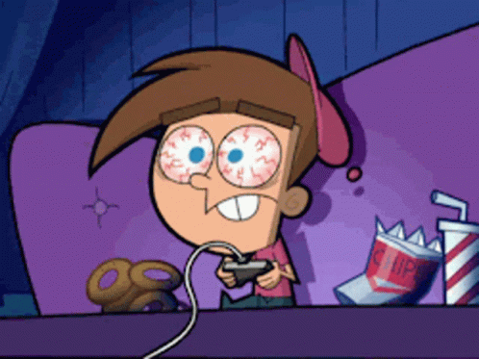
Barriers to sleep in Teens
Delay in melatonin release
Decreased sleep opportunity
Late day caffeination as compensation

Slide 4
Sleep Amounts
1
Amounts
2
Quality
3
Compound interest from lack of sleep
8-10 hours
70% to 89% of teens are not sleeping enough
Amounts may vary based on illness, sleep debt, and physiologic or psychological stress
Athletes may require more sleep Athletes have an advantage
Amount is not the only concern
Uninterrupted
Refreshing
consistent
Cumulative effects
May not always FEEL tired
Notes:
than nonactive individuals to allow for adequate recovery and adaptation between bouts of exercise
athletes exhibit similar or perhaps slightly better sleep duration and quality than sedentary counterparts
Body can adapt to sleep restriction meaning you may not feel it but you may already have significant declines in mental and physical performance declines

Slide 5
Consequences of too little sleep
Reduction in academic performance
Mood Disturbance
Increases in risk taking behavior
Reductions in athletic performance (more on this next)
Reductions in decision making ability
Reductions in learning and cognition (not just important for school)
Reductions in immune function
Increased susceptibility to weight gain

Slide 6
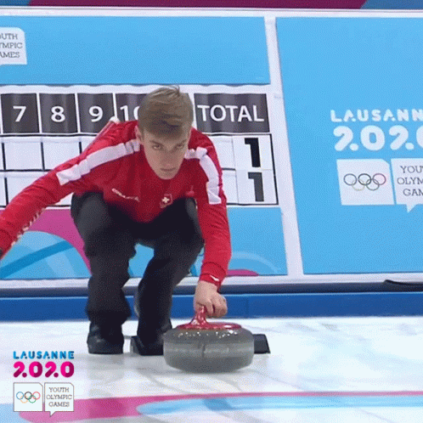
Effects on Performance: Accuracy and Reaction Time
Sleep deprivation and minimal amounts of sleep restriction consistently shown to impair accuracy in athletic events, ]
Accuracy has been found to improve after sleep extension.
Accumulated sleep debt through the week that was associated with worsening reaction times by the end of the week
Notes:
Together, these studies suggest that sleep deprivation and sleep restriction are associated with impairments in reaction time and accuracy, while sleep extension appears to have a beneficial effect on performance of these tasks.
estricted sleep may impair recovery between bouts of strenuous exercise
5- to 7-wk period of 2-h sleep extension in male collegiate basketball players, Mah et al. (²⁴) identified significant improvements in sprint test times, as well as improved self-ratings of fatigue, vigor, and performance during practices and games
maximal weights lifted in bench press, leg press, and dead lift all decreased after three consecutive nights of only 3 h of sleep (³⁴). However, one night of total sleep deprivation was not found to significantly affect lifting performance in male collegiate weightlifters despite worse ratings of sleepiness, fatigue, confusion, mood, and affect (⁴). It has been suggested that sleep loss may have a smaller effect on performance during shorter, maximal events when the effects of increased perceived exertion or muscle glycogen deficits would be less impactful than during prolonged submaximal or progressive efforts

Slide 7
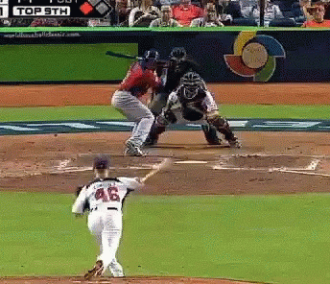
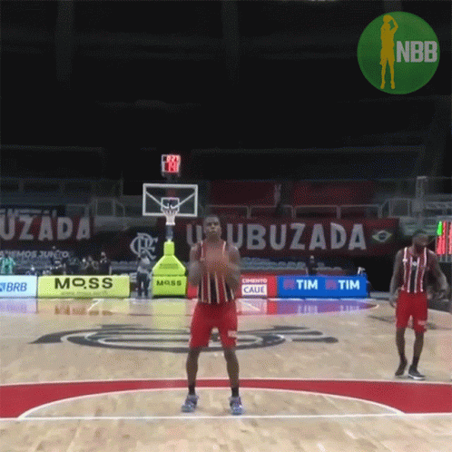
Increased sleep associated with….
Basketball: 9% increase in free-throw accuracy
Basketball: 9.2% increase in three-point field goal percentage
Tennis; 36% to 41% increase in serving accuracy
Swimming: 17% improvement in reaction time off the start block
significantly better strike zone judgment

Slide 8

Effects on Performance: Endurance
Feel exhausted sooner and increases perception of needed effort
Decrease in distance covered
Decrease time to exhaustion in progressive testing in volleyball players
Notes:
Preexercise muscle glycogen stores have been found to be decreased after sleep deprivation, suggesting an alteration in energy availability that could translate into impaired performance in endurance efforts

Slide 9
Effects on Performance: Motor Memory and Cognitive Function
Increased effect on muscle memory
Better coordination and split- second decision making
Memory consolidation
Deprivation associated with loss of focus and flexible thinking
Impairments in neurocognitive performance may be the most critically important effect of impaired sleep on athletic performance in competition
Notes:
sport-specific muscle techniques athletes spend hours training for won't stick as well.
Learning and remembering plays
Tendency to space out and not be able to change plans when needed during a game
particularly in athletic events with large elements of quick decision-making

Slide 10
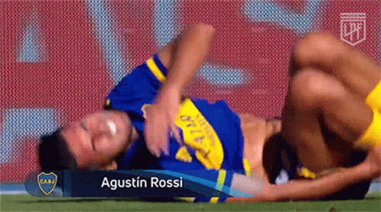
Effects on Performance: Injury Risk & Recovery
Human growth hormone is important for tissue repair, as well as muscle and bone development — and it's only secreted during deep sleep
impaired or decreased sleep is associated with an increased risk of injury.
Cortisol, the "stress hormone," is hard on the body, and sleep decreases it. The result: less frequent illness and faster recovery.
Decreased sleep has been shown to be immunosuppressive and increases susceptibility to upper respiratory infections in particular
Notes:
training availability is a primary determinant of athletic success, and injuries and illnesses represent the greatest obstacle to training participation in athletes.
individuals who slept less than 8 h per night on average were 70% more likely to report an injury than those who slept more than 8 h. In addition, a recent study of 496 adolescent athletes from 16 different individual and team sports found that increased training load and decreased self-reported sleep duration were independently associated with an increased risk of injury. In fact, the greatest risk for injury resulted when training load increased and sleep duration decreased simultaneously, as is often seen in competitive travel and training camps
Those individuals who slept less than 7 h were nearly three times as likely to develop an infection compared with those who slept 8 h or more

Slide 11
Effects on Overall Performance
Improved sleep duration and quality are associated with increased chances of competitive success
Poor sleep quality was an independent predictor of lost competition
Finally, sleep loss has been found to have a negative effect on a number of measures of subjective well-being, including fatigue, mood, soreness, depression, and confusion

Slide 12

FAQ’s
Should you nap?
Can you “catch up” on sleep?
Is there a thing as too much sleep?
Notes:
While further research is needed to clarify the role of naps in athletic performance, the available evidence seems to suggest that naps could be a useful way to increase total sleep duration during periods when sleep restriction is not avoidable, but not necessarily as a substitute for nighttime sleep.

Slide 13

Building Solid Sleep Habits
Environment
Cool (68), dark room
No electronic devices
Minimal ambient noise/ distraction
Bed used for sleeping ONLY
Notes:
electronic devices (¹⁹), they may suppress natural melatonin production and interfere with sleep, To the extent that training and competition schedules allow, athletes should establish consistent sleep and wake times and incorporate a 30- to 60-min period of quiet relaxation before bedtime that can help facilitate sleep onset.
Half life of caffeine is 12 hours -
Naps and sleep pressure- to avoid sleep inertia and avoided late in the day to prevent any disruption of nighttime sleep.
Nicotine is a stronger stimulant than caffiene

Slide 14
Building Solid Sleep Habits
Routine
Consistent sleep and wake times
30-60 min of quiet relaxation before bed
NO SCREENS 1 hr before bed
intake of caffeine or other stimulants (e.g., medication for attention deficit disorder) should be limited to the morning hours, and alcohol and nicotine should be avoided due to their disruptive effects on sleep.

Slide 15
Building Solid Sleep Habits
Lifestyle
No caffeine or other stimulants after lunch
Naps should be relatively brief (~30 min)
No nicotine
Consistent training times
Minimize early morning or late night practices when possible
Exposure to light (natural light) as soon as possible after wakening
No sleep aids/ medications

