Slide 1
Maximizing Athlete Performance with Training and Activation
By Michael Dias MBA, LAT, ATC

Slide 2
Overview
Recovery
Signs of Overtraining and Burnout
Types of Recovery
How and When to Recover
Cases

Slide 3
Recovery... Why does it matter?
As young athletes push themselves to improve performance, they often overlook the importance of recovery.
However, recovery is as vital to success as training itself.
This presentation will explore why recovery is crucial for young athletes' physical, mental, and long-term development.
The work off the field translates to on-field performance.

Slide 4
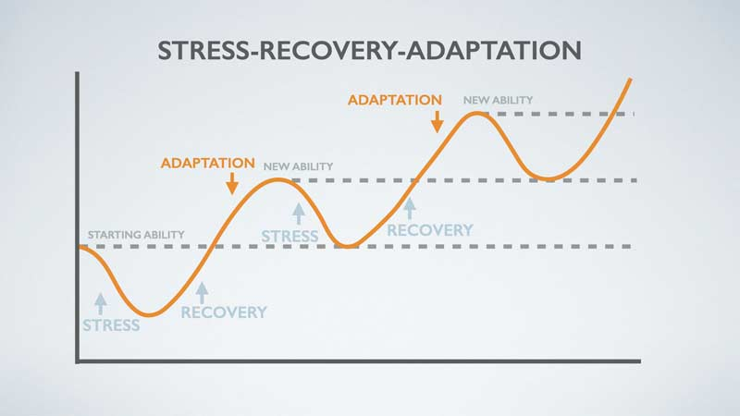
What is Recovery?
Recovery refers to the process of allowing the body and mind to rest and repair after physical activity. It includes both physical and mental aspects, helping the athlete restore energy levels, repair muscle tissue, and reduce stress.
Forms of recovery:
  Physical Recovery
  Mental Recovery
  Active Recovery

Slide 5
Why does it matter?
Muscle Repair & Growth:
During intense exercise, muscles sustain tiny tears. Recovery allows the body to repair these tears, leading to stronger muscles.
Prevention of Overuse Injuries:
Consistent training without adequate recovery can lead to overuse injuries, such as tendinitis and stress fractures, particularly in young athletes whose bones and joints are still developing.
Energy Restoration:
Exercise depletes glycogen stores in muscles. Recovery helps restore these energy stores, improving performance for the next workout or competition.
Mental Health:
Recovery isn't just physical. Mental fatigue from continuous training or competition can lead to burnout, anxiety, and reduced motivation. Recovery periods give athletes time to rest their minds and maintain a love for the sport.
Notes:
Increased Risk of Injury:
Overtraining without proper rest weakens muscles and joints, leading to a higher chance of acute injuries like sprains, strains, and fractures.
Decreased Performance:
Without recovery, performance stagnates or declines. Athletes may find themselves fatigued, unable to perform at their peak, and more prone to mistakes.
Mental Burnout:
Constant training without downtime can lead to burnout, reducing an athlete's motivation, passion, and overall enjoyment of the sport.
Long-Term Health Implications:
Overuse injuries in youth sports can have long-term consequences, potentially affecting an athlete's future in the sport and general mobility later in life.

Slide 6
Signs That Young Athletes Need Recovery
Physical Symptoms:
Persistent soreness or muscle tightness.
Decreased performance or difficulty completing workouts.
Increased risk of injuries (strains, sprains).
Fatigue or feelings of heaviness in the body.
Mental Symptoms:
Decreased motivation or interest in the sport.
Feelings of stress, anxiety, or irritability.
Trouble focusing or lack of enthusiasm during training or competition

Slide 7
How Can Young Athletes Recover Effectively?
Short-Term recovery (Active Recovery)
Long- Term Recovery
Prioritize Sleep
Balanced Nutrition
Incorporate Active Rest Days
Stretching & Mobility
Strength Training
Therapeutic Modalities
Mental Recovery Techniques
Prioritize OFF Days/Weeks!
Nutrition
Sleep
Notes:
Prioritize Sleep:
Sleep is the most important recovery tool. Growth hormone, which aids muscle recovery, is released during deep sleep. Ensure 8–10 hours of sleep per night.
Balanced Nutrition:
Proper nutrition provides the body with the fuel needed for recovery.
Incorporate Active Rest Days:
Take days off from intense training, but engage in light activity such as walking, stretching, or yoga to keep the body moving and promote circulation.
Stretching & Mobility Work:
Regular stretching, foam rolling, and mobility exercises help reduce muscle stiffness and improve flexibility.
Mental Recovery Techniques:
Encourage relaxation techniques like deep breathing, meditation, or visualizing success to reduce stress and anxiety

Slide 8
Active Recovery Methods

Slide 9
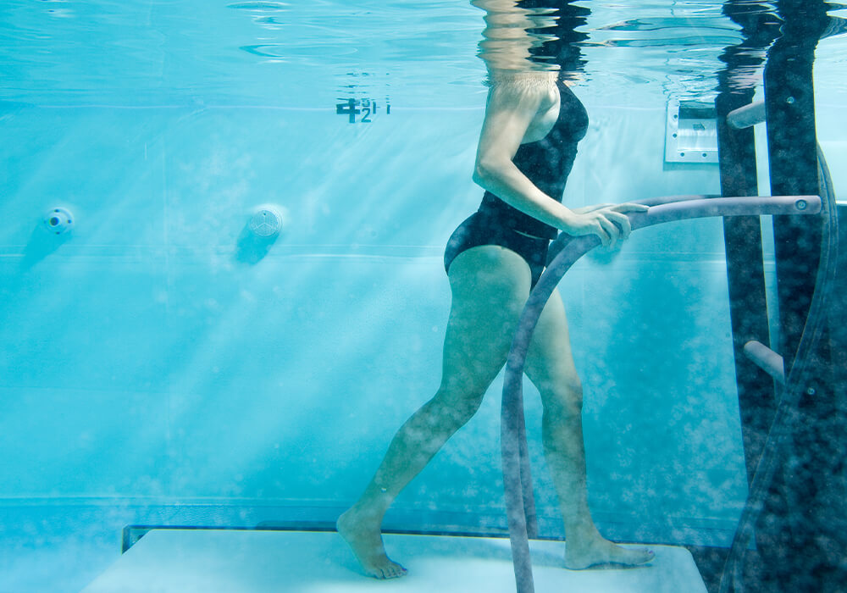
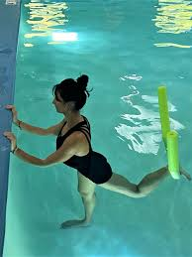
Aquatics
Benefits
Examples:
Swimming
Aqua Walking
Therapeutic Exercises
Stretching
Hot Tub
Reduces Stress/Impact
Increase Resistance
Improves Circulation
Pain Relief
Low Impact Cardiovascular Benefits
Relaxation and Stress Relief
Notes:
Reduces Impact
Provides buoyancy which decreases stress on joints and muscles
Increased Resistance
Water is denser than air, which allows for resistance training without heavy weights
Improves circulation
The hydrostatic pressure of water can enhance blood flow and promote healing and reducing swelling
Pain Relief
Warm Water can alleviate pain and soothe muscles
Low impact Cardiovascular benefits
Aquatics activities can provide cardiovascular conditioning with less risk of injury
Relaxation and Stress Relief
Soothing properties- relieve stress and anxiety

Slide 10
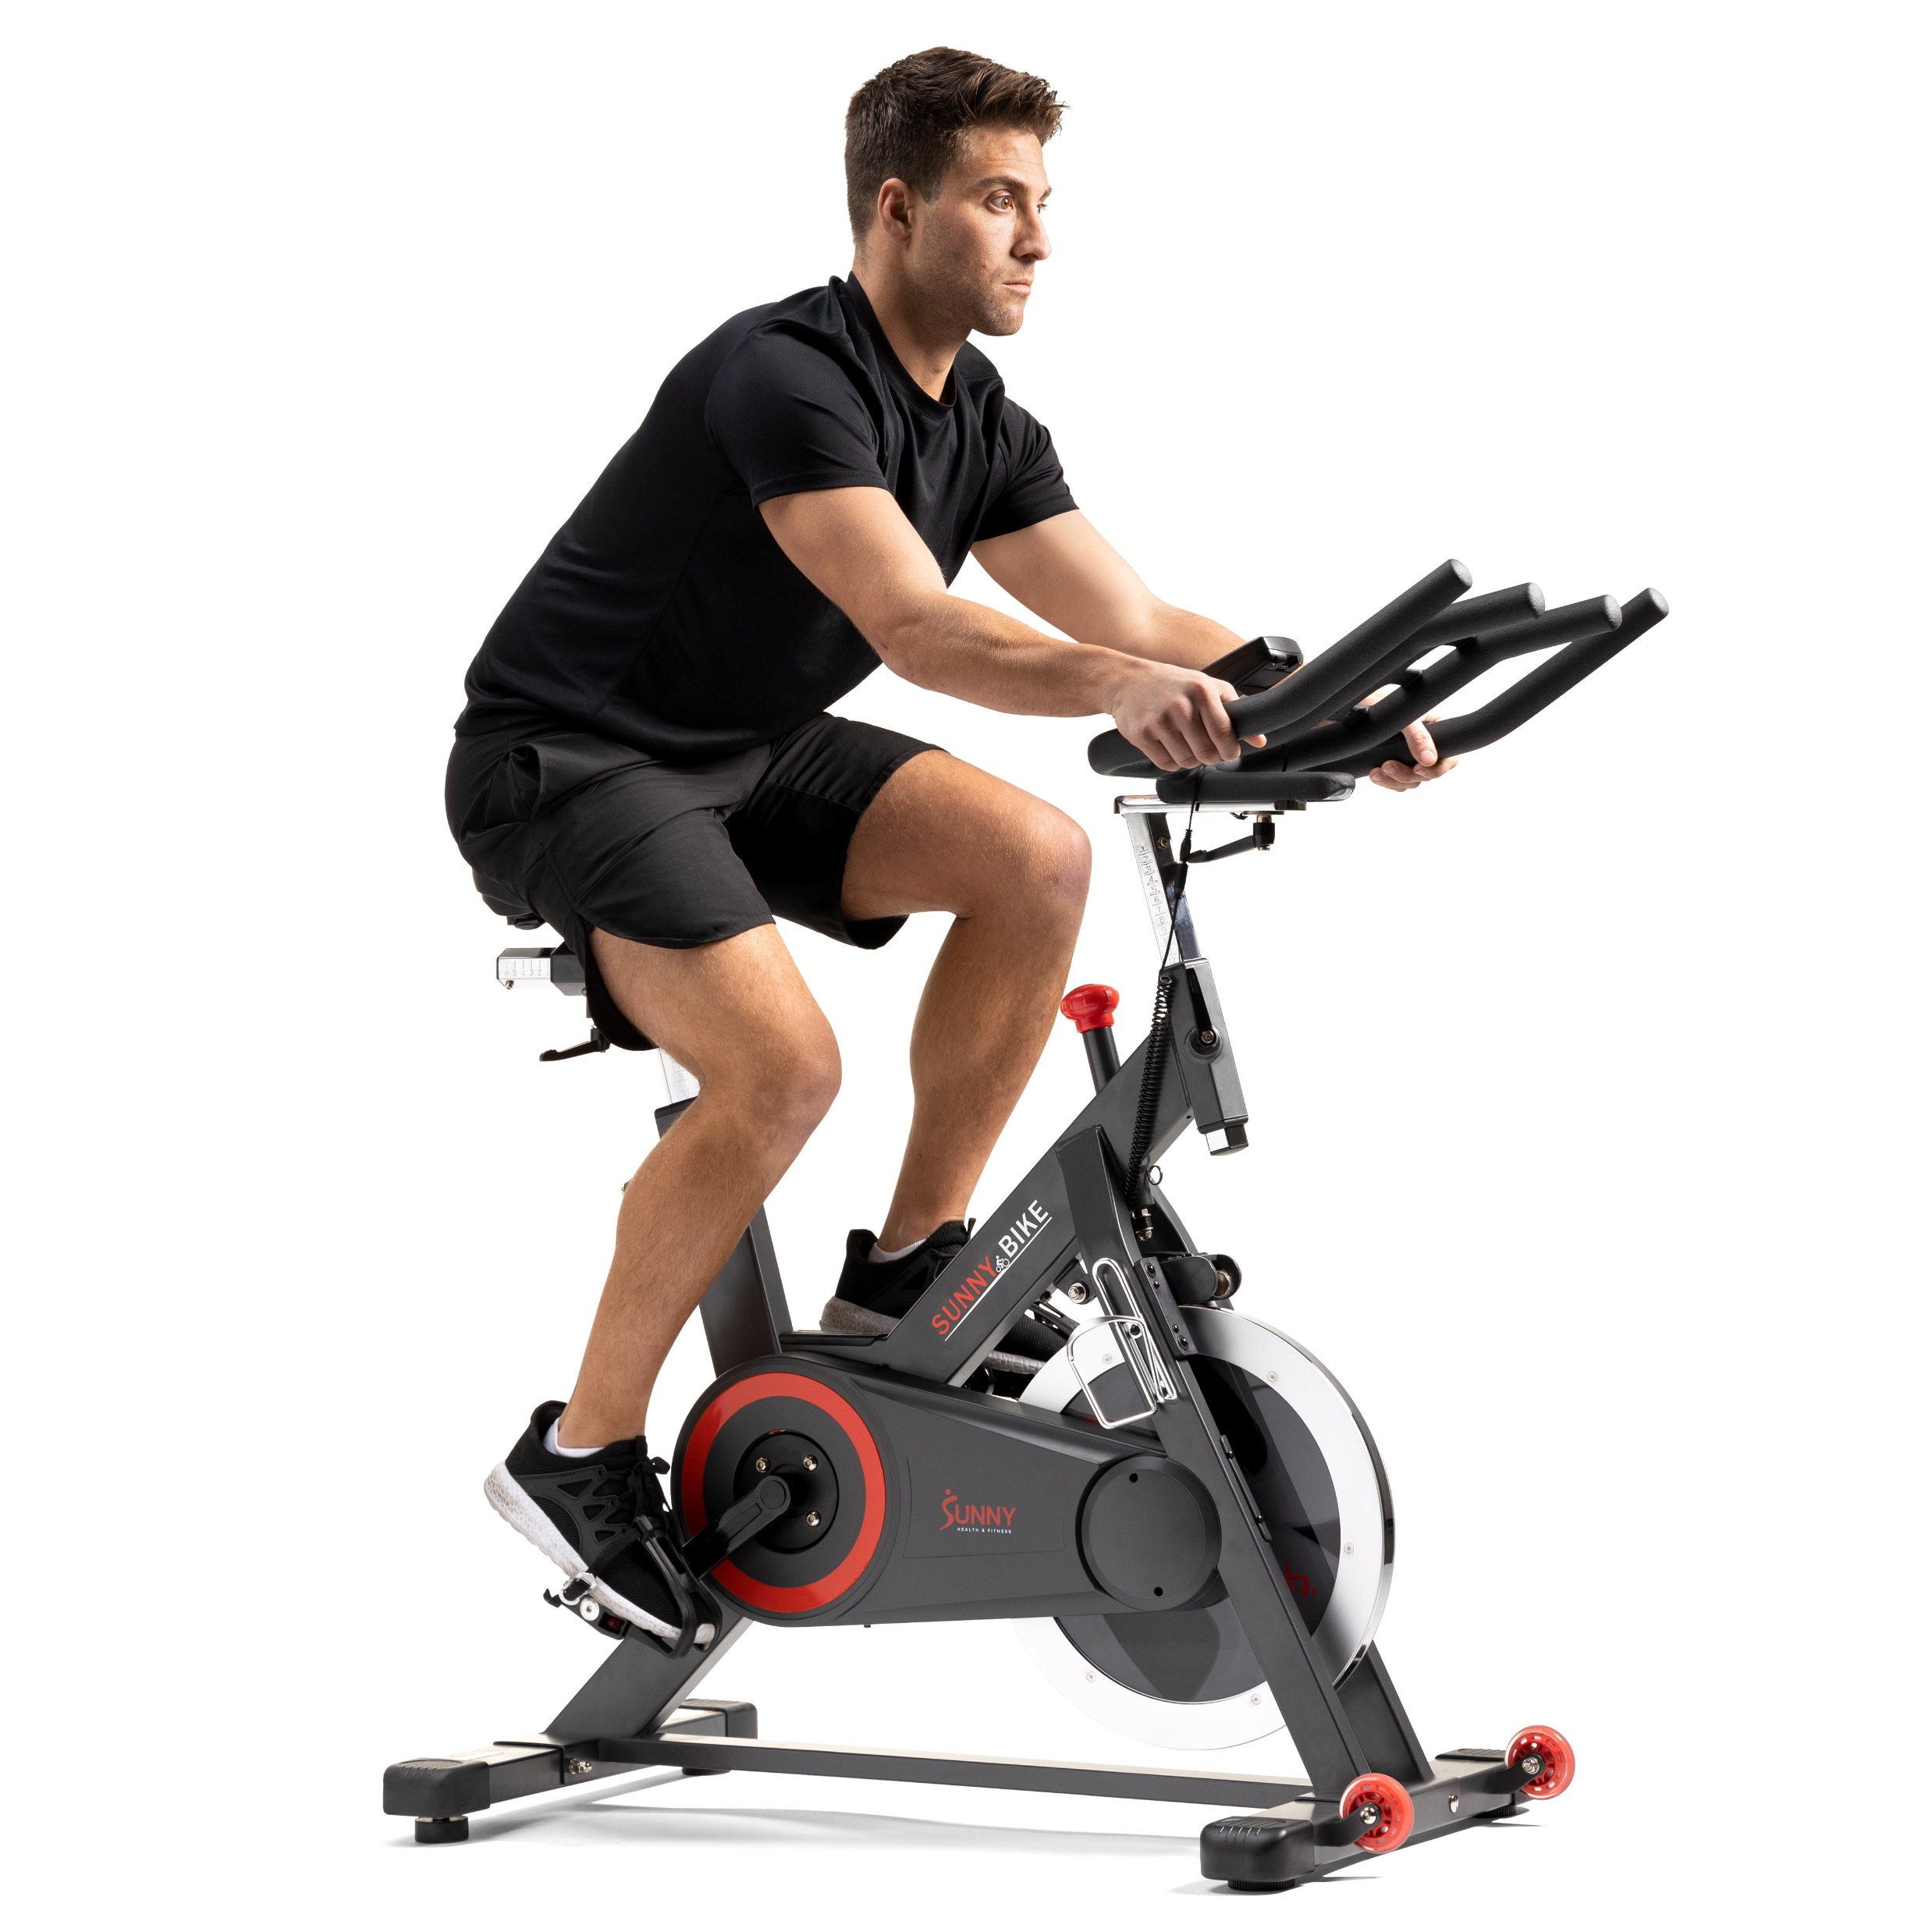
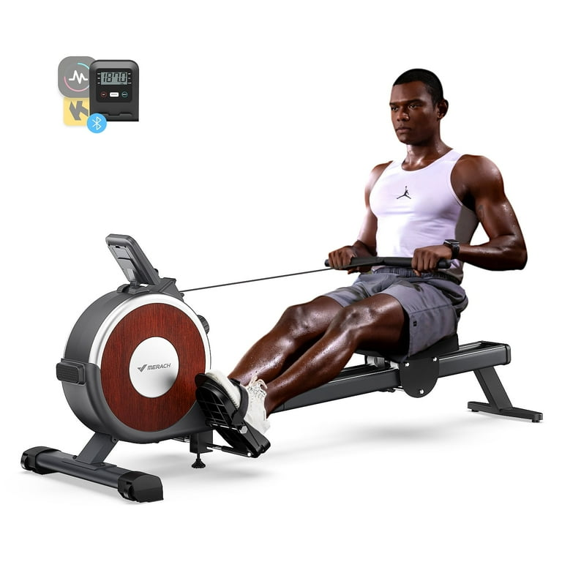
Cycling/ Elliptical
Benefits
Low- Impact
Cardiovascular Fitness
Strengthening Muscles
Improves Circulation/ Mobility
Examples:
Stationary Cycling
Cycling at trails or neighborhoods
Elliptical
Rowing Machine
Notes:
Low- Impact
Low- Impact to the joints as compared to running/ Jogging
Cardiovascular Fitness
Improves Cardiovascular Health, enhances endurance and overall fitness without overexerting the body
Strengthens Muscles
Improves Lower body muscle groups
Improves Circulation/ Mobility
Increases blood flow, aids in healing with nutrient dense blood to tissues
Improves lower body joint mobility

Slide 11

Trail Day
Notes:
Benefits
Low-Impact
Cardiovascular
Mental Well-being
Examples:
Brisk Walk
Hiking

Slide 12
Weightlifting
Benefits
Key
Improve Blood Circulation
Reduce Muscle Soreness
Muscle Maintenance
Joint Mobility
Improve Mental Health
Lifting 30-40% of your usual weight
High Repetitions
Focus on Form
Include Different Muscle Groups
Notes:
Weightlifting during the season is OK!

Slide 13
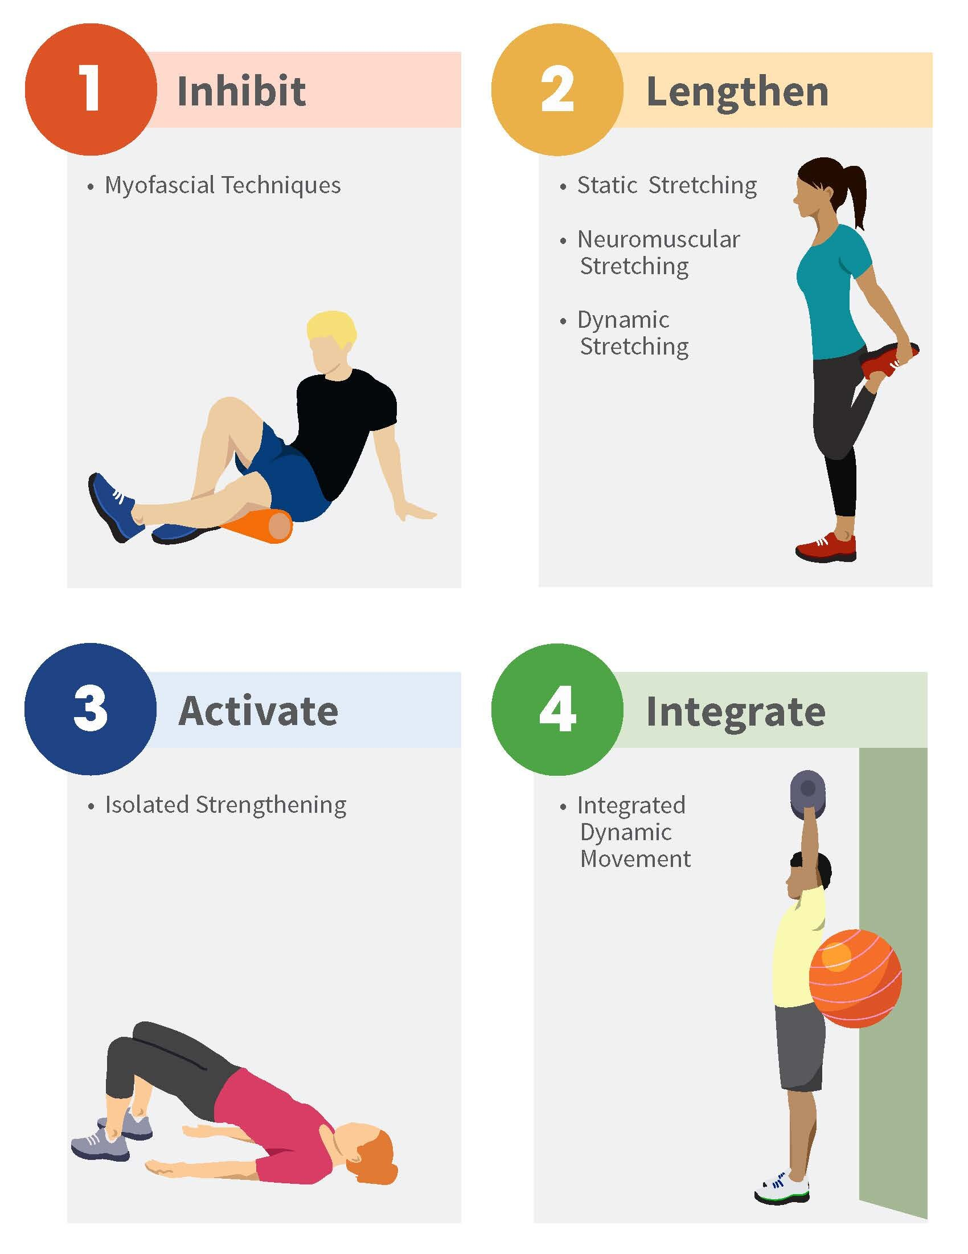
Stretching & Corrective Exercise
Benefits:
Reduce Muscle Soreness
Improve Flexibility and Range of Motion
Low Impact
Decrease Risk of Injury
Improve Blood Circulation
Maintaining Strength
Examples:
Theraband Exercises
Functional Movements

Slide 14
Pregame Warm-Ups
Goal:
Increase Blood Circulation
Increase Range of Motion and Strength
Reduce Anxiety
Reduce Risk of Injury
Key:
Dynamic Warm-up
Sport Specific Movements
Theraband activation
Stationary Bike/ Jog

Slide 15
Therapeutic Modalities

Slide 16
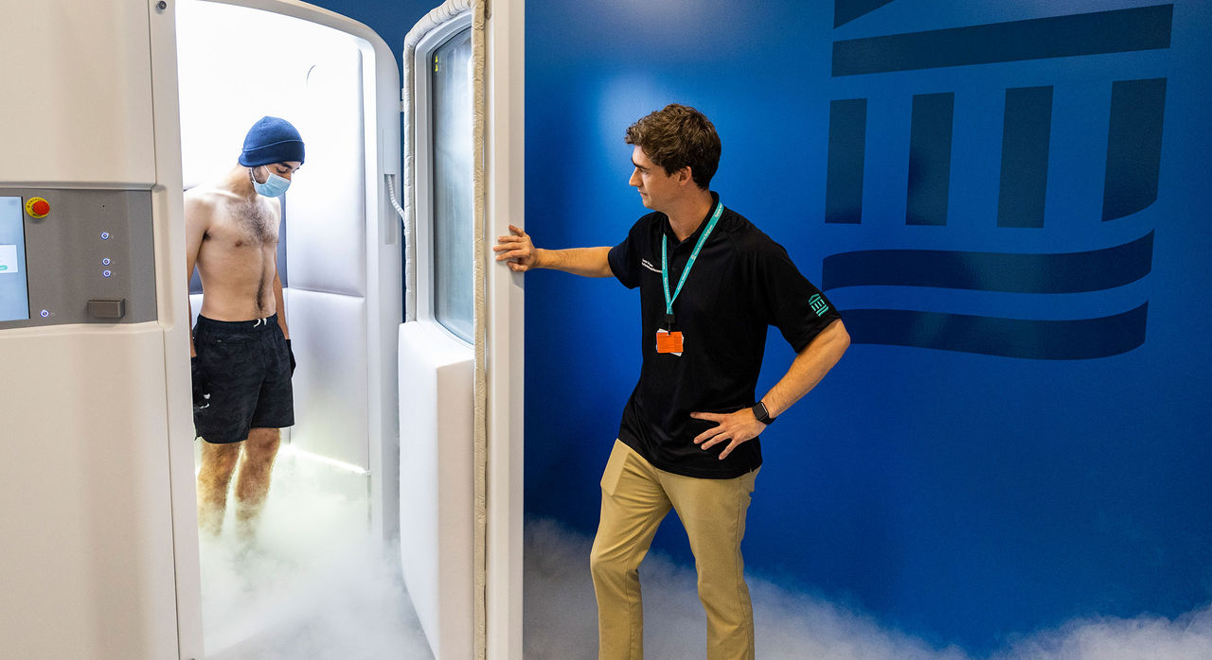
Cryotherapy
Benefits
Examples
Reduce swelling and pain
Reduce delayed onset muscle soreness (DOMS)
Reduces Fatigue
Cryochambers
Ice Baths
Ice
Gameready units
Notes:
Cryotherapy- how does it work?
Cold therapies vasoconstrict your blood vessels/ tissues which restrict blood flow to the area of your body. This decreases the amount of inflammation and perception of pain and fatigue. Less inflammation to the joint, muscle tissue, tendon= faster recovery time.
Time and place for Cryotherapy

Slide 17
Thermotherapy
Benefits
Examples
Increase Blood Circulation
Pain Relief
Muscle Relaxation
Improve Range of Motion
Hot Tub
Heat pack
Saunas
Notes:
Opposite to Cryotherapy- Thermotherapy (Heat) will vasodilate your blood vessels and tissue
Increase Blood Circulation
Improve the circulation of oxygen and nutrients to the muscle tissues
Pain Relief/ Muscle relaxation
Increase in blood flow will reduce tight/ spasming muscle tissue and reduce pain
Improves Range of motion
Mention Contrast therapy and segway to Compression/ Massage therapy

Slide 18
Compression/ Massage Therapy
Benefits
Examples
Increase Blood Flow
Reduce Inflammation
Enhance Lymphatic Drainage
Muscle Relaxation
Decrease Stress
Full body massage
Compression boots
Compression pants
Massage guns
Foam rollers

Slide 19
See your ATC!
We are specialist
We all carry different techniques/ skill set to help you perform at your best!
Cupping
Dry Needling
IASTM
Trigger point
Stretching

Slide 20
Example A
Soccer player in the middle of their season feeling sluggish, lack of energy (delayed), “legs feel like 1,000 pounds”.
Games are on Wednesday and Saturdays, and they get Sundays off.
What advice should we give them?

Slide 21
Example B
A senior basketball player who had a long season with the team by making it to the finals of the State Championship and played every varsity game. Leading up to the Championship game the athlete began noticing some lower back pain and knee soreness in the mornings. The athlete thought nothing much of it and pushed through to finish the Championship game. Following the Championship game Saturday the volleyball coach spoke to the athlete about having him join the team as the spring season has begun.
What recommendations should we give to this athlete?

Slide 22
Example C
We have an avid running athlete, who participates in all three high school seasons. They go see the athletic trainer early in the fall season to discuss a recovery program for the year. What are some examples we can discuss with them that will be beneficial to prevent burn out and decrease in performance?

