Slide 1

ACL Tears: Understanding Injury Mechanisms and Prevention
Jim Spak, MD

Slide 2
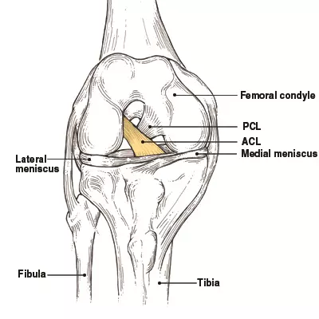
Background
Anterior Cruciate Ligament (ACL)
Anatomy
  Posterior lateral femoral condyle → anterior medial tibial plateau
  Crosses anterior to the PCL
Function
  Limits anterior translation of the tibia
  Limits rotation of the tibia
Notes:
https://www.vumedi.com/video/what-is-new-in-female-acl-acl-injury-prevention/

Slide 3
Epidemiology
Increasing rates of both:
Mid-substance ACL injury
ACL reconstruction (ACL – R)
Possible explanations:
Increased awareness → increased diagnosis
True increase in injuries
Changing patterns in sports participation
Younger ages
Higher physical demands
Sports specialization
~350,000 surgeries/yr performed in the US

Slide 4

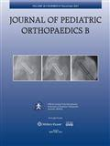
Epidemiology
Werner et al. , JPO 2015
  2007-2011
  Patients aged 10-14 yrs
  Nationwide rates of:
    ACL Injury
      18.9% increase
    ACL – R
      27.6% Increase
Dodwell, AJSM 2014
  1990-2009
  Patients aged 3-20 yrs
  NY State Rates of ACL-R
    Significant increase from 18 – 51 ACL-R/100,000

Slide 5
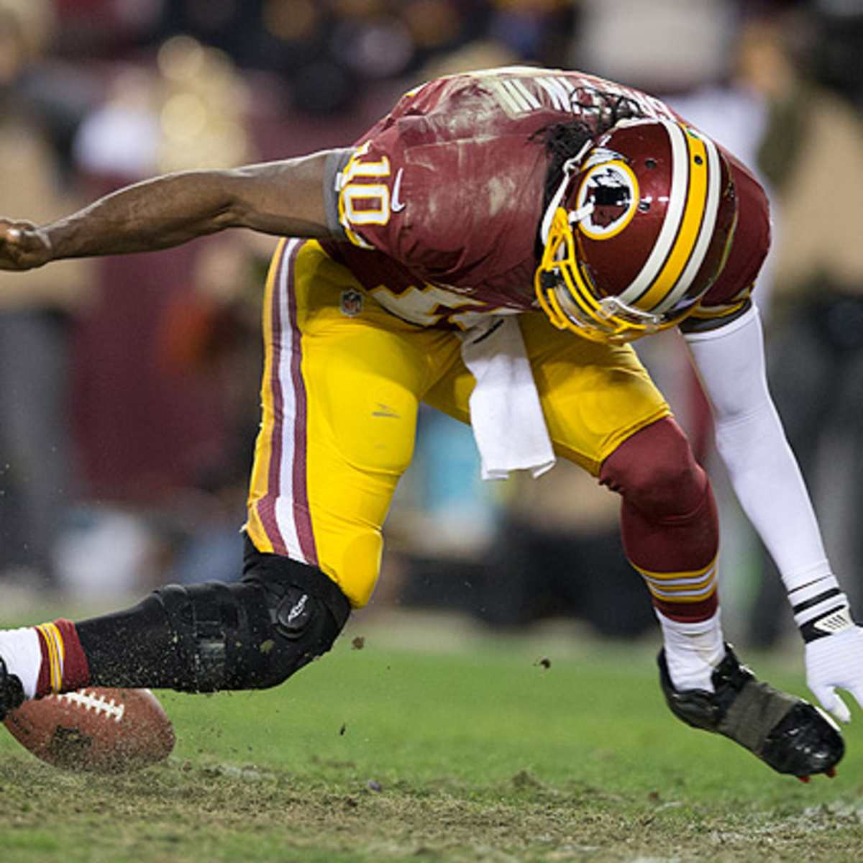
Clinical Presentation
  History
  Non-contact pivoting mechanism
  Acute onset of pain
  Palpable/audible “pop”
  Rapidly-appearing knee swelling
  Physical Examination
  Joint swelling
  Positive ACL Stability Tests
    Anterior drawer
    Lachman
    Pivot Shift

Slide 6
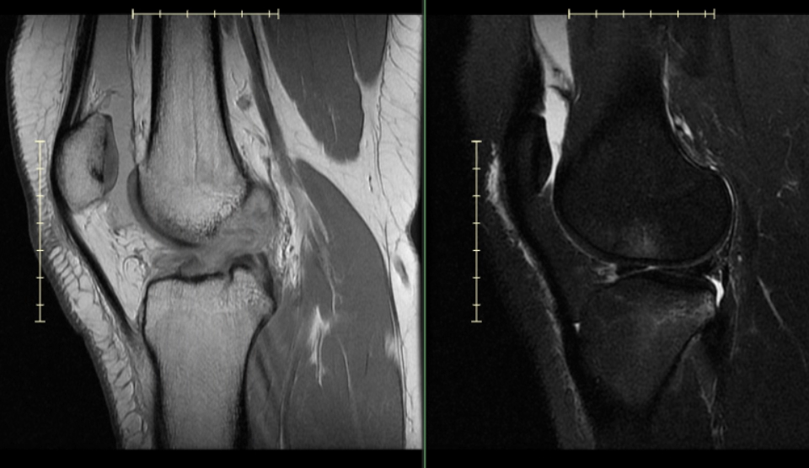
Clinical Imaging
X-Rays
  Tibial Spine Injury
  Bony avulsions
  Physeal (growth plate) injuries
MRI
  ACL Tear – 95% sensitive, 88% specific
  Other Injuries: Meniscus, Cartilage
  Physeal Patency

Slide 7
Can we predict who is likely to suffer injury?

Slide 8
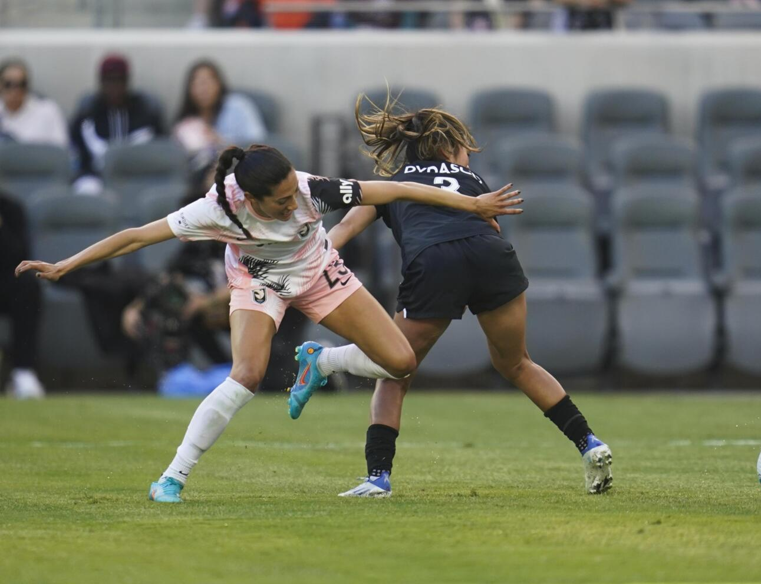
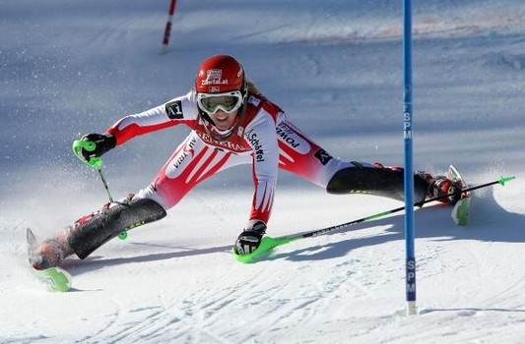
Higher Risk Sports
1. Soccer
2. Skiing
3. Football
4. Basketball
Lower Risk Sports
1. Swimming
2. Golf
3. Ice Hockey
Notes:
Dynamic cutting, pivoting, jumping and tackling sports like soccer, basketball and football are the highest risks for ACL injury. Other sports such as handball, volleyball, gymnastics, skiing and tennis also place the knee at risk for ACL injury. Sports that present a much lower risk for ACL injury include swimming, golf, baseball and ice hockey.
REF: ACL Moon Group Website
https://acltear.info/acl-injury-prevention/

Slide 9
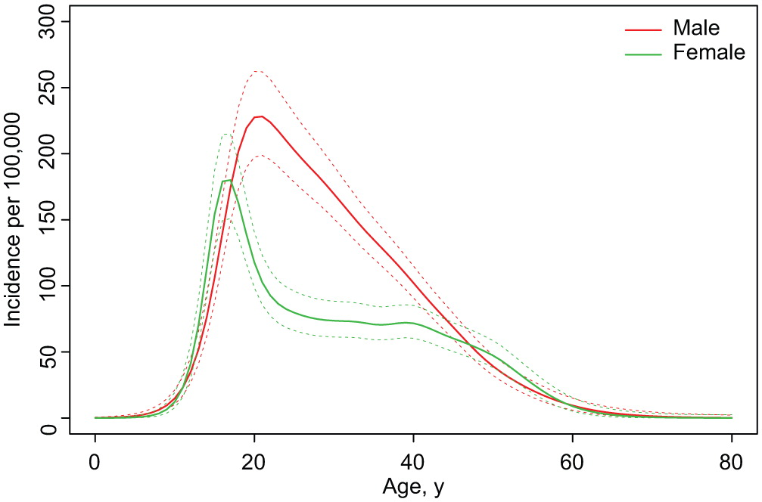
Age
Increased injury rates in patients between ages 15 and 25 yrs
Krych et al. 2016, AJSM
Notes:
People between 15 and 25 years old sustain more ACL injuries. This is mostly because this population is more physically active. Despite the growing obesity problem in America and the rise of sedentary activities, adolescents are playing competitive sports at higher rates than ever before. Besides being more active in sports, children also tend to be more flexible than adults due to the higher elasticity of their ligaments, tendons and joints.
Ref: Incidence of Anterior Cruciate Ligament Tears and Reconstruction: A 21-Year Population-Based Study, Krych et al 2016

Slide 10
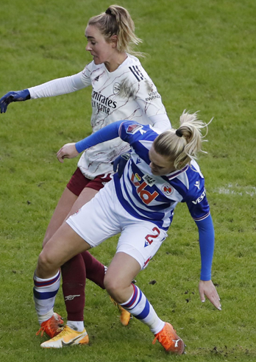
Sex-Based Differences
Females have higher rates of ACL injury vs males
  Previous estimates as high as 8x the risk
  Recent studies estimate ~2-fold risk for female athletes
Absolute # of injuries is higher in males BUT relative risk is higher in females
Notes:
Several studies show that female athletes are more likely to tear their ACLs than males competing in the same cutting and pivoting sports. Theories for this sex difference range from hormonal and anatomical differences to lower biomechanics and neuromuscular control.
Two pieces of good news for women:
Following ACL surgery on one knee, females have the same—NOT higher—risk as males to tear the ACL in the other knee.
Following surgery, female and male athletes have the same retear risk of their reconstructed ACLs.

Slide 11
Prior ACL Injury History
25% of all athletes who have an ACL reconstruction will suffer another ACL tear at some point in their athletic career.

Slide 12
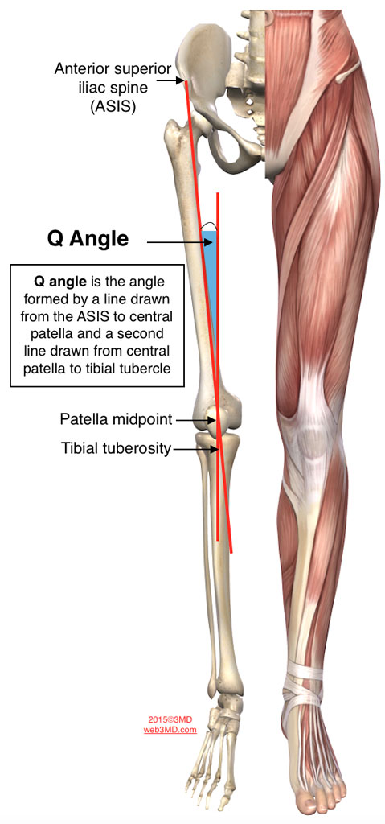
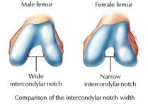
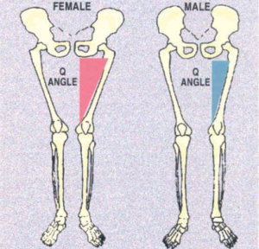
Non-Modifiable Risk Factors
Increased Q angle
Decreased Intercondylar Notch Width
Increased Posterior Tibial Slope

Slide 13
Non-Modifiable Risk Factors
ACL Morphology
  Smaller ACL size, smaller fibers, decreased mechanical properties
Cyclical variation in sex hormone (Estrogen, Relaxin)
  Changes in muscle coordination, muscle functionality
  Altered decelerated relaxation + increased fatigability during the ovulatory phase of the menstrual cycle
Genetic Predisposition
  1st degree relatives of patients w/ ACL tears 2x as likely
  White European or American > other ethnicities
  COL5A1 gene liked to increased injury in female athletes
Notes:
Perhaps get sources here (8-10) UPMC talk

Slide 14
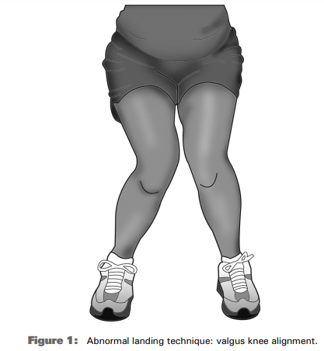
Modifiable Risk Factors
Biomechanical/neuromuscular
  ↓ Hip and knee flexion angles
  ↑ Internal hip rotation
  Dynamic knee valgus
  High quadriceps forces
    ↑ Q/HS
  “Stiff” landing

Slide 15
Understanding Injury Mechanism and Prevention
Notes:
Sources:
Allertorn-Geli et al 2009

Slide 16
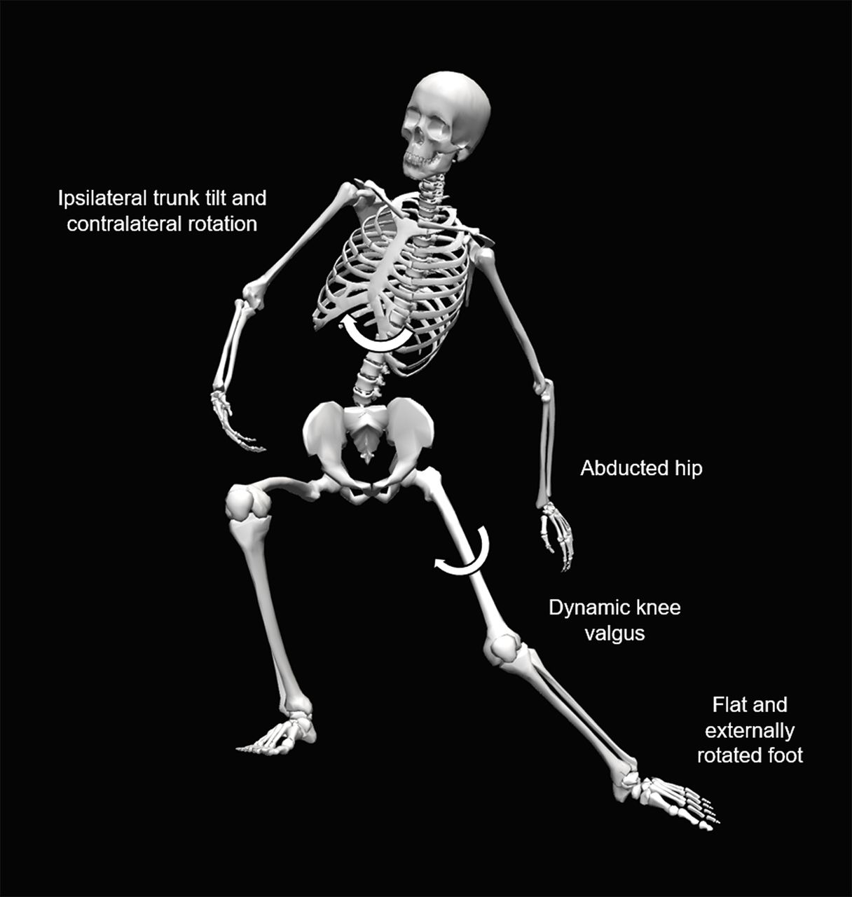
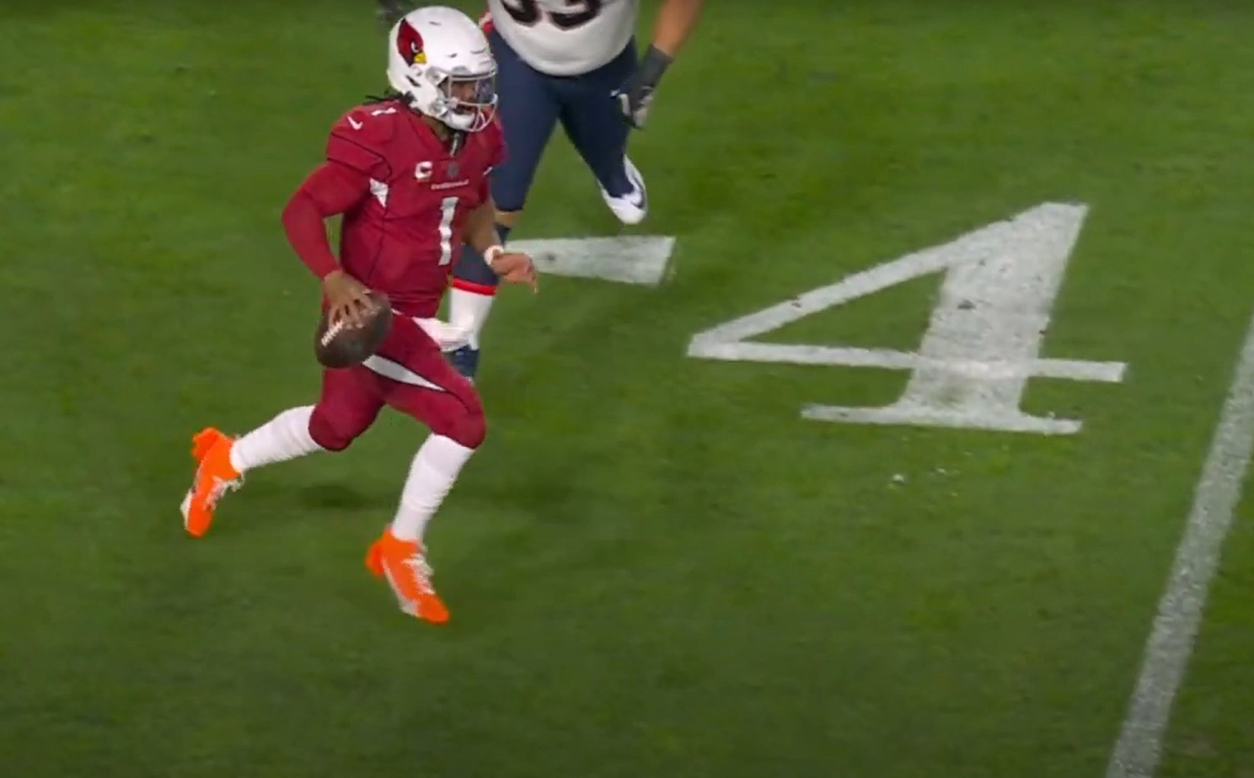
Della Villa et al. 2020, BJSM
Ipsilateral Trunk Tilt and Contralateral Rotation
Abducted Hip
Dynamic Knee Valgus
Foot Planted and Externally Rotated
Notes:
Ref:
Systematic video analysis of ACL injuries in professional male football (soccer): injury mechanisms, situational patterns and biomechanics study on 134 consecutive cases
Della Villa et al.

Slide 17
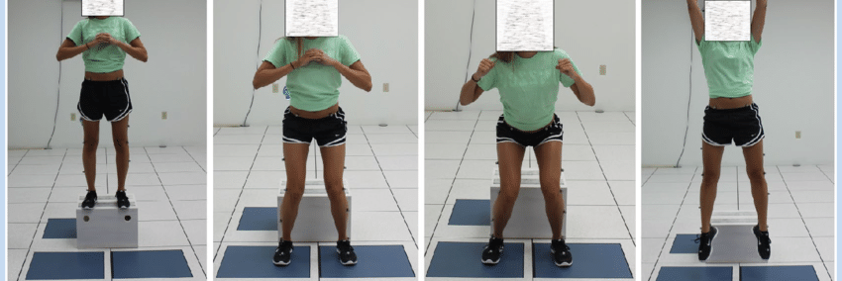
Drop- Jump Test
Notes:
The identification of those athletes at increased risk may be a salient first step before designing and implementing specific pre-season and in-season training programs aimed to modify the identified risk factors and to decrease ACL injury rates.
A deficiency in the neuromuscular control of the hip has been identified as a key risk factor for noncontact anterior cruciate ligament injury. This deficiency can manifest itself as a valgus knee alignment during tasks involving hip and knee flexion. The Drop jump test is a test to observe and evaluate the dynamic knee valgus. It helps clinicians decide whether patients have a low-risk of high-risk landing mechanism.
Kappa coefficients for intra-rater and inter-rater agreement ranged from 0.75 – 0.85, indicating that ratings were reasonably consistent over time and between physiotherapists. Sensitivity and specificity values were inadequate, ranging from respectively 67% – 87% and 60% – 72%. To detect a greater proportion of individuals at risk of ACL injury, clinicians should ensure that they include additional tests for other high-risk characteristics in their screening protocols.
To conduct the test, let your patient stand on a 31cm high box. Then the patient drops down to the floor and immediately performs a maximum vertical jump. The patient needs to keep his or her arms in the “stop position”. The shoulders should be abducted at 45° and the elbows flexed at 90°, to reduce momentum from the arm swing. To minimize learning effects, 3 practice trials of the drop-jump are allowed. After this, 9 consecutive drop-jump trials were conducted. A ten-second rest between trials is allowed to reduce fatigue.
REF: https://www.physiotutors.com/wiki/drop-jump-test/
Development and Validation of a Portable and Inexpensive Tool to Measure the Drop Vertical Jump Using the Microsoft Kinect V2
August 2017
Sports Health A Multidisciplinary Approach 9(6):1941738117726323
DOI:10.1177/1941738117726323

Slide 18
Integrative Neuromuscular Training
Education and Instruction
Mastery of Fundamental Movements
Progressive Exercise
Structured Volume and Recovery
Exercise and Variation
Myer et al. 2011, Curr Sports Med. Rep.
Notes:
Focus of most preventative programs are focused on neuromuscular training
Neuromuscular control refers to the unconscious activation of dynamic restraints surrounding a joint in response to sensory stimuli
The neuromuscular system generates movement and determines the biomechanics of the movement action which emphasizes its importance in atheletic activity
At the center of this is proper education and instruction – testing needs to be administered by a trained professional – where feedback needs to be administered regularly
Proper instruction and education is required – often where most of these programs fall short.
REF: https://www.vumedi.com/video/prevention-strategies-for-acl-injuries-a-hop-skip-and-a-jump/
https://pmc.ncbi.nlm.nih.gov/articles/PMC3105332/
When to initiate integrative neuromuscular training to reduce sports-related injuries in youth?
Gregory D Myer ^{1,2,4}, Avery D Faigenbaum ³, Kevin R Ford ^{1,2}, Thomas M Best ^{4,5}, Michael F Bergeron ⁶, Timothy E Hewett ^{1,2,4,7}
Author information
Copyright and License information
PMCID: PMC3105332 NIHMSID: NIHMS289927 PMID: 21623307

Slide 19
Foundational Strength
Much literature points to strengthening of core and posterior chain for primary ACL prevention
  Core:
    Ex: Planks, side plans
  Glutes
    Ex: Lunge variations
  Hamstrings
    Nordics, Deadlifts
  Plantar-flexors
    Soleus and Gastroc heel raises, hopping
It is critical that foundational movements such as squats and lunges are well understood to assist w/ INT implementation
Plyometrics often incorporates all of these components

Slide 20
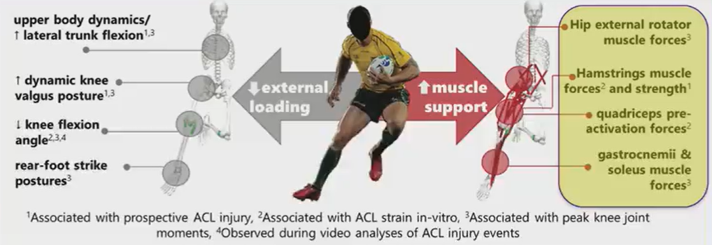
Foundational Strength
Weir et al. 2021, Sports Biomechanics
Notes:
On the right we have the biomechanical risk factors on the left
And on the right, we have the methods of how we address these weaknesses on the right

Slide 21
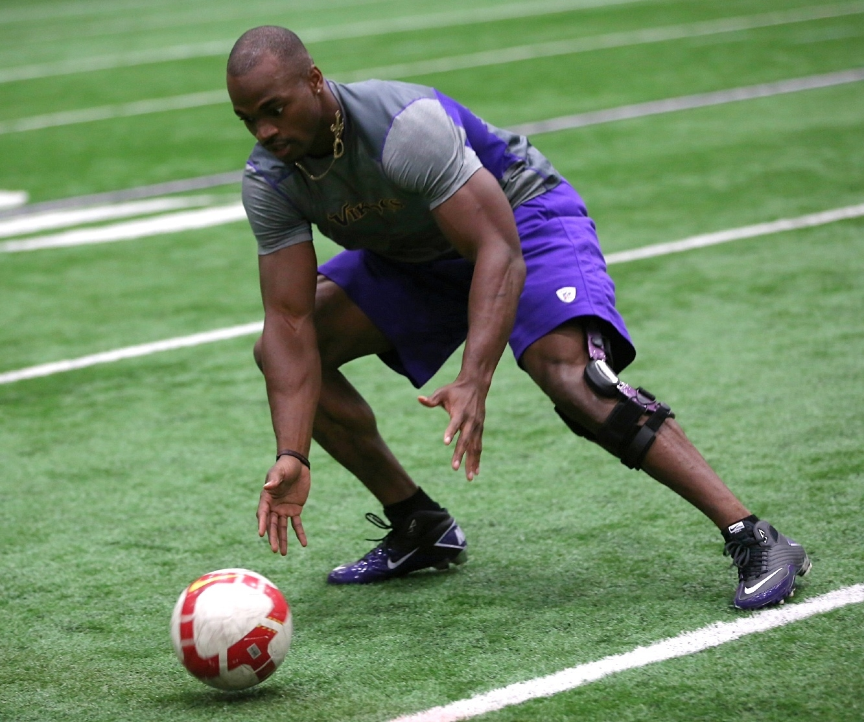
Do ACL Prevention Exercises Really Work?

Slide 22
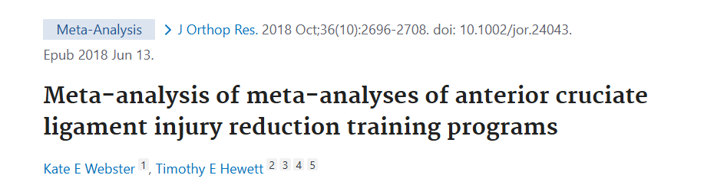

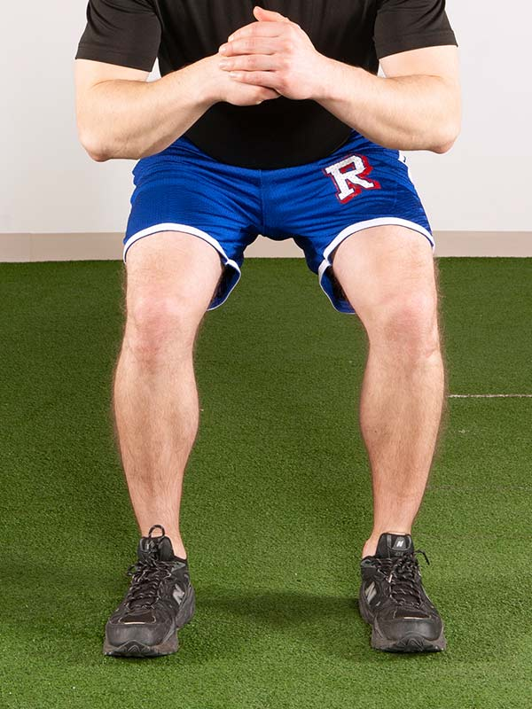
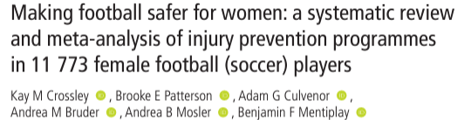

Overall 50% reduction in risk of all ACL injuries in all athletes
67% reduction for non-contact ACL injuries in females
111,773 Female Soccer Players
Overall injuries in females reduced 27%
ACL injuries reduced 47%
Notes:
Short answer is yes

Slide 23
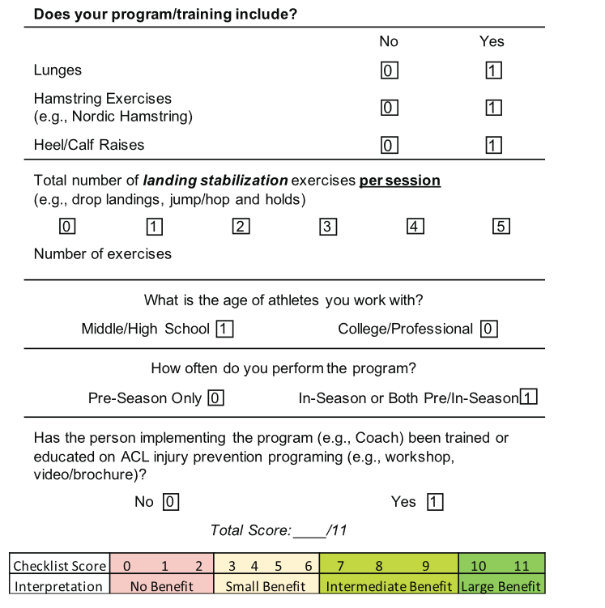
What makes a good ACL prevention program?
Programs in younger athletes perform better
Increased benefit w/ both pre-season and in-season programs
Better w/ coach/trainer specifically educated and trained on ACL prevention
  FEEDBACK IS CRITICAL
Poor compliance limits success
Petuscheck et al. 2018, AJSM
Notes:
Poor compliance is likely the reason why we are not seeing significant decreases in ACL injury rates in young athletes

Slide 24
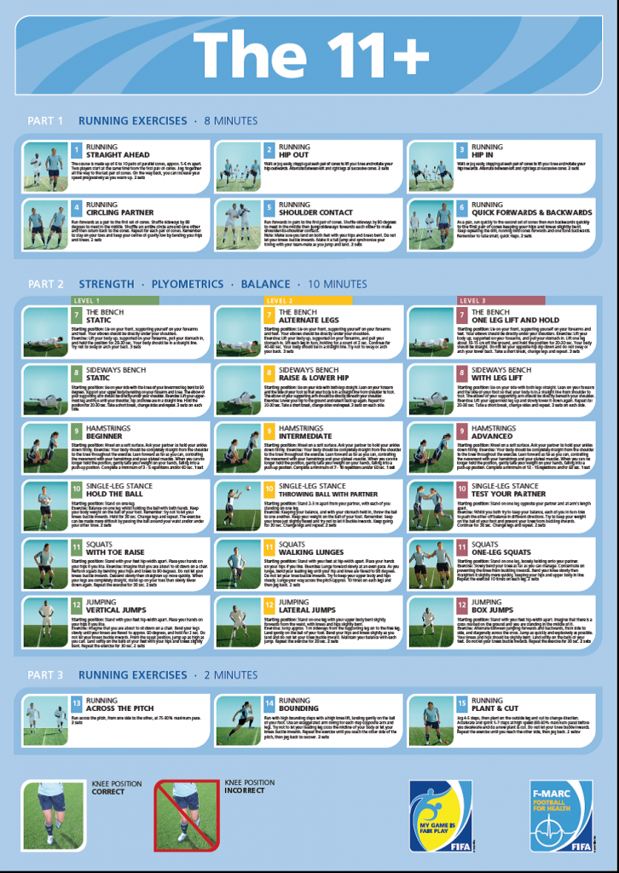

Risk Reduction Programs
FIFA- +11
Prevention Enhance Performance Program (PEP)
Sportsmetrics
Australia Perform + Program

Slide 25
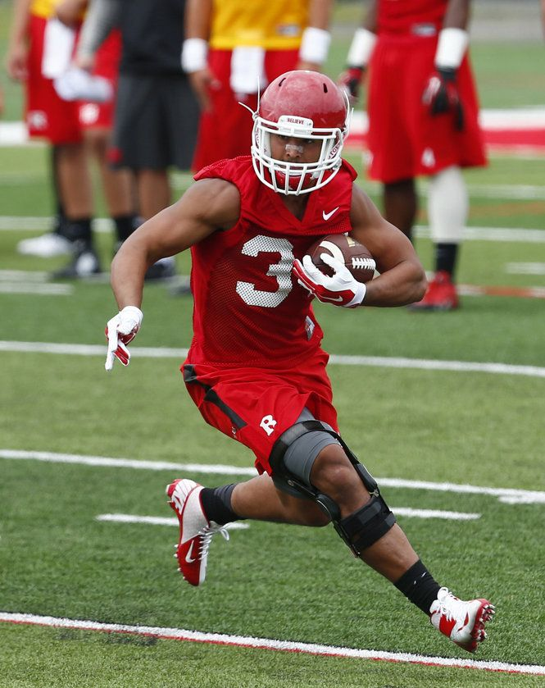
What has not demonstrated significant effect with ACL prevention?
Post-surgical rehab not including functional neuromuscular strengthening and sports-specific exercises
Rehab methods only focusing on the involved knee
Prophylactic knee bracing

Slide 26
What has no proven effect?

Slide 27
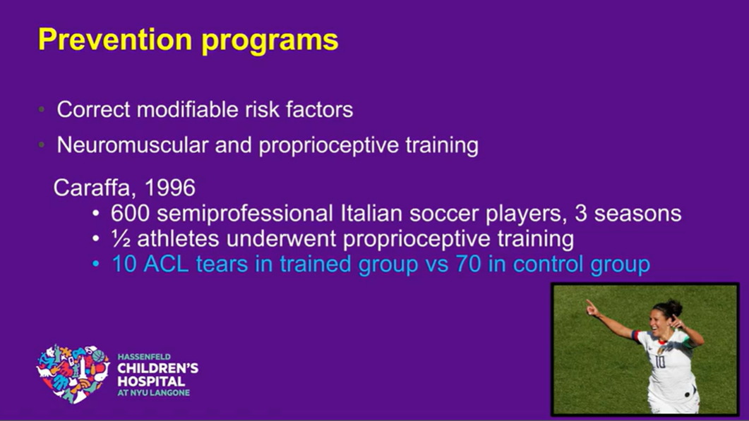
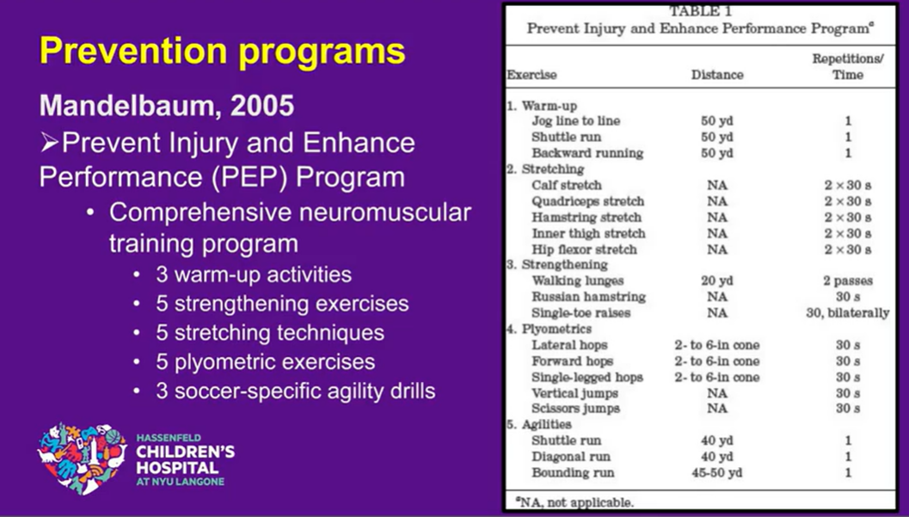
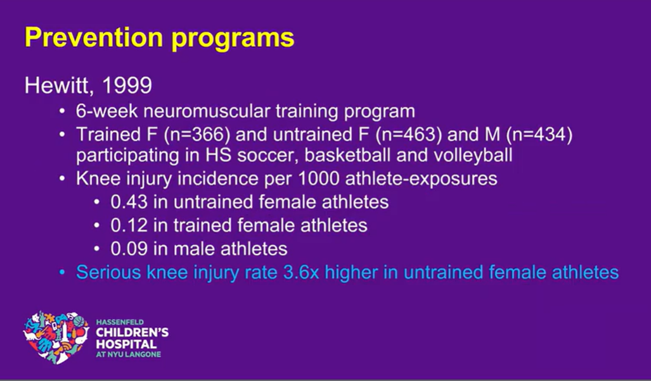
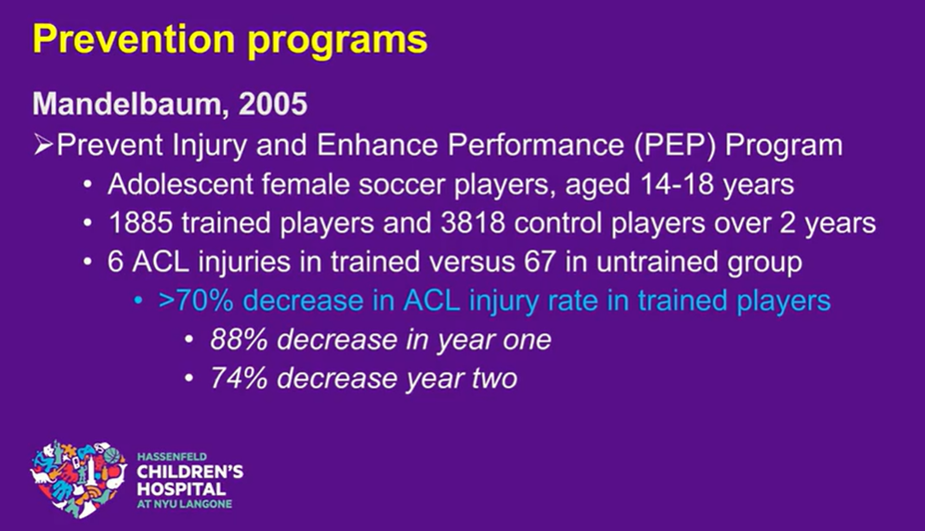

Slide 28
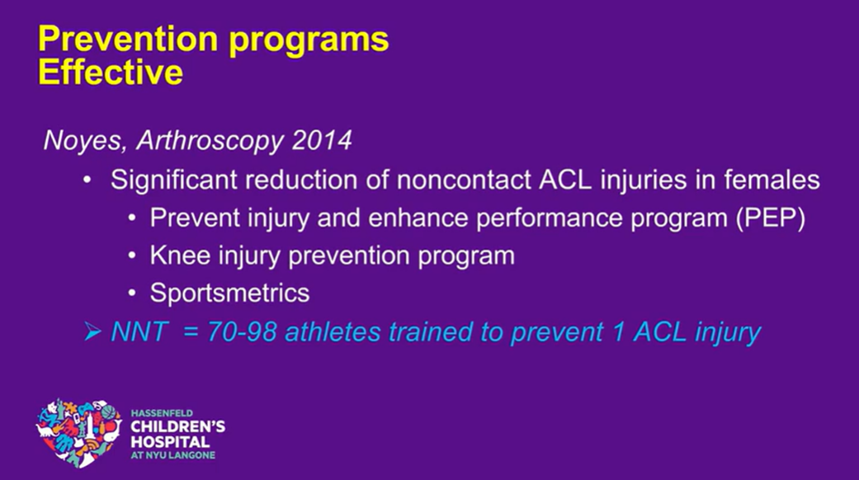

Slide 29
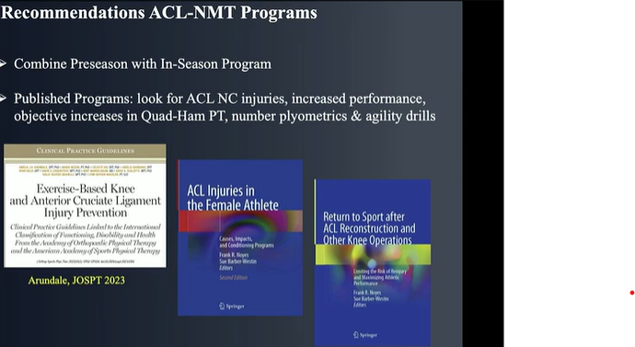

Slide 30


