Slide 1

Parts of an IEP
RISE: Resources and Information for Special Education
Thursday, October 8th, 2024

Slide 2

RISE Mission Statement:
Resources and Information for Special Education empowers parents of diverse learners within the East Stroudsburg Area School District through monthly informational sessions. Our mission is to provide essential resources, foster community support, and promote educational advocacy, ensuring every child receives the support they need to thrive. We are committed to ensuring parents feel supported and empowered throughout the journey of their child's educational career.

Slide 3
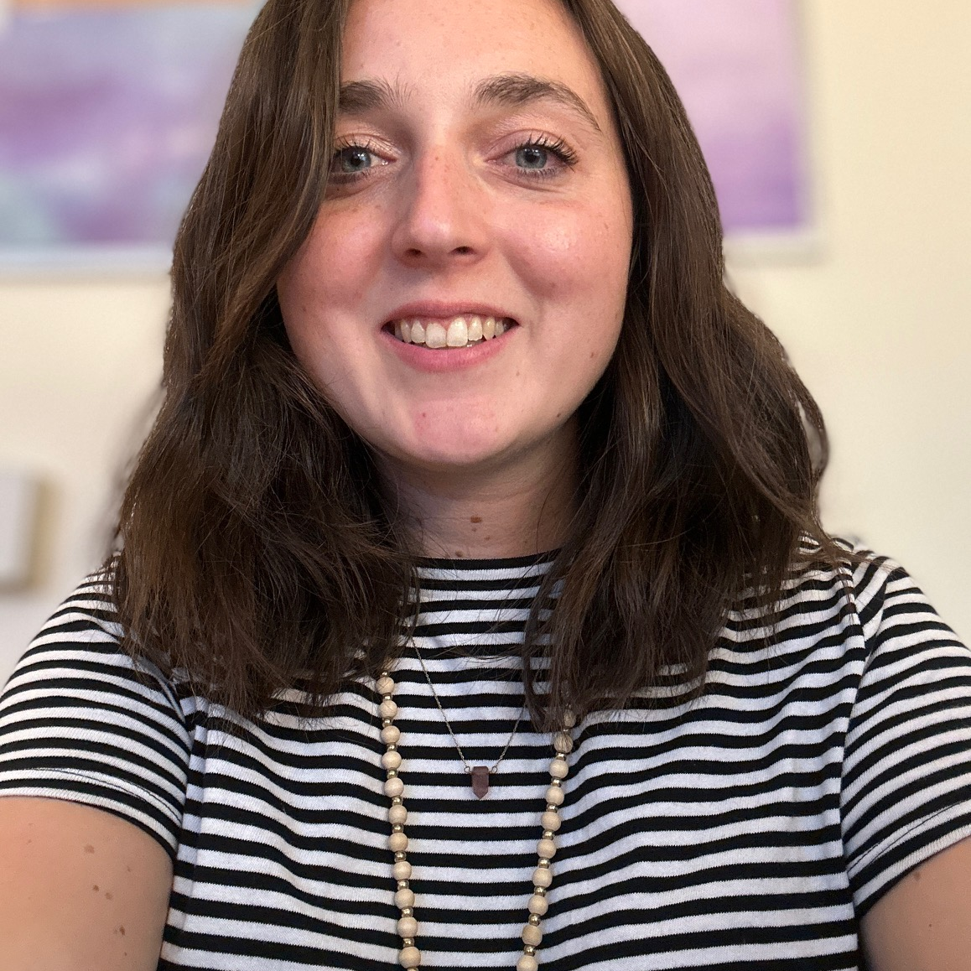
Meet Your Presenters
JM Hill Elementary
6 years teaching special education (Early Intervention to 5th Grade)
7 years in education
Bachelors of Science in Early Childhood and Special Education
Soon to be Masters in Education in Reading (December of 2024)
Samantha Barone

Slide 4
Meet Your Presenters
J M Hill Elementary School
7 years teaching elementary special education (Grades 1-5)
Bachelor of Science In Early Childhood and Special Education
Master of Science in Special Education with a concentration in Supervision
Master of Education in Professional and Secondary Education
Sarah Walsh

Slide 5

IEP Binder

Slide 6
IEP Binder
This binder will include resources to support you throughout the school year.
This includes building contact information, communication logs, and a place to store your child's current IEP documents.
A suggestion would be to use this binder for everything.
  To keep record of all communication that you have with the school.
  All IEP documents.
  Questions you have the IEP team.
  To keep notes.

Slide 7
Tonight we will cover…
1
2
3
IEP Goals
Roles of Team Members
Description of Each Section
4
5
NOREP/LRE
State/Local Testing Modifications

Slide 8

Roles of IEP Team Members

Slide 9
Team Members and Responsibilities
Team Member
Role:
Child’s Parent/ Guardian: A biological parent, foster parent, legal guardian, or an individual who acts in place of the parent (e.g., grandparent, stepparent, other relative)
Actively participate in all discussions
Provide meaningful input into decisions regarding their child’s IEP
Provide important information about priorities, the child’s strengths and needs, as well as information about the cultural and developmental appropriateness of goals and intervention strategies

Slide 10
Team Members and Responsibilities
Team Member:
Role:
Special Education Teacher: An educator with expertise about the disability and its impact on the student’s developmental and educational progress
Provide meaningful input into decisions regarding their student’s IEP
Provides services outlined in the IEP
Ensures that student performance data is collected and analyzed, and then instruction and intervention are modified accordingly

Slide 11
Team Members and Responsibilities
Team Member:
Role:
Case Manager: An educator responsible for making sure your child’s special education services and supports are in place. The case manager ensures that those services and supports are being provided for in the way that’s described in your child’s plan.

Slide 12
Team Members and Responsibilities
Team Member:
Role:
General Education Teacher: A general educator who is, or will be, a teacher of the child.
Provides the core academic instruction
Implements required accommodation and modifications
Provides input for the IEP regarding the students performance in general education.

Slide 13
Team Members and Responsibilities
Team Member:
Role:
(LEA)- Representative of the local educational agency: A designated representative of the LEA, often a school principal
Provides or supervises the provision of the specially designed instruction
Contributes to the understanding of the general education curriculum
Presents information about the availability of the LEA’s resources

Slide 14
Team Members and Responsibilities
Team Member:
Role:
Other relevant individuals: Others who have relevant knowledge or expertise regarding the student can be included, such as Related Service Providers
Related services personnel provide discipline-specific expertise beyond that of the classroom or special education teachers (e.g., physical therapy, speech-language therapy)
Child/family advocate speaks out on behalf of the parent(s) or student
Language interpreters aid communication between the educators and the family (when appropriate)

Slide 15

Team Members & Responsibilities: Key Takeaways
Be an active participant in your child’s IEP.
Ask questions

Slide 16

Description of IEP Sections
Section I: Special Considerations

Slide 17
Lets add a slide about procedural safeguards and signature on that page of the IEP

Slide 18
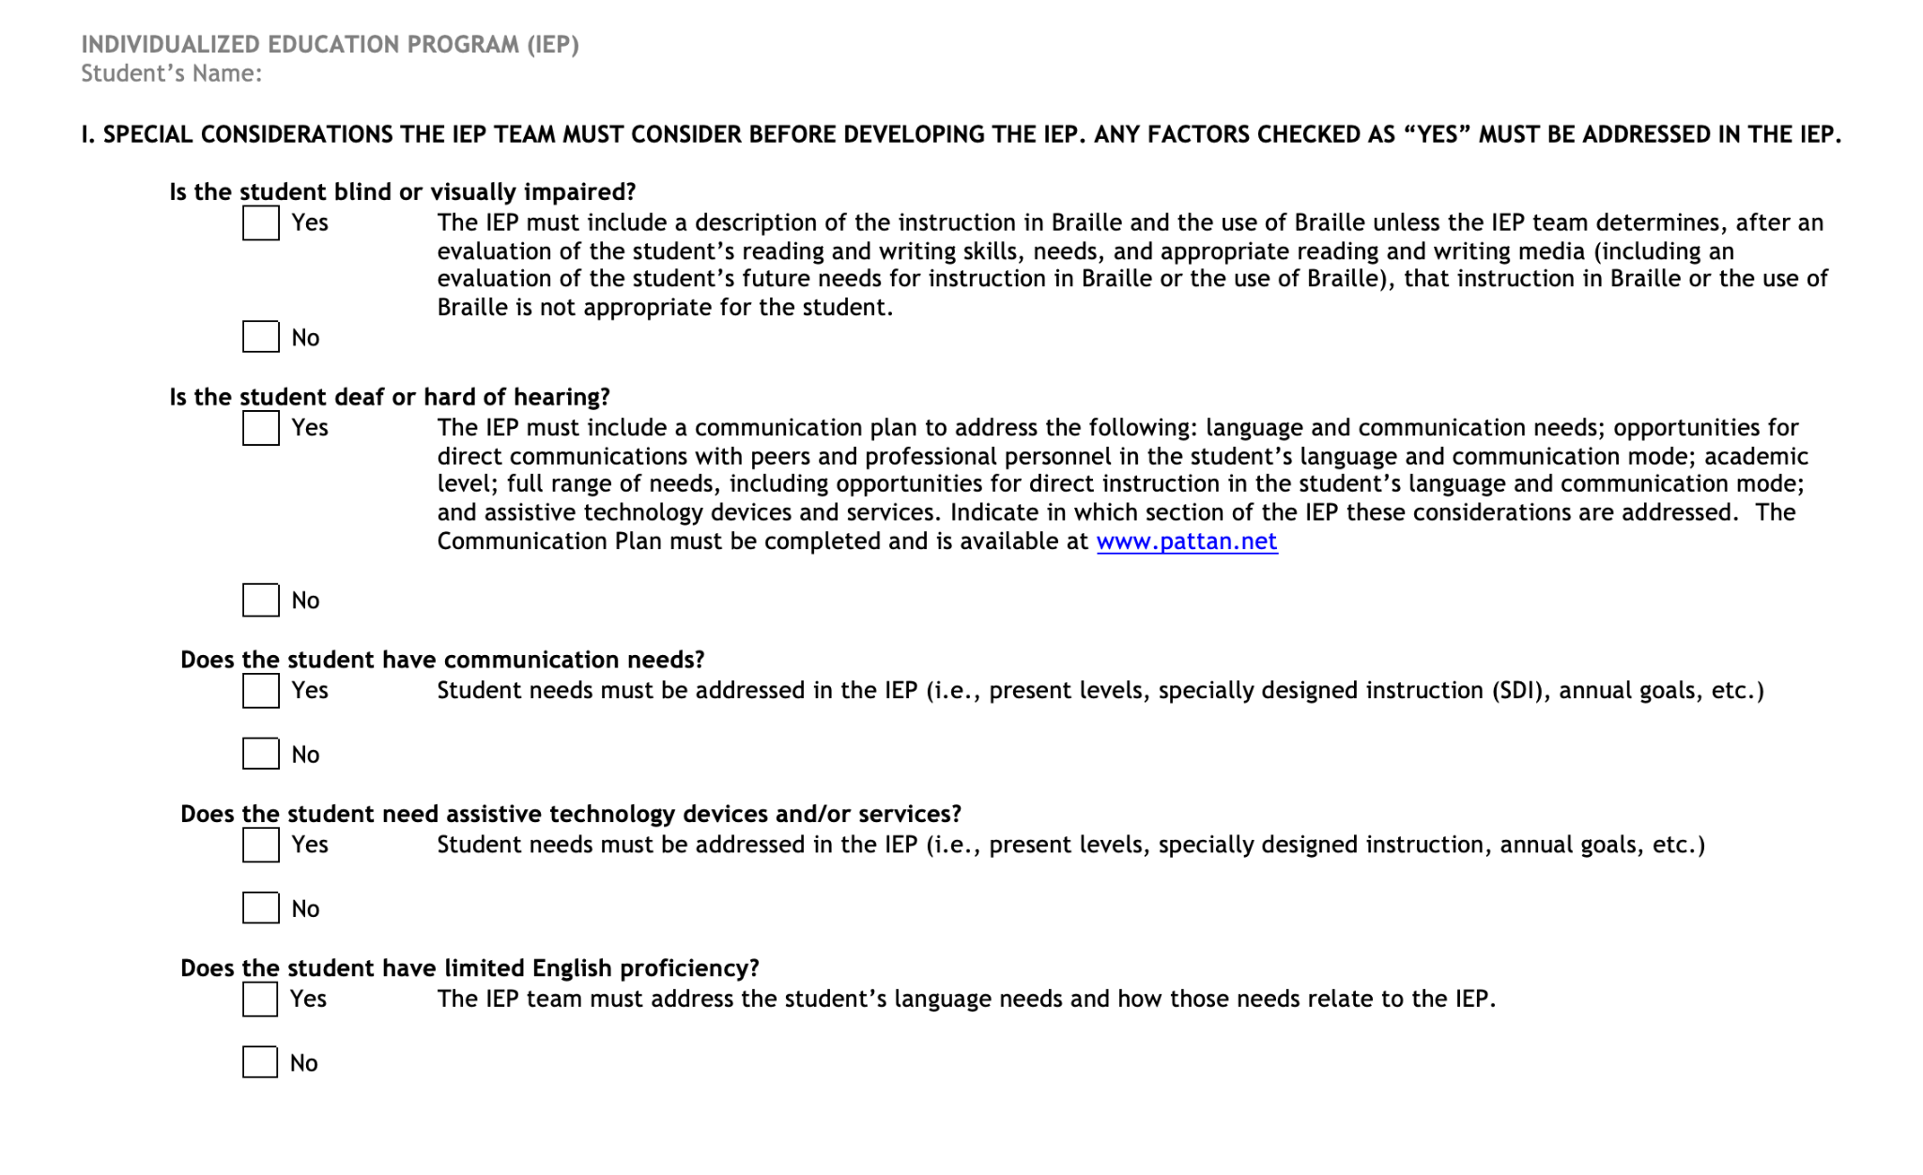
Section I: Special Considerations:
Notes:
Discussion Points:
A chance to talk about a few items that must be discussed before moving on to the remainder of the IEP
These considerations are very important because they can impact how your child learns and participates in school.
If the team has answered “yes” to any of the questions on this page, the team will have to make sure to address that question in your child’s IEP

Slide 19
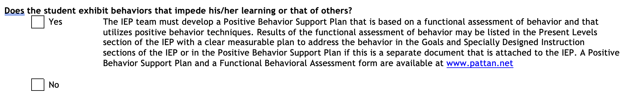
Section I: Special Considerations:
Notes:
Discussion Points:
If Behavior is considered to be a Special Consideration, a Positive Behavior Support Plan (PBSP) will need to be created that is based upon the finding of a Functional Behavioral Assessment (FBA)

Slide 20
Section I: Special Considerations - Key Takeaways:
If the team has answered “yes” to any of the questions in this section of the IEP, the team will address those specific needs in your child’s IEP.

Slide 21
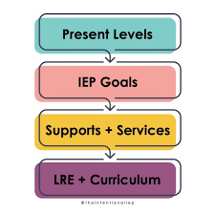
Description of IEP Sections
Section II: Present Levels

Slide 22
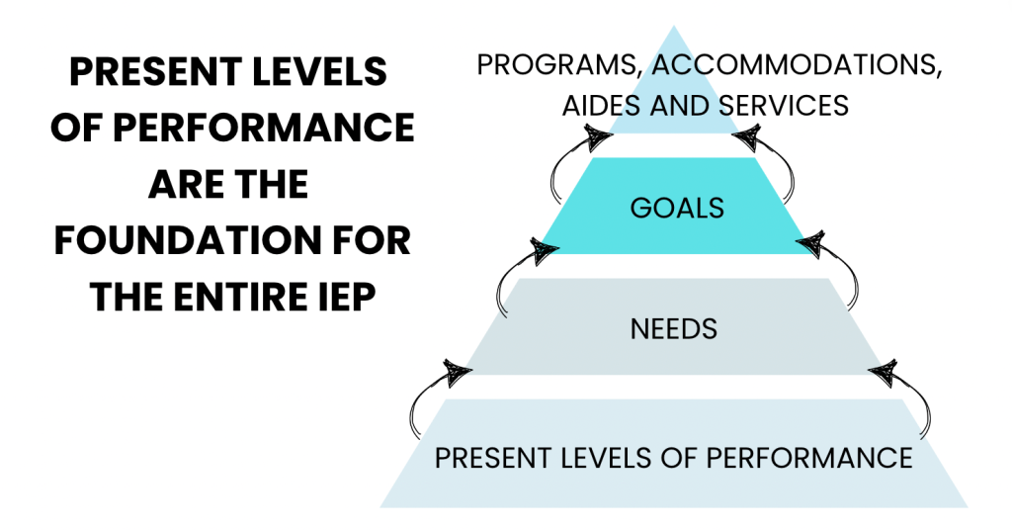
Section II: Present Levels
Notes:
Discussion Points:
Present Levels are the foundation of your child’s entire IEP
It looks at what your child knows and is able to do at school, as well as in other areas of their life
As a team, we gather information about how your child is doing in their classes and subject areas, what kind of activities they seems to really enjoy, and what areas they might be having difficulty
In this section, the team gets an overall picture of how things are going, celebrate the success that your child has had over the last IEP year, and brainstorm ideas for how the team can better support your child’s progress

Slide 23
Section II: Present Levels - Key Takeaways
The foundation to your child’s IEP
Team is able to gain an understanding of your child’s progress throughout the last IEP year
  Team can address any difficulties your child is having and develop a plan to address those difficulties
Includes:
  Academic skills - skills for learning subjects like math or reading
  Functional skills - skill used for daily life, such as organizing things, communicating, and taking care of hygiene
  Behavioral
Input from all teachers who work with children will be included

Slide 24

Description of IEP Sections
Section III: Transition Services

Slide 25
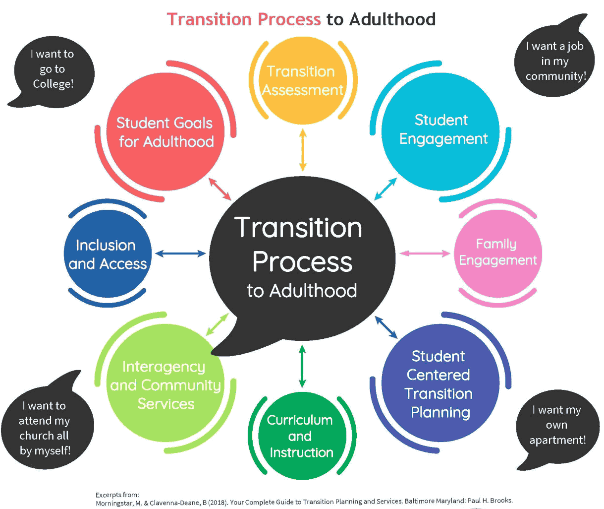
Section III: Transition Services
This selection is required for students who are 14 years of age or older, or who will turing 14 during the IEP cycle.

Slide 26

Description of IEP Sections
Section IV: State and Local Assessments

Slide 27
State vs Local Assessments
State Assessments:
These assessments are given once a year
PSSA - Pennsylvania System of School Assessment
PASA - Pennsylvania Alternative System of Assessment
Key Stone Exams (High school)
Local Assessments:
These assessments are given multiple times throughout the school year
Curriculum assessments in subject areas
Acadience
HMH Growth Measure (3rd-5th Grades)
Superkids Beginning of the year, mid-year, and end of year test
IXL Real-Time Diagnostic
Notes:
Discussion Points
This part of the IEP talks about tests that your child might take and how the team can support them during tests.
The state of Pennsylvania requires all students in statewide testing, including students with disabilities
The purpose of these tests is to figure out what your child knows and what they need to learn.

Slide 28

Selection IV: State Assessment
PSSA - Pennsylvania System of School Assessment:
Given to students in 3rd-8th grades in ELA and Math
  4th and 8th graders take science
Some students with disabilities are allowed to have certain accommodations to take it easier for them to participate in testing
PASA - Pennsylvania Alternative System of Assessment:
Only about 1% of the total number of students in the state participate in this assessment
This assessment is designed for students with the most significant cognitive disabilities

Slide 29

Testing Accommodations:
Students with disabilities are allowed to have certain accommodations
Are changes in testing that help students show us what they can do
Might change how a test is given, where it is given, when it is given, or how the student answers the questions
Might differ from test to test because of certain rules concerning what accommodations are allowed with specific tests
Any accommodations written into the IEP for a state test should align with accomodation they need during day-to-day test in school

Slide 30

Description of IEP Sections
Section V: Measurable Annual Goals

Slide 31
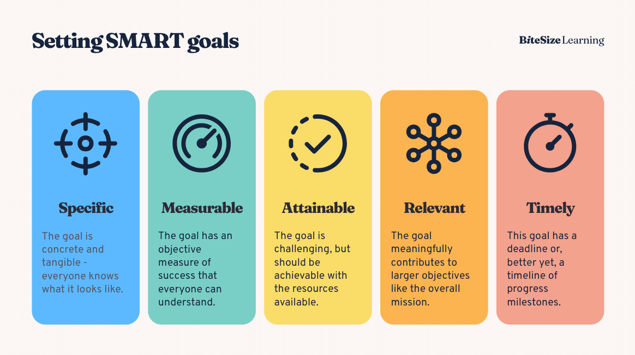
Section V: Measurable Annual Goals
Notes:
Discussion Points:
Setting goals helps people create a roadmap for success. That’s why we set goals in special education, too!
In this section of the IEP contains information about your child’s goals, which need to be updated at least once a year.
These goals can related to many different areas, such as academics, behavior, activities of daily living, and more.
All goals are written as a SMART Goal
Go Over what a SMART goal is
Educator will keep track of your child’s progress on their goals with bi-weekly progress monitoring or daily data collection if your child has behavioral goals
You will receive updates on your child’s IEP goals at the end of each marking period through a Progress Report

Slide 32

Description of IEP Sections
Section IV: Special Education
Program Modifications & Specially Designed Instruction
Related Services
Supports to School Personnel
Gifted Support Services
Extended School Year

Slide 33
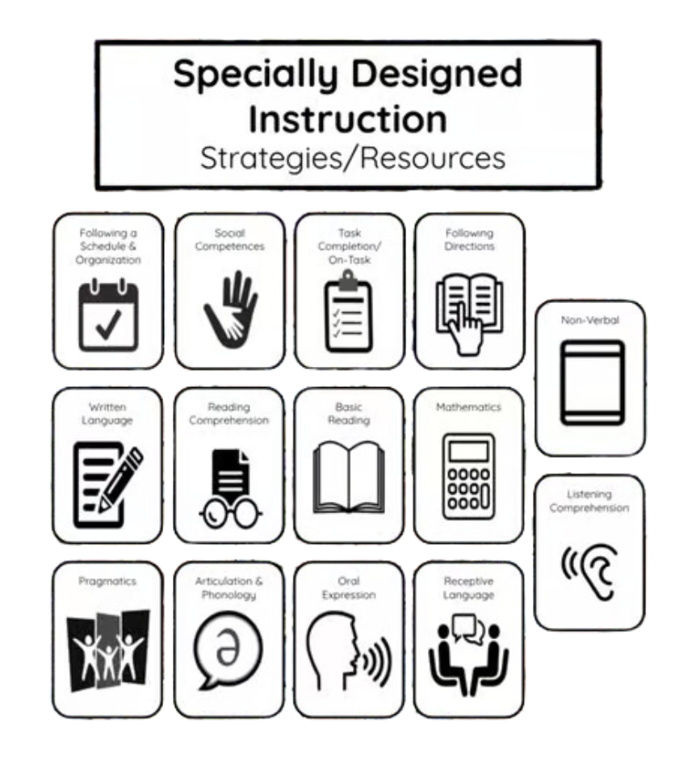
Program Modification and Specially Designed Instruction (SDI)
Program modification - changes that are made to your child’s education to help them learn and participate in school
SDI is a set of supports, personalized for your child based on their needs

Slide 34
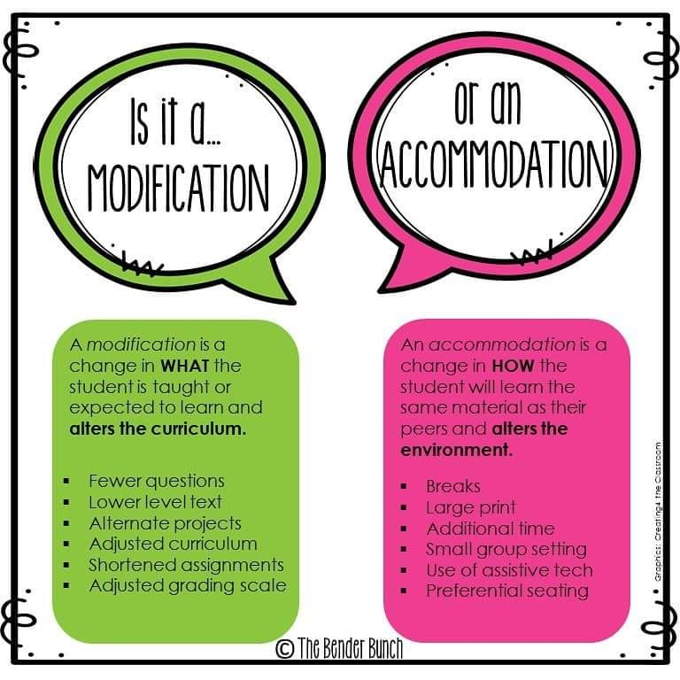
Modification vs. Accommodation

Slide 35
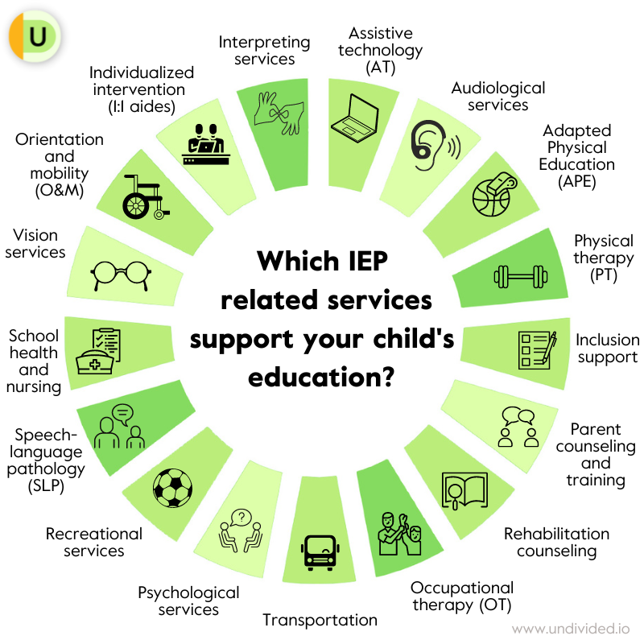
Related Services
Any supportive services to assist your child to benefit from special
Can include:
  Occupational therapy
  Speech-language services
  Nursing services
  Physical therapy
  And more!
This section will also talk about the type and location of related services, as well as how oft your students will receive the service

Slide 36

Supports to School Personnel:
The supports for school personnel that might be necessary to best meet your child’s needs

Slide 37

Gifted Support Services
If your child receives gifted supports, as well as supports for special education, they are listed in this section

Slide 38

Extended School Year (ESY)
The purpose of ESY is to help children retain skills they learned before a long break in schooling, such as a summer vacation
The loss of skills they already learned is called “regression of skills”
It is a team discussion as to if your child will quality for ESY and is based on several factors listed in special education law.

Slide 39
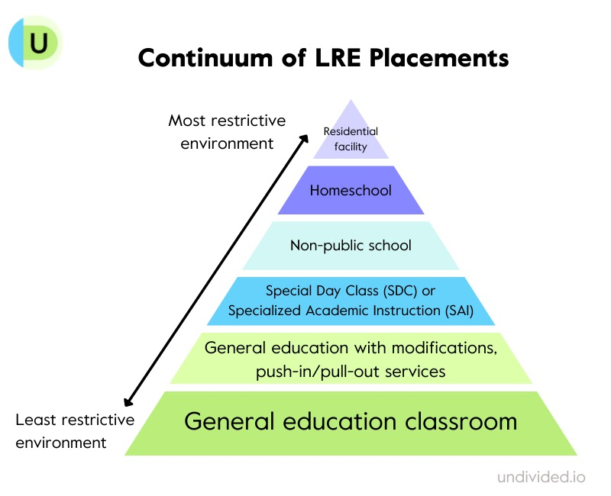
Description of IEP Sections
Section VII: Educational Placement

Slide 40
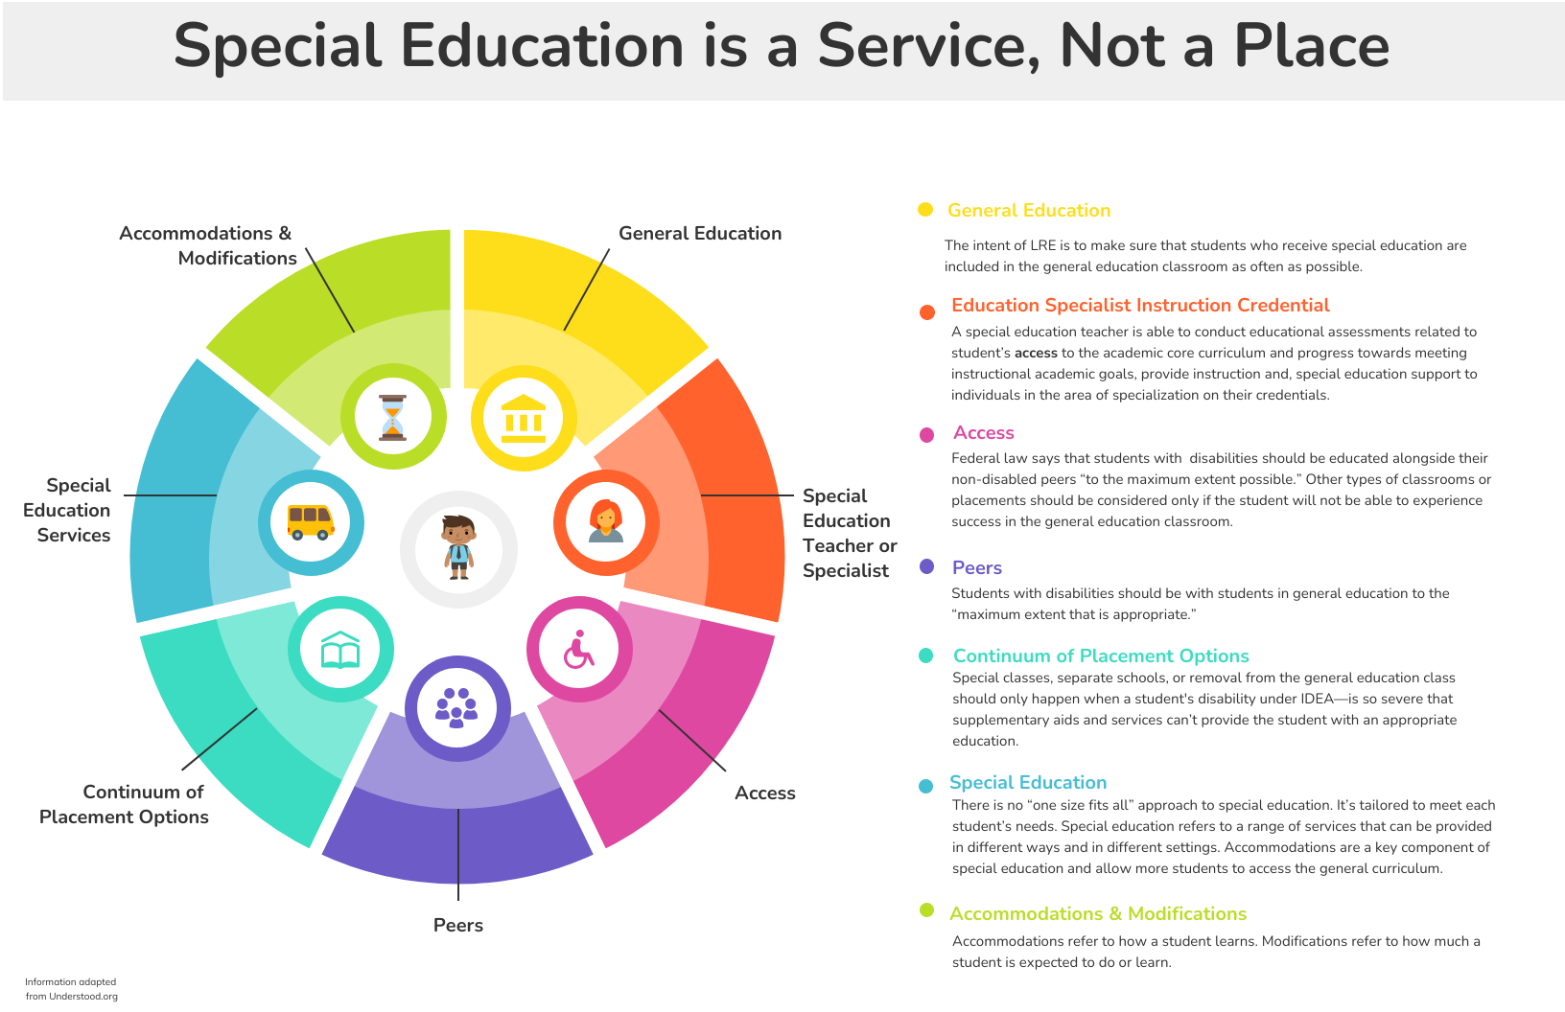

Slide 41

Section VII: Educational Placement
We always want students to participate in the least restrictive environment, or LRE
LRE isn’t a specific place; it means that your child should be with their same-aged peers who do not have disabilities, as much as appropriate to your child’s strengths and needs
Notes:
Discussion Points:
This will include explaining any scenarios in which your child will not receive instruction in a general education environment, as well as scenarios in which your child’s educational programming will differ from the general education curriculum

Slide 42
Description of IEP Sections
Section VIII: PennData

Slide 43

Selection VII: PennData
Every state is required to report information (data) about where students with disabilities are educated
We calculate the percentage of a typical school day that our child is in general education setting, which includes environments outside of the classroom, such as lunch, homeroom, and recess
Our goal is for most students to be in the general education classroom for 80 percent or more time.

Slide 44
Thanks!
Next RISE Meeting is
Tuesday, November 12th

