Slide 1
Introduction to Special Education
RISE: Resources and Information for Special Education
Tuesday, September 17th, 2024

Slide 2

RISE Mission Statement
Resources and Information for Special Education empowers parents of diverse learners within the East Stroudsburg Area School District through monthly informational sessions. Our mission is to provide essential resources, foster community support, and promote educational advocacy, ensuring every child receives the support they need to thrive. We are committed to ensuring parents feel supported and empowered throughout the journey of their child's educational career.

Slide 3
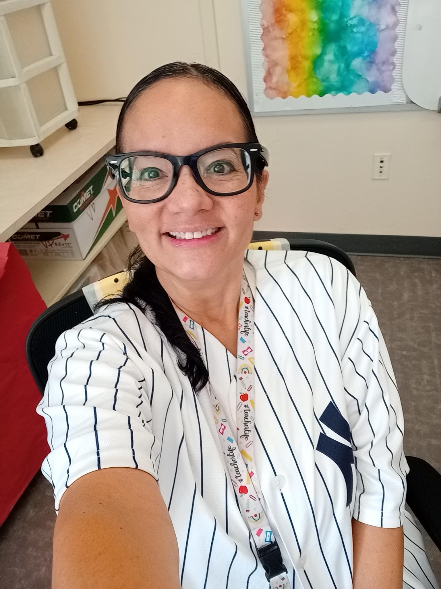
Meet Your Presenters
Valerie Bermuda
J M Hill Elementary School
7 years Special Education experience
Bachelor of Art in History
Master of Science in Education
Certified in Special Education
Current coursework in Applied Behavior Analysis (ABA)

Slide 4

Meet Your Presenters
Sarah Walsh
J M Hill Elementary School
7 years teaching elementary special education (Grades 1-5)
Bachelor of Science In Early Childhood and Special Education
Master of Science in Special Education with a concentration in Supervision
Master of Education in Professional and Secondary Education

Slide 5
Tonight we will cover…
01
03
05
02
04
06
07
IEP Binder
MTSS & Child Study Team
Classification & Diagnosis
Defining Special Education
Permission & Evaluation
IEP- a Working Document
Starting the School Year off Right

Slide 6

IEP
Binder

Slide 7

Parent IEP Binder
You will be provided with a binder to help keep your resources organized.
  This can be used to store all of the presentations, materials, and documents you will receive from the RISE program.
  You will be given new resources every month to add to your binder.
  Contents of the binder will also be posted on a Google Site for reference.
Please bring this binder with you to all meetings.

Slide 8
Parent IEP Binder
This binder will include resources to support you throughout the school year.
This includes building contact information, communication logs, and a place to store your child's current IEP documents.
A suggestion would be to use this binder for everything.
  To keep record of all communication that you have with the school.
  All IEP documents.
  Questions you have the IEP team.
  To keep notes.

Slide 9

Special Education Definition
Special education is a tailored instructional program designed to meet the unique needs of children with disabilities. It provides individualized support and services to help children succeed academically, socially, and emotionally.
Under Pennsylvania and federal law, a child with a disability has a right to special education and related services.

Slide 10

Key Points About Special Education
Individualized Approach: Each child in special education has an Individualized Education Program (IEP) that outlines their specific needs, goals, and the services they will receive.
Specialized Instruction: Teachers and specialists use various teaching methods and materials to help the child learn in ways that suit their abilities and learning style.
Related Services: Special education may include additional services such as speech therapy, occupational therapy, physical therapy, counseling, and assistive technology to support the child's learning.

Slide 11
Key Points About Special Education
Inclusive Education: Whenever possible, children in special education are included in regular classrooms with their peers to promote social interaction and equal opportunities. This is known as "mainstreaming" or "inclusion."
Support and Accommodations: The program includes accommodations and modifications to the learning environment, curriculum, and assessments to help the child succeed. Examples include extended time on tests, modified assignments, or the use of special equipment.
Legal Rights: Special education is governed by laws like the Individuals with Disabilities Education Act (IDEA), which ensures that children with disabilities have the right to a free and appropriate public education (FAPE).

Slide 12
Procedural Safeguards
Procedural safeguards are legal protections that protect the rights of children with disabilities and their parents/guardians. Some examples of procedural safeguards include:
Parental consent: A requirement for evaluation, services, placement, and changes to services or placement.
Prior written notice: A requirement that schools provide written notice before changing a child's special education experience.
Due process: A formal process for resolving disagreements between parents and schools.
Educational records access: A right for parents and guardians to request access to their child's educational records at any time.

Slide 13
Procedural Safeguards
State complaints: A mechanism for individuals and organizations to address special education conflicts and resolve disputes
Mediation: A formal dispute resolution process for parents and PEAs to use to resolve matters under the Individuals with Disabilities Education Act (IDEA)
Independent educational evaluation (IEE): A right to obtain an IEE of the child
Participation in meetings: A right to participate in all meetings
Parents/guardians will receive a copy of their procedural standards during the IEP process.

Slide 14
MTSS
Multi-Tiered System of Supports (MTSS)
MTSS is a proactive and preventative framework that integrates data and instruction to maximize student achievement and support students social, emotional, and behavior needs from a strengths-based perspective.
MTSS supports are monitored by building MTSS Coordinators and the Child Study Team.
MTSS is not Special Education

Slide 15
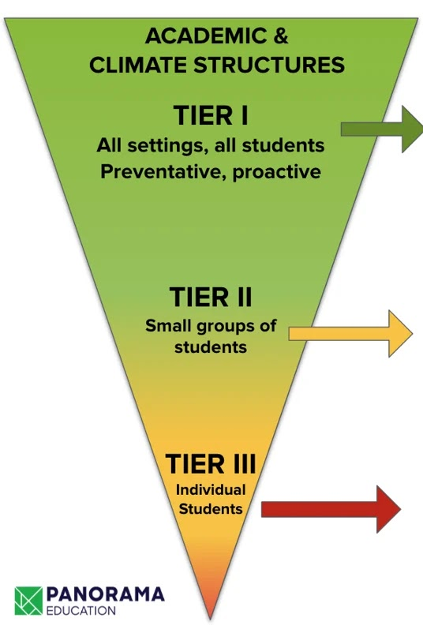
MTSS
MTSS is divided into three tiers:
Tier 1: Universal instruction and supports for all students.
Tier 2: Targeted interventions for students who need more support beyond what is provided in Tier 1.
Tier 3: Intensive, individualized interventions for students who have not responded to Tier 1 and Tier 2 support.

Slide 16
Child Study Team
A child study team consists of professionals that determine if students need additional support and if their current level of support is effective. A child study team monitors if students are showing growth or success with the support provided through MTSS. The child study team can make a recommendation that a student be evaluated for special education services if the student does not show growth over a period of time.

Slide 17
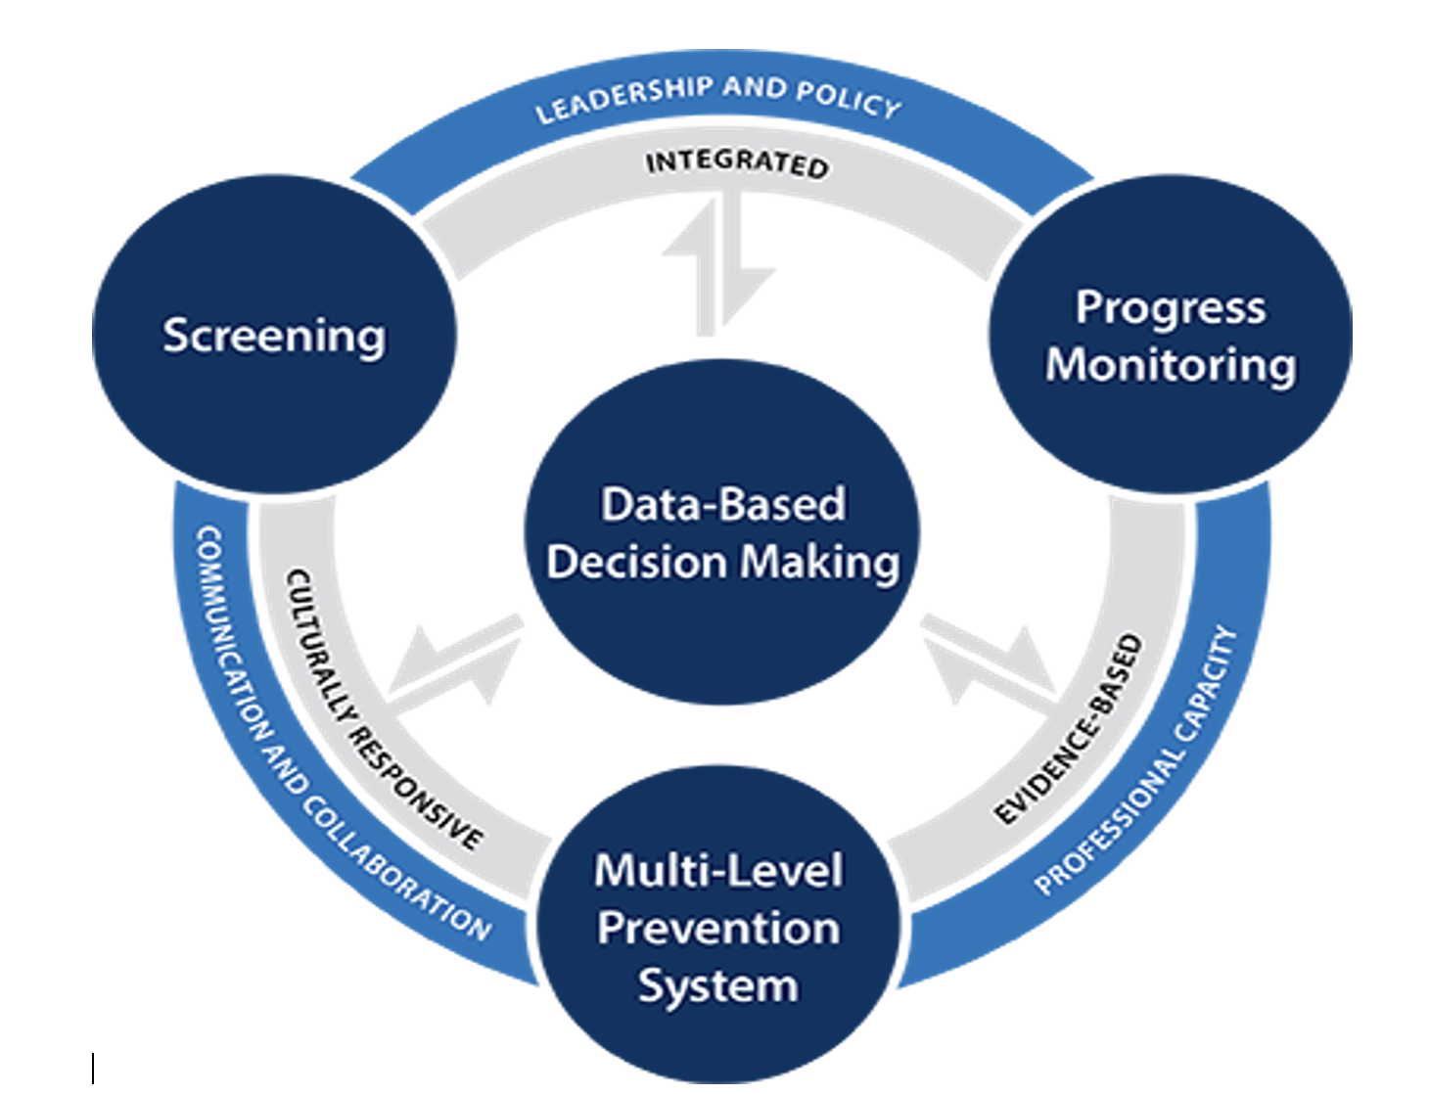

Slide 18

Permission to Evaluate/ Re-evaluate

Slide 19
Permission for Initial Evaluation
The purpose of the Permission to Evaluate (PTE) is to obtain informed parental permission to evaluate a child in order to determine eligibility and need for special education services.
Parents have the right to consent to testing.
Once a parent signs the PTE, the evaluation will be completed within 60 calendar days.
Parents can request to meet with school staff to discuss MTSS, student growth and achievement, and parental concerns prior to requesting an evaluation.
For a parent to make an official request for evaluation, they must complete the parent request form. This form will be provided to the parents within 10 days of their verbal request.

Slide 20
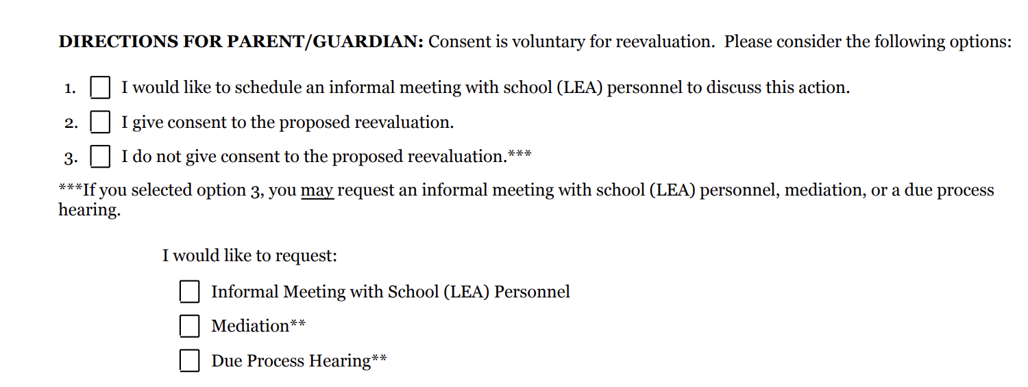
Permission to Evaluate
Example of parent choices when signing the PTE

Slide 21
Permission to Re-evaluation
Permission to Reevaluate (PTRE)
Students that are already in special education will be re-evaluated every 3 years (depending on their disability).
  Students who are Intellectually disabled are re-evaluated every 2 years.
Re-evaluations can also be conducted sooner if the school or parents believe the student’s needs have changed or if more information is needed to adjust services or placement.

Slide 22
Re-evaluation
A re-evaluation assesses whether the student still qualifies for special education services and whether adjustments need to be made to the Individualized Education Program (IEP).
It determines if the student’s needs have changed and whether current services and supports are appropriate.
The evaluation can also guide decisions regarding the student’s progress, placement, or potential transition out of special education services.

Slide 23
How Does a Child Qualify for Special Education?
Evaluation: The process begins with a comprehensive evaluation to determine if the child has a disability that affects their learning.
Eligibility: Based on the evaluation, a team of educators and specialists, along with the parents, determine if the child is eligible for special education services.
Developing the IEP: If eligible, an IEP is created, outlining the child's specific needs, goals, and the special education services they will receive.

Slide 24
Special Education Classifications
13 Classifications
  Intellectual Disability
  Hearing impairment
  Speech or language impairment,
  Visual impairment (including blindness)
  Emotional disturbance
  Orthopedic impairment
  Autism
  Multiple disabilities
  Traumatic brain injury
  Other health impairment
  Specific learning disability
  Deafness
  Deaf-blindness

Slide 25
Role of Medical Diagnosis
Informing the IEP: Medical diagnoses provide essential information for creating an effective IEP, ensuring that the child's educational needs are appropriately addressed.
Collaboration: Schools often collaborate with healthcare providers to understand the child's condition and implement necessary accommodations and services.
  If your child has a medical diagnosis that is addressed in the IEP, share medical updates with the IEP team.
Eligibility for Services: Medical diagnoses can help determine eligibility for special education services under the Individuals with Disabilities Education Act (IDEA).

Slide 26
What is
an IEP?

Slide 27
What is an IEP?
Children who qualify for special education services have an Individualized Education Program (IEP).
An Individualized Education Program (IEP) is a legally binding document that outlines the special education services and supports a child with disabilities will receive in school. It is designed to help the child succeed academically and develop other important skills.

Slide 28
The IEP Process
Referral and Evaluation: A child is referred for an evaluation to determine if they have a disability and qualify for special education services.
IEP Meeting: A team, including parents, teachers, and specialists, meets to develop the IEP. The team discusses the child’s needs, sets goals, and determines the services required.
Implementation: The school provides the services and supports outlined in the IEP.
Review and Update: The IEP is reviewed at least once a year to update goals and services as needed. Parents can request a meeting at any time to discuss concerns or changes.

Slide 29
IEP Process
Referral or request for testing.
Parents sign the Permission to Evaluate (PTE).
An Evaluation Report (ER) is produced within 60 calendar days from the date the PTE was signed.
  The student is formally evaluated during this timeframe. Parent and teacher input is collected and a classroom observation is conducted.
Parents review and sign the Evaluation Report. This gives the district permission to proceed with the creation of the IEP.
An IEP meeting will be held within 30 days of the Evaluation Report date.
The IEP will go into effect within 10 days of the IEP meeting.
The IEP will be reviewed annually by the IEP team. Revisions can be made when necessary.

Slide 30

IEP Team
An IEP is a collaborative effort to provide your child with the best possible education.
By working together, we can help your child achieve their full potential.
Members of an IEP Team:
Parent(s)/ Guardian(s)
LEA
  Administrator
General Education Teacher
Special Education Teacher
Related Service Provider(s)

Slide 31
Your Role as a Parent
Communication is key: Be sure to actively communicate with the IEP team members regularly. This includes your child’s general and special education teachers and related services providers (speech therapist, occupational therapist, Physical therapists).
Active Participant: You are an important member of the IEP team. Your insights and concerns are crucial in developing a plan that works for your child.
Advocate: Ensure your child’s needs are being met and that the school is providing the agreed-upon services. Be very familiar with your child's IEP and know how your child is being supported.
Monitor Progress: Stay involved by regularly reviewing your child’s progress and communicating with teachers and service providers.

Slide 32


Slide 33
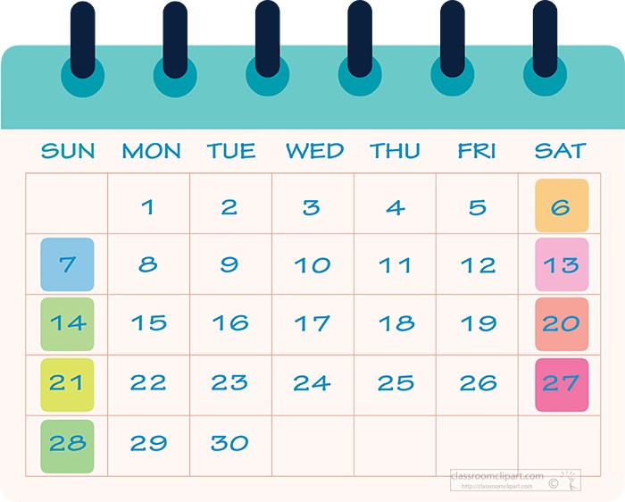
How Long does an IEP last?
1 year minus a day
An IEP revision can happen at any time

Slide 34
IEP Revision
IEPs are revised to ensure that the educational plan remains appropriate and effective for the student. Here are some common reasons for IEP revisions:
  Changes in student needs
    Academic Progress
    Behavior Needs
    Health or Medical Changes
  New Evaluation Results
    Reevaluations
    Independent Evaluations
  Changes in Educational Placement or Services
    Transition to New Grade Level
    Service Changes
  Parental or Teacher Concerns
    Parent Request
    Teacher Observations

Slide 35
Starting the Year Off Right
How you and your child start the school year off right?

Slide 36
Tips & Tricks
Establish a daily routine
  This includes a consistent bedtime
Get involved!
  Join your school’s PTO
Stay connected
  Reach out to teachers/case managers if you have a concern or question
Create a homework zone
  This should be a quite set place for your child to work
Check child’s backpack and folder daily
  Many important forms will go home in the first months of school
Frequently check Class DoJo for updates

Slide 37
Thanks!
Next RISE meeting is
October 8, 2024

