Slide 1


Full Day Kindergarten
ENHANCING FOUNDATIONAL READINESS AND GRADE-LEVEL ACHIEVEMENT
Notes:
Notes from meeting with K teachers 10/11.
- Start with schools that are staying in buildings. Paxtang, West Hanover, Middle Paxton. Revamp where AS classes are
- Talk about which schools will go to each of the new kindergarten centers. (small split of MVE K students)
Early intervention - work with IU
AS classrooms already there for easy transitions.
-Playground
-Cafeteria
-Adminitrator
- Specials or shorten Day
- Need a timeline from the architect- Next year or put off for a year?
- furniture or materials some things might be prioritized for everyone to have.
-The importance of early learning on the lifepath of each student.

Slide 2

Purpose
  Students who graduate from Central Dauphin School District will be ready to participate fully as citizens in the workforce or post-secondary schooling.
  Ensuring students are at grade level by third grade.
  Assist families with a single place for students to learn all day where they do not need to pay for that service.
  Create capacity across the district for our growing population.
Notes:
https://www.nea.org/sites/default/files/2020-07/18001_Full-Day_Kindergarten_Policy_Brief-final.pdf
https://ccsd.net/resources/assessment-accountability-research-school-improvement-division/full-day-kindergarten-review-of-literature.pdf
https://nces.ed.gov/pubs2004/web/2004078.asp

Slide 3

The Research Behind Full Day Kindergarten
National Trends
Percentage of students attending full day kindergarten grew from 10% in the 1970s to more than 80% in 2016
17 states plus Washington, DC mandate kindergarten
14 states plus Washington, DC require full day kindergarten to be offered
The importance of supporting early learning is an emphasis of the ESSA legislation

Slide 4


Full Day Kindergarten in Pennsylvania

Slide 5
Full Day Kindergarten in Dauphin County
10 Public School Districts in Dauphin County
Central Dauphin
Derry Township
Halifax
Harrisburg
Lower Dauphin
Middletown
Millersburg
Steelton-Highspire
Susquehanna
Upper Dauphin

Slide 6

Academic Benefits
Rigor based on state standards and increased instructional time:
Extended Learning Time
Enhanced Literacy and Numeracy
Individualized Attention
Better School Readiness
Notes:
Extended Learning Time: More hours in the classroom allow for deeper learning experiences and a broader curriculum.
Enhanced Literacy and Numeracy: Research shows that children in full-day programs tend to develop stronger reading, math, and language skills. Longer days allow for more time to practice these essential skills.
Individualized Attention: With more instructional time, teachers can give students the attention they need to master foundational concepts
Better School Readiness: Full-day kindergarten helps children arrive in 1st grade with a stronger academic foundation, better prepared for more complex learning tasks.

Slide 7

Social and Emotional Development
More Opportunities for Peer Interaction
Self Regulation Skills
Confidence Building
Consistency in the daily schedule
Notes:
More Opportunities for Peer Interaction: Full-day kindergarten gives children more time to interact with peers, develop social skills, and learn conflict resolution.
Self-Regulation Skills: The extended time in a structured environment helps children build emotional control, learn appropriate behaviors, and practice routines.
Confidence Building: Consistent exposure to new experiences in a supportive setting helps children gain confidence, take risks in learning, and develop a love for school.

Slide 8
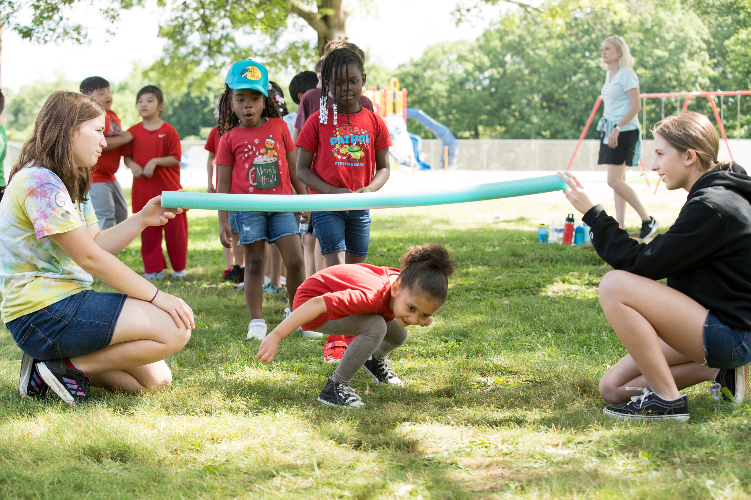
Physical Development
Physical Activity
Healthy Habits
Movement and Learning
Fine and gross motor skills
Notes:
Physical Activity: Longer school days often include structured playtime, recess, and physical activities, all crucial for motor development.
Healthy Habits: Full-day programs may include lunch breaks and healthy eating practices, which are important for cultivating healthy habits early on.
Movement and Learning: Physical activity has been shown to improve cognitive function, memory, and focus, which enhances overall learning.

Slide 9

Benefits for Families
Workforce Support
Consistency and Stability
Social Equity
Notes:
Workforce Support: Full-day kindergarten provides families with greater flexibility, particularly for working parents who need longer care options.
Consistency and Stability: A longer school day provides a stable routine for children, which can help them feel more secure and comfortable as they transition into school.
Social Equity: Full-day kindergarten programs can help bridge gaps for children from low-income families who may not have access to enriching after-school activities or parental support during half-day programs.

Slide 10

Academic Impact
Children in full-day kindergarten programs receive 40-50% more instruction than children enrolled in half-day programs.
The daily addition of three hours of instruction in kindergarten amounts to an additional half-year of education, which allows for broader and deeper curriculum coverage, a variety of instructional groupings, and diagnosis and intervention of learning challenges (Davies & Cress,2010; Elicker & Mathur, 1997).
Longitudinal data shows children in full-day classes have greater reading & math achievement gains than those in half-day classes.

Slide 11

Academic Impact a
Children with developmental delays or those “at-risk” of experiencing school problems have more time for completing projects and for needed socializing with peers and teachers.
Participating in the full-day schedule allows more appropriate challenges for children at all developmental levels.
A full day kindergarten program affords opportunities to identify and intervene early in all tiers, including academics and behavior.

Slide 12

Academic Impact b
Longer school days enable children to receive more individualized, academically focused and meaningful instruction from teachers, as well as more time interacting with their peers – both of which can lead to long-term benefits and increased scores in third grade assessments.
Switching to full-day kindergarten gives teachers more time for curriculum planning, offering more in-depth coverage of each unit.
Full-day kindergarten can produce long-term educational gains, especially for low-income and minority students.

Slide 13
Academic Impact:
Closing the Achievement Gap
The positive impact of full-day kindergarten has been demonstrated with a number of specific populations, including English learners and at-risk students.(Bingham & Hall-Kenyon, 2013;Davies & Cress, 2010).
According to research over the past three decades, full-day programs have led to stronger achievement, fewer gaps between student subgroups, decreased remediation in subsequent years, and better developed social/emotional skills. (Cooper et al., 2010; Raskin, Haar, & Zierdt, 2011).
Research by the National Education Association (NEA): Full-day kindergarten has been found to be especially beneficial for children from disadvantaged backgrounds, helping to bridge early gaps in education and prepare them for success in later years.
A study published in Early Childhood Research Quarterly (2016) demonstrated that full-day kindergarten narrowed achievement gaps in reading and math for low-income and minority children.

Slide 14
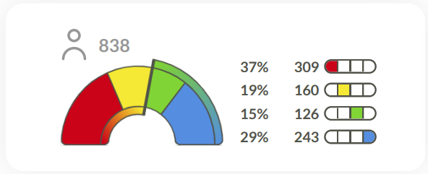
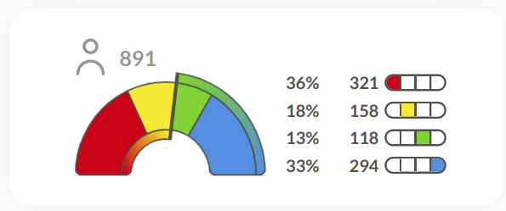
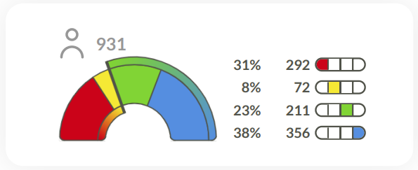
Current results for one cohort of students moving from Kindergarten to second grade.
Reading Benchmarking
Kindergarten Fall 22-23
SCORES ENTERING KINDERGARTEN
1st Grade Fall 23-24
SCORES ENTERING 1ST GRADE: MAINTAINED PERFORMANCE LEVELS
2nd Grade Fall 24-25
SCORES ENTERING 2ND GRADE: IMPROVED DURING FULL DAY 1ST GRADE

Slide 15
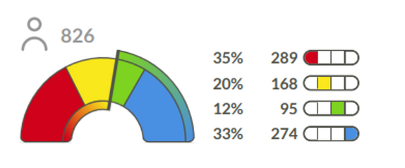
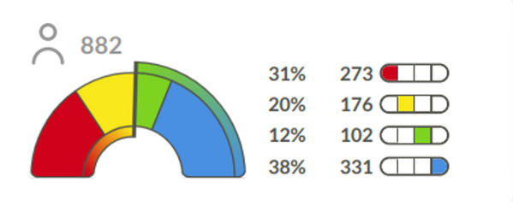
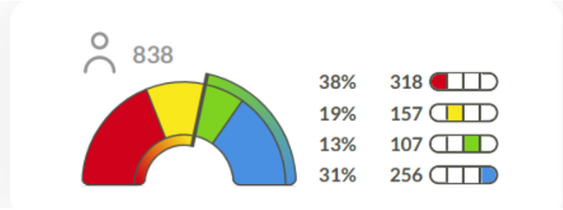
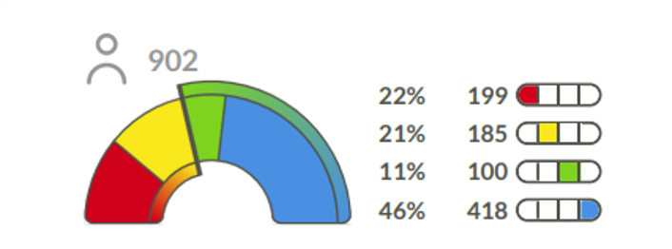
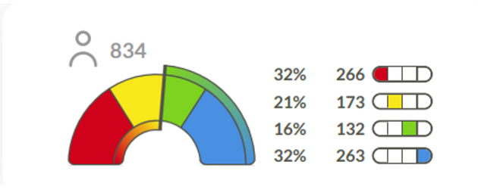
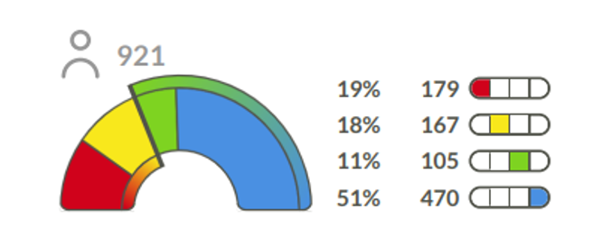
Current results for student growth in
a Kindergarten cohort and a first-grade cohort.
Math Benchmarking
K Fall 22-23
Math Benchmarking
1st Fall 22-23
K Winter 22-23
1st Winter 22-23
3% MOVED OUT OF BELOW BASIC IN
1/2 DAY KINDERGARTEN
K Spring 22-23
12% MOVED OUT OF BELOW BASIC IN FULL DAY 1ST GRADE
1st Spring 22-23

Slide 16
Societal and Economic Impact
The benefits to full day programming can have positive long range societal and economic effects such as: enhanced social and emotional development, improved overall health and wellness, reduced dropout rates, reduced delinquency, increased reading proficiency and overall increased academic achievement.
Research has demonstrated that funds invested in quality early education programs produce 3 to 1 return on investment.
  Reduce future costs related to remediation, retention, and special services

Slide 17
Societal and Economic Impact.
Students are less likely to be retained a grade if they attend full-day kindergarten (Cryan, Sheehan, Wiechel, & Bandy-Hedden, 1992).
In a study of over 17,000 students, researchers found that “by the time they reached the third and fourth grades, former full day kindergartners were more that twice as likely as children without any kindergarten experiences and 26% more likely than graduates of half day programs – to have made it there without having repeated a grade.”
This not only saves scarce resources but prevents the negative academic and social outcomes associated with retention (Gullo, 2000; National Association of School Psychologists, 2011; Sheehan, Cryan, Wiechel, & Bandy, 1991).

Slide 18
Long Term Outcomes of Full Day Kindergarten
Academic Success in Later Years
Research suggests that the benefits of full-day kindergarten continue into later grades. Students who attended full-day kindergarten are more likely to perform better academically in 3rd and 5th grades.
Graduation Rates
Study by the National Bureau of Economic Research (NBER): Longitudinal studies indicate that children who attended full-day kindergarten programs are more likely to graduate from high school.
Cumulative Benefits
Early investment in a child’s education, through full-day kindergarten, pays off in terms of higher academic achievement, greater social mobility, and reduced dropout rates.

Slide 19
A common argument against full-day kindergarten is that a full school day is too much for young kids to handle.
Experts say that, while curriculum varies, kids in full-day kindergarten programs have more time to play and participate in enrichment activities like music, physical education, and art while a half-day program is limited to academic instruction due to the limited time.
At present time, most preschool children in our community have a full day program, transition to a half-day kindergarten program, and then must transition back to a full-day program for first grade.

Slide 20

Key Research Takeaways
Full-day kindergarten supports stronger academic, social, emotional, and physical development in young children.
The extended learning time enhances school readiness, helps close achievement gaps, and prepares children for lifelong learning.
Families and communities benefit from the consistency and support that full-day programs provide.

Slide 21
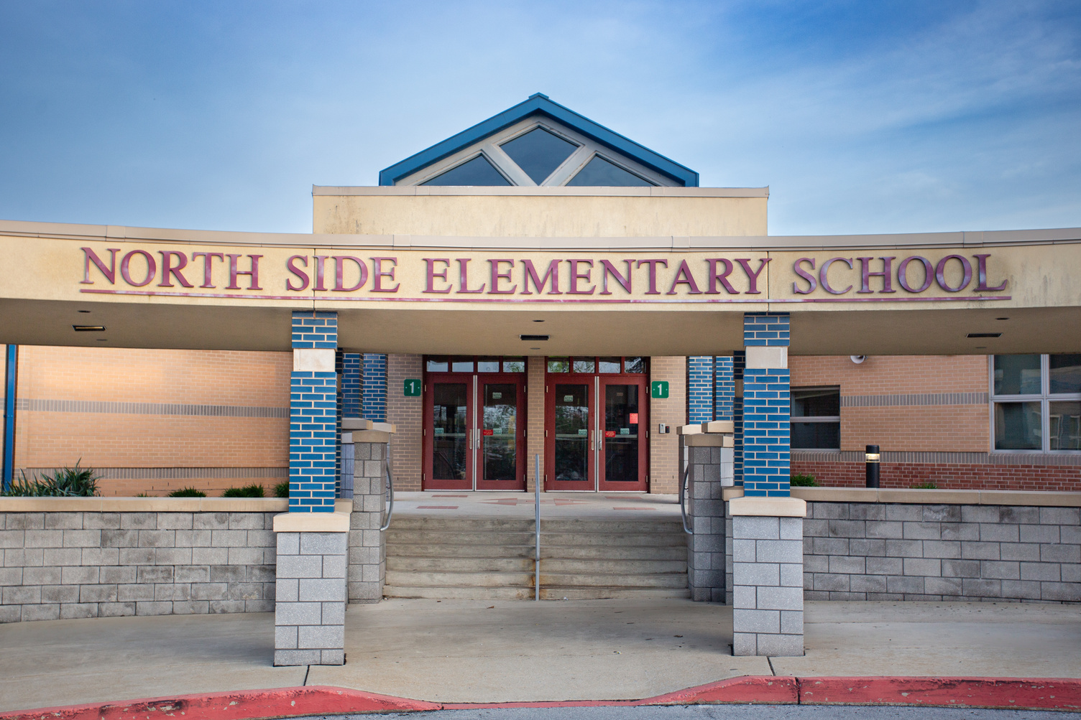
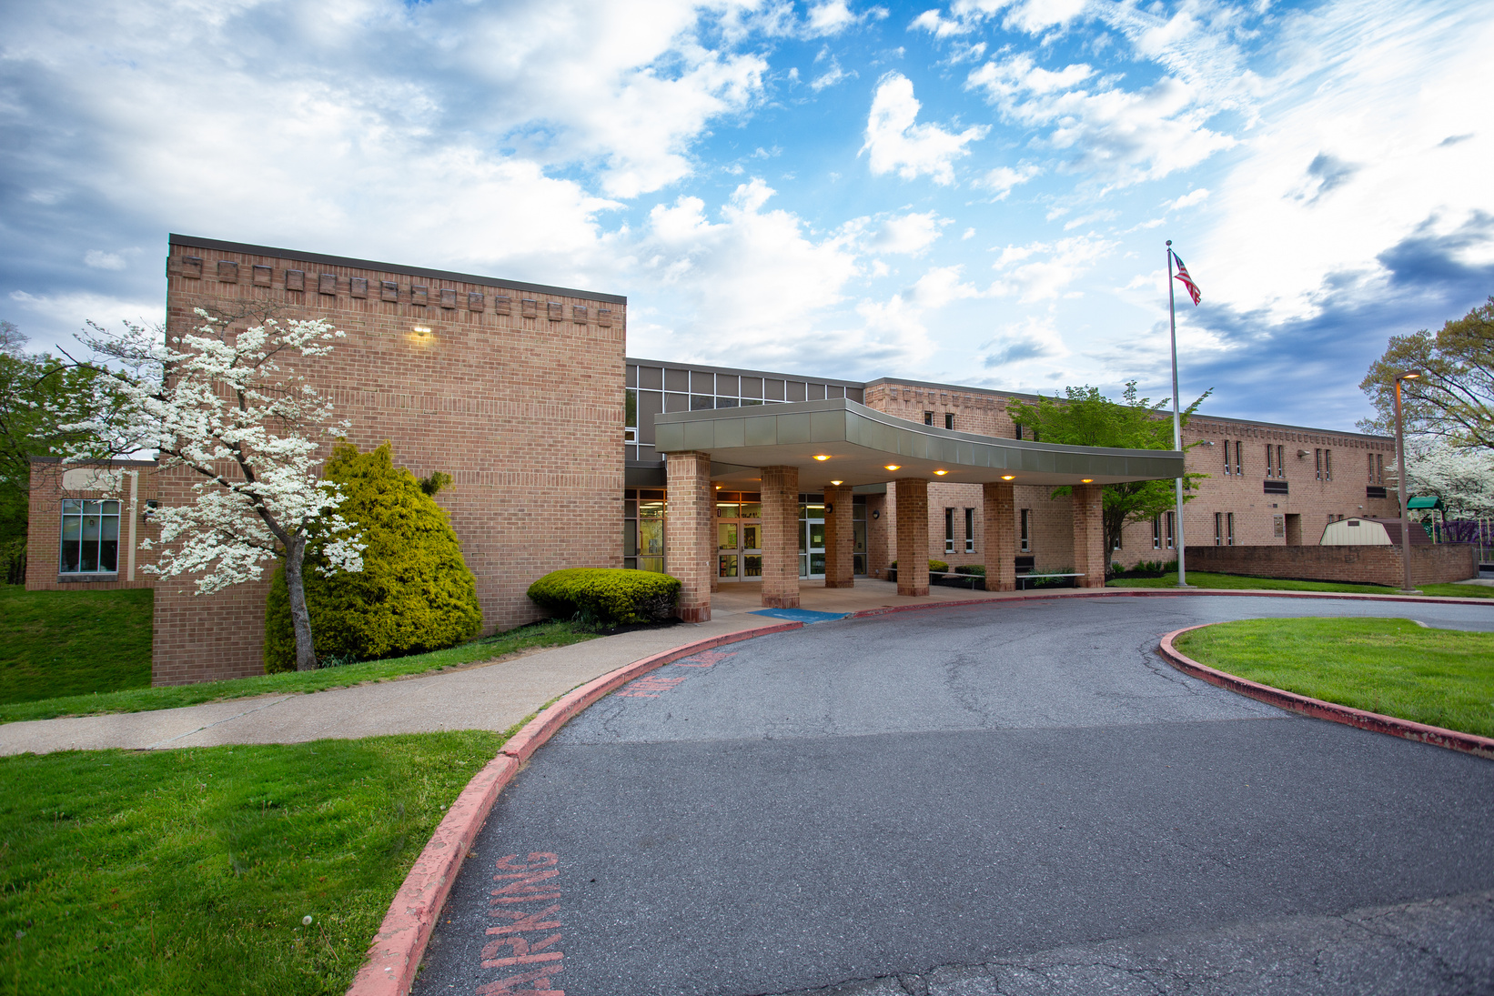
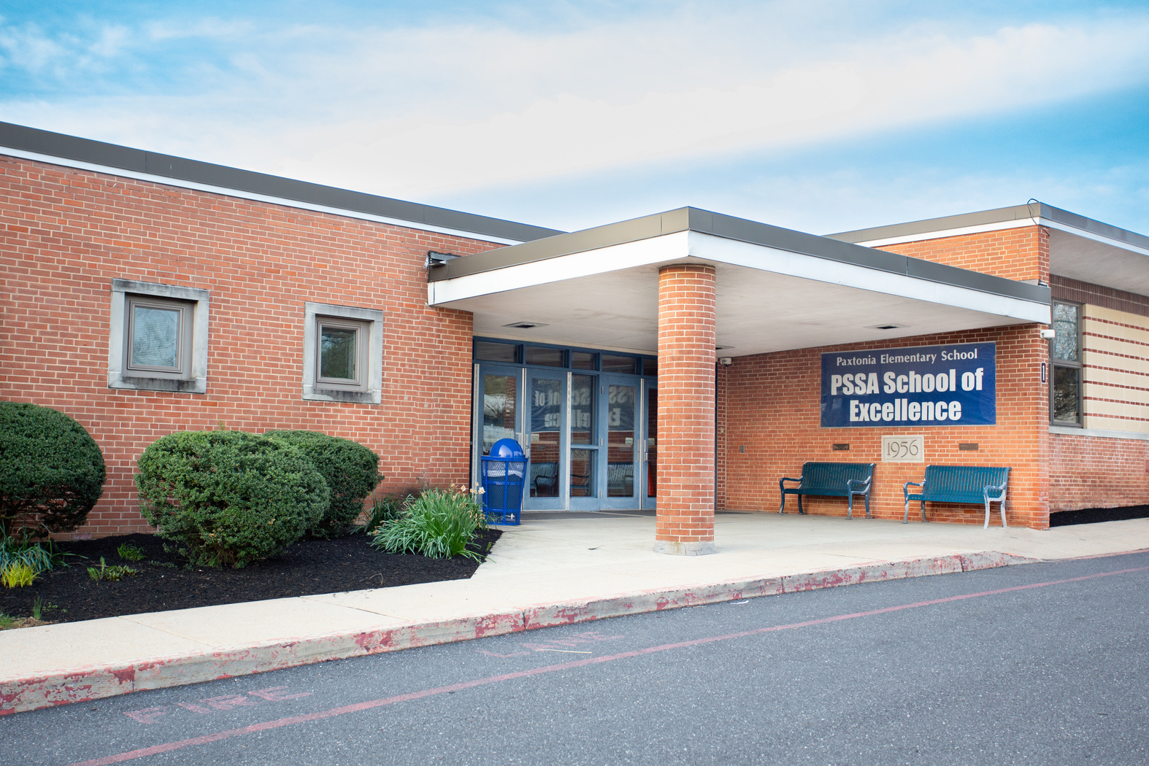
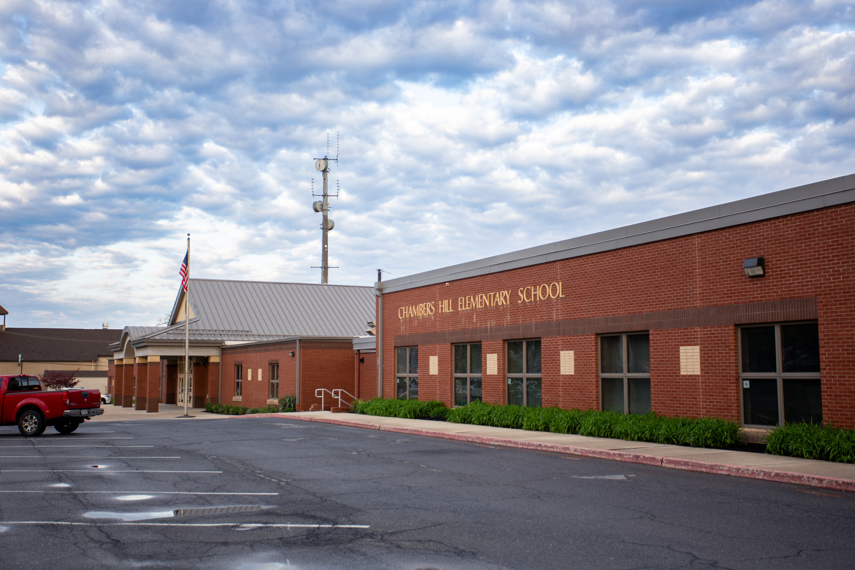
Current Functional Capacity
Building Name | 2024-2025 | Capacity | 2029-2030 | Capacity
Chambers Hill | 257 | 73% | 239 | 68%
Lawnton | 311 | 96% | 381 | 117%
Linglestown | 475 | 86% | 589 | 107%
Middle Paxton | 289 | 58% | 286 | 57%
Mt. View | 373 | 71% | 399 | 76%
North Side | 722 | 96% | 812 | 108%
Paxtang | 281 | 86% | 280 | 86%
Paxtonia | 682 | 83% | 871 | 106%
Phillips | 394 | 79% | 362 | 72%
Rutherford | 461 | 74% | 604 | 97%
South Side | 605 | 73% | 566 | 69%
Tri-Community | 427 | 71% | 447 | 75%
West Hanover | 589 | 76% | 681 | 88%
The capacity given is for the physical space in the buildings,
this is further restricted by special education classrooms, which have lower limits. Ex: 8 to a class.
Notes:
Additional class size limits
Cambers Hill = 3 Supplemental/Full-time Learning Support (SFLS)
EH Phillips = 4 AS
Lawnton = 2 AS
Linglestown ES = 2 AS, 3 ES, and 2 MDS
Middle Paxton = 2 AS
Mountain View = 5 AS
Paxtonia = 3 SFLS
Tri-C = 3 AS
West Hanover = 4 AS
LIMITS:
AS = 8
MDS = 8
ES = 20 Supplemental / 12 Full-time (we try to stay below 12)
SFLS = 20 Supplemental / 12 Full-time (we try to stay below 12)

Slide 22

Central Dauphin School District's Current Kindergarten Structure
Half Day Program Structure
2.5 hours school day
Core Instruction
  Literacy - 1 hour
  Math - 30 minutes
  Intervention - 20 minutes
  Content - 15 minutes
Limitations
  No Creative Arts
  Limited time for self-directed activities, play, and recess

Slide 23
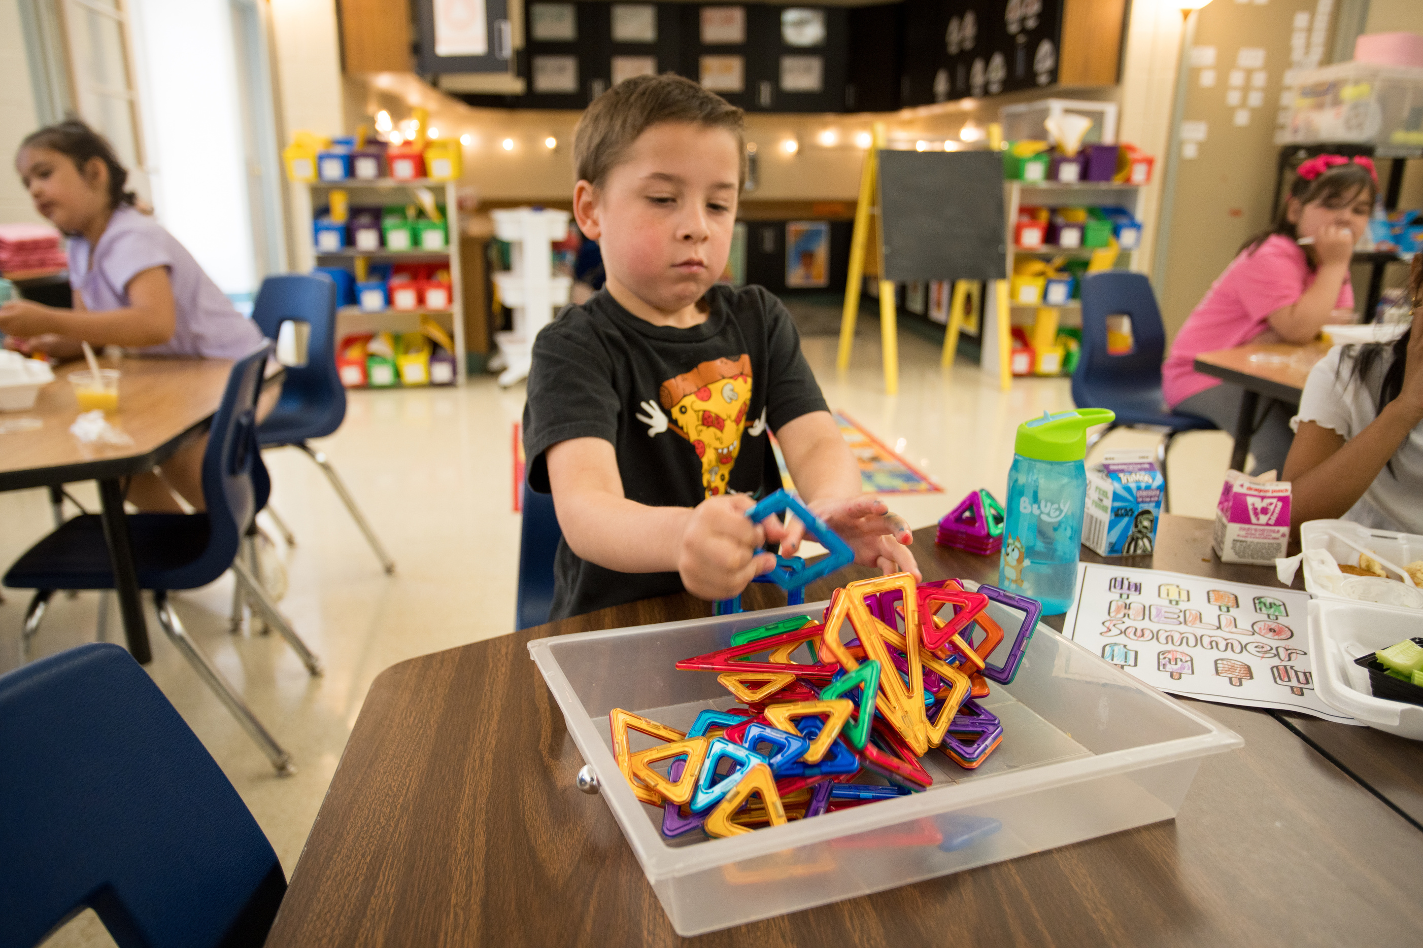
Proposal Overview
  Transition from half-day to full-day kindergarten in the 2025-2026 school year.
  Purchase of 3 additional buildings.
  Retrofit existing and newly purchased buildings.
  Move Penbrook neighborhood to Paxtang for 1-5.
  Increase the number of Kindergarten teachers from 23 to 44.
  The addition of 44 classrooms (regular and special education)
Notes:
Retrofit existing and newly purchased buildings. (Admin and 1240 Mountain Rd.
Feeder pattern change?

Slide 24

Enrollment Projections
  The total estimated Kindergarten enrollment for the 2025-2026 school year is 950 students.
  The estimated average Kindergarten class size is 21 students.
  Self-contained special education Kindergarten class size cannot exceed 8 students.
Notes:
Base on current 1st grade numbers and number of proposed classes.
Average Class size 904/44=20.546
Special Education Class Size 46/7= 6.571

Slide 25
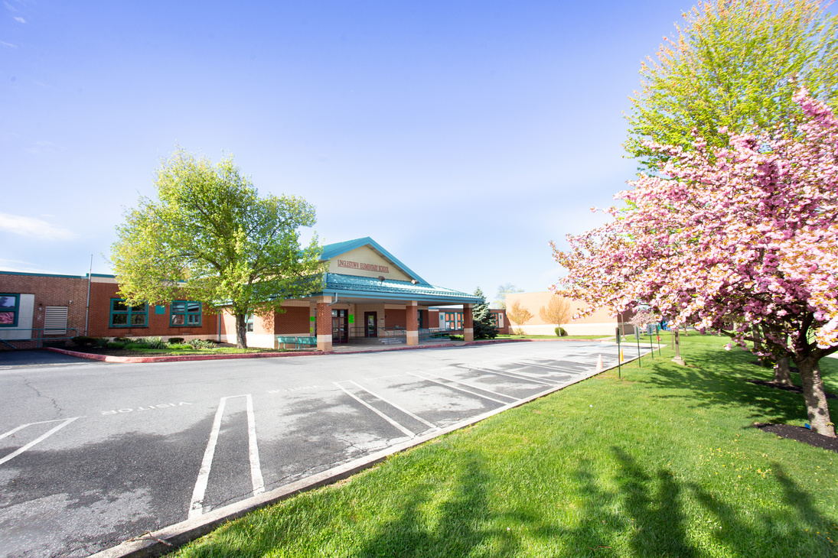
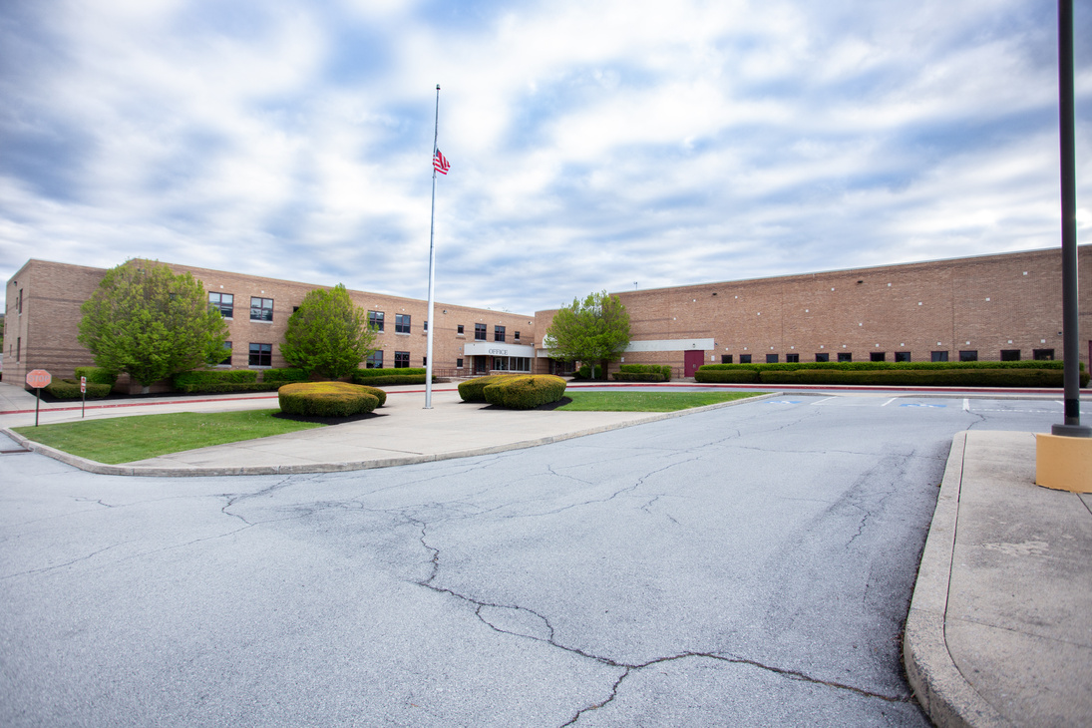
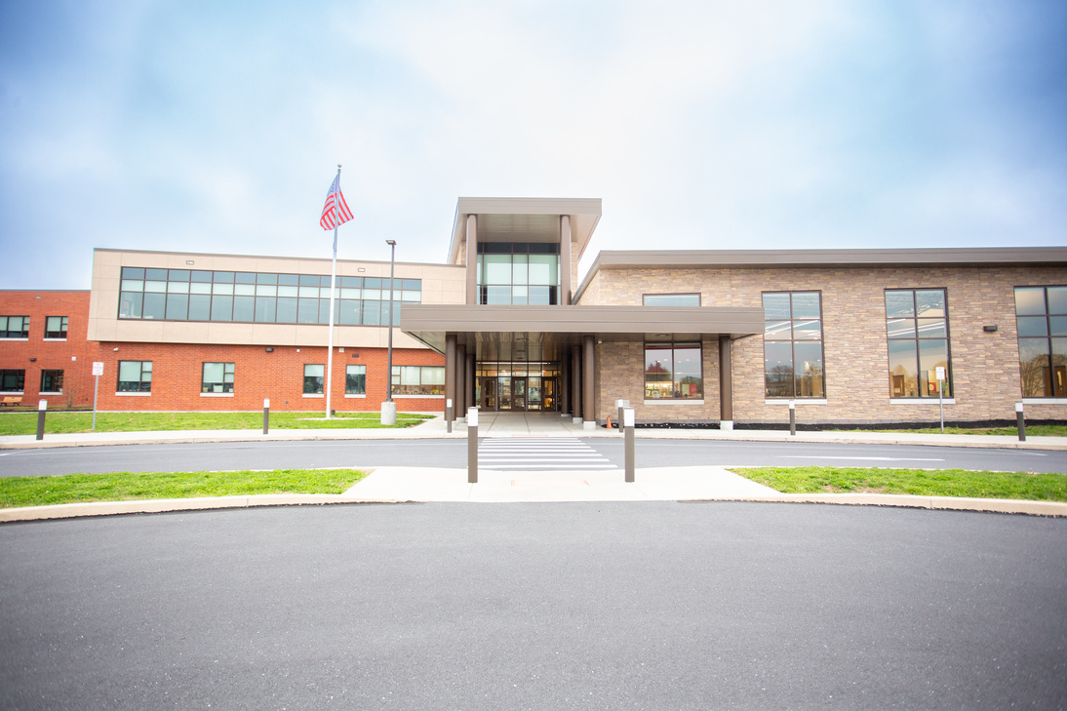
Building Plan
BUILDINGS STAYING K-5
Justifications to keep
some buildings K-5
  Transportation
  Enrollment numbers and growth projections in some buildings
Linglestown
Middle Paxton
West Hanover

Slide 26
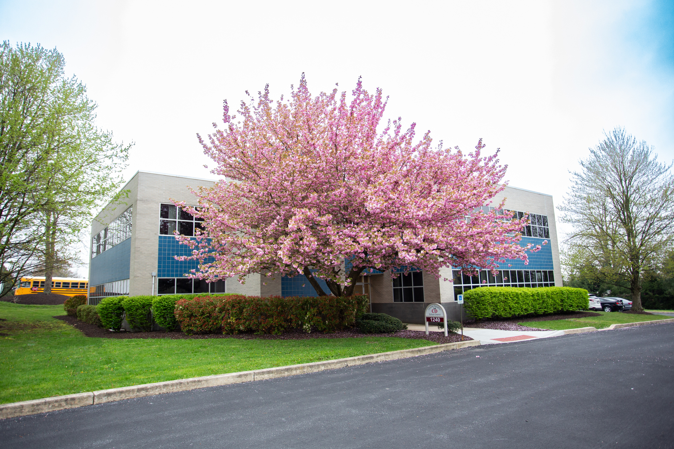
Facility Expansion
KINDERGARTEN CENTER
1240 MOUNTAIN RD
Paxtonia
5 new classrooms

Slide 27
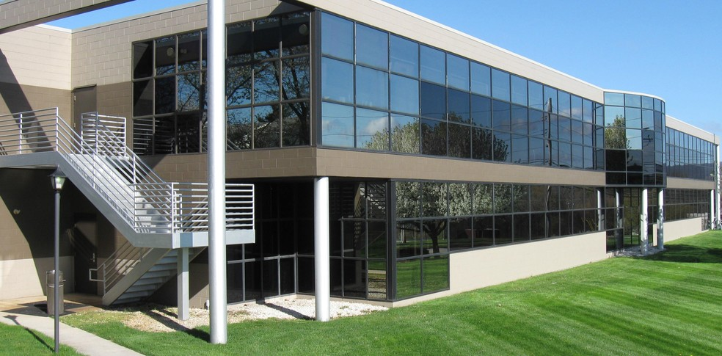
Facility Expansion a
KINDERGARTEN CENTER
4251 Crums Mill Rd
Mountain View, North Side
11 new classrooms
image from loopnet.com

Slide 28
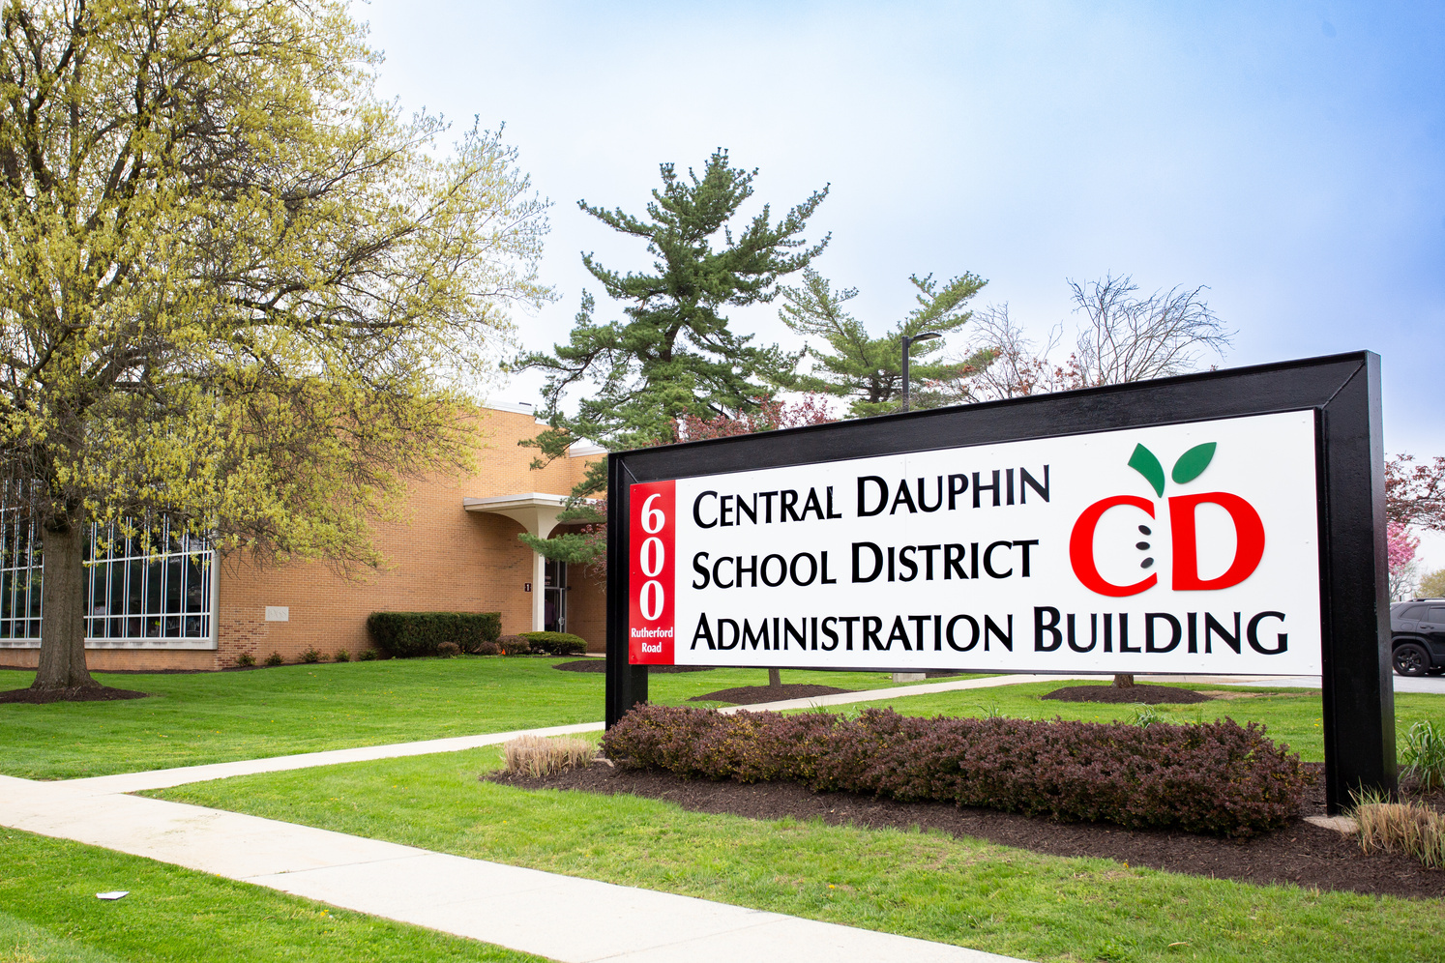
Facility Expansion b
KINDERGARTEN CENTER
600 RUTHERFORD RD
PAXTANG, South Side,
E. H. Phillips
13 new classrooms

Slide 29
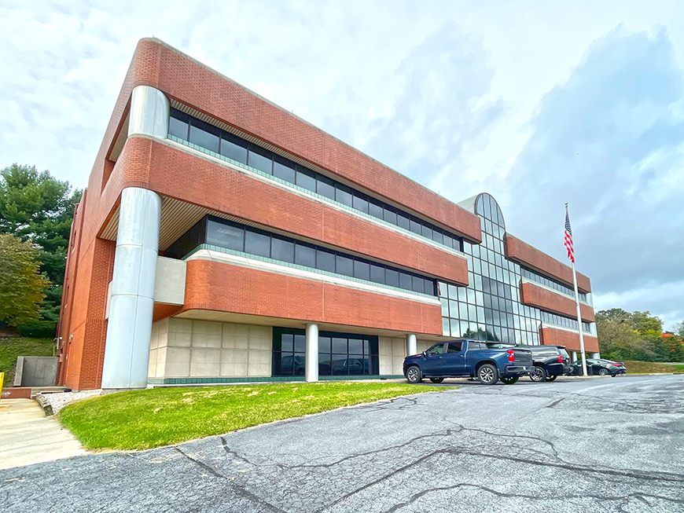
Facility Expansion d
KINDERGARTEN CENTER
4031 EXECUTIVE PARK DR
Chambers Hill, Lawnton,
Rutherford, Tri-Community
15 new classrooms
image from billgladstone.com

Slide 30
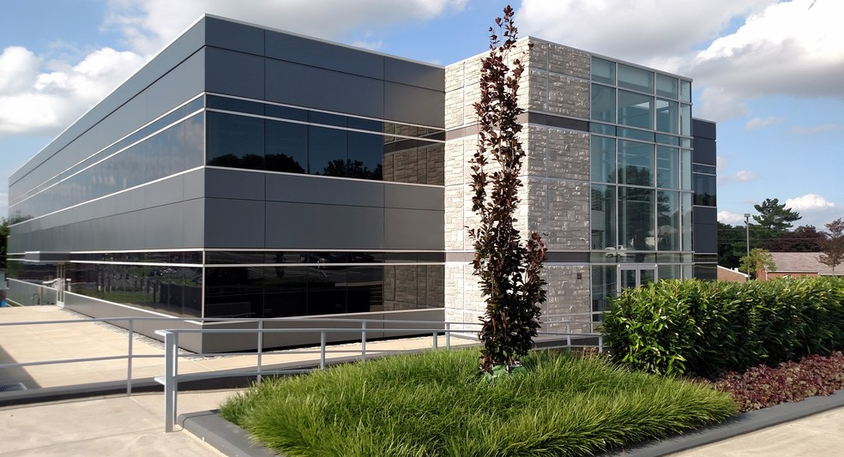
Facility Expansion c
Administration Building and
Resource Center
75 S HOUCKS RD
Resource Center
  A place to welcome families to the district.
  Enrollment Process
  Connect families to outside resources at one location
image from loopnet.com

Slide 31
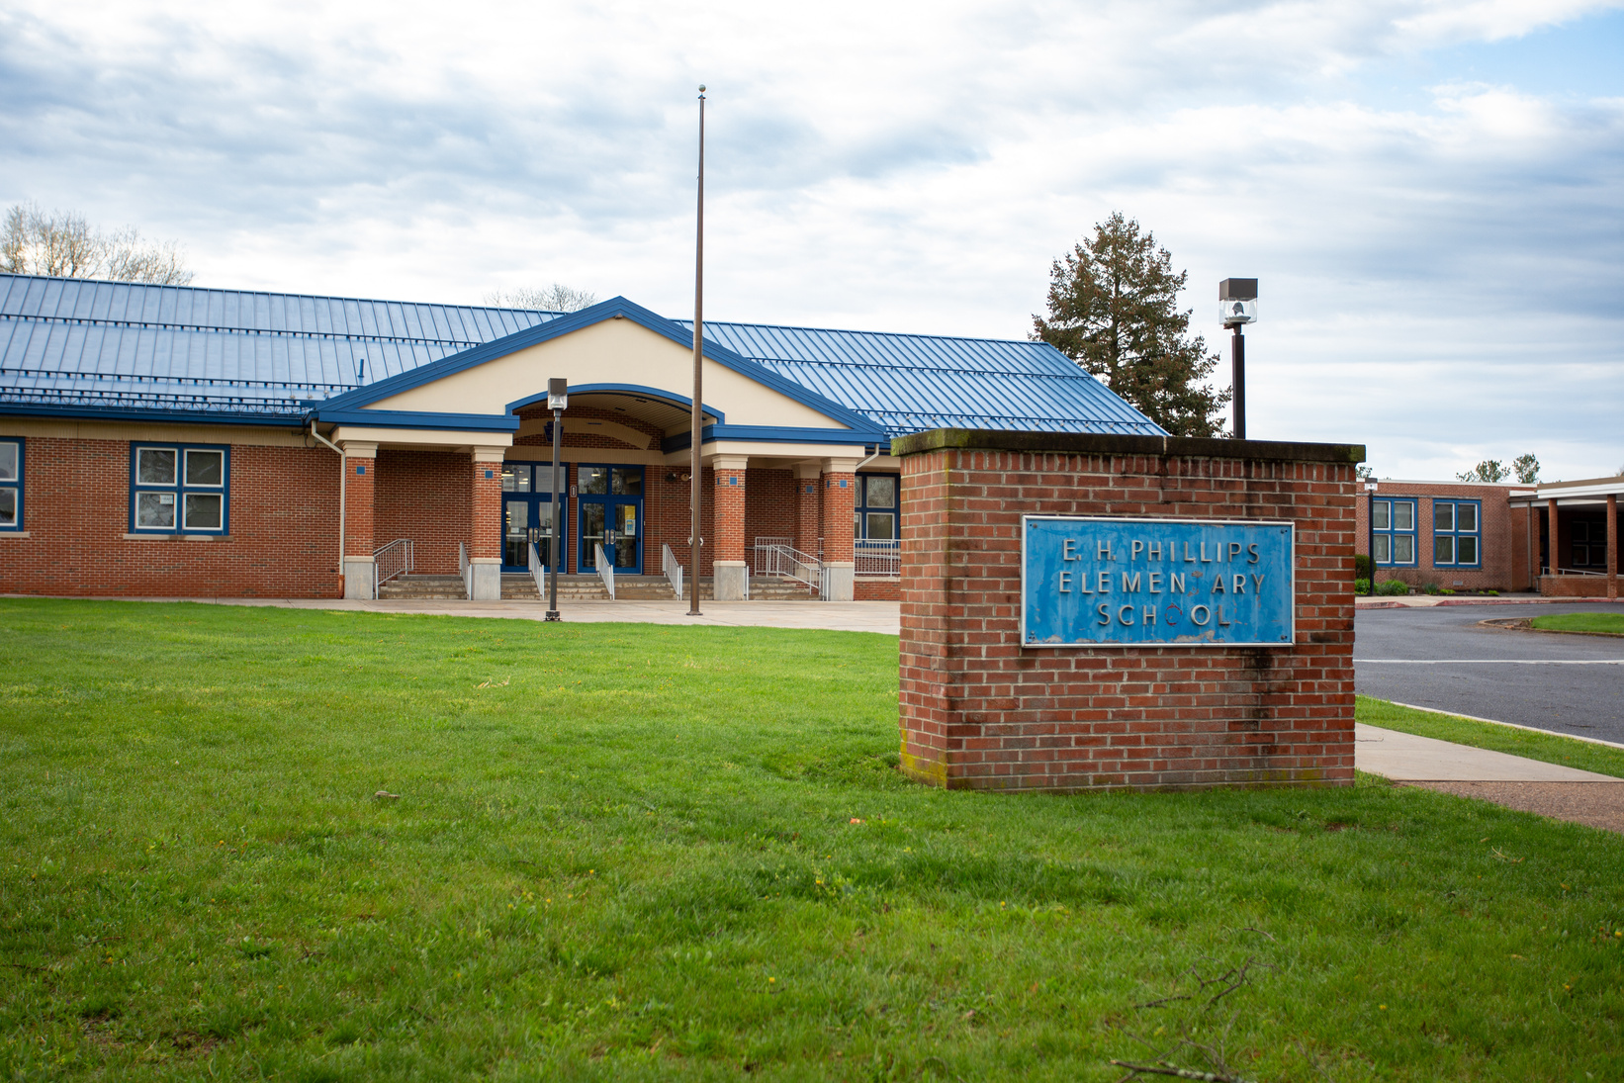
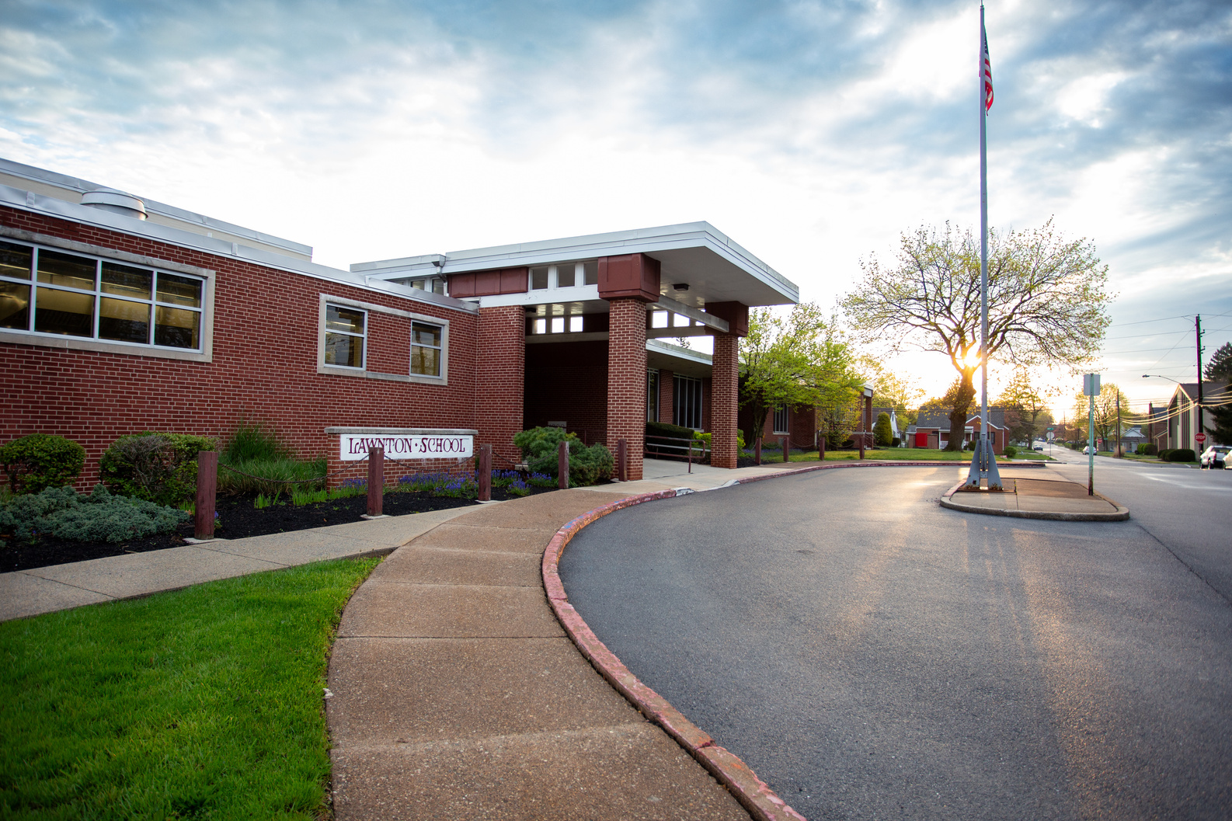
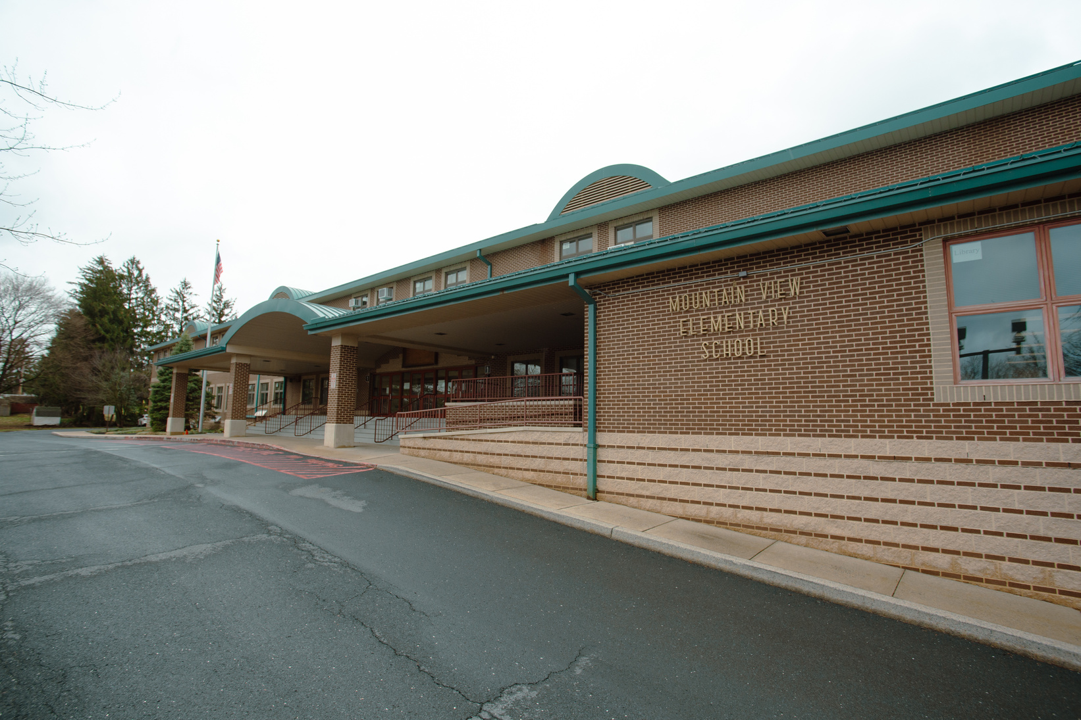
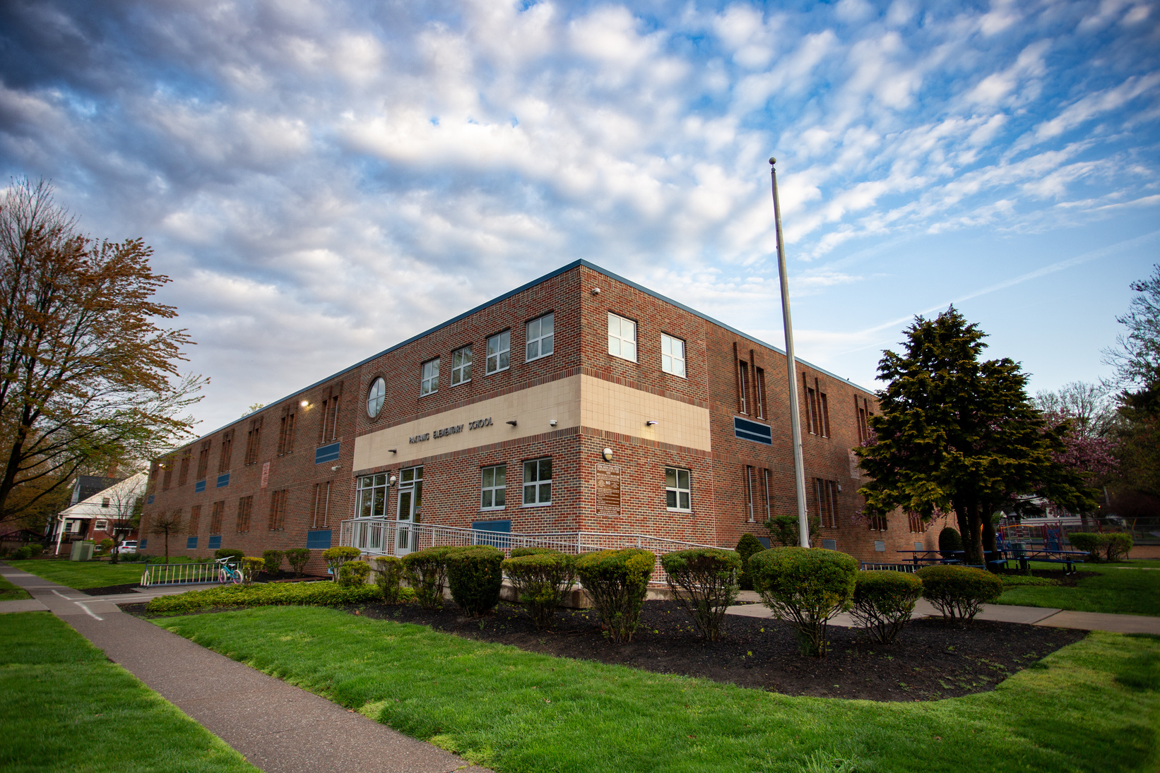
Proposed Functional Capacity
Building Name | 2024-2025 Current | Cap | 2024-2025 Proposed Changes | Cap
Chambers Hill | 257 | 73% | 226 | 65%
Lawnton | 311 | 96% | 245 | 75%
Linglestown | 475 | 86% | 467 | 85%
Middle Paxton | 289 | 58% | 289 | 58%
Mt. View | 373 | 71% | 325 | 62%
North Side | 722 | 96% | 610 | 81%
Paxtang | 281 | 86% | 204 | 62%
Paxtonia | 682 | 83% | 588 | 71%
Phillips | 394 | 79% | 337 | 67%
Rutherford | 461 | 74% | 394 | 63%
South Side | 605 | 73% | 605 | 73%
Tri-Community | 427 | 71% | 352 | 59%
West Hanover | 589 | 76% | 589 | 76%
Notes:
https://www.nea.org/sites/default/files/2020-07/18001_Full-Day_Kindergarten_Policy_Brief-final.pdf
https://ccsd.net/resources/assessment-accountability-research-school-improvement-division/full-day-kindergarten-review-of-literature.pdf
https://nces.ed.gov/pubs2004/web/2004078.asp

Slide 32

Full Day Kindergarten a
Half Day Kindergarten
Core Instruction
  Literacy - 1 hour
  Math - 30 minutes
  Intervention - 20 minutes
  Content - 15 minutes
Limitations
  No creative arts
  Limited time for self-directed activities, play, and recess
  One school meal available per day
Core Instruction
  Literacy - 1.5 hours
  Math - 1 hour
  Literacy Intervention - 20 minutes
  Math Intervention - 20 minutes
  Content - 20 minutes
Additions
  Time for creative arts standards
  Time for play and learning centers
  More time for social interactions
  Two school meals available per day
Notes:
Definately for Paxtang, Middle Paxton, and West Hanover. What does it look like at the Kindergarten Centers?

Slide 33

Sample Schedule
8:45-9:00 – Arrival, Breakfast, Morning Work
9:15- 9:25- Morning Meeting
9:25-9:40 – Number Corner
9:40-11:30 – Literacy (Science/SS Integration)
11:30-12:30 – Lunch/Recess
12:15-12:30 – Rest/Story
12:30- 12:50 – Literacy Intervention
1:10-1:45 – Classroom Play/Centers
1:45-2:30 – Math
2:30-2:50 – Recess/Snack
2:50- 3:10 – Math Intervention
3:10- 3:30 – Creative Arts (Music, Art, Library, PE, STEM)
3:30 - 3:40 – Clean up and prepare for dismissal
3:40- 3:45 - Dismissal

Slide 34

Special Education
Current K-2nd grade students will be educated in a school closer to their home.
Current 3rd and 4th grade students will be given the option to stay in their current school or switch to a school closer to their home.
An additional benefit close to home classes for special education is more efficient, timely transportation for all students.

Slide 35
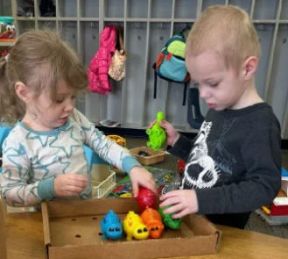
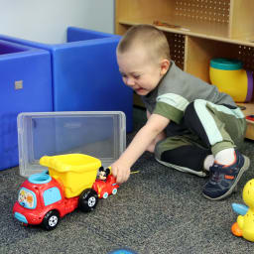
Early Intervention
Early intervention allows us to develop relationships with students and families before they start kindergarten.
Currently, there are no district classrooms available for IU early intervention classes. Students are being transported to other districts, such as districts located on the West Shore.
We could add these classes to the newly acquired buildings and in the current elementary buildings.
The current cost per year is over $700,000 just for transportation of early intervention students.
Images from caiu.org
Notes:
(Reading Specialist, ELD, Learning Support, Autistic Support, Emotional Support, Principals, custodians, food services, secretaries, nurse, counselor, MDS, creative arts)

Slide 36

Building Acquisition Cost
4251 Crums Mill Rd
4031 Executive Park Rd
75 S Houcks Rd
Total Investment
2.8 million
2.1 million
4.5 million
9.4 million
Notes:
(Bathrooms, Playgrounds, Cafeterias/Multipurpose Room, Library, Playground, Bus and car drop off routes- costs in renovations
Need Floor Plans for the 3 buildings

Slide 37

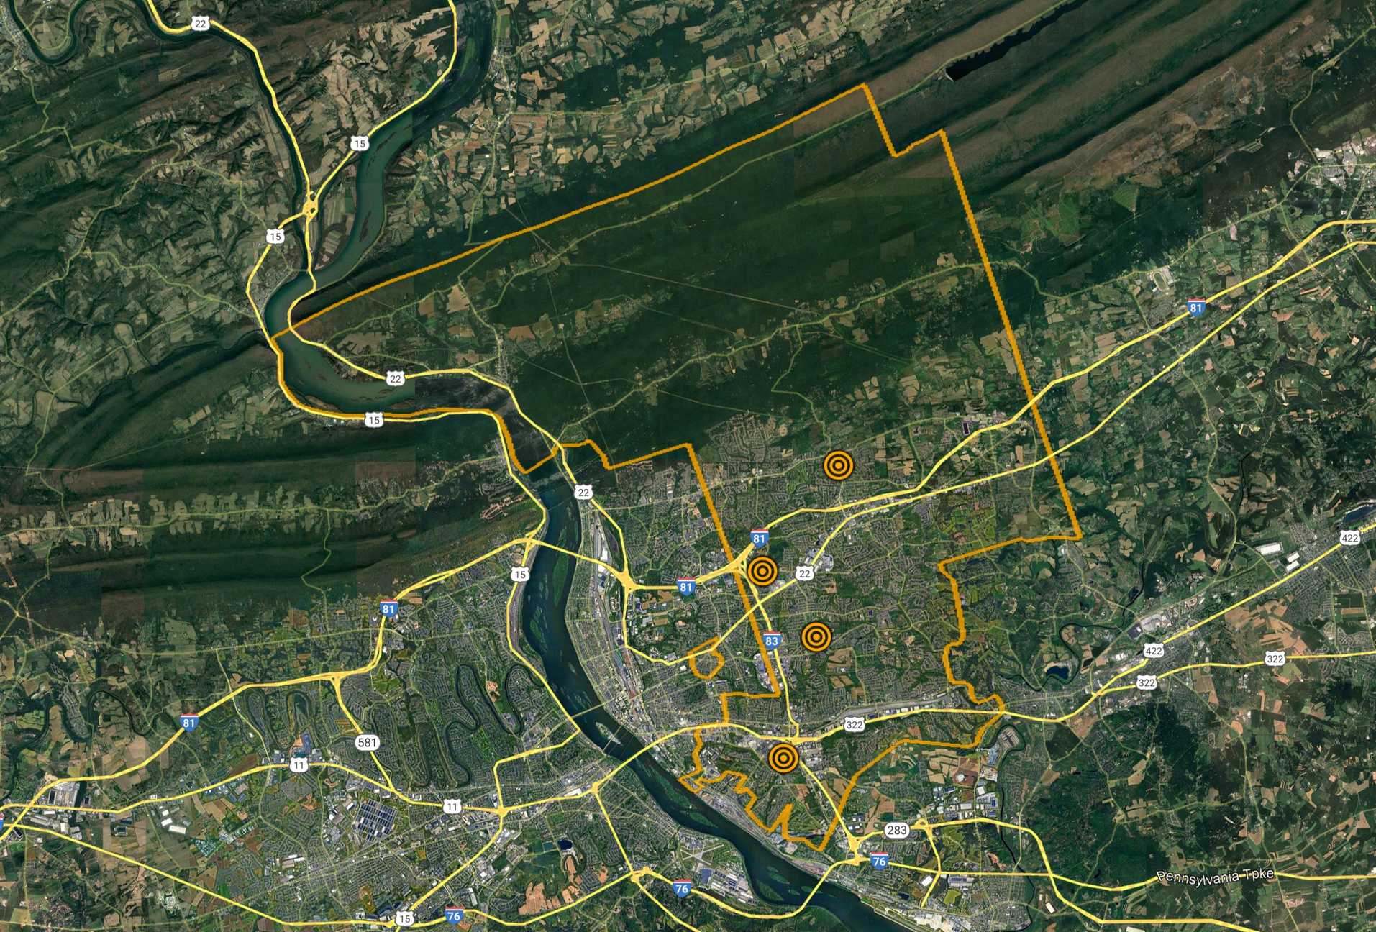




















Map of K locations

Slide 38


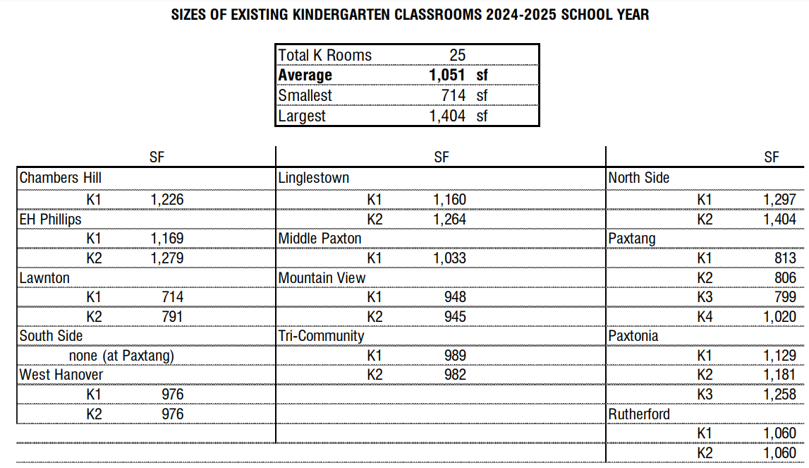


SF
25 1,051 714 1,404
sf sf sf
SF
SF
Chambers Hill
K1
Lingle s t own
1,160
1,264
North Side
1,297
1,404
1,226
K1 K2
K1 K2
EH Phillips
K1
K2
1,169
1,279
Middle Paxton
1,033
Pa xt a ng
813
806
799
1,020
K1
K1 K2 K3 K4
La wnt on
Mountain View
948
945
K1
K2
714
791
K1 K2
South Side
Tri-Community
989
982
Pa xt onia
1,129
1,181
1,258
none (at Paxtang)
K1 K2
K1 K2 K3
West Hanover
K1
K2
976
976
R ut he rf ord
1,060
1,060
K1 K2

Slide 39

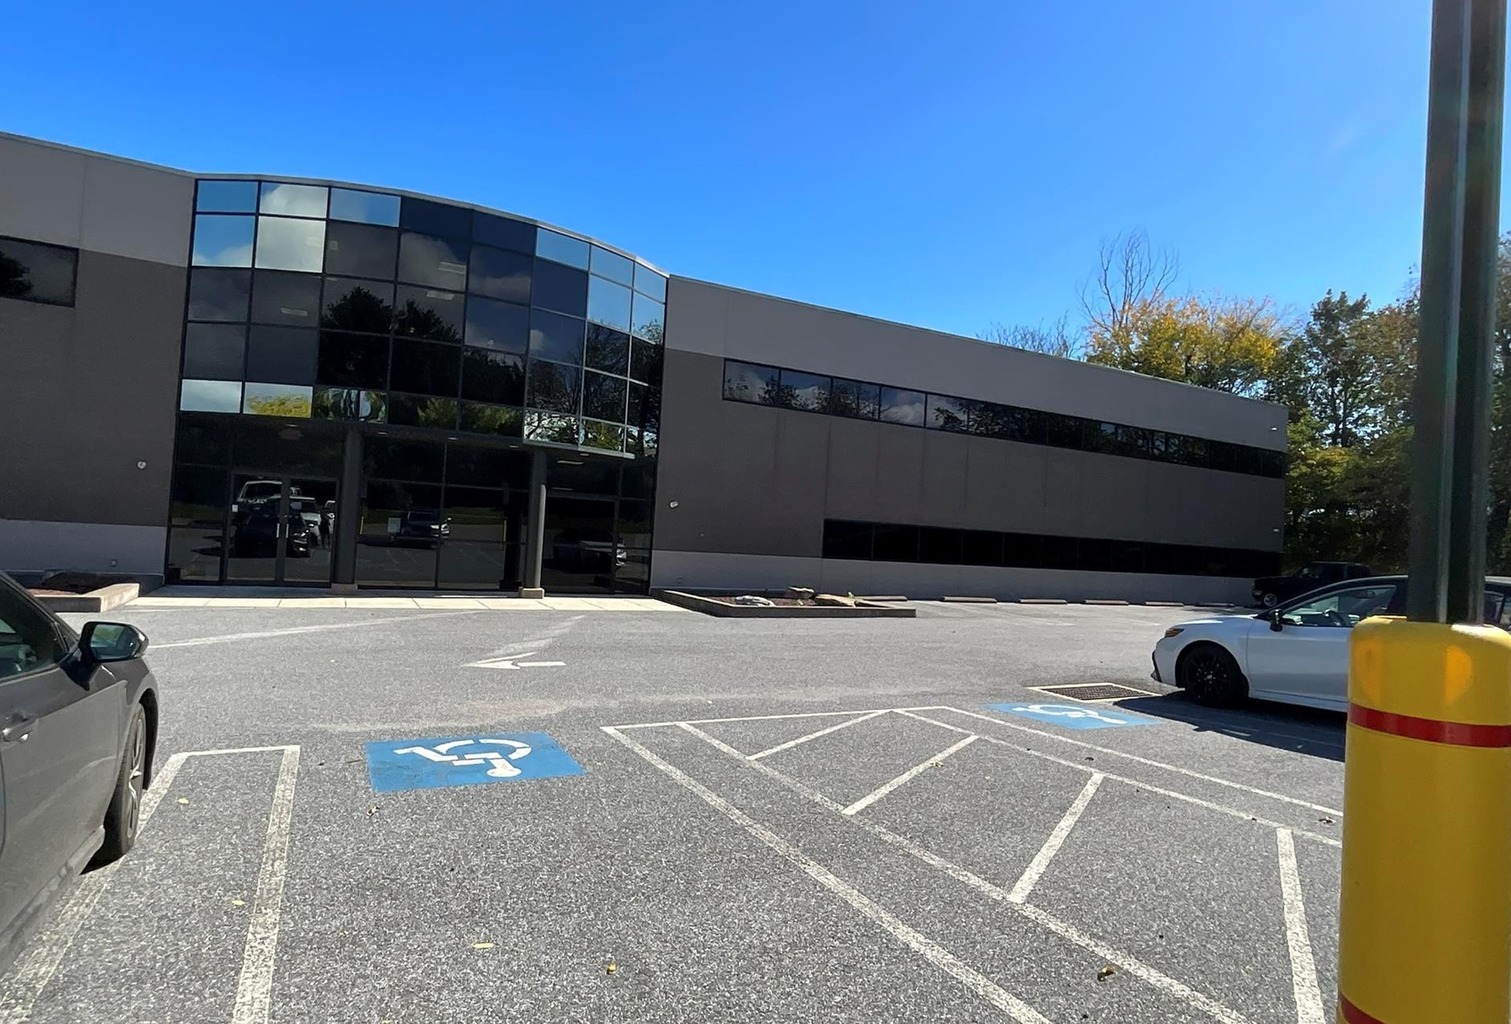



Total Area: 21,333 SF Classrooms: 9 / 2 SE Capacity: 214 Pupils

Slide 40
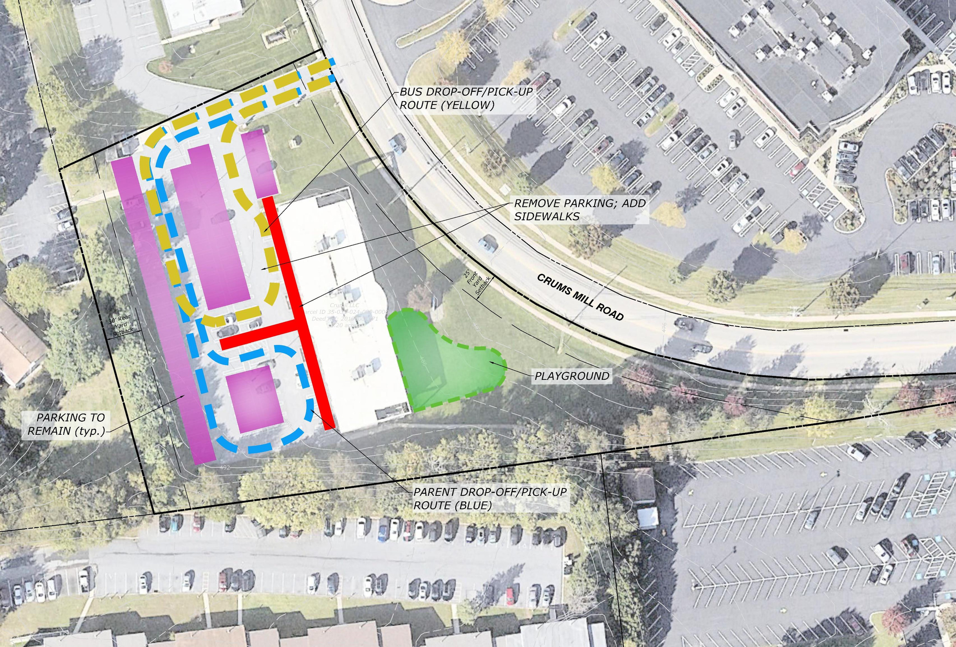

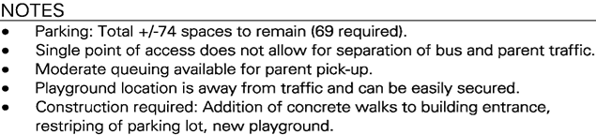

Crums mill bus turn around

Slide 41

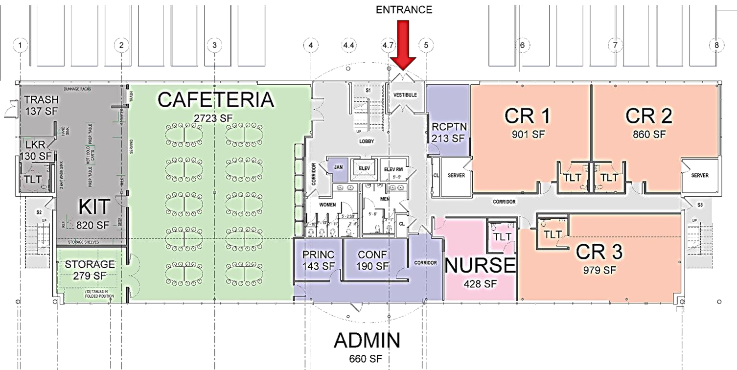


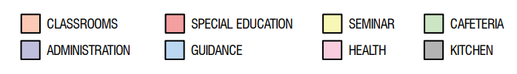





Crums mill renovation main floor
ENCLOSE STAIR
ENCLOSE STAIR
C LASSROOM S ADMINISTRATION
SPECIAL EDUCATION GUIDANCE
SEMINAR HEALTH
C AFE T E RIA KIT C HE N

Slide 42
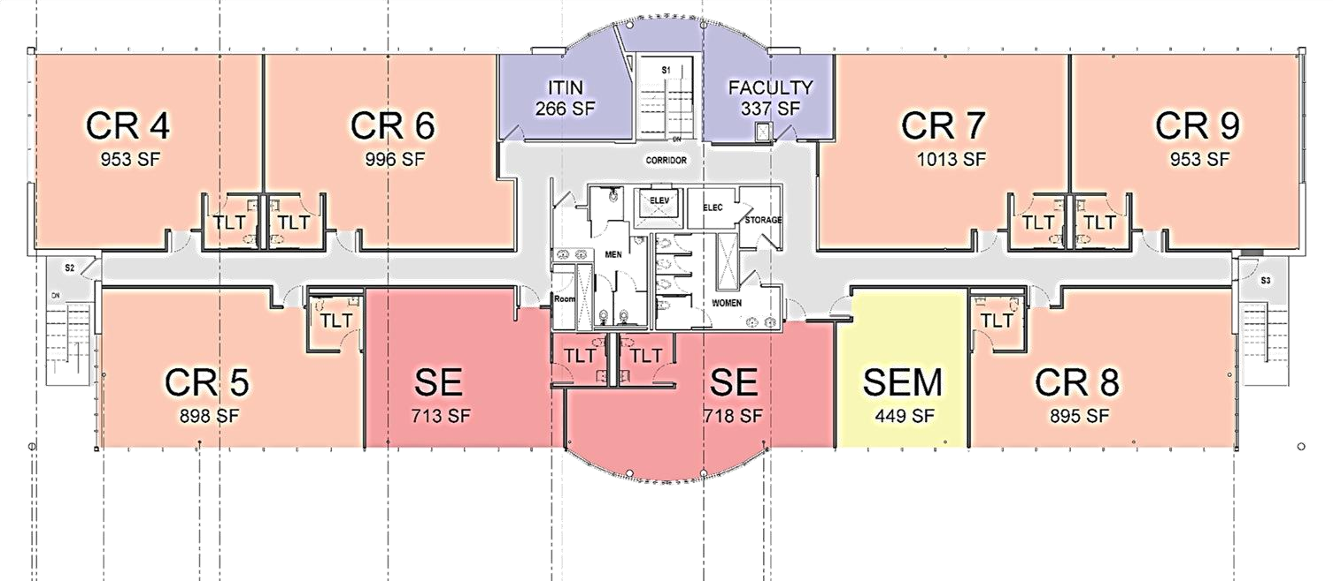


4521 Crums mill rd
ENCLOSE STAIR
ENCLOSE STAIR
C LASSROOM S ADMINISTRATION
SPECIAL EDUCATION GUIDANCE
SEMINAR HEALTH
C AFE T E RIA KIT C HE N

Slide 43
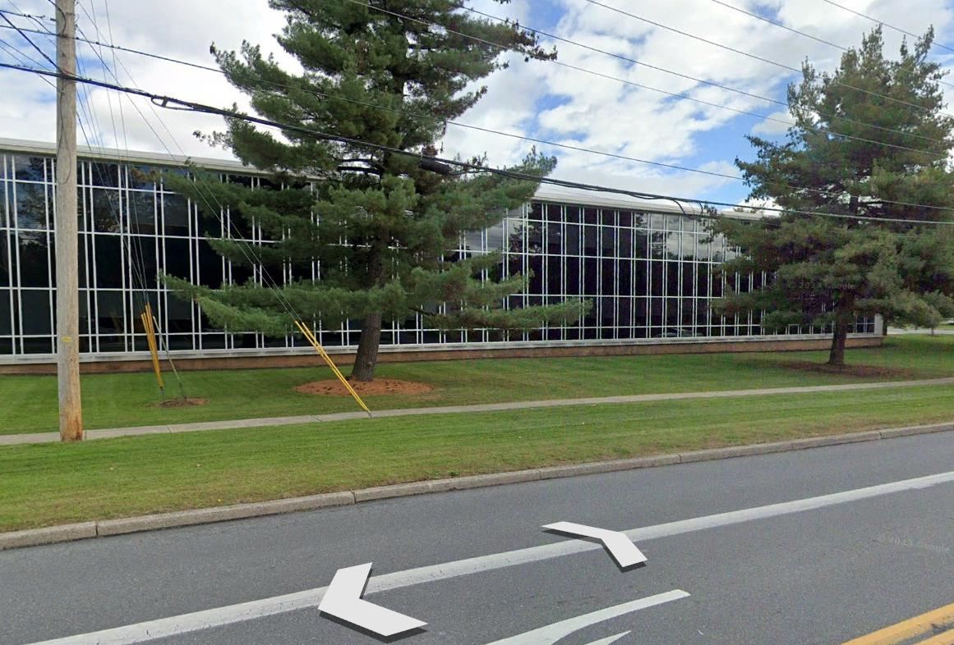



DAO site
Total Area: 32,697 SF Classrooms: 8 / 2 SE Capacity: 192 Pupils w/alt: 258 Pupils

Slide 44
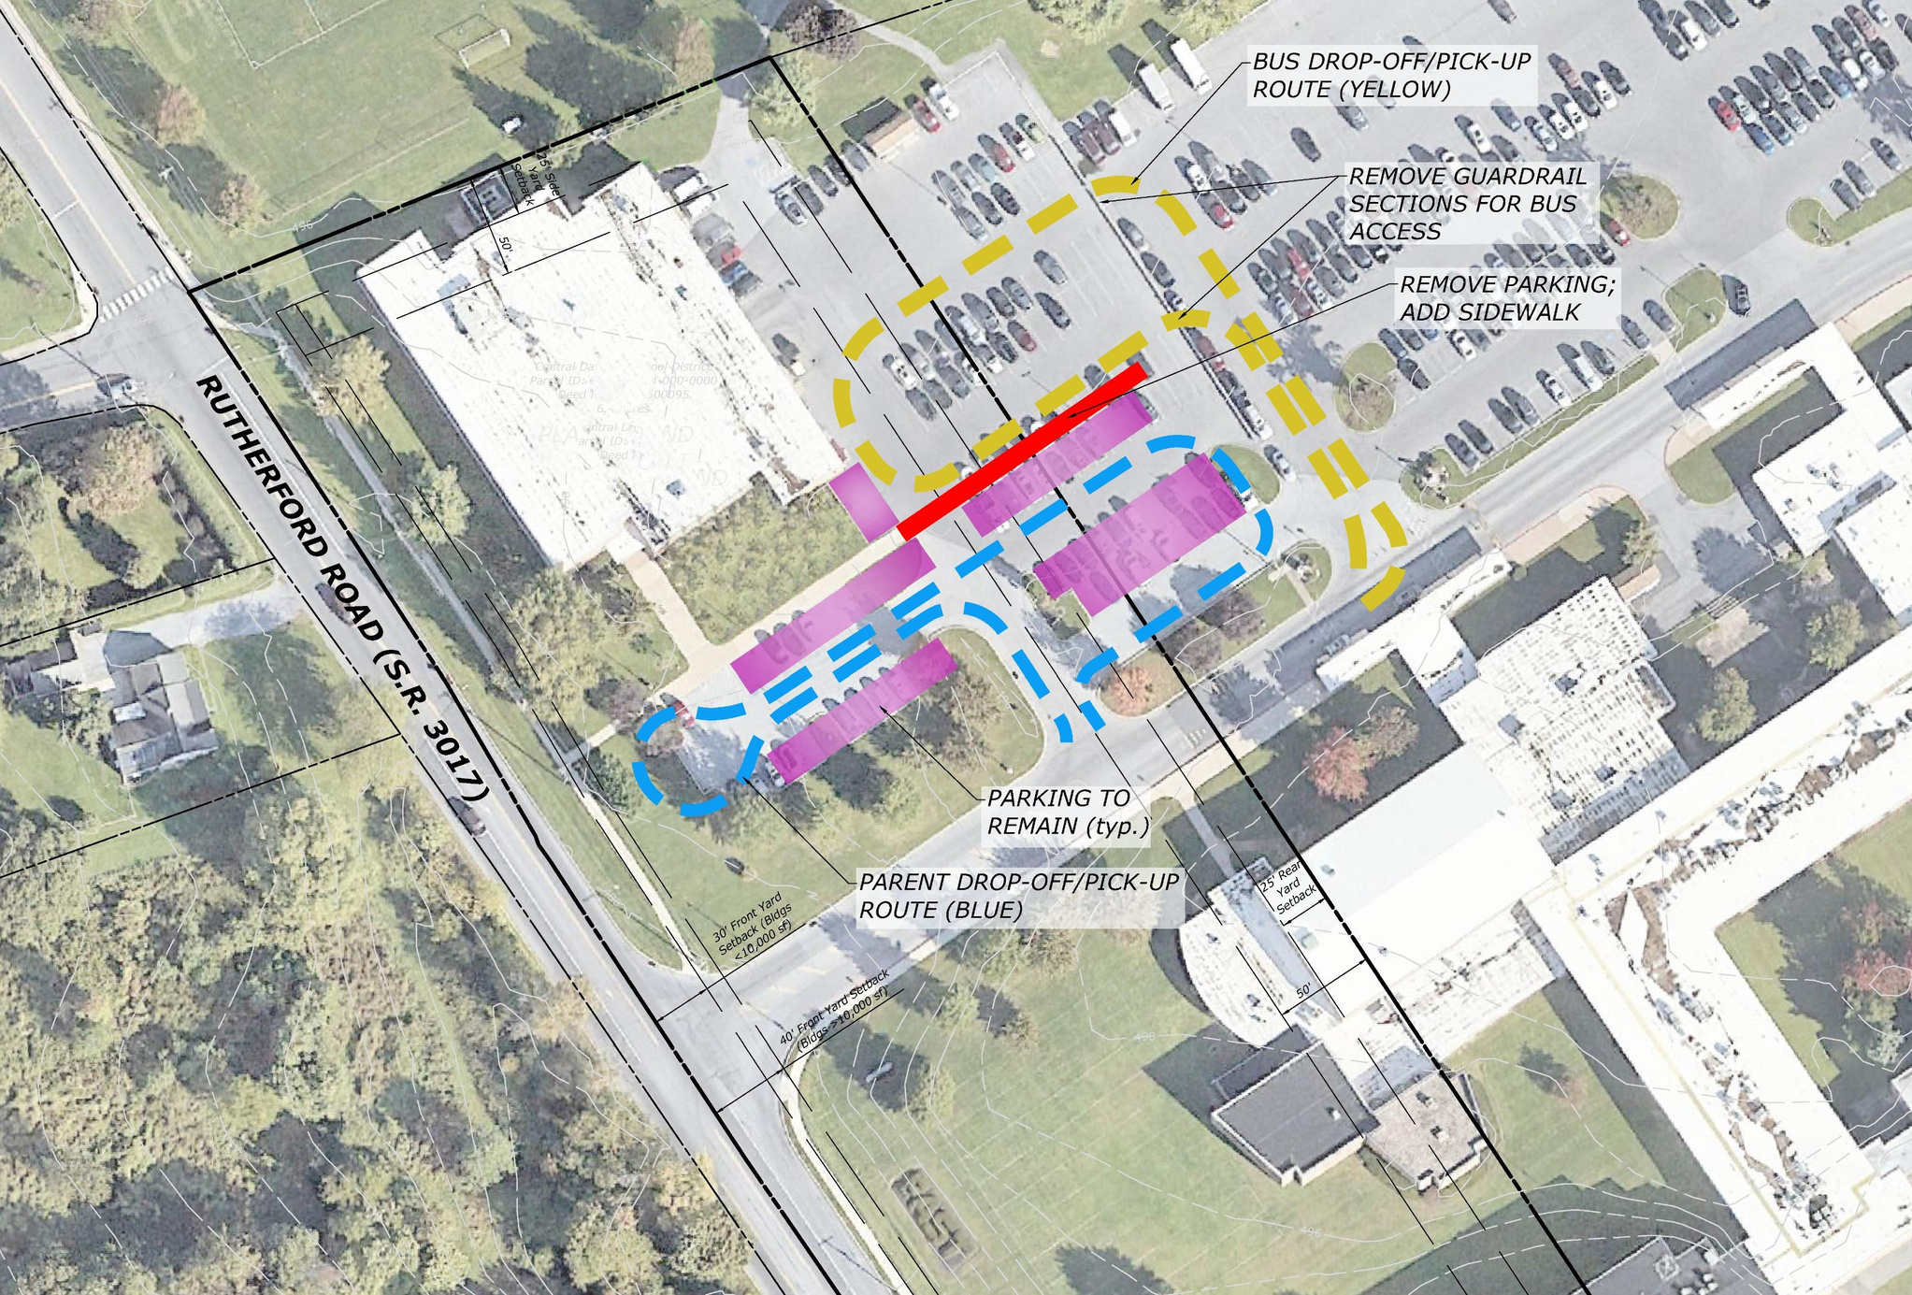


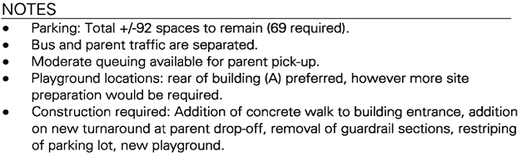

DAO Bus
PLAYGROUND

Slide 45
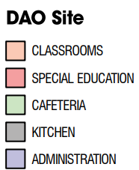
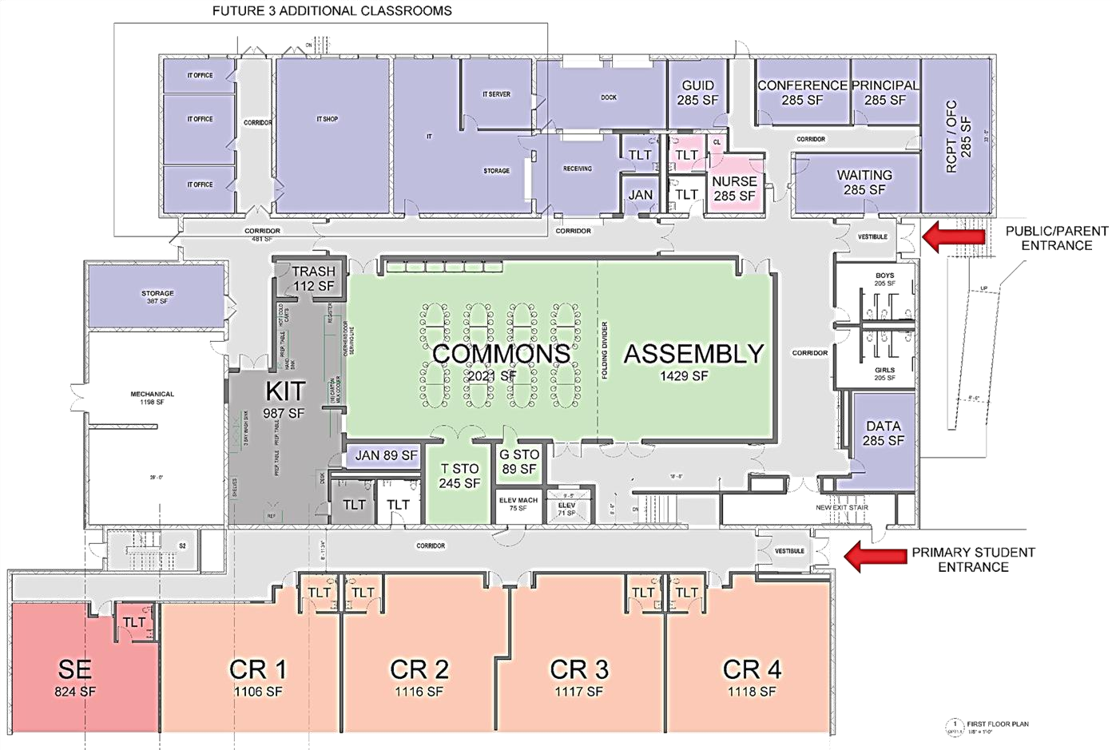




DAO Site 1st Floor
ALTERNATE BID FOR 3 CLASSROOMS
C LASSROOM S SPECIAL EDUCATION
C AFE T E RIA
KIT C HE N ADMINISTRATION
CR 9
CR 10
CR 11
GUIDANCE
HEALTH SEMINAR

Slide 46

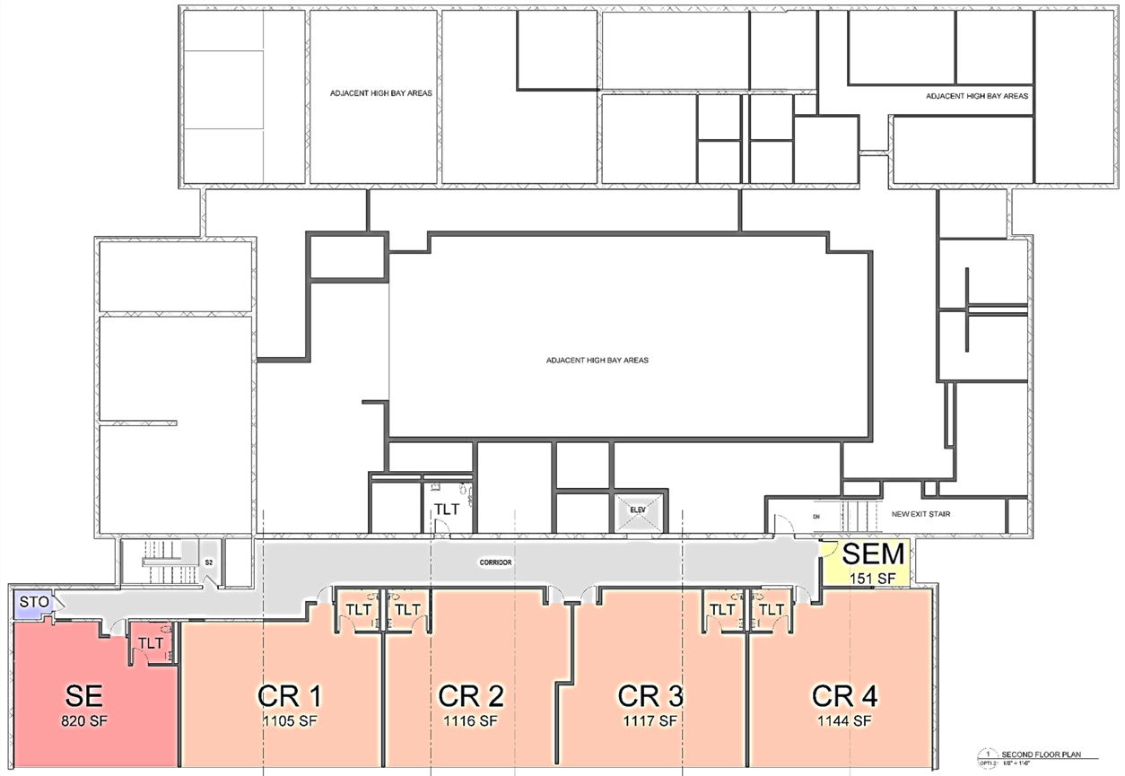


DAO Site 2nd Floor
C LASSROOM S SPECIAL EDUCATION
C AFE T E RIA
KIT C HE N ADMINISTRATION
GUIDANCE
HEALTH SEMINAR
ROOF
CR 5
CR 6
CR 7
CR 8

Slide 47

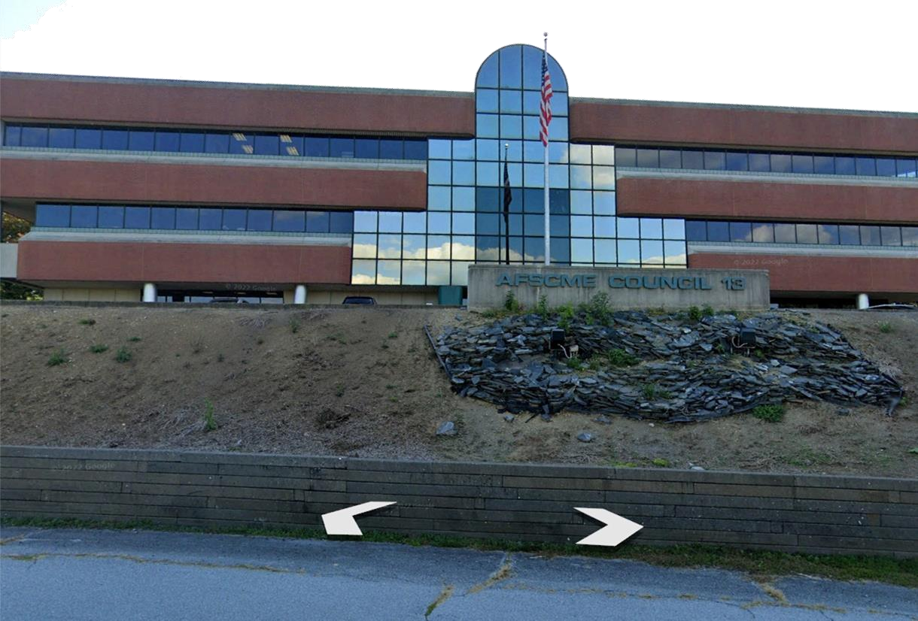



AFSCME Building
Total Area: 32,187 SF Classrooms: 12 / 3 SE Capacity: 288 Pupils

Slide 48
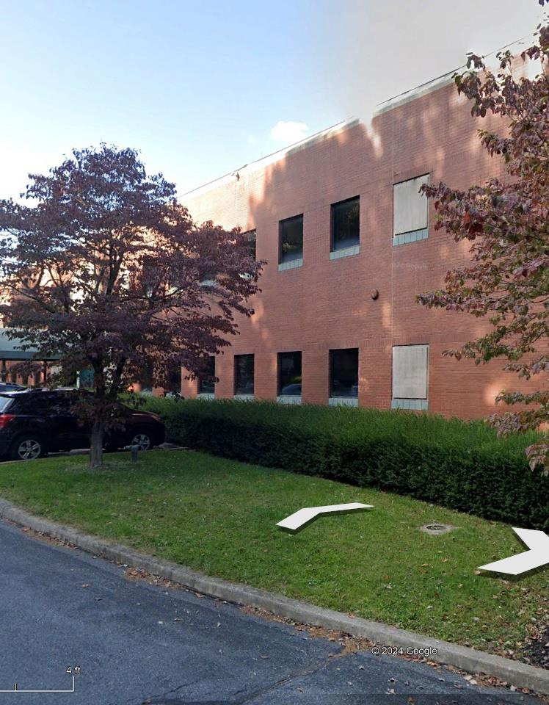
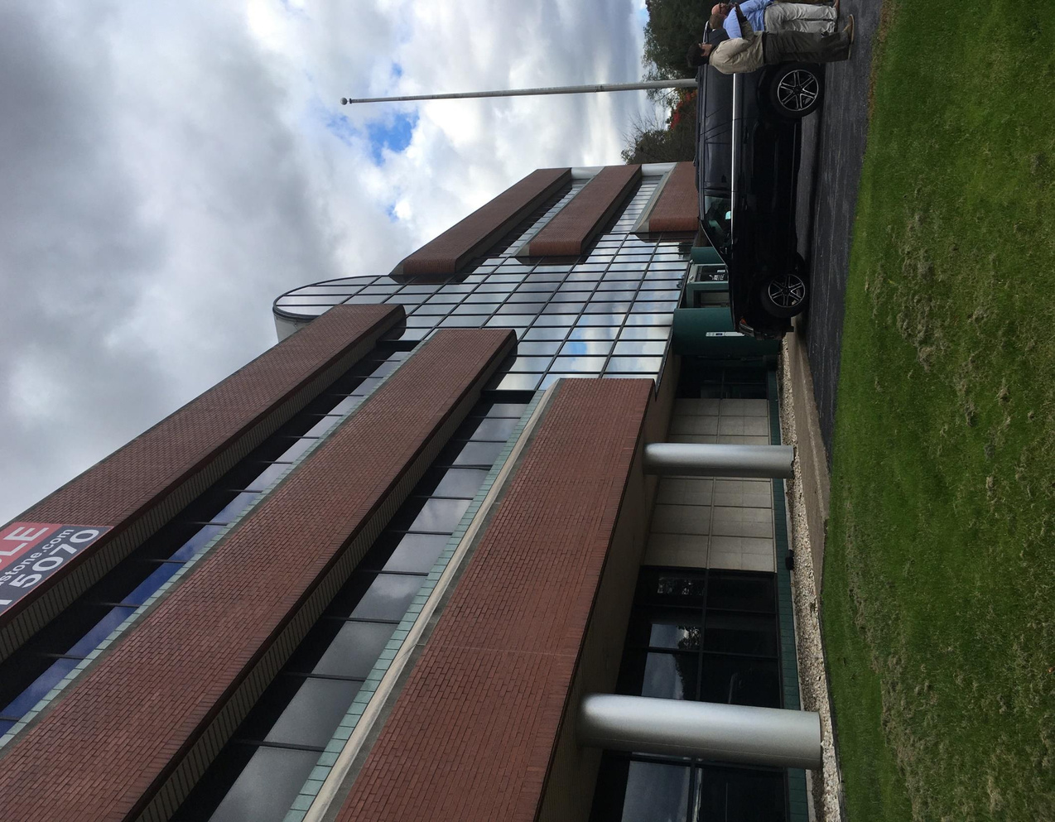

AFSCME Building Photos

Slide 49
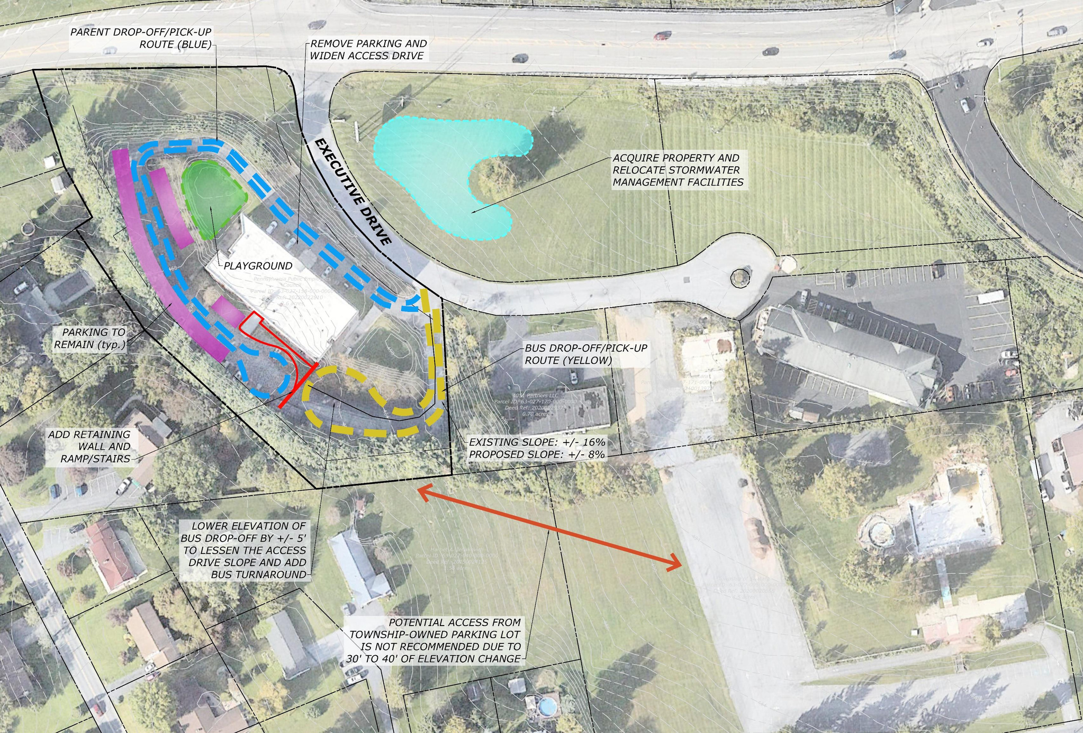

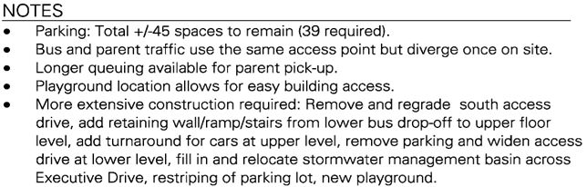

AFCME Bus

Slide 50
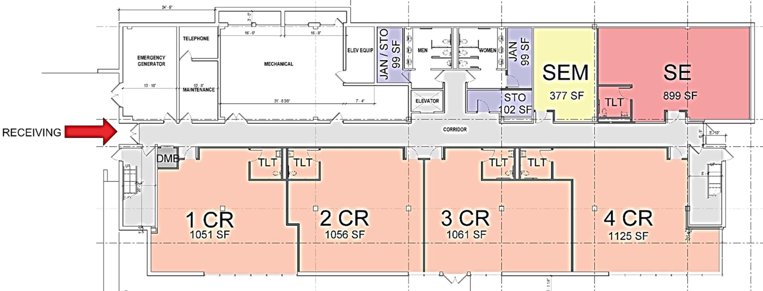
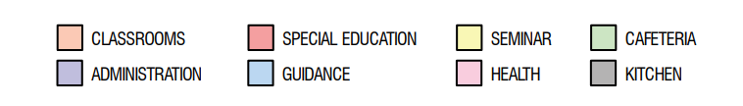

AFSCME Building 1
C LASSROOM S ADMINISTRATION
SPECIAL EDUCATION GUIDANCE
SEMINAR HEALTH
C AFE T E RIA KIT C HE N

Slide 51


AFSCME Building 2
C LASSROOM S ADMINISTRATION
SPECIAL EDUCATION GUIDANCE
SEMINAR HEALTH
C AFE T E RIA KIT C HE N

Slide 52


AFSCME Building 3
C LASSROOM S ADMINISTRATION
SPECIAL EDUCATION GUIDANCE
SEMINAR HEALTH
C AFE T E RIA KIT C HE N

Slide 53




Mountain Rd
Total Area: 11,713 SF Classrooms: 5 / 0 SE Capacity: 110 Pupils

Slide 54




Mountain Rd Bus

Slide 55



Mountain Rd Layout
C LASSROOM S SPECIAL EDUCATION
C AFE T E RIA KIT C HE N ADMINISTRATION
GUIDANCE HEALTH
SEMINAR

Slide 56


Mountain Rd Floor 2
C LASSROOM S SPECIAL EDUCATION
C AFE T E RIA KIT C HE N ADMINISTRATION
GUIDANCE HEALTH
SEMINAR

Slide 57

Financial Considerations
Estimated one-time cost of
materials needed per room
  Furniture
  School Related Materials
  Technology
Estimated total
cost of materials
$8,000-$10,000 $8,000-$10,000 $10,000-$17,000
$550,000-$800,000

Slide 58
Staffing Increase
HR Staffing Process
Current
23 Kindergarten teachers cost -
$2.7 million
  New Kindergarten positions will be posed internally and on the district website.
  Existing Kindergarten teachers will be transferred according to the process in the Collective Bargaining Agreement.
Full Day for All Students
  44 Kindergarten teachers estimated additional cost - $2.5 million
  9 Custodial staff estimated additional cost - $790,000
  Health room staff
  Administrative staff
Notes:
(Reading Specialist, ELD, Learning Support, Autistic Support, Emotional Support, Principals, custodians, food services, secretaries, nurse, counselor, MDS, creative arts)

Slide 59

Finances
Capital costs for Building Acquisition & Renovations
  Costs are anticipated to be $36 million.
  This will be paid through a Debt Issuance in early 2025.
Annual Operating Costs
  Anticipated to be $3.5 million.

Slide 60

Other Options
Considered
Build a new facility
Estimated cost per building =
$40-$50 million
Add on to existing buildings
Cost per building =
$30-$40 million
E. H. Phillips $
In 2022 the proposal to expand was $27-$29 million
Construction costs have been rising by 8% every 6 months.
Notes:
(Bathrooms, Playgrounds, Cafeterias/Multipurpose Room, Library, Playground, Bus and car drop off routes- costs in renovations
Need Floor Plans for the 3 buildings

Slide 61

Considerations
  Given the scope of the project, we are anticipating a later start time than Sept 2025.
  Daily start and end times at Kindergarten Centers need to be finalized based on transportation needs.
Notes:
Recap the befits and feasibility.
Call to action - listed on slides

Slide 62

Next Steps
  Approval for new buildings on the Dec 3rd board meeting
  Close on new sites
  Plan for movement of staff
  Construction
  Determine the timeline for starting full-day Kindergarten
  Hire new teaching staff
  Purchase materials for new sites
  Move staff to new locations
Notes:
Recap the befits and feasibility.
Call to action - listed on slides

Slide 63

Projected Outcomes
  Improved academic skills including literary and numeracy.
  Enhanced social skills.
  Greater number of students on or above grade level moving into 1st grade.
  More students achieve grade-level standards by the third grade.
  Decreased travel time for specialized transportation.
  Increased capacity and room to expand across the district.

Slide 64

Full Day Kindergarten
Question and Answer

