Slide 1

Kearney Public Schools
FY23 Budget Hearing
Sept. 27, 2022
5:30 pm

Slide 2
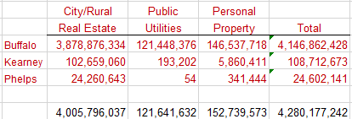
POSTCARD #1 error
2022 Estimated Tax Amount was incorrect (too high). Buffalo County did not include the valuations from Kearney Co. nor Phelps Co. They only used the Buffalo Co. valuation.
Adding those values would increase the total valuation and reduce everyone’s estimated tax payment.

Slide 3
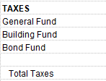

Postcard #2 error
2021 Estimated Tax Amount was incorrect (too low). The state of Nebraska only used the General Fund tax base for the district when they should have used the General Fund and the Bond Fund.
This resulted in 6,868,643.00 not being included in the formula.
No way to accurately calculate these amounts.
When you add those dollars back into the formula your taxes paid is actually higher than the postcard reads.
Ultimately, the Estimated Change Amount is too high. When you increase the amount paid in 2021, your overall estimated change will decrease.

Slide 4
State Funding Concerns…It’s only going to get worse!
In 1990, Nebraska ranked 49th nationally, trailing New Hampshire, for the percentage of K-12 funding by the state. As of Sept. 9, 2022, Nebraska is still ranked 49th nationally.
TEEOSA formula from 1989 is still used as a method to provide resources from the state to school districts. Very non-transparent formula that needs a major overhaul. In its creation, school districts were expected to receive 20% of income taxes back, lessening the burden on property tax owners. Today, approximately 2% is returned.
Funding for schools is too dependent on Local Effort…property taxes, fund approximately 62.5% of district’s annual budget. KPS can’t access sales taxes, fees or other revenue sources like the City can.
We anticipate that the upcoming legislative session will have bills introduced that will cause additional concerns for all districts across the state.
I would encourage all taxpayers to review the 2020 Nebraska Property Tax Credit legislative bill and apply for the credit. For more information please visit……….. https://revenue.nebraska.gov/about/nebraska-property-tax-credit

Slide 5

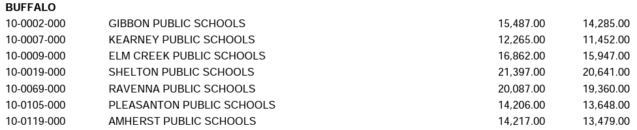
Buffalo County Per Pupil Costs
COST PER PUPIL BY AVERAGE DAILY ATTENDANCE (ADA) AND BY AVERAGE DAILY MEMBERSHIP (ADM)
FROM THE 2020/21 ANNUAL FINANCIAL REPORT
KPS is the 5th lowest spending school district in the state per pupil!

Slide 6
State Aid History
Year | Amount | Difference
2012-13 | $12,425,651.18 | $1,289,461.87
2013-14* | $13,380,901.58 | $955,250.40
2014-15 | $11,927,040.05 | ($1,453,861.53)
2015-16 | $10,680,478.95 | ($1,246,561.10)
2016-17 | $9,453,346.68 | ($1,227,132.27)
2017-18 | $7,897,369.00 | ($1,555,977.68)
2018-19 | $6,694,300.00 | ($1,203,069.00)
2019-20 | $6,882,243.00 | $187,943.00
2020-21 | $8,045,293.00 | $1,163,050.00
2021-22 | $8,439,117.00 | $393,824.00
2022-23 | $10,092,488.00 | $1,653,371.00

Slide 7
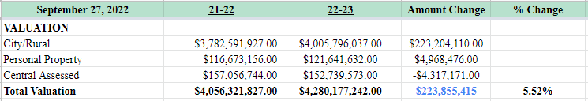
Valuation Comparison

Slide 8
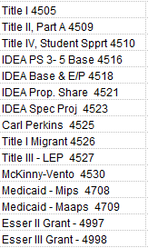
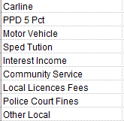
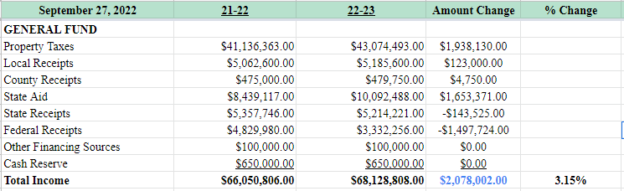
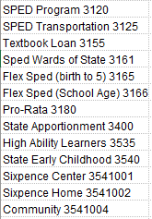
General Fund Comparison

Slide 9
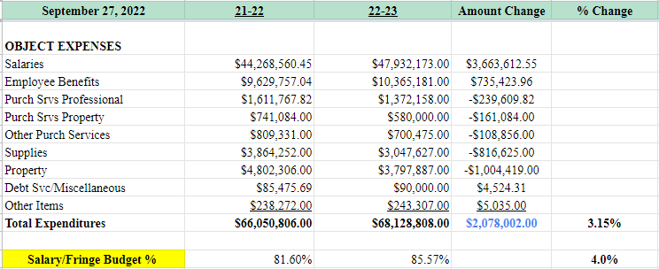
How we spend our General Fund $.
This category is used for payment of fees to consultants or for professional and technical services. It may also be used for payment from consortiums to schools for stipends to teachers or to reimburse for substitute pay.
Services purchased to operate, repair, maintain, and rent property owned or used by the school district. These services are performed by persons other than school district employees. Although a product may or may not result from the transaction, the primary reason for the purchase is the service provided.
Repair and/or maintenance of instructional equipment meeting these criteria is an eligible expenditure. General maintenance agreements for equipment not purchased under these criteria are not an eligible expenditure.
Expenses budgeted and reported here also include travel, conference expenses and other activities that support the requirements of the legislation.

Slide 10
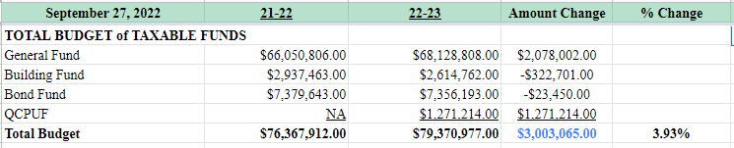
Total Budget of Taxable Funds

Slide 11
What is QCPUF?
Why now?
(skyrocketing construction costs. If we wait, these projects will costs significantly more in the future.)
This is a fund the legislature has identified that school districts can use to finance projects in existing buildings to address concerns related to environmental hazards, accessibility barriers (ADA), life safety codes, life safety hazards or mold, each as defined in Section 79-10,110.02, R.R.S. Neb.
PROJECT LIST: (Begin summer of 2023)
ADA accessible restrooms at Bryant, Emerson and Park Elementary Schools ($240,000 each)
Replace ventilation and air systems, including controls and install fire sprinklers at Glenwood Elementary School ($481,000)
Roof replacement at Horizon Middle School ($3,108,000)
Accessible parking and accessible playground at Kearney Education Center / Bright Futures ($746,000)
Roof replacement at Meadowlark Elementary School ($1,400,000)
Replace ventilation and air systems, including controls at Northeast Elementary ($500,000)
Replace ventilation and air systems, including controls, ADA accessible restrooms, replace window systems, install fire sprinkler system and replace roof at Windy Hills Elementary School ($4,250,000)
The QCPUF Levy ability is capped at .03 cents for current projects. Limited Tax School Bonds will be issued not to exceed $11,205,000. These taxes, outside of the $1.05 levy limit, will be collected from 2023 and will end in 2033. Could be paid off sooner.

Slide 12
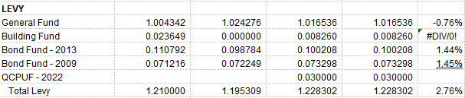
Levy Comparison

Slide 13
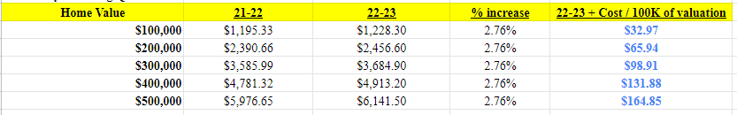
Estimated Taxes on your home…

Slide 14
How do we propose to use our increased resources in FY 23?
KPS is no different than any other entity in Kearney when it comes to its valued employees. We too, have challenges of hiring and retaining classified, exempt and certified staff. This can be directly attributed to a competitive job market and a low unemployment rate in our community and surrounding areas.
Use of $6,234,000 in QCPUF bond money for renovations at Horizon, Northeast, Bryant, Emerson, Meadowlark and Bright Futures.
Addition of $350,000 in tax ask to the Special Building Fund for future smaller renovation projects.
KPS Board of Education is embarking on it’s 2nd Strategic Plan (2022-2027) and is proactively planning for the future of KPS.

Slide 15
Budget Highlights
State Aid: Increase of 1.65 million from the previous year. Anticipate a decrease for next fiscal year (additional resources and fewer students = less state aid the following year).
Addition of QCPUF levy to pay for aging facilities at multiple locations across the district.
$1,200,000 in RESERVES used in building FY23 Budget
FY23 total operating budget for KPS would exceed last year’s budget by 3.15%
Tax increase for a home valued at $100,000. $1,228.30 compared to $1,195.33 in FY 22. Increase of $32.97 / 100K.

Slide 16
Concluding thoughts..
85.57% of budget towards salary and benefits for our 930 employees. The remaining 14.43% is used for all other functional expenses.
    Classified: 22%
    Classified Exempt: 5%
    Teachers: 66%
    Administration: 7%
I anticipate that State Aid will be reduced next year. Legislative session may see drastic changes to TEEOSA which would greatly affect school funding.
When at a conference last week, Mr. Mundorf and I learned that almost all districts in attendance will have significant challenges during negotiations for 23-24 as we are all competing for limited teacher candidates. Districts are mentioning 5-6% raises for teachers.
We anticipate this will affect our salary and benefit increases as well.
As of this afternoon, we have 16 classified vacancies and 2 certified vacancies, (School Psychologist and Special Education teacher).
UNK has reported a 30+% decrease in teacher candidates in the fall of 2022.
Due to retirements and for other reasons, KPS, on average must replace 25 teachers per year. We are fortunate to find outstanding teachers, however, with fewer teachers in the pool, we have to remain competitive with salary and benefits.

Slide 17
QUESTIONS?
Dr. Chris Loofe
Associate Superintendent / Director of Finance
Kearney Public Schools
chrloofe@kearneycats.com

