Slide 1






KEARNEY
PUBLIC SCHOOLS
kearneypublicschools.org
Annual Report
& Audit Access
Fiscal Year End 2024
Dr. Chris Loofe
Associate Superintendent

Slide 2

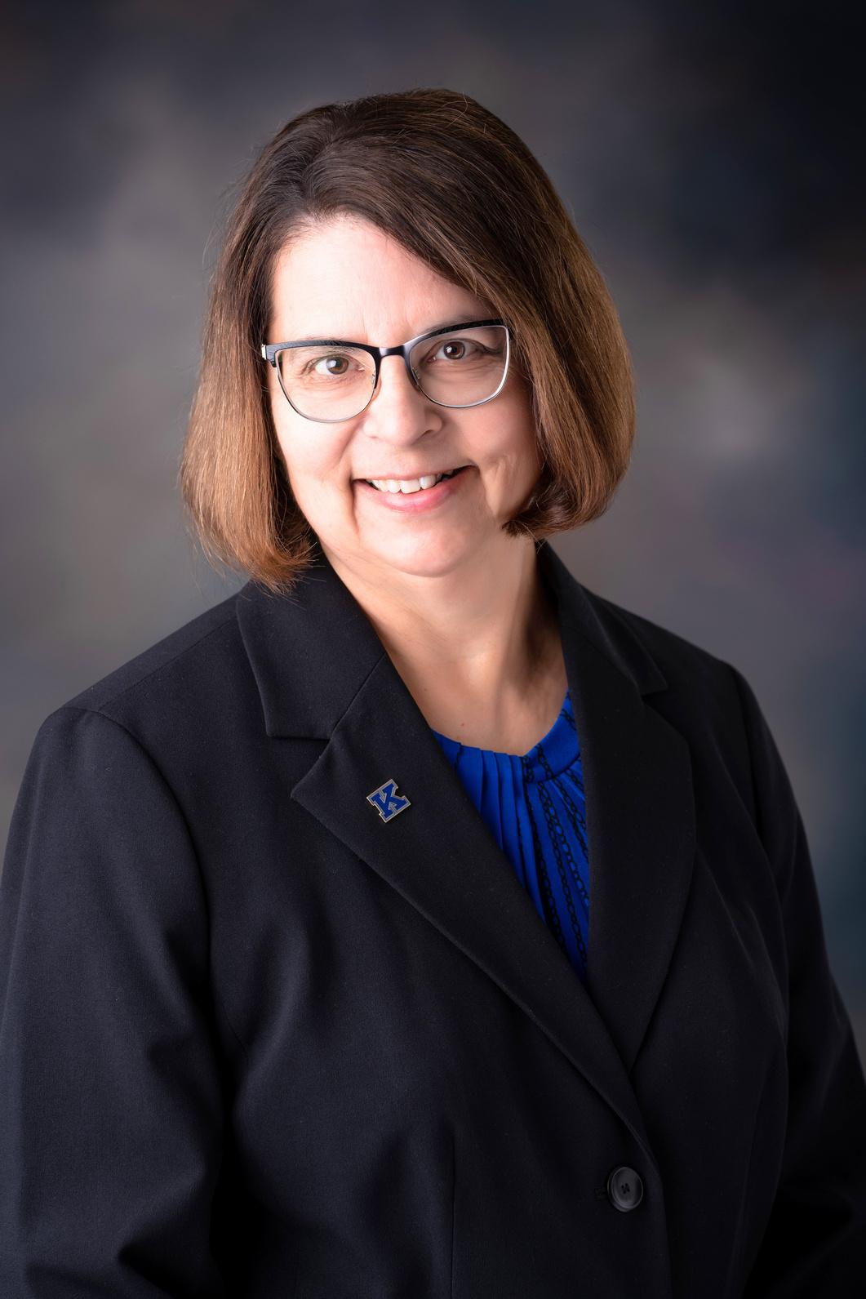


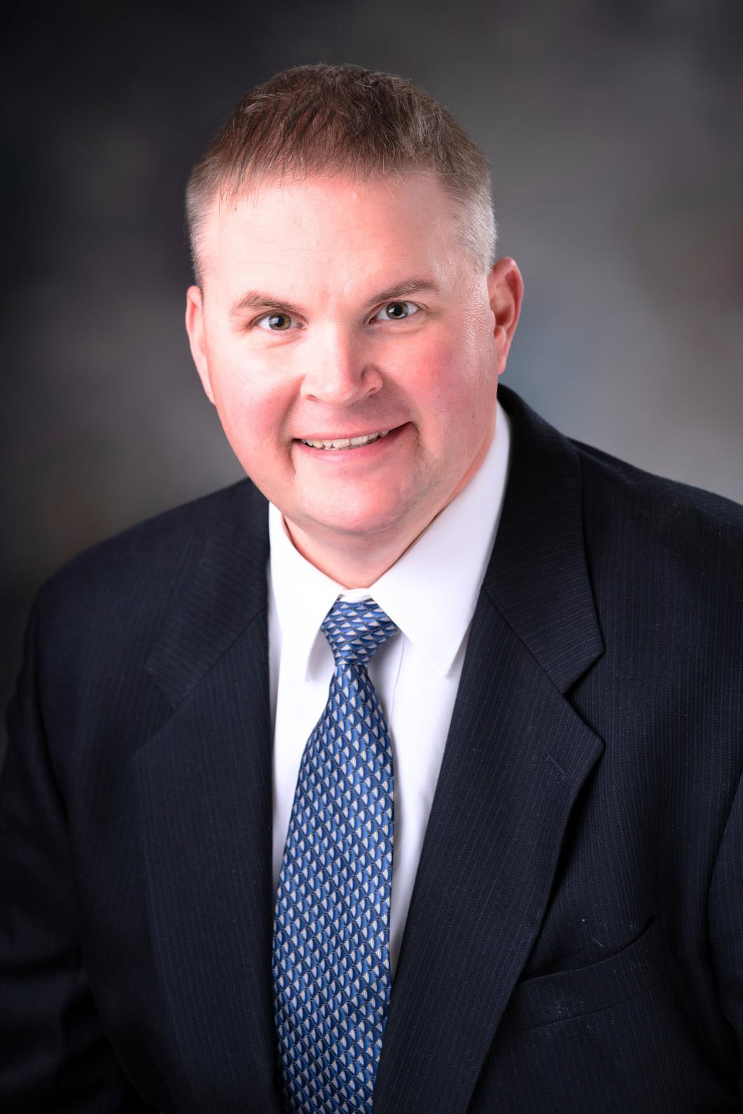
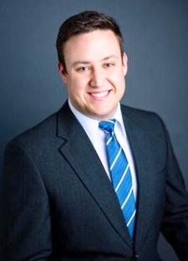


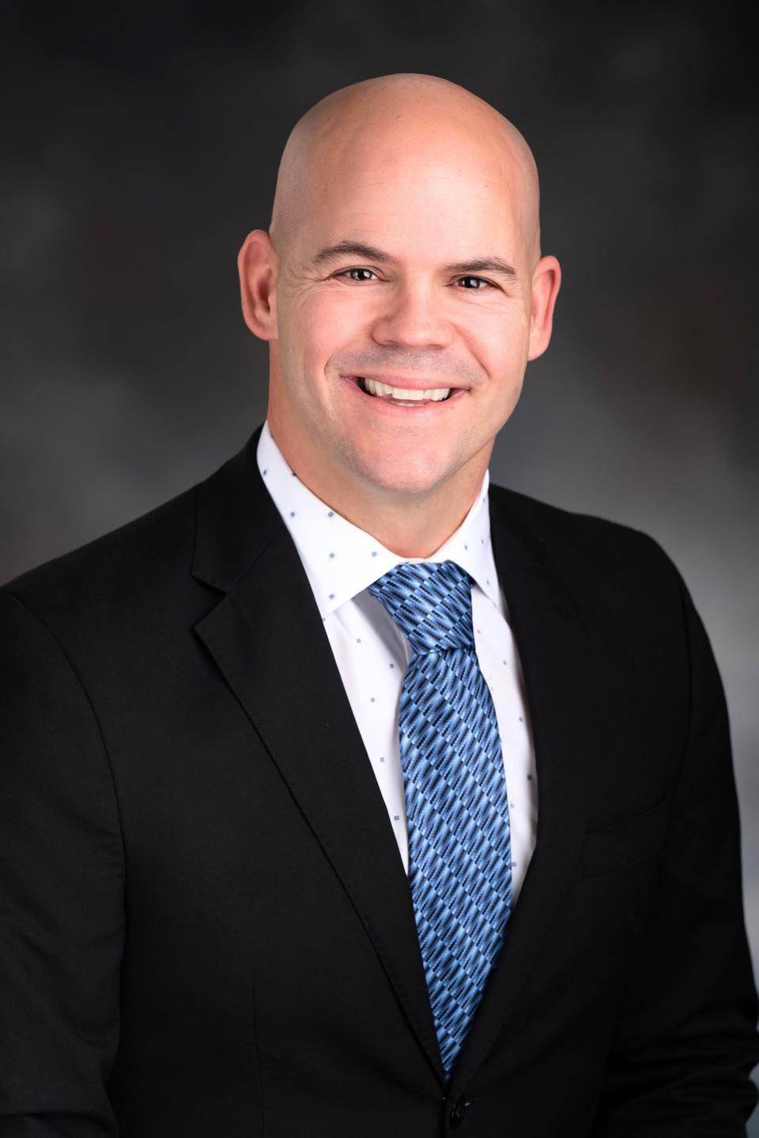



KPS BOARD OF EDUCATION
KATHY GIFFORD
STEVE GAASCH
8 Years of Service
2024 Term Expires
4 Years of Service
2024 Term Expires
Amy Barth
DREW BLESSING
Interim
2024 Term Expires
6 Years of Service
2026 Term Expires
PAUL HAZZARD
JOHN ICENOGLE
2 Years of Service
2026 Term Expires
2 Years of Service
2026 Term Expires

Slide 3

FY 24 ACTUAL VALUATION
 | City/Rural Real Estate | Public Utilities | Personal Property | Total
Buffalo | 4,227,479,729 | 175,759,834 | 137,929,302 | 4,541,168,865
Kearney | 114,848,610 | 199,473 | 4,535,261 | 119,583,344
Phelps | 26,110,054 | 0 | 265,266 | 26,375,320
 | 4,368,438,393 | 175,959,307 | 142,729,829 | 4,687,127,529

Slide 4

VALUATION HISTORY
SCHOOL YEAR | REAL ESTATE | PUBLIC UTILITIES | PERSONAL PROPERTY | TOTAL | % INCREASE
2014-15 | $2,336,566,405 | $69,838,416 | $150,080,336 | $2,556,485,157 | 8.70%
2015-16 | $2,607,971,830 | $74,466,897 | $140,801,189 | $2,823,239,916 | 10.43%
2016-17 | $2,991,246,779 | $87,907,177 | $164,007,851 | $3,243,161,807 | 14.87%
2017-18 | $3,236,934,564 | $92,415,621 | $166,634,458 | $3,495,984,643 | 7.80%
2018-19 | $3,407,439,150 | $94,193,915 | $170,983,205 | $3,672,616,270 | 5.05%
2019-20 | $3,595,025,766 | $101,095,156 | $171,750,427 | $3,867,871,349 | 5.32%
2020-21 | $3,703,968,134 | $102,634,718 | $160,210,050 | $3,966,812,902 | 2.56%
2021-22 | $3,770,350,281 | $106,623,953 | $159,984,574 | $4,036,958,808 | 1.77%
2022-23 | $4,056,703,9827 | $121,641,632 | $152,739,573 | $4,280,177,242 | 5.51%
2023-24 | $4,368,438,393 | $175,959,307 | $142,729,829 | $4,687,127,529 | 9.51%

Slide 5
AVERAGE DAILY MEMBERSHIP
Year | Elementary | Secondary | Total | % of Increase or Decrease | KPS Valuation/ADM | % of Increase or Decrease | Valuation
2014-15 | 2,726.55 | 2,462.00 | 5,188.55 | 0.0% | $544,128.88 | 10.4% | 2,556,485,157
2015-16 | 2,748.34 | 2,597.38 | 5,345.72 | 3.0% | $606,683.82 | 11.5% | 2,823,239,916
2016-17 | 2,784.17 | 2,605.22 | 5,389.39 | 0.8% | $648,679.10 | 6.9% | 3,243,161,807
2017-18 | 2,818.21 | 2,679.82 | 5,498.03 | 2.0% | $667,987.67 | 3.0% | 3,495,984,643
2018-19 | 2,833.67 | 2,750.61 | 5,584.28 | 1.6% | $692,635.64 | 3.7% | 3,672,616,270
2019-20 | 2,860.58 | 2,828.52 | 5,689.10 | 1.9% | $697,265.46 | 0.7% | 3,867,871,349
2020-21 | 2,856.23 | 2,853.70 | 5,709.93 | 0.37% | $707,006.71 | 1.4% | 3,966,812,902
2021-22 | 2,815.29 | 2,856.21 | 5,671.50 | -0.67% | $754,681.70 | 6.7% | 4,036,958,808
2022-23 | 2,780.11 | 2,840.42 | 5,620.53 | 1.01% | $755,227.66 | .01% | 4,280,177,242
2023-24 | 2,785.50 | 2,844.95 | 5,630.45 | 1.0% | $832,460.56 | 1.1% | 4,687,127,529
 |  |  |  |  |  |  | Cost Per Pupil $13,811.00

Slide 6

DEBT ADMINISTRATION
Despite state-mandated budget and levy limitations and other fiscal pressures on school districts in Nebraska, the School District has maintained exceptional bond ratings. Buffalo County School District 07 is currently rated “AA-” by Standard & Poor’s.
RATED
“AA-”
  In September 2013, voters passed a $75,400,000 bond issue.
  In February 2015, $48,920,000 worth of bonds were sold.
  In April of 2016, the remaining bonds were sold.
  In October 2020, the Series 2015 bonds were refinanced through an advanced refunding with proceeds of $49,625,000.
  Payments will be made according to schedule until December 2024 when the Series 2015 bonds become callable.
  In October 2022, $9,650,000 worth of QCPUF bonds were issued.
BONDS
DEBT
At year-end (8-31-24), the School District had outstanding debt in the following categories:
General Obligation Refunding Bonds (Prin. & Int.) $150,852,394
Lease Purchase Obligations (Prin. & Int.) -
TOTAL DISTRICT DEBT $150,852,394

Slide 7
FISCAL YEAR
FISCAL YEAR ENDING | SERIES 2015 BONDS |  | SERIES 2016 BONDS |  | SERIES 2017 BONDS |  | SERIES 2020a BONDS
August 31 | Principal | Interest | Principal | Interest | Principal | Interest | Principal | Interest
2025 | 42,730,000 | 933,014 | 1,255,000 | 610,425 | 1,050,000 | 107,075 | 735,000 | 101,625
2026 | - | - | 1,285,000 | 572,325 | 945,000 | 88,175 | 865,000 | 81,950
2027 | - | - | 1,300,000 | 533,550 | 890,000 | 69,158 | 885,000 | 64,450
2028 | - | - | 1,310,000 | 487,850 | 920,000 | 49,010 | 905,000 | 46,550
2029 | - | - | 1,340,000 | 434,850 | 475,000 | 32,730 | 930,000 | 28,200
2030-2034 | - | - | 7,345,000 | 1,353,475 | 1,060,000 | 13,515 | 945,000 | 9,450
2035-2037 | - | - | 4,830,000 | 219,450 | - | - | - | -
TOTAL | $ 42,730,000 | $ 933,014 | $ 18,665,000 | $ 4,211,925 | $ 5,340,000 | $ 359,663 | $ 5,265,000 | $ 332,225
SERIES 2015 BONDS
SERIES 2016 BONDS
SERIES 2017 BONDS
SERIES 2020A BONDS

Slide 8
FISCAL YEAR
FISCAL YEAR ENDING | SERIES 2015 BONDS |  | SERIES 2016 BONDS |  | SERIES 2017 BONDS |  | SERIES 2020a BONDS
August 31 | Principal | Interest | Principal | Interest | Principal | Interest | Principal | Interest
2025 | 1,015,000 | 119,910 | 685,000 | 825,800 | 815,000 | 369,075 | - | 14,500
2026 | 1,030,000 | 101,248 | 1,590,000 | 817,167 | 855,000 | 327,325 | 50,000 | 19,000
2027 | 1,100,000 | 80,720 | 1,655,000 | 802,426 | 895,000 | 283,575 | 60,000 | 16,800
2028 | 1,100,000 | 58,445 | 1,700,000 | 784,009 | 940,000 | 237,700 | 60,000 | 14,400
2029 | 1,060,000 | 35,510 | 2,245,000 | 758,608 | 990,000 | 194,000 | 60,000 | 12,000
2030-2034 | 1,060,000 | 11,925 | 22,765,000 | 2,496,390 | 4,365,000 | 357,500 | 270,000 | 22,600
2035-2037 | - | - | 16,955,000 | 934,534 | - | - | - | -
TOTAL | $ 6,365,000 | $ 407,758 | $ 47,595,000 | $ 7,418,934 | $ 8,860,000 | $ 1,769,575 | $500,000 | $ 99,300
SERIES 2020B BONDS
SERIES 2020C BONDS
SERIES 2022 BONDS
SERIES 2024 BONDS

Slide 9
FISCAL YEAR
FISCAL YEAR ENDING | TOTAL | TOTAL
August 31 | Principal | Interest
2025 | 48,285,000 | 3,081,424
2026 | 6,620,000 | 2,007,190
2027 | 6,785,000 | 1,8850,679
2028 | 6,935,000 | 1,667,964
2029 | 7,100,000 | 1,496,298
2030-2034 | 37,810,000 | 4,264,855
2035-2037 | 21,785,000 | 1,153,984
TOTAL | $135,320,000 | $ 15,532,394

Slide 10
TAX INFORMATION
YEARS | GENERAL FUND LEVY | SPECIAL BUILDING FUND | ELEM BOND FUND | KHS BOND FUND | QUALIFIED CAPITAL PURPOSE UNDERTAKING FUND | TOTAL LEVY
2019-2020 | 1.0021 | 0.0204 | 0.0822 | 0.1153 | 0.0000 | 1.2200
2020-2021 | 1.0043 | 0.0237 | 0.0712 | 0.1108 | 0.0000 | 1.2100
2021-2022 | 1.0243 | 0.0000 | 0.0722 | 0.0988 | 0.0000 | 1.1953
2022-2023 | 1.0165 | 0.0083 | 0.1735 | 0.0000 | 0.0300 | 1.2283
2023-2024 | .9828 | 0.0216 | 0.0673 | 0.0913 | 0.0300 | 1.1930
SCHOOL DISTRICT
TAX RATES
($ PER $100)
YEARS | TAX CERTIFIED* | AMOUNT COLLECTED** | % COLLECTED
2019-2020 | 39,355,092 | 39,384,882 | 100.1
2020-2021 | 40,139,482 | 40,372,368 | 100.6
2021-2022 | 41,136,363 | 41,361,130 | 100.5
2022-2023 | 43,074,493 | 43,235,239 | 100.4
2023-2024 | 45,606,038 | 46,362,538 | 101.7
SCHOOL DISTRICT
SCHEDULE OF
TAX COLLECTIONS
(GENERAL FUND)
*Does not include the 1% collection fee the County assesses.
**Includes property taxes collected, homestead exemption receipts from the State and property tax credit.

Slide 11
COMPARISON OF
SOURCES OF INCOME
The largest single source of receipts for the School District is property tax. In 2023-2024, the School District’s valuation increased from $4,280,177,242 to $4,687,127,259 or 9.51%. The following table shows the property tax rates, by fund, for the fiscal years, including a calculation of the amount and percentage by which each levy changed. Note: levies are expressed in dollars and cents per $100 of valuation.
Fund | FY 24 | FY 23 | Change
General Fund | 0.9828 | 1.0165 | -3.31%
Building Fund | 0.0216 | 0.0083 | 159.65%
2013 Bond Fund | 0.0913 | 0.1735 | -47.36%
2009 Bond Fund | 0.0673 | 0.0000 | 100.00%
Qualified Capital Purpose Undertaking Fund | 0.0300 | 0.0300 | 0.00%
District Totals | 1.1930 | 1.2283 | -( 0.0350)

Slide 12
TOTAL RECEIPTS
Below is information from that Statement, rearranged slightly, so you can see our total receipts and disbursements for the year.
Receipts | Governmental Activities | Business Type Activities | 2024 Total | 2023 Total
Program Receipts
Charges for Services | $ 132,983 | $ 1,417,265 | $ 1,550,248 | $ 1,514,560
Operating Grants | 11,361,148 | 2,276,661 | 13,637,809 | 10,820,936
General Receipts
Taxes | 56,138,125 | - | 56,138,125 | 52,536,378
Interest | 1,361,755 | 47,606 | 1,409,361 | 1,286,219
Fines & License Fees | 586,691 | - | 586,691 | 546,306
State Aid | 17,525,649 | - | 17,525,649 | 16,869,041
Activities Receipts | 2,757,395 | - | 2,757,395 | 2,102,481
Student Fee Receipts | 288,730 | - | 288,730 | 295,592
Other | 889,422 | - | 889,422 | 10,851,394
Total Receipts | $ 91,041,898 | $ 3,741,532 | $ 94,783,430 | $ 96,822,907

Slide 13
TOTAL DISBURSEMENTS
Below is information from that Statement, rearranged slightly, so you can see our total receipts and disbursements for the year.
Disbursements | Governmental Activities | Business Type Activities | 2024 Total | 2023 Total
Instruction | $ 41,016,718 | $ - | $ 41,016,718 | $ 38,915,924
Support Services | 24,927,563 | $ - | 24,927,563 | 21,791,986
General & Administrative | 6,616,852 | $ - | 6,616,852 | 5,428,172
Federal Programs | 4,697,193 | $ - | 4,697,193 | 3,967,613
Debt Services | 8,561,172 | $ - | 8,561,172 | 7,554,571
Capital Outlay | 1,716,899 | $ - | 1,716,899 | 426,459
Activities | 3,729,783 | $ - | 3,729,783 | 2,245,568
Student Fees | 225,327 | $ - | 225,327 | 197,206
School Nutrition |  | 4,188,032 |  | 3,887,917
Total Disbursements | $ 91,491,507 | $ 4,188,032 | $ 91,491,507 | $ 84,415,416

Slide 14
STATE AID HISTORY
YEAR | AMOUNT | DIFFERENCE | %CHANGE
14-15 | $11,927,040 | ($1,453,862) | -10.87 %
15-16 | $10,680,479 | ($1,246,561) | -10.45 %
16-17 | $9,453,347 | ($1,227,132) | -11.49 %
17-18 | $7,897,369 | ($1,555,978) | -16.46 %
18-19 | $6,694,300 | ($1,203,069) | -15.23 %
19-20 | $6,882,243 | $187,943 | 2.81%
20-21 | $8,045,293 | $1,163,050 | 16.90 %
21-22 | $8,439,117 | $393,824 | 4.6%
22-23 | $10,092,488 | $1,653,371 | 8.36%
23-24 | $10,034,566 | -$57,922 | -.57%

Slide 15
TEN YEAR ENROLLMENT HISTORY
Year | K | 1 | 2 | 3 | 4 | 5 | 6 | 7 | 8 | 9 | 10 | 11 | 12 | Total
2012-13 | 452 | 469 | 430 | 480 | 441 | 386 | 350 | 334 | 340 | 370 | 350 | 340 | 396 | 5,138
2013-14 | 474 | 456 | 471 | 414 | 481 | 439 | 333 | 343 | 351 | 346 | 373 | 332 | 372 | 5,185
2014-15 | 462 | 453 | 444 | 469 | 418 | 472 | 390 | 342 | 347 | 340 | 338 | 365 | 354 | 5,194
2015-16 | 460 | 475 | 458 | 440 | 471 | 414 | 400 | 399 | 351 | 350 | 357 | 336 | 398 | 5,309
2016-17 | 454 | 464 | 489 | 461 | 450 | 469 | 369 | 404 | 405 | 373 | 357 | 366 | 346 | 5,407
2017-18 | 491 | 454 | 467 | 482 | 460 | 449 | 420 | 375 | 412 | 408 | 362 | 346 | 381 | 5,507
2018-19 | 483 | 470 | 459 | 478 | 481 | 467 | 413 | 423 | 376 | 422 | 394 | 372 | 359 | 5,597
2019-20 | 528 | 470 | 463 | 449 | 468 | 475 | 417 | 407 | 412 | 391 | 420 | 404 | 384 | 5,688
2020-21 | 467 | 497 | 446 | 458 | 429 | 442 | 416 | 421 | 392 | 417 | 377 | 422 | 382 | 5,566
2021-22 | 528 | 472 | 486 | 460 | 451 | 430 | 406 | 411 | 409 | 398 | 406 | 361 | 416 | 5,634
2022-23 | 395 | 466 | 507 | 449 | 471 | 455 | 403 | 393 | 403 | 408 | 398 | 403 | 402 | 5,553
2023-24 | 428 | 464 | 504 | 450 | 480 | 450 | 393 | 390 | 401 | 406 | 388 | 407 | 398 | 5,678

Slide 16
2023-2024 ENROLLMENT BY BUILDING
 | K | 1 | 2 | 3 | 4 | 5 | 6 | 7 | 8 | 9 | 10 | 11 | 12 | Total
Bryant | 43 | 38 | 48 | 40 | 38 | 29 |  |  |  |  |  |  |  | 229
Buffalo Hills | 48 | 39 | 42 | 43 | 47 | 66 |  |  |  |  |  |  |  | 282
Central | 41 | 42 | 51 | 42 | 43 | 42 |  |  |  |  |  |  |  | 248
Emerson | 21 | 36 | 42 | 32 | 30 | 30 |  |  |  |  |  |  |  | 196
Glenwood | 16 | 15 | 24 | 21 | 20 | 25 |  |  |  |  |  |  |  | 119
Kenwood | 57 | 67 | 67 | 58 | 70 | 56 |  |  |  |  |  |  |  | 364
Meadowlark | 65 | 70 | 61 | 72 | 65 | 53 |  |  |  |  |  |  |  | 387
Northeast | 57 | 73 | 72 | 64 | 70 | 67 |  |  |  |  |  |  |  | 401
Park | 37 | 45 | 50 | 39 | 50 | 48 |  |  |  |  |  |  |  | 266
Windy Hills | 43 | 39 | 47 | 39 | 47 | 34 |  |  |  |  |  |  |  | 251
Horizon MS |  |  |  |  |  |  | 220 | 203 | 208 |  |  |  |  | 631
Sunrise MS |  |  |  |  |  |  | 173 | 185 | 185 |  |  |  |  | 558
HAC |  |  |  |  |  |  |  | 2 | 8 | 7 | 12 | 26 | 44 | 99
High School |  |  |  |  |  |  |  |  |  | 399 | 376 | 381 | 354 | 1522
 |  |  |  |  |  |  |  |  |  |  |  |  |  | 5,678

Slide 17
CASH RECEIPTS, DISBURSEMENTS
& CASH BALANCES FYE 2024
COMBINED SCHEDULE OF CASH RECEIPTS, DISBURSEMENTS AND CASH BALANCES
For the Year Ended August 31, 2024
 | Cash Balance at the Beginning of the Year | Receipts and Transfers | Disbursements and Transfers | Excess (Deficiency) of Receipts Over (Under) Disbursements | Cash Balance at the End of the Year
General Fund | $ 27,033,505 | $ 75,847,827 | $ 73,745,553 | $ 2,102,274 | $ 29,135,779
Activity Fund | 2,679,878 | 2,757,395 | 3,729,783 | (972,388) | 1,707,490
School Nutrition Fund | 2,787,009 | 3,741,532 | 4,188,032 | (446,500) | 2,340,509
Bond Fund | 10,080,340 | 7,853,080 | 7,361,572 | 491,508 | 10,571,848
Special Building Fund | 1,914,685 | 1,036,236 | 899,891 | 136,345 | 2,051,030
Depreciation Fund | 1,076,197 | 249,673 | 1,102,609 | (852,936) | 223,261
Employee Benefit Fund | 323,878 | 5,977 | 281,774 | (275,797) | 48,081
Cooperative Fund | 130,685 | 573,567 | 680,865 | (107,298) | 23,387
Student Fee Fund | 287,578 | 288,730 | 225,327 | 63,403 | 350,981
Qualified Capital Purpose Undertaking Fund | 10,549,850 | 2,666,596 | 3,701,316 | (1,034,720) | 9,515,130
Grand Total All Funds | $ 56,863,605 | $ 95,020,613 | $ 95,916,722 | $ (896,109) | $ 55,967,496

Slide 18


Kearney Public Schools
2024 Audit
KEARNEY PUBLIC SCHOOL DISTRICT NO. 07
KEARNEY, NEBRASKA
FINANCIAL REPORT
(AUDITED)
AUGUST 31, 2024
Access KPS FY 24 Audit
Dr. Chris Loofe
Associate Superintendent
chrloofe@kearneycats.com
308-698-8006

