Slide 1


southampton
Hazard Mitigation Plan (HMP) public meeting
November 12, 2024

Slide 2
Thank you to the committee
Scott Szczebak, Town Administrator
Christine Fowles, Select Board Chair
Richard Fasoli, Fire Chief
Ian Illingsworth, Police Chief
Randall Kemp, Highway Superintendent
Geraldine Swanson, Public Health Director
Brett Simmons, Water Department Superintendent

Slide 3


What is Hazard Mitigation?
“Any sustained action taken to reduce or eliminate long-term risk to people and property from natural hazards.”
Examples:
Limiting development in high-risk areas
Retrofitting structures to protect
them from floods, high winds, etc.
Drainage and flood control
projects in areas of localized flooding
Fire safety education

Slide 4

Benefits of updating the Hazard Mitigation plan
Makes communities eligible to apply for Hazard Mitigation funds from FEMA
Identifies cost-effective actions to reduce risk
Helps communities prevent future losses and save money on disasters
Makes communities more resilient to natural hazards and impacts of climate change
Increases awareness of hazards and risks
Can save lives!
Weather.gov

Slide 5
Mitigation vs. Preparedness
Hazard Mitigation
Planning and zoning
Emergency Preparedness
Open space preservation
Education and outreach
Infrastructure improvements
Evacuation plans and emergency shelters
Radio communications equipment
Emergency response drills
Notes:
Using the example of flooding, hazard mitigation strategies can prevent flooding from occurring in areas where there could be injuries/fatalities or property damage. If flooding does occur, being prepared for emergencies allows for a rapid response, rescues and sheltering if necessary.

Slide 6
Components of a Hazard Mitigation Plan
Hazard identification and description
Risk Assessment - how hazards impact buildings, property, and residents, especially vulnerable populations
Identification/mapping of critical infrastructure
Assessment of Town’s mitigation capabilities
Review of previous mitigation strategies and identification of new mitigation strategies
Risk Assessment
Vulnerability Assessment
Critical Facilities Inventory
Natural hazard identification
Capability Assessment

Slide 7

HMP Update Steps
5 Committee Meetings (approx. 1 per month)
First Public Meeting
PVPC Completes Draft Plan
Second Public Meeting
Submit Plan to MEMA/revise as needed
Submit Plan to FEMA/Revise as needed
FEMA Approval
Select Board adopts
Town eligible to apply for funds from FEMA

Slide 8
Project Timeline
August – Kick off meeting
September – Committee meeting #2
November – Committee meeting #3; Public Meeting #1; PVPC drafts Chapters 2 and 3, develops HMP map
December/January – Committee meeting #4, review previous mitigation actions and develop new mitigation actions
February – Committee meeting #5, finalize mitigation action plan
March – June, PVPC completes draft plan
June – Hold 2nd public meeting, committee and public review plan
June/July – Submit plan to MEMA for review
3-6 months for MEMA and FEMA reviews

Slide 9
HMP committee responsibilities
Provide supporting data and information
Assist with outreach and stakeholder engagement
Assist with the identification, development, and prioritization of mitigation actions
Review and comment on the draft plan

Slide 10
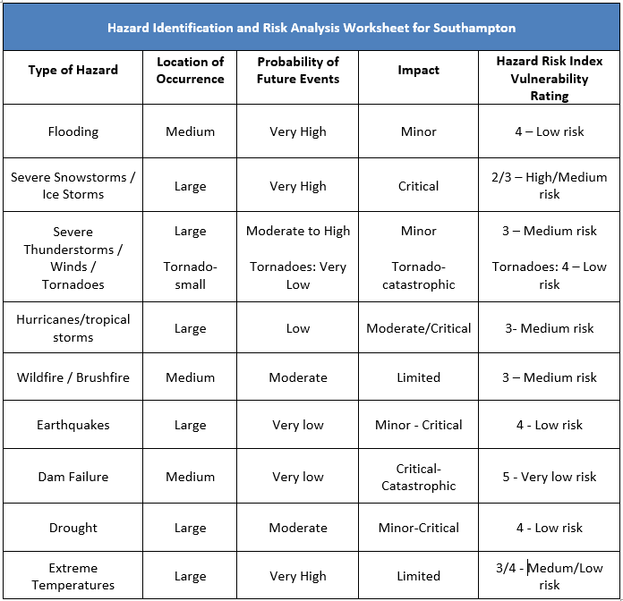
Natural Hazard Risk analysis

Slide 11
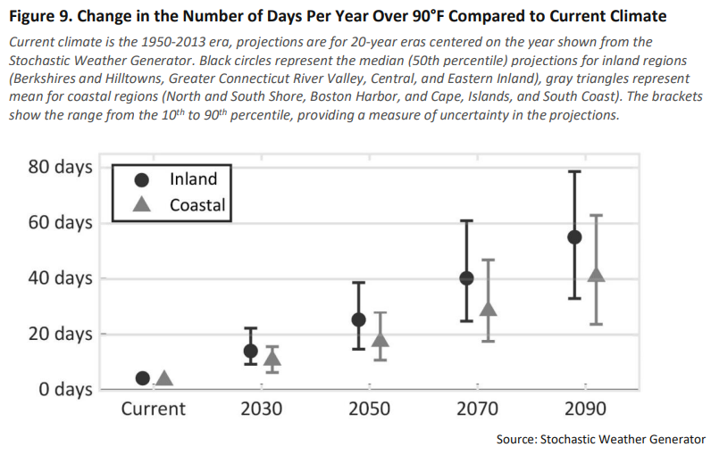
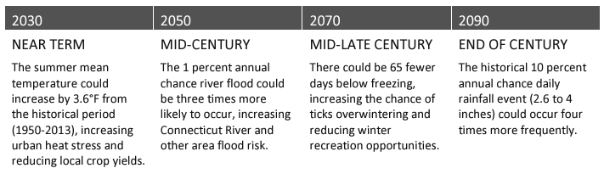
Impacts of climate change
MA Climate Change Assessment, 2022

Slide 12
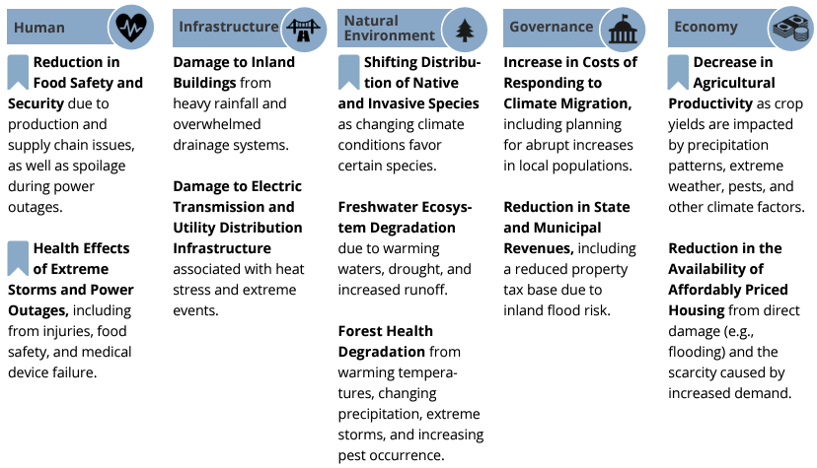
Most urgent Impacts of climate change for the Connecticut river valley
2022 MA Climate Change Assessment

Slide 13
Critical Facilities and populations/assets to protect
Fire and Police Stations, Emergency Operations Centers, Emergency Response Teams, Emergency Shelters
Utilities – Water supply, wastewater treatment, power
Communication facilities
Health care facilities, Custodial care facilities, Schools
Vulnerable population housing
Historic structures
Large places of employment

Slide 14
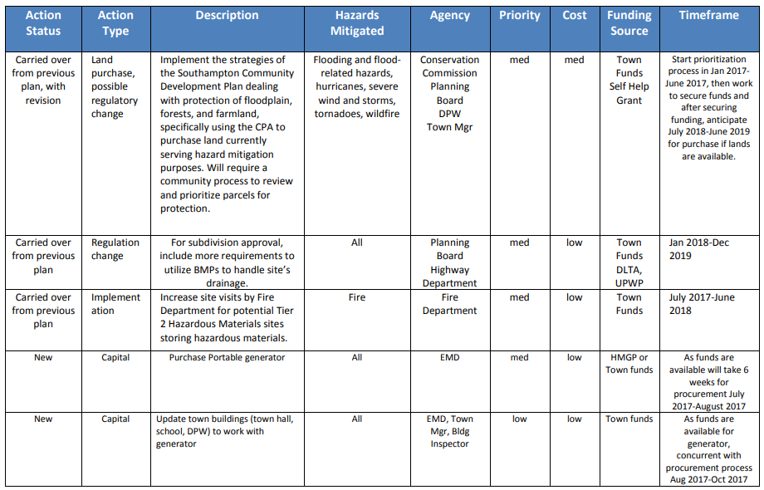
previous higher priority mitigation strategies

Slide 15
Public comment/brainstorm new actions
What are your concerns about natural hazards and climate change impacts in Southampton?
Suggestions for mitigation actions?
Other questions or comments?

Slide 16
Thank you!
Contact information:
Mimi Kaplan
Pioneer Valley Planning Commission mkaplan@pvpc.org
413-285-1188

