Slide 1

Academic and Linguistic Demands
Creating Access to the Next Generation Learning Standards in English Language Arts for Linguistically Diverse Learners (ALDs)
Bilingual/ENL Coordinators’ Meeting
December 8, 2023
Christa Stevenson, Executive Director, L.I. RBERN

Slide 2
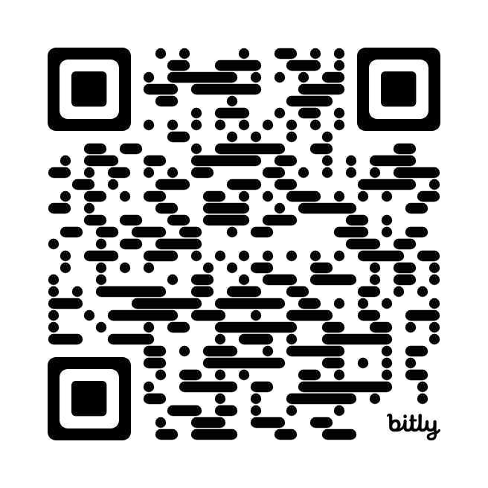
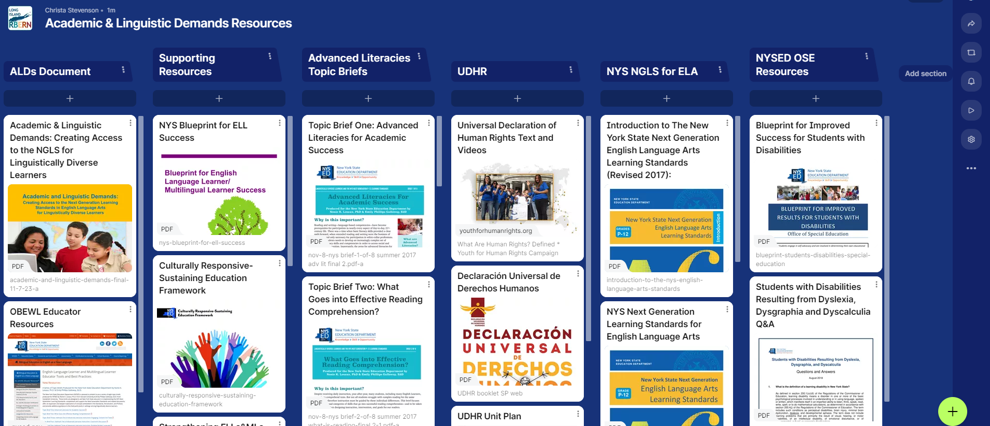
Resources
bit.ly/ALDsTurnkey

Slide 3
History of the
Academic and Linguistic Demands
Creating Access to the Next Generation Learning Standards in English Language Arts for Linguistically Diverse Learners
a.k.a. - ALDs

Slide 4
Timeline
Phase 1 - Spring 2019
Phase 2 - Fall 2019
Phase 3 - 2020 - 2022
Analyzed Ed Review Feedback & Edited ALDs
Draft submitted - 9/2021
Edited through end of ‘22
Alignment of CCLS GLADs and LDs to NGLS
Educator Review
4 sessions across the state
Phase 4 - 2022-2023
Phase 5 2023-2024
Finalize Document
Develop Roll-out & Training Materials
Roll-out Statewide

Slide 5

The ALDs Tool Is NOT Prescriptive…
This tool is not an all-encompassing reference identifying every linguistic demand that may be addressed by a particular standard!
The intent of this resource is to empower teachers to design instructional scaffolds that meet students language needs.

Slide 6
The ALDs Tool Does…
Provide a linguistic lens through which to examine the NGLS ELA and content standards.
Build teacher capacity to recognize the linguistic load of the lessons they are planning
ALDs may include:
Language Forms
Language Functions
Content-specific words and phrases
Grammatical structures

Slide 7
Resources in the ALDs

Slide 8
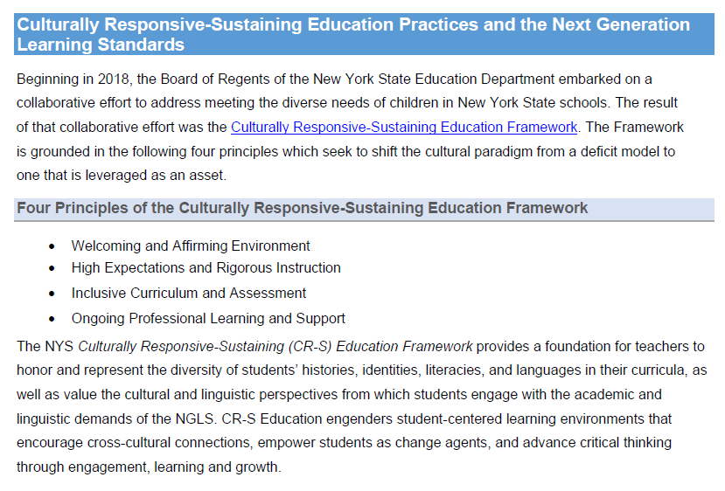
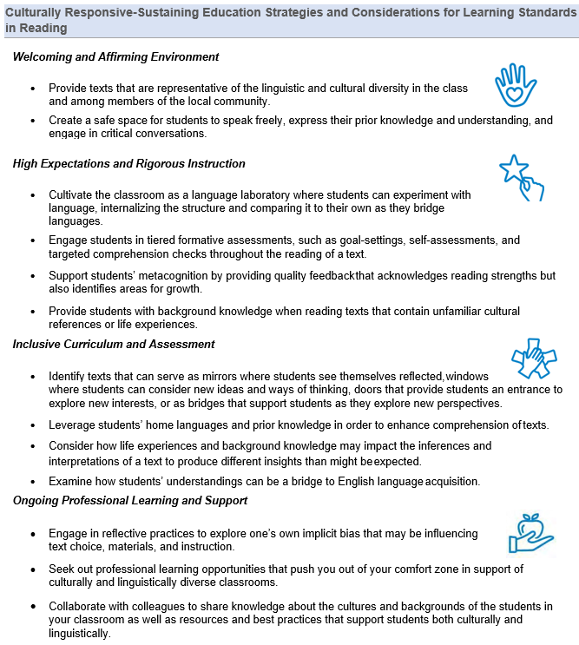
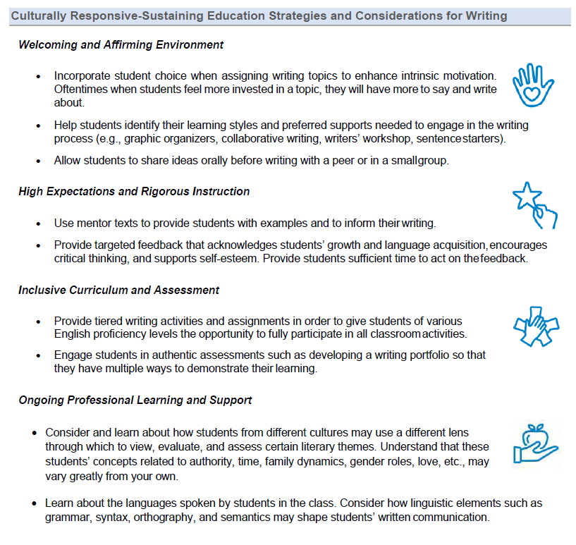
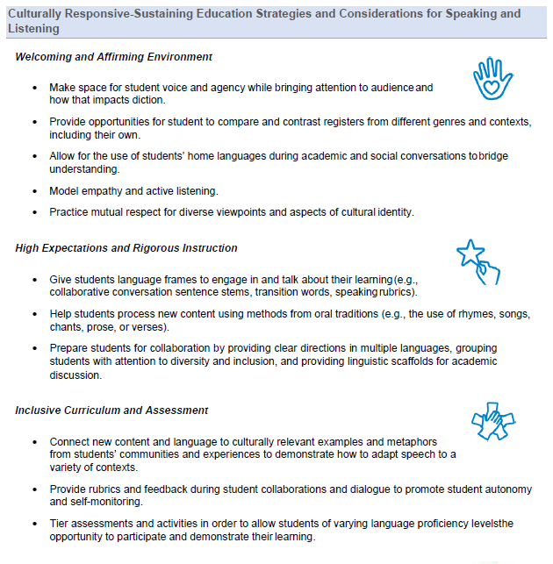
CR-SE Strategies & Considerations

Slide 9
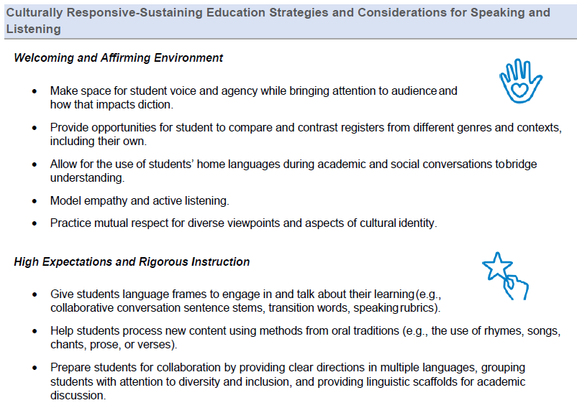

Slide 10
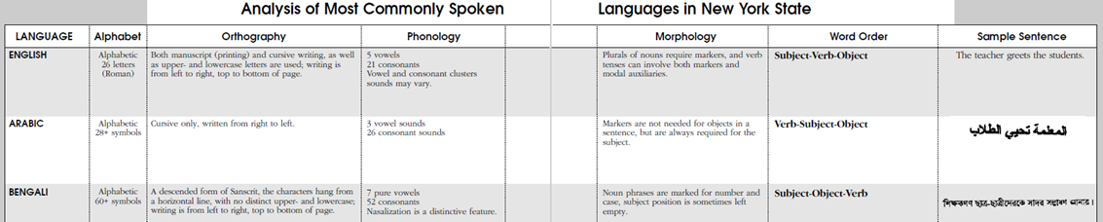
Home Language Instruction

Slide 11
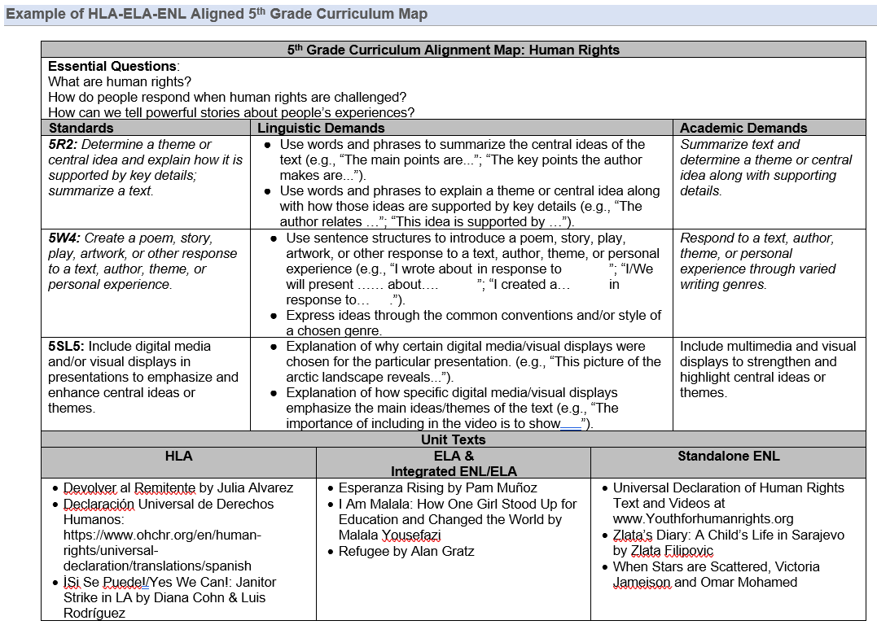
HLA-ELA-ENL Curriculum Alignment

Slide 12
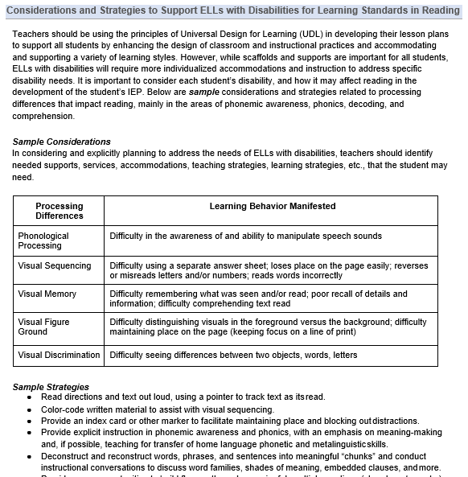
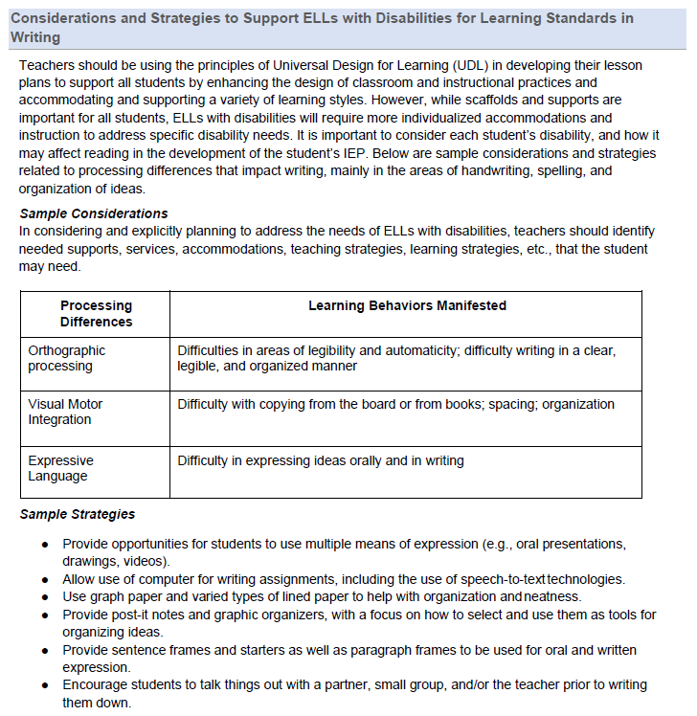
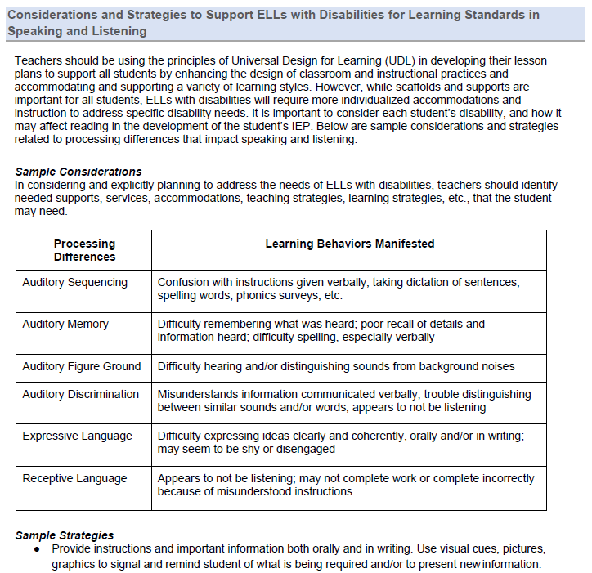
Considerations for ELLs With Disabilities

Slide 13
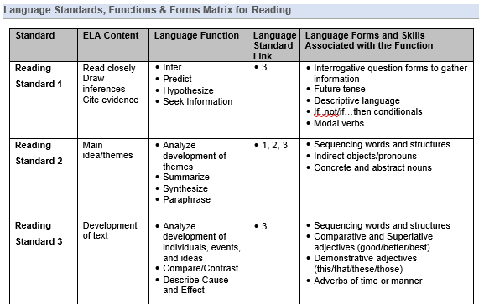
Language Standards, Functions & Forms Matrix

Slide 14
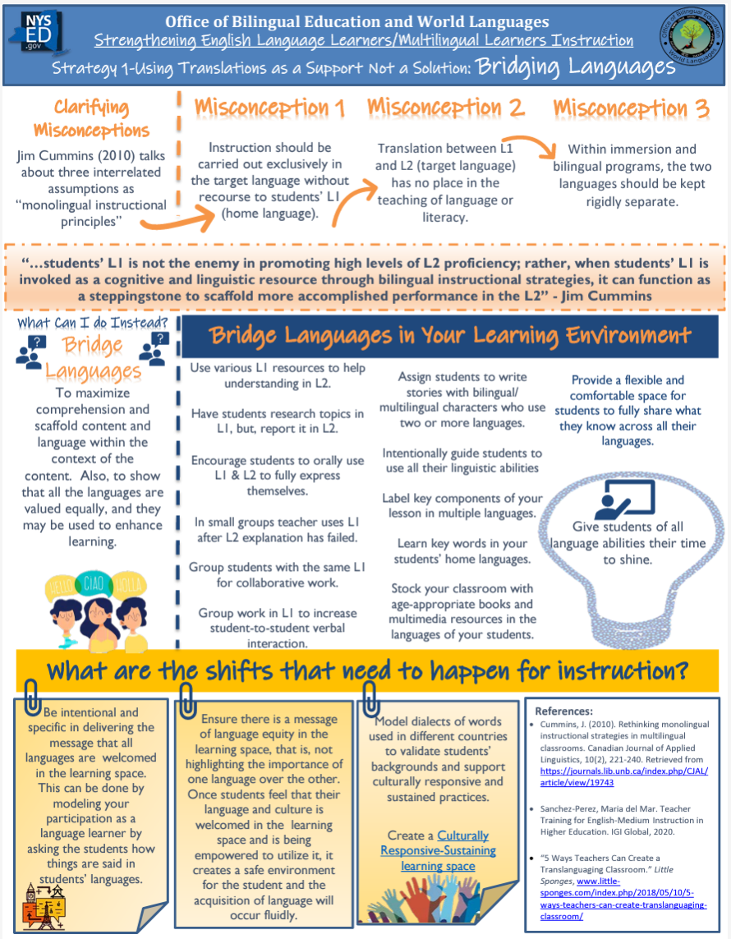

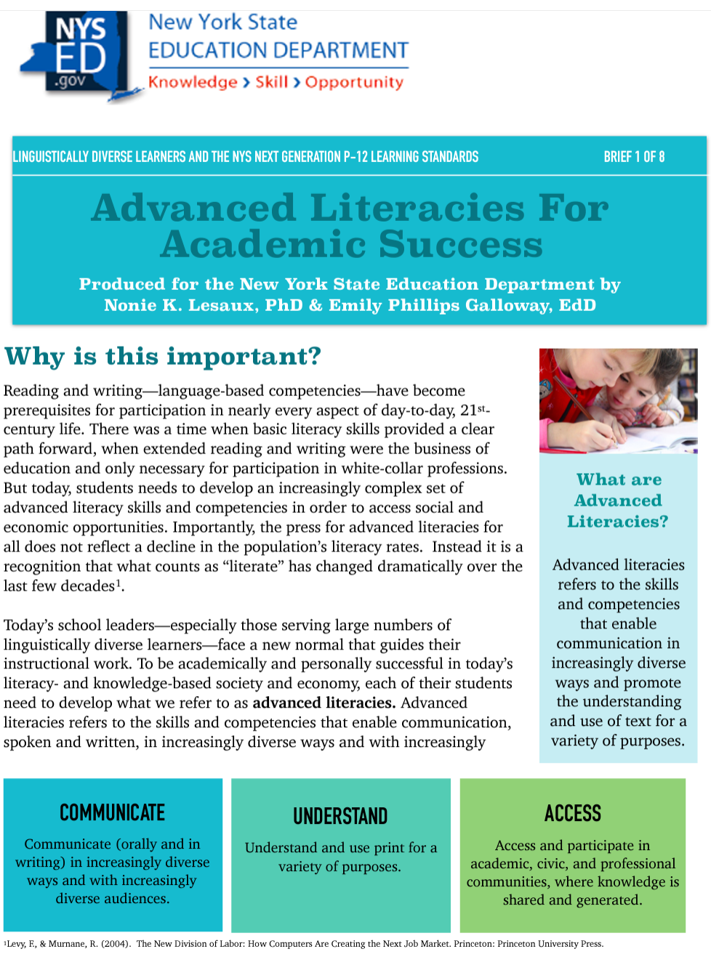
Integrates Existing OBEWL Resources

Slide 15
The Advanced Literacies & Classroom Practices Connection
How do the ALDs connect to the Advanced Literacies and the Classroom Practices?

Slide 16
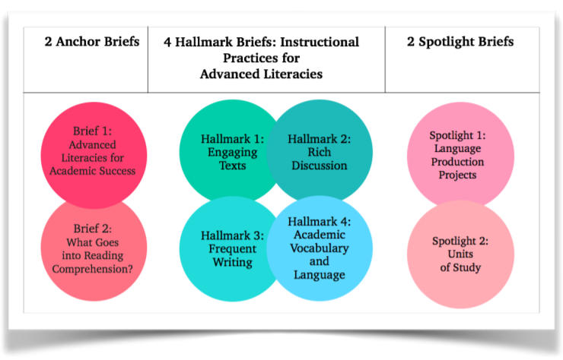
Linguistic Demands and Curricular Design: Advanced Literacies for Academic Success

Slide 17
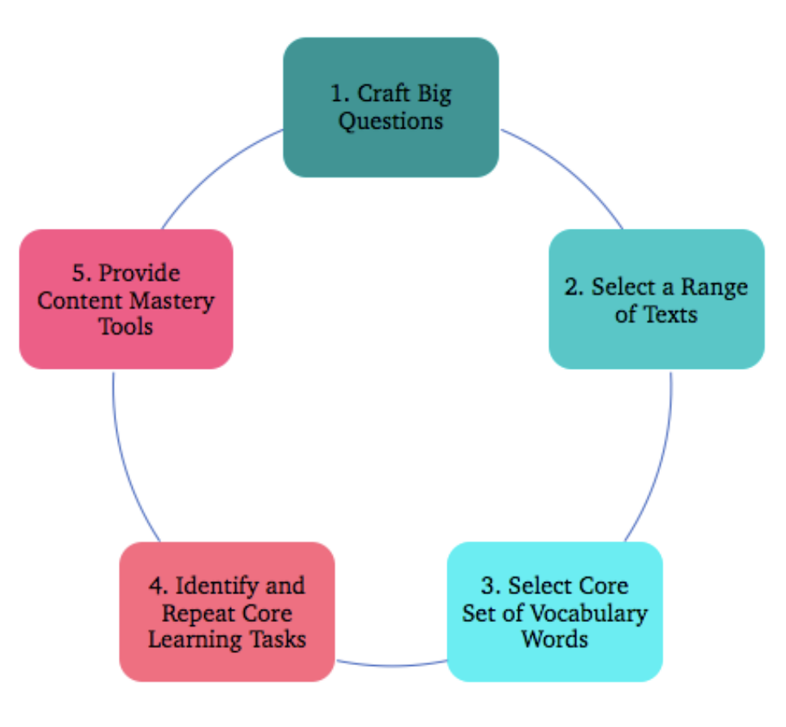
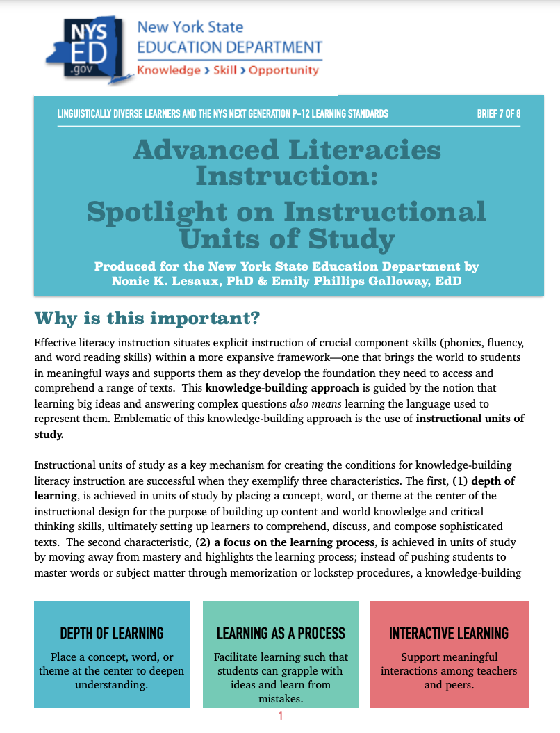
The Advanced Literacies Instructional Cycle
Advanced Literacies Brief 7, Spotlight on Instructional Units of Study, describes the Advanced Literacies Unit Planning Process

Slide 18
Where do the Linguistic Demands fit within the Knowledge-Building Instructional Cycle (Brief 7)?
Step 1: Craft Big Questions
ALDs Curriculum Alignment Map
Step 2: Select a Range of Texts
ALDs Curriculum Alignment Map
Step 5: Provide Core Learning Tasks
Instructional Scaffolds Framework
Step 3: Select Core Vocabulary Words
ALDs Instructional Scaffolds Framework
Step 4: Identify and Repeat Core Learning Tasks
Instructional Scaffolds Framework

Slide 19
Where do the Linguistic Demands fit within the
Knowledge-Building Instructional Cycle?
Step 5 of the Knowledge-Building Unit Cycle: Providing Content Mastery Tools (Scaffolds)
The Linguistic Demands help educators identify precise linguistic skills and language necessary for teachers to plan linguistic scaffolds:
Standards-based sentence stems and frames
Key words and phrases to assist with speaking and writing about the content

Slide 20
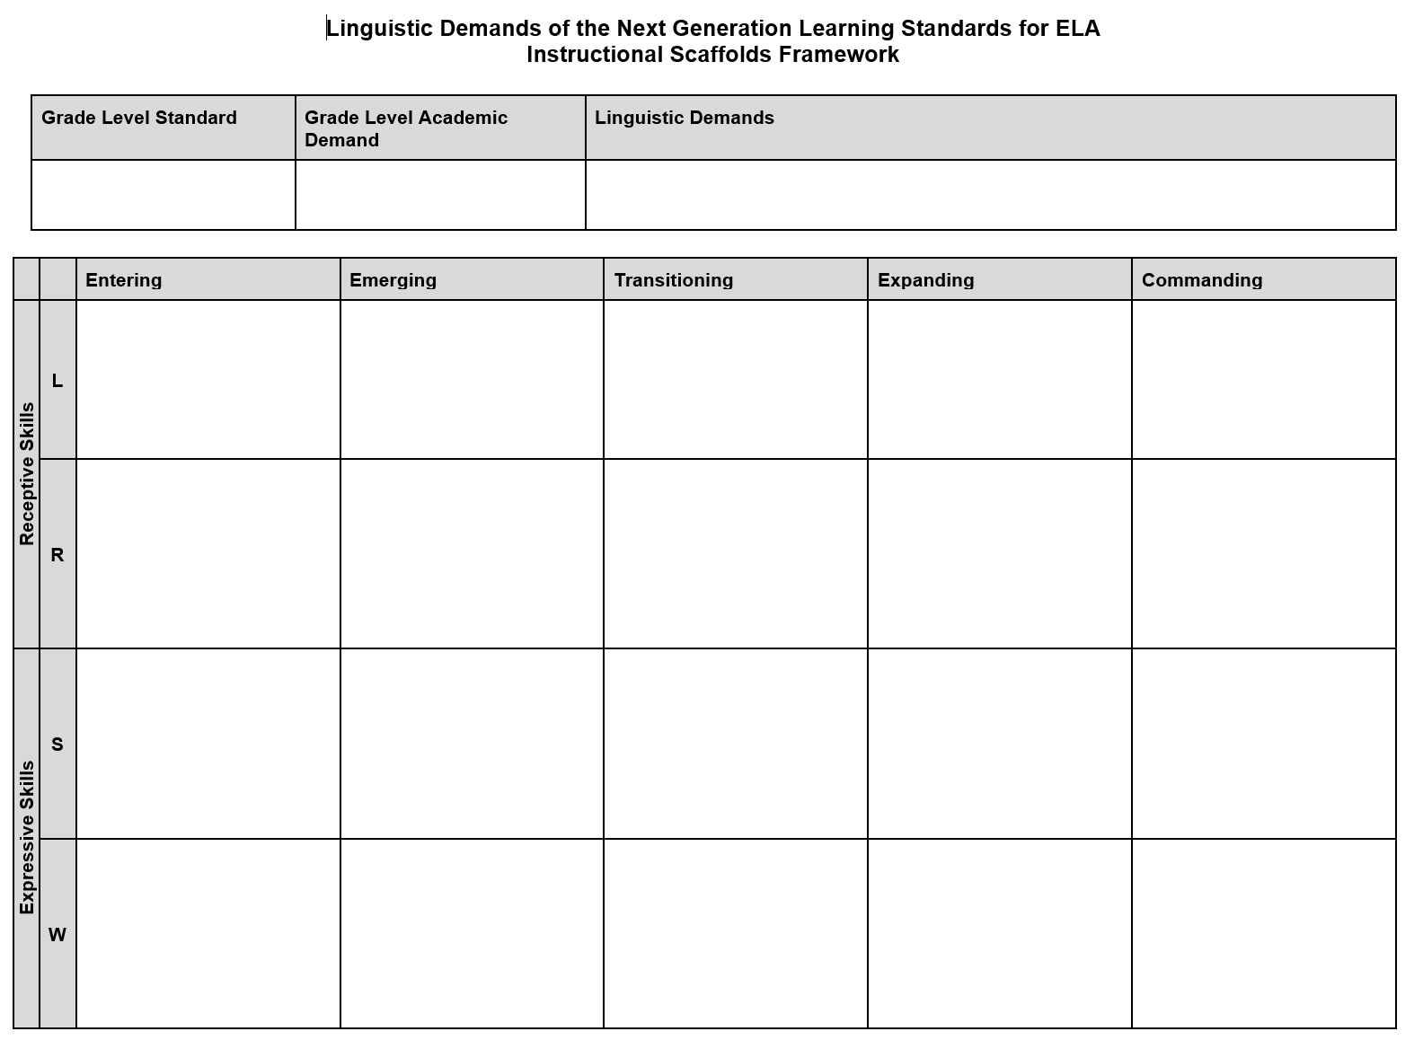

Slide 21
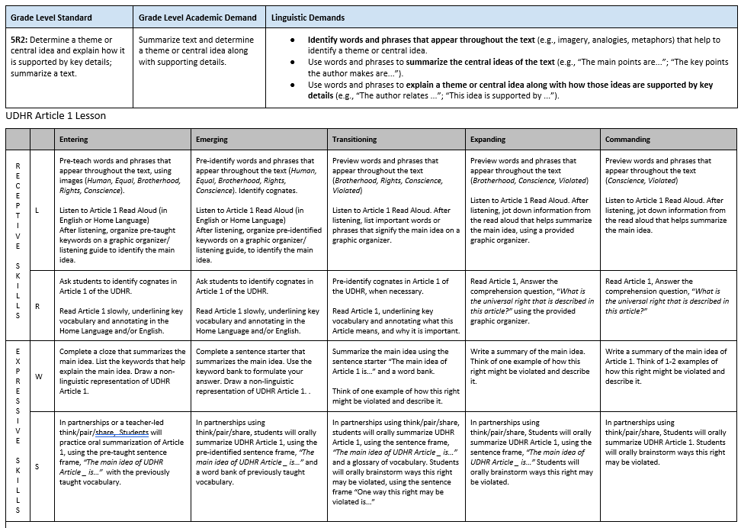

Slide 22
Sample Instructional Scaffolds Framework for a Lesson on Article 1 of the UDHR - Standard 5R2
Lesson Objective: By the end of this lesson, students will be able to identify and explain the main idea of Article 1 of the Universal Declaration of Human Rights (UDHR).
Grade Level Standard | Grade Level Academic Demand | Linguistic Demands
5R2: Determine a theme or central idea and explain how it is supported by key details; summarize a text. | Summarize text and determine a theme or central idea along with supporting details. | Identify words and phrases that appear throughout the text (e.g., imagery, analogies, metaphors) that help to identify a theme or central idea. Use words and phrases to summarize the central ideas of the text (e.g., “The main points are...”; “The key points the author makes are...”). Use words and phrases to explain a theme or central idea along with how those ideas are supported by key details (e.g., “The author relates ...”; “This idea is supported by ...”).

Slide 23
 | Entering | Emerging | Transitioning | Expanding | Commanding
L | Pre-teach words and phrases that appear throughout the text, using images (Human, Equal, Brotherhood, Rights, Conscience) Listen to Article 1 Read Aloud (can use a Home Language video or English with HL captions) After listening, organize pre-taught keywords on a graphic organizer/listening guide to identify the main idea. | Pre-identify words and phrases that appear throughout the text (Human, Equal, Brotherhood, Rights, Conscience) Identify cognates. Listen to Article 1 Read Aloud (can use a Home Language video or English with HL captions) After listening, organize pre-identified keywords on a graphic organizer/listening guide, to identify the main idea. | Preview words and phrases that appear throughout the text (Brotherhood, Rights, Conscience, Violated) Listen to Article 1 Read Aloud. After listening, list important words or phrases that signify the main idea on a graphic organizer. | Preview words and phrases that appear throughout the text (Brotherhood, Conscience, Violated) Listen to Article 1 Read Aloud. After listening, jot down information from the read aloud that helps summarize the main idea, using a provided graphic organizer. | Preview words and phrases that appear throughout the text (Conscience, Violated) Listen to Article 1 Read Aloud. After listening, jot down information from the read aloud that helps summarize the main idea.

Slide 24
 | Entering | Emerging | Transitioning | Expanding | Commanding
W | Complete a cloze exercise that summarizes the main idea. List the keywords that help explain the main idea. Draw a non-linguistic representation of UDHR Article 1. | Complete a sentence starter that summarizes the main idea. Use the keyword bank to formulate your answer. Draw a non-linguistic representation of UDHR Article 1. . | Summarize the main idea using the sentence starter “The main idea of Article 1 is…” and a word bank. Think of one example of how this right might be violated and describe it. | Write a summary of the main idea. Think of one example of how this right might be violated and describe it. | Write a summary of the main idea of Article 1. Think of 1-2 examples of how this right might be violated and describe them.

Slide 25
Curricular Planning Using the Linguistic Demands
5. Provide Content Mastery Tools
Step 5: Provide Content Mastery Tools (Scaffolds)
The Linguistic Demands provide a road map for choosing standards-based sentence-frames and key phrases to provide students as scaffolds when working with the content.
Plan for the Instructional Tools/Scaffolds that Aid Content Mastery and Support Academic Language Production
Sentence starters and sentence frames support ELLs, MLLs, and their classmates to take their ideas and put them into academic forms.
Key phrases that appear throughout the unit and allow students to discuss and write about the Big Question
Graphic organizers provide a visual, prearranged framework for students to get their ideas on the page and to link these ideas in ways that will ultimately line up with genre and audience expectations.
Click Image to View ALDs Document

Slide 26
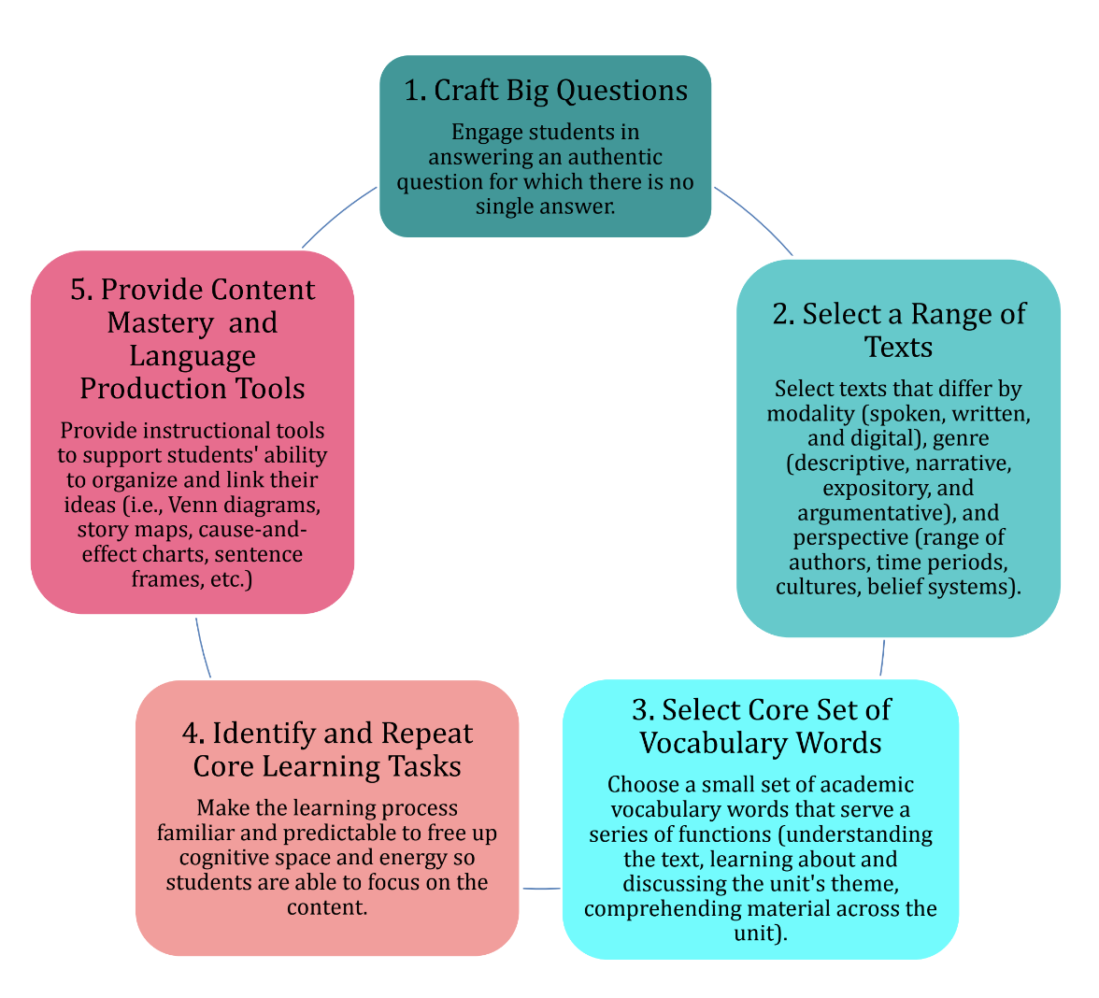
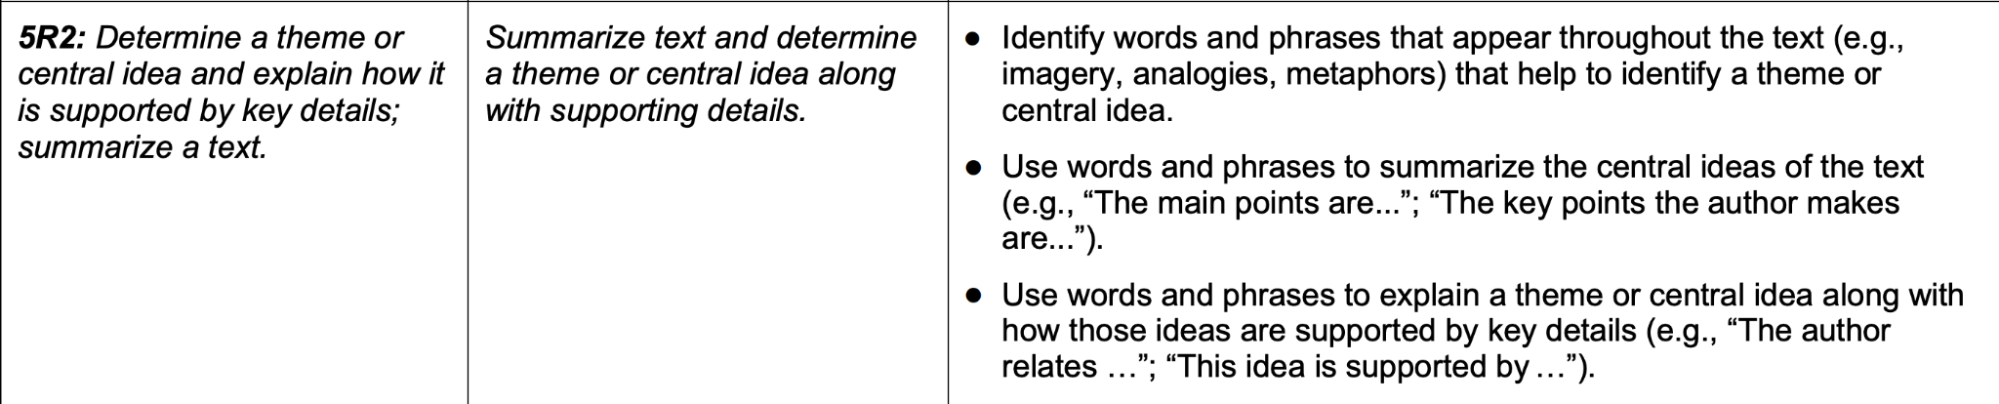
Where do the Linguistic Demands fit within the Knowledge-Building Instructional Cycle?
5. Provide Content Mastery Tools
Step 5: Provide Content Mastery Tools (Scaffolds), Continued
The Linguistic Demands provide a guide for choosing content mastery tools specific to the standards you will teach
Sentence Starters and Frames
Types of words and phrases to frontload and provide as language scaffolds
Grade Level NGLS ELA Standard
Grade Level Academic Demand: A concise statement of the academic skills required for students to achieve the grade-level learning standard.
Linguistic Demands of the Grade-Level Standard: The language-specific demands of a grade-level standard, including the words, phrases, and language structures needed to achieve the
standard.

Slide 27
Where do the Linguistic Demands fit within the Knowledge-Building Instructional Cycle?
5. Provide Content Mastery Tools
Step 5: Provide Content Mastery Tools (Scaffolds), Continued
Big Question:
“How can we ensure that everyone has basic human rights? ”
Identify words and phrases that appear throughout the text and help identify the main idea:
Words: Human, Equal, Brotherhood, Rights, Conscience, Violated
Phrases: "Everyone has the right to..."; “"All human beings..."; "No one shall be subjected to..."; "No one shall be..."
Use words and phrases to summarize the central ideas and details (Sentence Frames to discuss and write about the “Big Question”):
Article ____ of the UDHR is mainly about _____________________________.
The main points of Article ____ of the UDHR are________________________.
The author relates ______________ to human rights. This idea is supported by _______.

Slide 28

Wrap Up…
How will you use the ALDs in instruction or professional learning?
Share your response at:
www.menti.com
Enter code: 4489 6532

Slide 29
Thank You!

