Slide 1
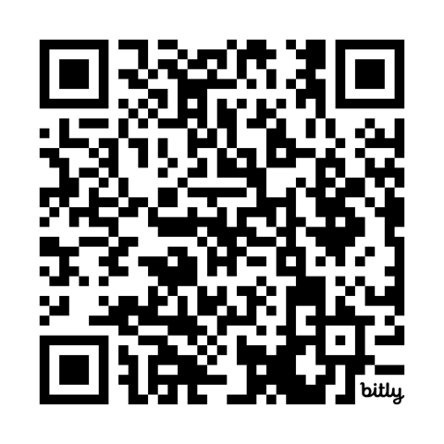
L.I. RBERN
Bilingual/ENL Coordinators’ Networking Meeting
https://bit.ly/dec8coordinators

Slide 2

Special Thanks!
Breakfast and Book Samples
Compliments of:
AMERICAN READING COMPANY
Andy Lowrey, M.S.Ed
Implementation Success Manager
American Reading Company
www.americanreading.com

Slide 3
Networking Discussion
1. In what ways might performance-based learning and assessment initiatives impact English Language Learners?
2. What needs to be considered when designing PBLA for ELLs? How might performance-based learning and assessment impact the way we teach?
3. What type of data collection might be used to measure the effectiveness of performance-based learning experiences?

