Slide 1
Biology Keystone Remediation
The Chemical Basis for Life

Slide 2
Importance & Properties of Water
Molecular Shape and Properties
A water molecule is composed of two hydrogen atoms and one oxygen atom (H₂O).
The oxygen end of the molecule carries a negative charge and the hydrogen end of the molecule carries a positive charge.
  This causes water molecules to be attracted to other water molecules (cohesion).
  These charges also cause water to be attracted to other materials that carry an electrical charge (adhesion).

Slide 3
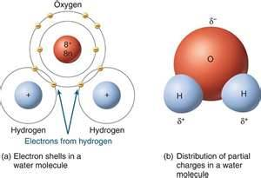
Water’s Shape
The bent shape of the water molecule gives a partial negative charge around the oxygen area, and a partial positive charge around the hydrogen atoms. With both partial positive and negative charges being present on the molecule, both positive and negative charges are attracted to it.

Slide 4
Water is a polar molecule.
The polar nature of water allows it to dissolve many different substances.
Due to its molecular structure, water is a polar substance. Therefore, it can dissolve many ionic substances, such as salt, and polar substances, such as sugar. As a result of the solvent properties of water, the liquid always contains dissolved materials, particularly ionic substances.
Water is known as the universal solvent because it dissolves such a large number of substances. More substances are soluble in water than in any other liquid. Water's ability to dissolve so many substances is due to its polar nature.

Slide 5
Properties of Water
Surface Tension
Another consequence of the structure of water is that liquid water exhibits surface tension. Surface tension is a force acting on the surface of a liquid that tends to make the surface curved. You perhaps have seen surface tension in action when water beads up on a car engine hood that has recently been waxed. Another example is the curved surface of water when it fills a glass to the very top.
Density
Another interesting property of water is that solid water (ice) is less dense than liquid water.
  Most other substances do not exhibit this property. When water freezes and becomes a solid, it expands and becomes less dense with an increase in volume. This happens because solid water forms a crystalline structure internally.

Slide 6
Water and Life
Water is the most abundant molecule found in living organisms.
  Without water, life as we know it would not be possible.
  Most plants and animals are made up of more than 60% water by mass.
  Mammals (including humans) are composed of approximately 70% water by mass.
    Two-thirds of this water is present inside the cells of the animal's body. The other one-third is located outside of the cells in such things as blood plasma.
Almost all the chemical reactions in life processes occur in solutions of water. Cell processes such as cellular respiration, diffusion, osmosis, and the production of ATP would all be impossible without the presence of water.
Water is not only known as the universal solvent, is it also known as the solvent of life. Water is necessary for dissolving organic wastes, as well as essential nutrients that plants and animals need to live.

Slide 7
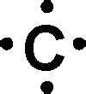
Carbon
Organic chemistry involves the study of carbon-containing compounds associated with life.
General Description of Organic Molecules
Carbon atoms form the backbone of many of the molecules that make up biological systems on Earth. These molecules, called biomolecules, are made up of carbon bonded with other elements, such as hydrogen, nitrogen, and oxygen.
Carbon atoms have four electrons in their outer shells, and all four are available for bonding. Carbon can share these electrons in single bonds with up to four other atoms to form very stable structures.
Alternatively, carbon can form multiple bonds with up to two other atoms by sharing two or more electrons with another atom. Carbon can also form a combination of double and single bonds, to a maximum of eight shared electrons by each carbon atom.

Slide 8
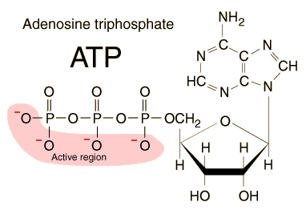
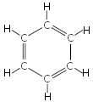
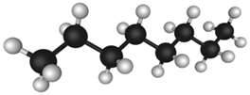
Structure and Shape of Organic Molecules
Carbon can also readily form bonds with other carbon atoms to form long, complex molecules.
These complex molecules can be long chains, ring-shaped molecules, or a combination of the two.
The backbones of carbon molecules can be of any size and may contain from one carbon atom to thousands of carbon atoms.
When chemists refer to organic molecules, they generally use structural formulas
Below are examples of some common carbon-containing compounds.

Slide 9
Complex Organic Molecules
Biological Molecules
Biological molecules are composed of small repeating subunits that bond together to form larger units.
  The subunits, or building blocks, are called monomers.
  Polymers are the complex molecules formed from the repeating subunits.
There are four basic classes of complex organic molecules, or macromolecules, that compose cells: carbohydrates, proteins, lipids, and nucleic acids.
  Each of the major classes of biological molecules is associated with different properties and functions within cells and whole organisms.

Slide 10
Chemical Reactions
Condensation Reaction – monomers link to form polymers
Hydrolysis – water is used to break down polymers

Slide 11
 | Carbohydrates | Lipids | Proteins | Nucleic Acids
Monomer | monosaccharides (glucose, fructose, ribose, etc.) | • glycerol • fatty acids | • amino acids (20 different amino acids) | • nucleotides (adenine, cytosine, guanine, thymine, uracil)
Function(s) in cell | • energy storage • structural support (plant cell walls) | • energy storage • insulation • protective covering • lubrication | • muscle contraction • oxygen transport • immune responses • chemical reactions | • information storage
Elements Present | • carbon • hydrogen • oxygen | • carbon • hydrogen • oxygen | • carbon • hydrogen • oxygen • nitrogen • sulfur (some) | • carbon • hydrogen • oxygen • nitrogen • phosphorus
Water Soluble | yes | • no | • many | • yes
Examples | • sugars • starches (glycogen & cellulose) | • fats • oils • waxes | • enzymes • hemoglobin • muscle fibers | • RNA • DNA

Slide 12
Carbohydrates
Carbohydrates are organic macromolecules that are made up of carbon, hydrogen, and oxygen atoms. These atoms are combined in a ratio of:
  1 carbon atom : 2 hydrogen atoms : 1 oxygen atom
The presence of multiple carbon-hydrogen bonds within carbohydrates makes them an excellent source of energy. (The energy is released when these bonds are broken.)
Carbohydrates may be simple or complex.
  The building blocks of carbohydrates are the simple sugars known as monosaccharides. Sugars such as glucose, fructose, and ribose are all examples of monosaccharides.
  Monosaccharides can be combined to form more complex carbohydrates known as polysaccharides.
    Glycogen, starch, and cellulose are all examples of polysaccharides. These compounds are typically used for long term energy storage or as structural molecules. Cellulose, for example, is a major component found in the cell walls of plants.
  Dietary fiber is a special class of carbohydrates that cannot be digested by the human body.
    Cellulose is one example of a carbohydrate that acts as fiber. Dietary fiber is an important part of a healthy diet because it is essential for proper digestion. Humans can get fiber by eating many different kinds of plants, such as whole grains, legumes, prunes, and potatoes.

Slide 13
Lipids
Lipids are organic macromolecules that are insoluble in water.
  This is why lipids are often found in biological membranes and other waterproof coverings (e.g. plasma membrane, intracellular membranes of organelles). These lipids play a vital role in regulating which substances can or cannot enter the cell.
  Fatty acids, triglycerides, phospholipids, waxes, and steriods
The most important lipids, however, are fats.
  Triglycerides are a type of fat that contain one glycerol molecule and three fatty acids.
Fatty acids are long chains of CH₂ units joined together.
  The fatty acids in saturated fats do not contain any double bonds between the CH₂ units
    Saturated fats are found in butter, cheese, chocolate, beef, and coconut oil.
  The fatty acids in unsaturated fats contain some carbon-carbon double bonds.
    Unsaturated fats are found in olives and olive oil, peanuts and peanut oil, fish, and mayonnaise.
Fats are important because they are a major source of energy. Since they contain even more carbon-hydrogen bonds than carbohydrates, fatty tissue has the ability to store energy for extended periods of time

Slide 14
Proteins
Proteins are organic macromolecules that are composed of amino acid monomers.
  There are 20 essential amino acids that are used by all living things to construct proteins.
  These amino acids are made up of the elements carbon, hydrogen, oxygen, and nitrogen. Some of the amino acids also contain sulfur.
Proteins differ from each other due to the number and arrangement of their component amino acids. Proteins also take on unique shapes as determined by their amino acid sequences.
Water is the most abundant molecule in the body, but proteins are the second most abundant type of molecule.
Proteins assist with muscular contractions and serve many structural roles.
  For example, cartilage and tendons are made of a protein known as collagen, and a protein known as keratin is found in hair, nails, feathers, hooves, and some animal shells.
  Proteins are also involved in cell signaling, cell transport, immune responses, and the cell cycle. Other proteins known as enzymes can also help speed up cellular reactions.

Slide 15
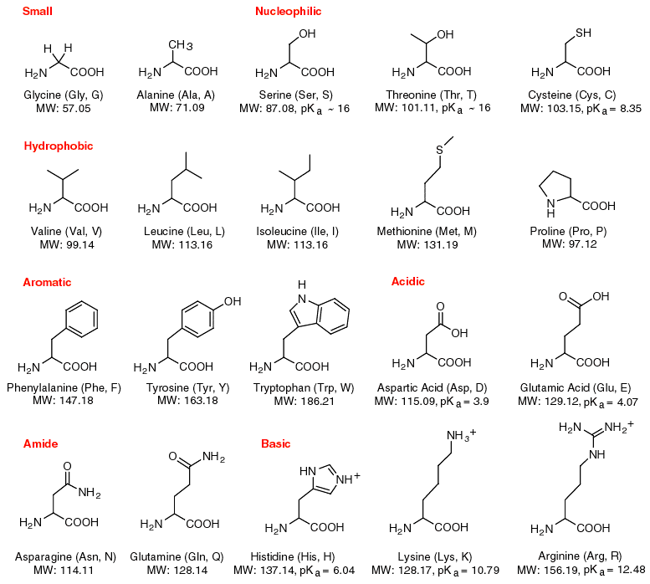

Slide 16
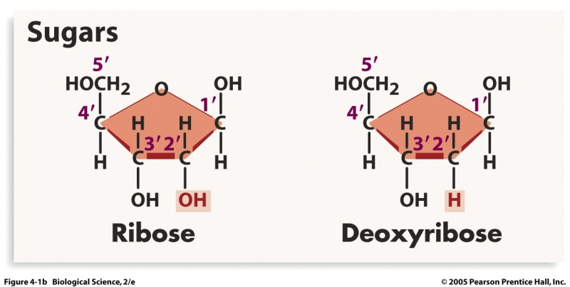
Nucleic Acids
Nucleic acids are formed from nucleotide monomers.
  Nucleotides are chemical compounds that are primarily comprised of the elements carbon, hydrogen, oxygen, nitrogen, and phosphorus.
  They consist of a five-carbon sugar, a nitrogenous base, and one or more phosphate groups.
There are two main types of nucleic acids - ribonucleic acids (RNA) and deoxyribonucleic acids (DNA).
  These nucleic acids are different because their five-carbon sugars are different. RNA contains ribose, and DNA contains deoxyribose.

Slide 17
Nucleic Acids
DNA and RNA also have different functions.
  DNA stores genetic information and encodes the sequences of all the cell's proteins.
  RNA is involved in the direct production of the proteins.
Nucleic acids are also different because the sequence of nitrogenous bases that they contain are different.
  There are five nitrogenous bases found in nucleic acids. Adenine (A), cytosine (C), and guanine (G) are found in both DNA and RNA. Thymine (T) is only found in DNA, and uracil (U) is only found in RNA.

Slide 18
Enzymes
Enzymes are biological catalysts that lower the activation energy of chemical reactions.
Substances which lower the amount of energy needed to activate a chemical reaction, without being consumed in the reaction, are called catalysts.
  Enzymes are biological catalysts, generally composed of proteins. By lowering the activation energy, chemical reactions generally occur more rapidly.
Most enzymes are proteins.
  Like other proteins, enzymes are produced by a cell's ribosomes.
  Ribosomes produce specific enzymes to act on specific substances, called substrates.
    For example, the enzyme catalase assists in the breakdown of hydrogen peroxide into water and oxygen. In this case, hydrogen peroxide is catalase's substrate.

Slide 19
Enzymes
Many of the chemical reactions that occur in cells are catalyzed by enzymes.
The activation energy for many reactions is simply too high to overcome without enzymes, and the reaction will not occur at all in the absence of an enzyme.
  Without enzymes catalyzing metabolic reactions, cells would not be able to perform metabolism quickly enough to support life.
Since enzymes are not consumed in a chemical reaction, their concentration will remain constant unless the cell triggers for re-uptake of the enzymes.
  Cells can control chemical reactions by producing or removing enzymes.
  Reaction rates can be increased by increasing the production of enzymes in environments highly concentrated with substrate.

Slide 20
Enzymes
Enzymes are also important for the synthesis of new molecules.
  For example, RNA polymerase is an enzyme that is essential to the process of transcription.
  Molecules of mRNA are transcribed by RNA polymerases and later new protein molecules are synthesized based on the instructions coded in the mRNA.
The shape of an enzyme determines how it works.
Most enzymes have a surface with one or more deep folds.
  The folds make pockets, which are called active sites.
  The active sites match folds in the substrate's surface.
  Thus, a particular enzyme fits against its substrate like two adjacent puzzle pieces.

Slide 21
Enzymes
An enzyme's shape is key to how the enzyme functions.
  If its shape is changed, the enzyme may not function as well or at all.
  Changes in temperature and pH can affect the shape of an enzyme's active sites.
  Therefore, enzymes are only able to work properly in a certain temperature and pH range.
  RNA polymerase is an enzyme that is essential to the process of transcription. Molecules of mRNA are transcribed by RNA polymerases and later new protein molecules are synthesized based on the instructions coded in the mRNA.

Slide 22
