Slide 1
College Presentation
Frewsburg Junior-Senior High School
Counseling and Career Staff
Randy Sitler-School Counselor
Michelle Cobbe- School Counselor
Richal Hair –Administrative Assistant

Slide 2
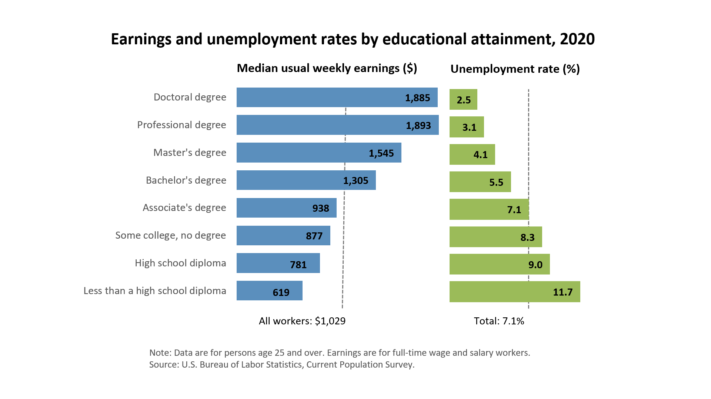
Education Pays

Slide 3


What have you done to prepare for college?
GPA
Difficulty of Coursework
  Honors/JCC Courses
Scores on Entrance Exams
Extra Curricular Activities
Volunteer Work/Community Service

Slide 4

What to consider when choosing a college
Graduation/ Retention Rate
Cost/Financial Package
Transfer of credits earned in HS
Majors Offered
Living Arrangements
Transportation
Safety
Location
Athletics
Diversity
Size
Selectivity

Slide 5














There is a right fit for everyone!

Slide 6

How many schools should I apply to?
A good ballpark figure is 5-6
1-2 reach schools
2 50/50 schools
3 safe schools
SUNY school?

Slide 7

Getting into College
HS Transcript
Test Scores
Recommendations
Essay
Interview
Special Talents
Interests and Activities
Community Service
Class Rank
College admission staff will check social media postings.

Slide 8

When Should I Apply?
Senior year, preferably before Christmas
Early Decision
Early Action
Rolling Admission

Slide 9

How Do I Apply?
Apply online (SUNY Application, fee required)
Application Form (Common Application, $40 per college)
Individual College Application ($40-$60 fee)
Letter of Recommendation
Essay
Transcripts
Test Scores
Interview (for highly competitive programs)
Financial Aid
  Fee Waiver?

Slide 10
College Admissions Exams
PSAT/NMSQT- Preliminary Scholastic Aptitude Test/National Merit Scholarship Qualifying Assessment Test
SAT I- Scholastic Aptitude Test
Scores on a scale of 400-1600
ACT- American College Testing Exam
Scores range from 10 - 36
Test Optional

Slide 11



SAT Test Preparation
SAT Prep:
Chautauqua Striders
@ 488-2203
Visit collegeboard.org for SAT Practice tests and study groups

Slide 12

Student Athletes
NCAA Eligibility
Advanced Regents Diploma-16 Core Courses
Athlete Recruitment Questionnaire
Apply during Junior Year
Div I, Div II, Div III/JUCO
Attend Sports Camps
Film

Slide 13
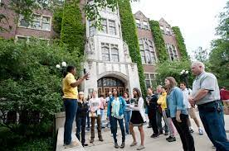
Campus Visits
Open House vs. Individual Visits
Visit college website to find an open house or schedule a visit.

Slide 14

Campus Visits
Contact School to set up visit
What’s important to you on campus?
  Clubs, sports, campus life, housing
Prepare a list of questions prior to attending:
  Employment rates/opportunities after graduation
  % of students who get scholarships

Slide 15

College Application Essays
Thoroughly Answer the Question
Make it Engaging
Proofread, Proofread, Proofread!

Slide 16

The Financial Aid Process
Scholarships
Grants
Loans
FAFSA
TAP
HESC (Higher Education Services Corp)
Estimated Family Contribution

Slide 17

Scholarships
USA Scholarship to attend JCC
  Top 20%
Scholar of Excellence to attend JBC
  Top 25%
Pitt Bradford- Out of State Panther Scholarship
  GPA 2.75
Community Foundation- Completed in School
  ALL STUDENTS

Slide 18

Five good questions for the Financial Aid Office
What percentage of the freshman class paid full tuition?
Is there a standard expectation for self-help?
What percentage of accepted aid applicants were offered full need?
How will my aid package change after my freshman year?
What happens if my need increases later?

Slide 19
Hot Web Sites
www.collegeboard.com
http://www.frewsburgcsd.org/
www.act.com
www.guidancedirect.com
www.mymajors.com
www.campusdirt.com
www.fastweb.com
https://web1.ncaa.org/eligibilitycenter/common/
www.hesc.ny.gov

Slide 20

Questions and Answers

Slide 21


